Slide 1
ESnet and the
OSCARS Virtual Circuit Service:
Motivation, Design, Deployment and Evolution of a
Guaranteed Bandwidth Network Service
Supporting Large-Scale Science
RENATER
October 5, 2010
William E. Johnston, Senior Scientist
(wej@es.net)
Chin Guok, Engineering and R&D
(chin@es.net)
Evangelos Chaniotakis, Engineering and R&D
(haniotak@es.net)

Slide 2
DOE Office of Science and ESnet – the ESnet Mission
The U.S. Department of Energy’s Office of Science (“SC”) is the single largest supporter of basic research in the physical sciences in the United States
  Provides more than 40 percent of total funding for US research programs in high-energy physics, nuclear physics, and fusion energy sciences
  Funds some 25,000 PhDs and PostDocs
  www.science.doe.gov
A primary mission of SC’s National Labs is to
build and operate very large scientific instruments - particle accelerators, synchrotron light sources, very large supercomputers - that generate massive amounts of data and involve very large, distributed collaborations
Notes:
Τηε ποιντ ηερε ισ τηατ μοστ μοδερν, λαργε−σχαλε, σχιενχε ανδ ενγινεερινγ ισ μυλτι−δισχιπλιναρψ, ανδ μυστ υσε γεογραπηιχαλλψ διστριβυτεδ χομπονεντσ, ανδ τηισ ισ ωηατ ηασ μοτιϖατεδ α ∃50−75Μ/ψρ (αππροξ) ινϖεστμεντ ιν Γριδ τεχηνολογψ βψ τηε ΥΣ, ΥΚ, Ευροπεαν, ϑαπανεσε, ανδ Κορεαν γοϖερνμεντσ.

Slide 3
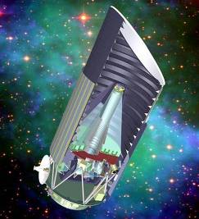
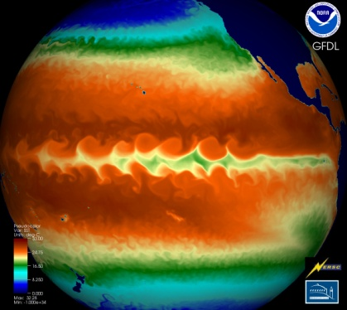
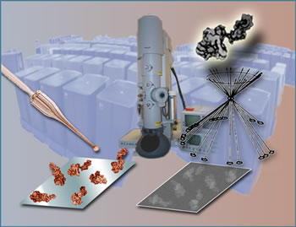

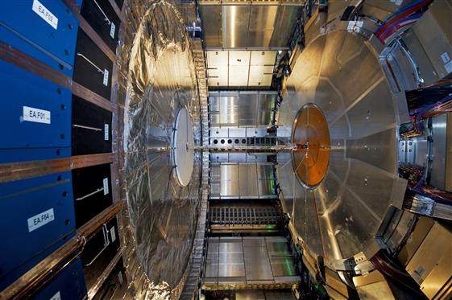
DOE Office of Science and ESnet – the ESnet Mission
ESnet - the Energy Sciences Network - is an SC program whose primary mission is to enable the large-scale science of the Office of Science that depends on:
  Sharing of massive amounts of data
  Supporting thousands of collaborators world-wide
  Distributed data processing
  Distributed data management
  Distributed simulation, visualization, and computational steering
  Collaboration with the US and International Research and Education community
In order to accomplish its mission the Office of Science’s Advanced Scientific Computing Research (ASCR) funds ESnet to provide high-speed networking and various collaboration services to Office of Science laboratories
  Ames, Argonne, Brookhaven, Fermilab, Thomas Jefferson National Accelerator Facility, Lawrence Berkeley, Oak Ridge, Pacific Northwest, Princeton Plasma Physics, and SLAC
  ESnet serves also most of the rest of DOE on a cost-recovery basis
Notes:
3
Τηε ποιντ ηερε ισ τηατ μοστ μοδερν, λαργε−σχαλε, σχιενχε ανδ ενγινεερινγ ισ μυλτι−δισχιπλιναρψ, ανδ μυστ υσε γεογραπηιχαλλψ διστριβυτεδ χομπονεντσ, ανδ τηισ ισ ωηατ ηασ μοτιϖατεδ α ∃50−75Μ/ψρ (αππροξ) ινϖεστμεντ ιν Γριδ τεχηνολογψ βψ τηε ΥΣ, ΥΚ, Ευροπεαν, ϑαπανεσε, ανδ Κορεαν γοϖερνμεντσ.

Slide 4
ESnet: A Hybrid Packet-Circuit Switched Network
A national optical circuit infrastructure
  ESnet shares an optical network with Internet2 (US national research and education (R&E) network) on a dedicated national fiber infrastructure
    ESnet has exclusive use of a group of 10Gb/s optical channels/waves across this infrastructure
  ESnet has two core networks – IP and SDN – that are built on more than 60 x 10Gb/s WAN circuits
A large-scale IP network
  A tier 1 Internet Service Provider (ISP) (direct connections with all major commercial networks providers)
A large-scale science data transport network
  A virtual circuit service that is specialized to carry the massive science data flows of the National Labs
  Virtual circuits are provided by a VC-specific control plane managing an MPLS infrastructure
  Multiple 10Gb/s connections to all major US and international research and education (R&E) networks in order to enable large-scale, collaborative science
A WAN engineering support group for the DOE Labs
An organization of 35 professionals structured for the service
  The ESnet organization designs, builds, and operates the ESnet network based mostly on “managed wave” services from carriers and others
An operating entity with an FY08 budget of about $30M
  60% of the operating budget is circuits and related, remainder is staff and equipment related
Notes:
4

Slide 5
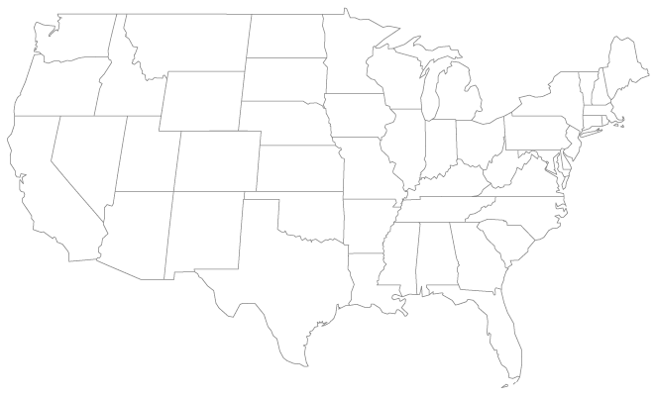
Current ESnet4 Inter-City Waves
Router node
10G link

Slide 6
ESnet Architecture
Chicago
Seattle
ESnet Science Data Network (SDN) core (multiple waves)
San Francisco/
Sunnyvale
New York
Metro Area Rings (multiple waves)
Washington
ESnet IP core (single wave)
Atlanta
ESnet core network connection points
Other IP networks
ESnet sites
Circuit connections to other
science networks (e.g. USLHCNet)
ESnet sites with redundant ESnet edge devices (routers or switches)
The IP and SDN networks are full interconnected and the link-by-link usage management implemented by OSCARS is used to provide a policy based sharing of each network by the other in case of failures

Slide 7
ESnet4 Provides Global High-Speed Internet Connectivity and a Network Specialized for Large-Scale Data Movement
Japan (SINet)
Australia (AARNet)
Canada (CA*net4
Taiwan (TANet2)
Singaren
Transpac2
CUDI
KAREN/REANNZ
ODN Japan Telecom America
NLR-Packetnet
Internet2
Korea (Kreonet2)
SINet (Japan)
Russia (BINP)
Vienna peering with GÉANT
(via USLHCNet circuit)
GÉANT
- France, Germany,
Italy, UK, etc
CA*net4 France
GLORIAD
(Russia, China)
Korea (Kreonet2
MREN
StarTap
Taiwan (TANet2,
ASCGNet)
CERN/LHCOPN
(USLHCnet:
DOE+CERN funded)
SEAT
PacWave
NSF/IRNC
funded
USHLCNet to GÉANT
KAREN / REANNZ Transpac2
Internet2 Korea (kreonet2)
SINGAREN Japan (SINet)
ODN Japan Telecom
America
CA*net4
AU
Internet2
NYSERNet
MAN LAN
BOST
PNNL
CHI-SL
LIGO
Starlight
USLHCNet
NLR
AOFA
MIT/
PSFC
BOIS
INL
NEWY
Salt Lake
FNAL
Internet2
Lab DC
Offices
BNL
NERSC
LVK
Internet2
LLNL
ANL
PPPL
JGI
PacWave
SNLL
GFDL
LBNL
FRGPoP
AMES
CHIC
DOE
PU Physics
SLAC
SUNN
ICCN
CLEV
NETL
PAIX-PA
Equinix, etc.
NREL
IU GPoP
DOE GTN
NNSA
Equinix
SNV1
DENV
Equinix
NASA
Ames
IARC
YUCCA MT
ORNL
WASH
MAXGPoP
NLR
Internet2
JLAB
LASV
LANL
KANS
KCP
ORAU
LOSA
BECHTEL-NV
NSTEC
OSTI
SDSC
GA
SNLA
ARM
NASH
NOAA
UCSD Physics
ALBU
Allied
Signal
PANTEX
SRS
AMPATH
CLARA
(S. America)
AU
CUDI
(S. America)
UNM
SOX
ATLA
DOE-ALB
~45 end user sites
ELPA
International (10 Gb/s)
10-20-30 Gb/s
SDN core
10Gb/s IP core
MAN rings (10 Gb/s)
Lab supplied links
OC12 / GigEthernet
OC3 (155 Mb/s)
45 Mb/s and less
Office Of Science Sponsored (22)
HOUS
NNSA Sponsored (13+)
Joint Sponsored (4)
Much of the utility (and complexity) of ESnet is in its high degree of interconnectedness
Other Sponsored (NSF LIGO, NOAA)
Laboratory Sponsored (6)
commercial peering points
R&E
networks
Specific R&E network peers
SUNN
ESnet core hubs
Other R&E peering points
Geography is
only representational
Notes:
7

Slide 8
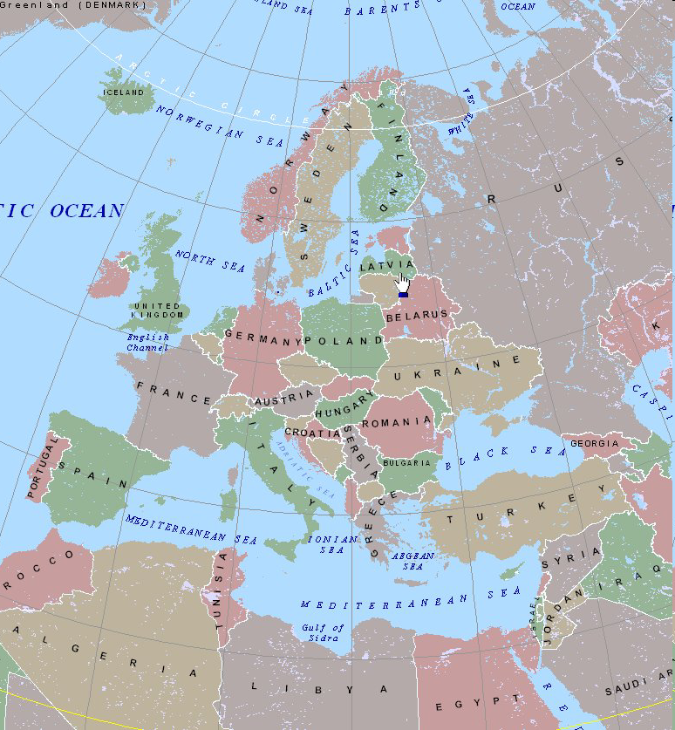
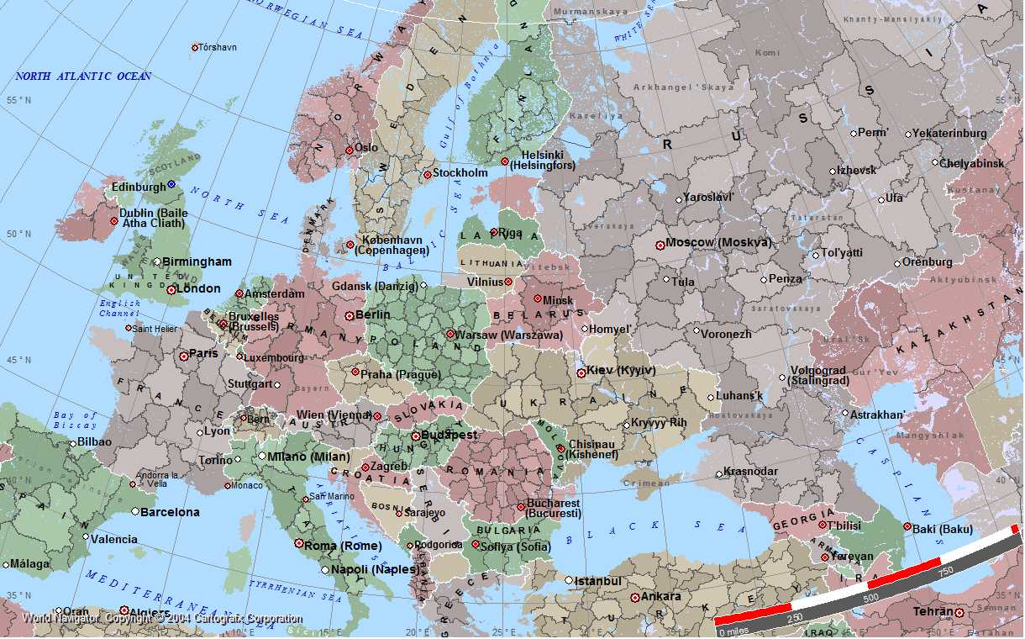
The Operational Challenge
ESnet has about
10 engineers in the core networking group and
10 in operations and deployment (and another 10 in infrastructure support)
The relatively large geographic scale of ESnet makes it a challenge for a small organization to build, maintain, and operate the network
Olso
1625 miles / 2545 km
Moscow
Dublin
2750 miles / 4425 km
Cairo

Slide 9
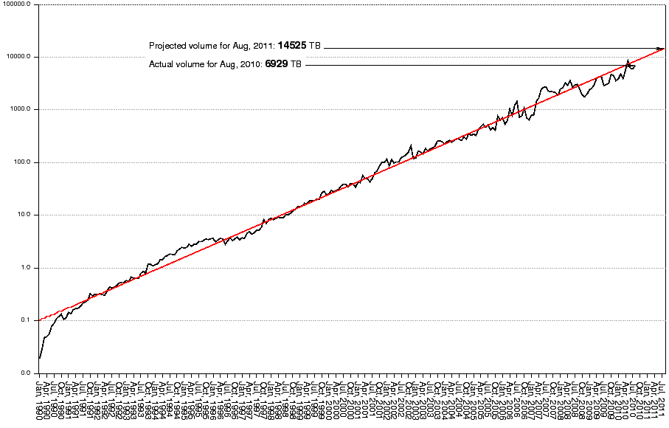
Current and Historical ESnet Traffic Patterns
Projected volume for Apr 2011: 12.2 Petabytes/month
Actual volume for Apr 2010: 5.7 Petabytes/month
ESnet Traffic Increases by
10X Every 47 Months, on Average
Terabytes / month
Apr 2006
1 PBy/mo
Oct 1993
1 TBy/mo
Nov 2001
100 TBy/mo
Aug 1990
100 GBy/mo
Jul 1998
10 TBy/mo
Log Plot of ESnet Monthly Accepted Traffic, January 1990 – Aug 2010

Slide 10
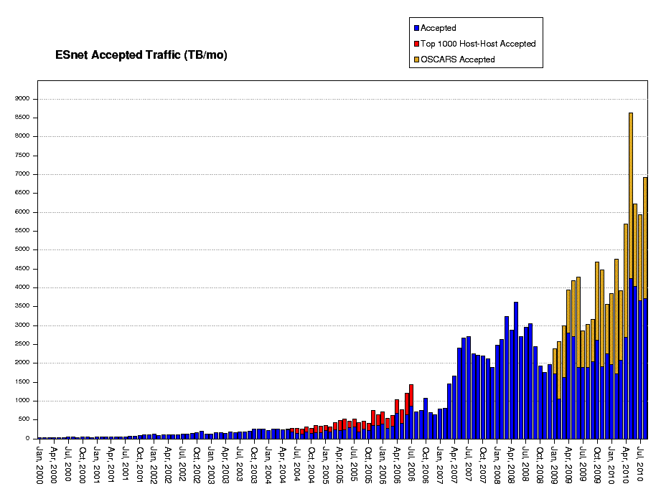
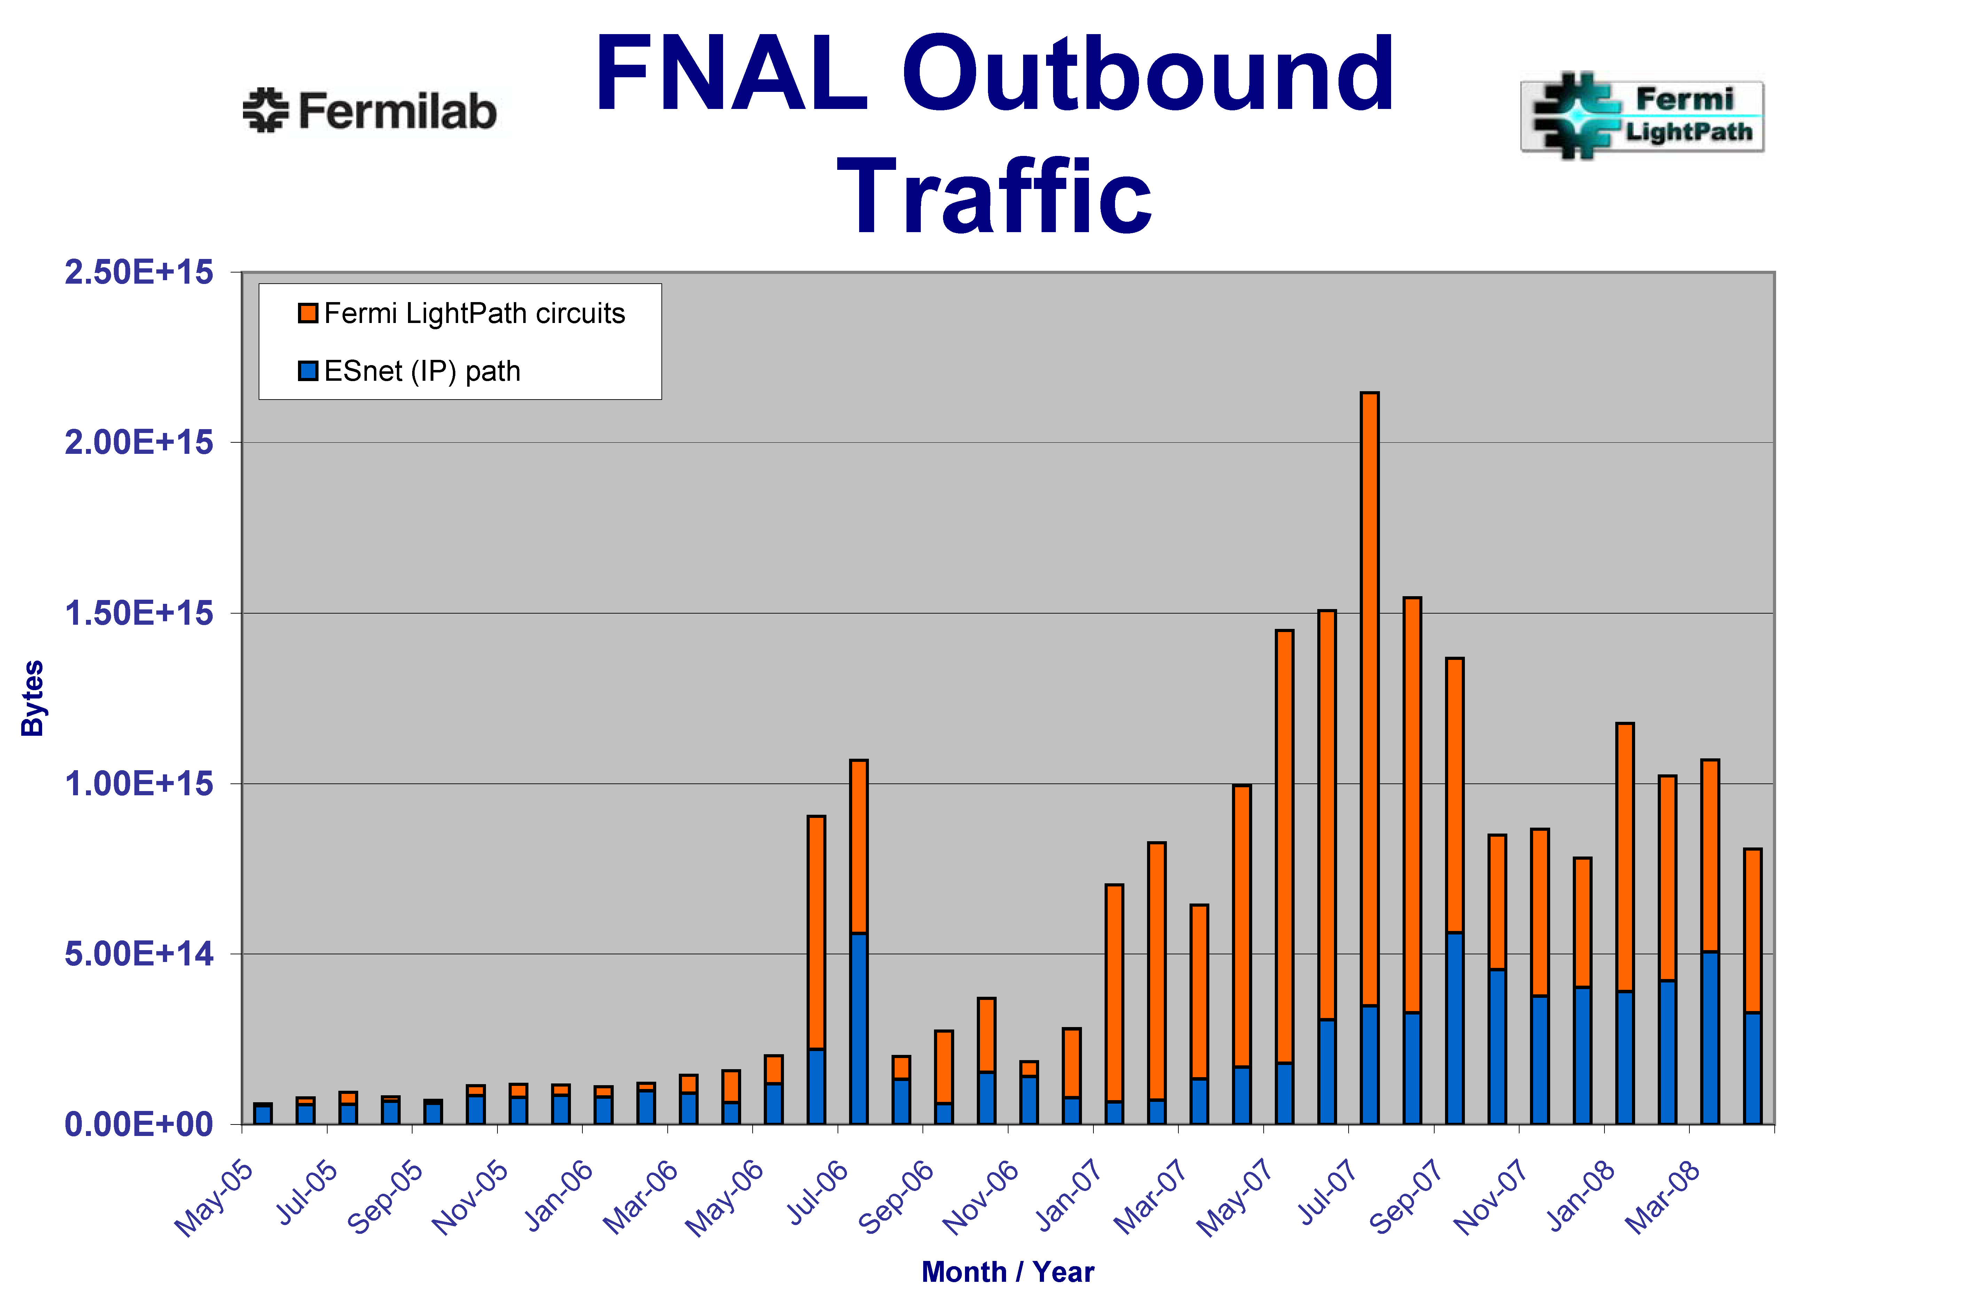
A small number of large data flows now dominate the network traffic – this motivates virtual circuits as a key network service
9000
Orange bars = OSCARS virtual circuit flows
No flow data available
Red bars = top 1000 site to site workflows
Starting in mid-2005 a small number of large data flows dominate the network traffic
Note: as the fraction of large flows increases, the overall traffic increases become more erratic – it tracks the large flows
Terabytes/month accepted traffic
Overall ESnet traffic tracks the very large science use of the network
FNAL (LHC Tier 1
site) Outbound Traffic
(courtesy Phil DeMar, Fermilab)

Slide 11
Exploring the plans of the major stakeholders
Primary mechanism is Office of Science (SC) network Requirements Workshops, which are organized by the SC Program Offices; Two workshops per year - workshop schedule, which repeats in 2010
  Basic Energy Sciences (materials sciences, chemistry, geosciences) (2007 – published)
  Biological and Environmental Research (2007 – published)
  Fusion Energy Science (2008 – published)
  Nuclear Physics (2008 – published)
  IPCC (Intergovernmental Panel on Climate Change) special requirements (BER) (August, 2008)
  Advanced Scientific Computing Research (applied mathematics, computer science, and high-performance networks) (Spring 2009 - published)
  High Energy Physics (Summer 2009 - published)
Workshop reports: http://www.es.net/hypertext/requirements.html
The Office of Science National Laboratories (there are additional free-standing facilities) include
  Ames Laboratory
  Argonne National Laboratory (ANL)
  Brookhaven National Laboratory (BNL)
  Fermi National Accelerator Laboratory (FNAL)
  Thomas Jefferson National Accelerator Facility (JLab)
  Lawrence Berkeley National Laboratory (LBNL)
  Oak Ridge National Laboratory (ORNL)
  Pacific Northwest National Laboratory (PNNL)
  Princeton Plasma Physics Laboratory (PPPL)
  SLAC National Accelerator Laboratory (SLAC)
Notes:
11

Slide 12
Science Network Requirements Aggregation Summary
Science Drivers Science Areas / Facilities | End2End Reliability | Near Term End2End Band width | 5 years End2End Band width | Traffic Characteristics | Network Services
ASCR: ALCF | - | 10Gbps | 30Gbps | Bulk data Remote control Remote file system sharing | Guaranteed bandwidth Deadline scheduling PKI / Grid
ASCR: NERSC | - | 10Gbps | 20 to 40 Gbps | Bulk data Remote control Remote file system sharing | Guaranteed bandwidth Deadline scheduling PKI / Grid
ASCR: NLCF | - | Backbone Bandwidth Parity | Backbone Bandwidth Parity | Bulk data Remote control Remote file system sharing | Guaranteed bandwidth Deadline scheduling PKI / Grid
BER: Climate |  | 3Gbps | 10 to 20Gbps | Bulk data Rapid movement of GB sized files Remote Visualization | Collaboration services Guaranteed bandwidth PKI / Grid
BER: EMSL/Bio | - | 10Gbps | 50-100Gbps | Bulk data Real-time video Remote control | Collaborative services Guaranteed bandwidth
BER: JGI/Genomics | - | 1Gbps | 2-5Gbps | Bulk data | Dedicated virtual circuits Guaranteed bandwidth
Note that the climate numbers do not reflect the bandwidth that will be needed for the
4 PBy IPCC data sets
Notes:
12

Slide 13
Science Network Requirements Aggregation Summary
Science Drivers Science Areas / Facilities | End2End Reliability | Near Term End2End Band width | 5 years End2End Band width | Traffic Characteristics | Network Services
BES: Chemistry and Combustion | - | 5-10Gbps | 30Gbps | Bulk data Real time data streaming | Data movement middleware
BES: Light Sources | - | 15Gbps | 40-60Gbps | Bulk data Coupled simulation and experiment | Collaboration services Data transfer facilities Grid / PKI Guaranteed bandwidth
BES: Nanoscience Centers | - | 3-5Gbps | 30Gbps | Bulk data Real time data streaming Remote control | Collaboration services Grid / PKI
FES: International Collaborations | - | 100Mbps | 1Gbps | Bulk data | Enhanced collaboration services Grid / PKI Monitoring / test tools
FES: Instruments and Facilities | - | 3Gbps | 20Gbps | Bulk data Coupled simulation and experiment Remote control | Enhanced collaboration service Grid / PKI
FES: Simulation | - | 10Gbps | 88Gbps | Bulk data Coupled simulation and experiment Remote control | Easy movement of large checkpoint files Guaranteed bandwidth Reliable data transfer
Notes:
13

Slide 14
Science Network Requirements Aggregation Summary
Science Drivers Science Areas / Facilities | End2End Reliability | Near Term End2End Band width | 5 years End2End Band width | Traffic Characteristics | Network Services
HEP: LHC (CMS and Atlas) | 99.95+% (Less than 4 hours per year) | 73Gbps | 225-265Gbps | Bulk data Coupled analysis workflows | Collaboration services Grid / PKI Guaranteed bandwidth Monitoring / test tools
NP: CMS Heavy Ion | - | 10Gbps (2009) | 20Gbps | Bulk data | Collaboration services Deadline scheduling Grid / PKI
NP: CEBF (JLAB) | - | 10Gbps | 10Gbps | Bulk data | Collaboration services Grid / PKI
NP: RHIC | Limited outage duration to avoid analysis pipeline stalls | 6Gbps | 20Gbps | Bulk data | Collaboration services Grid / PKI Guaranteed bandwidth Monitoring / test tools
Immediate Requirements and Drivers for ESnet4
Notes:
14

Slide 15
Services Characteristics of Instruments and Facilities
Fairly consistent requirements are found across the large-scale sciences
Large-scale science uses distributed applications systems in order to:
  Couple existing pockets of code, data, and expertise into “systems of systems”
  Break up the task of massive data analysis into elements that are physically located where the data, compute, and storage resources are located
Identified types of use include
  Bulk data transfer with deadlines
    This is the most common request: large data files must be moved in an length of time that is consistent with the process of science
  Inter process communication in distributed workflow systems
    This is a common requirement in large-scale data analysis such as the LHC Grid-based analysis systems
  Remote instrument control, coupled instrument and simulation, remote visualization, real-time video
    Hard, real-time bandwidth guarantees are required for periods of time (e.g. 8 hours/day, 5 days/week for two months)
    Required bandwidths are moderate in the identified apps – a few hundred Mb/s
  Remote file system access
    A commonly expressed requirement, but very little experience yet
Notes:
15

Slide 16
Services Characteristics of Instruments and Facilities
Such distributed application systems are
  data intensive and high-performance, frequently moving terabytes a day for months at a time
  high duty-cycle, operating most of the day for months at a time in order to meet the requirements for data movement
  widely distributed – typically spread over continental or inter-continental distances
  depend on network performance and availability
    however, these characteristics cannot be taken for granted, even in well run networks, when the multi-domain network path is considered
    therefore end-to-end monitoring is critical
Notes:
16

Slide 17
Services Requirements of Instruments and Facilities
Get guarantees from the network
  The distributed application system elements must be able to get guarantees from the network that there is adequate bandwidth to accomplish the task at the requested time
Get real-time performance information from the network
  The distributed applications systems must be able to get
  real-time information from the network that allows
    graceful failure and auto-recovery
    adaptation to unexpected network conditions that are short of outright failure
Available in an appropriate programming paradigm
  These services must be accessible within the Web Services / Grid Services paradigm of the distributed applications systems
See, e.g., [ICFA SCIC]
Notes:
17

Slide 18
Evolution of ESnet to 100 Gbps Transport
ARRA (“Stimulus” funding) Advanced Networking Initiative (ANI)
Advanced Networking Initiative goals:
  Build an end-to-end 100 Gbps prototype network
    Handle proliferating data needs between the three DOE supercomputing facilities and NYC international exchange point
  Build a network testbed facility for researchers and industry
RFP (Tender) for 100 Gbps transport and dark fiber released in June 2010
RFP for 100 Gbps routers/switches due out in October

Slide 19
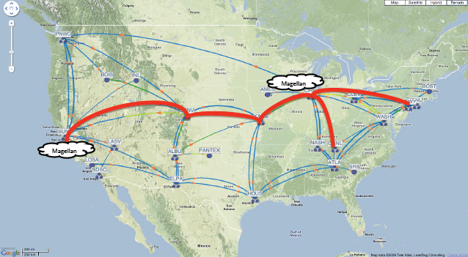
ANI 100 Gbps Prototype Network

Slide 20
Magellan Research Agenda
What part of DOE’s midrange computing workload can be served economically by a commercial or private-to-DOE cloud?
What are the necessary hardware and software features of a science-focused cloud and how does this differ from commercial clouds or supercomputers?
Do emerging cloud computing models (e.g. map-reduce, distribution of virtual system images, software-as-a-service) offer new approaches to the conduct of midrange computational science?
Can clouds at different DOE-SC facilities be federated to provide backup or overflow capacity?
(Jeff Broughton, System Department Head, NERSC)

Slide 21
Magellan Cloud: Purpose-built for Science Applications
720 nodes, 5760 cores in 9 Scalable Units (SUs) ➔ 61.9 Teraflops
SU = IBM iDataplex rack with 640 Intel Nehalem cores
SU
SU
SU
SU
SU
SU
SU
SU
SU
QDR IB (InfiniBand) Fabric
18 Login/network
nodes
Login
Network
I/O
14 I/O nodes
(shared)
10G Ethernet
Login
Network
8G FC
I/O
Internet
Load Balancer
100-G Router
NERSC Global Filesystem
HPSS (15PB)
1 Petabyte with GPFS
ANI
(Jeff Broughton, System Department Head, NERSC)

Slide 22
ESnet’s
On-demand Secure Circuits and
Advance Reservation System
(OSCARS)

Slide 23
OSCARS Virtual Circuit Service Goals
The general goal of OSCARS is to
  Allow users to request guaranteed bandwidth between specific end points for a specific period of time
    User request is via Web Services or a Web browser interface
    The assigned end-to-end path through the network is called a virtual circuit (VC)
    Provide traffic isolation
  Provide the network operators with a flexible mechanism for traffic engineering in the core network
    E.g. controlling how the large science data flows use the available network capacity
Goals that have arisen through user experience with OSCARS include:
  Flexible service semantics
    E.g. allow a user to exceed the requested bandwidth, if the path has idle capacity – even if that capacity is committed (now)
  Rich service semantics
    E.g. provide for several variants of requesting a circuit with a backup, the most stringent of which is a guaranteed backup circuit on a physically diverse path (2011)
Support the inherently multi-domain environment of large-scale science
  OSCARS must interoperate with similar services in other network domains in order to set up cross-domain, end-to-end virtual circuits
    In this context OSCARS is an InterDomain Controller (“IDC”)

Slide 24
OSCARS Virtual Circuit Service Characteristics
Configurable:
  The circuits are dynamic and driven by user requirements (e.g. termination end-points, required bandwidth, sometimes topology, etc.)
Schedulable:
  Premium service such as guaranteed bandwidth will be a scarce resource that is not always freely available and therefore is obtained through a resource allocation process that is schedulable
Predictable:
  The service provides circuits with predictable properties (e.g. bandwidth, duration, etc.) that the user can leverage
Reliable:
  Resiliency strategies (e.g. re-routes) can be made largely transparent to the user
  The bandwidth guarantees are ensured because OSCARS traffic is isolated from other traffic and handled by routers at a higher priority
Informative:
  The service provides useful information about reserved resources and circuit status to enable the user to make intelligent decisions
Geographically comprehensive:
  OSCARS has been demonstrated to interoperate with different implementations of virtual circuit services in other network domains
Secure:
  Strong authentication of the requesting user ensures that both ends of the circuit is connected to the intended termination points
  The circuit integrity is maintained by the highly secure environment of the network control plane – this ensures that the circuit cannot be “hijacked” by a third party while in use

Slide 25
Design decisions and constrains
The service must
  provide user access at both layers 2 (Ethernet VLAN) and 3 (IP)
  not require TDM (or any other new equipment) in the network
    E.g. no VCat / LCAS SONET hardware for bandwidth management
For inter-domain (across multiple networks) circuit setup no RSVP-style signaling across domain boundaries will be allowed
  Circuit setup protocols like RSVP-TE do not have adequate (or any) security tools to manage (limit) them
  Cross-domain circuit setup will be accomplished by explicit agreement between autonomous circuit controllers in each domain
    Whether to actually set up a requested cross-domain circuit is at thend discretion of the local controller (e.g. OSCARS) in accordance with local policy and available resources
  Inter-domain circuits are terminated at the domain boundary and then a separate, data-plane service is used to “stitch” the circuits together into an end-to-end path

Slide 26
OSCARS Implementation Approach
Build on well established traffic management tools:
  OSPF-TE for topology and resource discovery
  RSVP-TE for signaling and provisioning
  MPLS for transport
    The L2 circuits can accommodate “typical” Ethernet transport and generalized transport / carrier Ethernet functions such as multiple (“stacked”) VLAN tags (“QinQ”)
    NB: Constrained Shortest Path First (CSPF) calculations that typically would be done by MPLS-TE mechanisms are instead done by OSCARS due to additional parameters/constraints that must be accounted for (e.g. future availability of link resources)
    Once OSCARS calculates a path then RSVP is used to signal and provision the path on a strict hop-by-hop basis
Notes:
MPLS cannot be compared to IP as a separate entity because it works in conjunction with IP and IP's IGP routing protocols. MPLS gives IP networks simple traffic engineering, the ability to transport Layer 3 (IP) VPNs with overlapping address spaces, and support for Layer 2 pseudowires (with Any Transport Over MPLS, or ATOM - see Martini draft). Routers with programmable CPUs and without LSP can be
+ explicitly configured hop by hop,
+ dynamically routed by the Constrained Shortest Path First (CSPF) algorithm, or
+ configured as a loose route that avoids a particular IP or that is partly explicit and partly dynamic.
In a pure IP network, the shortest path to a destination is chosen even when it becomes more congested. Meanwhile, in an IP network with MPLS Traffic Engineering CSPF routing, constraints such as the RSVP bandwidth of the traversed links can also be considered, such that the shortest path with available bandwidth will be chosen. MPLS Traffic Engineering relies upon the use of TE extensions to OSPF or IS-IS and RSVP. Besides the constraint of RSVP bandwidth, users can also define their own constraints by specifying link attributes and special requirements for tunnels to route (or not to route) over links with certain attributes.
(Wikipedia “Multiprotocol Label Switching”)

Slide 27
OSCARS Implementation Approach
To these existing tools are added:
  Service guarantee mechanisms using
    Elevated priority queuing for the virtual circuit traffic to ensure unimpeded throughput
    Link bandwidth usage management to prevent over subscription
  Strong authentication for reservation management and circuit endpoint verification
  Circuit path security/integrity is provided by the high level of operational security of the ESnet network control plane that manages the network routers and switches that provide the underlying OSCARS functions (RSVP and MPLS)
  Authorization in order to enforce resource usage policy
Notes:
MPLS cannot be compared to IP as a separate entity because it works in conjunction with IP and IP's IGP routing protocols. MPLS gives IP networks simple traffic engineering, the ability to transport Layer 3 (IP) VPNs with overlapping address spaces, and support for Layer 2 pseudowires (with Any Transport Over MPLS, or ATOM - see Martini draft). Routers with programmable CPUs and without LSP can be
+ explicitly configured hop by hop,
+ dynamically routed by the Constrained Shortest Path First (CSPF) algorithm, or
+ configured as a loose route that avoids a particular IP or that is partly explicit and partly dynamic.
In a pure IP network, the shortest path to a destination is chosen even when it becomes more congested. Meanwhile, in an IP network with MPLS Traffic Engineering CSPF routing, constraints such as the RSVP bandwidth of the traversed links can also be considered, such that the shortest path with available bandwidth will be chosen. MPLS Traffic Engineering relies upon the use of TE extensions to OSPF or IS-IS and RSVP. Besides the constraint of RSVP bandwidth, users can also define their own constraints by specifying link attributes and special requirements for tunnels to route (or not to route) over links with certain attributes.
(Wikipedia “Multiprotocol Label Switching”)

Slide 28
OSCARS Implementation Approach
The bandwidth that is available for OSCARS circuits is managed to prevent over subscription by circuits
  The bandwidth that OSCARS can use on any given link is set by a link policy
    This allows, e.g., for the IP network to backup the OSCARS circuits-based SDN network (OSCARS is permitted to use some portion of the IP network) and similarly for using the SDN network to backup the IP network
  A temporal network topology database keeps track of the available and committed high priority bandwidth (the result of previous circuit reservations) along every link in the network far enough into the future to account for all extant reservations
    Requests for priority bandwidth are checked on every link of the
    end-to-end path over the entire lifetime of the request window to ensure that over subscription does not occur

Slide 29
OSCARS Implementation Approach
  Therefore a circuit request will only be granted if
    it can be accommodated within whatever fraction of the link-by-link bandwidth allocated for OSCARS remains after prior reservations and other link uses are taken into account
  This ensures that
    capacity for the new reservation is available for the entire path and entire time of the reservation
    the maximum OSCARS bandwidth usage level per link is within the policy set for the link
      this reflects the path capacity (e.g. a 10 Gb/s Ethernet link) and/or
      network policy: the path may have other uses such as carrying “normal” (best-effort) IP traffic that OSCARS traffic would starve out because of its high queuing priority if OSCARS bandwidth usage were not limited

Slide 30
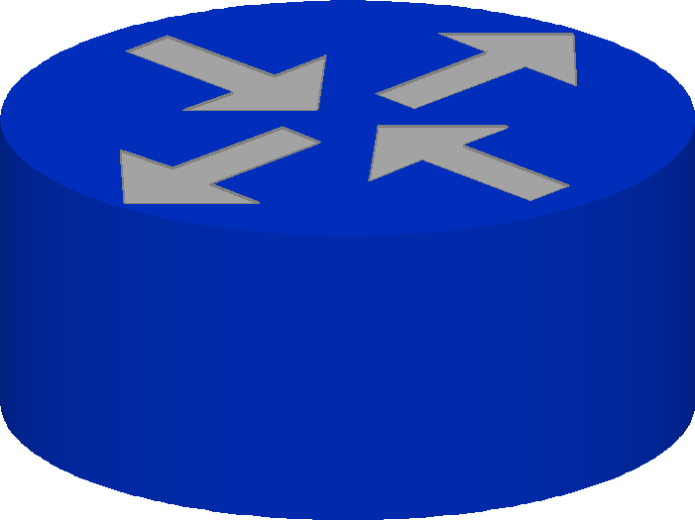
Network Mechanisms Underlying ESnet’s OSCARS
LSP between ESnet border (PE) routers is determined using topology information from OSPF-TE. Path of LSP is explicitly directed to take SDN network where possible.
On the SDN all OSCARS traffic is MPLS switched (layer 2.5).
Layer 3 VC Service: Packets matching reservation profile IP flow-spec are filtered out (i.e. policy based routing), “policed” to reserved bandwidth, and injected into an LSP.
Layer 2 VC Service:
Packets matching reservation profile VLAN ID are filtered out (i.e. L2VPN), “policed” to reserved bandwidth, and injected into an LSP.
Best-effort IP traffic can use SDN, but under normal circumstances it does not because the OSPF cost of SDN is very high
SDN
SDN
SDN
SDN Link
RSVP, MPLS, LDP
enabled on
internal interfaces
SDN Link
Sink
explicit
Label Switched Path
IP Link
Source
IP Link
IP
IP
IP
bandwidth
policer
Bandwidth conforming VC packets are given MPLS labels and placed in EF queue
Regular production traffic placed in BE queue
Oversubscribed bandwidth VC packets are given MPLS labels and placed in Scavenger queue
Scavenger marked production traffic placed in Scavenger queue
OSCARS high-priority queue
OSCARS IDC
Notif.
Topo
standard,
best-effort
queue
Lookup
AuthN
PCE
low-priority queue
Coord
Web
PSetup
AuthZ
ResMgr
W S API
Interface queues

Slide 31
Service Semantics
Basic
  User requests VC b/w, start time, duration, and endpoints
    The endpoint for L3VC is the source and dest. IP addr.
    The endpoint for L2VC is the domain:node:port:link - e.g.
    “esnet:chi-sl-sdn1:xe-4/0/0:xe-4/0/0.2370” on a Juniper router, where “port” is the physical interface and “link” is the sub-interface where the VLAN tag is defined)
  Explicit, diverse (where possible) backup paths may be requested
    This doubles the b/w request
VCs are rate-limited to the b/w requested, but are permitted to burst above the allocated b/w if unused bandwidth is available on the path
Currently the VC, in-allocation packet priority is set to high,
out-of-allocation (burst) packet priority is set to low,
this leaves a middle priority for non-OSCARS traffic (e.g. best effort IP)
  In the future VC priorities and over allocated b/w packet priorities will be settable
In combination, these semantics turn out to provide powerful capabilities

Slide 32
OSCARS Semantics Example
Three physical paths
Two VCs with one backup each, non-OSCARS traffic
  A: a primary service circuit (e.g. a LHC Tier 0 – Tier 1 data path)
  B: a different primary service path
  A-bk: backup for A
  B-bk: backup for B
  P1, P2, P3 queuing priorities for different traffic
BGP
Physical path | VC | Normal operating b/w | A fails operating b/w | A+B fail operating b/w
1 | A | 10 | 0 | 0
2 | A-bk | 0 | 4+other available from non-OSCARS traffic | 4+other available from non-OSCARS traffic
 | Non-OSACRS | 0-10 | 6 | 2
 | B-bk | 0 | 0 | 4+other available from non-OSCARS traffic
3 | B | 10 | 10 | 0
10G physical path #1 (optical circuit / wave)
User router/switch
wt=1
VC A - 10G
P1
wt=2
10G physical path #2 (optical circuit / wave)
Non-OSCARS traffic
P2
VC A-bk - 4G, P1, burst P3
VC B-bk - 4G, P1, burst P3
BGP
10G physical path #3 (optical circuit / wave)
User router/switch
wt=2
VC B - 10G,
P1
wt=1

Slide 33
OSCARS Semantics
In effect, the OSCARS semantics provide the end users the ability to manage their own traffic engineering, including fair sharing during outages
  This has proven very effective for the Tier 1 Centers which have used OSCARS circuits for some time to support their Tier 0 – Tier 1 traffic
    For example, Brookhaven Lab (U.S. Atlas Tier 1 Data Center) currently has a fairly restricted number of 10G paths via ESnet to New York City where ESnet peers with the US OPN (LHC Tier 0 – Tier 1 traffic)
    BNL has used OSCARS to define a set of engineered circuits that exactly matches their needs (e.g. re-purposing and sharing circuits in the case of outages) given the available waves between BNL and New York City
A “high-level” end user can, of course, create a path with just the basic semantics of source/destination, bandwidth, and start/end time

Slide 34
OSCARS Operation
At reservation request time:
  OSCARS calculates a constrained shortest path (CSPF) to identify all intermediate nodes between requested end points
    The normal situation is that CSPF calculations by the routers would identify the VC path by using the default path topology as defined by IP routing policy, which in ESnet’s case would always prefer the IP network over the SDN network
      To avoid this, when OSCARS does the path computation, we "flip" the metrics to prefer SDN links for OSCARS VCs
    Also takes into account any constraints imposed by existing path utilization (so as not to oversubscribe)
    Attempts to take into account user constraints such as not taking the same physical path as some other virtual circuit (e.g. for backup purposes)

Slide 35
OSCARS Operation
At the start time of the reservation:
  A “tunnel” – an MPLS Label Switched Path (“LSP”) – is established through the network on each router along the path of the VC
  If the VC is at layer 3
    a special route is set up for the packets from the reservation source address that directs those packets into the MPLS LSP
      Source and destination IP addresses are identified as part of the reservation process
      In the case of Juniper the “injection” mechanism is a special routing table entry that sends all packets with reservation source address to the start of the LSP of the virtual circuit
    This provides a high degree of transparency for the user since at the start of the reservation all packets from the reservation source are automatically moved onto a high priority path
  If the VC is at layer 2 (as most are)
    A VLAN tag is established at each end of the VC for the user to connect to
  In both cases (L2 VC and L3 VC) the incoming user packet stream is policed at the requested bandwidth in order to prevent oversubscription of the priority bandwidth
    Over-bandwidth packets can use idle bandwidth – they are set to a lower queuing priority

Slide 36
OSCARS Operation
At the end of the reservation:
  For a layer 3 (IP based) VC
    when the reservation ends the special route is removed and any subsequent traffic from the same source is treated as ordinary IP traffic
  For a layer 2 (Ethernet based) VC
    the Ethernet VLAN is taken down at the end of the reservation
  In both cases the temporal topology, link loading database is automatically updated to reflect the fact that this resource commitment no longer exists from this point forward
Reserved bandwidth, virtual circuit service is also called a “dynamic circuits” service
Due to the work in the DICE collaboration, OSCARS and most of the other R&E dynamic circuits approaches interoperate (even those using completely different underlying bandwidth management – e.g. TDM devices providing SONET Vcat/LCAS)

Slide 37
OSCARS is a Production Service in ESnet
OSCARS is currently being used to support production traffic ≈ 50% of all ESnet traffic is now carried in OSCARS VCs
Operational Virtual Circuit (VC) support
  As of 6/2010, there are 31 (up from 26 in 10/2009) long-term production VCs instantiated
    25 VCs supporting HEP: LHC T0-T1 (Primary and Backup) and LHC T1-T2
    3 VCs supporting Climate: NOAA Global Fluid Dynamics Lab and Earth System Grid
    2 VCs supporting Computational Astrophysics: OptiPortal
    1 VC supporting Biological and Environmental Research: Genomics
  Short-term dynamic VCs
    Between 1/2008 and 6/2010, there were roughly 5000 successful VC reservations
      3000 reservations initiated by BNL using TeraPaths
      900 reservations initiated by FNAL using LambdaStation
      700 reservations initiated using Phoebusª
      400 demos and testing (SC, GLIF, interoperability testing (DICE))
The adoption of OSCARS as an integral part of the ESnet4 network resulted in ESnet winning the Excellence.gov “Excellence in Leveraging Technology” award given by the Industry Advisory Council’s (IAC) Collaboration and Transformation Shared Interest Group (Apr 2009) and InformationWeek’s 2009 “Top 10 Government Innovators” Award (Oct 2009)
ª A TCP path conditioning approach to latency hiding - http://damsl.cis.udel.edu/projects/phoebus/

Slide 38
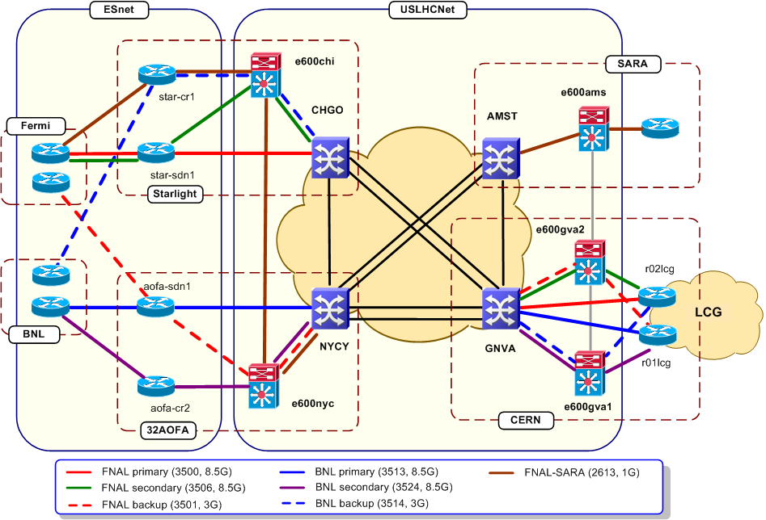
OSCARS LHC T0-T1 Paths
All LHC OPN paths in the ESnet domain are OSCARS circuits
FNAL primary and secondary paths are diverse except for FNAL PE router
Both BNL and FNAL backup VCs share some common links in their paths
BNL primary and secondary paths are completely diverse
Network diagram source: Artur Barczyk, US LHC NWG
10/5/2010

Slide 39
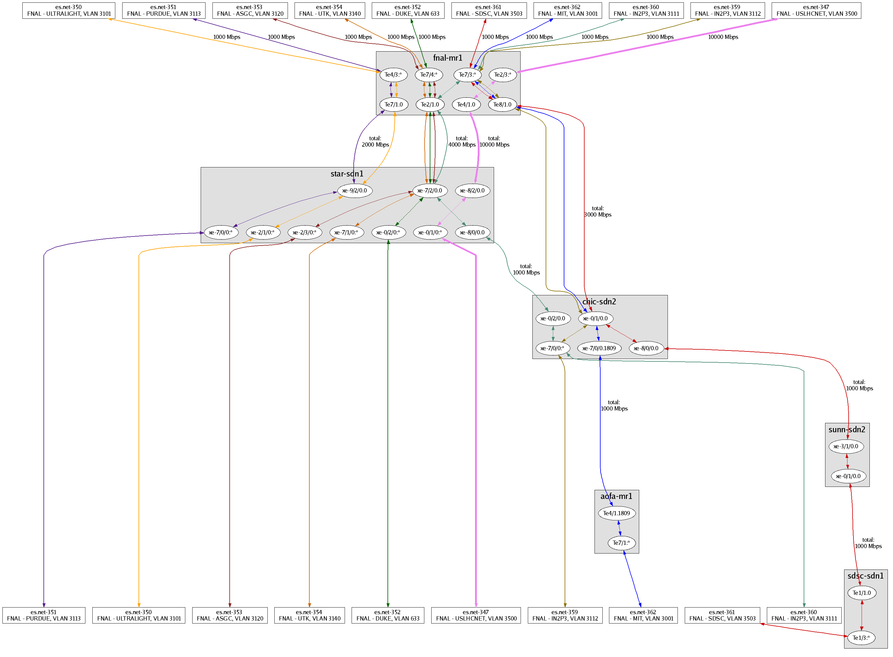
OSCARS is a Production Service in ESnet
10 FNAL Site VLANS
OSCARS setup all VLANs
ESnet PE
ESnet Core
USLHCnet VLANS
USLHCnet
(LHC OPN) VLAN
USLHCnet VLANS
USLHCnet VLANS
USLHCnet VLANS
Tier2 LHC VLANS
Tier2 LHC VLANS
T2 LHC VLAN
Automatically generated map of OSCARS managed virtual circuits
E.g.: FNAL – one of the US LHC Tier 1 data centers. This circuit map (minus the yellow callouts that explain the diagram) is automatically generated by an OSCARS tool and assists the connected sites with keeping track of what circuits exist and where they terminate.
Notes:
39

Slide 40
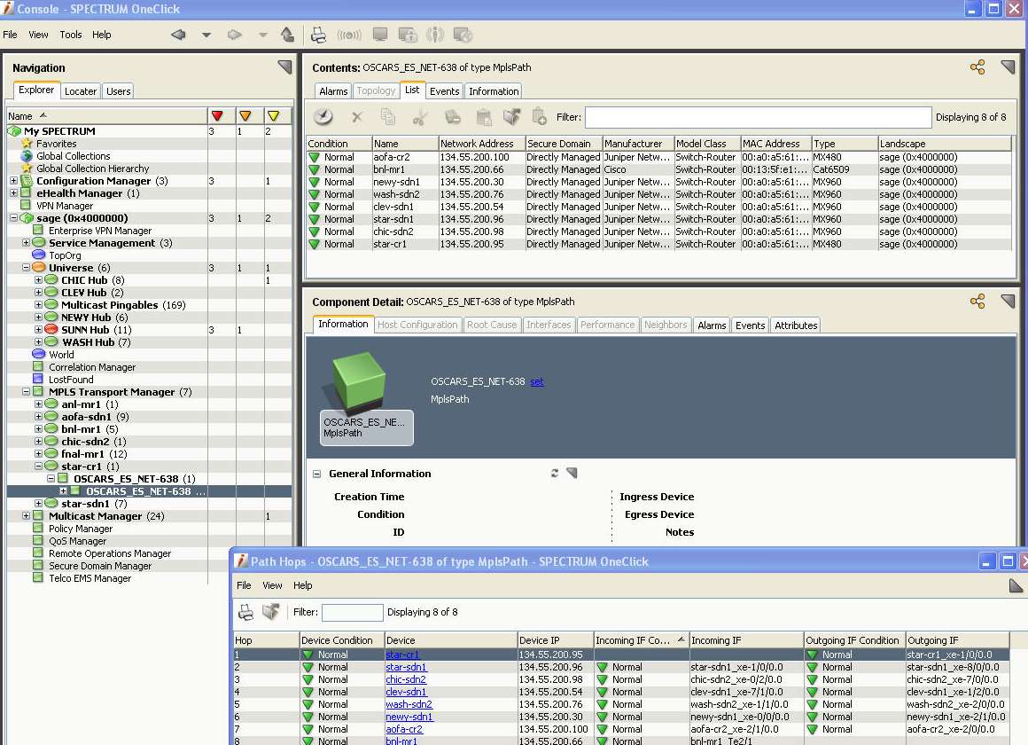
OSCARS is a Production Service in ESnet:
The Spectrum Network Monitor Monitors OSCARS Circuits
Notes:
40

Slide 41
OSCARS Example – User-Level Traffic Engineering
OSCARS backup circuits are frequently configured on paths that have other uses and so provide reduced bandwidth during failover
  Backup paths are typically shared with another OSCARS circuit – either primary or backup – or they are on a circuit that has some other use, such as carrying commodity IP traffic
  Making and implementing the sharing decisions is part of the traffic engineering capability that OSCARS makes available to the experienced site like the Tier 1 Data Centers

Slide 42
OSCARS Example: FNAL Circuits for LHC OPN
A user-defined capacity model and fail-over mechanism using OSCARS circuits
Moving seamlessly from primary to backup circuit in the event of hard failure is currently accomplished at the Tier 1 Centers by using OSCARS virtual circuits for L2 VPNs and setting up a (user defined) BGP session at the ends
  The BGP routing moves the traffic from primary to secondary to tertiary circuit based on the assigned, by-route cost metric
  As the lower cost (primary) circuits fail, the traffic is directed to the higher cost circuit (secondary/backup)
    Higher cost in this case because they have other uses under normal conditions

Slide 43
OSCARS Example (FNAL LHC OPN Paths to CERN)
Three OSCARS circuits are set up on different
optical circuits / waves
  2 x 10G primary paths
  1 x 3G backup path
The desired capacity model is:
Usage | Require-ments estimate | Normal primary b/w (20G available) | path | Usage when degraded by 1 path (10G primary available) | Usage when degraded by 2 paths (3G available for primary)
FNAL primary 1 (LHC OPN) | 10G | 10G | 3500 | 10G | 0G
FNAL primary 2 (LHC OPN) | 10G | 10G | 3506 | 0G | 0G
FNAL backup (LHC OPN) | 3G | 0G | 3501 | 0G | 3G
Estimated time |  | ≈ 363 days/yr |  | 1-2 days/ year | 6 hours/yr

Slide 44
OSCARS Example (FNAL LHC OPN Paths to CERN)
Implementing the capacity model with OSCARS circuits and available traffic priorities
Three paths (3500, 3506, and 3501)
Two VCs with one backup, non-OSCARS traffic
  Pri1: a primary service circuit (e.g. a LHC Tier 0 – Tier 1 data path)
  Pri2: a different primary service path
  Bkup1: backup for Pri1 and Pri2
  P1, P2, P3 queuing priorities for different traffic
BGP
Physical path | VC | Normal operating b/w | Pri1 fails operating b/w | Pri1 + Pri2 fail operating b/w
3500 | Pri1 | 10 | 0 | 0
3501 | Bkup1 | 0 | 0 | 3+other available from non-OSCARS traffic idle time
 | Non-OSACRS | 0-10 | 0-10 | 0-7
3506 | Pri2 | 10 | 10 | 0
10G physical path #1 (optical circuit / wave)
User router/switch
wt=1
VC:Pri1- 10G
P1
wt=2
10G physical path #2 (optical circuit / wave)
Non-OSCARS traffic
P2
VC Bkup1 - 3G, P1,
burst P3
BGP
10G physical path #3 (optical circuit / wave)
User router/switch
wt=2
VC:Pri2- 10G,
P1
Note that with both primaries down and the secondary circuit carrying traffic, that the Pri1 and Pri2 traffic compete on an equal basis for the secondary capacity.
wt=1

Slide 45
Fail-Over Mechanism Using OSCARS VCs – FNAL to CERN
CERN
US LHCnet
US LHCnet
ESnet SDN-AoA
ESnet SDN-Ch1
US LHCnet
ESnet SDN-Star1
CERN
US LHCnet
US LHCnet
CERN
ULHCNet
primary-1 10G
primary-2 10G
BGP
backup-1 3G
FNAL1
ESnet SDN-FNAL1
FNAL2
ESnet SDN-FNAL2
FNAL
ESnet
Network Configuration – Logical, Overall

Slide 46
FNAL OSCARS Circuits for LHC OPN (Physical)
OSCARS circuits
LHC/CERN
LHC OPN paths
USLHCnet
USLHCnet
Boston
MAN LAN
(AofA)
StarLight
IP
Chicago
IP
SDN
Clev.
SDN
IP
IP
SDN
IP
SDN
SDN
primary 1 (VL 3500)
NYC
BNL
2
backup
(VL 3501)
1
primary 2 (VL 3506)
SDN
IP
Wash. DC
FNAL
Network Configuration – Physical in U.S.

Slide 47
The OSCARS L3 Fail-Over Mechanism in Operation
Primary-1 and primary-2 are BGP costed the same, and so share the load, with a potential for 20G total
Secondary-1 (a much longer path) is costed higher and so only gets traffic when both pri-1 and pri-2 are down
What OSCARS provides for the secondary / backup circuit is
  A guarantee of three Gbps for the backup function
  A limitation of OSCARS high priority use of the backup path to 3Gbps so that other uses continue to get a share of the path bandwidth

Slide 48
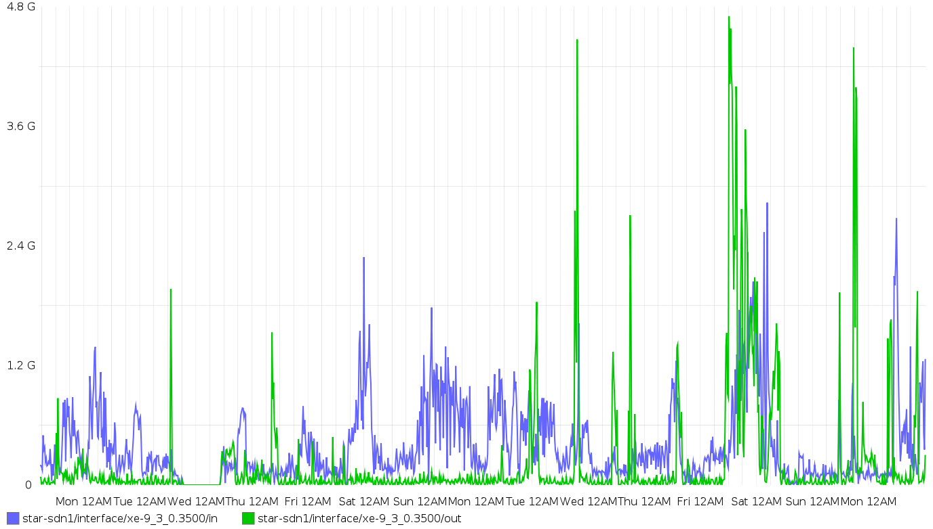
VL 3500 – Primary-1
3.0G
Fiber cut

Slide 49
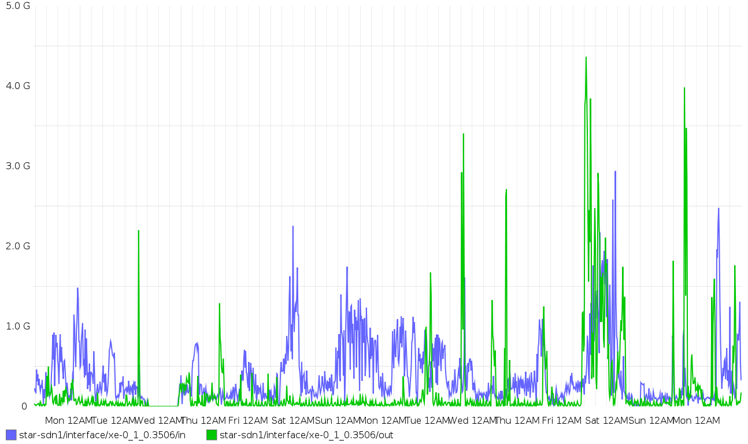
VL3506 – Primary-2 (same fiber as primary 1)
Fiber cut

Slide 50
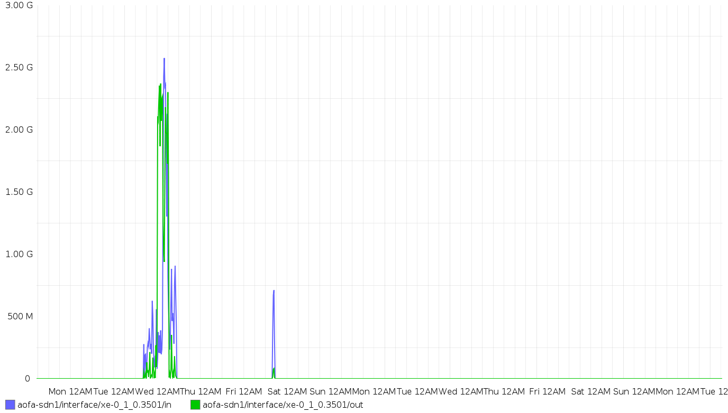
VL3501 - Backup
Backup path circuit traffic during fiber cut

Slide 51
A Transatlantic Traffic Engineering Issue
The HEP community – esp. the LHC community – has developed applications and tools that enable very high network data transfer rates
This is necessary in order to accomplish their science
On the LHC OPN – a private optical network designed to facilitate data transfers from Tier 0 (CERN) to Tier 1 (National experiment data centers) – the HEP data transfer tools are essential
  These tools are mostly parallel data movers – typically GridFTP
  The related applications run on hosts that have modern TCP stacks that are appropriately tuned for high latency WAN transfers (e.g. international networks)

Slide 52
A Transatlantic Traffic Engineering Issue
Recently, the Tier 2 (mostly physics analysis groups at universities) have abandoned the old hierarchical data distribution model
  Tier 0 -> Tier 1 -> Tier 2, with attendant data volume reductions as you move down the hierarchy
in favor of a chaotic model
  get whatever data you need from wherever it is available
This has resulted in enormous, site to site, data flows on the general IP infrastructure that have never been seen before apart from DDOS attacks

Slide 53
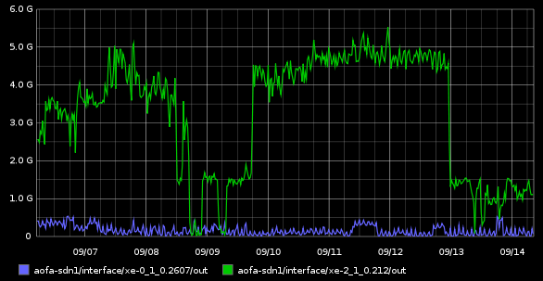
A Transatlantic Traffic Engineering Issue
GÉANT observed a big spike on their transatlantic peering connection with ESnet (in the past week)
  headed for Fermilab – the U.S. CMS Tier 1 data center
ESnet observed the same thing on their side

Slide 54
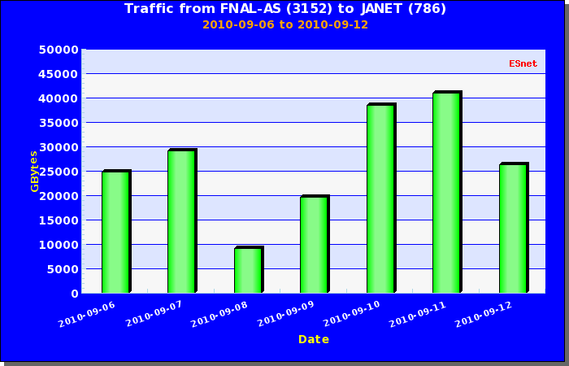
A Transatlantic Traffic Engineering Issue
At FNAL is was apparent that the traffic was going to the UK
Recalling that moving 10 TBy in 24 hours requires a data throughput of about 1 Gbps, the graph above implies 2.5 to 4+ Gbps of data throughput – which is what was being observed at the peering point

Slide 55
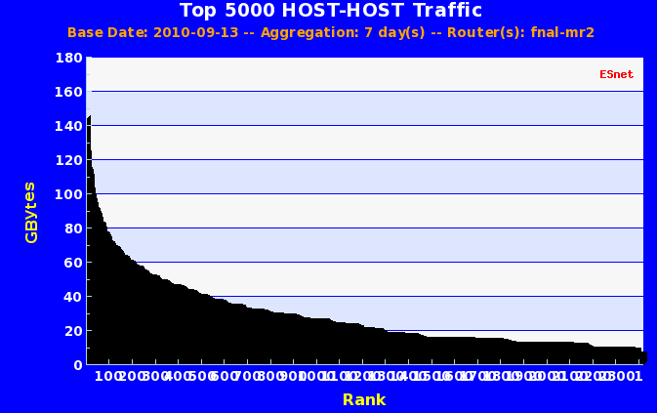
A Transatlantic Traffic Engineering Issue
Further digging revealed the site and nature of the traffic
The nature of the traffic was – as expected – parallel data movers, but with an uncommonly high degree of parallelism:
33 hosts at the UK site and about 170 at FNAL
(Initial query by Guy Roberts (Dante), analysis by W. Johnston, C. Tracey, and J. Metzger (ESnet))

Slide 56
A Transatlantic Traffic Engineering Issue
This high degree of parallelism means that the largest host-host data flow rate is only about 2 Mbps, but in aggregate this data mover farm is doing 860 Mbps (seven day average) and has moved 65 TBytes of data
  the high degree of parallelism makes it hard to identify the sites involved by looking at all of the data flows at the peering point – nothing stands out as an obvious culprit
THE ISSUE:
This clever physics group is consuming 60% of the available bandwidth on the primary U.S. – Europe general R&E IP network link – for weeks at a time!
This is obviously an unsustainable situation and this is the sort of thing that will force the R&E network operators to mark such traffic on the general IP network as scavenger to ensure other uses of the network

Slide 57
A Transatlantic Traffic Engineering Issue
In this case marking the traffic as scavenger probably would not have made much difference for the UK traffic (from a UK LHC Tier 2 center) as the net was not congested
However, this is only one Tier 2 center operating during a period of relative quiet for the LHC - when other Tier 2s start doing this things will fall apart quickly and this will be bad news for everyone:
  For the NOCs to identify and mark this traffic without impacting other traffic from the site is labor intensive
  The Tier 2 physics groups would not be able to do their physics
  It is the mission of the R&E networks to deal with this kind of traffic
There are a number of ways to rationalize this traffic, but just marking it all scavenger is not one of them

Slide 58
Inter-Domain Control Protocol
DICE has standardized the inter-domain control protocols to set up
end-to-end circuits across multiple domains:
  The domains exchange topology information containing at least potential VC ingress and egress points
  VC setup request (via IDC protocol) is initiated at one end of the circuit and passed from domain to domain as the VC segments are authorized and reserved
  Data plane connection is facilitated by a helper process – not by signaling across domain boundaries
Topology
exchange
Local InterDomain Controller
VC setup request
VC setup request
VC setup request
Local IDC
VC setup request
Local IDC
User source
VC setup request
Local IDC
Local IDC
User destination
FNAL (AS3152)
[US]
GEANT (AS20965)
[Europe]
DESY (AS1754)
[Germany]
ESnet (AS293)
[US]
End-to-end
virtual circuit
Example only – not all of the domains shown support a VC service
DFN (AS680)
[Germany]
OSCARS
data plane connection helper at each domain ingress/egress point
data plane connection helper at each domain ingress/egress point
Notes:
58

Slide 59
OSCARS IDC Interoperability
The OSCARS IDC has successfully interoperated with several other IDCs to set up cross-domain circuits
  OSCARS (and IDCs generally) provide the control plane functions for circuit definition within their network domain
  To set up a cross domain path the IDCs communicate with each other using the DICE defined Inter-Domain Control Protocol to establish the piece-wise, end-to-end path
  A separate mechanism provides the data plane interconnection at domain boundaries to stitch the intra-domain paths together

Slide 60
OSCARS Approach to Federated IDC Interoperability
The following organizations have implemented/deployed systems which are compatible with the DICE IDCP:
  Internet2 ION (based on OSCARS/DCN)
  ESnet SDN (based on OSCARS/DCN)
  GÉANT AutoBHAN System (pan-European backbone R&E network)
  NORDUnet (Nordic R&E Network) (based on OSCARS)
  Surfnet (NREN – European national network) (based on Nortel DRAC)
  LHCNet (based on OSCARS/DCN + Dragon (Ciena CoreDirector manager)
  Nysernet (New York Regional Optical Network) (OSCARS/DCN)
  LEARN (Texas RON) (OSCARS/DCN)
  LONI (Louisiana RON) (OSCARS/DCN)
  Northrop Grumman (OSCARS/DCN)
  University of Amsterdam (OSCARS/DCN)
  MAX (OSCARS/DCN)
The following “higher level service applications” have adapted their existing systems to communicate using the DICE IDCP:
  LambdaStation (manages and aggregates site traffic) (FNAL)
  TeraPaths (manages and aggregates site traffic) (BNL)
  Phoebus (University of Delaware) (TCP connection re-conditioner for WAN latency hiding)

Slide 61
OSCARS Collaborative Research Efforts
DOE funded projects
  DOE Project “Virtualized Network Control”
    To develop multi-dimensional PCE (multi-layer, multi-level, multi-technology, multi-layer, multi-domain, multi-provider, multi-vendor, multi-policy)
  DOE Project “Integrating Storage Management with Dynamic Network Provisioning for Automated Data Transfers”
    To develop algorithms for co-scheduling compute and network resources
GLIF GNI-API “Fenius”
  To translate between the GLIF common API to
    DICE IDCP: OSCARS IDC (ESnet, I2)
    GNS-WSI3: G-lambda (KDDI, AIST, NICT, NTT)
    Phosphorus: Harmony (PSNC, ADVA, CESNET, NXW, FHG, I2CAT, FZJ, HEL IBBT, CTI, AIT, SARA, SURFnet, UNIBONN, UVA, UESSEX, ULEEDS, Nortel, MCNC, CRC)
OGF NSI-WG
  Participation in WG sessions
  Contribution to Architecture and Protocol documents

Slide 62
OSCARS 0.6 New Functionality
OSCARS v 0.6 involves the code for modularity and generalizing some data structures to enable new functionality
One important generalization is introducing “topology groups” to represent circuits rather than single, linear paths
  This allows for multiple MPLS paths to underlay one OSCARS VC
    This is a first step in enabling MPLS protection fail-over for OSCARS circuits

Slide 63
MPLS Protection Fail-Over
Like SONET, the MPLS transport that underlies OSCARS has a protection mechanism
  MPLS can establish alternate paths (LSPs) in addition to the primary path, and then manages the use of these paths with a routing mechanism that is below the virtual circuit (“VC”) level seen by the user
  That is, the VC id that is set up by OSCARS – typically an Ethernet VLAN tag – and is used by the user connection, does not change during the MPLS reroute for protection
  The MPLS failover reroute / recovery time is comparable with SONET/SDH recovery time of about 50ms
  OSCARS will use MPLS protection as a fast reroute mechanism to switch between paths that OSCARS has set up to backup a primary path

Slide 64
MPLS Protection Fail-Over
OSCARS MPLS protection (cont.)
  Multiple protection paths may be set up and assigned different (MPLS) routing weights and different queuing priorities
    The different path routing weights work similarly to BGP path weights so that a hierarchy of paths, potentially each with a different priority, can be established
    This mechanism works similarly to the explicit user specification of backup paths and priorities that are the basis of fair sharing of degraded bandwidth and provides yet another tool for fine tuning the use of critical circuits
BGP
BGP
Three different physical paths
User router/switch
VC id = 1 / VLAN tag M
VC id = 1 / VLAN tag N
User router/switch
LSP routing priority 100
MPLS routing
LSP path 1 (established and active)
MPLS routing
LSP routing priority 200
LSP path 2 (routed and instantiated, but in standby state)
LSP routing priority 300
LSP path 3 (routed and instantiated, but in standby state)

Slide 65
OSCARS 0.6 New Functionality
Path “coloring” provides a much richer routing path constraint mechanism that will be directly useful to the LHC community
  The new path constraint mechanism will allow “coloring” of paths, and the path colors can be used as a constraint class
  For example, all paths that are specifically for the use of the HEP community might be colored yellow
  The constraint that can then be applied is that only HEP users may have their VCs routed over the yellow paths
  Additionally, the LHC OPN paths (the primary paths for Tier 0 to Tier 1 traffic) might be colored orange, and only VC requests from the Tier 1 centers would have their paths routed over the orange paths

Slide 66
OSCARS 0.6 New Functionality
The underlying mechanism for both the MPLS path restoration reroute and path coloring have been tested and will be incorporated in OSCARS in the second half of 2011

Slide 67
OSCARS Software is Evolving
The code base is undergoing its third rewrite (OSCARS v0.6)
  V 0.6 restructures the code to increase the modularity and expose internal interfaces so that the community can start standardizing IDC components
    For example there are already several different path setup modules that correspond to different hardware configurations in different networks
    Several capabilities are being added to facilitate research collaborations
  As the service semantics get more complex (in response to user requirements) attention is now given to how users request complex, compound services
    Are defining “atomic” service functions and building mechanisms for users to compose these building blocks into custom services
  New capabilities described above are being added

Slide 68
OSCARS Version 0.6 Software Architecture
user Web client
other IDCs
user apps
perfSONAR services
The lookup and topology services are now seconded to perfSONAR
Notification Broker
Manage subscriptions
Forward notifications
Lookup Bridge
Lookup service
Topology Bridge
Topology information management
External interfaces only on a small number of modules
Source
IP Link
AuthN
Authentication
Path Computation Engine
Constrained path computations
IP
SDN
routers
and
switches
Coordinator
Workflow coordinator
SDN Link
IP
SDN
Web Browser User Interface
All internal interfaces are standardized and accessible via SOAP
ESnet
WAN
Path Setup
Network element interface
IP
SDN
SOAP + WSDL
over http/https
IP
Link
SDN
Link
AuthZ*
Authorization
Costing
*Distinct data and control plane functions
Sink
other
IDCs
Resource Manager
Manage reservations
Auditing
Web Services API
Manages external WS communications
user
apps
OSCARS IDC - Inter-Domain Controller

Slide 69
OSCARS 0.6 Software Goals
Re-structure code so that distinct functions are in stand-alone modules
  Supports distributed model
  Facilitates module redundancy
Formalize (internal) interfaces between modules
  Facilitates module plug-ins from collaborative work (e.g. PCE, topology, naming)
  Customization of modules based on deployment needs (e.g. AuthN, AuthZ, Path Setup)
Standardize the DICE external API messages and control access
  Facilitates inter-operability with other dynamic VC services (e.g. Nortel DRAC, GÉANT AutoBAHN)
  Supports backward compatibility of with previous versions of IDC protocol

Slide 70
OSCARS 0.6 Implementation Progress (as of 2Q2010)
other IDCs
user apps
perfSONAR services
Notification Broker
Manage subscriptions
Forward notifications
Lookup Bridge
Lookup service
Topology Bridge
Topology information management
50%
95%
95%
AuthN
Authentication
PCE
Constrained path computations
90%
Coordinator
Workflow coordinator
70%
routers
and
switches
80%
Web Browser User Interface
Path Setup
Network element interface
50%
SOAP + WSDL
over http/https
60%
other
IDCs
AuthZ*
Authorization
Costing
*Distinct Data and Control Plane Functions
Resource Manager
Manage reservations
Auditing
WS API
Manages External WS Communications
50%
100%
user
apps
90%

Slide 71
OSCARS 0.6 Implementation Progress
Code Development
  10 of 11 modules completed for intra-domain provisioning, are undergoing testing
  Packaging of PCE-SDK underway (for integration of third-party PCEs)
Collaborations
  2-day developers meeting with SURFnet on OSCARS/OpenDRAC collaboration
  Supports GLIF GNI-API Fenius protocol version 2
    Fenius is a short term effort to help create a critical mass of providers of dynamic circuit services to exchange reservation messages
  Contributing to OGF NSI (Network Service Interface) and NML (Network Mark-up Language) working groups to help standardize inter-domain network services messaging
    OSCARS will adopt the NSI protocol once it has been rectified by OGF
Deployment Objectives
  ESnet planning on deploying OSCARS v0.6 into production 2Q2011
  Internet2 aims to deploy ~60 instances of OSCARS in 1H2011
    DyGIR will deploy ~5 instances of OSCARS in collaboration with USLHC by 1Q2011
    DYNES aims to deploy ~55 instances of OSCARS at U.S. RONs and universities by 2Q2011

Slide 72
OSCARS 0.6 Path Computation Engine Features
Creates a framework for multi-dimensional constrained path finding
  The framework is also intended to be useful in the R&D community
Path Computation Engine takes topology + constraints + current and future utilization and returns a pruned topology graph representing the possible paths for a reservation
A PCE framework manages the constraint checking modules and provides API (SOAP) and language independent bindings
  Plug-in architecture allowing external entities to implement PCE algorithms: PCE sub-modules.
  Dynamic, runtime: computation is done when creating or modifying a path
  PCE constraint checking modules organized as a graph
  Being provided as an SDK to support and encourage research

Slide 73
Composable Network Services Framework
Motivation
  Typical users want better than best-effort service but are unable to express their needs in network engineering terms
  Advanced users want to customize their service based on specific requirements
  As new network services are deployed, they should be integrated in to the existing service offerings in a cohesive and logical manner
Goals
  Abstract technology specific complexities from the user
  Define atomic network services which are composable
  Create customized service compositions for typical use cases

Slide 74
Atomic and Composite Network Services Architecture
Network Services Interface
Network Service Plane
Composite Service (S1 = S2 + S3)
Service templates pre-composed for specific applications or customized by advanced users
Composite Service (S2 = AS1 + AS2)
Composite Service (S3 = AS3 + AS4)
Service Abstraction Increases
Service Usage Simplifies
Atomic services used as building blocks for composite services
Atomic Service (AS1)
Atomic Service (AS2)
Atomic Service (AS3)
Atomic Service (AS4)
Multi-Layer Network Data Plane

Slide 75
Atomic and Composite Network Services Architecture
e.g. a backup circuit– be able to move a certain amount of data in or by a certain time
Network Services Interface
e.g. dynamically manage priority and allocated bandwidth to ensure deadline completion
e.g. monitor data sent and/or potential to send data
Network Service Plane
Composite Service (S1 = S2 + S3)
Service templates pre-composed for specific applications or customized by advanced users
Composite Service (S2 = AS1 + AS2)
Composite Service (S3 = AS3 + AS4)
Service Abstraction Increases
Service Usage Simplifies
Atomic services used as building blocks for composite services
Atomic Service (AS1)
Atomic Service (AS2)
Atomic Service (AS3)
Atomic Service (AS4)
Multi-Layer Network Data Plane

Slide 76



Examples of Atomic Network Services
Topology to determine resources and orientation
Security (e.g. encryption) to ensure data integrity
Path Finding to determine possible path(s) based on multi-dimensional constraints
Store and Forward to enable caching capability in the network
Connection to specify data plane connectivity
Measurement to enable collection of usage data and performance stats
Protection to enable resiliency through redundancy
Monitoring to ensure proper support using SOPs for production service
1+1
Restoration to facilitate recovery

Slide 77
Examples of Composite Network Services
LHC: Resilient High Bandwidth Guaranteed Connection
1+1
connect
topology
find path
protect
measure
monitor
Reduced RTT Transfers: Store and Forward Connection
Protocol Testing: Constrained Path Connection

Slide 78
Atomic Network Services Currently Offered by OSCARS
Network Services Interface
ESnet OSCARS
Connection creates virtual circuits (VCs) within a domain as well as multi-domain end-to-end VCs
Monitoring provides critical VCs with production level support
Path Finding determines a viable path based on time and bandwidth constrains
Multi-Layer Multi-Layer Network Data Plane

Slide 79
References
[OSCARS] – “On-demand Secure Circuits and Advance Reservation System”
For more information contact Chin Guok (chin@es.net). Also see
  http://www.es.net/oscars
[Workshops]
see http://www.es.net/hypertext/requirements.html
[LHC/CMS]
http://cmsdoc.cern.ch/cms/aprom/phedex/prod/Activity::RatePlots?view=global
[ICFA SCIC] “Networking for High Energy Physics.” International Committee for Future Accelerators (ICFA), Standing Committee on Inter-Regional Connectivity (SCIC), Professor Harvey Newman, Caltech, Chairperson.
  http://monalisa.caltech.edu:8080/Slides/ICFASCIC2007/
[E2EMON] Geant2 E2E Monitoring System –developed and operated by JRA4/WI3, with implementation done at DFN
http://cnmdev.lrz-muenchen.de/e2e/html/G2_E2E_index.html
http://cnmdev.lrz-muenchen.de/e2e/lhc/G2_E2E_index.html
[TrViz] ESnet PerfSONAR Traceroute Visualizer
https://performance.es.net/cgi-bin/level0/perfsonar-trace.cgi
Notes:
79

Slide 81
Details

Slide 82
Advanced Networking Initiative
ESnet Update
Summer 2010 ESCC Meeting
Columbus, OH
Steve Cotter, ESnet Dept Head
Lawrence Berkeley National Lab
RFP Status, Technology Evaluation, Testbed Update

Slide 83
ARRA Advanced Networking Initiative (ANI)
Advanced Networking Initiative goals:
  Build an end-to-end 100 Gbps prototype network
    Handle proliferating data needs between the three DOE supercomputing facilities and NYC international exchange point
  Build a network testbed facility for researchers and industry
RFP for 100 Gbps transport and dark fiber released last month (June)
RFP for 100 Gbps routers/switches due out in Aug

Slide 84
ANI 100G Technology Evaluation
Most devices are not designed with any consideration of the nature of R&E traffic – therefore, we must ensure that appropriate features are present and devices have necessary capabilities
Goals (besides testing basic functionality):
  Test unusual/corner-case circumstances to find weaknesses
  Stress key aspects of device capabilities important for ESnet services
Many tests conducted on multiple vendor alpha-version routers, examples:
  Protocols (BGP, OSPF, ISIS, etc)
  ACL behavior/performance
  QoS behavior
  Raw throughput
  Counters, statistics, etc

Slide 85
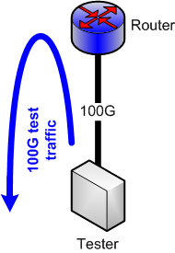
Example:
Basic Throughput Test
Test of hardware capabilities
Test of fabric
Multiple traffic flow profiles
Multiple packet sizes

Slide 86
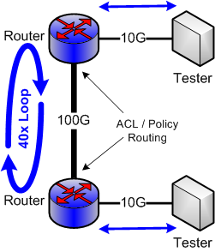
Example:
Policy Routing and ACL Test
Traffic flows between testers
ACLs implement routing policy
Policy routing amplifies traffic
Multiple packet sizes
Multiple data rates
Multiple flow profiles
Test SNMP statistics collection
Test ACL performance
Test packet counters

Slide 87
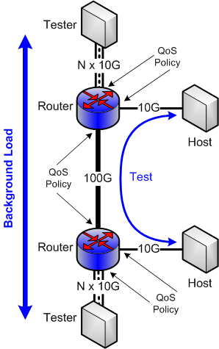
Example:
QoS / Queuing Test
Testers provide background load on 100G link
Traffic between test hosts is given different QoS profile than background
Multiple traffic priorities
Test queuing behavior
Test shaper behavior
Test traffic differentiation capabilities
Test flow export
Test SNMP statistics collection

Slide 88
Testbed Overview
A rapidly reconfigurable high-performance network research environment that will enable researchers to accelerate the development and deployment of 100 Gbps networking through prototyping, testing, and validation of advanced networking concepts.
An experimental network environment for vendors, ISPs, and carriers to carry out interoperability tests necessary to implement end-to-end heterogeneous networking components (currently at layer-2/3 only).
Support for prototyping middleware and software stacks to enable the development and testing of 100 Gbps science applications.
A network test environment where reproducible tests can be run.
An experimental network environment that eliminates the need for network researchers to obtain funding to build their own network.

Slide 89
Testbed Status
Progression
  Operating as a tabletop testbed since June
  Move to Long Island MAN as dark fiber network is built out
  Extend to WAN when 100 Gbps available
Capabilities
  Ability to support end-to-end networking, middleware and application experiments, including interoperability testing of multi-vendor 100 Gbps network components
  Researchers get “root” access to all devices
  Use Virtual Machine technology to support custom environments
  Detailed monitoring so researchers will have access to all possible monitoring data

Slide 90



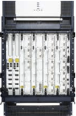
Tabletop: A layered view
10G Tester
FS/BS/
App host
Monitoring
Host
10G Tester
Applications
Layer 3
Openflow
Switch
Layer 2/Openflow
WDM/
Optical
WDM Link
10GE Link
1GE Link
Layer 0/1

Slide 91

LIMAN ANI Testbed
Configuration
(40G aggregate)
MX80 Router
100G Prototype Network
Prod.
Mon host
ssh gateway
App Host
AofA
File Server
Infinera
4x10GE
8x1GE
Testbed
IO Tester
To Internet
MX80 Router
NEC Openflow
Mon host
App Host
NEC Openflow
File Server
Infinera
4x10GE
Prod.
Testbed
Testbed
IO Tester
Infinera
4x10GE
IO Tester
NEC Openflow
IO Tester
Testbed
Infinera
2x10GE
Prod.
Prod.
WDM Link
2 x 10 G Infinera
10 GE Link
1 GE Link
NEWY
BNL

Slide 92
Details

Slide 93
OSCARS 0.6 Standard PCE’s
OSCARS implements a set of default PCE modules (supporting existing OSCARS deployments)
Default PCE modules are implemented using the PCE framework.
Custom deployments may use, remove or replace default PCE modules.
Custom deployments may customize the graph of PCE modules.

Slide 94
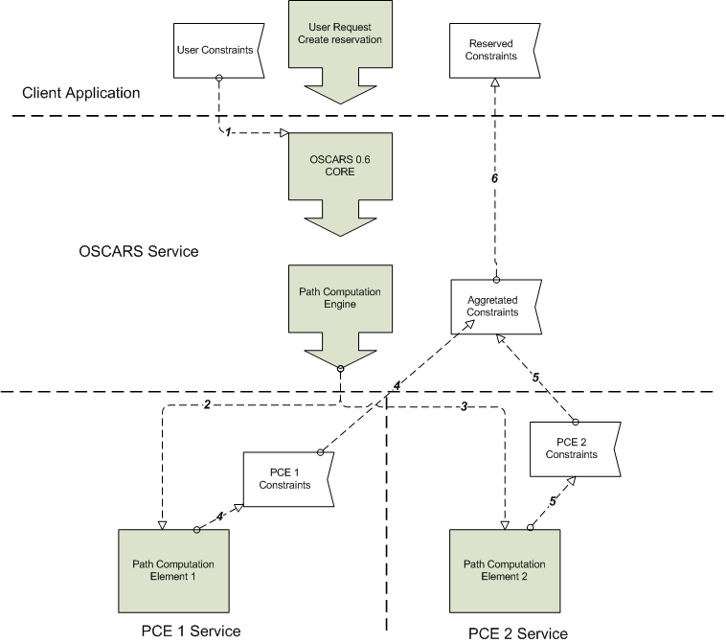
OSCARS 0.6 PCE Framework Workflow
Topology +
user constraints
Constraint checkers are distinct PCE modules – e.g.
  Policy (e.g. prune paths to include only LHC dedicated paths)
  Latency specification
  Bandwidth (e.g. remove any path < 10Gb/s)
  protection

Slide 95
Graph of PCE Modules And Aggregation
Aggregator collects results and returns them to PCE runtime
  Also implements a tag.n .and. tag.m or tag.n .or. tag.m semantic
PCE
Runtime
User Constrains
User Constrains
Aggregate Tags 1,2
PCE 1
PCE 4
Tag 1
User + PCE4 Constrains (Tag=2)
Tag 2
User + PCE4 Constrains (Tag=2)
User + PCE1 Constrains (Tag=1)
Aggregate Tags 3,4
PCE 2
PCE 5
PCE 6
Tag 1
Tag 3
Tag 4
User + PCE1 + PCE2 Constrains (Tag=1)
User + PCE4 + PCE6 Constrains (Tag=4)
User + PCE4 + PCE5 Constrains (Tag=3)
PCE 3
PCE 7
Tag 1
Intersection of [Constrains (Tag=3)] and [Constraints (Tag=4)] returned as Constraints (Tag =2)
Tag 4
User + PCE1 + PCE2 + PCE3 Constrains (Tag=1)
User + PCE4 + PCE6 + PCE7 Constrains (Tag=4)
*Constraints = Network Element Topology Data

