Slide 1
perfSONAR
ESCC
Indianapolis IN
July 21, 2009
Joe Metzger, Brian Tierney
ESnet/LBNL

Slide 2
Measurement Recommendations
White Paper has been posted at:
  http://fasterdata.es.net/ps_howto.html
  This is a draft
  I am expecting additional community input and will continually refine this document.

Slide 3
Measurement Recommendations
Deploy perfSONAR tools
At Site border:
  1 Bandwidth system, 1 latency system & several other services (Utilization, NDT, etc)
Near significant network resources
Use it to:
  Find & fix current local problems
  Identify when they re-occur
  Set user expectations by quantify your network services

Slide 4
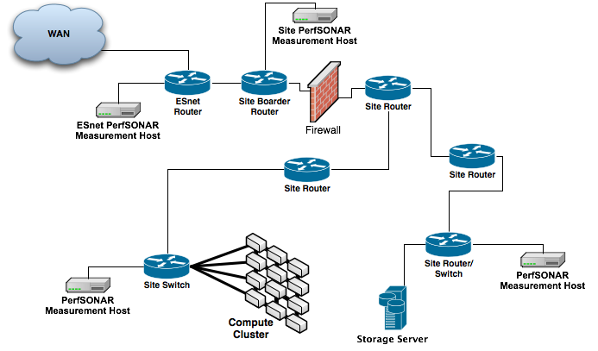
Typical Campus Deployment

Slide 5
Soft Network Failures
Soft failures are where basic connectivity functions, but high performance is not possible.
TCP was intentionally designed to hide all transmission errors from the user:
  “As long as the TCPs continue to function properly and the internet system does not become completely partitioned, no transmission errors will affect the users.” (From IEN 129, RFC 716)
Some soft failures only affect high bandwidth long RTT flows.
Hard failures are easy to detect & fix, soft failures can lie hidden for years.

Slide 6
Deploying a perfSONAR measurement host in under 30 minutes
Using the PS Performance Toolkit is very simple
  Boot from CD
  Use command line tool to configure
    what disk partition to use for persistent data
    Network address and DNS
    User and root passwords
  Use Web GUI to configure
    Select which services to run
    Select remote measurement points for bandwidth and latency tests
    Configure Cacti to collect SNMP data from key router interfaces

Slide 7
PS-Performance Toolkit Components
Apache http
What is missing from the picture?
hLS
perfAdmin
Config Tools
Visualization
Tools
perfSONAR BOUY
NDT
Support Applications
pSB MA
Pinger MA
NPAD
Provides a perfSONAR
Web Service
Bwctl
Pinger
SNMPMA
nuttcp
iperf
owamp
ping
cacti
Low Level Measurement Tools

Slide 8
Backup Slides
The following slides were from the measurement BOF at Joint Techs.

Slide 9
Measurement Recommendations
Deploy perfSONAR tools
At Site border:
  1 Bandwidth system, 1 latency system & several other services (Utilization, NDT, etc)
Near significant network resources
Use it to:
  Find & fix current local problems
  Identify when they re-occur
  Set user expectations by quantify your network services

Slide 10
High Performance Networking
  Most of the R&E community has access to 10 Gbps networks.
  Naive users with the right tools should be able to easily get:
    200 Mbps/per stream between properly maintained systems
    2 Gbps aggregate rates between significant computing resources
  Most users are not experiencing this level of performance
    “There is widespread frustration involved in the transfer of large data sets between facilities, or from the data’s facility of origin back to the researcher’s home institution. “ From the BES network requirements workshop: http://www.es.net/pub/esnet-doc/BES-Net-Req-Workshop-2007-Final-Report.pdf
  We can increase performance by measuring the network and reporting problems!

Slide 11
Network Troubleshooting is a
Multi-Domain Problem
Source
Campus
Education
Backbone
Destination
Campus
S
D
JET
Network
Regional

Slide 12
Where are common problems?
Latency Dependant problems inside domains with small RTT
Bad Link or Interfaces between Domains
Source
Campus
Education
Backbone
Destination
Campus
S
D
JET
Network
Regional

Slide 13
Soft Network Failures
Soft failures are where basic connectivity functions, but high performance is not possible.
TCP was intentionally designed to hide all transmission errors from the user:
  “As long as the TCPs continue to function properly and the internet system does not become completely partitioned, no transmission errors will affect the users.” (From IEN 129, RFC 716)
Some soft failures only affect high bandwidth long RTT flows.
Hard failures are easy to detect & fix, soft failures can lie hidden for years.

Slide 14
Common Soft Failures
Small Queue Tail Drop
  Switches not able to handle the long packet trains prevalent in long RTT sessions and cross traffic at the same time
Un-intentional Rate Limiting
  Process Switching on Cisco 6500 devices due to faults, acl’s, or mis-configuration
  Security Devices…
Random Packet Loss
  Bad fibers or connectors
  Low light levels due to amps/interfaces failing
  Duplex mismatch

Slide 15
Local testing will not find some problem.
Performance is good when RTT is < 20 ms
Performance is poor when RTT is > 20 ms
Source
Campus
Education
Backbone
Destination
Campus
S
D
Switch with small buffers
JET
Network
Regional

Slide 16
Addressing the Problem: perfSONAR
Developing an open web-services based framework for collecting, managing and sharing network measurements
Deploying the framework across the science community
Encouraging people to deploy ‘known good’ measurement points near domain boundaries

Slide 17
What is perfSONAR?
A collaboration
  For developing, deploying & utilizing network measurement tools
An architecture and protocols
A collection of software

Slide 18
perfSONAR Terminology
perfSONAR Collaboration: Collection of groups working on perfSONAR tools
perfSONAR Schemas: OGF standards for perfSONAR communications
perfSONAR Bundle: collection of tools into a release
perfSONAR MDM: A measurement service coordinated by DANTE
perfSONAR PS: Perl-based tools
perfSONAR Performance Toolkit: Bootable CD packaging of several tool
perfSONAR Bandwidth Services: Active bandwidth probe control (bwctl)
perfSONAR Latency Services: Active latency probe control (owamp/PingER)
perfSONAR Measurement Archives: Store and publish results / data
perfSONAR Analysis Tools: data visualization tools
perfSONAR Troubleshooting Services: NDT and NPAD
perfSONAR = all of the above

Slide 19
perfSONAR Developers
ESnet
GEANT
Internet2
RNP
University of Delaware
FERMI
Georgia Tech
SLAC
ARIES
BELNET
CARNet
CESNET
DANTE
DFN
FCCN
Consortium GARR
GRNET
IST
POZNAN Supercomputing Center
Red IRIS
Renater
SURFnet
SWITCH
UNINETT
Notes:
From http://www.perfsonar.net/partners.html

Slide 20
perfSONAR Deployments
Internet2
University of Michigan, Ann Arbor
Indiana University
Boston University
University of Texas Arlington
Oklahoma University, Norman
Michigan Information Technology Center
William & Mary
University of Wisconsin Madison
Southern Methodist University, Dallas
University of Texas Austin
Vanderbilt University
ESnet
Argonne National Lab
Brookhaven National Lab
Fermilab
National Energy Research Scientific Computing Center
Pacific Northwest National Lab
APAN
GLORIAD
JGN2PLUS
KISTI Korea
Monash University, Melbourne
NCHC, HsinChu, Taiwan
Simon Fraser University
  Surrey Campus
  West Burnaby Campus
  Vancouver
Notes:
From https://dc211.internet2.edu/cgi-bin/perfAdmin/serviceList.cgi

Slide 21
perfSONAR Deployments (2)
GEANT
GARR
HUNGARNET
PIONEER
SWITCH
CCIN2P3
CERN
CNAF
DE-KIT
NIKHEF/SARA
PIC
RAL
TRIUMF
ASCC
Note: These are just the deployments I know about. There are probably more…
Notes:
European NRENs and LHC Tier1 Centers
GRIDKA was renamed DE-KIT.

Slide 22
perfSONAR JET deployment
The Joint Engineering Team is developing a perfSONAR deployment plan
  Reviewing the network measurement data each network is willing to share, or would like to access
  Reviewing the perfSONAR tools & monitoring functions to evaluate which networks will deploy which ones.
First deployments in the nets with open science missions and exchange points

Slide 23
perfSONAR Architecture
Interoperable network measurement middleware (SOA):
  Modular
  Web services-based
  Decentralized
  Locally controlled
Integrates:
  Network measurement tools and data archives
  Data manipulation
  Information Services
    Discovery
    Topology
    Authentication and authorization
Based on:
  Open Grid Forum Network (OGF) Network Measurement Working Group (NM-WG) schema
  Currently attempting to formalize speciﬁcation of perfSONAR protocols in a new OGF WG (NMC-WG)
  Network topology description being deﬁned in the Network Markup Language Working Group (NML-WG)

Slide 24
perfSONAR Protocols
Web Services based protocols for:
  Finding measurement services
  Exchanging measurement data
  Scheduling measurements
We are standardizing these protocols in the OGF

Slide 25
Main perfSONAR Services
Lookup Service
  gLS – Global service used to find services
  hLS – Home service for registering local perfSONAR metadata
Measurement Archives
  SNMP MA – Interface Data
  pSB MA -- Scheduled bandwidth and latency data
Measurement Points
  BWCTL
  OWAMP
  PINGER
Troubleshooting Tools
  NDT
  NPAD
Topology Service

Slide 26
Selecting Network Measurements
Router Interface Data
  Utilization, Errors, Discards
  Border & internal bottleneck links
  Before & after the security infrastructure
Active Bandwidth Measurements
  Identify Important paths to measure
  Do you need to test 10G paths?
Latency Measurements
  Identify important paths to measure
LAN/Desktop performance
  NDT & NPAD

Slide 27
perfSONAR Software Terminology
There are multiple perfSONAR services
  Ie, lookup service, measurement archives, measurement points, authentication, etc
There are multiple code trains
  perfSONAR-PS
  perfSONAR MDM
perfSONAR service bundles
  Integrated tested releases that may contain services picked from both code trains.

Slide 28
perfSONAR PS
Primarily written in Perl
Emphasis on
  ease of deployment
  community driven development & support
Mostly US Developers

Slide 29
perfSONAR MDM
Heavy reliance on Java
  Some perl as well
Emphasis on
  measurement as a service offering
  security & access restrictions
Mostly European developers

Slide 30
perfSONAR Bundles
PS-Performance Toolkit
  Based on perfSONAR-PS code train
  CDROM that automates creating a measurement appliance
perfSONAR-PS v3.1
  Packages of individual perfSONAR services
perfSONAR-MDM v3.1
  The basis of the LHCOPN perfSONAR MDM service

Slide 31
Selecting a Bundle or Distribution
Do you need to support NDT & NPAD, or are you looking for a simple measurement appliance?
  Consider PS-Performance Toolkit
Does your organization have restrictions on OS’s and patching for servers supporting external network services?
  Consider perfSONAR PS RPM packages
Is publishing data to restricted groups critical, and are you a member of the eduGAIN federation?
  Consider MDM release

Slide 32
PS-Performance Toolkit Components
Apache http
What is missing from the picture?
hLS
perfAdmin
Config Tools
Visualization
Tools
perfSONAR BOUY
NDT
Support Applications
pSB MA
Pinger MA
NPAD
Provides a perfSONAR
Web Service
Bwctl
Pinger
SNMPMA
nuttcp
iperf
owamp
ping
cacti
Low Level Measurement Tools

Slide 33
perfSONAR Hardware
Requires dedicated hardware (not virtual servers)
Copy somebody else, or try before you buy…
  ESnet deployed hardware details at
    https://performance.es.net/PMP.html
  Sample host configuration for PS Performance Toolkit
    http://fasterdata.es.net/ps_howto.html
  Find somebody with the class of machine that your looking for and ask them how it works!

Slide 34
Typical Campus Deployment

Slide 35
Developing a Measurement Plan
What are you going to measure?
  Achievable bandwidth
    2-3 regional destinations
    4-8 important collaborators
    4-12 times per day to each destination
    20 second tests within the NA, longer to EU or Asia
  Latency
    OWAMP: ~10 collaborators over diverse paths
    Pinger: Important collaborators who don’t support owamp
  Interface Utilization & Errors
What are you going to do with the results?
  NAGIOS Alerts
  Reports to user community
  Website

Slide 36
Deploying a perfSONAR measurement host in under 30 minutes
Using the PS Performance Toolkit is very simple
  Boot from CD
  Use command line tool to configure
    what disk partition to use for persistent data
    Network address and DNS
    User and root passwords
  Use Web GUI to configure
    Select which services to run
    Select remote measurement points for bandwidth and latency tests
    Configure Cacti to collect SNMP data from key router interfaces

Slide 37
Measurement “Communities”
The PS Performance Toolkit lets you specify which measurement community you measurement host is meant to service
  Sample communities: LHC, DOE-SC-LAB, Internet2, ESnet, Climate, etc.
This makes it easier to locate other measurement hosts of interest

Slide 38
Example: US Atlas
Tier 1 to Tier 2 Center Data transfer problem
  Couldn’t exceed 1 Gbps across a 10GE end to end path that included 5 administrative domains
  Used perfSONAR tools to localize problem
  Identified problem device
    An unrelated domain had leaked a full routing table to the router for a short time causing FIB corruption. The routing problem was fixed, but the router started process switching some flows after that.
  Fixed
    Rebooting device fixed the symptoms of the problem
    Better BGP filters configured to prevent reoccurrence (of 1 cause of this particular class of soft faults)
Notes:
More Details at: http://fasterdata.es.net/success_stories.html

Slide 39
Example: NERSC & OLCF
Users were having problems moving data between supercomputer centers
  One user was: “waiting more than an entire workday for a 33 GB input file”
perfSONAR Measurement tools were installed
  Regularly scheduled measurements were started
Numerous choke points were identified & corrected
Dedicate wide area transfer nodes were setup
  Tuned for Wide Area Transfers
  Now moving 40 TB in less than 3 days
Notes:
More details at: http://www.lbl.gov/cs/Archive/news051809.html

Slide 40
How to Participate
Deploy perfSONAR
Use perfSONAR to find & correct the hidden performance problems in your networks.

Slide 41
Firewalls
If your server is behind a firewall, you need to open the following ports
Open to Global perfSONAR Servers
  Lookup Service -- open port tcp/8095
Open to perfSONAR Users
  SNMP MA -- open port tcp/8065
  PingER -- open port tcp/8075
  perfSONAR-BUOY -- open port tcp/8085
  bwctl -- open port tcp/4823, edit /usr/local/etc/bwctld.conf, set peer_port to a value, open the tcp port for that value, and edit /usr/local/etc/bwctld.conf, set iperf_port, thrulay_port and nuttcp_port to a specific range, and open the tcp/udp ports for those ranges.
  owamp -- open port tcp/861, edit /usr/local/etc/owampd.conf, set testports to range, open the udp ports for that range
  NDT -- open port tcp/3001, open port tcp/3002, open port tcp/3003, open port tcp/7123
  NPAD -- open port tcp/8100, open port tcp/8200
Open for local management
  Apache HTTP Server -- open port tcp/80, open port tcp/443
  SSH -- open port tcp/22

Slide 42
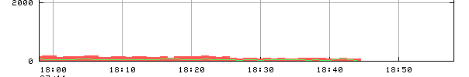
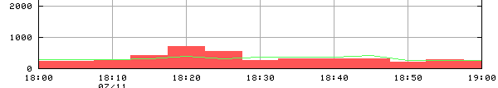
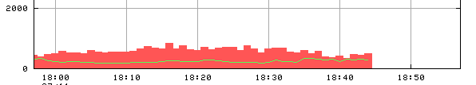
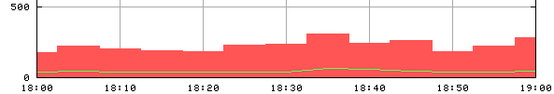
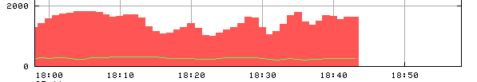
Traceroute Visualizer
Forward direction bandwidth utilization on application path from LBNL to INFN-Frascati (Italy)
  traffic shown as bars on those network device interfaces that have an associated MP services (the first 4 graphs are normalized to 2000 Mb/s, the last to 500 Mb/s)
1 ir1000gw (131.243.2.1)
2 er1kgw
3 lbl2-ge-lbnl.es.net
4 slacmr1-sdn-lblmr1.es.net (GRAPH OMITTED)
5 snv2mr1-slacmr1.es.net (GRAPH OMITTED)
6 snv2sdn1-snv2mr1.es.net
7 chislsdn1-oc192-snv2sdn1.es.net (GRAPH OMITTED)
8 chiccr1-chislsdn1.es.net
9 aofacr1-chicsdn1.es.net (GRAPH OMITTED)
10 esnet.rt1.nyc.us.geant2.net (NO DATA)
11 so-7-0-0.rt1.ams.nl.geant2.net (NO DATA)
12 so-6-2-0.rt1.fra.de.geant2.net (NO DATA)
13 so-6-2-0.rt1.gen.ch.geant2.net (NO DATA)
14 so-2-0-0.rt1.mil.it.geant2.net (NO DATA)
15 garr-gw.rt1.mil.it.geant2.net (NO DATA)
16 rt1-mi1-rt-mi2.mi2.garr.net
17 rt-mi2-rt-rm2.rm2.garr.net (GRAPH OMITTED)
18 rt-rm2-rc-fra.fra.garr.net (GRAPH OMITTED)
19 rc-fra-ru-lnf.fra.garr.net (GRAPH OMITTED)
20
21 www6.lnf.infn.it (193.206.84.223) 189.908 ms 189.596 ms 189.684 ms
link capacity is also provided

