Slide 1
ESxSNMP:
ESnet eXtensible SNMP System
Jon Dugan <jdugan@es.net>
Summer JointTechs 2010, Columbus, OH

Slide 2
ESnet Statistics Overview
ESxSNMP
(Data Collection)
Graphite
(Visualization)
Analytics
(Custom Reports)
Net Almanac
(Metadata)

Slide 3
Why another SNMP collection system?
Desire to retain raw, unmolested data
  Disk is cheap
  At least one application in ESnet needs raw data
  Aids in troubleshooting of erroneous statistics
Automatically detect changes in the network
  New interfaces are detected within minutes (tunable)
  Dynamic circuits make this especially important
Metadata
  Efficiently maintain a history of the network
Integration with other systems
  perfSONAR, web sites (REST/JSON)

Slide 4
Principles
Automate
  routers are added/removed automatically
  interfaces are added/removed automatically
  monthly reports are generated automatically
Don’t make (too many) assumptions
  keep raw data
  keep history
  polling does minimal processing/interpretation
Be flexible
  work in the general case, allow for exception cases
  group of cooperating processes, components can be replaced
  clear entry points for modifying behavior
Share
  REST/JSON
  perfSONAR (coming soon)

Slide 5
Implementation
Python
  About 4,000 SLOC
  Dependencies
    TSDB
    SQLAlchemy
    web.py
    DLNetSNMP: wrapper for net-snmp

Slide 6
Multiple Process Architecture
Flexibility / Reduced Coupling
  Components can be replaced individually
  One part can be upgraded without restarting everything
  Each piece is simple and focused (cf. Unix tools approach)
Concurrency
  Process level concurrency
  “Do not communicate by sharing memory; instead share memory by communicating.” (Go language)
  Python threads are lacking
    Excellent for I/O bound applications
    Poor performance for compute intensive applications

Slide 7
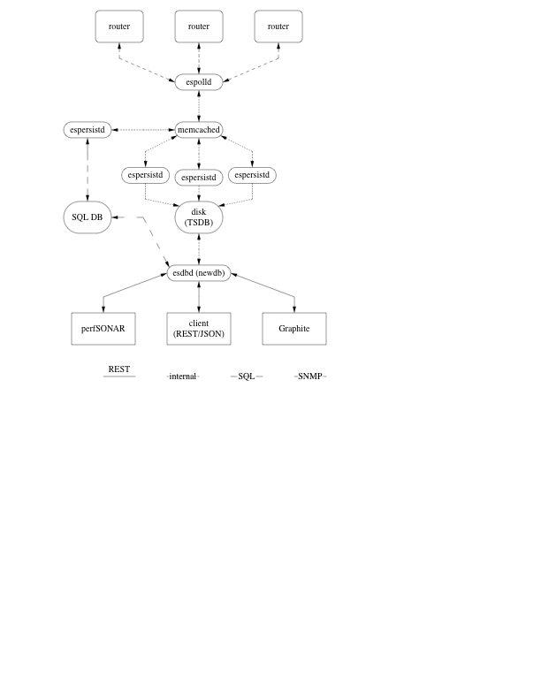
ESxSNMP Architecture

Slide 8
Devices, OIDs and OIDSets (Oh my!)
Device
  Referred to by DNS name
  Properties: SNMP community, begin time, end time
OID
  Referred to by shortest unique name, eg ifHCInOctets
OIDSet
  Collection of OIDs that are polled as a group
    FastPollHC: ifHCInOctets, ifHCOutOctets
    ifRefPoll: ifDescr, ifAlias, ifSpeed, ifHighSpeed, ifIndex, ipAdEntIfIndex

Slide 9
Polling: espolld
Multithreaded process
  thread per OIDSet per Device
  Thread to gather results and ship them to work queue
  (It’s I/O bound so Python threads are happy)
Polling method
  Call correlator setup function (might do get some additional info)
  For oid in oidset: get entire table (BULKWALK)
  Correlate results
  Hand off to thread which will place them in the work queue

Slide 10
Correlators
Provide a mapping between raw data and something useful
Examples:
  IfDescrCorrelator
    translates ifIndex to ifDescr (interface name)
    ifHCInOctets.116 becomes ifHCInOctets/ge-1_0_0
  JnxFirewallCorrelator
    jnxFWCounterByteCount."test-from-eqx"."from-eqx".counter
    becomes counter/test-from-eqx/from-eqx

Slide 11
Work Queue
Advantages
  Decouple polling from saving to disk (persisting)
  Distribute the load
  Send to multiple work queues (if there are multiple consumers)
  Use all cores without thrashing
Implementation
  Currently memcached and custom code
  Work objects represented as JSON strings
    Anything that can do JSON and talk to memcached can enqueue work (Perl, Ruby, C/C++, etc, etc)
  AMPQ is a possible future alternative

Slide 12
Metrics Storage: espersistd
Manager process
  Starts/stops/restarts worker processes
Worker processes
  Simple ones have single instance
  Compute and I/O bound tasks have many worker processes
    In this case n workers are started
    Queuing process hashes them into a worker specific queue
    (Sevice, OIDSet) tuple hashed to same worker queue each time
Lookup table maps OIDSet to a class that handles the persisting

Slide 13
TSDB: Time Series Database
Custom data store, similar to RRD without the round robin
  Never discards raw data
  Generates aggregates
Basic Types
  TSDB
    Container for TSDBSets and TSDBVars
    Implements a simple multilevel file store
  TSDBSet
    It’s a directory/folder
    Container to hold TSDBVars or TSDBSets
  TSDBVar
    Contains actual data
    Stored in chunks (usually one day of data)
    Each var is made up of rows which are indexed by timestamp

Slide 14
TSDB Aggregates
Average / Minimum / Maxium per time interval
Stackable time periods
  Aggregates can be used to generate larger time period aggregates
    eg. 30 second, 5 minute, 1 hour, 24 hour, 1 week
Aggregate calculation is very similar to RRD
  Test suite includes comparison tests with RRD
  Within 2% to pass (floating point can be a harsh mistress)

Slide 15
Metrics Retrieval: esdbd
Allow easy, consistent access to data
  Data will be used in unanticipated ways
  Language neutral
Technical details
  RESTful interface
  URL hierarchy: eg, core-rtr-1/interface/xe-0_0_0/in
  HTTP transport using HTTP semantics
  Data returned in JSON format
  Uses web.py framework

Slide 16
perfSONAR Support
Current
  Added a new database type to the perfSONAR-PS SNMP MA
  Uses the esdbd REST interface
  In production for at least a year
Future
  esdb will be a perfSONAR-MA
  Some initial exploration done already
  Initial Python perfSONAR library developed by Dan Gunter and Monte Goode at LBL

Slide 17
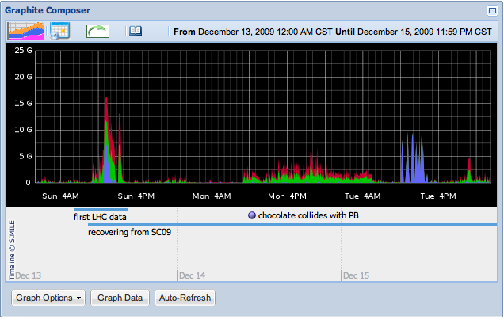
Graphite visualization with Net Almanac annotation

Slide 18
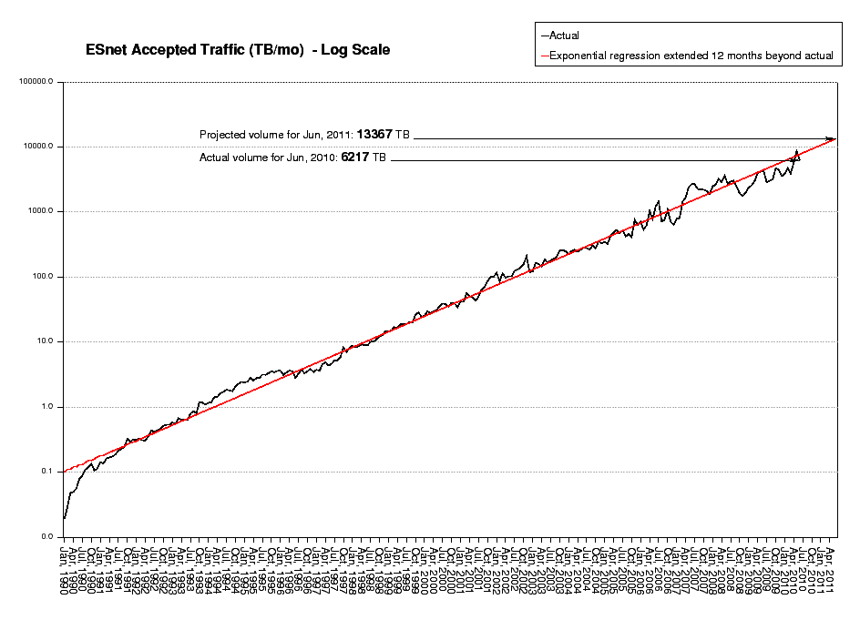
Monthly Stats

Slide 19
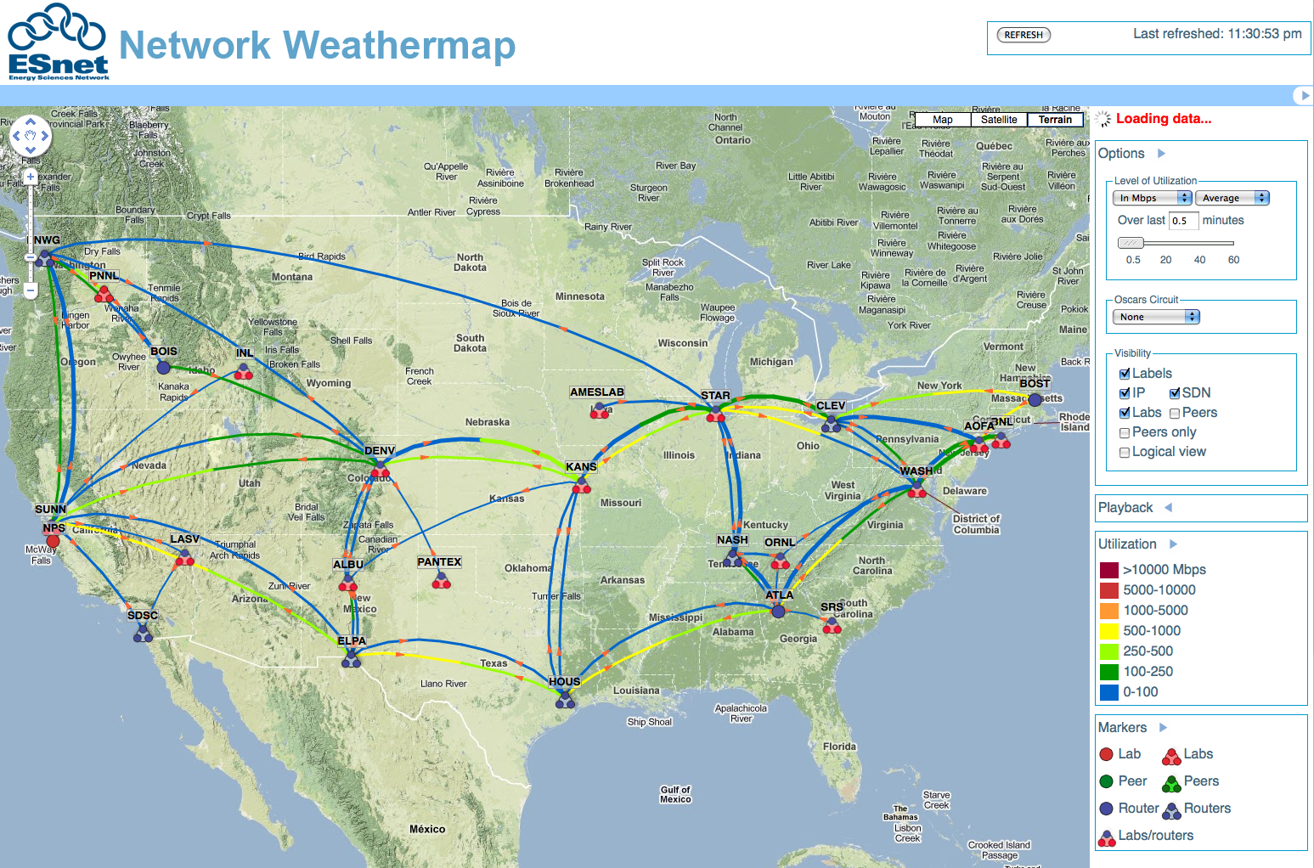
Network Weathermap

Slide 20
Supercomputing 2009 and 2010
Primary SNMP data collection system
Source for perfSONAR
Used to judge the bandwidth challenge (2009)
Store and display energy utilization data (2009)

Slide 21
Upcoming Features (Vaporware)
Link upgrade prediction
  Statistical analysis
  Very interested in other people’s experiences
  Summer student has initial implementation
Better Caching and I/O Scheduling
Documentation
Official Release

Slide 22
Questions?
ESxSNMP: http://code.google.com/p/esxsnmp/
Email: jdugan@es.net
Follow us: http://esnetupdates.wordpress.com, http://www.twitter.com/esnetupdates

