Slide 1
Energy Sciences Network
ESnet4 Update
July 22, 2009
Steve Cotter steve@es.net
Dept. Head, Energy Sciences Network
Lawrence Berkeley National Lab

Slide 2
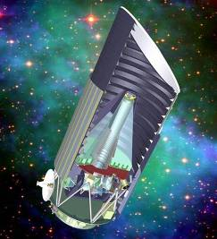
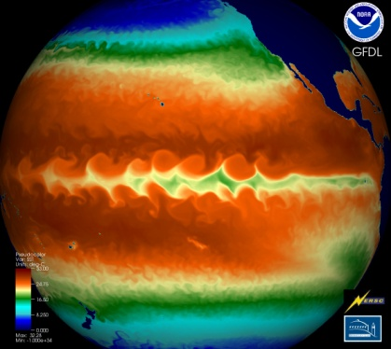
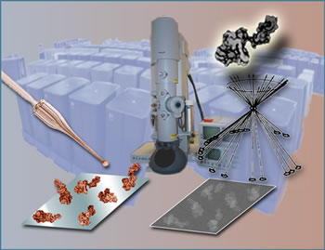

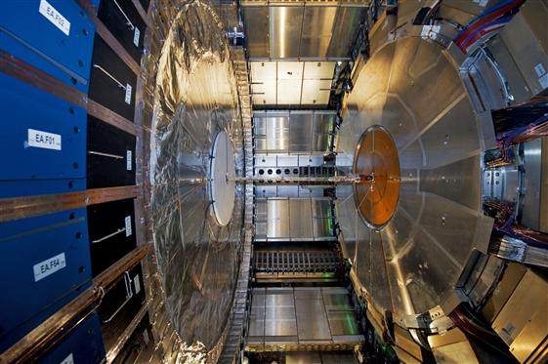
Agenda
Network Update
  Network builds
  Circuit installs
Services Update
Futures

Slide 3



2009 Site Installs
Feb
Mar
Apr
May
June
July
FNAL
MR2
NERSC
MR2
PAIX
ANL
MR2
SNLA-RT2
MX480
MX480
FNAL
MR3
BNL
MR3
MX480
BNL
MR2
JGI
MR2
Qwest AOA-HUB decommissioned
Qwest DC-HUB decommissioned
FNAL MX40 & MX960 (replaced 6509)
JGI MX480 (replaced 6509)
NERSC MX480 (replaced 6509)
BNL MX40 & MX960 (replaced 6509)
PAIX-PA M10i (replaced M10)
PAIX-PA M10i (replaced M10)
ANL MX960 (replaced 6509)
PAIX-PA M10i (replaced M10)
1 10GE LIMAN#3 AofA-BNL IP up Feb 2nd
1 10GE DF circuit between AofA-NEWY up on Feb 2nd
1 1GE PPPL-HEP-PU Feb 4th
1 10GE LIMAN#4 NEWY-BNL up on Feb 9th
1 10GE STAR-HUB USLHCnet E300 Feb 10th
1 DS3 OSTI-WASH-HUB (backup) up on Mar 3rd
1 10GE BOST-MIT IP peering enabled on Mar 19th
1 10GE peering BOST-HUB –NoX for BNL on May 27th
1 1GE SDN between PPPL (GFDL) – WASH on June 1st
1 10GE SDN PNWG-HUB – PNNL on June 6th
1 10GE NASH-ORNL-#2 SDN Wave on June 14th
1 1GE Peering PNWG-HUB – CSTNET (China) on June 17^{h}
1 10M PNNL Sire office at OSTI June 19th
1 10GE KANS-Great Plains Net (GPN) for the DUSAL & OneNet Peering June 27th
1 1GE Level3 private peering @ PAIX-PA up on July 2nd
1 OC12 GA-LASV-HUB up on July 9th
1 10GE SDN peering with ANL Site July 13th

Slide 4
Backbone Hub & Wave Count
Current Hub Count: 21
32 AofA, NEWY, WASH, ATLA, NASH, CLEV, BOST, CHIC, STAR, KANS, HOUS, ELPA, DENV, ALBU, BOIS, PNWG, SUNN, SNV(Qwest), LOSA, SDSC, LASV (SwitchNap)
Current Backbone Wave Count:
Internet2/Level3 10G waves:
  IP: 17 new/split for a total of 25
  SDN: 25 new/split for a total of 30
NLR 10G waves:
  5 10G waves

Slide 5
Circuit & Site Installs
Replace site 6509s (FNAL, ANL & BNL) with MX’s
FNAL: installed MX960 on Feb 9th and MX480 on Feb 20th
BNL: installed MX480 on Mar 16th and MX960 on Mar 31st
ANL: installed MX960 on June 30th
All BAMAN sites now have MX’s
JGI-MR2: installed on Feb 26th
NERSC-MR2: installed on Mar 5th
Site and Hub router upgrades
PAIX-PA M10: replaced by M10i on May 7th
SNLA M10: will be replaced by M10i on July 30th
Circuit installs
  3 10GE Lightower circuits LIMAN#3, LIMAN#4 & AofA-NEWY dark fiber (Feb 2009)
  1 1GE PPPL to HEP (Princeton Univ.) Feb 4th
  1 10GE STAR-HUB to USLHCnet E300 peering Feb 10th
  1 DS3 back-up for ORAU to WASH-HUB Mar 3rd

Slide 6
Circuit & Site Installs (cont.)
Circuit installs (cont.)
  1 10GE in BOST to MIT enabled on Mar 19th
  1 10GE peering BOST-HUB to NoX for BNL May 27th
  1 1GE SDN between PPPL (GFDL) – WASH June 1st
  1 10GE SDN PNWG-HUB – PNNL June 6th
  1 10GE NASH-ORNL-#2 SDN Wave June 14th
  1 1GE Peering PNWG-HUB – CSTnet (China) June 17th
  1 10M PNNL Site Office @ OSTI June 19th
  1 10GE KANS HUB-GPN for the 1GE DUSAL & 1GE OneNet Peering June 27th
  1 1GE Level3 private peering @ PAIX-PA July 2nd
  1 OC12 GA-LASV-HUB July 9th
  1 10GE ANL SDN site peering July 13th

Slide 7
Future Circuit Installs
Future Circuit Installs:
OC12 between DENV-HUB and Pantex (TBD)
1GE wave in BOIS to INL via IRON (TBD)
1GE links in D.C. Area for Germantown, IN to WASH-HUB (TBD)
OC3 for NSTech-NV to LASV-HUB (on order)
10G peering at PNWG-HUB with Korea (KSTAR & KISTI) (TBD)

Slide 8
ESnet Connections
 | Sites | IP Access | SDN Access | Notes
Office of Science Laboratories
 | Ames Laboratory | 2 x 1G | none
 | Argonne National Laboratory | 2 x 10G | 1 x 10G | CHIMAN
 | Brookhaven National Laboratory | 2 x 10G | 2 x 10G | LIMAN
 | Fermi National Accelerator Laboratory | 2 x 10G | 4 x 10G | CHIMAN
 | Thomas Jefferson National Accelerator Facility | 1 x 10G | none | Via MATP & ELITE
 | Lawrence Berkeley National Laboratory | 2x10G | 2 x 10G | SF BA MAN
 | Oak Ridge National Laboratory | 1 x 10G + OC48 | 1 x 10G | ORNL extended demark to NASH-HUB (capacity 2x10G IP & 4x10G SDN) Qwest OC48 to ATLA
 | Pacific Northwest National Laboratory | 1 x 10G | 1 x 10G | PNNL entended demark to PNWG-HUB (capacity 2x10G IP & 4x10G SDN) Future 10G to BOIS-HUB
 | Princeton Plasma Physics Laboratory | 1 x 10G | none
 | SLAC National Accelerator Laboratory | 2 x 10G | 2 x 10G | SF BA MAN
Multi-Purpose Laboratories
 | Lawrence Livermore National Laboratory | 2 x 10G | 2 x 10G | SF BA MAN
 | Los Alamos National Laboratory | 1 x 10G | none | LANL extended demark to ALBU hub (capacity 2x10G IP & 2x10G SDN)
 | Sandia National Laboratory - California (SNL-CA) | 2 x 10G | 2 x 10G | SF BA MAN
Office of Science Facilities
 | NERSC | 2 x 10G | 2 x 10G | SF BA MAN
 | OSTI | 1 x 1G + T1 | none | via ORNL Connection
Office of Science Collaborative Facilities
 | JGI | 2 x 10G | 2 x 10G | SF BA MAN
 | ORAU | 1 x 1G + 1 x DS3 (backup) | none | via ORNL Connection

Slide 9
ESnet Connections
 | Sites | IP Access | SDN Access | Notes
 | Bechtel Jacobs Company (BJC) | 44 Mb/s | none | via ORNL connection
 | DOE NNSA Headquarters - Germantown (DOE-NNSA-GTN) | 155 Mb/s | none | Future: DC MAN participant
 | DOE NNSA Service Center - Albuquerque (DOE-NNSA-SC) | 52 Mb/s | none | via SNL-NM connection
 | NNSA Information Assurance Response Center (IARC) | 45 Mb/s | none | at LASV-Hub
 | Idaho National Laboratory (INL) | 155 Mb/s | none | Future: 1G to BOIS-Hub
 | Kansas City Plant (KCP) | 155 Mb/s | none
 | KCP Kirtland AFB Site Office (KCP-KIRTLAND) | 52 Mb/s | none | via SNL-NM connection
 | LANL DC Office (LANL-DC) | 22 Mb/s | none | shared DS3 with LLNL-DC Office
 | LLNL DC Office (LLNL-DC) | 22 Mb/s | none | shared DS3 with LANL-DC Office
 | Mathematical Sciences Research Institute (MSRI) | 44 Mb/s | none | via LBNL SF BA MAN connection
 | National Geospatial-Intelligence Agency - Forrestal Bldg | 20 Mb/s | none | Future: DC MAN participant
 | National Geospatial-Intelligence Agency - LLNL | 20 Mb/s | none | via LLNL SF BA MAN connection
 | National Geospatial-Intelligence Agency - NVIC | 20 Mb/s | none | via NSTec NTS connection
 | National Geospatial-Intelligence Agency - SNL-NM | 80 Mb/s | none | via SNL-NM connection
 | National Geospatial-Intelligence Agency - SRS | 20 Mb/s | none | via SRS connection
 | National Renewable Energy Laboratory (NREL) | 1 G | none | site owned circuit to DENV-Hub
 | NSTec Livermore Operatios (NSTec-LivOps) | 45 Mb/s | none | at LASV-Hub
 | NSTec Nevada Test Site Office (NSTec-NTS) | 45 Mb/s | none | Future: DS-3 to be upgraded to rate-limited OC3
 | PANTEX | 155 Mb/s | none | Future: OC3 to be upgraded to OC12
 | Sandia National Laboratory - New Mexico (SNL-NM) | 2 x 1G | none | 1 SNL and 1 NGA
 | Savannah River Site (SRS) | 155 Mb/s | none | Future: additional OC3 for backup
 | Y-12 National Security Complex (Y-12) | 45 Mb/s | none | portion of OR OC48
 | Yucca Mountain Project (YUCCA) | 45 Mb/s | none | at LASV-Hub

Slide 10
ESnet Connections
 | Interchange Points | IP Access | SDN Access | Notes
 | CENIC (Sunnyvale, CA) | 1 x 10G | none
 | CENIC (Seattle, WA) | 1 x 10G | none
 | Equinix Ashburn | 1 x 1G | none | Future: upgrade to 10G peering
 | Equinix Chicago | 1 x 1G | none | Future: upgrade to 10G peering
 | Equinix San Jose | 1 x 1G | none | Future: upgrade to 10G peering
 | MANLAN (New York, NY) | 2 x 10G | none
 | MAX Gigapop | 1 x 10G | none
 | MREN at STARLIGHT (Chicago, IL) | 1 x 10G | none
 | PAIX (Palo Alto, CA) | 1 x 1G | none
 | STARLIGHT (Chicago, IL) | 1 x 10G | none
 | US R&E Peerings: 3ROX, ABQ Gigapop, CICNET, DREN, DUSEL, FRGP, GFDL, Indiana Gigapop, Internet2, LOSNETTOS, NASA, NLR, NOX, NYSERNET, NWU, OMNIPOP, ONENET, OSOGRANDE, PSC, PU-HEP, SDSC, SOX, TECHNET, UCHICAGO, UI-ICCN, ULTRALIGHT, USDOI, UWMadison, and WISCNET
 | International Peerings: AARnet (Australia), AMPATH (South America), ASGC (Asia-Pacific), BINP (Asia-Pacific), CANARIE (Canada), CLARA (South America), CUDI (Latin America), GEANT (Europe), GLORIAD (China and Russia), HEPNET (Asia-Pacific), KAREN (Asia-Pacific), KREONET2 (Asia-Pacific), NUS-GP (Asia-Pacific), ODN (Asia-Pacific), OPEN TRANSIT (France), REANNZ (Asia-Pacific), SINET (Asia-Pacific), TANET2 (Asia-Pacific), TRANPAC2 (Asia-Pacific), and USLHCNet (CERN)

Slide 11
Agenda
Network Update
Services Update
  Network
  OSCARS
ARRA
Misc

Slide 12
ESnet4 – July 09
ESnet Network Weathermap
http://weathermap.es.net

Slide 13
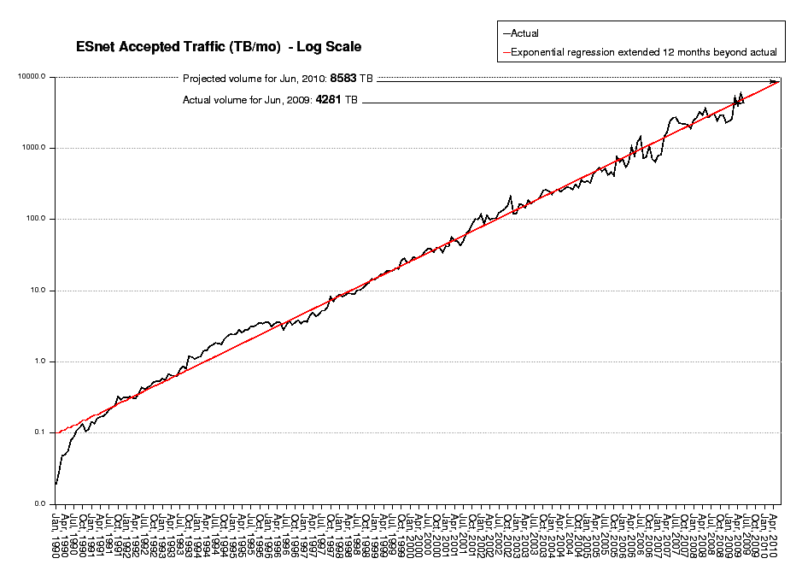
ESnet Traffic Growth
Apr 2006
1 PBy/mo
Oct 1993
1 TBy/mo
Nov 2001
100 TBy/mo
Aug 1990
100 GBy/mo
Jul 1998
10 TBy/mo

Slide 14
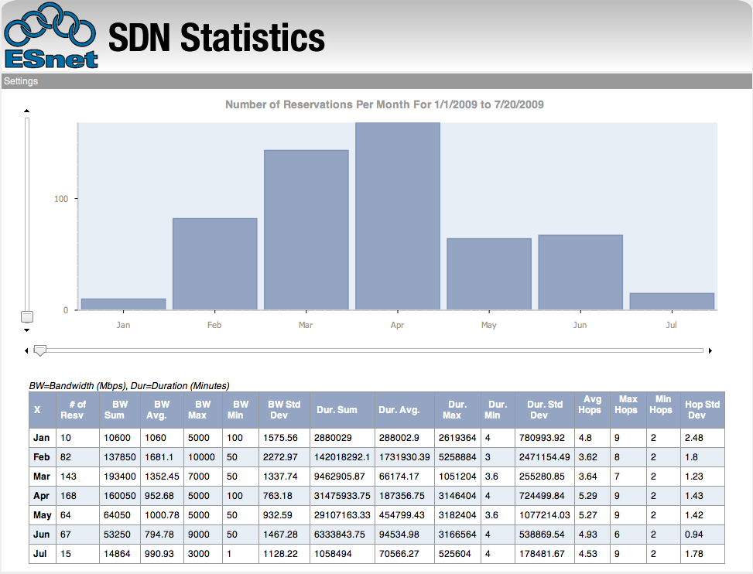
SDN Statistics
https://oscars.es.net/stats/
*Developed by Andy Lake (Internet2)

Slide 16
ESnet Total Accepted Traffic, TBy/mo
5.9 PBytes in May 2009
OSCARS circuits vs. everything else
“top 1000 flows” vs. everything else
1 PBytes in April 2006

Slide 17
OSCARS: Multi-Domain VC Service
OSCARS Services
Guaranteed bandwidth with resiliency: User specified bandwidth for primary and backup paths - requested and managed in a Web Services framework
Traffic isolation: Allows for high-performance, non-standard transport mechanisms that cannot co-exist with commodity TCP-based transport
Traffic engineering (for ESnet operations): Enables the engineering of explicit paths to meet specific requirements
  e.g. bypass congested links; using higher bandwidth, lower latency paths; etc.
Secure connections: Circuits are “secure” to the edges of the network (the site boundary) because they are managed by the control plane of the network which is highly secure and isolated from general traffic
End-to-end, cross-domain connections between Labs and collaborating institutions

Slide 18
OSCARS 0.5 Architecture (1Q09)
Tomcat
Web Service
Interface
Web Browser
User Interface
Web Service
Interface
OSCARS
AAA
Notification Broker
RMI
RMI
RMI
Core
Resource Scheduler
Path Computation Eng
Path Setup Modules
Core
Manage Subscriptions
Forward Notifications
Core
Authentication
Authorization
Auditing
BSS DB
AAA DB
Notify DB

Slide 19
OSCARS 0.6 Design / Implementation Goals
Support production deployment of service and facilitate research collaborations
  Distinct functions in stand-alone modules
    Supports distributed model
    Facilitates module redundancy
  Formalize (internal) interface between modules
    Facilitates module plug-ins from collaborative work (e.g. PCE)
    Customization of modules based on deployment needs (e.g. AuthN, AuthZ, PSS)
  Standardize external API messages and control access
    Facilitates inter-operability with other dynamic VC services (e.g. Nortel DRAC, GÉANT AuthBAHN)
    Supports backward compatibility of IDC protocol

Slide 20
OSCARS 0.6 Architecture (Target 12/09)
Notification Broker
Manage Subscriptions
Forward Notifications
Lookup
Lookup service
Topology Manager
Topology Information Management
95%
50%
0%
AuthN
Authentication
PCE
Constrained Path Computations
30%
Coordinator
Workflow Coordinator
0%
20%
Web Browser User Interface
Path Setup
Network Element Interface
50%
40%
AuthZ*
Authorization
Costing
*Distinct Data and Control Plane Functions
Resource Manager
Manage Reservations
Auditing
WS API
Manages External WS Communications
30%
20%
80%

Slide 21
OSCARS Support for SC09
SCinet will deploy an IDC to manage VC bandwidth allocations for demos and Bandwidth Challenge
Committed participants running an IDC include
  ESnet (SDN)
  Internet2 (DCN)
  University of Amsterdam (Netherlight)
Potential collaborating participants include
  GÉANT
  AIST, Japan
  KREONet2 (KISTI), Korea

Slide 22

OSCARS Collaborative Research Efforts
LBNL LDRD “On-demand overlays for scientific applications”
  To create proof-of-concept on-demand overlays for scientific applications that make efficient and effective use of the available network resources
GLIF GNI-API “Fenius” to translate between the GLIF common API to:
  DICE IDCP: OSCARS IDC (ESnet, I2)
  GNS-WSI3: G-lambda (KDDI, AIST, NICT, NTT)
  Phosphorus: Harmony (PSNC, ADVA, CESNET, NXW, FHG, I2CAT, FZJ, HEL IBBT, CTI, AIT, SARA, SURFnet, UNIBONN, UVA, UESSEX, ULEEDS, Nortel, MCNC, CRC)
DOE Projects:
  “Virtualized Network Control” to develop multi-dimensional PCE (multi-layer, multi-level, multi-technology, multi-layer, multi-domain, multi-provider, multi-vendor, multi-policy)
  “Integrating Storage Management with Dynamic Network Provisioning for Automated Data Transfers” to develop algorithms for co-scheduling compute and network resources
  “Hybrid Multi-Layer Network Control” to develop end-to-end provisioning architectures and solutions for multi-layer networks

Slide 23
Agenda
Network Update
Services Update
ARRA
Misc

Slide 24
ARRA Plans
  ESnet designated to received ~$67M in ARRA funds for an Advanced Networking Initiative
  Build a prototype wide area network to address our growing data needs while accelerating the development of 100 Gbps networking technologies
  Build a network testbed facility for researchers and industry
  Fund $5M in network research with the goal of near term technology transfer to the production network

Slide 25
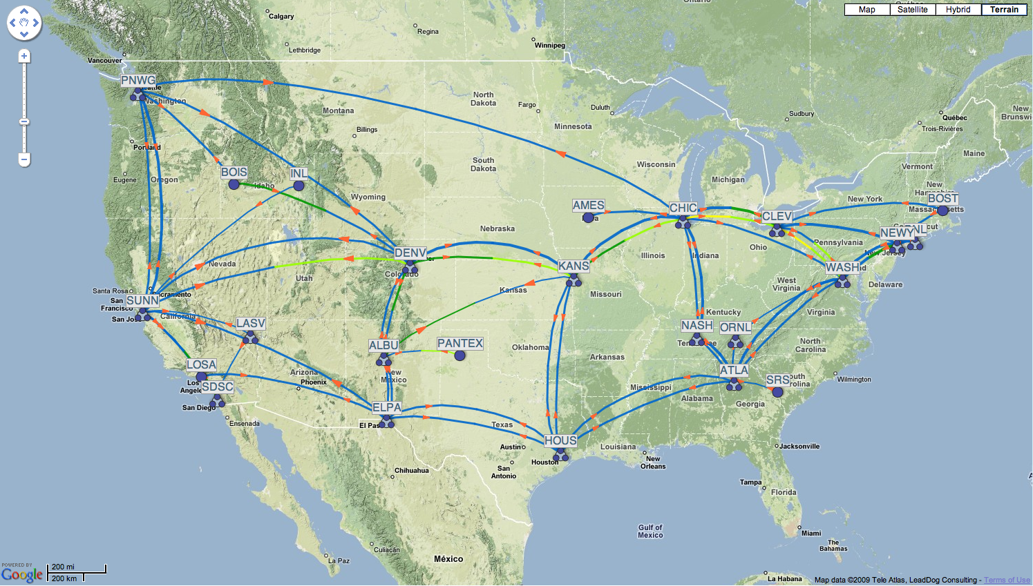
Advanced Networking Initiative

Slide 26
Experimental Optical Testbed
Will consist of advanced network devices and components assembled to give network and middleware researchers the capabilities to prototype ESnet capabilities anticipated in the next decade.
A community network R&D resource – the experimental facility will be open to researchers and industry to conduct research activities
Multi-layer dynamic network technologies - that can support advanced services such as secure end-to-end on-demand bandwidth and circuits over Ethernet, SONET, and optical transport network technologies
Ability to test the automatic classification of large bulk data flows and move them to a dedicated virtual circuit
Network-aware application testing – provide opportunities for network researchers and application developers such as Grid-based middleware, cyber security services, and so on, to exploit advanced network capabilities in order to enhance end-to-end performance and security
Technology transfer to production networks – ESnet, as host of the facility, will develop strategies to move mature technologies from testing mode to production service

Slide 27
Agenda
Network Update
Services Update
ARRA
Misc

Slide 28
Other Activities
Web site overhaul
  Hardware and content management system upgrade
  Requirements documented
  RFP going out end of this month
Infrastructure upgrades
  Improve scalability of internal systems
Table-top exercise simulating pandemic
  Testing ESnet disaster recovery processes

Slide 29
Continuity / CA Cloning Project Update
Short summary:
  Move to network based hardware security modules for key management
  Clone the CA hosts and instances (UI + databases)
  Distribute around the country at various ESnet coloc points
See this slide deck for a more complete story / plan
  http://doegrids.posterous.com/esnet-ca-cloning-project
Current Progress
  netHSM test host up and running
  One Internal CA moving to netHSM very soon
  Upgrading CAs to RedHat CS 7.3 – required version upgrade for cloning support

Slide 30
Federation Efforts
Shibboleth Federation for DOE labs/sites?
  Some Lab CIOs asked for a strategic discussion paper, to be taken up at next meeting
  Proposed: Model after University of California and University of Texas local federations
  Proposed: Join InCommon (US Shibboleth federation)
  Interested parties please get in touch with Mike Helm helm@fionn.es.net

Slide 31
Federation Efforts
Summer projects (student-powered)
  OpenID – Kevin Bauer U Colorado
    An OpenID consuming CA (OpenID->X.509 cert)
    Additional work on OpenID consumers (relying party)
      Attribute and information exchange
      Security
      UI – discovery – other topics
  Shibboleth – Jan Durand, Grambling State
    Shibboleth consuming CA (Shibboleth/SAML -> X.509 cert)
    Additional work on Shibboleth/SAML relying parties
    Interoperability with LBNL and other Shibboleth providers
  Registration
    How do I get myself registered in a service?
    The essential pattern, but very costly to support – both KB and JD will work on possible improvements later this summer

Slide 32
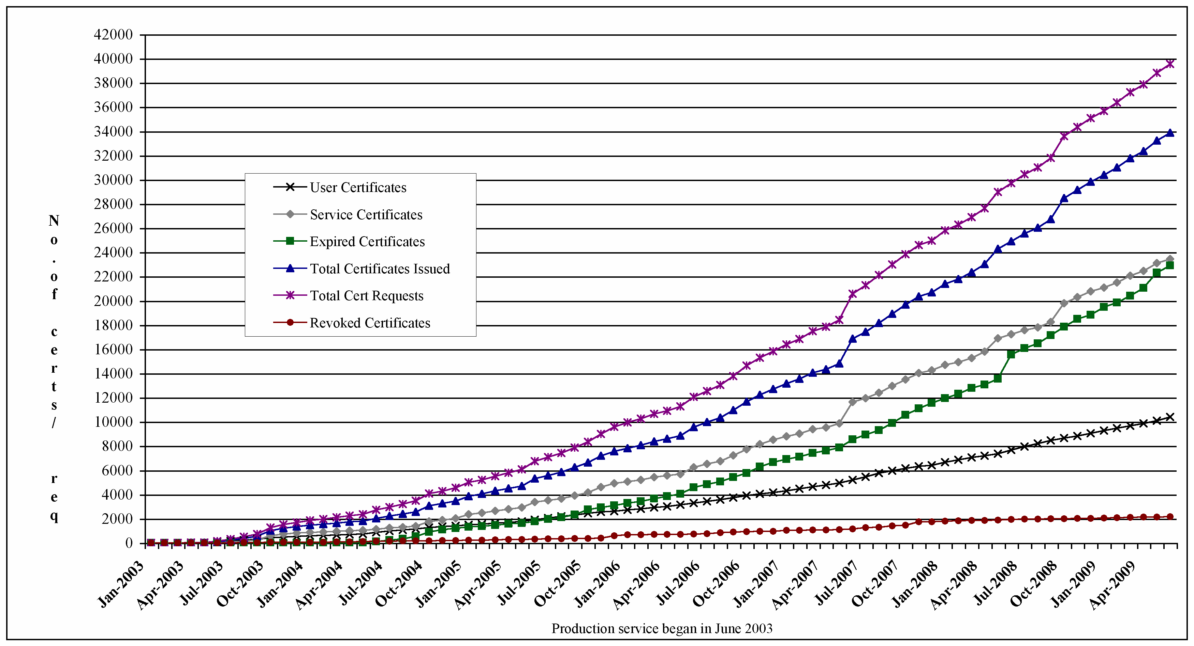
DOEGrids CA Usage Statistics
User Certificates | 10398 | Total No. of Revoked Certificates | 2157
Host & Service Certificates | 23459 | Total No. of Expired Certificates | 22923
Total No. of Requests | 39549 | Total No. of Certificates Issued | 33886
 |  | Total No. of Active Certificates | 8806
ESnet SSL Server CA Certificates |  |  | 52
FusionGRID CA certificates |  |  | 127
* Report as of Jun 30, 2009

Slide 33
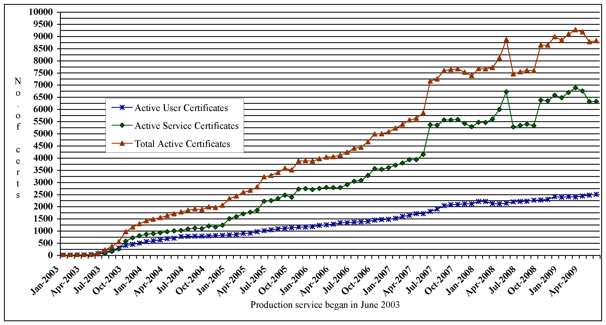
DOEGrids CA (Active Certs) Usage Statistics
* Report as of June 30, 2009

Slide 34
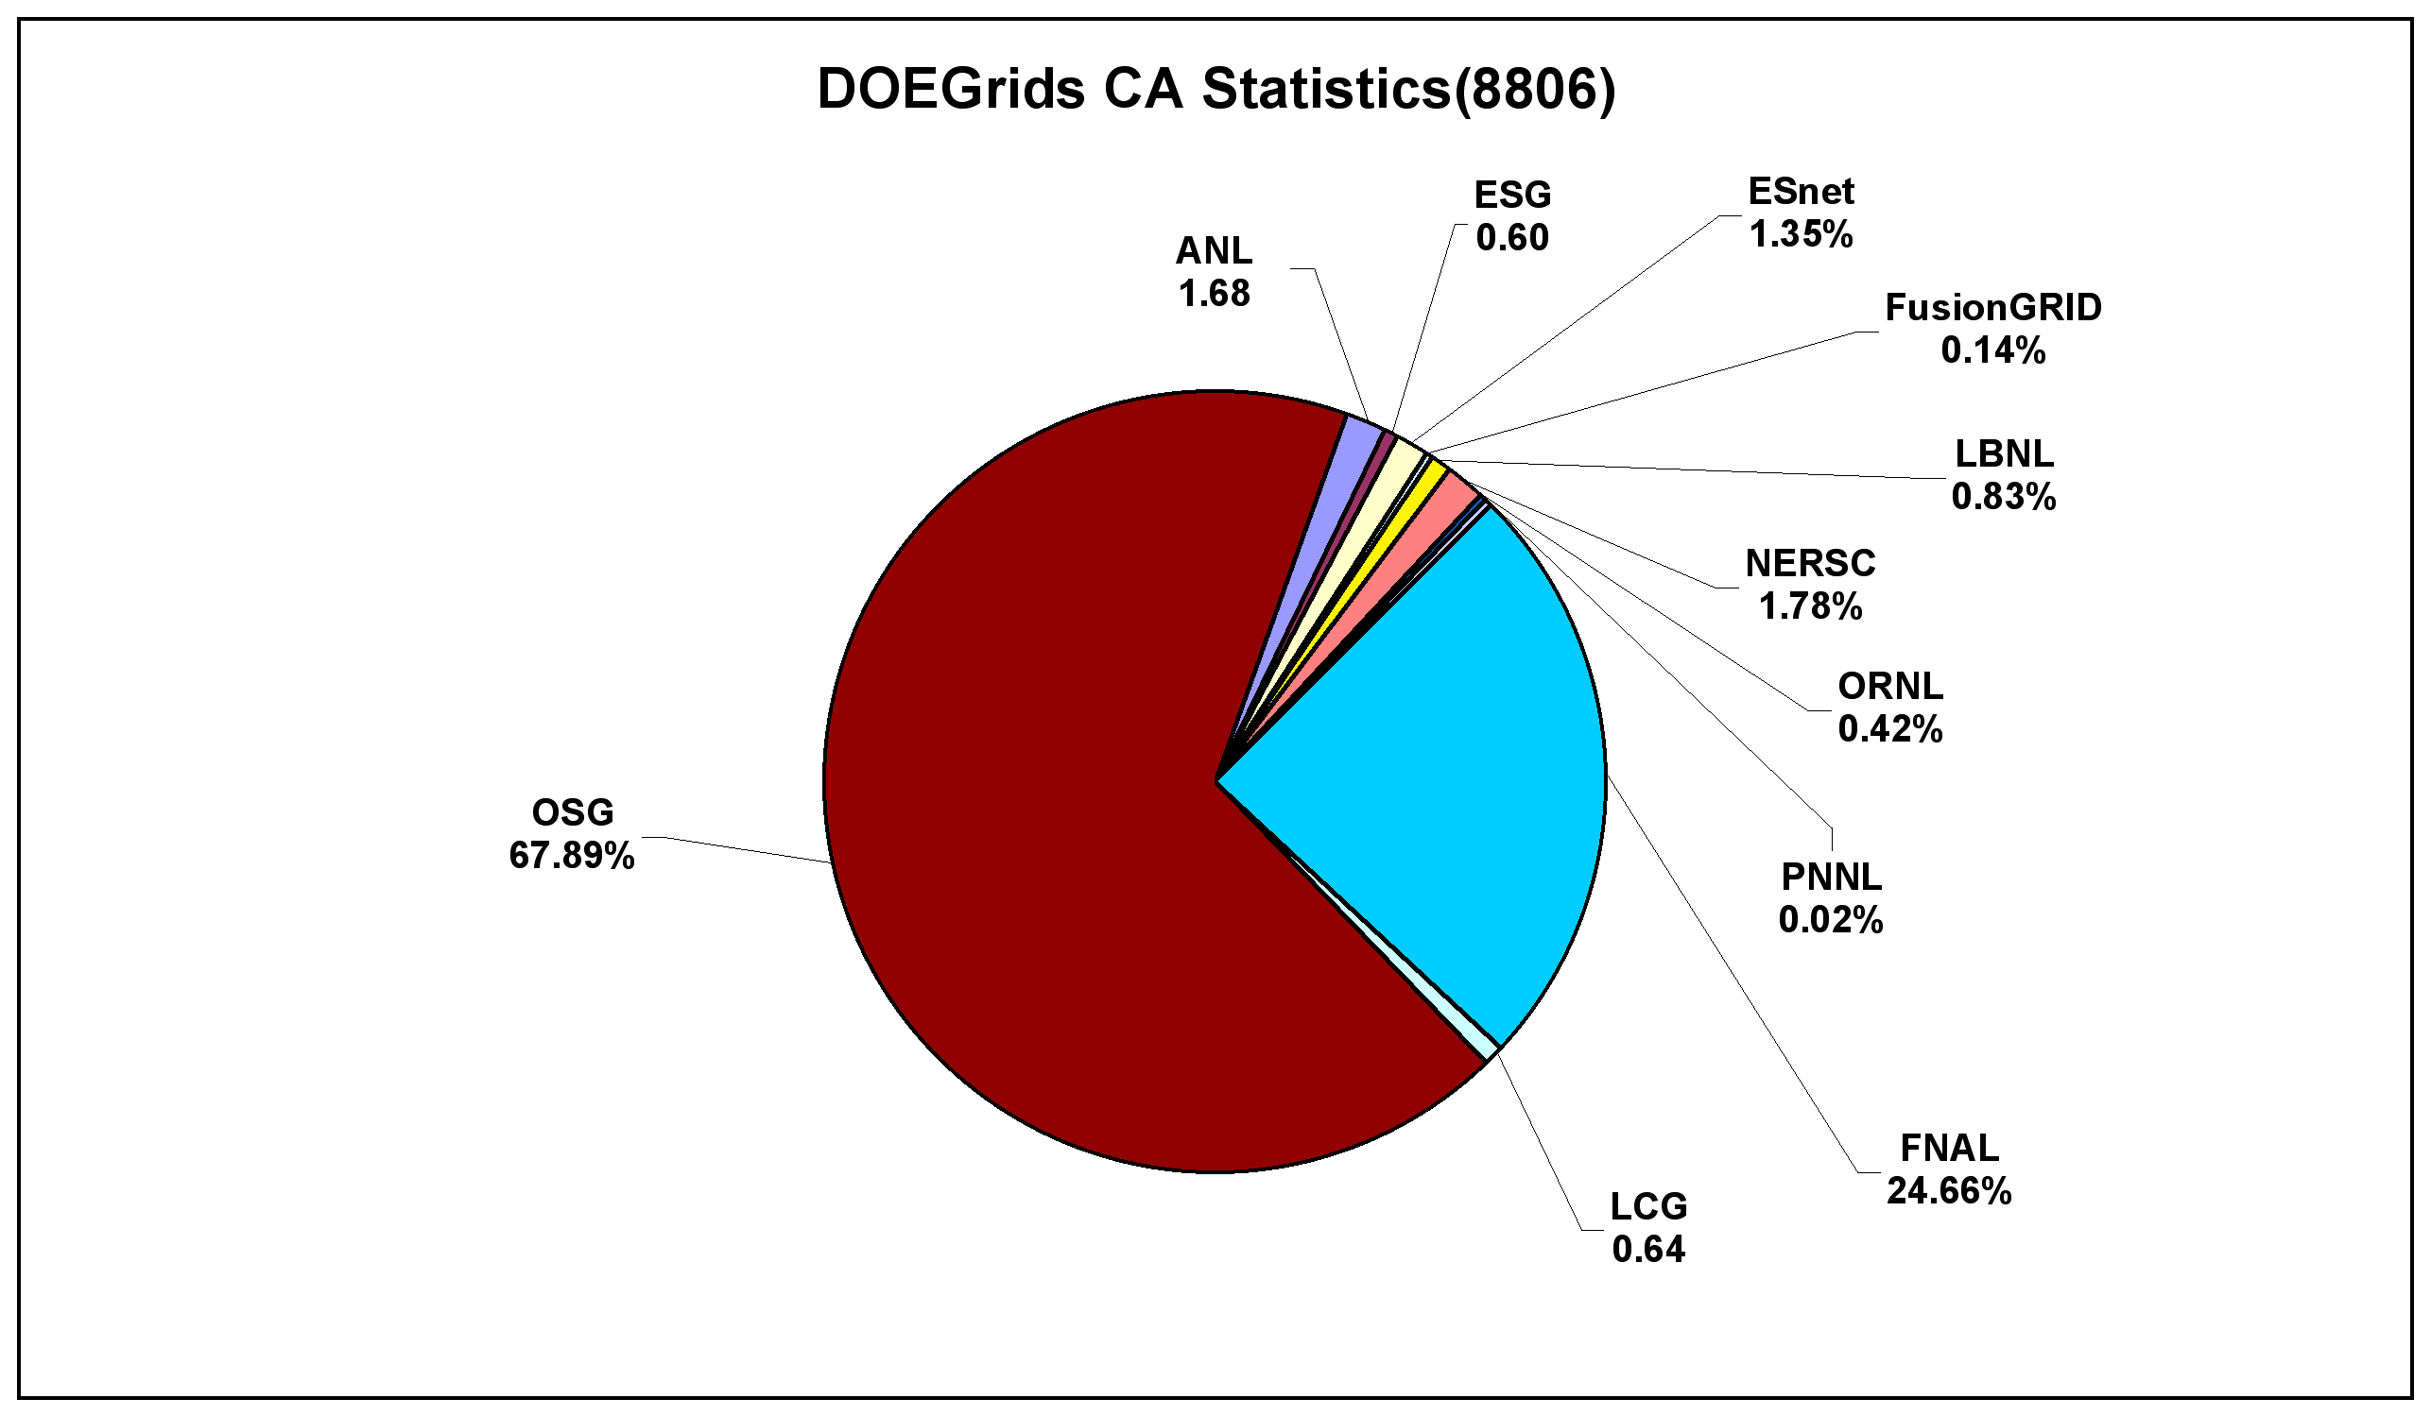
Active DOEGrids CA Breakdown
%
%
** OSG Includes (ALICE, ATLAS, BNL, CDF, CIGI,CMS, CompBioGrid, DES, DOSAR, DZero, Engage, Fermilab, geant4, GLOW, GROW, GPN, GRASE, i2u2, IceCube, ILC, JDEM, JLAB, LIGO, mariachi, MIS, nanoHUB, NWICG, NYSGrid, OSG, OSGEDU, SBGrid, SDSS, SLAC & STAR)
%

Slide 35



