Slide 1
Utilization of Transatlantic Circuits by European LHC Tier 2 Accesses of US LHC Tier 1 Centers
February, 2010
William E Johnston
Senior Scientist, Energy Sciences Network
Lawrence Berkeley National Lab
wej@es.net, www.es.net

Slide 2
Managing Transatlantic Capacity Used by non-OPN LHC
The Tier 2 accesses across the Atlantic (in both directions) utilize a mix of planned and ad hoc capacity as opposed to the carefully managed capacity of the OPN
GÉANT provides transatlantic capacity for general IP traffic, as does NSF / IRNC (?), and several European countries
ESnet partnered with USHLCnet some time ago to provide some capacity specifically to support European Tier 2 accesses of US Tier 1 centers
What ESnet is seeing is LHC traffic coming from Europe on almost every available path, including once or twice over the commercial peerings

Slide 3
Managing Transatlantic Capacity Used by non-OPN LHC
An analysis of the traffic from ESnet’s point of view seems essential in order to understand
  whether the current planned capacity for this traffic is adequate and
  how it will need to evolve
The current exercise (deliberately a bottom up view) is to
  determine the traffic patterns,
  see if they are optimal, and
  establish a baseline for capacity prediction when the LHC starts producing physics data
Most of the European Tier 2 to US Tier 1 traffic is currently Layer 3 traffic, so focus on that
  What data is available to determine traffic patterns and how can it be used?
What is presented here is definitely a work in progress

Slide 4
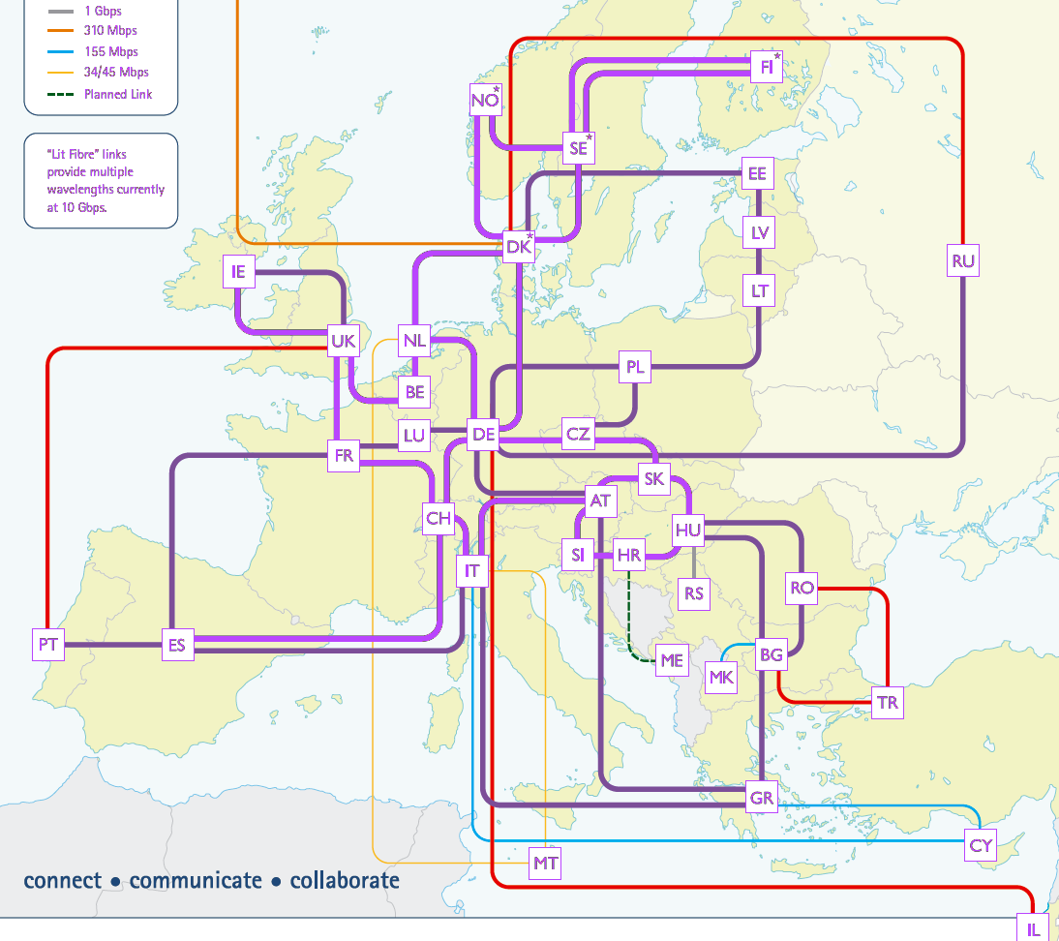
Layer 3 Paths Related to LHC traffic to ESnet
LHC OPN
To CERN
Boston
USLHC
USLHC
Starlight
MAN
LAN
Chicago
FNAL
Clev.
UK
NL
AofA
5G
KC
Phil
NYC
BNL
DE
Wash. DC
FR
FNAL
MAX
xG
AT
CH
ORNL
Tulsa
Nashville
Atlanta
Notes:
All paths are 10Gb/s unless noted
The two ESnet transatlantic paths are carried on virtual circuits provided by USLHCnet to Amsterdam where
  GÉANT carries the 3G circuit to Vienna where it advertises ESnet routes
  USLHCNet carries the 2G circuit to CERN where CERN advertises ESnet routes internally
ESnet IP core
ESnet Science Data Network core (N X 10G)
ESnet SDN core, NLR links (backup paths)
Other international
LHC OPN (USLHCNet)
Metro ring link
International GÉANT
Houston

Slide 5
Logical Connectivity for ESnet, GÉANT, and USLHCnet
ESnet
GÉANT
ESnet IP
ESnet
GÉANT
Amsterdam
32 AofA, New York
MAN LAN
London
Fermilab
ESnet
GÉANT
ESnet GÉANT
5G
Paris
Vienna
xG
ESnet IP
ESnet
CERN
ESnet
GÉANT
Washington
MAX
CERN (internal)
Frankfurt

Slide 6
What are Top Level Traffic Patterns?
ESnet
GÉANT
ESnet IP
ESnet
GÉANT
Amsterdam
32 AofA, New York
MAN LAN
London
How do I get to Fermilab?
Fermilab
ESnet
GÉANT
ESnet GÉANT
Who comes to me?
5G
Paris
Vienna
xG
ESnet IP
ESnet
CERN
ESnet
GÉANT
Washington
MAX
CERN (internal)
Frankfurt

Slide 7
Who Comes to Fermilab?
LHC Known European T2 sites per Ian Bird
Nordunet
Kharkov, Ukraine
LHC Unknown European sites
Ioannina, Greece
Kharkov, Ukraine

Slide 8
How do they get to Fermilab on the US side?
JANET (786) (UK) | aofa-sdn1 | JINR/HEPNET (2875) | star-cr1
REDIRIS (766) (Spain) | aofa-sdn1 | RADIO-MSU (2683) | star-cr1
DFN (680) (Germany) | aofa-sdn1 | FR-RENATER (2200) | aofa-sdn1
Russian (6801) | star-cr1 | PIONIER-AS (8501) | aofa-sdn1
BELNET (2611) (Belgian) | aofa-sdn1 | EENet (3221) | aofa-sdn1
SWITCH (559) (Switzerland) | aofa-sdn1 | ASGARR (137) | aofa-sdn1
 |  | FUNETAS (1741) | aofa-sdn1
DESY-HAMBURG (1754) (Germany) | aofa-sdn1 | CEA-Saclay (777) | aofa-sdn1
IN2P3 (789) (France) | aofa-sdn1 | SURFNET-NL (1103) | aofa-sdn1
ITEP (2148) (Russia) | star-cr1 | ACONET (1853) | aofa-sdn1
NDGF (Nordunet) 39590 (Nordic) | aofa-sdn1 | KFKI-AS (3314) | aofa-sdn1
RCCN (1930) (Portugal) | aofa-sdn1 | NERDCNET (6356) | star-cr1
NSCKIPT-AS (35296) (Ukraine) | eqx-chi-rt1 (ouch) | UOI (8581) | aofa-sdn1
IHEP-SU (2643) | star-cr1 | Rede (1916) | aofa-sdn1
GRIDPNPI (29493) (Russia) | aofa-sdn1 | ULAKNET (8517) | aofa-sdn1

Slide 9
How do they get to Fermilab on the US side?
The traffic through star-cr1 is on an IRNC (?) or country provided path or GLORIAD path
Not all of FNAL’s traffic is LHC, though most of it is (e.g. FNAL is also the data center for the Sloan Digital Sky Survey)

Slide 10
Top Level Traffic Patterns
Looking Glass to traceroute from both ends
ESnet
GÉANT
UK
ESnet IP
Belgian
ESnet
GÉANT
Amsterdam
32 AofA, New York
MAN LAN
London
How do I get to Fermilab?
Fermilab
ESnet
GÉANT
ESnet GÉANT
Who comes to me?
5G
Paris
Vienna
xG
Austria
ESnet IP
ESnet
CERN
Switzerland
CERN (internal)
Estonia
ESnet
GÉANT
Washington
MAX
Spain
Germany
Frankfurt

Slide 11
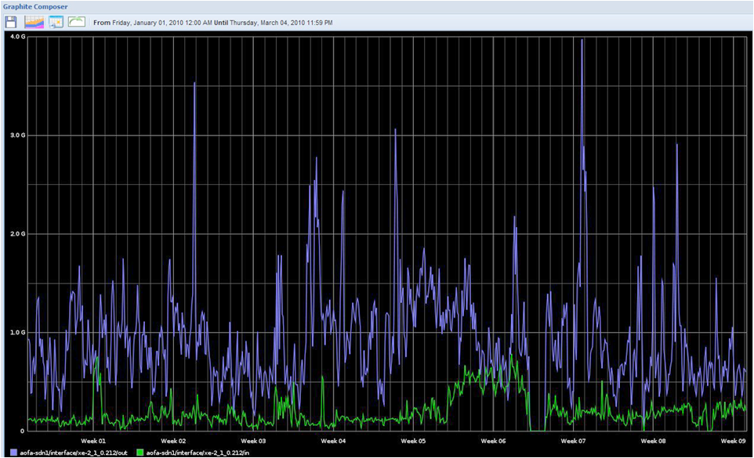
ESnet – GEANT peering in Amsterdam
4.0G
Out
In

Slide 12
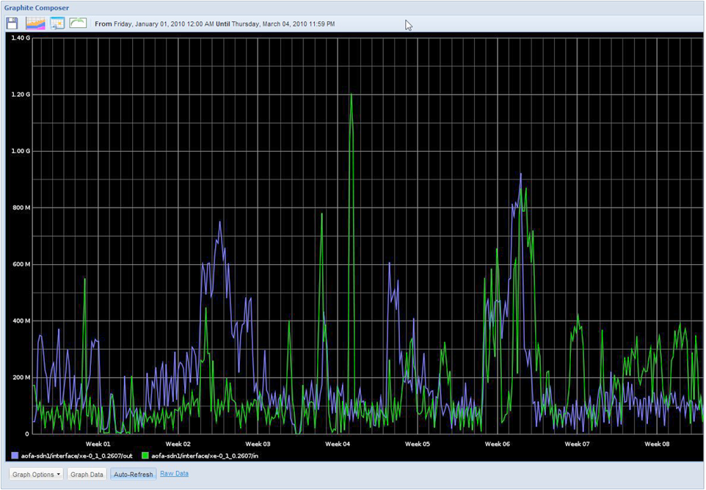
ESnet – GEANT peering in Vienna
1.4G

Slide 13
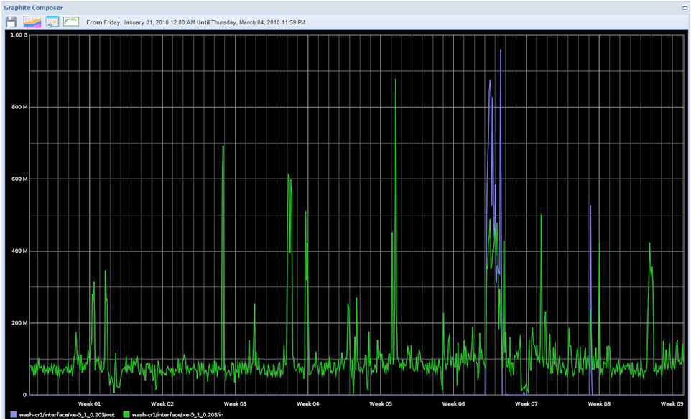
ESnet – GEANT peering in Frankfurt
1.0G

Slide 14
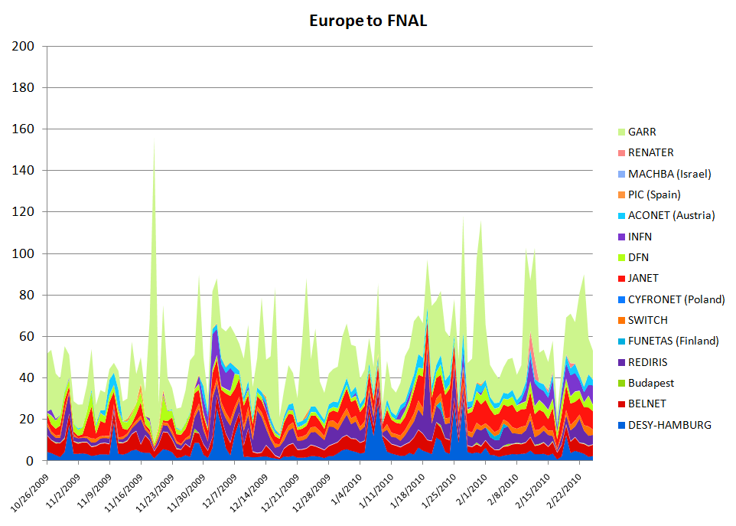
By-Site Traffic: Europe -> FNAL (Mb/s)

Slide 15
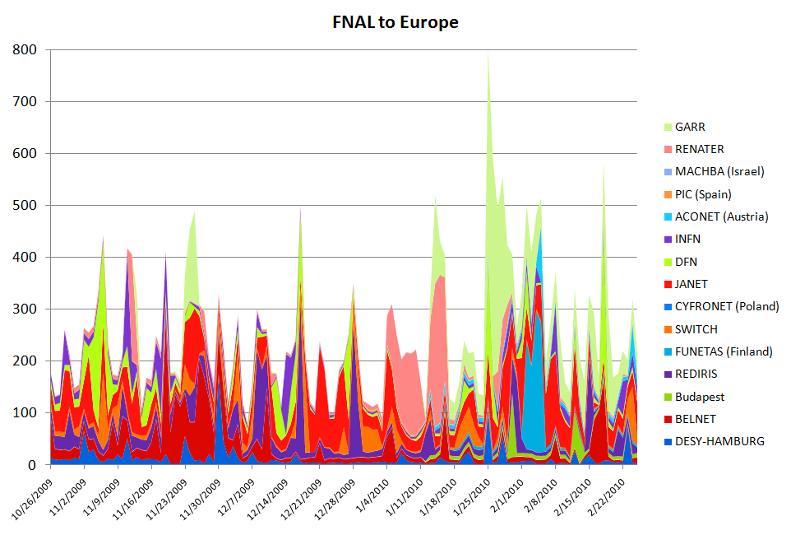
By-Site Traffic: FNAL-> Europe
The pattern of substantially more Tier 1 (FNAL) to Tier 2 (Europe) traffic compared to T2 to T1 is at least approximately consistent with the
European Tier 2s getting data from the US Tier 1s

Slide 16
Next Steps
Sort by-site traffic by path
Disambiguate LHC site traffic in European ASNs
Decide what is useful to publish monthly
  Engage Internet2 to publish similar data for their network
    Would expect to see the complimentary pattern –
    US Tier 2s pulling data from European Tier 1s
  Probably need to also involve NLR and the new IRNC links as some of the US Tier2 connect directly to the New York exchange point (MAN LAN) and if GEANT peers with them, Internet2 would not see the traffic

Slide 17
END of Slides

Slide 18
ESnet
Japan (SINet)
Australia (AARNet)
Canada (CA*net4
Taiwan (TANet2)
Singaren
Transpac2
CUDI
KAREN/REANNZ
ODN Japan Telecom America
NLR-Packetnet
Internet2
Korea (Kreonet2)
SINet (Japan)
Russia (BINP)
ESnet Vienna peering with GÉANT (via USLHCNet circuit)
GÉANT
- France, Germany,
Italy, UK, etc
CA*net4 France
GLORIAD
(Russia, China)
Korea (Kreonet2
MREN
StarTap
Taiwan (TANet2,
ASCGNet)
CERN/LHCOPN
(USLHCnet:
DOE+CERN funded)
SEAT
PacWave
NSF/IRNC
funded
USHLCNet to GÉANT
KAREN / REANNZ Transpac2
Internet2 Korea (kreonet2)
SINGAREN Japan (SINet)
ODN Japan Telecom
America
CA*net4
AU
Internet2
NYSERNet
MAN LAN
BOST
PNNL
CHI-SL
LIGO
Starlight
USLHCNet
NLR
AOFA
MIT/
PSFC
BOIS
INL
NEWY
Salt Lake
FNAL
Internet2
Lab DC
Offices
BNL
NERSC
LVK
Internet2
LLNL
ANL
PPPL
JGI
PacWave
SNLL
GFDL
LBNL
FRGPoP
AMES
CHIC
DOE
PU Physics
SLAC
SUNN
ICCN
CLEV
NETL
PAIX-PA
Equinix, etc.
NREL
IU GPoP
DOE GTN
NNSA
Equinix
SNV1
DENV
Equinix
NASA
Ames
IARC
YUCCA MT
ORNL
WASH
MAXGPoP
NLR
Internet2
JLAB
LASV
LANL
KANS
KCP
ORAU
LOSA
BECHTEL-NV
NSTEC
OSTI
SDSC
GA
SNLA
ARM
NASH
NOAA
UCSD Physics
ALBU
Allied
Signal
PANTEX
SRS
AMPATH
CLARA
(S. America)
AU
CUDI
(S. America)
UNM
SOX
ATLA
DOE-ALB
~45 end user sites
ELPA
International peers (10 Gb/s)
10-20-30 Gb/s
SDN core (I2, NLR)
10Gb/s IP core
MAN rings (Nx10 Gb/s)
Lab supplied links
OC12 / GigEthernet
OC3 (155 Mb/s)
45 Mb/s and less
Office Of Science Sponsored (22)
HOUS
NNSA Sponsored (13+)
Joint Sponsored (4)
An accurate map is located at
http://www.es.net/pub/maps/current.pdf
Other Sponsored (NSF LIGO, NOAA)
Laboratory Sponsored (6)
commercial peering points
R&E
networks
Specific R&E network peers
SUNN
ESnet core hubs
Other R&E peering points
Geography is
only representational
Notes:
18

Slide 19
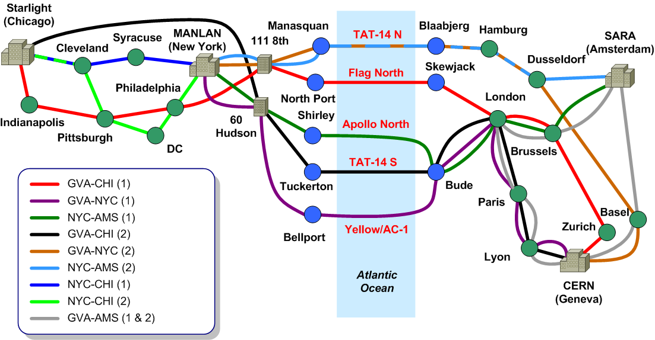
USLHCNet 1/2010

Slide 20
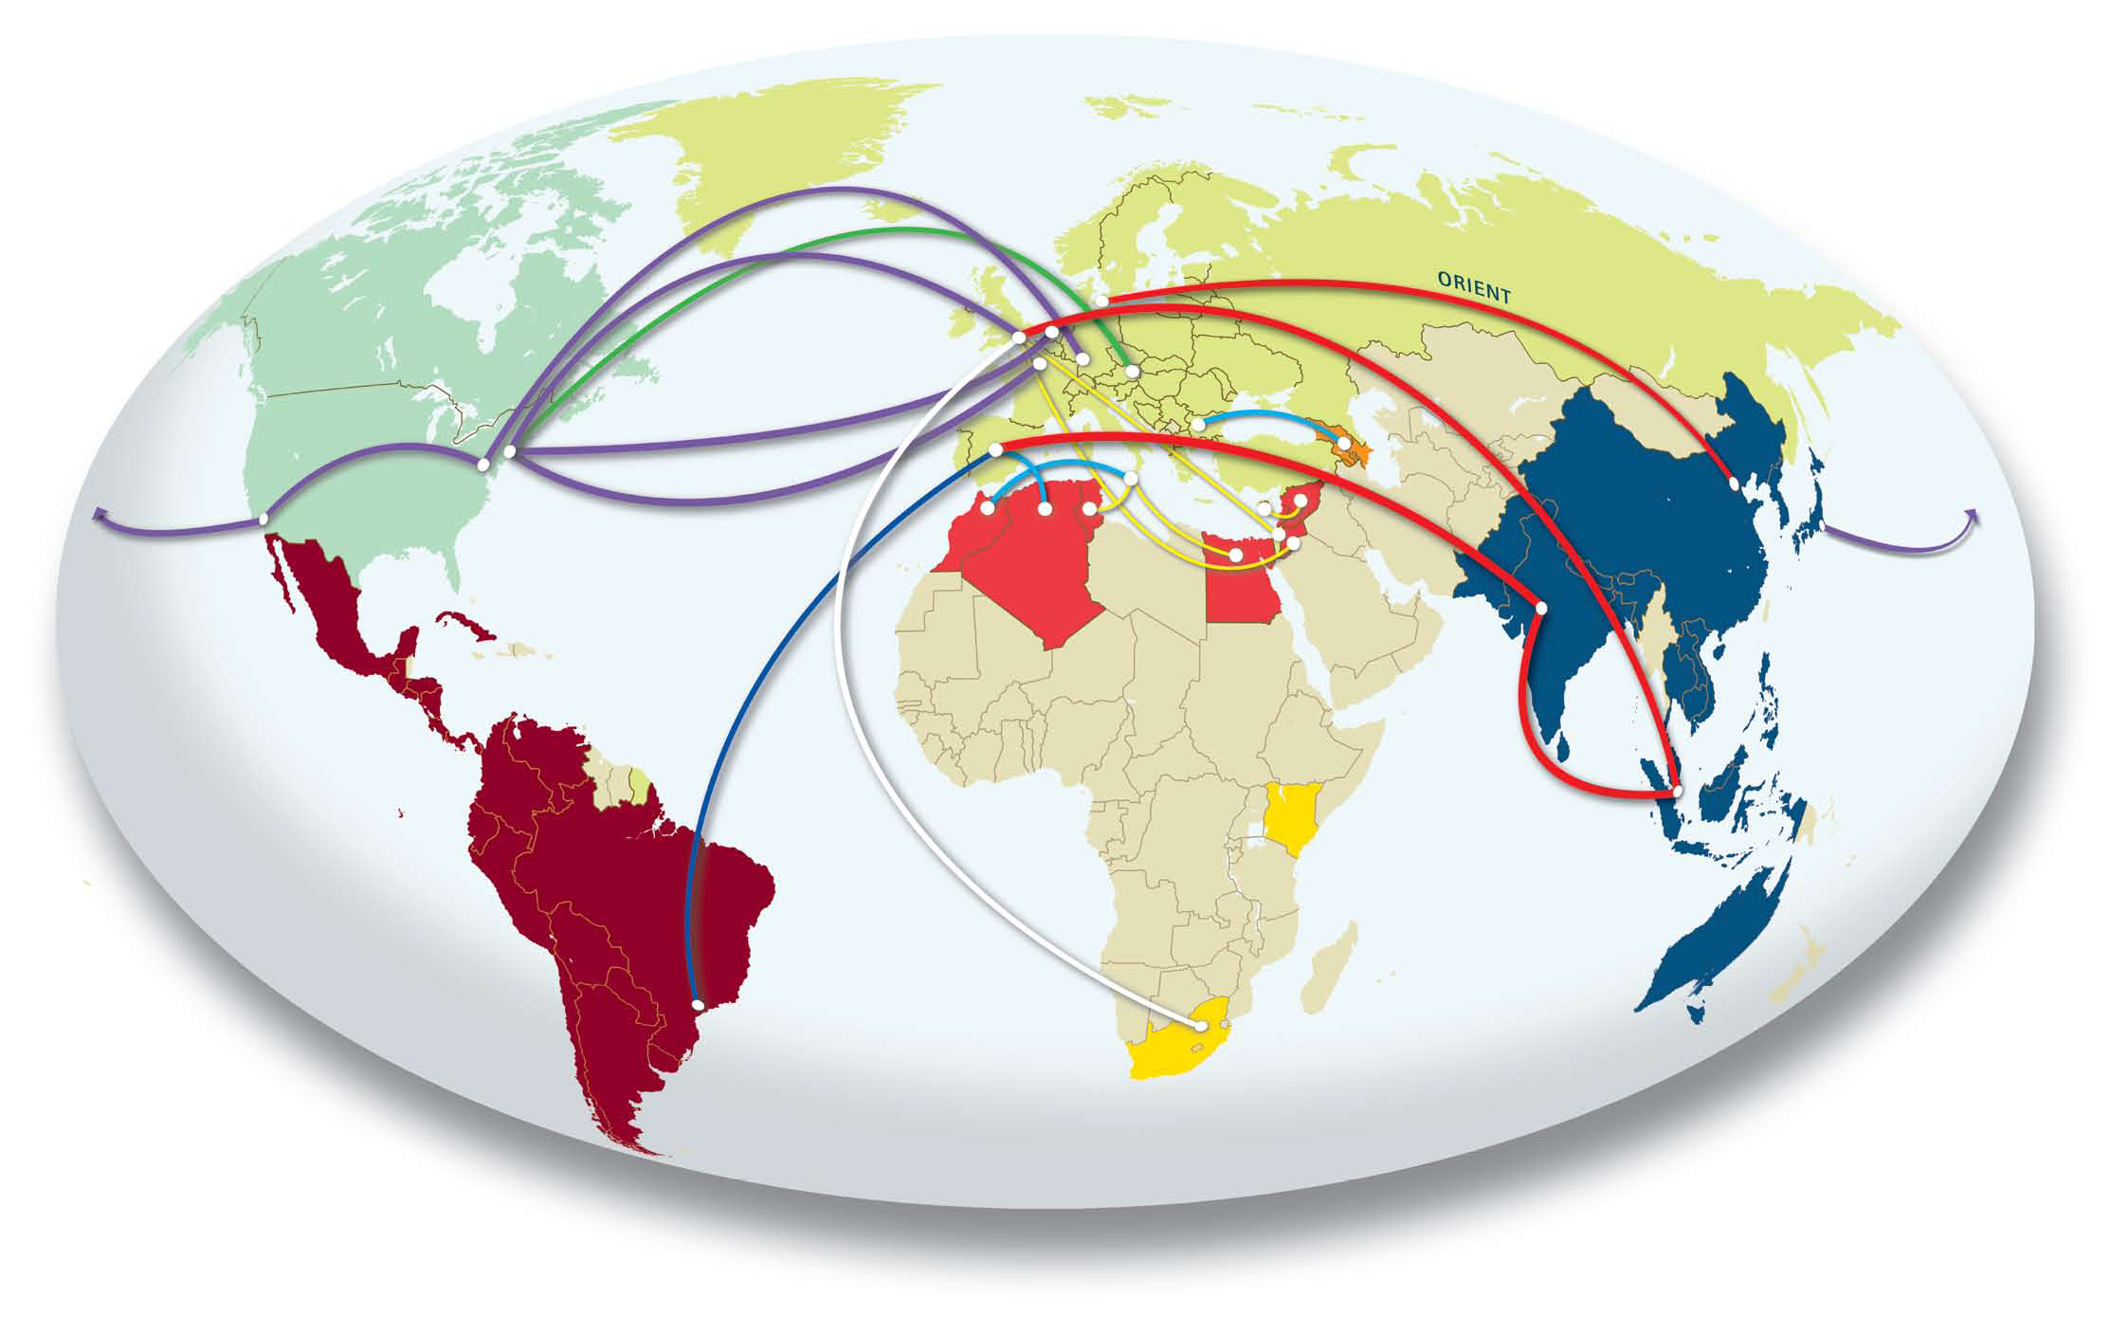
GEANT International

