Slide 1
ESnet Update
Steve Cotter, Dept Head
Lawrence Berkeley National Lab
ESCC
Clemson, SC
Feb 2, 2011

Slide 2
DOE Network Requirements Workshops

Slide 3
Strategic Imperatives for ESnet
  More bandwidth to DOE facilities and Labs at lower costs
  Richer network services in support of distributed science
    Develop ‘network aware’ integrated services that deliver ‘end-to-end’ high-performance data transfer, HPC/cloud computing, and science collaborative services
  Carrier-class network operations providing high network availability to all DOE facilities
    Seamless network interoperability across multiple network domains
  Develop and deploy energy-aware and efficient networking infrastructure
  Provide a networking research testbed for DOE community
    Conduct/enable groundbreaking research in new protocols/storage/energy efficient networking

Slide 4
ESnet4 IP & SDN Networks

Slide 5
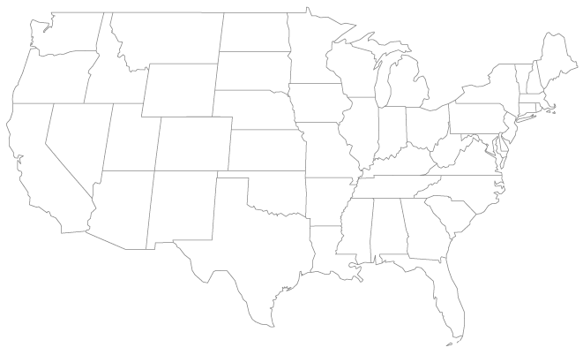
Current ESnet4 Topology
SDN node
IP router node
10G link

Slide 6
ESnet4 Topology End-2011
ORNL
SDN node
IP router node
10G link
New 10G link

Slide 7
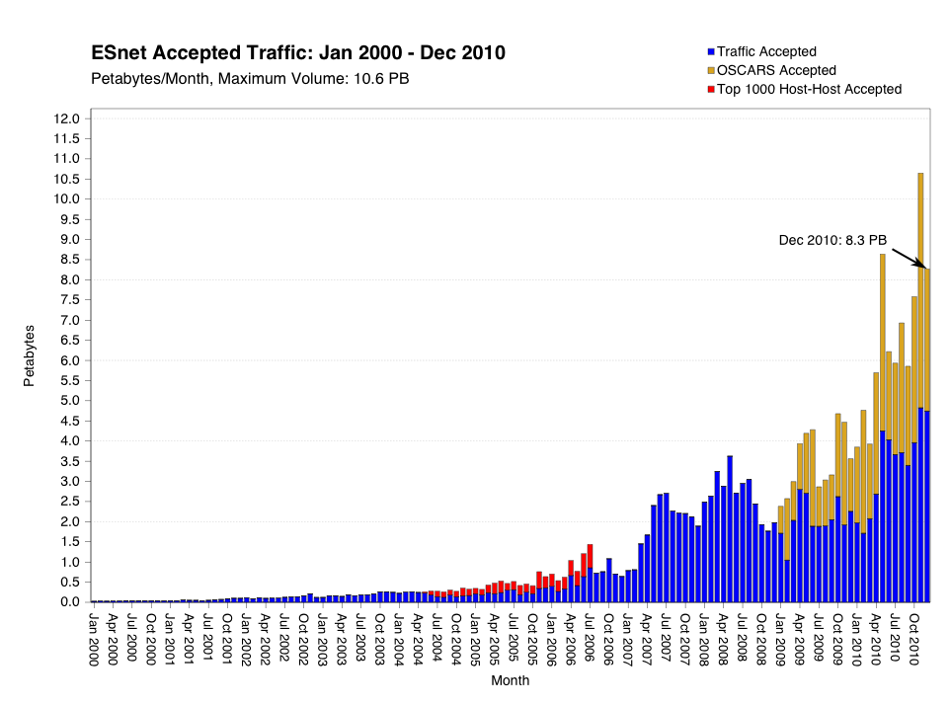
ESnet4 Network
Peaked at 10.6 PB in Nov
  >1PB of genomics traffic between JGI – NERSC that month alone
More than 50% continue to go over OSCARS circuits
Instrumenting with perfSONAR all connections 1G and up
99.9983% network availability to Office of Science labs

Slide 8
Site Upgrades
AOFA-HUB 1 Infinera DTC chassis installed (Dec 2010)
NEWY-HUB 3 Infinera DTC Chassis installed (Dec 2010)
    Testbed servers at LBL to be installed (Mar/Apr 2011)
BNL 4 Infinera DTC chassis installed (Dec 2010)
    Testbed servers at LBL to be installed (Mar/Apr 2011)
Adding perfSONAR servers to ESnet small sites
    Completed PPPL, PANTEX< PAIX-PA, OSTI, ORAU, FORR, INL, GA,
    Future installs: AMESLAB, DOE-GTN, EQX-CHI, EQX-SJ, LASV, LVK, NREL, NSO, SNLA, SRS
PPPL M120: to be replaced with MX480 TBD

Slide 9
Site Disconnects
YMP 1GE XC via LASV disconnected (Sept 2010)
NOAA T1 via ORAU disconnected (Oct 2010)
NSTec-Liv-OPS disconnected DS3 and removed router (Dec 2010)

Slide 10
Circuit Installs & Upgrades
1GE private peering at EQX-ASH with Level3 (July 2010)
10GE Level3 circuit replaced the 1GE circuit between Equinix SJ (SV1) (July 2010)
10GE MAXGigapop circuit replaced the Qwest 1GE link between Equinix Ashburn (DC2) (July 2010)
10GE peering with CICnet at CHIC (Aug 2010)
1GE peering with FNAL DOE-FSO (Aug 2010)
2 10GE Cross-connect for future peering with NOAA at DENV-HUB and CHIC-HUB (Aug 2010)
10GE private peering with MERIT at Starlight (Aug 2010)
10GE MERIT wave added to the existing 1GE MERIT link between Equinix Chicago (CH2) (Aug 2010)
3 1GE private peering with TATA Communications at all Equinix (EQX-ASH. EQX-SJ and EQX-CHI) (Sept/Oct 2010)

Slide 11
Circuit Installs & Upgrades
1GE private peering with SAVVIS at EQX-ASH (Nov 2010)
4 10GE SC2010 waves (2 from ATLA, 1 from HOUS, 1 from STAR) (Nov 2010)
1GE site ordered from KCP to KANS-HUB (replaced OC3 to ALBU) (Dec 2010)
10GE peering with LLNL LVOC (Jan 2011)
20G (2x10GE aggraded) connection to FNAL (Jan 2011)
OC3c to LANL-SW peering in DENV-HUB (Jan 2011 Pending XC)
NEWY to AOFA Metro OCG darkfiber installed and under test (Jan 2011)
100M → 1GE upgrade to Teliasonera peering at EQX-SJ (Jan 2011)
OC3 to 1GE upgrade on the AOL peering at EQX-ASH (Oct 2010)
10M to 100M upgrades for the Sprint peering at EQX-ASH & EQX-SJ (Oct 2010)

Slide 12
In Progress
1GE backup PPPL-AofA MAGPI wave, waiting on hardware (Date TBD)
10GE SDN / ION peerings in CHIC and SUNN / SEAT (via PacificWave fabric) (date TBD)
PNNL-OSTI 10M → 100M upgrade pending contract mod.
SRS-EM 10M → 100M upgrade pending contract mod.
Future 1GE for NNSA peering at FORR (date TBD)
Future 1GE for OSTI-Y12 disaster recovery (TBD)
1GE wave in BOIS to INL via IRON (TBD)

Slide 13
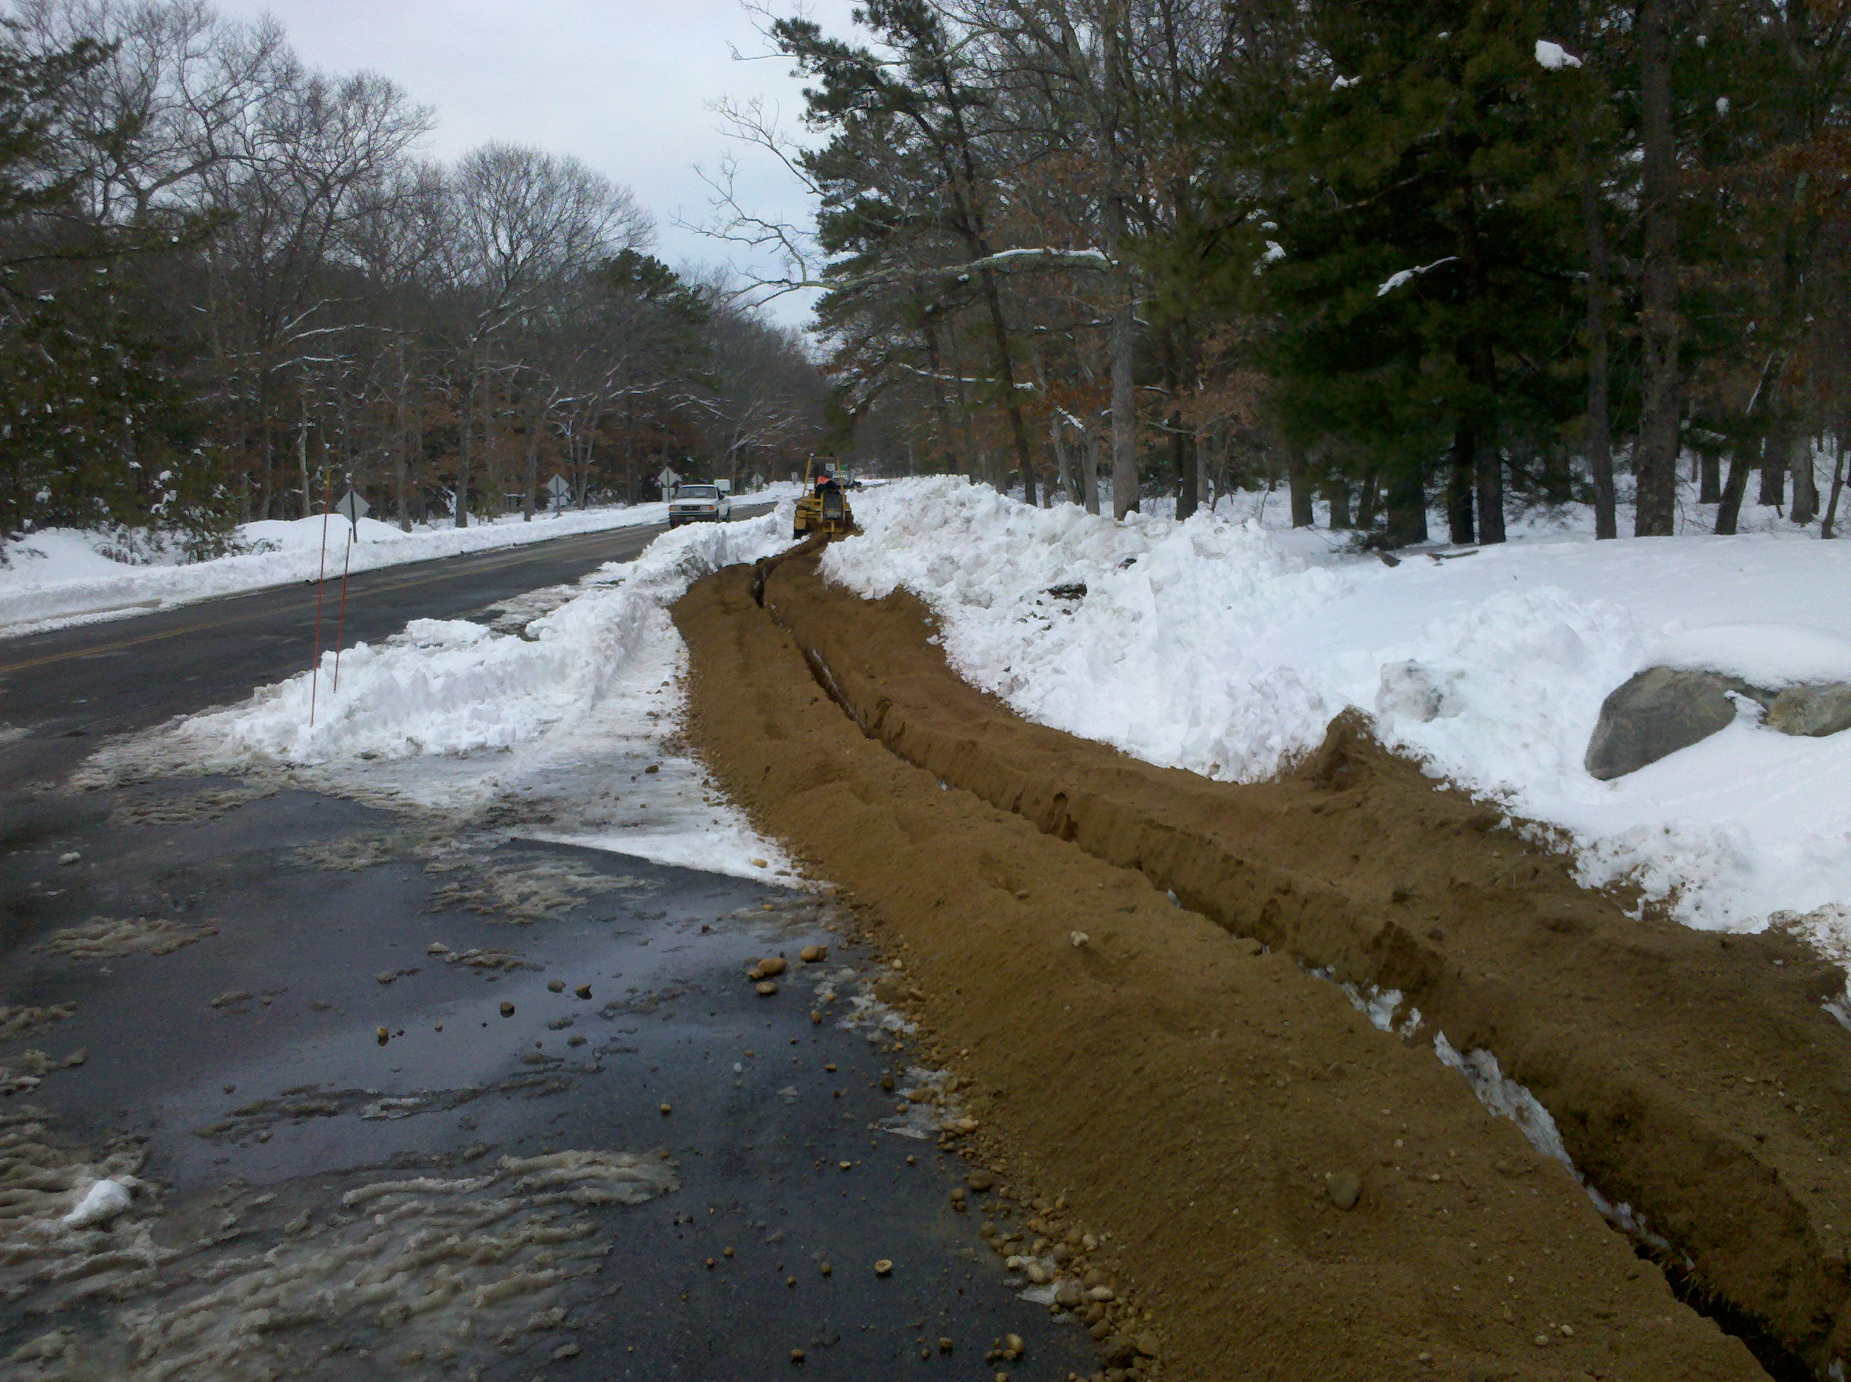
Long Island MAN
Argh! No more snow! It’s impossible to find manholes under 15’ snow
Light between 111 8th & 32 AofA waiting for portions of the ring to be constructed
  Southern: (was) early Feb
  Northern: Mid-March
Will handle testbed & production traffic (eventually) using Layer 1 VPN capability
Dramatically reduces our costs to reach BNL
Learned some lessons that will be helpful when ANI gets going

Slide 14
  OSCARS Development Status
PCE SDK (v01.11.11) is done
  SDK for development of PCEs for use in OSCASR (v0.6)
  ESnet has used the PCE SDK to develop bandwidth and VLAN selection PCEs
  Several DOE funded projects have identified interest in using the SDK
  PCE SDK is available for downloads to beta-user (contact chin@es.net)
OSCARS (v0.6 native) is close to code complete
  ~120,000 lines of code now (~130K when complete)
  Undergoing testing right now
  OSCARS v0.6 native (i.e. communicates with other OSCARS v0.6 servers) should be in beta in February
  Backward compatibility with v0.5.x is on target to be completed by April

Slide 15
OSCARS Deployment Status
OSCARS is now one of the core applications deployed by SCinet to support dynamic circuits
  First deployed in SCinet in SC09
  For SC10 over 150 dynamic circuits were configured in support of roughly 15 demonstrations
First deployments of OSCARS (v0.6) will be in 2Q2011
  Green field installations as part of I2's DYNES project
Proven use cases
  Extending site LAN over the WAN (Genomics: JGI/NERSC)
  Traffic engineering to avoid congestion points (Cloud testing: LBNL/Google)
  Guaranteeing network resources (LHC T0-T1, T1-T2)
  Deadline scheduling (Fusion DIII-D: GA/NERSC)

Slide 16
Fermi Challenge: Between 10G and 100G

Slide 17
Architectural Issues
The current ESnet backbone architecture has 3 types of links:
  IP links for carrying normally routed traffic
  SDN links for carrying traffic in engineered circuits (OSCARS)
  DMZ’s for connections to sites & peers
The general philosophy has been:
  Move large and predictable flows to circuits over SDN
  ‘Everything else’ should fit in the 10G IP backbone

Slide 18
FERMI Challenge
They moved the bulk of their traffic to more than 15 OSCARS circuits distributed across multiple 10GE interfaces.
The remaining traffic was still approaching 10G from time to time.
They could not move it to Layer 2 OSCARS circuits because that requires a willing and able partner at the far end of the circuit!
They could not move it to Layer 3 OSCARS circuits because OSCARS Layer 3 circuits start and terminate on ESnet routers, and the bottleneck was on the 10GE link to ESnet on the FERMI egress router

Slide 19
Plan
Moved FERMI ‘IP’ DMZ to a 2x10GE aggregated connection
Deploy a minor enhancement to OSCARS
    Allow Layer 3 circuits to dump packets into the standard forwarding table if the MPLS LSP supporting the circuit fails.
Re-route several large FERMI ‘IP’ flows onto SDN across the backbone
    Note that re-routing a flow into a circuit is hit less!
Automate portions of the process of identify candidate large flows and re-routing them over OSCARS Layer3 circuits
Develop circuit life-cycle management processes
    Documented processes for deciding when to turn up, change bandwidth, or turn down circuits

Slide 20
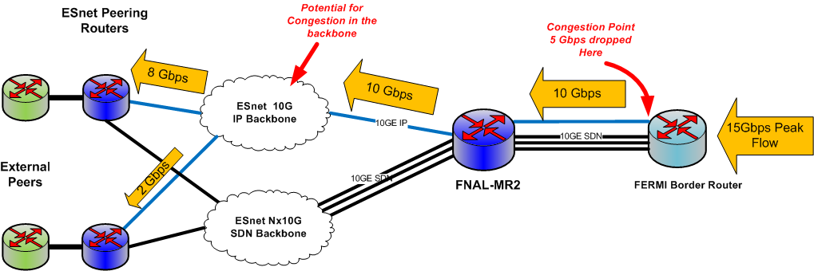
Before

Slide 21
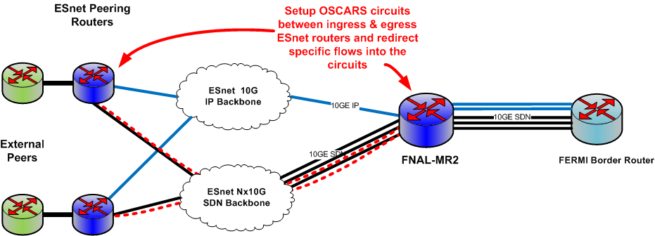
Transition

Slide 22
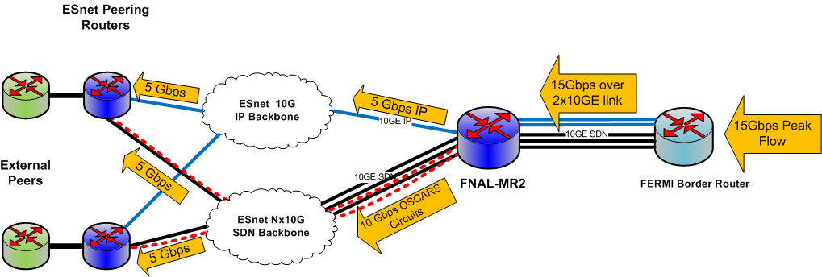
Future

Slide 23
Open Questions
The tools to re-route IP flows over SDN are available to OSCARS users including:
    ESnet Engineers
    Site Technical Contacts
    Others
Currently, ESnet is taking the lead creating the OSCARS circuits. Do others want to be involved?
What level of coordination should we have between ESnet engineers and site technical contacts when we re-route flows?

Slide 24
ANI & Testbeds

Slide 25
Advanced Networking Initiative
$62M ARRA funded 100G prototype network and testbed
  Leveraging this infusion of funds to lower long-term networking costs
    Dark fiber in metro areas
    Scalable, cost-effective 100G network
    National dark fiber testbed
  Testbed already in use
    Table-top being used by first round of research projects
    Disassembled and shipped to Long Island as LI MAN fiber build completes
    Second round of research projects selected by Advisory Committee comprising of R&E, lab, and commercial members

Slide 26
Minimizing the Impact of ANI
On staff:
  Hing Chow, PMP certified project manager
  Chris Tracy, Network Engineer
    Optical experience
New hires:
  Michael Sinatra, Network Engineer (UC Berkeley) starts Feb 8th
    DNSSec and IPv6 experience
  Patrick Dorn, Network Engineer (NCSA) starts Feb 22nd
    Active w/Supercomputing
  Gopal Vaswani, Web Apps Dev (start-up) starts Feb 22nd
    Web portal, working w/Dugan on network tool development
Open positions:
  Group Lead, Infrastructure Team
  Strategic Partnerships & Site Outreach Coordinator
  Software Developer
Upgrading infrastructure with an eye toward:
  Scalability
  Automation
  Reduced support requirements
Don’t hesitate to bring it to our attention if you see issues!

Slide 27

New Ticketing System
  Moving to Service-Now.com SaaS (Software-as-a-Service) solution for ticketing
  Same vendor as UC Berkeley, NERSC, LBNL IT Division
  Benefits: easier to open, query, update tickets, track issues
  On our roadmap: integration with new website
    ticketing portal + knowledge base for the entire community
  We’re interested in your experience: have you adopted a new ticketing system recently?
    please share your experience with greg@es.net
Notes:
Moving on to another application at the top of the infrastructure stack.
Ticketing. Same system since 1995. Showing its age.
Important point: ticketing is a single instance of a business process.
New ‘ticketing’ systems are really generic business process automation applications.
They let you automate almost any process: on-boarding summer studens, DNS requests, procurements, whatever.
Shines light on the logic / efficiency of your business process.

Slide 28
OpenDevNet
Platform for testing software/systems prior to deployment
Virtualization
  40 cores, 128 GB RAM, 6TB storage
Performance hosts
  2 Data Transfer hosts (10G disk to disk, RDMA capable)
Networking
  1 OpenFlow switch

Slide 29
OpenDevNet
Users
  13 users (9 ESnet, 4 external collaborators)
  30 virtual machines
Projects
  OSCARS 0.5 testing
  OSCARS 0.6 development and testing
  perfSONAR development and testing
  ANI testbed control framework development and testing
  Iperf testing
  OpenFlow testing
  GENI/ORCA testing
  RDMA testing with WAN simulation

Slide 30
New ESnet Website

Slide 31
Our Vision and Goals
More relevant, engaging, up-to-date content
World-class tools for DOE networking community and beyond
  ‘My ESnet portal’ to offer custom view of information you care about: interface / circuit utilization, maintenance calendar, tickets, knowledge base…
  Talented tools developer (Gopal Vaswani) starting Feb 22
Easier to update, maintain, extend
  CMS (content management system) technology

Slide 32
No New Passwords
To customize your ‘My ESnet’ portal, a login is required
  But we won’t force you to get a new password…
  instead we’ll leverage federated identity, using InCommon or OpenID accounts
It’s likely you have one of these already
  Existing accounts with Google, Yahoo, AOL (and many other organizations) will work
We’ve been promoting federated identity throughout the DOE community
  Science Identity Federation

Slide 33
Status
Currently finalizing content and site architecture
Our web contractor is finishing styling, integrations
Hope to ‘go live’ in early March
We’ll be eager to get feedback on the new site
  CMS makes it very easy to update, refine, optimize

Slide 34

ESnet Website: now
Notes:
Status quo as of a few months ago.
Serviceable, not very dynamic. No integrations with outside data sources, etc.
Stale content once you got past home page.

Slide 35
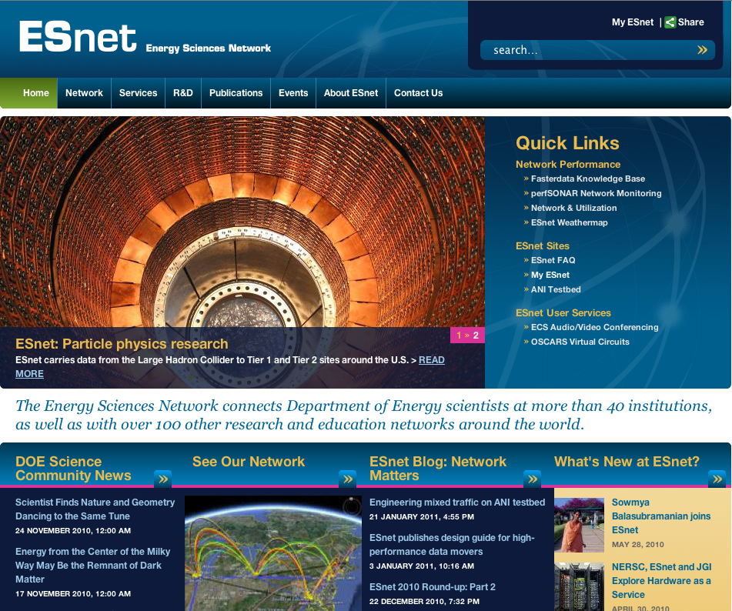
ESnet Website: soon
Notes:
Early design concepts for the new website.
Much more modern, interactive, easier to navigate.
These designs have more subdued colors; NERSC people gravitating towards one on the left.

Slide 36
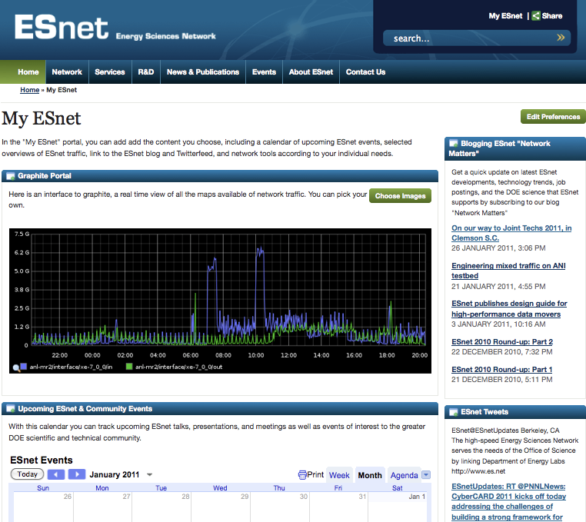
ESnet Website: Soon
Notes:
Early design concepts for the new website.
Much more modern, interactive, easier to navigate.
These designs have more subdued colors; NERSC people gravitating towards one on the left.

Slide 37
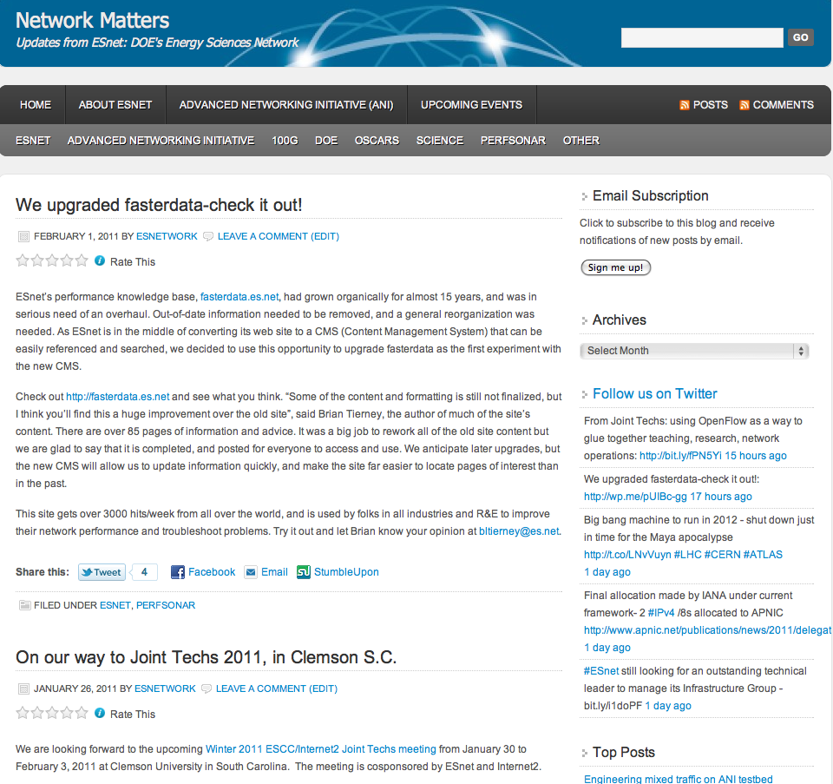
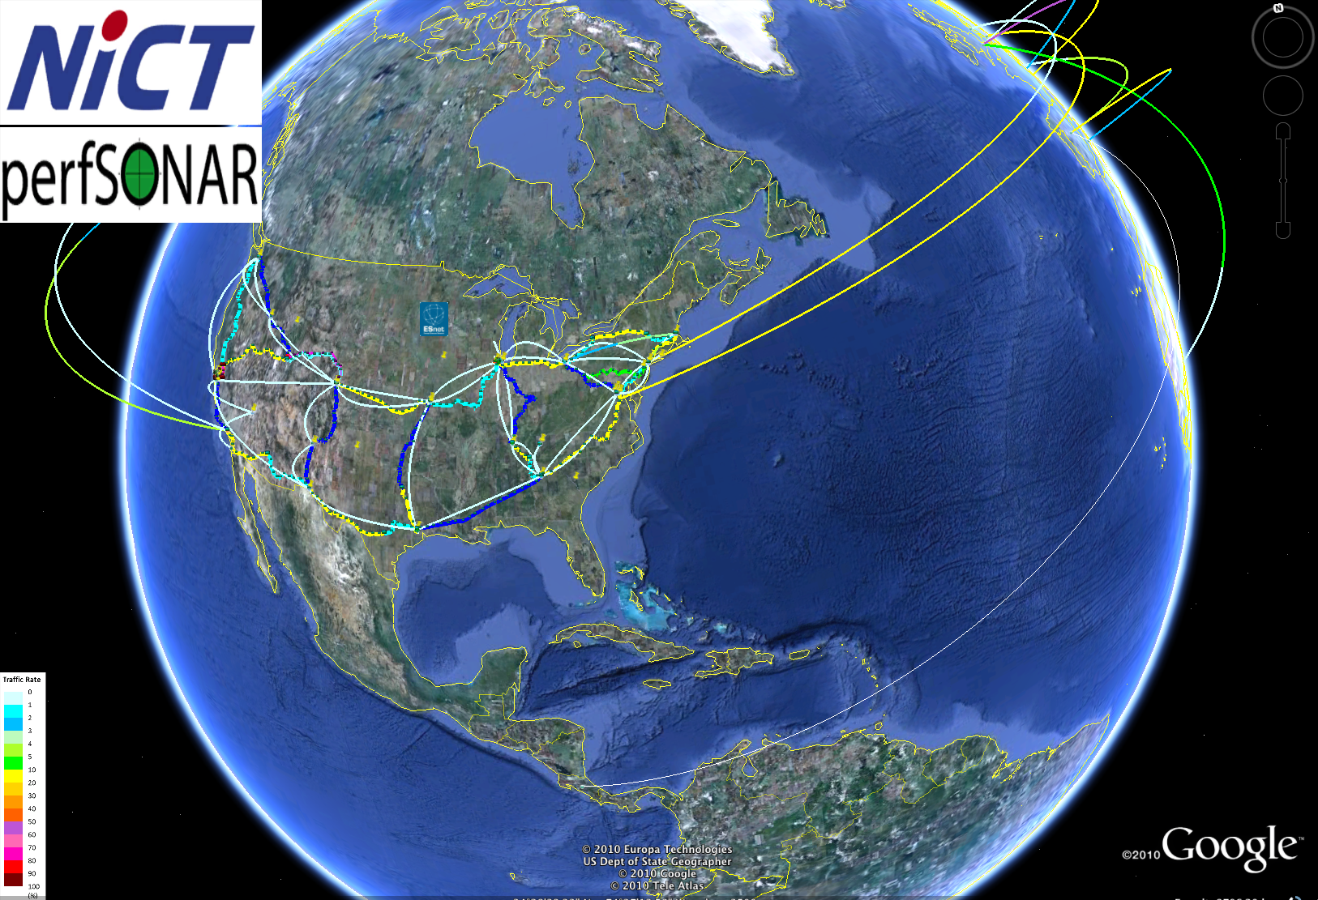
Web Content
Are existing sites like blog or fasterdata.es.net useful to you?
What sort of portal content, tools or visualizations would you like to see?
  Real-time, global perfSONAR app on Google Earth?
  OSCARS circuit visualizations?
  Network performance data/interface utilization stats?
  Is there interest in social networking applications to share project specific information, publications, slides, maybe instruments etc.?

Slide 38
Authentication & Trust Fabrics Update

Slide 39
DOEGrids CA
DOEGrids v4 nears completion
  Distributed key management devices (netHSM) are online
    Sunnyvale
    Chicago
  Distributed key management in place
    California: OSF (ESnet operations)
    New York: ESnet remote engineer
  CA Cloning tested – current efforts
    Smooth transition between old and new CA operation
    Uniform certificate revocation management
    Uniform agent and user interfaces
Notes:
v4 - Version 4
netHSM - network enabled Hardware Security Module
focus here is to come up with the Geographically distributed CA infrastructure to withstand natural disaster

Slide 40
Science Identity Federation (SIF)
Focus: Get labs into InCommon
  Blanket agreement in place
    3 year memberships in InCommon for DOE labs, sites, user facilities
    Primary: SC sites - but there should be sufficient funding for some non-SC
  Sites sign a participation agreement with InCommon
  Berkeley Lab will manage the procurement (billing)
  Agreement web sites will be available soon (maybe this week)
Future focus: applications; interoperability with DOE – ICAM
(Contact Mike Helm helm@fionn.es.net for more information)

Slide 41
Network Analytics

Slide 42
Network Traffic and Routing Analysis
Key Benefits
  Provides a data-driven understanding of the conduct of science as seen by the network
  Observation of network traffic flow characteristics over time allows us to understand how the conduct of science is changing from the perspective of the network
    Examples include:
      Dramatic rise in the mid-2000s of the parallel data movers
      Growing dominance of science traffic as the primary customer of ESnet
  Enables ESnet staff to trace large flows and understand where they are coming from and going to
  Improves productivity of staff, reduces network instability/anomalies

Slide 43
Network Traffic and Routing Analysis
Legacy NetFlow and BGP analysis system (2004-present)
  ESnet staff has developed and maintained an in-house, custom analysis system
    Based on open-source tools
    Limited number of reporting options
    Significant overhead involved in maintenance, debugging and development of new features
Motivation for switching to a commercial system
  Provides more sophisticated reporting options, “what-if” analysis
  Minimize overhead in maintenance and development of legacy system (will be kept for purpose of raw data archiving)
  Commercial support, increased robustness

Slide 44
Network Traffic and Routing Analysis
Deployment of Commercial Appliances
  Arbor Networks: Peakflow SP
    Models traffic across the entire network by monitoring NetFlow statistics and BGP attributes at the peering edge
    Chosen for their extensive BGP analytics and automatic tracking mechanisms which provide many different ways of examining network traffic
    Provides ESnet staff with the necessary data to make informed decisions about routing, transit, partners, customers and quality of service
    Includes alerting capability to notify operations of significant changes to the network (DDoS attack, link saturation, etc.)
    Includes support for a customer-facing web-based portal

Slide 45
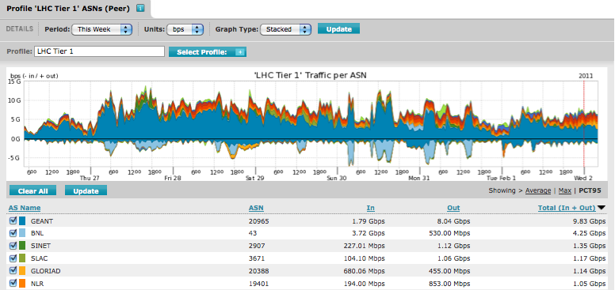
Network Traffic and Routing Analysis
Arbor Networks: Peakflow SP

Slide 46
Network Traffic and Routing Analysis
Deployment of Commercial Appliances
  Packet Design: Traffic Explorer & Route Explorer
    Provides integrated, real-time view of network-wide routing and traffic behavior by monitoring NetFlow data and routing protocols
    Chosen for their planning mode features and routing analytics
    Enables ESnet staff to rapidly prototype network optimization schemes and perform “what-if” analyses with historical data
      e.g., report on impact of link/node failures, understand impact of expected traffic growth for one particular science community
    Traffic grouping features allow flows belonging to a particular customer or science community to be reported on separately
    Improves productivity of network engineering staff by automating the analysis of complex problems previously done manually

Slide 47
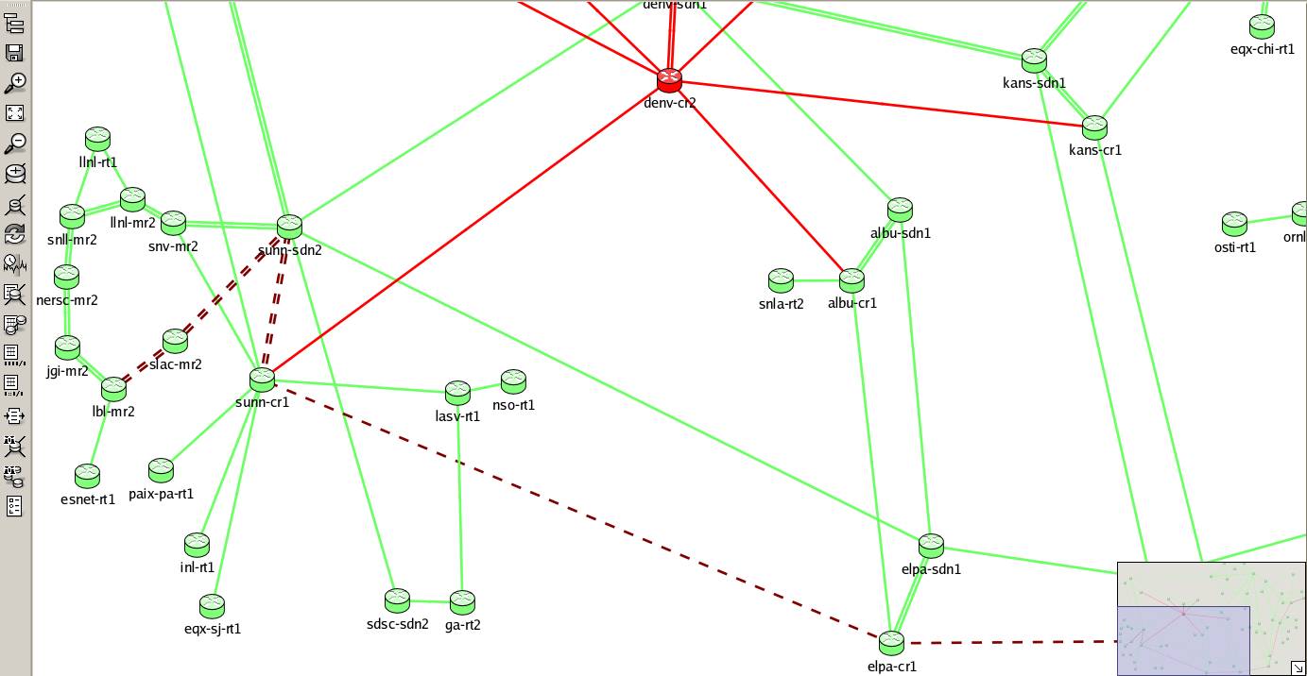
Network Traffic and Routing Analysis
  Packet Design: Traffic Explorer & Route Explorer

Slide 48
Network Traffic and Routing Analysis
Current Status of Deployment
  Both Arbor and Packet Design provided loaner systems which were evaluated by ESnet staff during a 60-day trial period
    Evaluation period has given ESnet staff the opportunity to become familiar with how to deploy and manage each system
    Insight provided by these systems during our evaluation helped to identify problems which had gone unnoticed
      Asymmetric IP routing
      Duplicate flow sampling
  Orders placed for Arbor and Packet Design appliances in Aug 2010
    Deployed at LBNL in early Nov 2010
    Now used by ESnet staff for traffic, routing and peering analysis

Slide 49

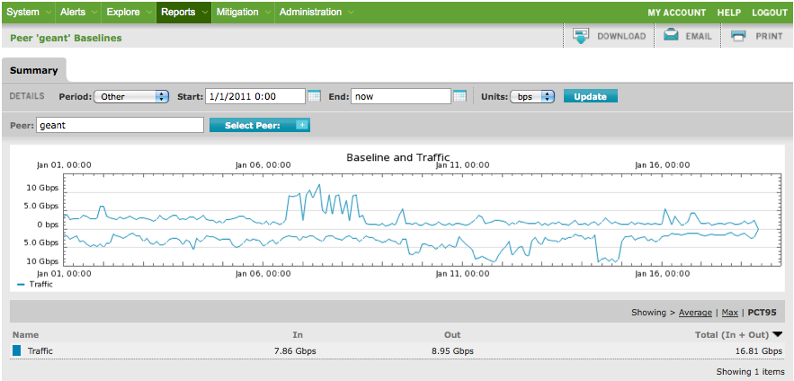
Arbor Managed Objects
Baseline traffic to/from GEANT (as20965)
01/11/11
Lawrence Berkeley National Laboratory
U.S. Department of Energy | Office of Science

Slide 50
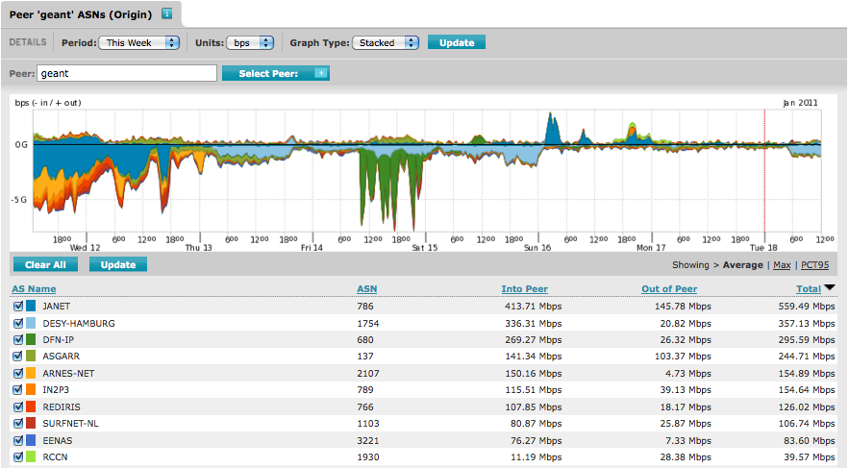
Arbor Managed Objects
Traffic to/from GEANT broken down by Origin AS
01/11/11
Lawrence Berkeley National Laboratory
U.S. Department of Energy | Office of Science

Slide 51
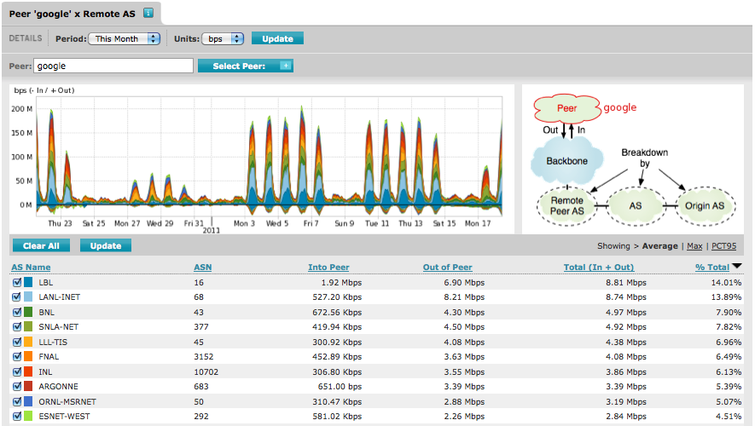
Arbor Managed Objects
Traffic to/from Google broken down by ESnet customers (DOE sites)
01/11/11
Lawrence Berkeley National Laboratory
U.S. Department of Energy | Office of Science

Slide 52
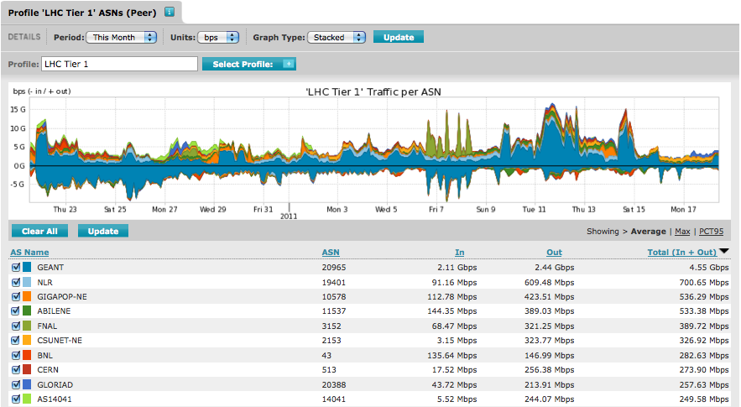
Arbor Managed Objects
Traffic to/from LHC Tier 1 sites broken down by ESnet peers
01/11/11
Lawrence Berkeley National Laboratory
U.S. Department of Energy | Office of Science

Slide 53
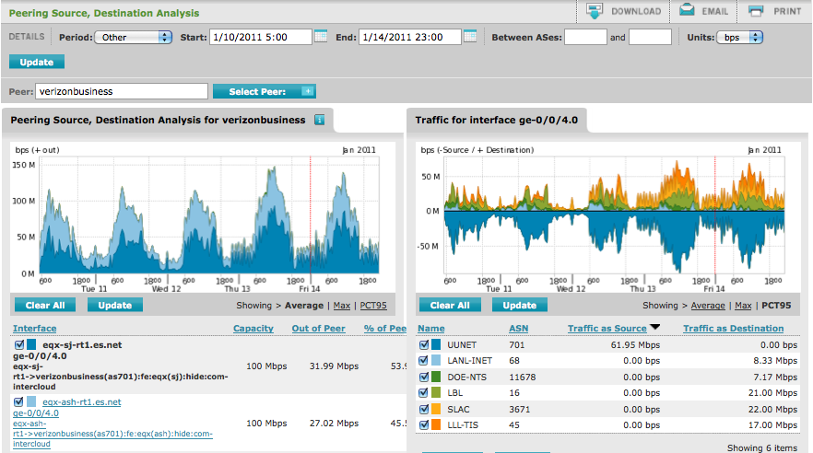
Arbor Peering Analytics
Verizon Business Peering in SJ is Warm - Who’s using it most?
01/11/11
Lawrence Berkeley National Laboratory
U.S. Department of Energy | Office of Science

Slide 54
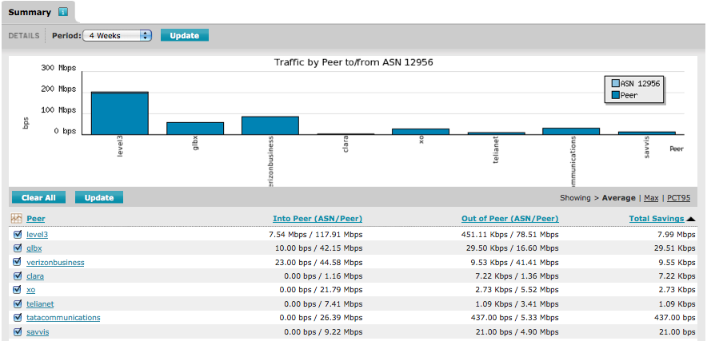
Arbor Peering Analytics
Is it worth it to peer directly with Telefonica (as12956) ?
01/11/11
Lawrence Berkeley National Laboratory
U.S. Department of Energy | Office of Science

Slide 55
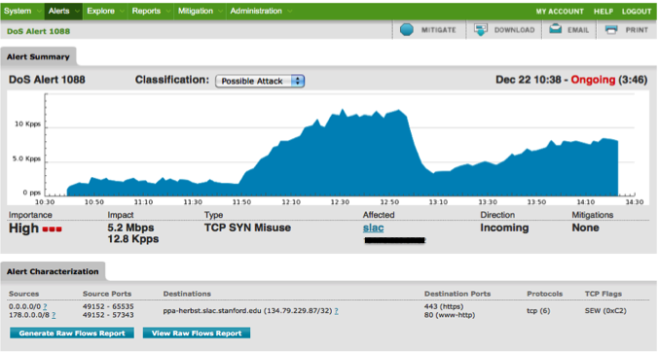
Arbor DDoS Alert
To single IP address at SLAC - really an attack, or slashdot effect?
01/11/11
Lawrence Berkeley National Laboratory
U.S. Department of Energy | Office of Science

Slide 56
Experimental Capacity Planning Tool

Slide 57
Experimental Capacity Planning Tool
ESnet has grown to beyond the point where it is no longer feasible to use manual processes to determine when a circuit needs to be upgraded.
What kinds of traffic patterns can we detect that might give us an idea when a link is becoming saturated?
But what does saturated mean?
  There is no widely held idea of what percentage of utilization indicates that a circuit is becoming saturated. A thread on NANOG has ranges from 40% to 95%http://nanog.markmail.org/thread/vmkjrldzvsrbz3en
  The traffic profile of the network will effect this threshold. R&E networks are significantly different than the commercial Internet.

Slide 58
Approach
Taking some of the ‘art’ out of deciding when to add capacity
Process:
  Define metrics that can describe utilization patterns that may indicate circuits are busy
  Analyze all circuits each day and assign a score for each metric
  Initially the thresholds for the metrics and for which values of each metric indicate an “interesting” circuit will require human supervision
  Over time note which circuits are upgraded
  Use the decisions from step 4 along with the historical scores for each metric as an input for logistic regression

Slide 59
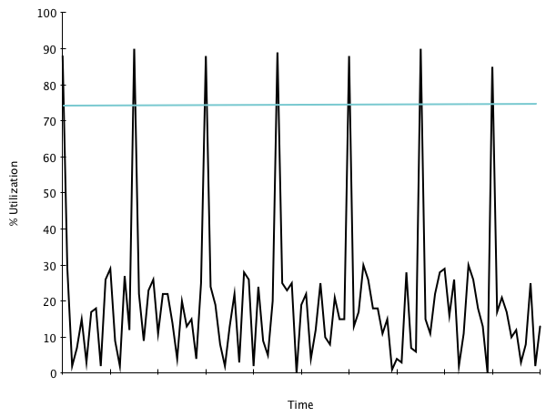
Peaks Metric
The number of sampling intervals where the utilization is over some threshold T.
In this example:
  T = 75%
  The value of the metric is 7 (there is a peak at time 0)
Notes:
Blue line represents the threshold. Both patterns are a bit exaggerated for emphasis.

Slide 60
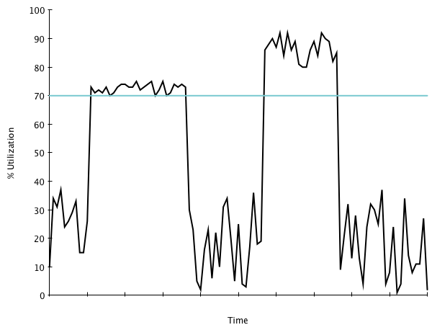
Plateaus Metric
The number of sampling intervals where the utilization is over some threshold T for at least t intervals.
In this example:
  T is 70%
  t is 20
  Metric value is 48 (left plateau is 27 time intervals wide, the right is 21 time intervals wide)
  Peaks which persist for less than t intervals are NOT counted
Notes:
Blue line represents the threshold. Both patterns are a bit exaggerated for emphasis.

Slide 61
Current Status And Limitations
Status
Limitations of the regression
Peaks and Plateaus metrics are both implemented
In the process of finding appropriate thresholds for each metric
Need more data regarding past upgrades to feed the logistic regression
The peaks and plateaus metrics when properly tuned may provide enough filtering to allow a human to evaluate the remaining circuits
Topology (both physical and routing) changes can complicate things
The past may or may not be a good predictor of the future
Additional metrics would be helpful
Contact Jon Dugan (jdugan@es.net) with questions, comments or suggestions!

Slide 62
Focus Areas for the Next 12 Months

Slide 63
Finding Ways to Make the Network More Useful
If your scientists aren’t effectively using the network, it’s unlikely you are going to invest in the network because there are other areas with a better return on investment
  Science productivity and collaboration suffer
How do we get there?
  WAN: Improved efficiency (OSCARS), perfSONAR, security, etc.
  LAN: Science DMZs, perfSONAR, Openflow, data transfer nodes, security, etc.
  New tools for LANs that improve WAN effectiveness, visualization
  What else?

Slide 64
How do we become the Dept of (Less) Energy?
Ideas we’re contemplating:
  Begin to understand how to measure the energy cost of moving data using existing infrastructure
    Extend to 100G network
  Expand http://weathermap.es.net/ to include energy costs
  Test movement of VMs in terms of energy costs
  What is more energy efficient – computing in the cloud or locally? How can this decision be made?
  Use path computation engine SDK to create virtual networks on demand that satisfy not just BW allocation costs but also min energy cost, or max green energy costs
  Analyze the idleness of the paths – is there a chance for power management there? Does it make sense to purposefully create idle paths at a slight performance cost?
  Switch to move flows dynamically to create idleness along a path

Slide 65
Thank you
Twitter: ESnetUpdates
Blog: http://esnetupdates.wordpress.com/

