Slide 1
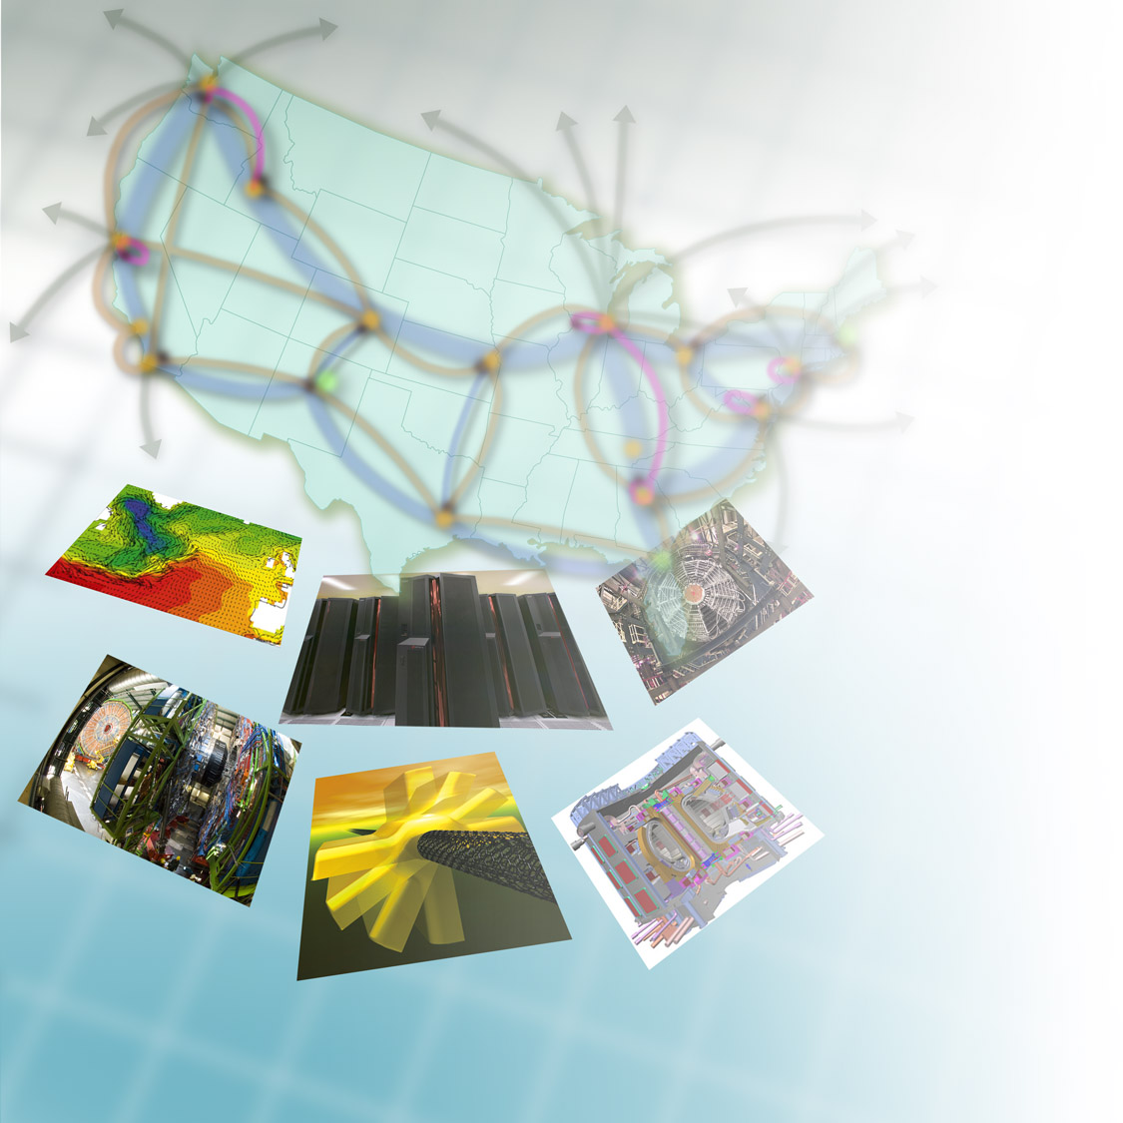




SDN and OSCARS
how-to
Evangelos Chaniotakis
Network Engineering Group
Energy Sciences Network
Lawrence Berkeley National Laboratory
ESCC
Indianapoilis, July 2009
Networking for the Future of Science

Slide 2
Why use SDN?
Provides tools to do traffic engineering on big science flows (vs. small enterprise).
For these big flows:
  Traffic isolation allows impolite protocols
  Guaranteed WAN bandwidth
  More efficient long-latency flows
  Use appropriate layer (L2 : cheaper)
SDN can help your site network (and ESnet!) be more efficient and cost-effective.

Slide 3
Preparing for SDN

Slide 4
Using SDN

Slide 5
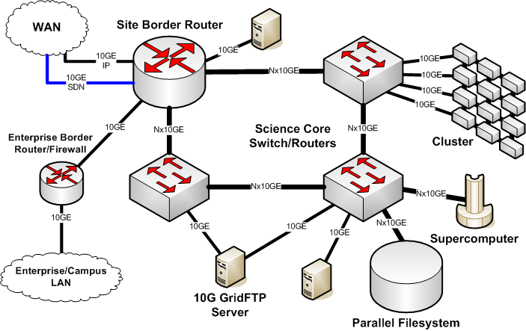

Separate Enterprise and Science Networks

Slide 6
Baseline SDN setup
Use case: A data source / sink at an ESnet site.
  The site network is configured once (at most) , statically.
  Other endpoints can now be connected to it over SDN.
  Minimal site setup needed
Allows site to separately manage & engineer big flows.

Slide 7
Minimal L3 VC service
Site decides schedule, bw, and a flowspec:
  Source / destination subnets
  DSCP bits
Zero config needed in either site / app.
VC is by default unidirectional
Hops onto / off ESnet will take regular IP route

Slide 8
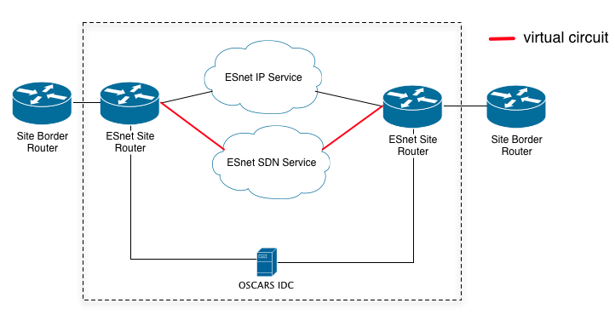
L3 VC service

Slide 9
Minimal L2 VC service
Site decides destination, bandwidth, VLAN
Big flows arrive at a subinterface
  Much easier to manage inside the site
Site config needed: VLAN plumbing.
VC participant sites must arrange routing
  ESnet highly recommends use of a dynamic routing protocol for this.

Slide 10
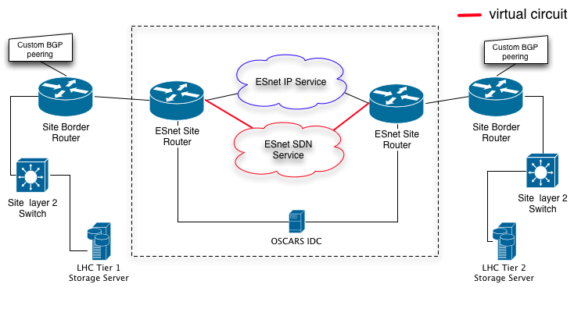
L2 VC service

Slide 11
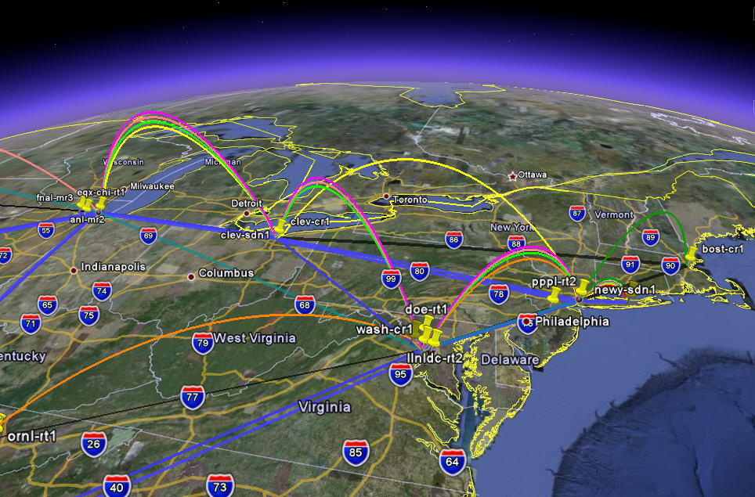
Expanding SDN

Slide 12
Active SDN endpoint
Use case: More than one data intensive application at the site need to use the same network resources.
  The site has decided to programmatically schedule and control virtual circuits on SDN.
Site configuration:
  Should install & configure OSCARS client software
  Need to have a DOEGrids certificate and related OSCARS user account

Slide 13
Active SDN endpoint (cont.)
Advantage: Good measure of control, better utilization of resources
Applications that bring up VCs only when they absolutely are needed
  helps bring both site and ESnet networking costs down.

Slide 14
Integrated SDN site
Use case: Evolution of the active endpoint, with data intensive applications transparently and dynamically configuring VCs.
This usually means that the site hosts and / or network need to be dynamically reconfigured.
The site can use a solution like TeraPaths / LambdaStation / Phoebus to automate the process.
Can integrate this with overall data and computing workflow

Slide 15
Integrated SDN site (cont.)
Advantages:
  Almost / fully transparent to applications.
  Can do sophisticated scheduling.
  Can guarantee QoS inside the site network.
The site has almost created its own internal virtual circuit service, stitched to the SDN service
Next step: run an IDC!

