Slide 1
PerfSONAR Update
Joe Metzger, Network Engineer
ESnet Network Engineering Group
Summer ESCC
Columbus, OH
July 15, 2010

Slide 2
perfSONAR Workshop Summary
4 Topics addressed
    Community building
    Expanding perfSONAR technology
    Research uses
    Operations & deployment
Results
    Very optimistic schedule: final report due in 2 months
    Working documents are on-line with links on the workshop agenda

Slide 3
Operations & Deployment Breakout
I lead the O&D breakout session
The community identified a set of priorities
Simplify deployment & make it easier to use
Support management of a set of remote servers
Documentation
Security, analysis & visualization tools, data management, etc
There is a very strong correlation between what the community current priorities, and the development teams priorities over the last year.

Slide 4
  DICE
  We are working on developing a set of common well-defined interoperable services
    Diagnostic Service
    Path Characterization Service
    Circuit Monitoring Service
    Dynamic Circuit Provisioning Service
The aggressive target is 1st quarter 2011 for deployment
    GEANT, Internet2, ESnet, 6 NRENs, & some US regionals

Slide 5
General Updates
Hardware
  Finishing up deploying PS nodes at last couple 10G Sites and commercial peering points
  Planning for deploying PS nodes at some of the lower speed ESnet sites
Software
  PS Tookit 3.2 RC1 was released Monday
    Moved from Knoppix to Centos
      New packaging will better support lab environments
Notes:
$325M is a quick back of the envelope sum of BTOP, ANI & ARI proposals. I am probably missing a lot.
66,000 institutions is from the US-UCAN proposal

Slide 6
JET/LSN perfSONAR Demonstration Project

Slide 7
Status
Domain | Latency Deployed | Latency Scheduled | Bandwidth Deployed | Bandwidth Scheduled
ESnet | Yes |  | Yes | Partial
Internet2 | Yes | Partial | Yes | Partial
NOAA | Yes |  | Yes | Partial
NLR | Yes |  | Yes
NASA |  |  | Yes | Partial
UEN | Yes | Partial | Yes | Partial
http://code.google.com/p/perfsonar-ps/wiki/JETPerfSONARDemo
Notes:
$325M is a quick back of the envelope sum of BTOP, ANI & ARI proposals. I am probably missing a lot.
66,000 institutions is from the US-UCAN proposal

Slide 8
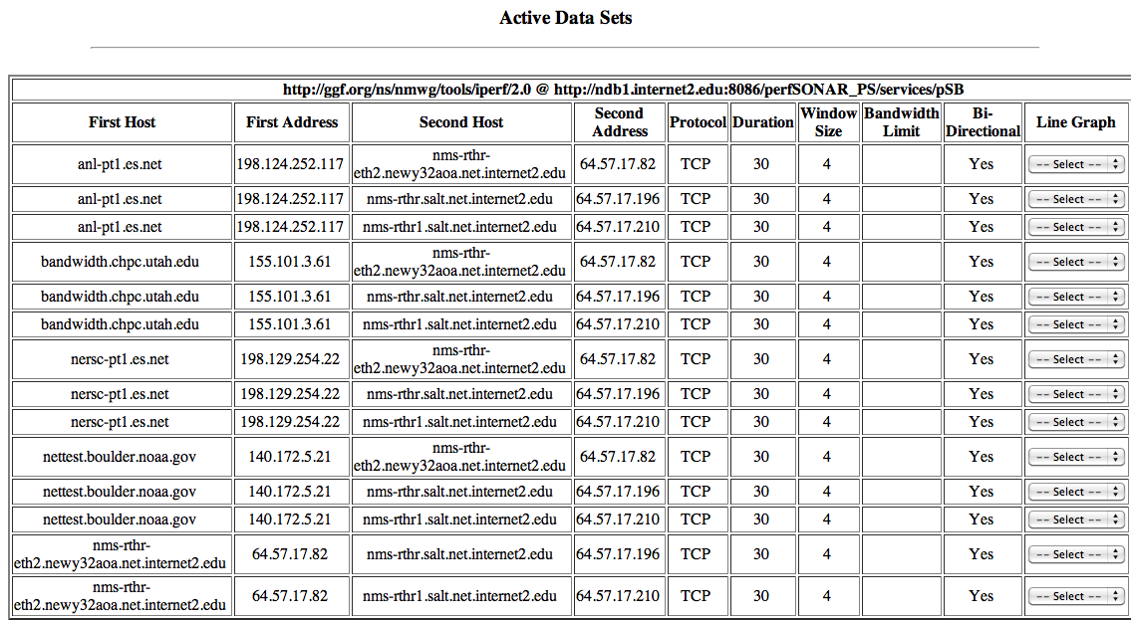
  Active Tests Internet2 Perspective

Slide 9
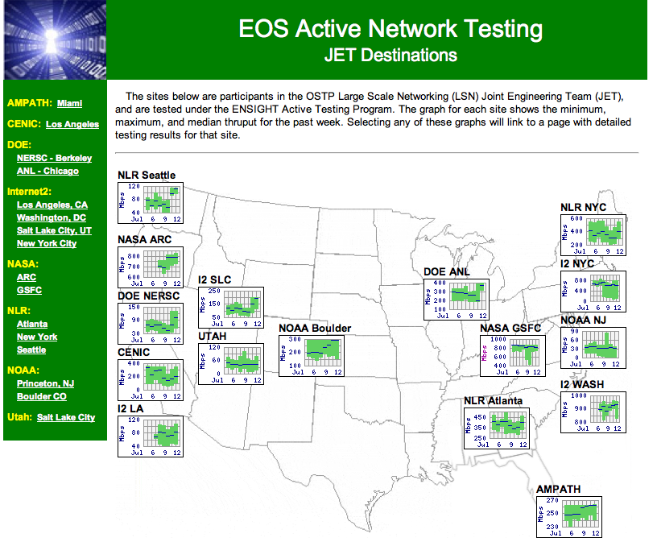
Active Tests NASA Perspective

Slide 10
Test Results Summary
There is significant variability on the cross-domain paths being tested.
  Some are actively used paths with significant cross traffic
  Some paths are mostly idle
  Some paths are not allowed by policy
Bandwidth results
    Many show high, stable performance
    Some show significant variability
    Some are asymetric, probably due to test infrastructure configuration issues

Slide 11
Lessons Learned – Initial Comments
BWCTL tests are far more prevalent than the latency tests
Having a mostly full mesh of both the latency and the throughput yields a better and more rounded picture
Exposing the data for 3rd party access is problematic from a policy and technical perspective. However, this data is necessary for good troubleshooting.
Exposing the data for fixed site and tests is useful, but being able to dynamically bring up sites and graphs would be even more useful to active troubleshooting.
Not everyone is setting up IPv6 interfaces for measurement at this time
    More thoughts on how to balance IPv6 measurements might be necessary.

Slide 12
Next Steps
July - Collect Lessons Learned
August - Write up a report

Slide 13
Questions?

