Slide 1


NSI Implementation Task Force
GLIF Technical Working Group Meeting
Winter 2012
Baton Rouge, LA
Inder Monga
John MacAuley

Slide 2
GOAL
OGF
Production deployment of NSI protocols
NSI Standards
Best Practices/Impl. Agree.
Prototype/Interop (AutoGOLE)
GLIF

Slide 3
Standards define a protocol
Specifies the format of that information
Carries a lot of information
Guides behavior of the implementation

Slide 4
Standards do not define…
Proper process and procedures
How to debug an interoperability issue? Tools?
How do you maintain and specify the information needed?
What policies make sense for security?
What to do when information is missing?
What information is discovered versus configured?
…
Network Engineers
NSI Implementers
Task Force
Developers
Standards Group
Implementation agreements, Best Practices, Operational Guidelines are needed to bridge the gap between standards and production deployment

Slide 5
What is the output?
GLIF Best Practices documents
  On topics that need similar service understanding to work, like security profiles
  To aid new R&E operators to understand the peripheral technologies needed to run a service
  To help users to work with GLIF using the NSI protocol
Recommendations to OGF Standards group
  Protocol extensions will be submitted as GLIF contributions to the OGF
Implementation Agreements
  Service Definitions (L2 Ethernet Service) to provide a consistent GLIF service across operators of GOLES/participating networks

Slide 6
Process
Identify existing gaps between standard specifications and requirements of a production service
Document and prioritize the list of gaps
Input from R&E Network Engineers participating in the GLIF
Input from potential users of the NSI service

Slide 7
Process
Form small teams of volunteers to make recommendations
  Discussion within mailing list of GLIF
  Tiger teams on topics of interest
  NO BROAD CALLS → EMAIL DISCUSSIONS encouraged
Work with NSI implementers in the GLIF / Automated GOLE group to vet and prototype solutions
Publish agreements in documents

Slide 8
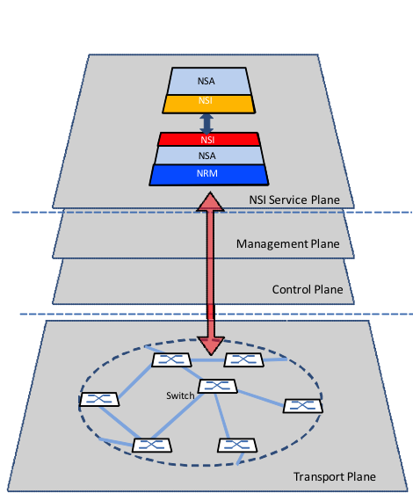
Network Services Framework
Community driven collaboration effort
Defined concept of Network Service Plane
Simple technology agnostic view of the network
Notes:
The development of a successful protocol involves considerably more than a basic protocol specification, such as the often-neglected operationalization considerations for the implementation and deployment of a protocol into a production network. Network operators require a complete solution to be available before putting a new service into production, including solutions for operation, administration, maintenance, provisioning, and security that fall beyond the purview of the protocol standard. An investigation into key operational gaps and open challenges within the Open Grid Forum (OGF) Network Service Interface (NSI) specification will be discussed, with key conclusions presented and next steps for development of a comprehensive solution.
The NSI specification was a community driven collaboration primarily involving OGF members from National Research and Education Networks (NREN).

Slide 9
NSI Connection Service Protocol
NSI-CS key deliverable of working group
Validated in 2011 through prototype activities and interoperability demonstrations (AGOLE)
Discovered issues with the base protocol
Operational issues were also identified
Notes:
The NSI Connection Services (NSI-CS) protocol [2] was a key deliverable from this community driven activity, providing the protocol foundation for a globally deployable bandwidth on demand service. The NSI-CS was validated in 2011 through a number of prototype implementations and interoperability demonstrations utilizing the Automated Global Lambda Integrated Facility Open Lightpath Exchange (AGOLE), an international network of interconnected data switching sites supporting data-intensive scientific research. During these demonstrations and associated integration activities, protocol developers discovered a number of issues with the base protocol. These issues have been tracked and either corrected, or scheduled for correction in a future release. Also, as part of these activities a number of operational issues were also identified that, unless a solution is defined, will restrict the production deployments of the NSI-CS protocol.

Slide 10
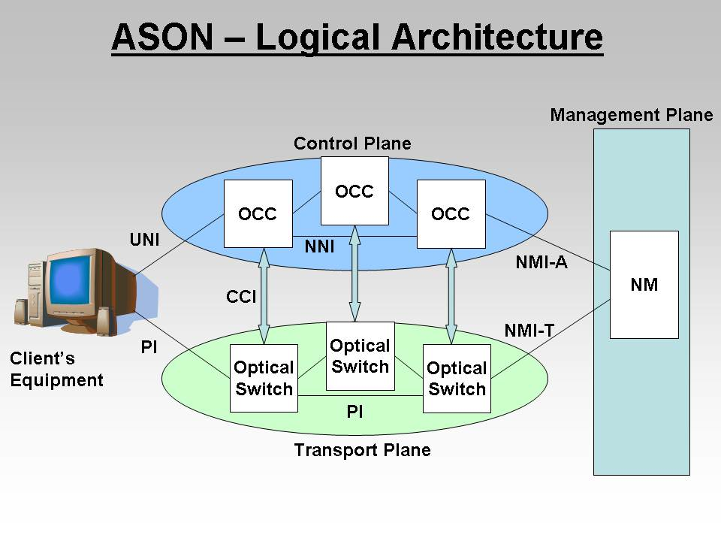
Strategy
Identify solutions to similar problems
Understand common design patterns/best practices
Evaluate applicability to new problem based on new goals and requirements
Notes:
The NSI Network Services Framework (NSI-F) specification [1] defines a logical architecture similar in concept to the Automatically Switched Optical Network (ASON) logical architecture [3]. The ASON logical architecture defines three distinct “planes” of functionality: Transport/Data plane, Control Plane, and the Management Plane. The NSI-F introduces the additional NSI Service Plane to the standard ASON model, with an abstract protocol definition for a service plane oriented messaging service. Conceptually, the Network Service Plane is similar to the ASON Control Plane, but providing a higher layer service abstraction for the network. Where ASON defines Optical Connection Controllers (OCC) the NSI-F defines Network Service Agents (NSA), and where ASON defined the Network-to-Network Interface (NNI) the NSI-F defines the Network Service Interface (NSI). However, unlike the ITU-T specifications, key features needed for implementation and deployment of the protocol into a production network are left for further definition.
A detailed analysis of the current operational shortcomings has revealed a number of open issues with the architectural framework and NSI-CS protocol that will need to be addressed. This is not an exhaustive set, but a key starting point for both protocol and implementation developers to consider in the near future.

Slide 11
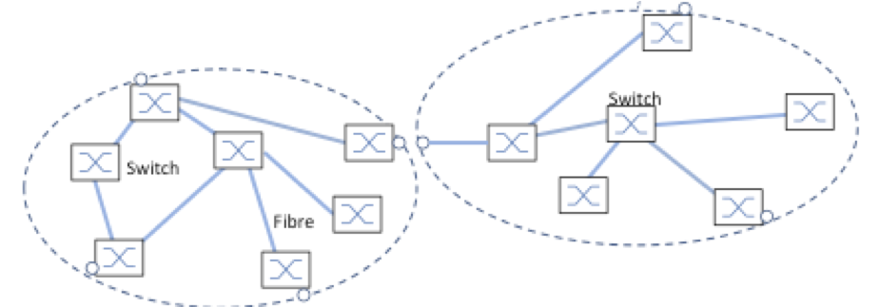
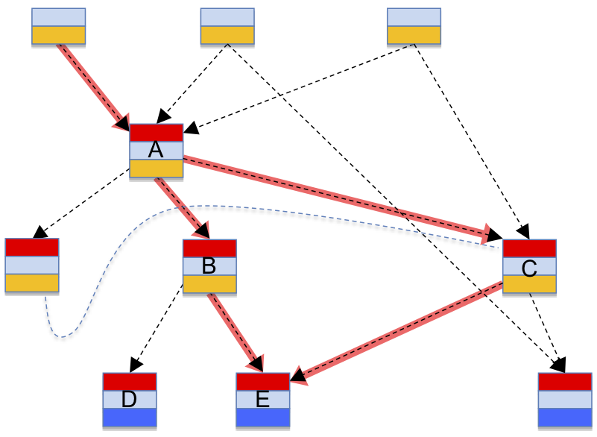
Topology
Data plane topology and discovery
Signaling plane topology and discovery
Notes:
Data Plane Topology
The NSI working group has started to focus on addressing some of these important issues such as the definition of service plane resource and topology discovery meeting the needs of the connection services protocol. This is a key feature needed for a Network Service Agent (NSA) to implement another important control plane capability - dynamic path computation (routing). NSI cannot be deployed on a global scale without the flexibility of constraint based path computation.
Signaling Plane Topology
Discovery of peer NSA, their connectivity to other NSA, and forming trusted associations are import aspects that will permit the exchange of NSI messages. A key open signaling issue within the NSI-CS is how to determine a reservation request path through the NSA peering hierarchy such that it is received by the NSAs involved in the connection setup.

Slide 12
Security
Signaling plane security (NSA-to-NSA)
End user authentication and authorization (client-to-NSA)
Multi-domain policy enforcement
Protection of network resources from unauthorized access
Protect integrity of data plane
Notes:
Signaling Plane Security
Establishing peering relationships between inter-domain NSA can be considered a management administration function given the complexity of multi-organizational agreements. However, once a peering relationship has been established a pair of NSA the protocol will need to programmatically established trust between the peers to guarantee authenticated and authorized associations. Introduction of concepts such as IP address ACL, certificate based authentication for TLS, and application layer authentication are possible solutions for investigation as trust mechanisms. In addition, message integrity and confidentiality with need to be addressed with solutions such as WS-Security.
Authorization and Policy Enforcement
Once an associated NSA has authenticated a user over the UNI interface, there is still the open issue of how this user’s request will be authorized throughout the network as their request is propagated to children NSA within the routable network. The existing NSI-CS specification includes a generic set of SAML security parameters that can allow for the transport of a user’s associated identity attributes, however, no formal specification has been defined for attributes that will need to be passed, nor how these attributes can be used to perform authorization and policy enforcement.

Slide 13
Protocol Enhancements
Interaction with Data Plane errors
Connection protection/restoration
Traffic engineering
Protocol extensions
Protocol capabilities and version discovery
Notes:
Interaction with Data Plane errors
Another important aspect of a control plane protocol is how it will interact with errors from the underlying data plane. Many consider this a management system monitoring issue, however, it is far from that simple since the control plane may need to react to these errors. The NSI-CS has considered some of the basic failure issues around reservation, provisioning, and administrative deletion of a connection segment; however, additional consideration must be given around autonomous network events before many common operationalization issues are addressed.
Connection protection/restoration
With many different underlying protection mechanisms being used within the NREN network it is important to define a protection and restoration solution within the NSI-CS protocol that can be flexible enough to address the individual NREN needs. Unlike the ASON control plane, the NSI-CS is a service level protocol, and therefore does not necessarily have to implement restoration itself, but needs to coordinate compatible underlying data plane protection for services requiring higher level availability guarantees. Open issues include how to present (aggregate) end-to-end protection/restoration to the requesting agent when multiple NSAs are involved in a reservation each with distinct protection/restoration schemes. Protection using proprietary extensions with the existing NSI-CS protocol definition has been demonstrated, but nothing had been standardized to date.
Traffic engineering
There has been considerable debate within the NSI working group about the level of traffic engineering support the protocol should standardize, versus what should be left up to individual service agreements between organizations. The NSI-CS protocol includes service specific attribute extensions intended to allow individual deployments to support additional traffic engineering capabilities. At the moment, no two organizations have agreed on a shared set of attributes to implement. As a result, more formalized definitions should be investigated to provide proof points to the existing protocol definitions, and to build a set of common set of extensions for implementation. These investigations should also focus on the protocol’s existing explicit path support and guaranteed bandwidth reservations, to validate operationalization aspects in production networks.
Protocol extensions
Operationalization discussions with NREN within the global community has revealed that NSI-CS protocol version 1.1 does not have sufficient capabilities to justify replacement of their existing connection services solutions. Although a large step forward on the path to a common inter-domain connection solution, the lack of basic capabilities such as modification of existing reservations means full network deployments may be limited in the near future.
Protocol capabilities and version discovery
The vision for the NSI-F is to build a suite of protocols required for realizing the overall needs of a service oriented control plane. As these protocols are defined and implemented within the network it will become increasing difficult to keep deployed NSA implementations in sync with respect to protocol versions and capabilities. The existing NSI-CS protocol is versioned through XML namespace definitions, allowing for protocol compatibility enforcement. One key capability that will need to be introduced into the NSI-F is a mechanism for protocol capabilities and version discovery, allowing for dynamic exchange of interface version information between NSA.

Slide 14
User Network Interface
NSI-CS is equivalent to E-NNI (network-to-network) protocol definition
UNI is a demarcation point between network service provider and the subscriber or end user
Need to consider a light-weight protocol definition for end users (signaling, network utilization, management, authentication, and authorization)
Notes:
User Network Interface (UNI)
The primary purpose of the NSI-F is to provide end users with the ability to programmatically reserve a connection between two or more network endpoints with a desired bandwidth. These two endpoints could be on different network domains, but from an end user perspective, this should not change the user experience. In telecommunications speak this is referred to as a User Network Interface (UNI).
The UNI is a demarcation point between the responsibility of the network service provider and the responsibility of the subscriber or end user. This is distinct from a Network-to-Network Interface (NNI) that defines a similar interface between provider networks. The NSI-CS protocol is currently defined as a peering NSA-to-NSA protocol with all the flexibility and associated complexity of an NNI protocol interface. Development during the demonstration activities has shown that if the NSI protocol is to be more widely accepted, further consideration will need to be focused on how NSI end clients can be introduced into the NSI-CS such that they are not exposed to the level of manual provisioning and protocol complexity of a fully functional NSA.
The NSI working group will need to consider a lighter-weight protocol definition corresponding closer to a true UNI interface. This interface will need to address user client issues such as signaling (connection reservation, connection deletion, status exchange, and discovery), network utilization (traffic metrics, accounting), management functions (debug, traffic faults, administrative activities), as well as end user authentication and authorization.

Slide 15
Management and Administration
Monitor health of NSI service plane
Troubleshooting (fault isolation and debug)
Operational measurements
Configuration
Support for “verifiable” and “billable” services
Notes:
Management and Administration
At the moment there are no interfaces or mechanisms defined for debug, configuration, troubleshooting (fault isolation), operational measurements, or monitoring the health of the NSI service plane. The NSI working group has gone to painful lengths to maintain a separation of concerns, keep troubleshooting capabilities out of the NSI-CS protocol. Although this was justifiable, it leaves network deployments operationally exposed if they want to provide production services. The NSI working group will need to address this issue in the immediate future.
In the ASON specifications [3], the ITU-T defined the “Management Plane” as a logical entity responsible for managing the Control Plane. Responsibilities of this Management Plane included configuration management of the Control Plane resources, routing areas, transport plane resources, Control Plane policies, and the standard FCAPS capabilities. Specifications were developed defining a Management Plane interface into the OCC called the Network Management Interface for ASON Control Plane (NMI-A). The NSI-F will need to model a similar logical separation of the management interface requirements from the NSI service plane definition.
This talk will provide background and context behind the above so the protocol designers, network operators and application designers can work together to build an effective abstract NSI-CS connection service for the users.

Slide 16
Additional Information
Building a Production Connection Service using NSI-CS protocol
  http://code.google.com/p/ogf-nsi-project/downloads/detail?name=TNC12-operationalization.pdf

Slide 17
Questions?

