Slide 1
Firewalls: A Contrabulous Fabtraption That Embiggens Cromulent Networking
Jason Zurawski
Senior Research Engineer, Internet2

Slide 2

Firewalls: A Contrabulous Fabtraption That Embiggens Cromulent Networking
Contents
State of the Campus
When Security and Performance Clash
“The Science DMZ”, or “The Words You Will Hear 100s of Times This Week”
Implementation Suggestions
Conclusions

Slide 3
State of the Campus
Show of hands – is there a firewall on your campus?
  Do you know who ‘owns’ it? Maintains it? Is it being maintained?
  Have you ever asked for a ‘port’ to be opened? White list a host? Does this involve an email to ‘a guy’ you happen to know?
  Has it prevented you from being ‘productive’?
In General …
  Yes, they exist.
  Someone owns them, and probably knows how to add rules – but the ‘maintenance’ question is harder to answer.
    Like a router/switch, they need firmware updates too…
  Will it impact you – ‘it depends’. Yes, it will have an effect on your traffic at all times, but will you notice?
    Small streams (HTTP, Mail, etc.) – you won’t notice slowdowns, but you will notice blockages
    Larger streams (Data movement, Video, Audio) – you will notice slowdowns

Slide 4
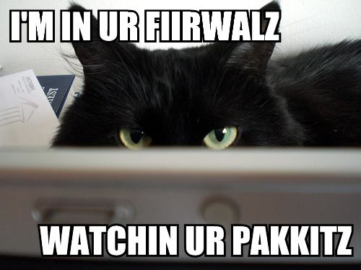
State of the Campus – A Word Of Caution…
To be 100% clear – the firewall is a useful tool:
  A layer or protection that is based on allowed, and disallowed, behaviors
  One stop location to install instructions (vs. implementing in multiple locations)
  Very necessary for things that need ‘assurance’ (e.g. student records, medical data, protecting the HVAC system, IP Phones, and printers from bad people, etc.)
To be 100% clear again, the firewall delivers functionality that can be implemented in different ways:
  Filtering ranges can be implemented via ACLs
  Port/Host blocking can be done on a host by host basis
  IDS tools can implement near real-time blocking of ongoing attacks that match heuristics

Slide 5
State of the Campus - Clarifications
I am not here to make you throw away the Firewall
  The firewall has a role; it’s time to define what that role is, and is not
  Policy may need to be altered (pull out the quill pens and parchment)
  Minds may need to be changed
I am here to make you think critically about campus security as a system. That requires:
  Knowledge of the risks and mitigation strategies
  Knowing what the components do, and do not do
  Humans to implement and manage certain features – this may be a shock to some (lunch is never free)

Slide 6
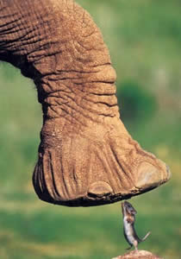
State of the Campus – End Game
The end goal is enabling true R&E use of the network
  Most research use follows the ‘Elephant’ Pattern. You can’t stop the elephant and inspect it’s hooves without causing a backup at the door to the circus tent
  Regular campus patterns are often ‘mice’, small, fast, harder to track on an individual basis (e.g. we need big traps to catch the mice that are dangerous)
  Security and performance can work well together – it requires critical thought (read that as time, people, and perhaps money)
  Easy economic observation – impacting your researchers with slower networks makes them less competitive, e.g. they are pulling in less research dollars vs. their peers

Slide 7
Firewalls: A Contrabulous Fabtraption That Embiggens Cromulent Networking
Contents
State of the Campus
When Security and Performance Clash
“The Science DMZ”, or “The Words You Will Hear 100s of Times This Week”
Implementation Suggestions
Conclusions

Slide 8
When Security and Performance Clash
What does a firewall do?
  Streams of packets enter into an ingress port – there is some buffering
  Packet headers are examined. Have I seen a packet like this before?
    Yes – If I like it, let it through, if I didn’t like it, goodbye.
    No - Who sent this packet? Are they allowed to send me packets? What port did it come from, and what port does it want to go to?
  Packet makes it through processing and switching fabric to some egress port. Sent on its way to the final destination.
Where are the bottlenecks?
  Ingress buffering – can we tune this? Will it support a 10G flow, let alone multiple 10G flows?
  Processing speed – being able to verify quickly is good. Verifying slowly will make TCP sad
  Switching fabric/egress ports. Not a huge concern, but these can drop packets too
  Is the firewall instrumented to know how well it is doing? Could I ask it?

Slide 9
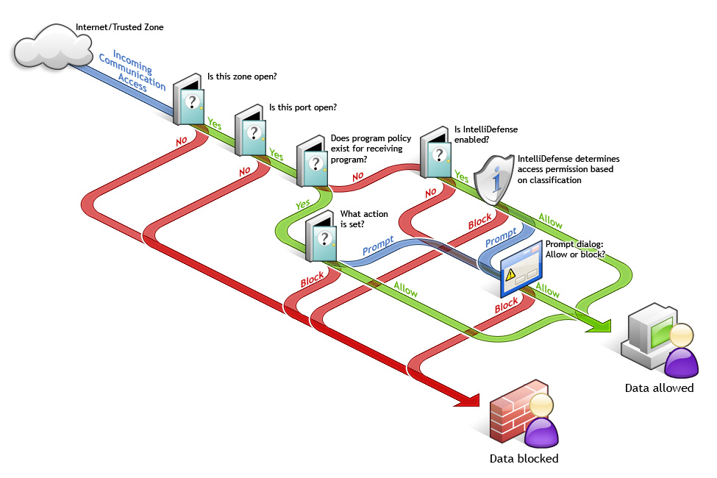
“Personal” (Software) Firewall Flow Chart

Slide 10
When Security and Performance Clash
Lets look at two examples, that highlight two primary network architecture use cases:
  Totally protected campus, with a border firewall
    Central networking maintains the device, and protects all in/outbound traffic
    Pro: end of the line customers don’t need to worry (as much) about security
    Con: end of the line customers *must* be sent through the disruptive device
  Unprotected campus, protection is the job of network customers
    Central networking gives you a wire and wishes you best of luck
    Pro: nothing in the path to disrupt traffic, unless you put it there
    Con: Security becomes an exercise that is implemented by all end customers

Slide 11
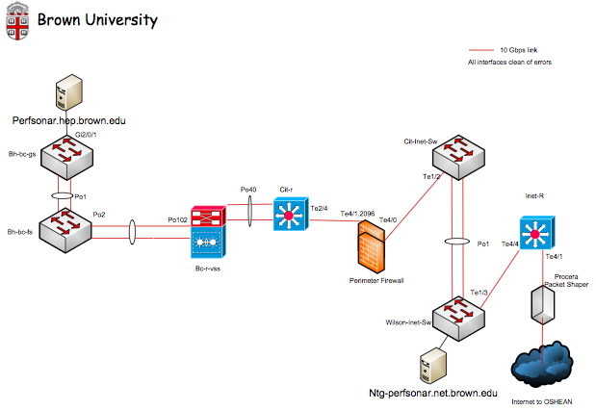
Brown University Example
Totally protected campus, with a border firewall

Slide 12
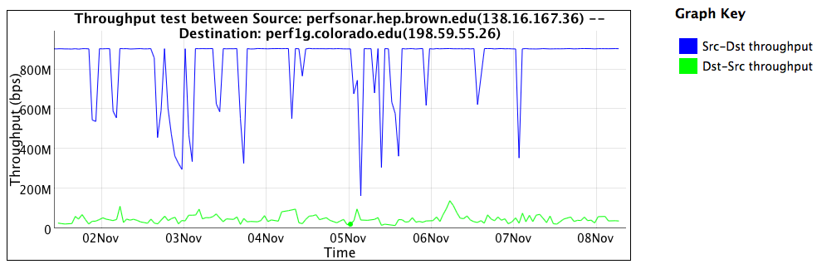
Brown University Example
Behind the firewall:

Slide 13
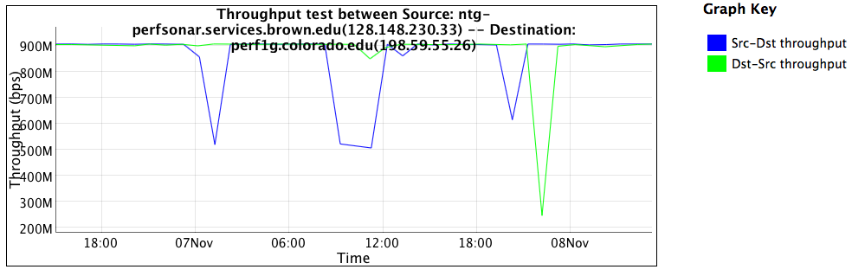
Brown University Example
In front of the firewall:

Slide 14
Brown University Example – TCP Dynamics
Want more proof – lets look at a measurement tool through the firewall.
  Measurement tools emulate a well behaved application
‘Outbound’, not filtered:
  nuttcp -T 10 -i 1 -p 10200 bwctl.newy.net.internet2.edu
  92.3750 MB / 1.00 sec = 774.3069 Mbps 0 retrans
  111.8750 MB / 1.00 sec = 938.2879 Mbps 0 retrans
  111.8750 MB / 1.00 sec = 938.3019 Mbps 0 retrans
  111.7500 MB / 1.00 sec = 938.1606 Mbps 0 retrans
  111.8750 MB / 1.00 sec = 938.3198 Mbps 0 retrans
  111.8750 MB / 1.00 sec = 938.2653 Mbps 0 retrans
  111.8750 MB / 1.00 sec = 938.1931 Mbps 0 retrans
  111.9375 MB / 1.00 sec = 938.4808 Mbps 0 retrans
  111.6875 MB / 1.00 sec = 937.6941 Mbps 0 retrans
  111.8750 MB / 1.00 sec = 938.3610 Mbps 0 retrans
  1107.9867 MB / 10.13 sec = 917.2914 Mbps 13 %TX 11 %RX 0 retrans 8.38 msRTT

Slide 15
Brown University Example – TCP Dynamics
‘Inbound’, filtered:
  nuttcp -r -T 10 -i 1 -p 10200 bwctl.newy.net.internet2.edu
  4.5625 MB / 1.00 sec = 38.1995 Mbps 13 retrans
  4.8750 MB / 1.00 sec = 40.8956 Mbps 4 retrans
  4.8750 MB / 1.00 sec = 40.8954 Mbps 6 retrans
  6.4375 MB / 1.00 sec = 54.0024 Mbps 9 retrans
  5.7500 MB / 1.00 sec = 48.2310 Mbps 8 retrans
  5.8750 MB / 1.00 sec = 49.2880 Mbps 5 retrans
  6.3125 MB / 1.00 sec = 52.9006 Mbps 3 retrans
  5.3125 MB / 1.00 sec = 44.5653 Mbps 7 retrans
  4.3125 MB / 1.00 sec = 36.2108 Mbps 7 retrans
  5.1875 MB / 1.00 sec = 43.5186 Mbps 8 retrans
  53.7519 MB / 10.07 sec = 44.7577 Mbps 0 %TX 1 %RX 70 retrans 8.29 msRTT

Slide 16
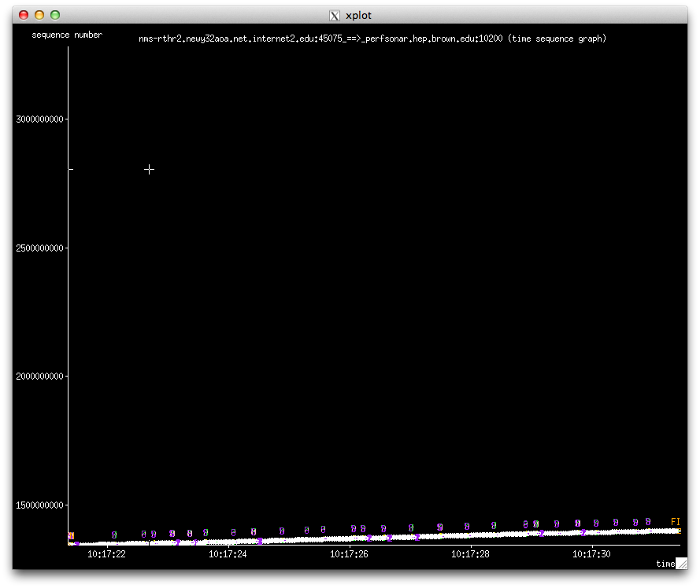
Brown University Example – TCP Plot (2nd)

Slide 17
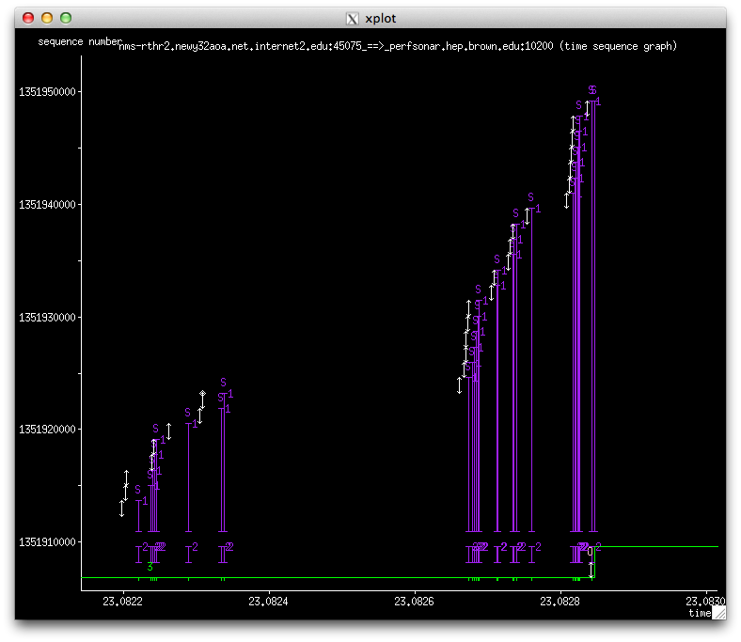
Brown University Example – TCP Plot (2nd)

Slide 18
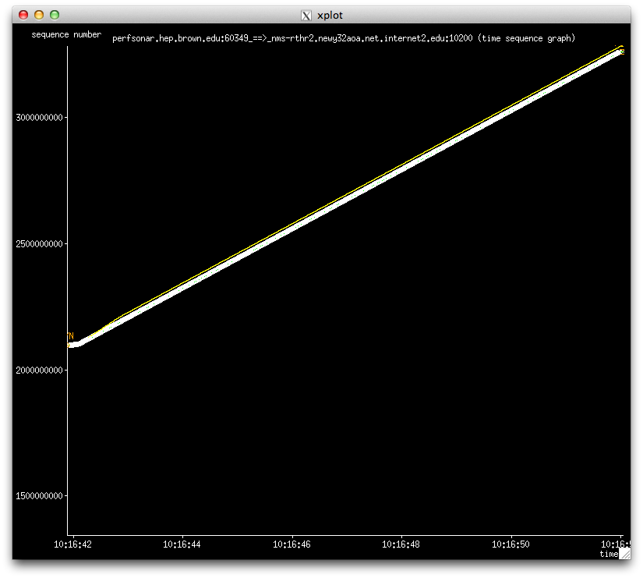
Brown University Example – Side By Side

Slide 19
Brown University Example
Series of problems and solutions implemented:
  10G Firewall was not even coming close – configuration and issue with tech support were to blame
  After this, switching infrastructure was revealed to be dropping packets on large flows (lack of buffering)
  Mitigating step of using 1G network (not protected through firewall) was found to be insufficient due to demand
Epilogue:
  perfSONAR Monitoring (Department and Campus) goes a long way in producing ‘proof’
  Network architectural changes to support heavy hitters will be needed
  Firewalls are complex, its easy to get it ‘wrong’ in terms of configuration.
    And they need a human to watch them – its not set and forget

Slide 20
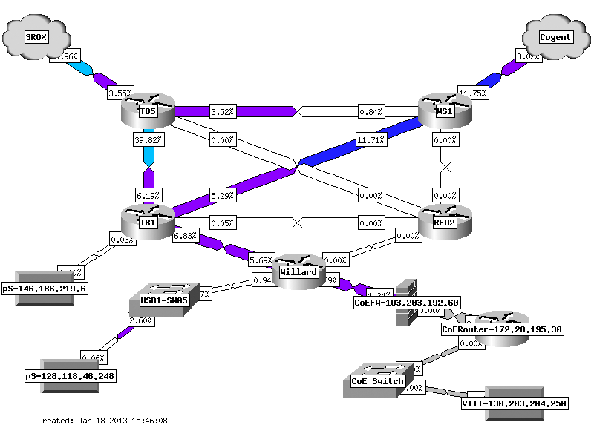
The Pennsylvania State University Example
Unprotected campus, protection is the job of network customers

Slide 21
The Pennsylvania State University Example
Initial Report from network users: performance poor both directions
  Outbound and inbound (normal issue is inbound through protection mechanisms)
From previous diagram – CoE firewalll was tested
  Machine outside/inside of firewall. Test to point 10ms away (Internet2 Washington)
jzurawski@ssstatecollege:~> nuttcp -T 30 -i 1 -p 5679 -P 5678 64.57.16.22
5.8125 MB / 1.00 sec = 48.7565 Mbps 0 retrans
6.1875 MB / 1.00 sec = 51.8886 Mbps 0 retrans
…
6.1250 MB / 1.00 sec = 51.3957 Mbps 0 retrans
6.1250 MB / 1.00 sec = 51.3927 Mbps 0 retrans
184.3515 MB / 30.17 sec = 51.2573 Mbps 0 %TX 1 %RX 0 retrans 9.85 msRTT

Slide 22
The Pennsylvania State University Example
Observation: net.ipv4.tcp_window_scaling did not seem to be working
  64K of buffer is default. Over a 10ms path, this means we can hope to see only 50Mbps of throughput:
  BDP (50 Mbit/sec, 10.0 ms) = 0.06 Mbyte
Implication: something in the path was not respecting the specification in RFC 1323, and was not allowing TCP window to grow
  TCP window of 64 KByte and RTT of 1.0 ms <= 500.00 Mbit/sec.
  TCP window of 64 KByte and RTT of 5.0 ms <= 100.00 Mbit/sec.
  TCP window of 64 KByte and RTT of 10.0 ms <= 50.00 Mbit/sec.
  TCP window of 64 KByte and RTT of 50.0 ms <= 10.00 Mbit/sec.
Reading documentation for firewall:
  TCP flow sequence checking was enabled
  What would happen if this was turn off (both directions?

Slide 23
The Pennsylvania State University Example
jzurawski@ssstatecollege:~> nuttcp -T 30 -i 1 -p 5679 -P 5678 64.57.16.22
55.6875 MB / 1.00 sec = 467.0481 Mbps 0 retrans
74.3750 MB / 1.00 sec = 623.5704 Mbps 0 retrans
87.4375 MB / 1.00 sec = 733.4004 Mbps 0 retrans
…
91.7500 MB / 1.00 sec = 770.0544 Mbps 0 retrans
88.6875 MB / 1.00 sec = 743.5676 Mbps 28 retrans
69.0625 MB / 1.00 sec = 578.9509 Mbps 0 retrans
2300.8495 MB / 30.17 sec = 639.7338 Mbps 4 %TX 17 %RX 730 retrans 9.88 msRTT

Slide 24
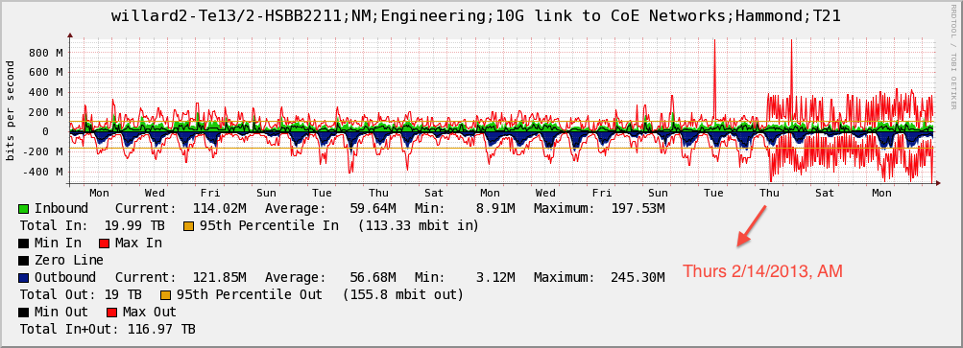
The Pennsylvania State University Example
Impacting real users:

Slide 25
The Pennsylvania State University Example
Series of problems and solutions implemented:
  Firewall was not configured properly
  Lack of additional paths to implement a true research bypass
Epilogue:
  perfSONAR Monitoring (Department and Campus) still goes a long way in producing ‘proof’
    FYI – Penn State has around 50 perfSONAR boxes now for all of their campuses. Tremendous value from a $1,000 machine and free software
  No “One Size Fits All” solution will cut it in a dynamic environment

Slide 26
Firewalls: A Contrabulous Fabtraption That Embiggens Cromulent Networking
Contents
State of the Campus
When Security and Performance Clash
“The Science DMZ”, or “The Words You Will Hear 100s of Times This Week”
Implementation Suggestions
Conclusions

Slide 27
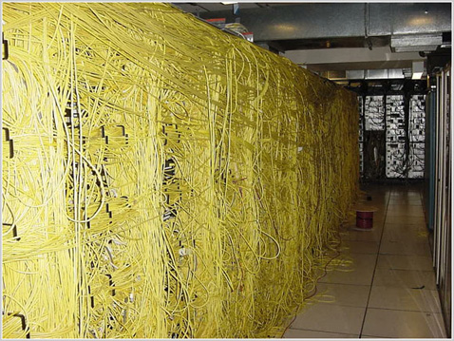
Science DMZ (?)
A staple of the meeting circuit for several years
What is it really?
  “Blueprint”, not a specific design
  Approach to network architecture that preserves the ability to securely manage two different worlds
    Enterprise – BYOD, IP Phones, Printers, HVAC, things you don’t know enough about to trust, and shouldn’t
    Research – Well defined access patterns, Elephant flows, (normally) individuals that can manage their destiny with regards to data protection

Slide 28
Science DMZ (In One Slide)
Consists of 3 key components, all required:
“friction free” network path
  Highly capable network devices (wire-speed, deep queues)
  Virtual circuit connectivity option
  Security policy and enforcement specific to science workflows
  Located at or near site perimeter if possible
Dedicated, high-performance data movers
  a.k.a.: Data Transfer Node (DTN)
  Optimized bulk data transfer tools such as GlobusOnline/GridFTP
Performance measurement/test node
  perfSONAR
Details at: http://fasterdata.es.net/science-dmz/
Source: B. Tierney @ ESnet

Slide 29
Science DMZ – Pro/Con on Generalities
Pro:
  Unspecified nature makes the pattern fungible for anyone to implement
  Hits the major requirements for major science use cases
  A concept that “anyone” should be able to understand on a high level
Con:
  Unspecified nature implies you need your own smart person to think critically, and implement it for a specific instantiation
  Those that don’t do heavy science (or don’t know they do) may feel “its not for us”
  A concept easy to treat as a ‘checkbox’ (hint: CC-NIE schools – are you stating ‘we have perfSONAR’ and moving on?)

Slide 30
Firewalls: A Contrabulous Fabtraption That Embiggens Cromulent Networking
Contents
State of the Campus
When Security and Performance Clash
“The Science DMZ”, or “The Words You Will Hear 100s of Times This Week”
Implementation Suggestions
Conclusions

Slide 31
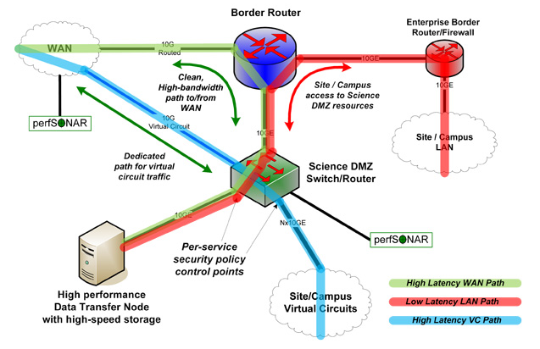
When Rubber Meets the Road
Lets start with the generic diagram:

Slide 32
When Rubber Meets the Road
There are 4 areas I am going to hit on, briefly (note the last one is not ‘pictured’):
  Network Path
  Adoption of “New” Technology
  Security
  User Outreach

Slide 33
Network Path
Engineers ‘get it’
  No one will dispute that protected and unprotected path will have benefits (and certain dangers).
  $, 100G isn’t cheap (10 and 40 are). You don’t have to go 100, implementing the architecture with existing technology is a perfectly good way forward
  You still need a security professional (if you don’t have one already) for the secured and non-secured paths. Learn to love your IDS just as much as your firewall and shapper …
Tuning is important. Small buffers (as seen previously) make data movement sad. This means servers, and network devices
Ounce of prevention – you need monitoring, and you certainly need training in how to use the performance tools to debug. You will be debugging (bet me a $1 if you honestly think you won’t be…)

Slide 34
Adoption of “New” Technology
SDN, perfSONAR, etc. etc.
  We will keep making acronyms, don’t worry
What matters in all this? Being able to make your job easier
  perfSONAR = insurance policy against risky behavior.
    Will tell you if you have done things wrong, and warn you if something breaks.
    Crucial for your campus, and costs only the price of a server, and getting an engineer up to speed on how to use it
  SDN will be a game changer. Is it ready for production (?) – hard to say. The ability to afford more control over the network to the end user relies on applications (and end users) getting caught up. Hint.
There will be more changes in the future, it’s the nature of the game. R&E needs to be about certain risky moves away from the norm

Slide 35
Security
I can spend an entire deck on this, but to keep it short:
  Component based security is wrong. Needs to be a system.
    E.g. the firewall by itself has limited use, and can be easily broken by a motivated attacker
  System:
    Cryptography to protect user access and data integrity
    IDS to monitor before (and after) events
    Host-based security is better for performance, but takes longer to implement. Firewalls are bad on performance but easy to plot down in a network.
    Let your router help you – if you know communication patterns (and know those that should be disallowed), why not use filters?
  Campus CI Plan. Make one, update it often. Shows funding bodies you know what is going on and have plans to address risks, and foster growth
Economic argument – if you are non-competitive for grants because you cheaped out on security, are you better in the long run?

Slide 36
User Outreach
The unstated factor:
  Could you name your top 10 (5? 3?) network users? Do you know where their traffic is going? Do you know why? Should you care?
  Simple solution – (net | s)flow monitoring (pick a brand, many are good).
    Top 10 src/dst for some period of time, go and talk to the researchers.
    Ask them what they are doing, how they are doing it, and if its going ok.
  Campus CI days – was a sponsored thing, but why not have one ‘just because’?
    Gets IT and research talking.
    Identifies areas of growth; areas of friction
  Requires an outgoing person – hire a research engineer.
    Someone who knows what a network is, and can translate statements like “the beamline will be firing at 200Khz 2 times a week and generating 2PB of data a year” into “they need 40Gbps and a clear path to 4 international sites as well as the domestic routing table”

Slide 37
Firewalls: A Contrabulous Fabtraption That Embiggens Cromulent Networking
Contents
State of the Campus
When Security and Performance Clash
“The Science DMZ”, or “The Words You Will Hear 100s of Times This Week”
Implementation Suggestions
Conclusions

Slide 38
Conclusions
A lot to consider
  Security factors, when done poorly, are hurting your users in a noticeable and significant manner
  Easily found, if you have the right tools at your disposal … and you are listening to them whine (yeah, that’s a hard one)
Its not impossible…
  Approaches like the Science DMZ are here to help
  They are not turn key though
…but it will require some thought and planning
  Know your campus, know your needs
  Implementation won’t take a weekend, plan for some burn in and testing
  Will pay off in the end (we promise)

Slide 39

Firewalls: A Contrabulous Fabtraption That Embiggens Cromulent Networking
Jason Zurawski – zurawski@internet2.edu
Senior Research Engineer, Internet2
http://www.internet2.edu/research

