Slide 1
Scientific User Outreach: Challenges and Strategies
Lauren Rotman
Partnerships and Outreach Lead, ESnet
Jason Zurawski
Senior Research Engineer, Internet2

Slide 2

Topic: Networking Issues for Life Sciences Research
July 17- 18, 2013
Lawrence Berkeley National Laboratory
Berkeley, California
Building on the success of Joint Techs, meeting will bring together technical experts in a smaller setting with domain scientists.
Workshop will include a slate of invited speakers and panels.
Format to encourage lively, interactive discussions with the goal of developing a set of tangible next steps for supporting this data-intensive science community
Four sub-topic areas: Network Architectures, Workflow Engines, Public and Private Cloud Architectures, and Data Movement Tools
Website: http://goo.gl/v1YL3
Proposals Due: May 17, 2013, 11:59 PDT

Slide 3
Scientific User Outreach: Challenges and Strategies
Outline
Introduction
ESnet Research Support Overview
Internet2 Research Support Overview
Discussion

Slide 4
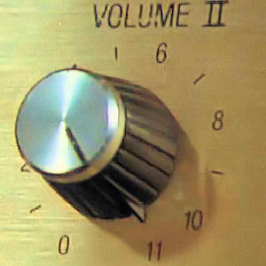
Introduction
What’s not news:
  Distributed research/science facilities
    Central collection/remote processing
    Remote collection/central or remote processing
  Distributed sets of people
  Innovation will soon be producing data at Tbps (that’s ‘Terabit’)
What may be news:
  Capacity is increasing, but so is demand
  Flaws in the underlying networks (local, regional, national) are common, and will impact progress
  Security as a component, not a system (and this is a problem)
  Economics always wins – spend preparing, fixing, or don’t win the resources to spend at all…

Slide 5
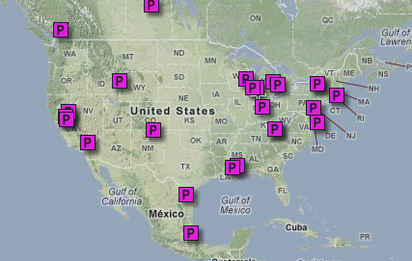
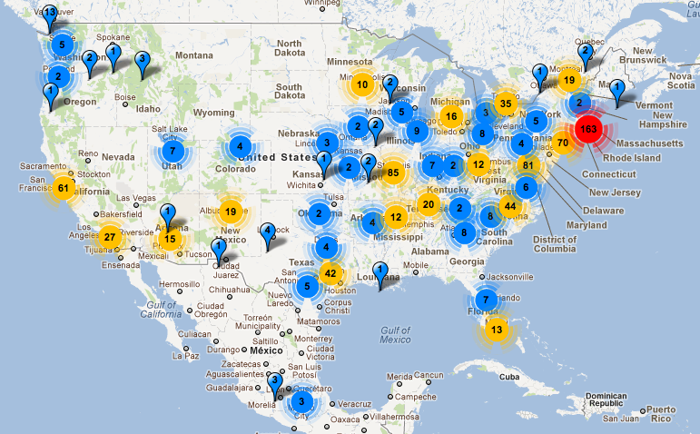
Facilities/Collaborations
Physics
22 “Tier2” Physics Groups
Life Sciences
758 Genome Sequencers
Source: //find.mapmuse.com/map/particle-accelerators, Apr. 22, 2012
Source: http://omicsmaps.com/, Dec. 5, 2011
Notes:
Sequence data - sequence of base pairs that make up an organism’s DNA.
While a sequencer costs hundreds of thousands of dollars, an accelerator cost millions.
There are 35 times more sequencers than accelerators.
What you don’t see, however, is the rapid growth in the number of sequencers. Four months ago there were 1800 sequencers worldwide (40% in the US). Now there are almost 8,000, a fourfold increase in four months. That growth rate will increase greatly in the years ahead.

Slide 6
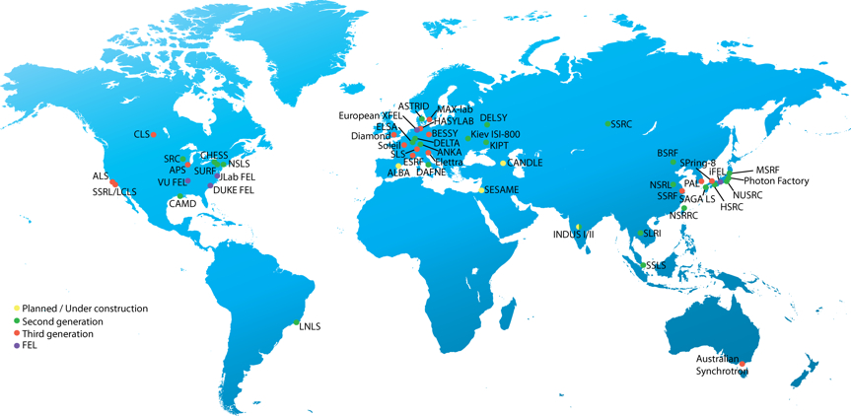






Light Sources in Production or Under Construction
source: Paul Alivisatos
2015
2023
2016
2011
2009
LCLS-II
2018
2014
low rep rate
high rep rate
Notes:
KHz data rates x Megapixel detector resolution
10⁶ increase in data output compared to previous generation
8 Gbps flows to supercomputer for real-time analysis
probing the the electronic structure of matter,
semiconductors,
magnetic materials,
3D-biological imaging,
protein crystallography,
ozone photochemistry,
x-ray microscopy of biological samples,
chemical reaction dynamics,
atomic and molecular physics,
optics testing.

Slide 7

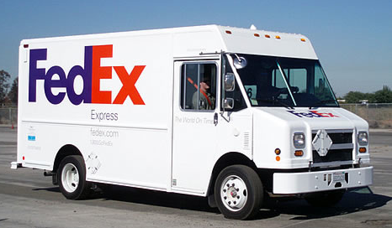
Small/Mid Collaborations:
Science Data Transport Today
“It is estimated that the transfer of multiple terabytes of output to a Core Data Node would take much longer via the internet . . . than via physical disks, which is why the data will usually be transferred using portable hard disks. ”
CMIP5 Data Submission website (Climate)
http://cmip-pcmdi.llnl.gov/cmip5/submit.html
Notes:
Data increases lead to challenges
Data sets increasing beyond capacity of portable media
Portable media has worked for generations – significant upheaval in workflow
Most don’t have success using the network or don’t know how
Not scalable (technically or financially) to support data growth
Not useful, there is a better way
Climate Coupled Model Intercomparison Project
PCMBI

Slide 8
Science Data Transport Tomorrow?
No!
Notes:
Networking will become key to the success of science
Many ESnet constituents are not able to use networks effectively, and are unable to bootstrap without help – ESnet must provide that help

Slide 9
Scientific User Outreach: Challenges and Strategies
Outline
Introduction
ESnet Research Support Overview
Internet2 Research Support Overview
Discussion

Slide 10
Understanding the Community
ESnet conducts regular reviews with DOE Office of Science Program Offices to understand current and future needs of the DOE science
Two meetings per year, each program office reviewed every three years
  Advanced Scientific Computing Research
  Basic Energy Sciences
  Biological and Environmental Research
  Fusion Energy Sciences
  High Energy Physics
  Nuclear Physics.
Focus is on:
  Instruments and facilities
  Process of science
Explicitly do not ask scientists for bandwidth requirements

Slide 11
Collaborations Have Different Capabilities
Science collaborations of sufficient human scale can adapt to increased data scale better than smaller collaborations
  LHC has made significant investments in time and expertise; other collaborations do not have capital or similar organization
  This shows – the LHC experiments are highly capable users of the network
  Able to reap the scientific benefits of data scale
Smaller-scale science collaborations need help
  These collaborations are unable to bootstrap the necessary expertise
  Alternative structures must exist for smaller collaborations to import expertise that they cannot develop internally

Slide 12
Common Denominator – Data Mobility
Data produced at one facility, analyzed elsewhere
  Scientist has allocation at facility A, data at facility B
  Transactional and workflow issues
    Experiment, data collection, analysis, results, interpretation, action
    Short duty cycle workflows between distant facilities
The inability to move data hinders science
  Instruments are run at lower resolution so data sets are tractable
  Grad students often assigned to data movement rather than research
Large data movement doesn’t happen by accident, requires:
  Properly tuned system and network, default settings do not work
  Combination of networks, systems, tools infrastructure must work together cohesively

Slide 13
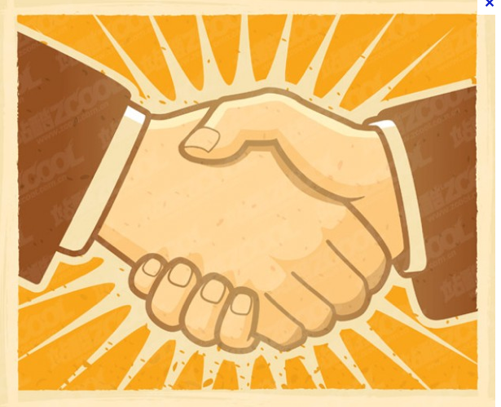


ESnet Outreach Strategy/Pilot
Partnerships
Consultation and Education
Communications
Notes:
Focus on Climate, Light Sources, Genomics or other Life Sciences
Partner with User Facilities, Partner with Service Providers, Complimentary organizations
Develop phased approach, from awareness to adoption to developing success stories – already doing this at the ALS
Developing resources that readily understood by scientists

Slide 14
Most ESnet Traffic Leaves the DOE Complex
Network traffic follows funding.
DOE SC supports:
27,000 Ph.D.s
at 300 colleges & universities
in 50 states
Notes:
DOE funds the 17 national labs, and many other sites & facilities. We connect them them together.
I2 has a complementary role, to interconnect the regional networks serving US universities.
One difference architecturally we run metro (Express) networks as well. We are an NREN & regionals.
Should not be surprising that most of ESnet’s traffic leaves the national Lab complex, travels over Internet2 to regional networks – such as CENIC – and to universities. And of course to European collaborators. In fact half of our traffic is LHC related.

Slide 15
Scientific User Outreach: Challenges and Strategies
Outline
Introduction
ESnet Research Support Overview
Internet2 Research Support Overview
Discussion

Slide 16
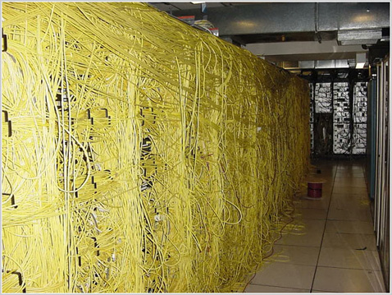
Internet2 Research Support Overview
Comprehensive end-to-end support for the research community
  Work with the research community to understand their needs
  Provide network engineering, planning and pricing for project and proposal development
  Collaborate with the community to anticipate research needs
  Foster network infrastructure and service research that can be incubated, tested and deployed

Slide 17
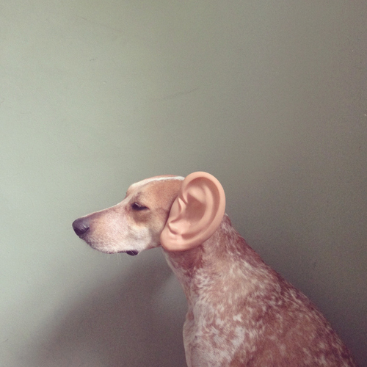
Research Support Center
“The golden rule for every business man is this: Put yourself in your customer’s place.”
Orison Swett Marden
Provide a clearinghouse for “researchers” who have questions regarding how to utilize Internet2 resources
  Support extends to those who support researchers as well (e.g. sysadmin/netadmin at regional/campus nets).
  Emphasis on cross domain needs – home for the homeless
Simple contact mechanisms
  Email - rs@internet2.edu
  Updated web presence - www.internet.edu/research
Ticket Analysis - Data as of 4/21/2013
  Total Tickets = 232
    31 Open/In Progress
    201 Closed

Slide 18
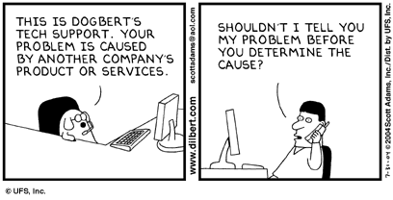
Ticket Breakdown
Categories:
  Network Performance = 50%
    Increase from 25% (Summer 2012), 36% (Fall 2012) and 39% (Winter 2013)
  GENI = 2%
  Letters of Support = 22%
    CC-NIE rush during Spring 2013
  Network Connectivity (Layer 2/General) = 5%
  Research Support & Demo/Paper Collaboration = 18% (was 15% in Fall 2012, and 20% in Winter 2013)
  Internet2 Initiatives = 14%
  General = 2%
Other Tags:
  24% of tickets involve an international component (steady increase since summer 2012)
  10% are related to Healthcare/Medical topics
  6% (mostly in the performance space) are related to Internet2 NET+ activities

Slide 19
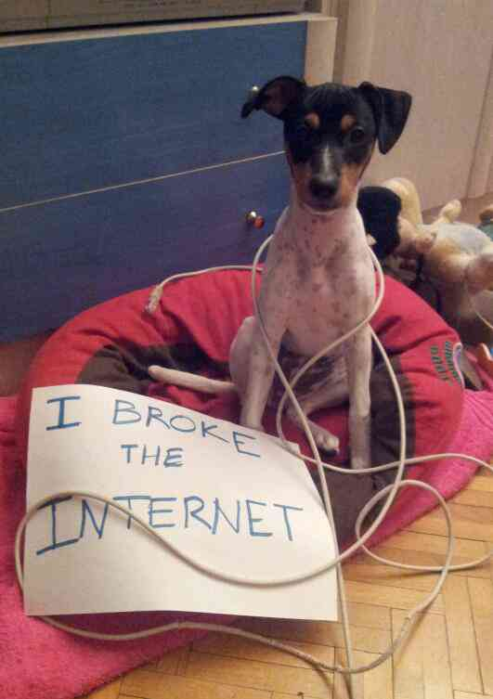
Expectations & Realities
"In any large system, there is always something broken.”
Jon Postel
Consider the technology:
  100G (and larger soon) Networking
  Changing control landscape (e.g. SDN, be it OSCARS or OpenFlow, or something new)
  Smarter applications and abstractions
Consider the realities:
  Heterogeneity in technologies
  Mutli-domain operation
  “old applications on new networks” as well as “new applications on old networks”
  Component based security

Slide 20
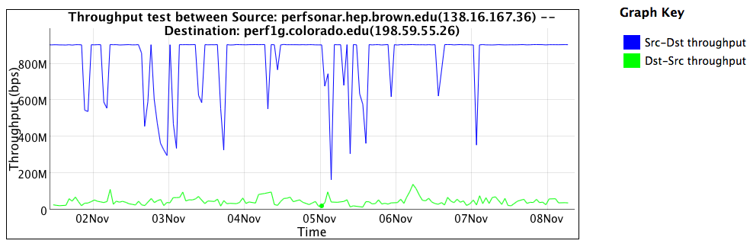
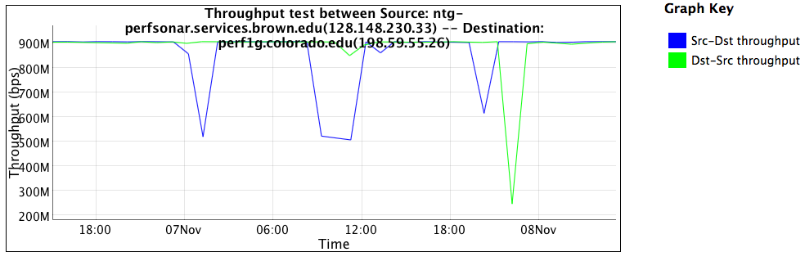
Firewall Performance Example

Slide 21
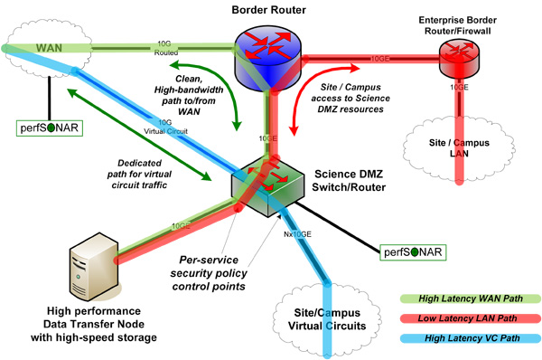
ESnet Science DMZ

Slide 22
Comprehensive Security
“Science DMZ” = A Blueprint, not a packaged solution
Good Things to Consider
  Data movement and packet disruption do not get along
    What else can do what a firewall does? Host level monitoring, filters to well known locations, etc.
  Figure out what your campus is doing (e.g. go with a netflow solution, and find a human to help identify SRC/DST of flows on campus).
    TALK to your users
  IDS and Forensics – its good to know what is going on, even after it happens
  Campus CI Plan. Do you have one? Why Not?
    Not all data is PHI, so why treat it as such?

Slide 23
Comprehensive Security (cont.)
In General:
  Avoid a “Lack of Security”. The firewall has a role and does what it needs to do well (e.g. protecting fragile infrastructure – Printers, Phones, HVAC, 100s of BYOD)
  Security is a way to address risk (think insurance)
  To fully assess this risk, it is imperative to know what you are trying to protect, and why. Do this often.
  Getting it wrong has an economic impact (e.g. if you don’t allow your scientists clean paths to innovate, they will be punished with a lack of grants, or just go elsewhere)
  The attacker always has the advantage over the defender – but the attacker is an opportunist and will go after easy targers
    E.g. ‘the pursing bear will get the slowest hiker’

Slide 24

Performance Monitoring
perfSONAR Deployments mean:
  Instrumentation on a network
  The ability for a user at location A to run tests to Z, and things “in the middle”
  Toolkit deployment is the most important step for debugging, and enabling science
Debugging:
  End to end test
  Divide and Conquer
  Isolate good vs bad (e.g. who to ‘blame’)

Slide 25
Scientific User Outreach: Challenges and Strategies
Outline
Introduction
ESnet Research Support Overview
Internet2 Research Support Overview
Discussion

Slide 26
Discussion
What things matter most to the audience? Performance? Capacity? Architecture (network, system, enterprise)? Other?
What information resources are needed to help on campuses/facilities
Who are some of the top groups to target (not LHC)?
Future events - Webinars? Workshops? And targeted at who? Scientists, Sys Admins, Network Engineers? Or all?

Slide 27
Scientific User Outreach: Challenges and Strategies
Lauren Rotman
Partnerships and Outreach Lead, ESnet
Jason Zurawski
Senior Research Engineer, Internet2
Extra info, contact, web address, etc.

