Slide 1
Site Performance Measurement & Monitoring Best Practices
Jason Zurawski, Science Engagement Engineer
ESnet
ESCC
Lawrence Berkeley National Lab, Berkeley, CA
July 16th 2013

Slide 2
Outline
Review of the perfSONAR Concept
Survey Results
Deployment Best Practices
Q/A & Discussion

Slide 3
Review of the perfSONAR Concept
Network Monitoring
  E.g. everyone has some form on their network (e.g. SNMP, NAGIOS, etc.). Addresses the needs of local staff for knowing what is going on
    Would this information be useful to external users?
    Are tools such as CACTI really able to function on a multi-domain basis?
  Beyond passive methods, there are active tools.
    E.g. Iperf can be run to get a ‘throughput’ number. Do we store these anywhere?
    Wouldn’t it be nice to get some sort of plot of performance over the course of a day? Week? Year? Multiple endpoints?
perfSONAR = Measurement Middleware

Slide 4

Expectations & Realities
"In any large system, there is always something broken.”
Jon Postel
Modern networks are large and complicated
Many users will encounter unforeseen (and therefore challenging) situations:
  Upgrading networks breaks them (loss of configuration, etc.)
  Synergy between the new and the old
  Statistical anomalies, e.g. that 7 year old interface will stop working eventually…
Mitigating the risk can be done in a number of ways:
    Analysis and alteration to architecture
    Careful thought to security/data policies in target areas
© Dog Shaming 2012
  Integration of software designed to exercise the network, and alert/visualize

Slide 5

Where Are The Problems?
Latency dependant problems inside domains with small RTT
Congested or faulty links between domains
Source
Campus
Backbone
Destination
Campus
S
D
NREN
Regional
Congested intra- campus links

Slide 6
Local Testing Will Not Find Everything
Performance is good when RTT is < ~10 ms
Performance is poor when RTT exceeds ~10 ms
Source
Campus
R&E
Backbone
Destination
Campus
S
D
Switch with small buffers
Regional
Regional

Slide 7
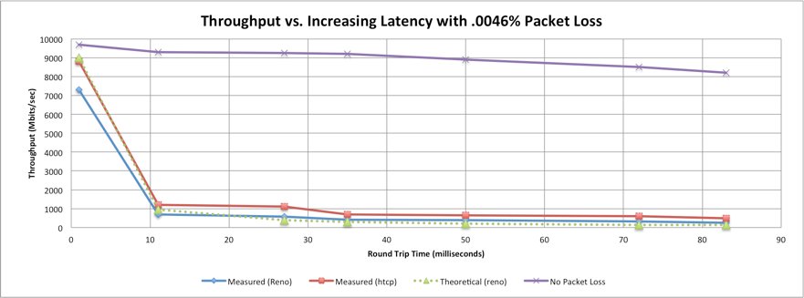
Why Network Performance Matters
Notes:
A Nagios alert based on ESnet’s regular throughput testing between one site and ESnet core alerted us to poor performance on high latency paths
No errors or drops reported by routers on either side of problem link
only active testing using perfSONAR bwctl tests caught this problem
Using packet filter counters, we saw 0.0046% loss in one direction
1 packet in 22000 packets
Performance impact of this: (outbound/inbound)
To/from test host 1 ms RTT : 7.3 Gbps out / 9.8 Gbps in
To/from test host 11 ms RTT: 1 Gbps out / 9.5 Gbps in
To/from test host 51ms RTT: 122 Mbps out / 7 Gbps in
To/from test host 88 ms RTT: 60 Mbps out / 5 Gbps in
More than 80 times slower!

Slide 8
Science DMZ Overview
Significant commonality in issues encountered with science collaborations … and similar solution set
  The causes of poor data transfer performance fit into a few categories with similar solutions
    Un-tuned/under-powered hosts
    Packet loss issues
    Security devices
  A successful model has emerged – the Science DMZ
    This model successfully in use by CMS/ATLAS, ESG, NERSC, ORNL, ALS, and others
The Science DMZ is a blueprint for network design.
  Not all implementations look the same, but share common features
  Some choices don’t make sense for everyone, caveat emptor

Slide 9
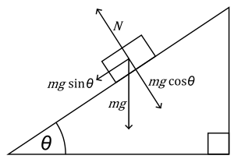


The Science DMZ in 1 Slide
Consists of three key components, all required:
“Friction free” network path
  Highly capable network devices (wire-speed, deep queues)
  Virtual circuit connectivity option
  Security policy and enforcement specific to science workflows
  Located at or near site perimeter if possible
Dedicated, high-performance Data Transfer Nodes (DTNs)
  Hardware, operating system, libraries all optimized for transfer
  Includes optimized data transfer tools such as Globus Online and GridFTP
Performance measurement/test node
  perfSONAR
  Details at http://fasterdata.es.net/science-dmz/
© 2013 Wikipedia
© 2013 Globus

Slide 10
Science DMZ – Simple Abstract Cartoon
Notes:
Note security policy control points

Slide 11

One motivation for Science DMZ model: Soft Network Failures
Soft failures are where basic connectivity functions, but high performance is not possible.
TCP was intentionally designed to hide all transmission errors from the user:
  “As long as the TCPs continue to function properly and the internet system does not become completely partitioned, no transmission errors will affect the users.” (From IEN 129, RFC 716)
Some soft failures only affect high bandwidth long RTT flows.
Hard failures are easy to detect & fix
  soft failures can lie hidden for years!
One network problem can often mask others
Notes:
Random Packet Loss
Bad/dirty fibers or connectors
Low light levels due to amps/interfaces failing
Duplex mismatch
Small Router/Switch Buffers
Switches not able to handle the long packet trains prevalent in long RTT sessions and local cross traffic at the same time
Un-intentional Rate Limiting
Processor-based switching on routers due to faults, acl’s, or mis-configuration
Security Devices
E.g.: 10X improvement by turning off Cisco Reflexive ACL

Slide 12
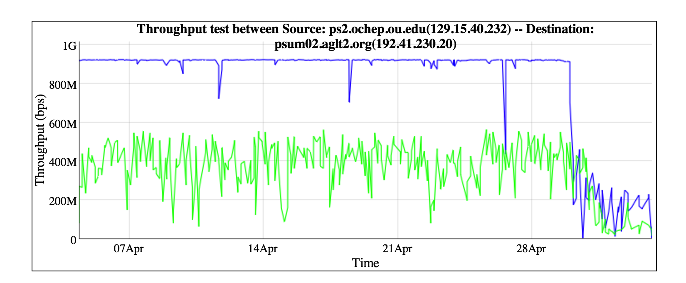
What Monitoring Can (and Cannot) Tell You
Can you tell, by looking, what is going on here?
Notes:
2 Real sets of problems. 1G to 10G testing (e.g. machines were not tuned/testing properly) to start. Actual network problem at the end (routing change + dropped packets). Would you alert/alarm on the first? The second?

Slide 13
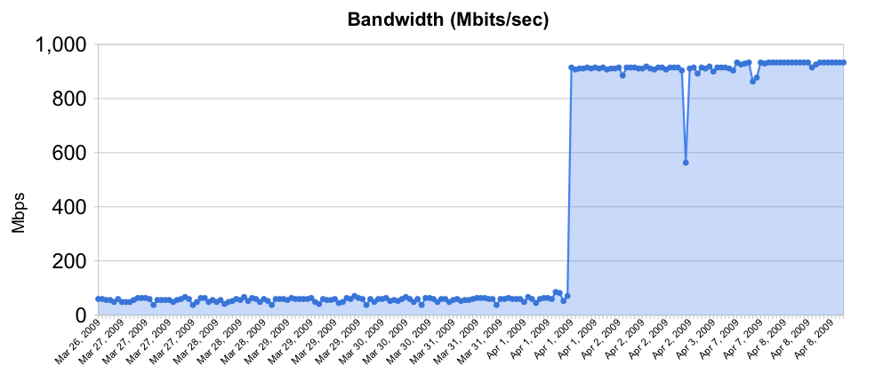
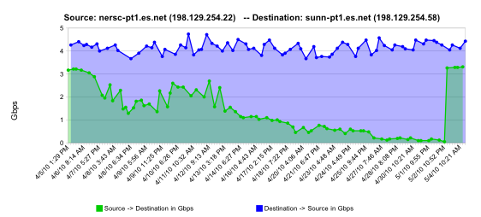
Sample Soft Failures
Rebooted router with full route table
Gradual failure of optical line card

Slide 14
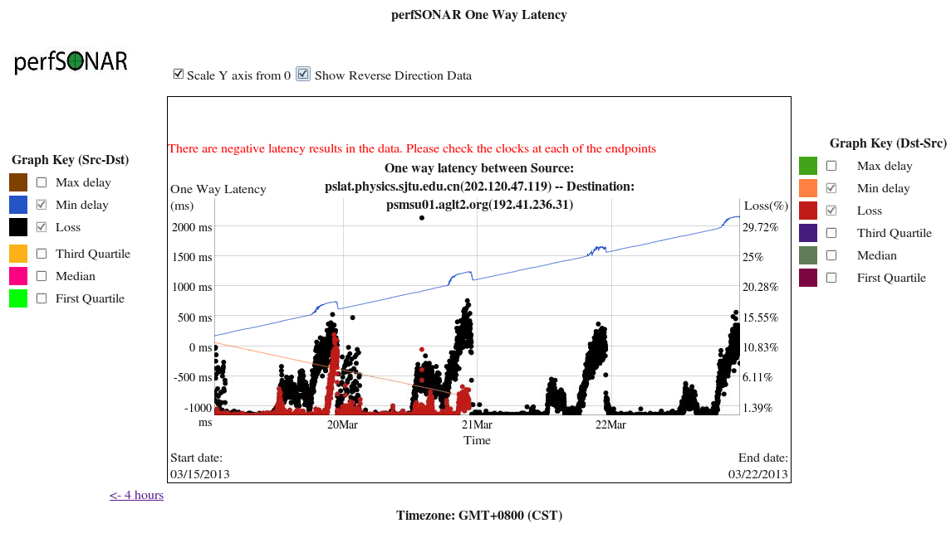
Congestion on Link + Drifting Clock

Slide 15
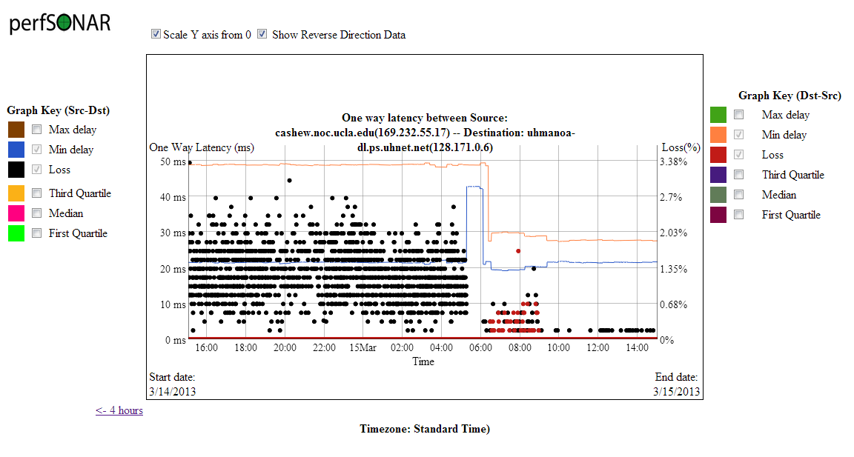
Adding Attenuator to Noisy Link

Slide 16
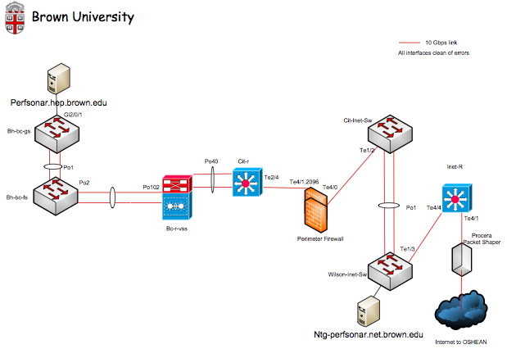
Firewall Example
Totally protected campus, with a border firewall

Slide 17
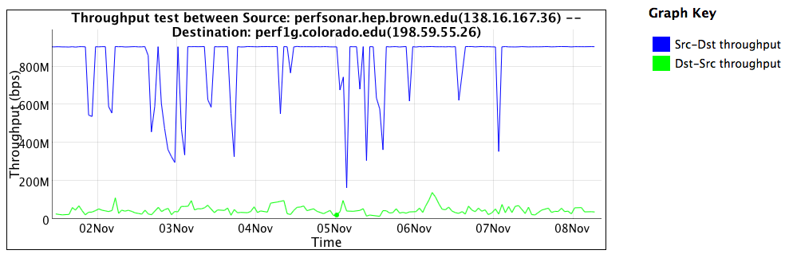
Performance Behind the Firewall
Blue = “Outbound”, e.g. campus to remote location upload
Green = “Inbound”, e.g. download from remote location

Slide 18
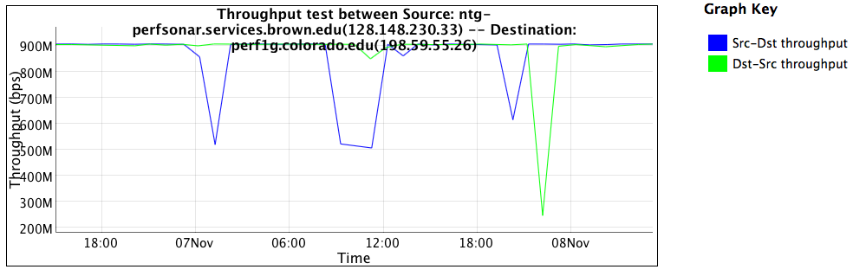
Performance In Front of the Firewall
Blue = “Outbound”, e.g. campus to remote location upload
Green = “Inbound”, e.g. download from remote location
Note – This machine is in the *SAME NETWORK*, it just bypasses the firewall vs. that of the previous

Slide 19

What is perfSONAR?
perfSONAR is a tool to:
Set network performance expectations
Find network problems (“soft failures”)
Help fix these problems
All in multi-domain environments
These problems are all harder when multiple networks are involved
perfSONAR is provides a standard way to publish active and passive monitoring data
  This data is interesting to network researchers as well as network operators
Notes:
Enables Federation
Service oriented
Designed with ‘multi-domain’ in mind
Brings together useful tools to address different needs
Several active and passive tools
Interface to configure regular testing
Diagnostic tools ready with ‘0 configuration’
Easy to install, easy to use
ISO image can be burned to CD/USB key
‘Wizard’ interface for configuration
Encouraging people to deploy ‘known good’ measurement points near domain boundaries
“known good” = hosts that are well configured, enough memory and CPU to drive the network, proper TCP tuning, clean path, etc.
Community Adoption
Over 600 instances seen world wide as of early May
20+ countries
100s of domains

Slide 20
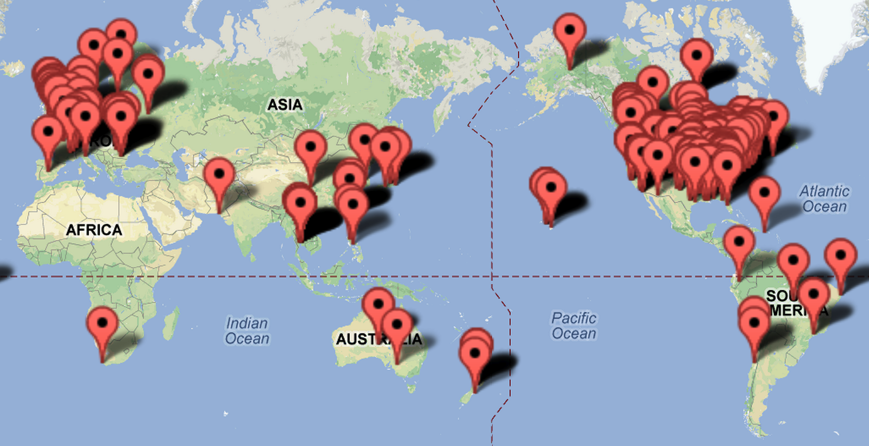
World-Wide perfSONAR-PS Deployments:
572 bwctl nodes, 552 owamp nodes as of Jun ‘13

Slide 21
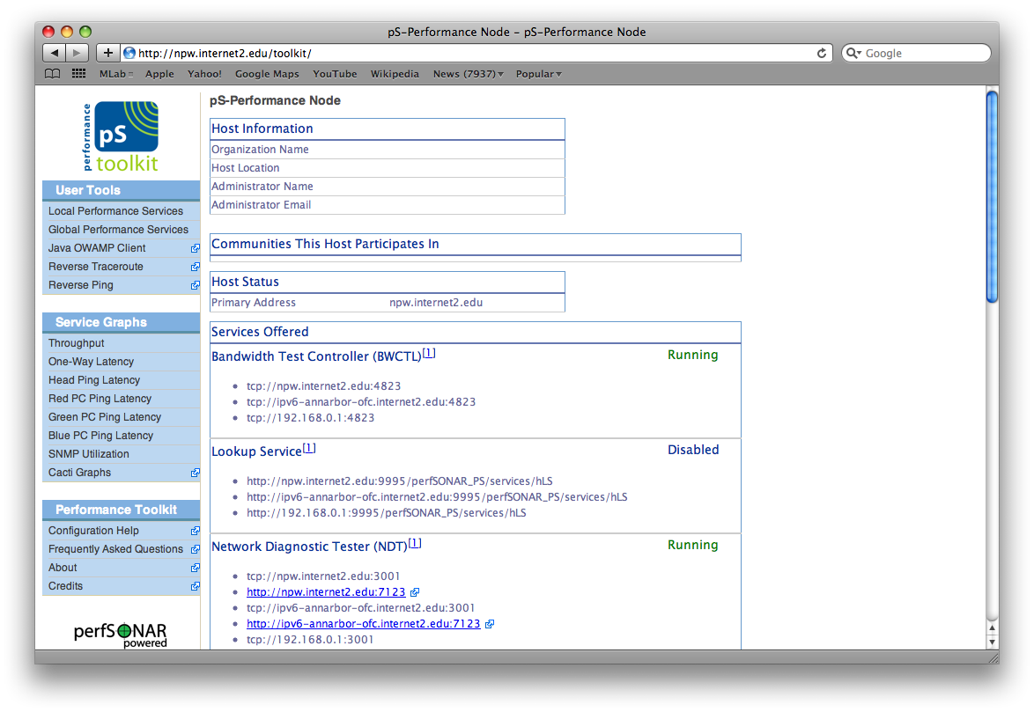
perfSONAR-PS Software
http://psps.perfsonar.net
Complete measurement operating system, or packages to install where you need them.

Slide 22
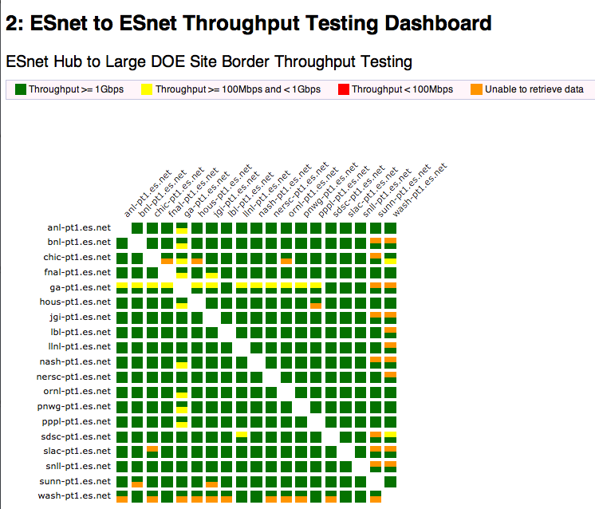
Visualizations & Alarms – Automation is the key
(http://ps-dashboard.es.net)

Slide 23
Outline
Review of the perfSONAR Concept
Survey Results
Deployment Best Practices
Q/A & Discussion

Slide 24
Survey Results
As of 7/14, 7am PDT…
10 Sites (Jefferson Lab, PPPL, ORNL, BNL, NESRC, PNNL, SLAC, ORISE/ORAU, ANL, LBL)
100% have a perfSONAR instance, and 100% have used it to debug something
100% would be interested in training in how to use it better (more on this later)
We also collected contact names, and machine names.
Some useful comments on what needs improvement (we will talk about this later too)
Thanks to those who participated – the pS community (for those of you on the mailing list) will be sending out another one of these soon. We would still encourage you to participate.

Slide 25
Outline
Review of the perfSONAR Concept
Survey Results
Deployment Best Practices
Q/A & Discussion

Slide 26
perfSONAR Deployment Locations
Critical to deploy such that you can test with useful semantics
perfSONAR hosts allow parts of the path to be tested separately
  Reduced visibility for devices between perfSONAR hosts
  Rely on counters or other means where perfSONAR can’t go
Effective test methodology derived from protocol behavior
  TCP suffers much more from packet loss as latency increases
  TCP is more likely to cause loss as latency increases
  Testing should leverage this in two ways
    Design tests so that they are likely to fail if there is a problem
    Mimic the behavior of production traffic as much as possible
  Note: don’t design your tests to succeed – it is not helpful
Notes:
A lot of people want to prove that they are not the problem, and design their tests to succeed. This is not helpful.

Slide 27
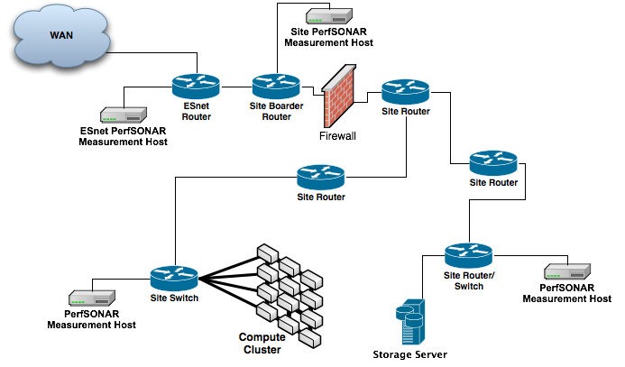
Sample Site Deployment

Slide 28
Importance of Regular Testing
You can’t wait for users to report problems and then fix them (soft failures can go unreported for years!)
Things just break sometimes
  Failing optics
  Somebody messed around in a patch panel and kinked a fiber
  Hardware goes bad
Problems that get fixed have a way of coming back
  System defaults come back after hardware/software upgrades
  New employees may not know why the previous employee set things up a certain way and back out fixes
Important to continually collect, archive, and alert on active throughput test results

Slide 29
Develop a Plan
What are you going to measure?
  Achievable bandwidth
    2-3 regional destinations
    4-8 important collaborators
    4-10 times per day to each destination
    20 second tests within a region, longer across oceans and continents
  Loss/Availability/Latency
    OWAMP: ~10 collaborators over diverse paths
    PingER: use to monitor paths to collaborators who don’t support owamp
  Interface Utilization & Errors
What are you going to do with the results?
  NAGIOS Alerts
  Reports to user community
  Post to Website

Slide 30
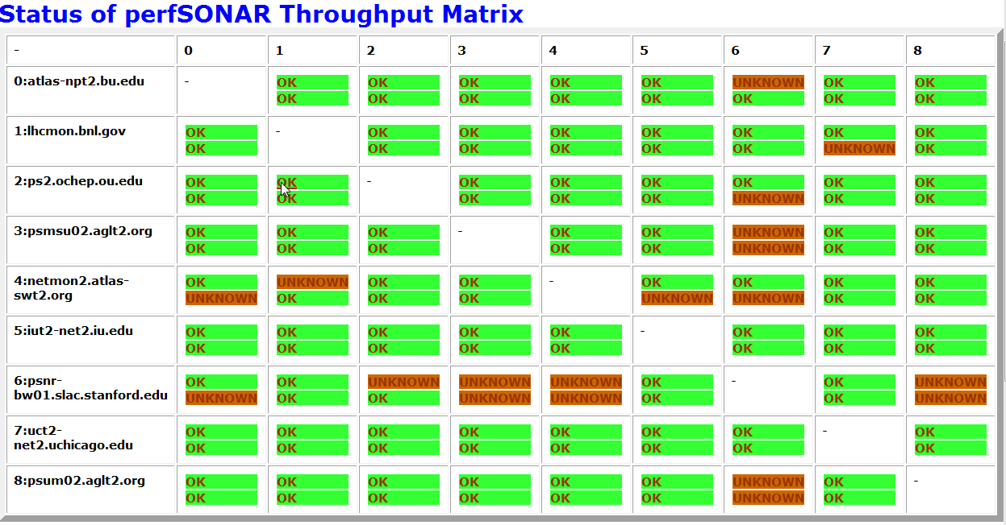
ATLAS Dashboard

Slide 31
Host Considerations
http://psps.perfsonar.net/toolkit/hardware.html
Dedicated perfSONAR hardware is best
  Server class is a good choice
  Desktop/Laptop/Mini (Mac, Shuttle) can be problematic, but work in a diagnostic capacity
Other applications will perturb results
Separate hosts for throughput tests and latency/loss tests is preferred
  Throughput tests can cause increased latency and loss
  Latency tests on a throughput host are still useful however
1Gbps vs 10Gbps testers
  There are a number of problem that only show up at speeds above 1Gbps
Virtual Machines do not always work well as perfSONAR hosts (use specific)
  Clock sync issues are a bit of a factor
  throughput is reduced significantly for 10G hosts
  VM technology and motherboard technology has come a long way, YMMV
  NDT/NAGIOS/SNMP/1G BWCTL are good choices for a VM, OWAMP/10G BWCTL are not

Slide 32
Outline
Review of the perfSONAR Concept
Survey Results
Deployment Best Practices
Q/A & Discussion

Slide 33
perfSONAR Community
perfSONAR-PS is working to build a strong user community to support the use and development of the software.
perfSONAR-PS Mailing Lists
  Announcement List:
    https://mail.internet2.edu/wws/subrequest/perfsonar-ps-announce
    https://mail.internet2.edu/wws/subrequest/performance-node-announce
  Users List:
    https://mail.internet2.edu/wws/subrequest/performance-node-users

Slide 34
Science DMZ Community
In addition to perfSONAR, the Science DMZ community is growing as well. We would encourage everyone to join the conversation as you implement your networks:
  General Info:
    http://fasterdata.es.net/science-dmz/
  Mailing List
    https://listserv.es.net/mailman/listinfo/sciencedmz
  Forums:
    http://fasterdata.es.net/forums/

Slide 35
http://fasterdata.es.net
ESnet maintains a “knowledge base” of tips and tricks for obtaining maximum WAN throughput
Lots of useful stuff there, including:
  TCP tuning information (in cut and paste friendly form)
  Data Transfer Node (DTN) tuning information
    Also in cut and paste friendly form
  DTN reference designs
  Science DMZ information
  perfSONAR information

Slide 36
Q/A & Discussion
From the Survey:
    100% of respondents have perfSONAR at the site, 100% Noted it was useful in solving a problem, and 100% say that if additional training was made available – they would take it.
    Training opportunities: existing workshops (FTW, ESCC), new ones (OIN). Site visits?
    Who is reporting the problems that perfSONAR is solving – end users or network operations staff?
Also from the survey (things that need improvement):
    Documentation is unclear, LiveCD use case has bugs, disks fill up with data over time, results may not always show, and the entire suite needs more end to end diagnostic tools.
    Doc: how can we make this better?
    Tools: Who wants to throw in cycles to assist?
    LiveCD: Who is still using this?
    Disk Filling: addressed in 3.3
Other topics?

Slide 37
Site Performance Measurement & Monitoring Best Practices
Questions?
Jason Zurawski – zurawski@es.net
http://www.es.net/
http://fasterdata.es.net/

