Slide 1
Jason’s 5 Minute Rant on Security and the pSPT
Jason Zurawski - ESnet
zurawski@es.net
2nd NSF Workshop on perfSONAR
Feb 21st 2014

Slide 2
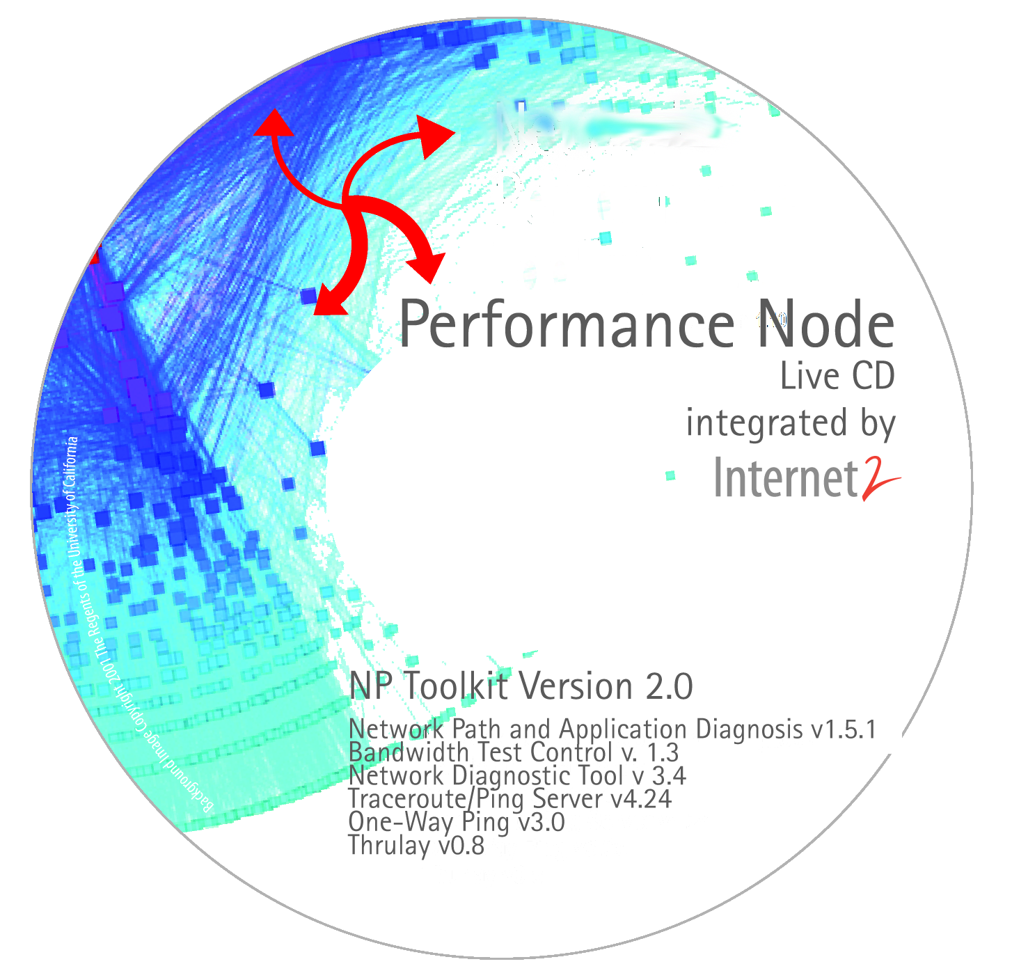
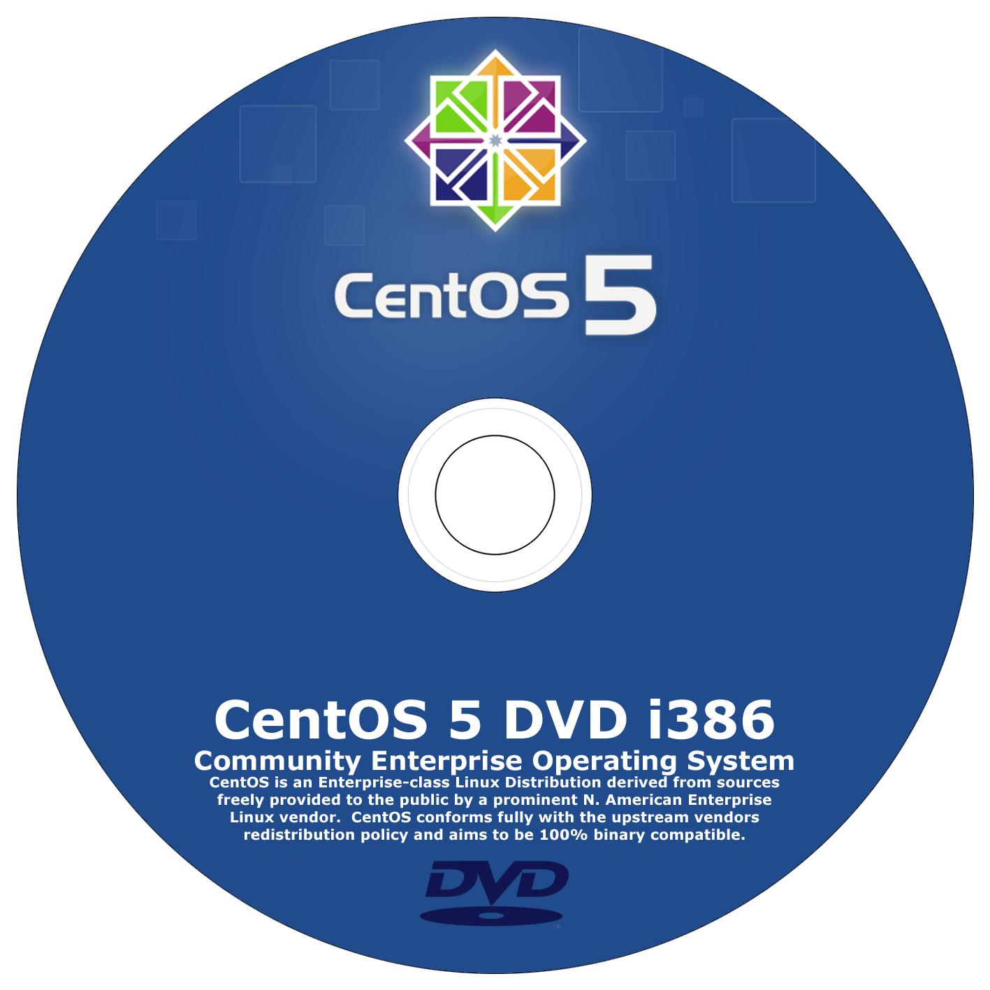
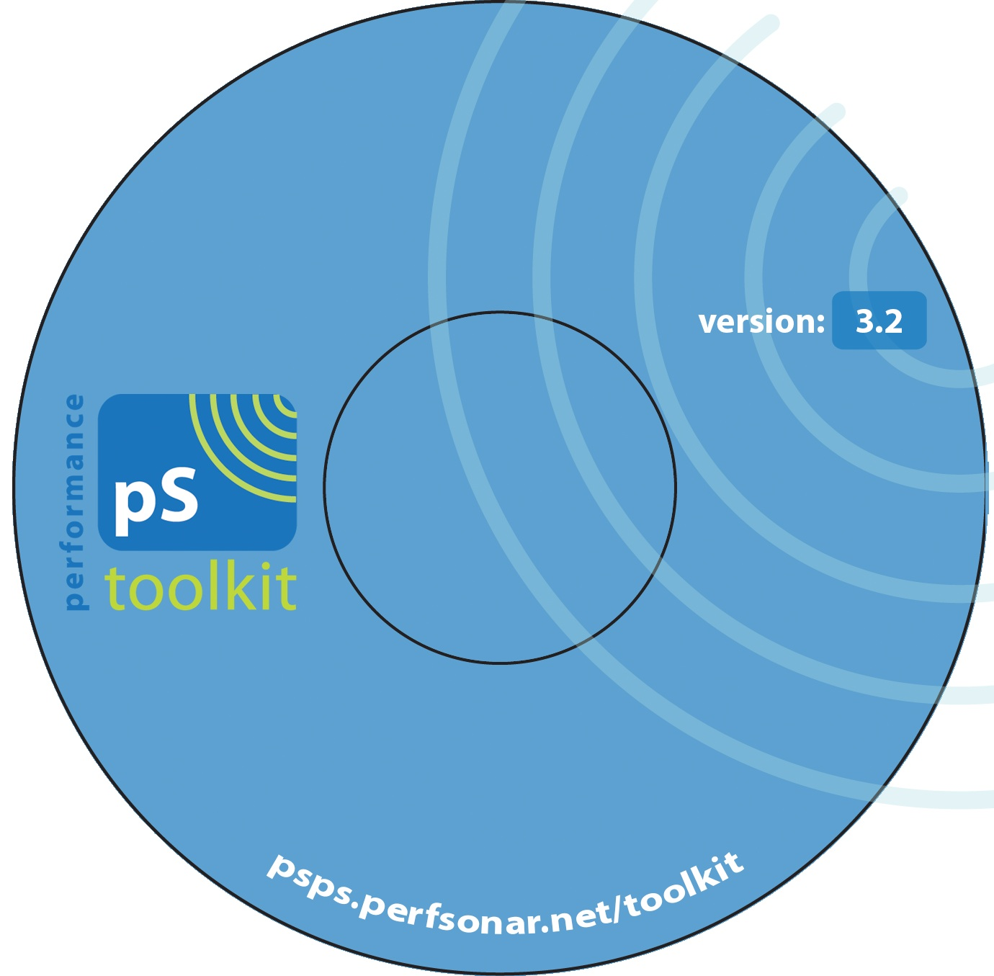
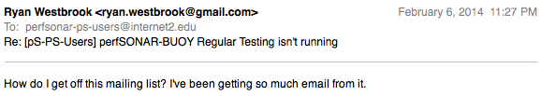
Meet the pSPT! Seen with all the cool kids…
Software – Repackaged Linux (e.g. CentOS) Distro … “Appliance Like”
    We keep it stock, some things removed (e.g. office software)
    Add in custom tools (BWCTL, etc.)
Hardware – Server class (most times 10G connected)
Network – well protected, or ‘specialized’*
Expectations/Realities:
    Developers:
      We are secure in our development and testing
      We pass along CVEs (from upstream) in a timely manner and suggest fixes and workarounds
      Public lists to foster communication (all alerts go here)
    Community:
      There has always been the expectation that the owner will secure and maintain things in a consistent and regular manner. There are risks.
      We take the time to make mailing lists – you really should join them (and yes – this involves getting mail …)

Slide 3
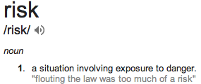


Of if you prefer:
              The perfSONAR team attempts to mitigate risk by using best practice and sane defaults
                Most configs inherited from upstream
                Responsibility of end site to follow BCPs
              What we did to assist:
                IPTables
                Host IDS (fail2ban)
Risks are all around for this (or any) server:
  Software vulnerabilities – use ‘yum’ or update your CD (and update config between releases)
  Account breaches – pick good passwords, restrict SSH access
  Abuse of protocols – Sometimes happens, best practice evolves

Slide 4
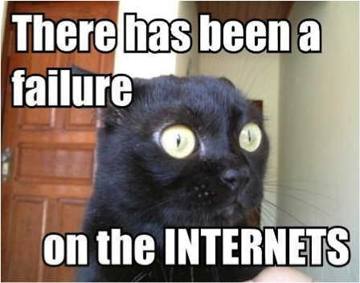
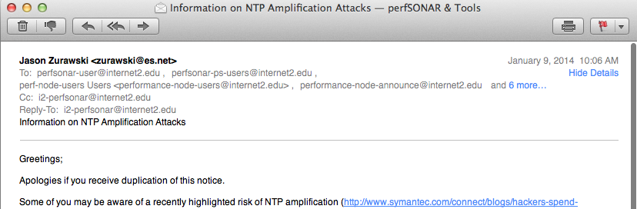
Google “NTP Amplification” please
Protocol/software had a weakness – mischief is probable
    Thought: “protocol misuse” v. “vulnerability”
Many devices running NTP on the Internet and open to misuse (e.g. routers, servers, and firewalls too)
    To stop – tighten up your config
We became aware around the holidays – via word of mouth, not CentOS (word from them came later).
We did the honorable thing – we sent notice to our lists.
    “We know its an issue, its with NTP upstream, do these steps to stop”
    “We will make this permanent with the next release”. Note that you don’t need to wait …

Slide 5
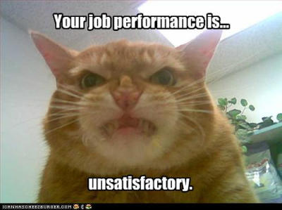
And then people got mad …
http://www.itnews.com.au/News/372033,worlds-largest-ddos-strikes-us-europe.aspx
Complex question fallacy of the day:
    "So when you are going to stop producing a product that puts my entire network at risk”
The response was quick from the loudest elements of the community:
    “The pSPT instance at our site was a part of this attack”
    “We never knew this was a problem”
    “We haven’t been told of a solution”
    “We are demanding the ‘compromised’ machine be taken off the network.”
Lets dissect this - the definition of security incident will differ from site to site
      We are calling this a protocol abuse. Remember the smurf attack?
      Is this different than a full breach of the machine?
      Is it different than exposure of PHI?

Slide 6
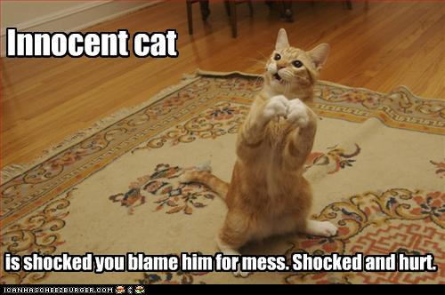
The Response
Long story short – the pSPT participated, and this was the first time the community had had to worry about pSPT boxes.
    A lot of of feel personal ‘ownership’ of success in this space, so it does sting to see the response
Lets be rational:
    Protocol misuse leads to better BCPs
    Project was nimble, and responded fast.
    Assigning blame for something new assumes foreknowledge of the unknown
Floating the concept of “removing machines permanently from the network” is not rational.
    Will the Juniper be going too?
    DNS servers have been abused like this for years, and DNS best practice has evolved – NTP best practice just got better.

Slide 7
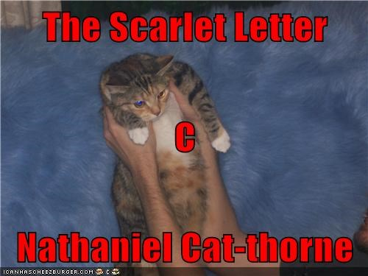
Commentary & Questions
Where do we go from here?
    Security policy and posture – is our process right?
    Are we providing enough external things to assist (e.g. filters, scrapers, alerts)?
    We have BCP on everything from hardware to configuration to network placement. Is security next? Volunteers to help?
The Science DMZ is a game changer – and one day it will lead to more headaches in this space (e.g. “Eli told us to stick it out there!!!”). We are preparing the aspirin for that day.
SDN is too – and if you aren’t thinking that the same story won’t impact that world, then hopefully my rant didn’t interrupt your email reading.
        Send me (hate) mail: zurawski@es.net

