Slide 1
Network and Host Design to Facilitate High Performance Data Transfer
Jason Zurawski - ESnet Engineering & Outreach
engage@es.net
globusWorld 2014
April 15th 2014
With contributions from S. Balasubramanian, G. Bell, E. Dart, M. Hester, B. Johnston, A. Lake, E. Pouyoul, L. Rotman, B. Tierney and others @ ESnet

Slide 2
Overview
Motivations
The Science DMZ Model
Network Architecture
Data Transfer Node Design
Application Integration
Conclusions

Slide 3
Motivations
Networks are an essential part of data-intensive science
Connect data sources to data analysis
Connect collaborators to each other
Enable machine-consumable interfaces to data and analysis resources (e.g. portals), automation, scale
Performance is critical
Exponential data growth
Constant human factors
Data movement and data analysis must keep up
Effective use of wide area (long-haul) networks by scientists has historically been difficult
Notes:
Human factors – attention span, ability to manage complexity
It is our hope that this work enables effective use of networking for science

Slide 4
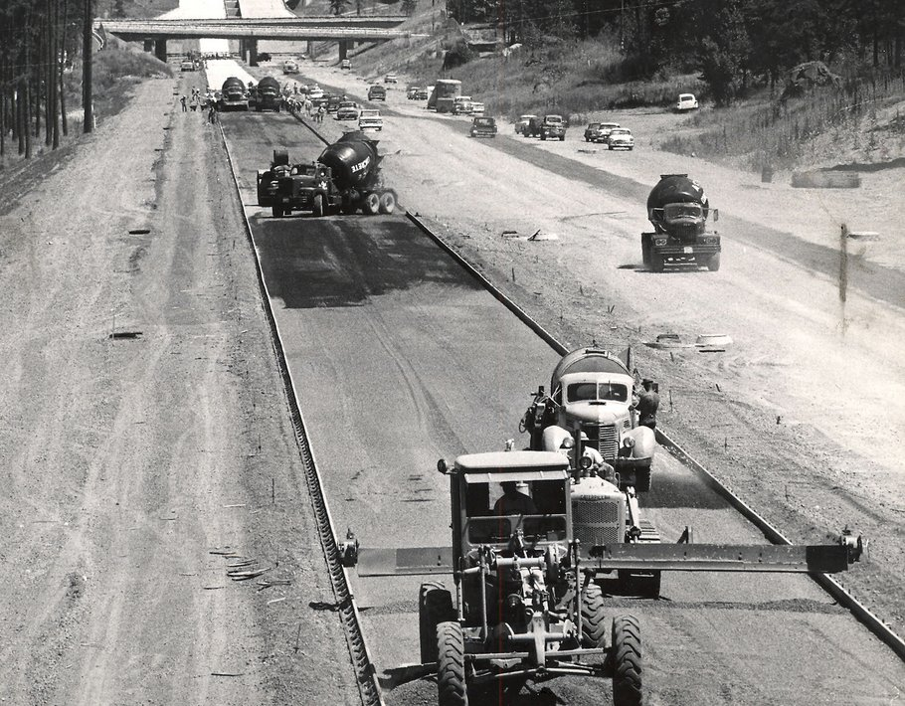
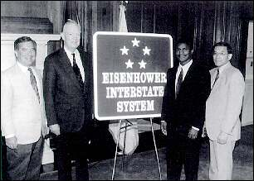
“Our unity as a nation is sustained by free communication of thought and by easy transportation of people and goods. The ceaseless flow of information throughout the Republic is matched by individual and commercial movement over a vast system of interconnected highways crisscrossing the country and joining at our national borders with friendly neighbors to the north and south.
Together, the united forces of our communication and transportation systems are dynamic elements in the very name we bear—United States. Without them, we would be a mere alliance of many separate parts.”
President Dwight D. Eisenhower - February 22, 1955

Slide 5
The Central Role of the Network
The very structure of modern science assumes science networks exist: high performance, feature rich, global scope
What is “The Network” anyway?
“The Network” is the set of devices and applications involved in the use of a remote resource
This is not about supercomputer interconnects
This is about data flow from experiment to analysis, between facilities, etc.
User interfaces for “The Network” – portal, data transfer tool, workflow engine
Therefore, servers and applications must also be considered
What is important?
Correctness
Consistency
Performance
Notes:
If networks are so important, we need to make them useful

Slide 6
TCP – Ubiquitous and Fragile
Networks provide connectivity between hosts – how do hosts see the network?
From an application’s perspective, the interface to “the other end” is a socket
Communication is between applications – mostly over TCP
TCP – the fragile workhorse
TCP is (for very good reasons) timid – packet loss is interpreted as congestion
Packet loss in conjunction with latency is a performance killer
Like it or not, TCP is used for the vast majority of data transfer applications (more than 95% of ESnet traffic is TCP)
© Dog Shaming 2012

Slide 7
A small amount of packet loss makes a huge difference in TCP performance
Local
(LAN)
With loss, high performance beyond metro distances is essentially impossible
International
Metro Area
Regional
Continental
Measured (TCP Reno)
Measured (HTCP)
Theoretical (TCP Reno)
Measured (no loss)
7 – ESnet Science Engagement (engage@es.net) - 4/15/14
Notes:
On a 10 Gb/s LAN path the impact of low packet loss rates is minimal
On a 10 Gb/s WAN path the impact of low packet loss rates is enormous
Beyond your metro area, zero loss is essentially required for performance
Where are your collaborators? Where are your users?
When global collaboration is the norm, nobody can afford to be a local-only resource
This is why we do the engineering we do for data-intensive science

Slide 8
Putting A Solution Together
© 2013 icanhascheezburger.com
Effective support for TCP-based data transfer
Design for correct, consistent, high-performance operation
Design for ease of troubleshooting
Easy adoption is critical
Large laboratories and universities have extensive IT deployments
Drastic change is prohibitively difficult
Cybersecurity – defensible without compromising performance
Borrow ideas from traditional network security
Traditional DMZ – separate enclave at network perimeter (“Demilitarized Zone”)
Specific location for external-facing services
Clean separation from internal network
Do the same thing for science – Science DMZ

Slide 9
Overview
Motivations
The Science DMZ Model
Network Architecture
Data Transfer Node Design
Application Integration
Conclusions

Slide 10
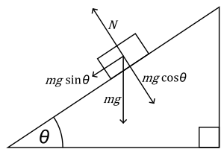
The Science DMZ in 1 Slide
Consists of four key components, all required:
“Friction free” network path
Highly capable network devices (wire-speed, deep queues)
Virtual circuit connectivity option
Security policy and enforcement specific to science workflows
Located at or near site perimeter if possible
Dedicated, high-performance Data Transfer Nodes (DTNs)
Hardware, operating system, libraries all optimized for transfer
Includes optimized data transfer tools such as Globus Online and GridFTP
Performance measurement/test node
perfSONAR
Engagement with users and use cases.
Education, Partnership, Knowledgebase
Details at http://fasterdata.es.net/science-dmz/
© 2013 Wikipedia
© 2014 Globus

Slide 11
Science DMZ Takes Many Forms
There are a lot of ways to combine these things – it all depends on what you need to do
Small installation for a project or two
Facility inside a larger institution
Institutional capability serving multiple departments/divisions
Science capability that consumes a majority of the infrastructure
Some of these are straightforward, others are less obvious
Key point of concentration: eliminate sources of packet loss / packet friction

Slide 12
Ad Hoc DTN Deployment
Notes:
This is often what gets tried first
Data transfer node deployed where the owner has space
This is often the easiest thing to do at the time
Straightforward to turn on, hard to achieve performance
If present, perfSONAR is at the border
This is a good start
Need a second one next to the DTN
Entire LAN path has to be sized for data flows
Entire LAN path is part of any troubleshooting exercise
This usually fails to provide the necessary performance.

Slide 13
Multiple Ingress Data Flows, Common Egress
Hosts will typically send packets at the speed of their interface (1G, 10G, etc.)
Instantaneous rate, not average rate
If TCP has window available and data to send, host sends until there is either no data or no window
Hosts moving big data (e.g. DTNs) can send large bursts of back-to-back packets
This is true even if the average rate as measured over seconds is slower (e.g. 4Gbps)
On microsecond time scales, there is often congestion
Router or switch must queue packets or drop them

Slide 14
Science DMZ Design Pattern (Abstract)
Notes:
Dedicated enclave for resources requiring high performance over long distances

Slide 15
Multiple Projects

Slide 16
Supercomputer Center
Notes:
High-performance networking is assumed in this environment
Data flows between systems, between systems and storage, wide area, etc.
Global filesystem often ties resources together
Portions of this may not run over Ethernet (e.g. IB)
Implications for Data Transfer Nodes
“Science DMZ” may not look like a discrete entity here
By the time you get through interconnecting all the resources, you end up with most of the network in the Science DMZ
This is as it should be – the point is appropriate deployment of tools, configuration, policy control, etc.
Office networks can look like an afterthought, but they aren’t
Deployed with appropriate security controls
Office infrastructure need not be sized for science traffic

Slide 17
Equipment – Routers and Switches
Deep interface queues
Output queue or VOQ – doesn’t matter
What TCP sees is what matters – fan-in is *not* your friend
No, this isn’t buffer bloat
(but if you know that’s an issue for you, account for it!)
Good counters
We like the ability to reliably count *every* packet associated with a particular flow, address pair, etc
Very helpful for debugging packet loss
Must not affect performance (just count it, don’t punt it)
If the box is going to drop a packet, it should increment a counter somewhere indicating that it dropped the packet
Magic vendor permissions and hidden commands should not be necessary
Some boxes just lie – run away!
Single-flow performance – wire-speed

Slide 18
Overview
Motivations
The Science DMZ Model
Network Architecture
Data Transfer Node Design
Application Integration
Conclusions

Slide 19
Data Transfer Node
A DTN server is made of several subsystems. Each needs to perform optimally for the DTN workflow:
Storage: capacity, performance, reliability, physical footprint
Networking: protocol support, optimization, reliability
Motherboard: I/O paths, PCIe subsystem, IPMI
Chassis: adequate power supply, extra cooling
Note: the workflow we are optimizing for here is sequential reads/write of large files, and a moderate number of high bandwidth flows.
We assume this host is dedicated to data transfer, and not doing data analysis/manipulation
Notes:
A Data Transfer Node is not a processing, rendering, server. Its only workflow is:
Sender host:
1) read data from the storage subsystem
2) send it to the receiver host
Receiver host:
1) read data from the network
2) write it onto the storage subsystem
We will focus only on this workflow: while the Data Transfer Node is tuned to perform at its best for this workflow, it may perform poorly for other workflows: the DTN is a dedicated host.

Slide 20
Motherboard/Chassis/Memory
Full 40GE requires a PCI Express gen 3 (up to 16 GB/sec) motherboard (Intel Sandy Bridge or Ivy Bridge)
Other considerations are memory speed, number of PCI slots, extra cooling, and an adequate power supply.
Turbo boost (up to 3.9 Ghz for the i7)
Faster QPIC for communication between processors
We recommend 32GB of RAM for a DTN node. More is better
Be sure to get the right number of the right type of PCI slots for your needs.
Form factor: This is the length of the slots, referred as the number of PCI lanes it can support. A 16 lane controller is twice as long as a 8 lane controller.
Number of wired lanes: not all lanes of the slot may be wired. Some 8 lanes controller may only have 4 lanes wired.
PCIe 2.0 is 500 MB/sec per lane. A typical host supports 8 lane (x8) cards, or up to 4 GB/sec. A high-end host might have 16 lane (x16) slots, or up to 8 GB/sec.
PCIe 3.0 = Double the above
Notes:
The motherboard not only incorporates the CPU’s and memory, it is also providing all the busses between the various component of the server. An inadequate motherboard can become a major bottleneck. It is, then, very important to correctly select it. The questions to ask while selecting are:
How many PCI cards will I need ? How many lanes each ?
What is the aggregate throughput I need on my PCI cards ?
How many cores do I need ? At what speed ?
What kind of remote access (maintenance) do I need.

Slide 21
PCI Bus Considerations
Make sure the motherboard you select has the right number of slots with the right number of lanes for you planned usage. For example:
10GE NICs require a 8 lane PCIe-2 slot
40G/QDR NICs require a 8 lane PCIe-3 slot
Most RAID controllers require 8 lane PCIe-2 slot
A high-end Fusion IO ioDrive may require a 16 lane PCIe-3 slot
Possibilities:
SuperMicro X9DR3-F
Sample Dell Server (Poweredge r320-r720)
Sample HP Server (ProLiant DL380p gen8 High Performance model)

Slide 22
Storage Architectures
There are multiple options for DTN Storage - this does not really impact DTN node design
DTN
Local storage
Raid, SSD
Distributed file system
Infiniband, Ethernet
Storage system
Fiber, Infiniband
Deciding what storage to use in your DTN is based on what you are optimizing for:
performance, reliability, and capacity, and cost.
SATA disks historically have been cheaper and higher capacity, while SAS disks typically have been the fastest.
Technologies have been converging (and its hard to keep up)
Notes:
Depending on the deployment environment, a DTN may have different type of storages.
Storage Systems: Those are usually more massive systems (EMC, Netapp, DDN, etc) providing raw volumes to servers. The connectivity is usually fiber, but it can also be infiniband and even ethernet. Typically this architecture benefits storage capacity.
However, it requires, usually, a dedicated HCA and sometimes, a special software stack (OFED)
Dsitributed FileSystem: this is similar to the storage system, except that the exported volumes are not RAW but file system (PNFS, Lustre, GPFS…). This set up is typical of a tiered system: data is acquired and processed, and stored. Then the DTN read from the shared storage.
Local storage: the storage system (just a bunch of drives / JBOD) is packaged with the server. That can from 12 drivers up to 48 drives depending on vendor/model. In addition, external chassis with more drives can be added, connected to the server with SAS or FC. This is ideal for standalone servers since it does not require plumbing for the storage subsystem. However, maintenance is typically more difficult since it does not have all the tooling that usually comes with storage systems.

Slide 23
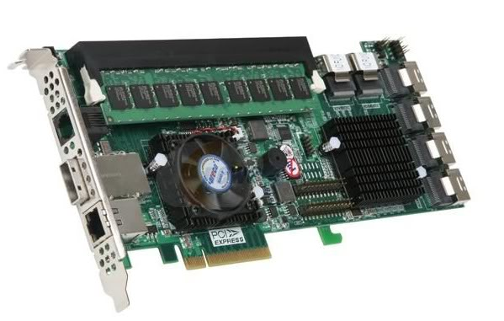
RAID Controllers
Often optimized for a given workload, rarely for performance.
RAID0 is the fastest of all RAID levels but is also the least reliable.
The performance of the RAID controller is a factor of the number of drives and its own processing engine.
Be sure your RAID controller has the following:
>= 1GB of on-board cache
PCIe Gen3 support
dual-core RAID-on-Chip (ROC) processor if you will have more than 8 drives

Slide 24
Network Subsystem Selection
There is a huge performance difference between cheap and expensive 10G NICs.
E.g. please don’t cheap out on the NIC – it’s important for an optimized DTN host.
NIC features to look for include:
support for interrupt coalescing
support for MSI-X
TCP Offload Engine (TOE)
support for zero-copy protocols such as RDMA (RoCE or iWARP)
Note that many 10G and 40G NICs come in dual ports, but that does not mean if you use both ports at the same time you get double the performance. Often the second port is meant to be used as a backup port.
True 2x10G capable cards include the Myricom 10G-PCIE2-8C2-2S and the Mellanox MCX312A-XCBT.

Slide 25
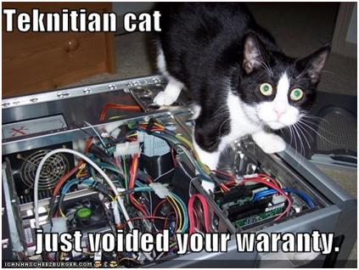
DTN Tuning http://fasterdata.es.net/science-dmz/DTN/tuning/
Defaults are usually not appropriate for performance.
What needs to be tuned:
BIOS
Firmware
Device Drivers
Networking
File System
Application

Slide 26
Overview
Motivations
The Science DMZ Model
Network Architecture
Data Transfer Node Design
Application Integration
Conclusions

Slide 27
Sample Data Transfer Rates
This table available at:
http://fasterdata.es.net/fasterdata-home/requirements-and-expectations/

Slide 28
Sample Data Transfer Results
Using the right tool is very important
Sample Results: Berkeley, CA to Argonne, IL (near Chicago). RTT = 53 ms, network capacity = 10Gbps.
Tool Throughput
scp: 140 Mbps
HPN patched scp: 1.2 Gbps
ftp 1.4 Gbps
GridFTP, 4 streams 6.6 Gbps (disk limited)
Note that to get more than 1 Gbps (125 MB/s) disk to disk requires RAID.

Slide 29
Overview
Motivations
The Science DMZ Model
Network Architecture
Data Transfer Node Design
Application Integration
Conclusions

Slide 30
Science DMZ Security
Goal – disentangle security policy and enforcement for science flows from security for business systems
Rationale
Science data traffic is simple from a security perspective
Narrow application set on Science DMZ
Data transfer, data streaming packages
No printers, document readers, web browsers, building control systems, financial databases, staff desktops, etc.
Security controls that are typically implemented to protect business resources often cause performance problems
Separation allows each to be optimized

Slide 31
http://fastdata.es.net
ESnet maintains a knowledge base of tips and tricks for obtaining maximum WAN throughput
Lots of useful stuff there, including:
Network/TCP tuning information (in cut and paste-friendly form)
Data Transfer Node (DTN) tuning information
DTN reference designs
Science DMZ information
perfSONAR information

Slide 32
Network and Host Design to Facilitate High Performance Data Transfer
Questions/Comments/Criticisms?
Jason Zurawski - zurawski@es.net
ESnet Science Engagement – engage@es.net
http://fasterdata.es.net

