Slide 1
Fundamentals of Data Movement Hardware
Jason Zurawski – ESnet Science Engagement
engage@es.net
CC-NIE PI Workshop
April 30th 2014
With contributions from S. Balasubramanian, G. Bell, E. Dart, M. Hester, B. Johnston, A. Lake, E. Pouyoul, L. Rotman, B. Tierney and others @ ESnet

Slide 2
Overview
Motivations
The Data Transfer Node
Application Integration
Campus Integration
Conclusions

Slide 3

Motivations
© 2013 icanhascheezburger.com
Networks are an essential part of data-intensive science
  Connect data sources to data analysis
  Connect collaborators to each other
  Enable machine-consumable interfaces to data and analysis resources (e.g. portals), automation, scale
Performance is critical
  Exponential data growth
  Constant human factors
  Data movement and data analysis must keep up
Effective use of wide area (long-haul) networks by scientists has historically been difficult
Notes:
Human factors – attention span, ability to manage complexity
It is our hope that this work enables effective use of networking for science

Slide 4
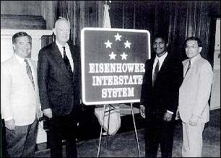
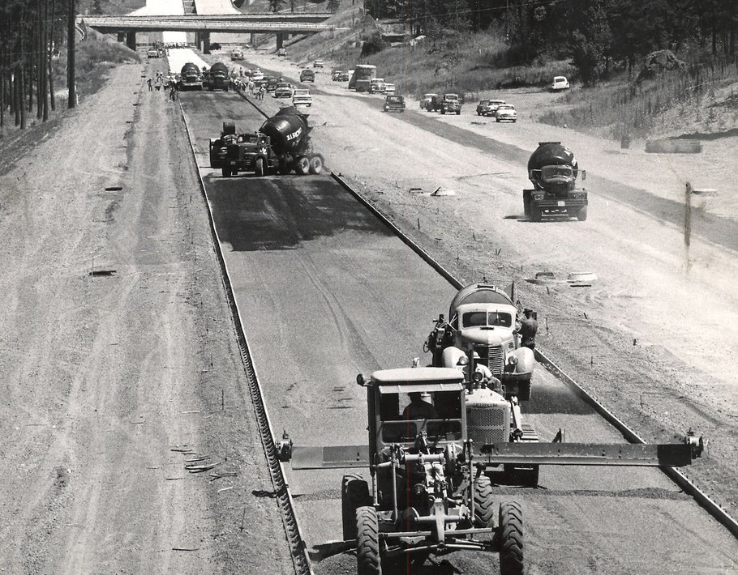
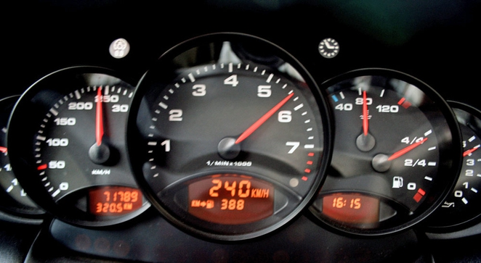
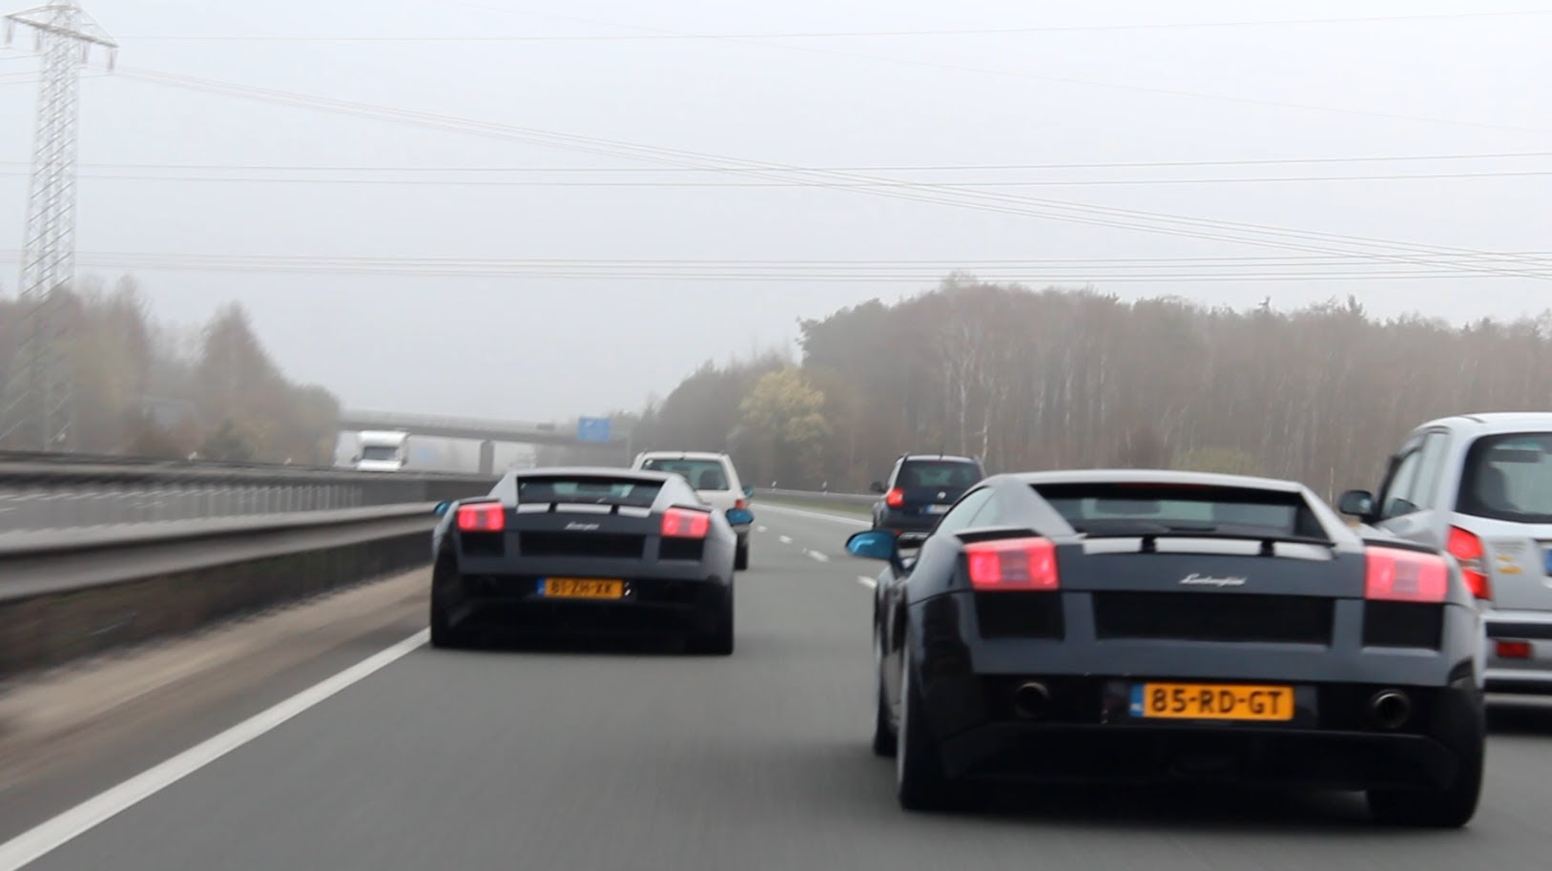
“Our unity as a nation is sustained by free communication of thought and by easy transportation of people and goods. The ceaseless flow of information throughout the Republic is matched by individual and commercial movement over a vast system of interconnected highways crisscrossing the country and joining at our national borders with friendly neighbors to the north and south.
Together, the united forces of our communication and transportation systems are dynamic elements in the very name we bear—United States. Without them, we would be a mere alliance of many separate parts.”
President Dwight D. Eisenhower - February 22, 1955

Slide 5

TCP – Ubiquitous and Fragile
Networks provide connectivity between hosts – how do hosts see the network?
  From an application’s perspective, the interface to “the other end” is a socket
  Communication is between applications – mostly over TCP
TCP – the fragile workhorse
  TCP is (for very good reasons) timid – packet loss is interpreted as congestion
  Packet loss in conjunction with latency is a performance killer
  Like it or not, TCP is used for the vast majority of data transfer applications (more than 95% of ESnet traffic is TCP)
© Dog Shaming 2012

Slide 6
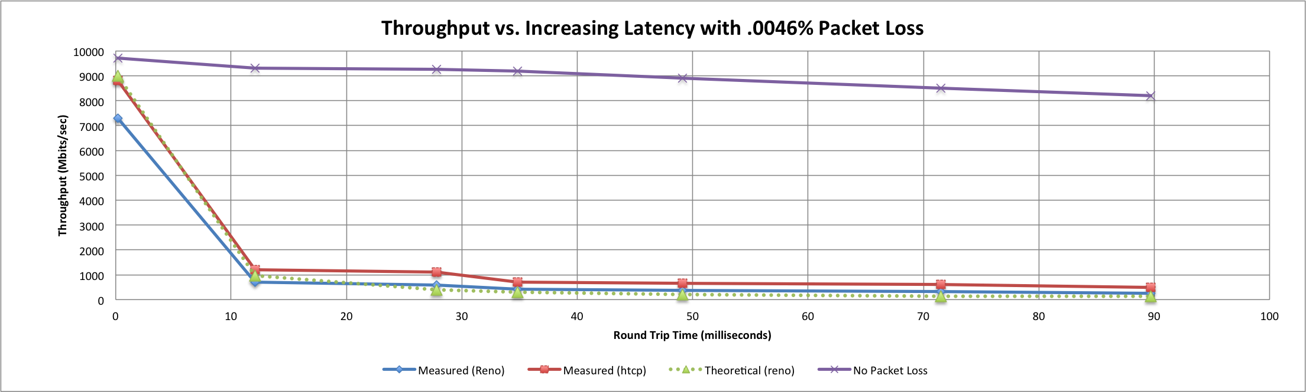
A small amount of packet loss makes a huge difference in TCP performance
Local
(LAN)
With loss, high performance beyond metro distances is essentially impossible
International
Metro Area
Regional
Continental
Measured (TCP Reno)
Measured (HTCP)
Theoretical (TCP Reno)
Measured (no loss)
6 – ESnet Science Engagement (engage@es.net) - 4/30/14
Notes:
On a 10 Gb/s LAN path the impact of low packet loss rates is minimal
On a 10 Gb/s WAN path the impact of low packet loss rates is enormous
Beyond your metro area, zero loss is essentially required for performance
Where are your collaborators? Where are your users?
When global collaboration is the norm, nobody can afford to be a local-only resource
This is why we do the engineering we do for data-intensive science

Slide 7
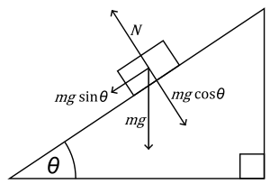


The Science DMZ in 1 Slide
Consists of four key components, all required:
“Friction free” network path
  Highly capable network devices (wire-speed, deep queues)
  Virtual circuit connectivity option
  Security policy and enforcement specific to science workflows
  Located at or near site perimeter if possible
Dedicated, high-performance Data Transfer Nodes (DTNs)
  Hardware, operating system, libraries all optimized for transfer
  Includes optimized data transfer tools such as Globus Online and GridFTP
Performance measurement/test node
  perfSONAR
Engagement with users and use cases.
  Education, Partnership, Knowledgebase
  Details at http://fasterdata.es.net/science-dmz/
© 2013 Wikipedia
© 2014 Globus

Slide 8
Overview
Motivations
The Data Transfer Node
Application Integration
Campus Integration
Conclusions

Slide 9
Data Transfer Node
A DTN server is made of several subsystems. Each needs to perform optimally for the DTN workflow:
Storage: capacity, performance, reliability, physical footprint
Networking: protocol support, optimization, reliability
Motherboard: I/O paths, PCIe subsystem, IPMI
Chassis: adequate power supply, extra cooling
Note: the workflow we are optimizing for here is sequential reads/write of large files, and a moderate number of high bandwidth flows.
We assume this host is dedicated to data transfer, and not doing data analysis/manipulation, or anything else for that matter.
Notes:
A Data Transfer Node is not a processing, rendering, server. Its only workflow is:
Sender host:
1) read data from the storage subsystem
2) send it to the receiver host
Receiver host:
1) read data from the network
2) write it onto the storage subsystem
We will focus only on this workflow: while the Data Transfer Node is tuned to perform at its best for this workflow, it may perform poorly for other workflows: the DTN is a dedicated host.

Slide 10
Motherboard/Chassis/Memory
Full 40GE requires a PCI Express gen 3 (up to 16 GB/sec) motherboard (Intel Sandy Bridge or Ivy Bridge)
    Other considerations are memory speed, number of PCI slots, extra cooling, and an adequate power supply.
    Turbo boost (up to 3.9 Ghz for the i7)
    Faster QPIC for communication between processors
We recommend 32GB of RAM for a DTN node. More is better
Be sure to get the right number of the right type of PCI slots for your needs.
    Form factor: This is the length of the slots, referred as the number of PCI lanes it can support. A 16 lane controller is twice as long as a 8 lane controller.
    Number of wired lanes: not all lanes of the slot may be wired. Some 8 lanes controller may only have 4 lanes wired.
    PCIe 2.0 is 500 MB/sec per lane. A typical host supports 8 lane (x8) cards, or up to 4 GB/sec. A high-end host might have 16 lane (x16) slots, or up to 8 GB/sec.
    PCIe 3.0 = Double the above
Notes:
The motherboard not only incorporates the CPU’s and memory, it is also providing all the busses between the various component of the server. An inadequate motherboard can become a major bottleneck. It is, then, very important to correctly select it. The questions to ask while selecting are:
How many PCI cards will I need ? How many lanes each ?
What is the aggregate throughput I need on my PCI cards ?
How many cores do I need ? At what speed ?
What kind of remote access (maintenance) do I need.

Slide 11
Storage Architectures
There are multiple options for DTN Storage - this does not really impact DTN node design
DTN
Local storage
Raid, SSD
Distributed file system
Infiniband, Ethernet
Storage system
Fiber, Infiniband
Deciding what storage to use in your DTN is based on what you are optimizing for:
    performance, reliability, and capacity, and cost.
SATA disks historically have been cheaper and higher capacity, while SAS disks typically have been the fastest.
    Technologies have been converging (and its hard to keep up)
Notes:
Depending on the deployment environment, a DTN may have different type of storages.
Storage Systems: Those are usually more massive systems (EMC, Netapp, DDN, etc) providing raw volumes to servers. The connectivity is usually fiber, but it can also be infiniband and even ethernet. Typically this architecture benefits storage capacity.
However, it requires, usually, a dedicated HCA and sometimes, a special software stack (OFED)
Dsitributed FileSystem: this is similar to the storage system, except that the exported volumes are not RAW but file system (PNFS, Lustre, GPFS…). This set up is typical of a tiered system: data is acquired and processed, and stored. Then the DTN read from the shared storage.
Local storage: the storage system (just a bunch of drives / JBOD) is packaged with the server. That can from 12 drivers up to 48 drives depending on vendor/model. In addition, external chassis with more drives can be added, connected to the server with SAS or FC. This is ideal for standalone servers since it does not require plumbing for the storage subsystem. However, maintenance is typically more difficult since it does not have all the tooling that usually comes with storage systems.

Slide 12
Network Subsystem Selection
There is a huge performance difference between cheap and expensive 10G NICs.
  E.g. please don’t cheap out on the NIC – it’s important for an optimized DTN host.
NIC features to look for include:
support for interrupt coalescing
support for MSI-X
TCP Offload Engine (TOE)
support for zero-copy protocols such as RDMA (RoCE or iWARP)
Note that many 10G and 40G NICs come in dual ports, but that does not mean if you use both ports at the same time you get double the performance. Often the second port is meant to be used as a backup port.
  True 2x10G capable cards include the Myricom 10G-PCIE2-8C2-2S and the Mellanox MCX312A-XCBT.

Slide 13
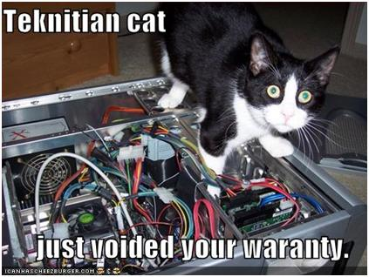
DTN Tuning http://fasterdata.es.net/science-dmz/DTN/tuning/
Defaults are usually not appropriate for performance.
What needs to be tuned:
BIOS
Firmware
Device Drivers
Networking
File System
Application

Slide 14
Overview
Motivations
The Data Transfer Node
Application Integration
Campus Integration
Conclusions

Slide 15
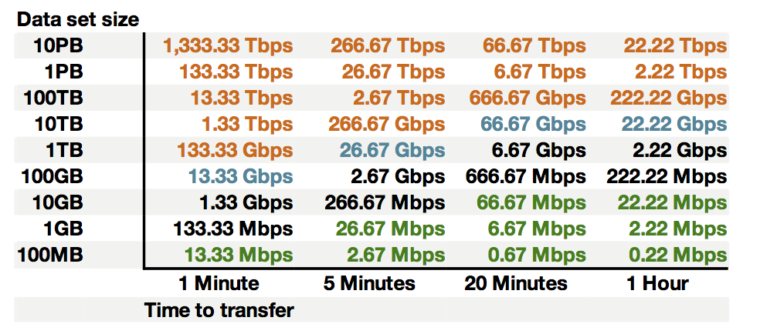
Sample Data Transfer Rates
This table available at:
http://fasterdata.es.net/fasterdata-home/requirements-and-expectations/

Slide 16
Sample Data Transfer Results
Using the right tool is very important
Sample Results: Berkeley, CA to Argonne, IL (near Chicago). RTT = 53 ms, network capacity = 10Gbps.
    Tool Throughput
    scp: 140 Mbps
    HPN patched scp: 1.2 Gbps
    ftp 1.4 Gbps
    GridFTP, 4 streams 6.6 Gbps (disk limited)
    Note that to get more than 1 Gbps (125 MB/s) disk to disk requires RAID.

Slide 17
Why Not Use SCP or SFTP?
Pros:
  Most scientific systems are accessed via OpenSSH
  SCP/SFTP are therefore installed by default
  Modern CPUs encrypt and decrypt well enough for small to medium scale transfers
  Credentials for system access and credentials for data transfer are the same
Cons:
  The protocol used by SCP/SFTP has a fundamental flaw that limits WAN performance
  CPU speed doesn’t matter – latency matters
  Fixed-size buffers reduce performance as latency increases
  It doesn’t matter how easy it is to use SCP and SFTP – they simply do not perform
Verdict: Do Not Use Without Performance Patches

Slide 18
GridFTP & Globus Connect/Transfer
GridFTP from ANL has features needed to fill the network pipe
  Buffer Tuning
  Parallel Streams
  Supports multiple authentication options (Anonymous, ssh, X509)
Ability to define a range of data ports that work for your security people, or VO
Key features needed by a Science DMZ
Drag and drop GUI
High Performance: parallel streams, small file optimization
Reliability: auto-restart, user-level checksum
Multiple security models and integration with major projects (XSEDE, etc.): ssh key, X509, Open ID, Shibboleth, etc.
Firewall/NAT traversal support
Easy to install, configure, and learn

Slide 19
Other Data Transfer Tools
FDT = Fast Data Transfer tool from Caltech
  http://monalisa.cern.ch/FDT/
  Java-based, easy to install
  used by CMS project and DYNES effort
bbcp: http://www.slac.stanford.edu/~abh/bbcp/
  supports parallel transfers and socket tuning
  bbcp -P 4 -v -w 2M myfile remotehost:filename
lftp: http://lftp.yar.ru/
  parallel file transfer, socket tuning, HTTP transfers, and more.
  lftp -e 'set net:socket-buffer 4000000; pget -n 4 [http|ftp]://site/path/file; quit'
axel: http://axel.alioth.debian.org/
  simple parallel accelerator for HTTP and FTP.
  axel -n 4 [http|ftp]://site/file

Slide 20
Overview
Motivations
The Data Transfer Node
Application Integration
Campus Integration
Conclusions

Slide 21
Science DMZ Performance & Security
Goal – disentangle security policy and enforcement for science flows from security for business systems
Rationale
  Science data traffic is simple from a security perspective
  Narrow application set on Science DMZ
    Data transfer, data streaming packages
    No printers, document readers, web browsers, building control systems, financial databases, staff desktops, etc.
  Security controls that are typically implemented to protect business resources often cause performance problems
Separation allows each to be optimized

Slide 22
Ad Hoc DTN Deployment
Notes:
This is often what gets tried first
Data transfer node deployed where the owner has space
This is often the easiest thing to do at the time
Straightforward to turn on, hard to achieve performance
If present, perfSONAR is at the border
This is a good start
Need a second one next to the DTN
Entire LAN path has to be sized for data flows
Entire LAN path is part of any troubleshooting exercise
This usually fails to provide the necessary performance.

Slide 23
Prototype Science DMZ Data Path

Slide 24
Supercomputer Center Data Path

Slide 25
Overview
Motivations
The Data Transfer Node
Application Integration
Campus Integration
Conclusions

Slide 26
http://fastdata.es.net
ESnet maintains a knowledge base of tips and tricks for obtaining maximum WAN throughput
Lots of useful stuff there, including:
  Network/TCP tuning information (in cut and paste-friendly form)
  Data Transfer Node (DTN) tuning information
  DTN reference designs
  Science DMZ information
  perfSONAR information

Slide 27
Fundamentals of Data Movement Hardware
Questions/Comments/Criticisms?
Jason Zurawski - zurawski@es.net
ESnet Science Engagement – engage@es.net
http://fasterdata.es.net

