Slide 1
The Role of End-user Engagement for Scientific Networking
Jason Zurawski, Brian Tierney, Mary Hester
ESnet Science Engagement
TNC 2014
Dublin IE
May 20th 2014
With contributions from G. Bell, I. Monga, S. Balasubramanian, B. Johnston, A. Lake, E. Dart, E. Pouyoul, L. Rotman, and others @ ESnet

Slide 2
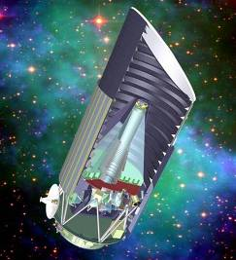
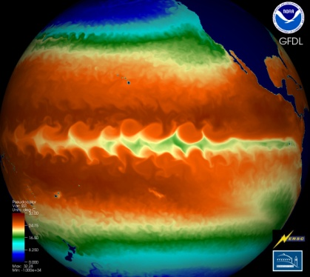
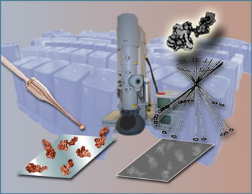
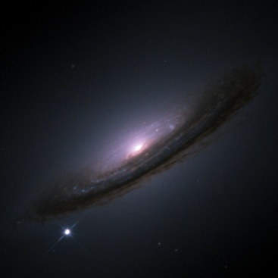
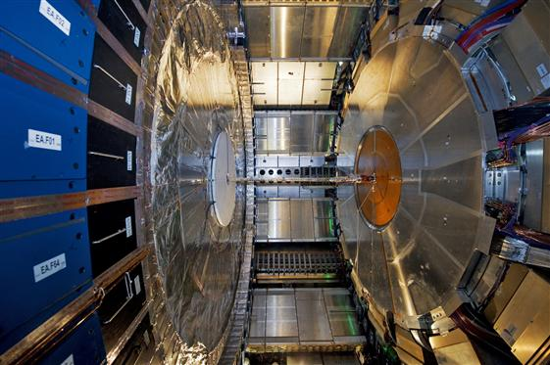
ESnet Supports DOE Office of Science
Notes:
This low-res map shows why most of our data flows terminate outside the national lab complex.
=-=-=-=-=-=-=-=-=-
ESnet - the Energy Sciences Network - is an SC program whose primary mission is to enable the large-scale science of the Office of Science that depends on:
Multi-institution, world-wide collaboration
Data mobility: sharing of massive amounts of data
Distributed data management and processing
Distributed simulation, visualization, and computational steering
Collaboration with the US and International Research and Education community
=-=-=-=-=-=-=-=-=-
ESnet connects the Office of Science National Laboratories and user facilities to each other and to collaborators worldwide
Ames, Argonne, Brookhaven, Fermilab, Lawrence Berkeley, Oak Ridge, Pacific Northwest, Princeton Plasma Physics, SLAC, and Thomas Jefferson National Accelerator Facility,

Slide 3
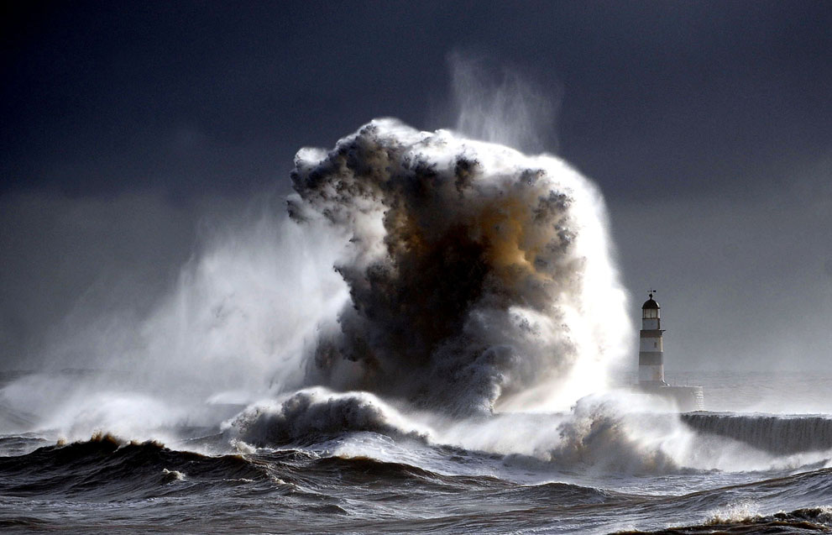
What is there to worry about?
Genomics
  Sequencer data volume increasing 12x over the next 3 years
  Sequencer cost decreasing by 10x over same time period
High Energy Physics
  LHC experiments produce & distribute petabytes of data/year
  Peak data rates increase 3-5x over 5 years
Light Sources
© Owen Humphreys/National Geographic Traveler Photo Contest 2013
  Many detectors on a Moore’s Law curve
  Data volumes rendering previous operational models obsolete
Common Threads
  Increased capability, greater need for data mobility due to span/depth of collaboration space
  Global is the new local. Research is no longer done within a domain. End to end involves many fiefdoms to cross – and yes this becomes your problem when your users are impacted
Notes:
This should not be news. The news is that there is convergence on how to support things in the network space.

Slide 4
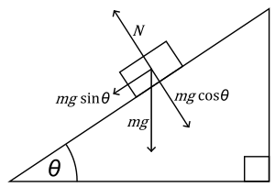


The Science DMZ in 1 Slide
Consists of four key components, all required:
“Friction free” network path
  Highly capable network devices (wire-speed, deep queues)
  Virtual circuit connectivity option
  Security policy and enforcement specific to science workflows
  Located at or near site perimeter if possible
Dedicated, high-performance Data Transfer Nodes (DTNs)
  Hardware, operating system, libraries all optimized for transfer
  Includes optimized data transfer tools such as Globus Online and GridFTP
Performance measurement/test node
  perfSONAR
Engagement with users on the nature of their scientific workflows and use cases
  Details at http://fasterdata.es.net/science-dmz/
© 2013 Wikipedia
© 2013 Globus

Slide 5
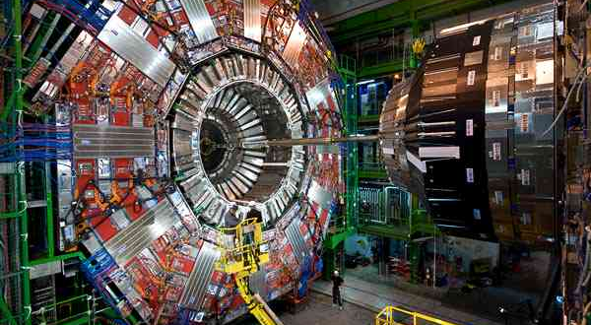
Traditional “Big Science”

Slide 6
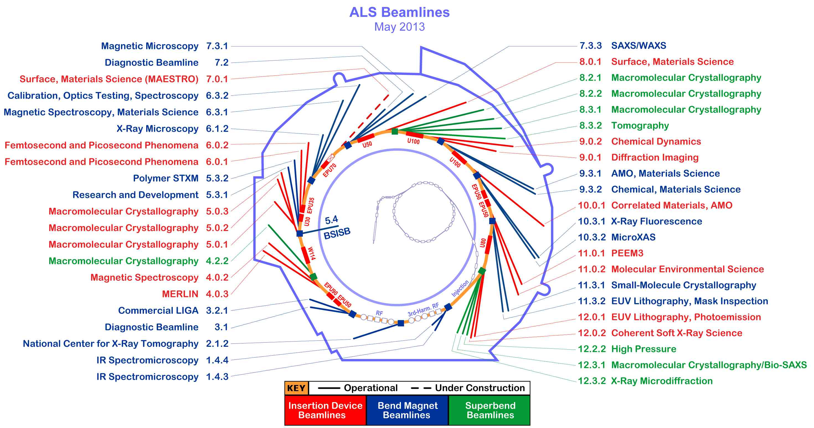
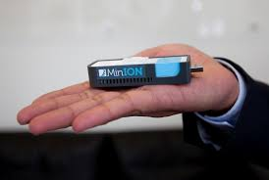
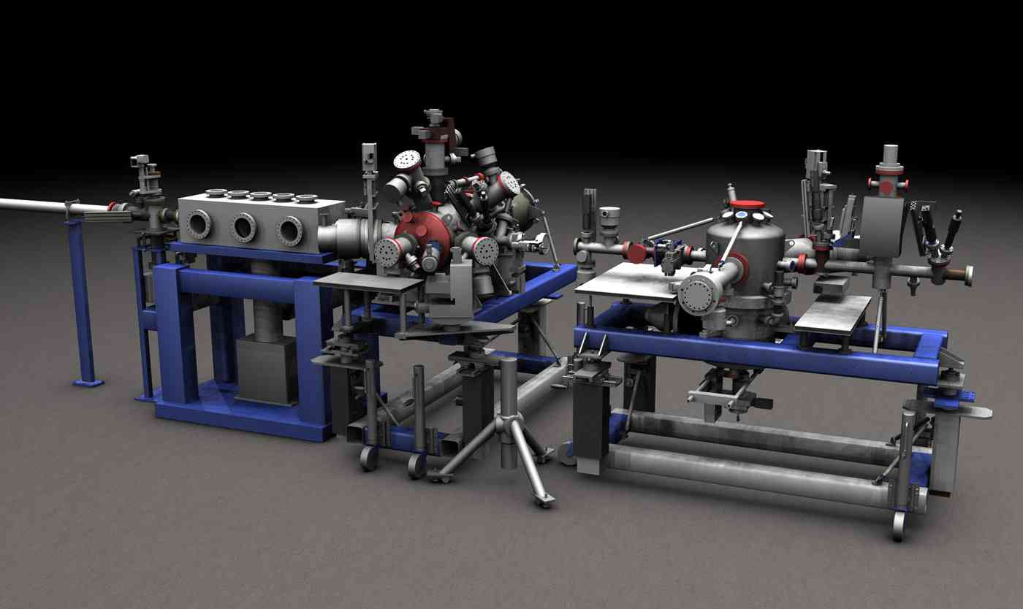
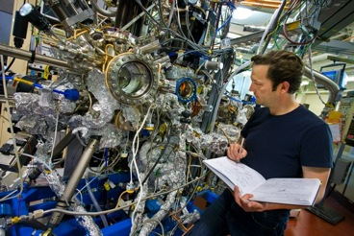
Big Science Now Comes in Small Packages
Notes:
Beamline 8.3.2 at the Advanced Light Source is a Synchrotron-based Hard X-ray Micro-Tomography instrument. It allows non-destructive 3-Dimensional imaging of solid objects at a resolution of approximately 1 micron.
10⁶ increase in data output compared to previous generation
8 Gbps flows to supercomputer for real-time analysis

Slide 7
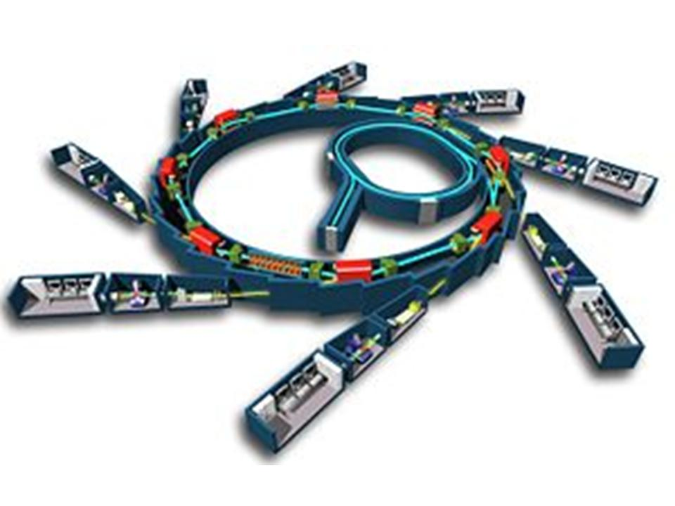
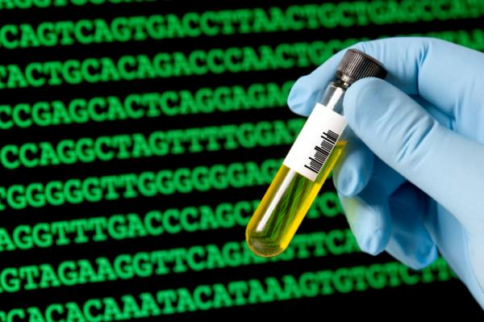
Light Sources and sequencers are producing data faster than Moore’s Law
Synchrotrons
Sequencers

Slide 8

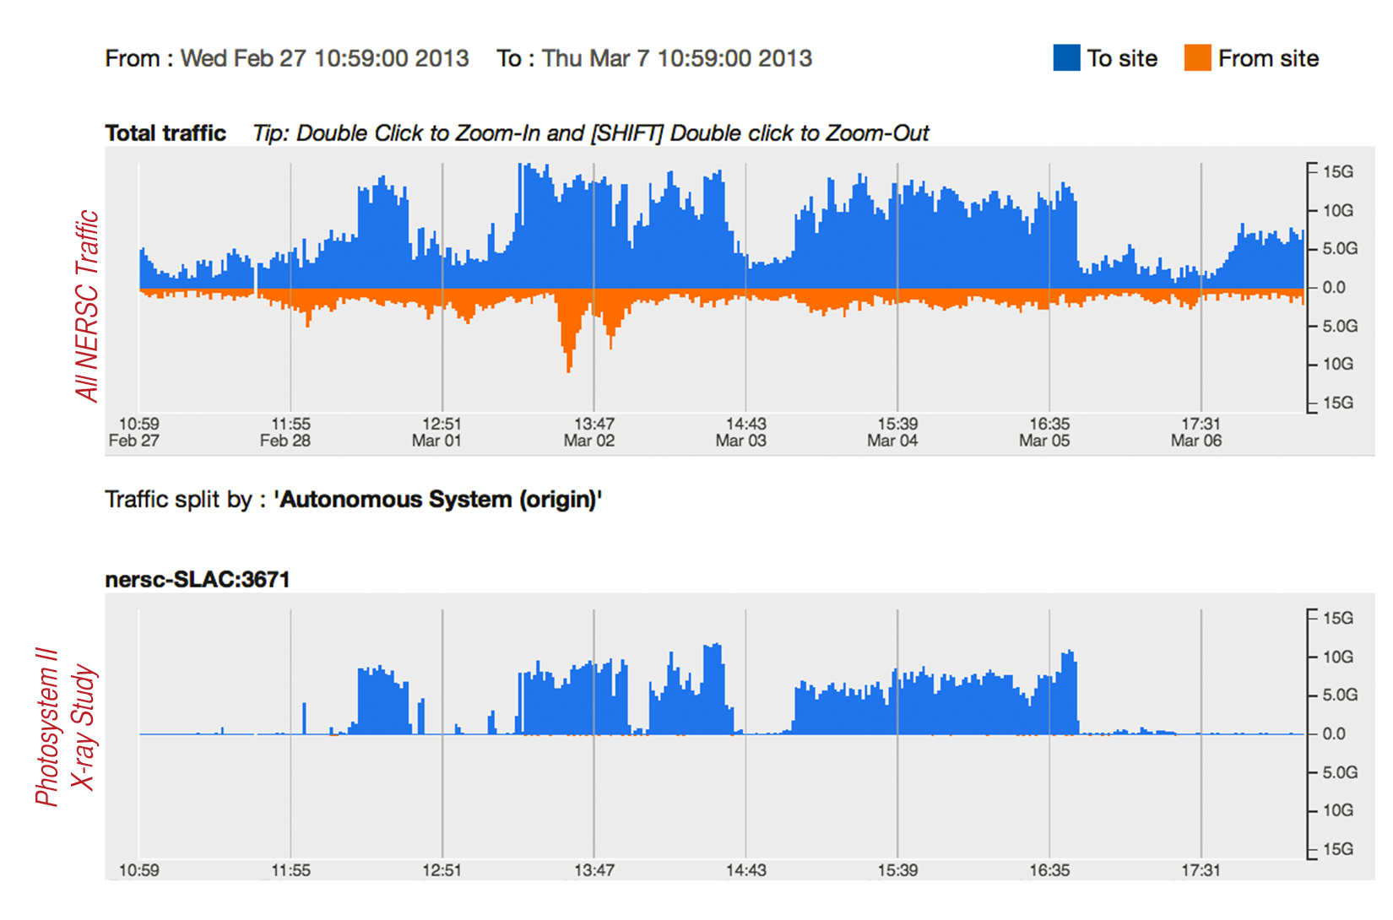
One Beamline Data Flow Tripled Network Use for a DOE Supercomputing Center

Slide 9
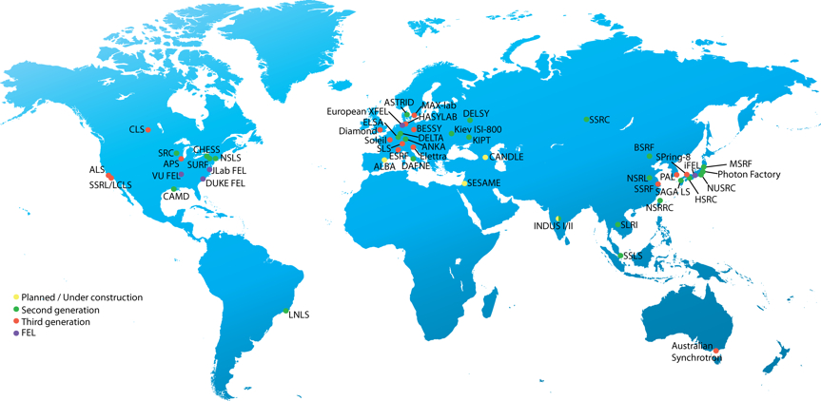





Light Sources in Production or Under Construction
2015
2016
2011
2009
LCLS-II
2018
2014
low rep rate
high rep rate
source: Paul Alivisatos

Slide 10
Understanding Data Trends
Notes:
Requirements workshops for all six program offices within the DOE office of Science

Slide 11
Notes:
Traffic destined to other locations
Run close to 40 user facilities – HPC centers, light source facilities, syncotrons, tokamaks

Slide 12
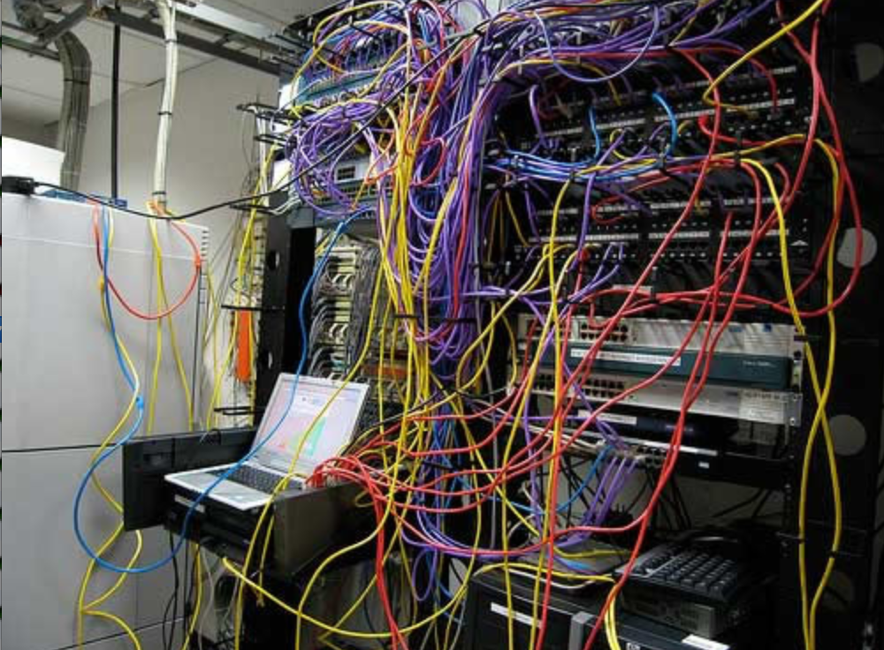
Challenges to Network Adoption
Causes of performance issues are complicated for users.
Lack of communication and collaboration between the CIO’s office and researchers on campus.
Lack of IT expertise within a science collaboration or experimental facility
User’s performance expectations are low (“The network is too slow”, “I tried it and it didn’t work”).
Cultural change is hard (“we’ve always shipped disks!”).
Scientists want to do science not IT support
The Capability Gap

Slide 13
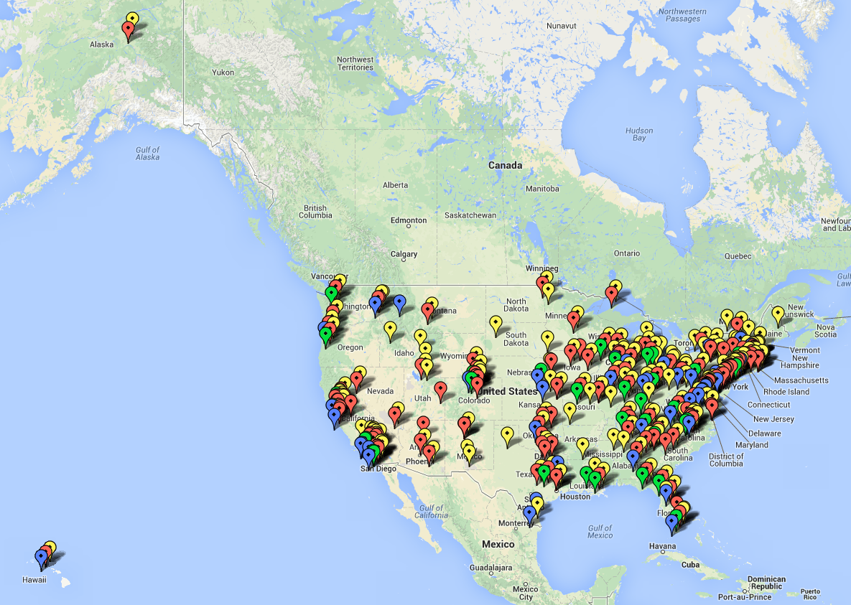




Universities funded by DOE & NSF
BER (genomics, climate)
BES (life & materials science)
CC-NIE awardees (round 1)
CC-NIE awardees (round 2)
Notes:
This does not include information about LHC sites – only two of the six DOE science program offices
Thousands and thousands of scientists

Slide 14
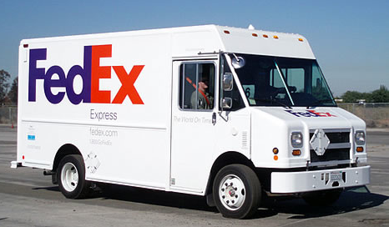
Science Data Transport Tomorrow?

Slide 15
Success Stories:
Science Workflow Consultation
Notes:
X-ray tomography beamline
General purpose network
Windows shares on an old computer with not enough storage
Data acquisition uses LabView
Data written to shared drive on firewalled Windows server
Analysis done on workstations
High-powered Windows hosts
Mix of proprietary and open-source tools
Scientists can be physically present or use Remote Desktop
Data export post-analysis – physical transport of portable media
USB hard drives

Slide 16

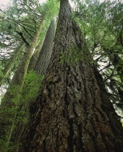

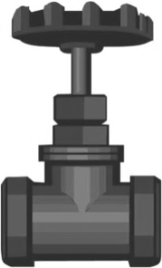

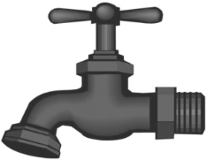
User Workflow:
Beamline 8.3.2
2. Endstation
3. Sample
4. Control Software
5. Data Collection
Users
1. Allocation
6. Data Transfer / Management
Publications
9. Write and edit
8. Data Analysis / Info Extraction / Visualization / Simulation
7. Data Processing

Slide 17
Improved Workflow Infrastructure
Notes:
Dedicated infrastructure, built for performance, outside the general purpose network, clear path to NERSC
Data acquisition uses LabView
Data written to SAMBA share on beamline Linux DTN
Writing via SAMBA is faster than local disk on acquisition computer
Data are TIFF files ~10MB each, ~1000 files per data set
Current max performance is ~200MB/sec
Automated workflow pushes data to NERSC for analysis
Workflow managed using signal files
Data set is rolled up into an HDF5 file
Python scripts drive Globus Online CLI
Data transferred to NERSC DTNs at ~300MB/sec
Analysis results pulled back to beamline DTN
Additional analysis done on workstations (still use some proprietary tools)
Primary data export is via Globus Online from beamline DTN

Slide 18

ESnet Engagement Team Vision
    Collaborations at every scale, in every domain, will have the information and tools they need to achieve maximum benefit from global networks.
    Scientific progress is completely unconstrained by the physical location of instruments, people, computational resources, or data.

Slide 19
ESnet Science Engagement Services
Education & Consulting
Webinars, workshops, 1:1 data mobility consultations with scientists, support teams.
Partnerships
With facilities / research teams / providers, building foundation for lasting impact.
Resources & Knowledgebase
Reference designs, case studies, papers, FAQs – tailored for multiple audiences.

Slide 20
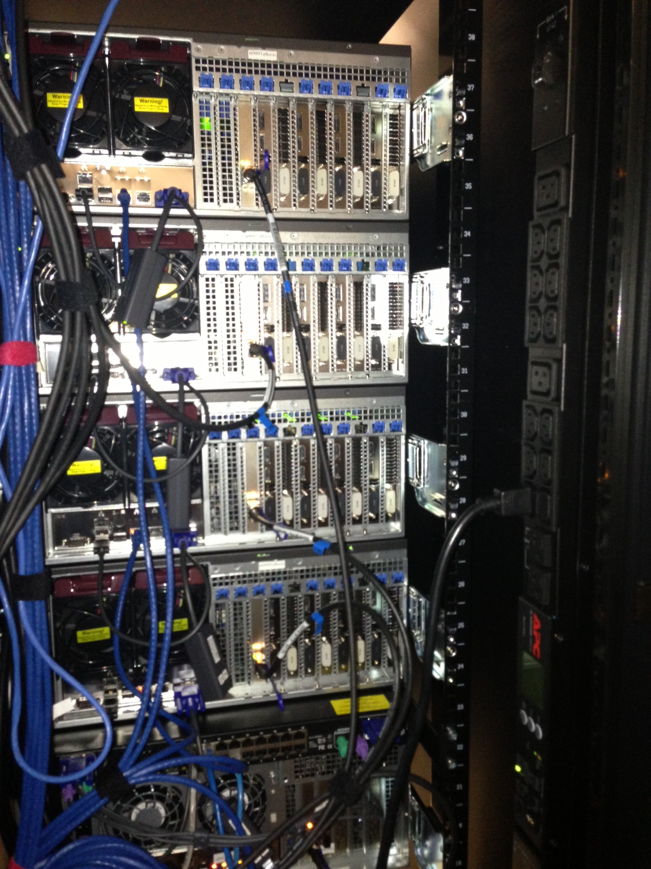
Slide courtesy of Rune Stromsness, LBL

Slide 21
The Role of End-user Engagement for Scientific Networking
Questions?
Jason Zurawski - zurawski@es.net
Brian Tierney – bltierney@es.net
Mary Hester – mchester@es.net
ESnet Science Engagement – engage@es.net
http://fasterdata.es.net

