Slide 1
A Brief Overview of the Science DMZ
Jason Zurawski - ESnet Engineering & Outreach
engage@es.net
OSG Campus Webinar
May 23th 2014
With contributions from S. Balasubramanian, G. Bell, E. Dart, M. Hester, B. Johnston, A. Lake, E. Pouyoul, L. Rotman, B. Tierney and others @ ESnet

Slide 2
Overview
What is ESnet?
Science DMZ Motivation and Introduction
Science DMZ Architecture
Network Monitoring
Data Transfer Nodes & Applications
On the Topic of Security
User Engagement
Wrap Up

Slide 3
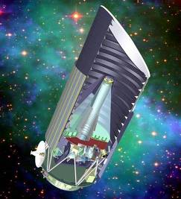
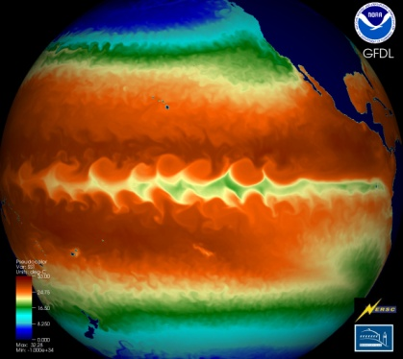
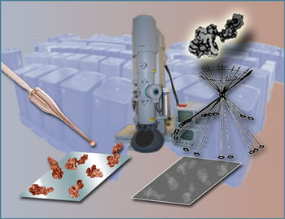
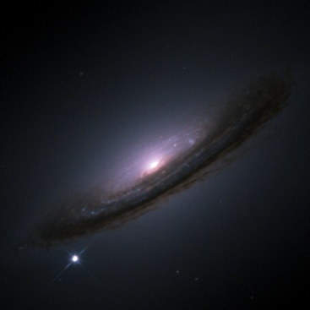
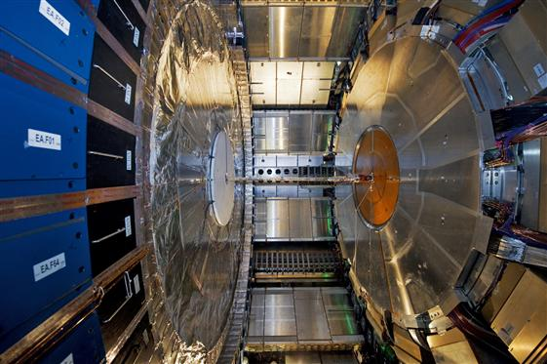
ESnet Supports DOE Office of Science
Notes:
This low-res map shows why most of our data flows terminate outside the national lab complex.
=-=-=-=-=-=-=-=-=-
ESnet - the Energy Sciences Network - is an SC program whose primary mission is to enable the large-scale science of the Office of Science that depends on:
Multi-institution, world-wide collaboration
Data mobility: sharing of massive amounts of data
Distributed data management and processing
Distributed simulation, visualization, and computational steering
Collaboration with the US and International Research and Education community
=-=-=-=-=-=-=-=-=-
ESnet connects the Office of Science National Laboratories and user facilities to each other and to collaborators worldwide
Ames, Argonne, Brookhaven, Fermilab, Lawrence Berkeley, Oak Ridge, Pacific Northwest, Princeton Plasma Physics, SLAC, and Thomas Jefferson National Accelerator Facility,

Slide 4
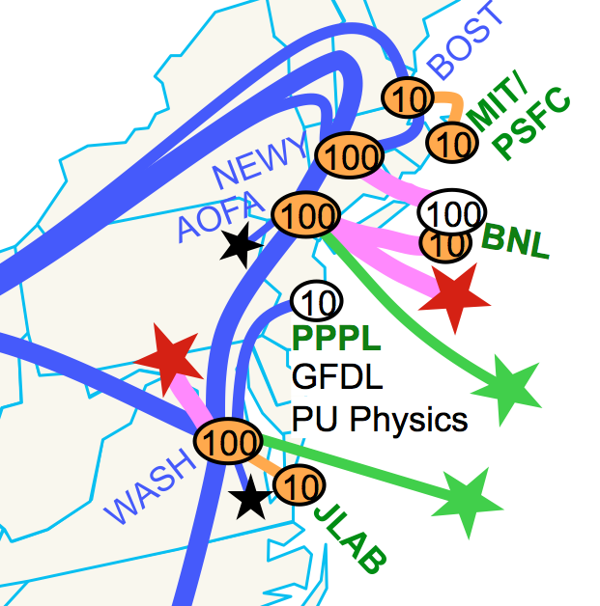
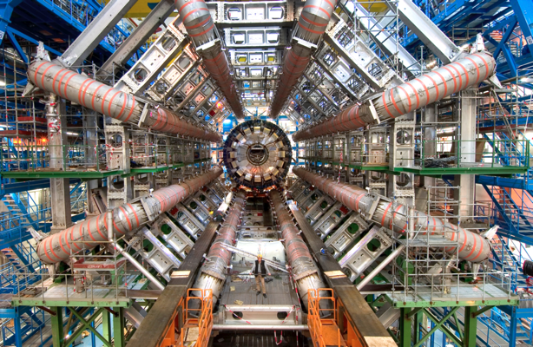
ESnet’s Vision
    Scientific progress is completely unconstrained by the physical location of instruments, people, computational resources, or data.

Slide 5
Overview
What is ESnet?
Science DMZ Motivation and Introduction
Science DMZ Architecture
Network Monitoring
Data Transfer Nodes & Applications
On the Topic of Security
User Engagement
Wrap Up

Slide 6
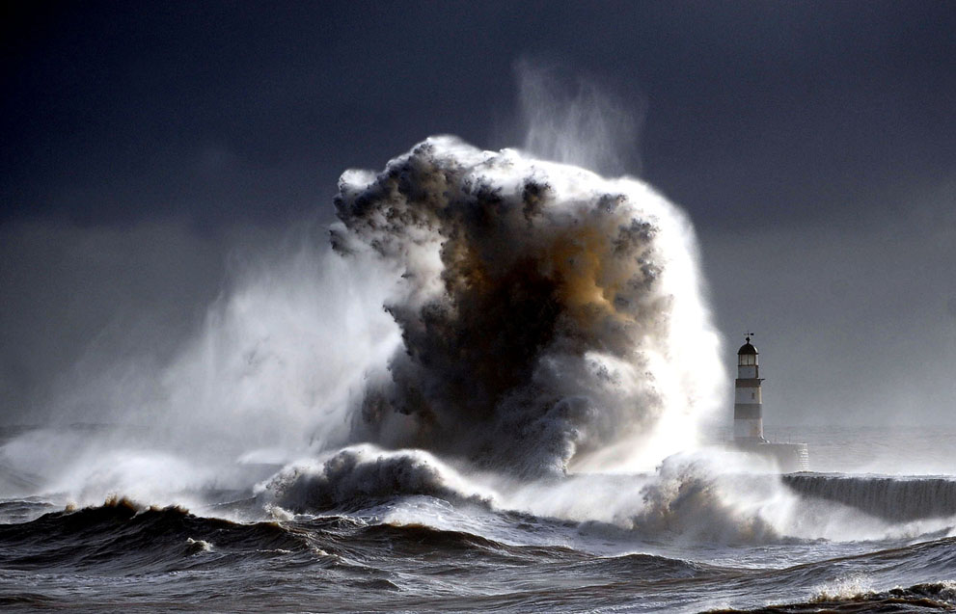
What is there to worry about?
Genomics
  Sequencer data volume increase = 12x in 3 years
  Sequencer cost decrease = 10x in 3 years
High Energy Physics
  LHC experimental data = petabytes of data/year
  Peak data rates increase 3-5x over 5 years
Light Sources
  Many detectors on a Moore’s Law curve
  Data volumes changing operational model
© Owen Humphreys/National Geographic Traveler Photo Contest 2013
Common Threads
  Increased capability, greater need for data mobility due to span/depth of collaboration space
  Global is the new local. Research is no longer done within a domain. End to end involves many fiefdoms to cross – and yes this becomes your problem when your users are impacted
The "Campus Cyberinfrastructure - Network Infrastructure and Engineering (CC-NIE CC-IIE)" program:
NSF 13-530: http://www.nsf.gov/pubs/2013/nsf13530/nsf13530.htm
NSF 14-521: http://www.nsf.gov/pubs/2014/nsf14521/nsf14521.htm
Notes:
This should not be news. The news is that there is convergence on how to support things in the network space.

Slide 7
Motivation
Networks are an essential part of data-intensive science
  Connect data sources to data analysis
  Connect collaborators to each other
  Enable machine-consumable interfaces to data and analysis resources (e.g. portals), automation, scale
Performance is critical
  Exponential data growth
  Constant human factors
  Data movement and data analysis must keep up
Effective use of wide area (long-haul) networks by scientists has historically been difficult
Notes:
Human factors – attention span, ability to manage complexity
It is our hope that this work enables effective use of networking for science

Slide 8

TCP – Ubiquitous and Fragile
© 2013 icanhascheezburger.com
Networks provide connectivity between hosts – how do hosts see the network?
  From an application’s perspective, the interface to “the other end” is a socket
  Communication is between applications – mostly over TCP
TCP – the fragile workhorse
  TCP is (for very good reasons) timid – packet loss is interpreted as congestion
  Packet loss in conjunction with latency is a performance killer
  Like it or not, TCP is used for the vast majority of data transfer applications (more than 95% of ESnet traffic is TCP)

Slide 9
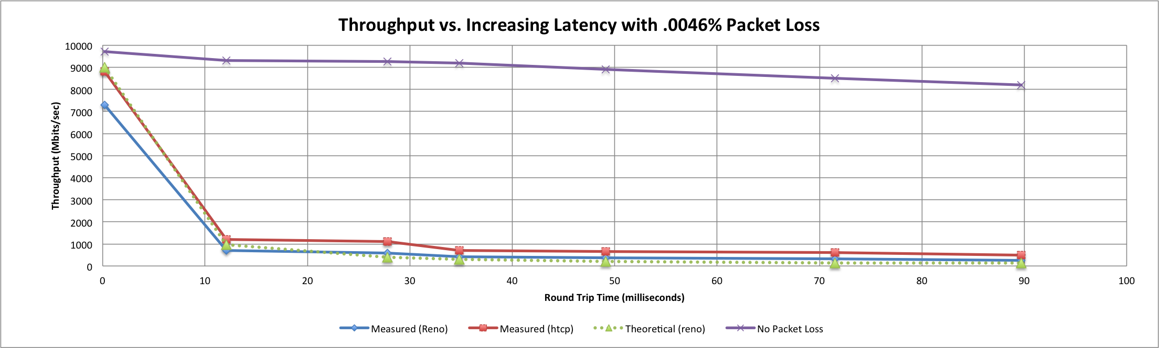
A small amount of packet loss makes a huge difference in TCP performance
Throughput vs. increasing latency on a 10Gb/s link with 0.0046% packet loss
Local
(LAN)
With loss, high performance beyond metro distances is essentially impossible
International
Metro Area
Regional
Continental
Measured (TCP Reno)
Measured (HTCP)
Theoretical (TCP Reno)
Measured (no loss)
Notes:
Beyond your metro area, zero loss is essentially required for performance
Where are your collaborators? Where are your users?
When global collaboration is the norm, nobody can afford to be a local-only resource

Slide 10
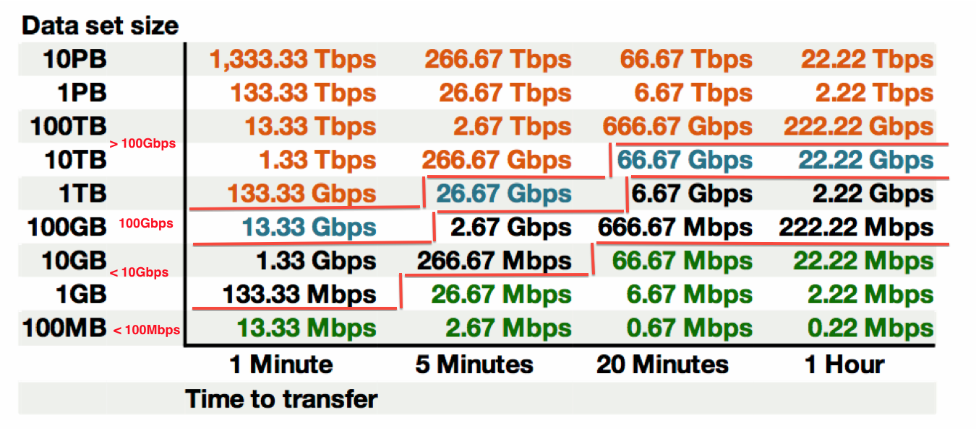
Sample Data Transfer Rates
This table available at:
http://fasterdata.es.net/fasterdata-home/requirements-and-expectations/

Slide 11
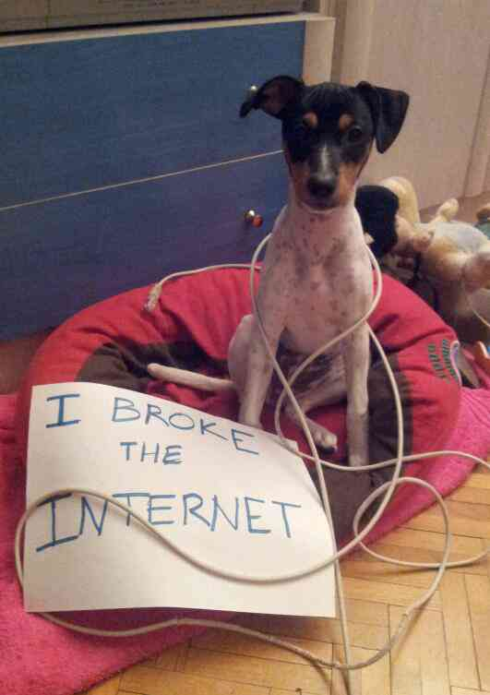
Working With TCP In Practice
Far easier to support TCP than to fix TCP
  People have been trying to fix TCP for years – limited success
  Like it or not we’re stuck with TCP in the general case
Pragmatically speaking, we must accommodate TCP
  Sufficient bandwidth to avoid congestion
  Zero packet loss
  Verifiable infrastructure
    Networks are complex
    Must be able to locate problems quickly
    Small footprint is a huge win – small number of devices so that problem isolation is tractable
© Dog Shaming 2012
Notes:
TCP fixes are significant

Slide 12
Overview
What is ESnet?
Science DMZ Motivation and Introduction
Science DMZ Architecture
Network Monitoring
Data Transfer Nodes & Applications
On the Topic of Security
User Engagement
Wrap Up

Slide 13

Putting A Solution Together
Effective support for TCP-based data transfer
  Design for correct, consistent, high-performance operation
  Design for ease of troubleshooting
Easy adoption is critical
  Large laboratories and universities have extensive IT deployments
  Drastic change is prohibitively difficult
Cybersecurity – defensible without compromising performance
Borrow ideas from traditional network security
  Traditional DMZ – separate enclave at network perimeter (“Demilitarized Zone”)
    Specific location for external-facing services
    Clean separation from internal network
  Do the same thing for science – Science DMZ

Slide 14
The Data Transfer Superfecta: Science DMZ Model
  Engagement
Partnerships
Education & Consulting
Resources & Knowledgebase
Engagement with Network Users
perfSONAR
Enables fault isolation
Verify correct operation
Widely deployed in ESnet and other networks, as well as sites and facilities
  Data Transfer Node
High performance
Configured for data transfer
Proper tools
Dedicated Systems for Data Transfer
Performance Testing & Measurement
Network Architecture
Science DMZ
Dedicated location for DTN
Proper security
Easy to deploy - no need to redesign the whole network

Slide 15
Ad Hoc DTN Deployment
This is often what gets tried first
Data transfer node deployed where the owner has space
  This is often the easiest thing to do at the time
  Straightforward to turn on, hard to achieve performance
If present, perfSONAR is at the border
  This is a good start
  Need a second one next to the DTN
Entire LAN path has to be sized for data flows
Entire LAN path is part of any troubleshooting exercise
This usually fails to provide the necessary performance.

Slide 16
Small-scale Science DMZ Deployment
Add-on to existing network infrastructure
  All that is required is a port on the border router
  Small footprint, pre-production commitment
Easy to experiment with components and technologies
  DTN prototyping
  perfSONAR testing
Limited scope makes security policy exceptions easy
  Only allow traffic from partners
  Add-on to production infrastructure – lower risk

Slide 17
A better approach: simple Science DMZ

Slide 18
Multiple Projects

Slide 19
Supercomputer Center

Slide 20
Common Threads
Two common threads exist in all these examples
Accommodation of TCP
  Wide area portion of data transfers traverses purpose-built path
  High performance devices that don’t drop packets
Ability to test and verify
  When problems arise (and they always will), they can be solved if the infrastructure is built correctly
  Small device count makes it easier to find issues
  Multiple test and measurement hosts provide multiple views of the data path
    perfSONAR nodes at the site and in the WAN
    perfSONAR nodes at the remote site

Slide 21
Overview
What is ESnet?
Science DMZ Motivation and Introduction
Science DMZ Architecture
Network Monitoring
Data Transfer Nodes & Applications
On the Topic of Security
User Engagement
Wrap Up

Slide 22
Performance Monitoring
Everything may function perfectly when it is deployed
Eventually something is going to break
  Networks and systems are complex
  Bugs, mistakes, …
  Sometimes things just break – this is why we buy support contracts
Must be able to find and fix problems when they occur
TCP was intentionally designed to hide all transmission errors from the user:
  “As long as the TCPs continue to function properly and the internet system does not become completely partitioned, no transmission errors will affect the users.” (From RFC793, 1981)
Notes:
Lead to soft failures

Slide 23
Soft Network Failures – Hidden Problems
“Soft failures” result in degraded capability
  Connectivity exists
  Performance impacted
  Typically something in the path is functioning, but not well
Hard failures are easy to detect
  Link down, system crash, software crash
  Traditional network/system monitoring tools designed to quickly find hard failures
Soft failures are hard to detect with traditional methods
  No obvious single event
  Sometimes no indication at all of any errors
Independent testing is the only way to reliably find soft failures

Slide 24
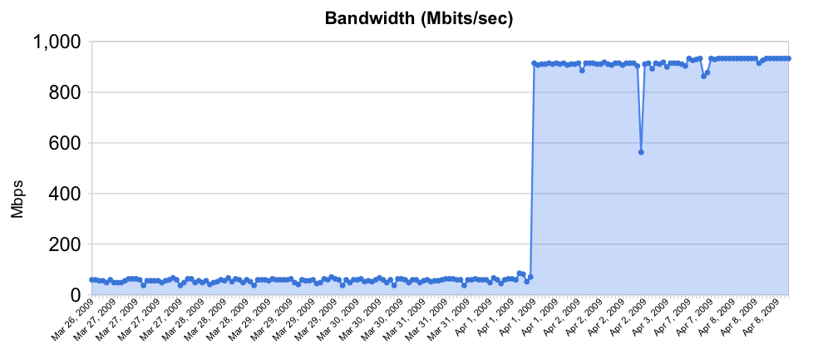
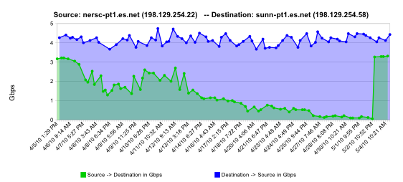
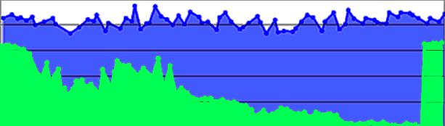
Sample Soft Failures
Rebooted router with full route table
normal performance
Gradual failure of optical line card
Gb/s
degrading performance
repair
one month

Slide 25
Testing Infrastructure – perfSONAR
perfSONAR is:
  A widely-deployed test and measurement infrastructure
    ESnet, Internet2, US regional networks, international networks
    Laboratories, supercomputer centers, universities
  A suite of test and measurement tools
  A collaboration that builds and maintains the toolkit
By installing perfSONAR, a site can leverage over 900 test servers deployed around the world
perfSONAR is ideal for finding soft failures
  Alert to existence of problems
  Fault isolation
  Verification of correct operation

Slide 26
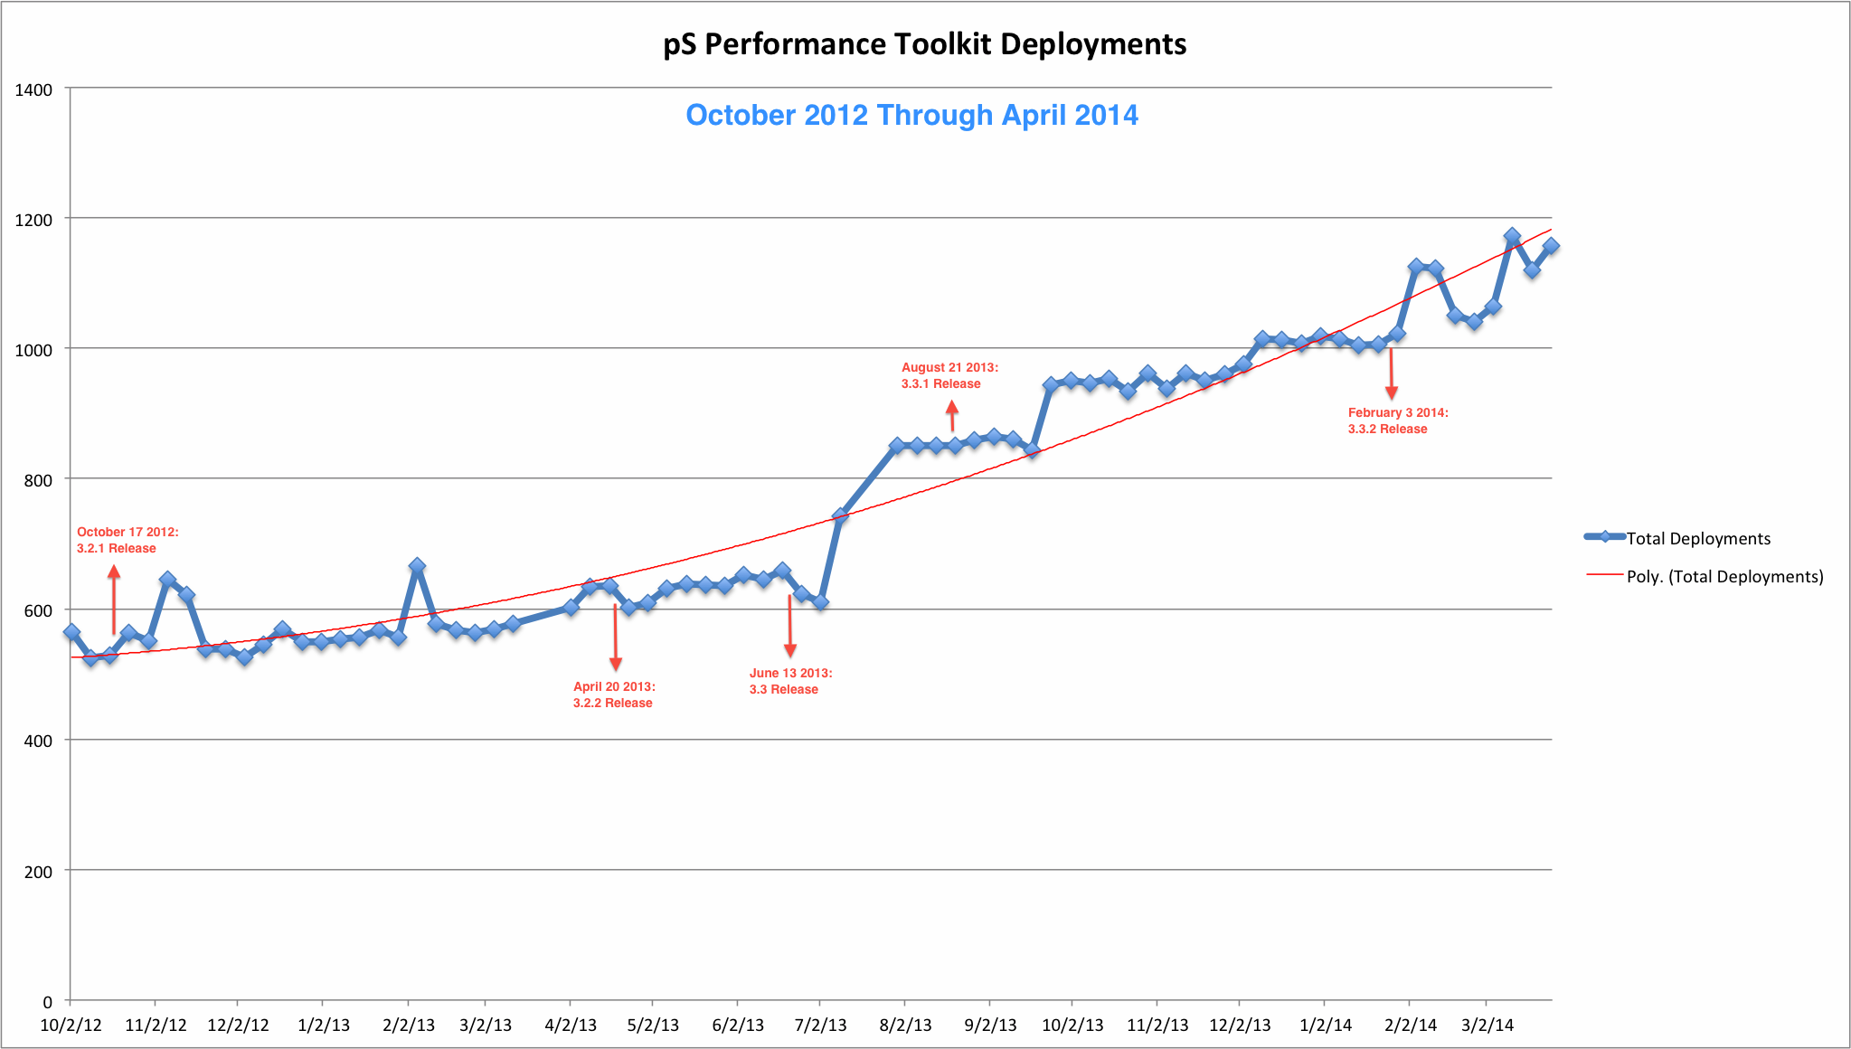
perfSONAR Deployment Footprint

Slide 27
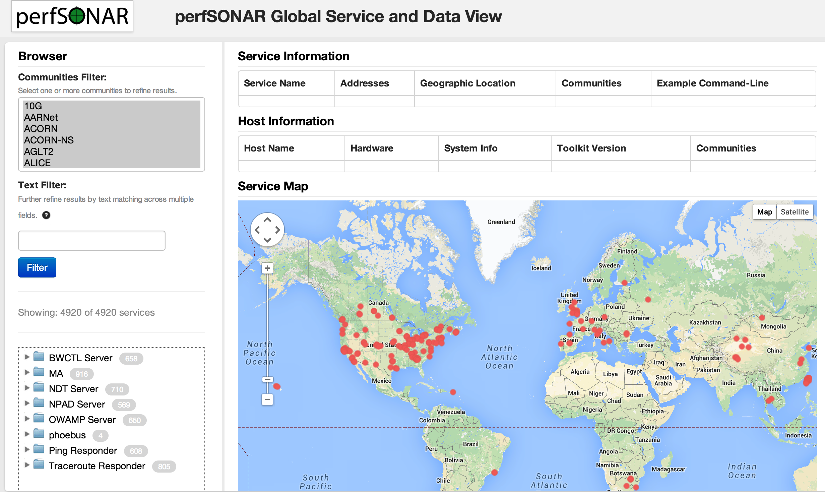
Lookup Service Directory Search: http://stats.es.net/ServicesDirectory/

Slide 28
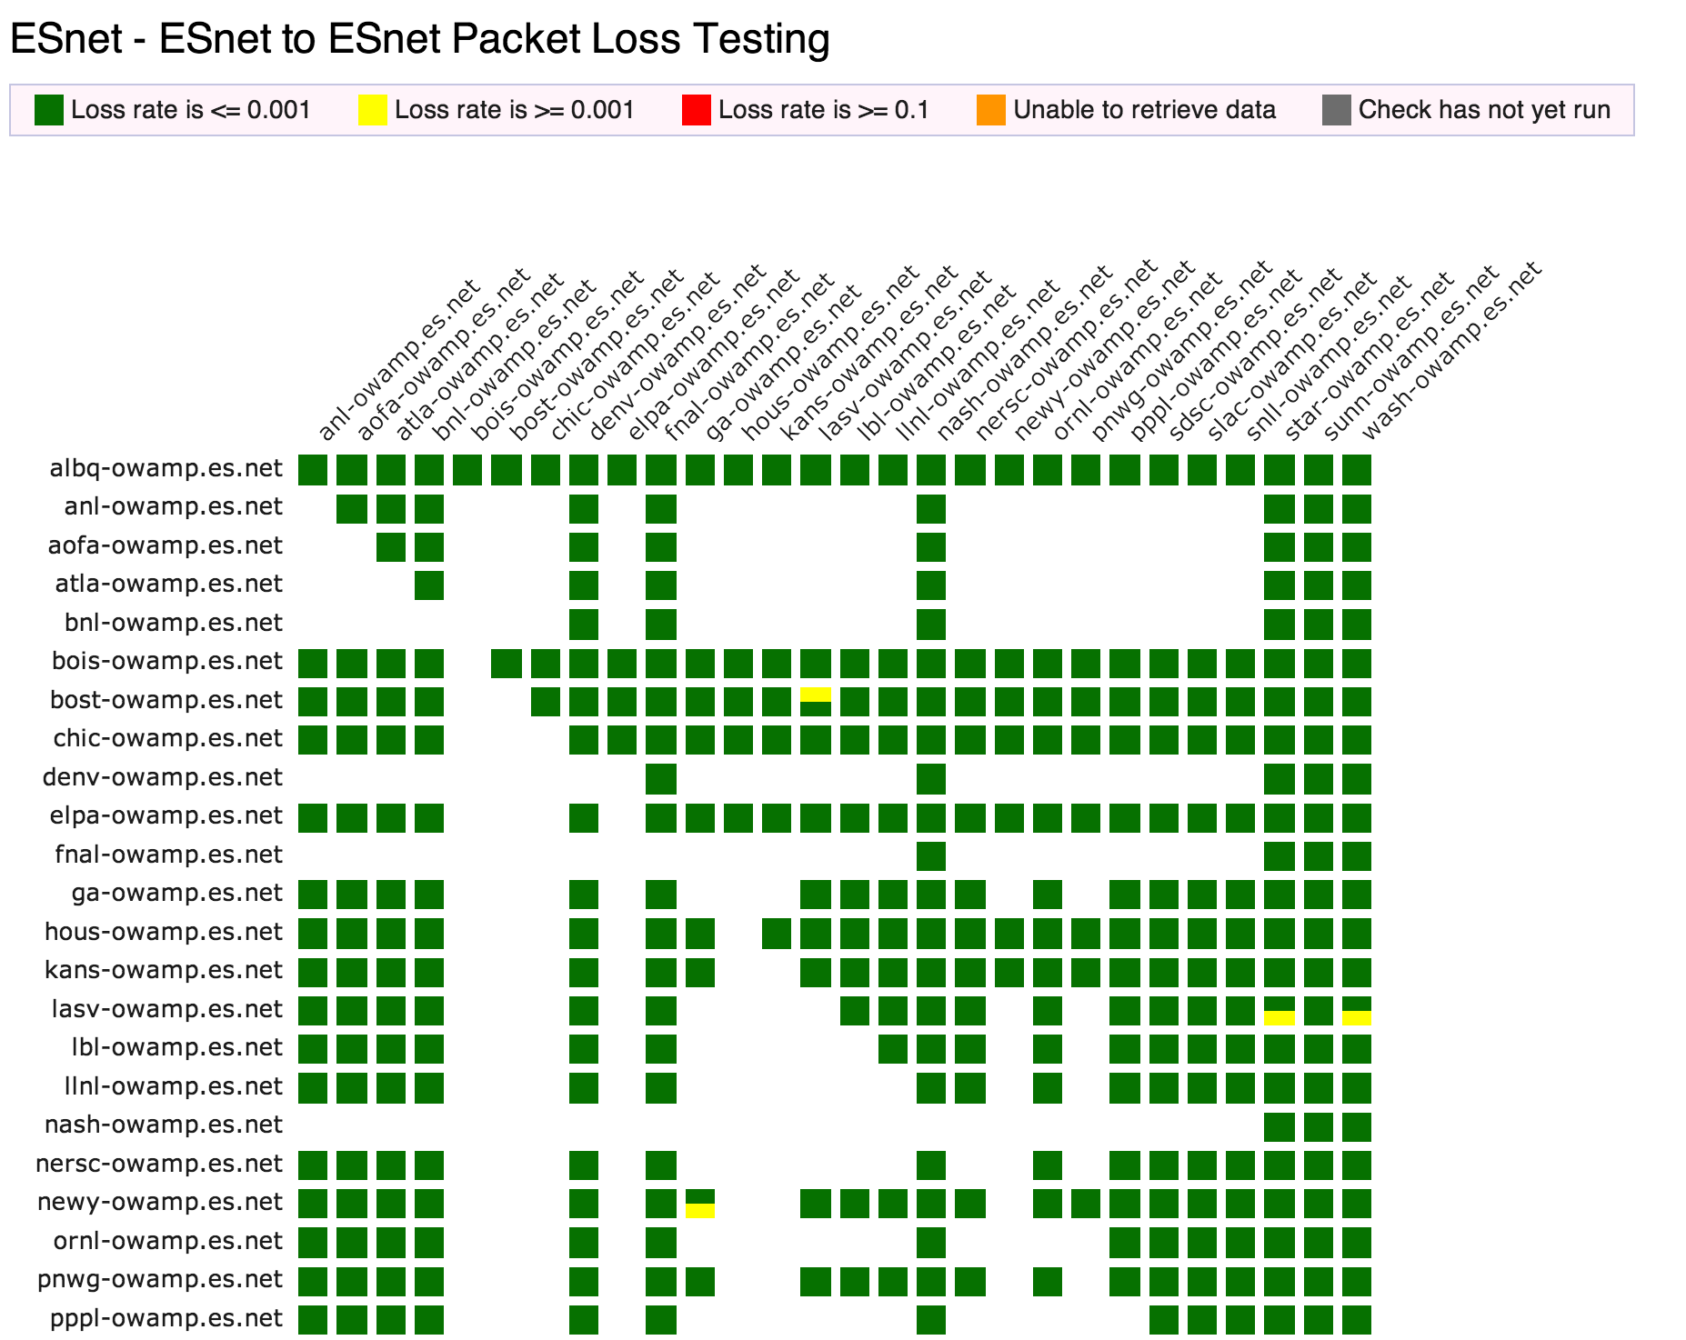
perfSONAR Dashboard: http://ps-dashboard.es.net

Slide 29
Overview
What is ESnet?
Science DMZ Motivation and Introduction
Science DMZ Architecture
Network Monitoring
Data Transfer Nodes & Applications
On the Topic of Security
User Engagement
Wrap Up

Slide 30
Dedicated Systems – The Data Transfer Node
The DTN is dedicated to data transfer
Set up specifically for high-performance data movement
  System internals (BIOS, firmware, interrupts, etc.)
  Network stack
  Storage (global filesystem, Fibrechannel, local RAID, etc.)
  High performance tools
  No extraneous software
Limitation of scope and function is powerful
  No conflicts with configuration for other tasks
  Small application set makes cybersecurity easier

Slide 31
Data Transfer Tools For DTNs
Parallelism is important
  It is often easier to achieve a given performance level with four parallel connections than one connection
  Several tools offer parallel transfers, including Globus/GridFTP
Latency interaction is critical
  Wide area data transfers have much higher latency than LAN transfers
  Many tools and protocols assume a LAN
Workflow integration is important
Key tools: Globus Online, HPN-SSH
Notes:
DTN is entry point for data from multi-facility workflows

Slide 32

Legacy Data Transfer Tools
In addition to the network, using the right data transfer tool is critical
Sample Results:
Data transfer from Berkeley, CA to Argonne, IL (near Chicago). RTT = 53 ms, network capacity = 10Gbps.
    Tool Throughput
    scp: 140 Mbps
    HPN patched scp: 1.2 Gbps
    ftp 1.4 Gbps
    GridFTP, 4 streams 5.4 Gbps
    GridFTP, 8 streams 6.6 Gbps
    Note that to get more than 1 Gbps (125 MB/s) disk to disk requires RAID (e.g. data distributed over multiple disks and accessed in parallel).

Slide 33
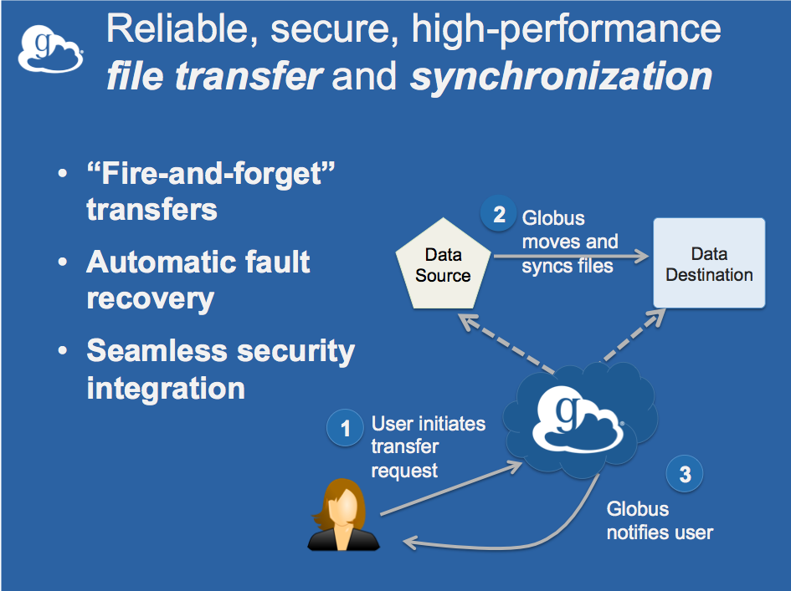

Slide 34
Overview
What is ESnet?
Science DMZ Motivation and Introduction
Science DMZ Architecture
Network Monitoring
Data Transfer Nodes & Applications
On the Topic of Security
User Engagement
Wrap Up

Slide 35

Science DMZ Security
Goal – disentangle security policy and enforcement for science flows from security for business systems
Rationale
  Science data traffic is simple from a security perspective
  Narrow application set on Science DMZ
    Data transfer, data streaming packages
    No printers, document readers, web browsers, building control systems, financial databases, staff desktops, etc.
  Security controls that are typically implemented to protect business resources often cause performance problems
Separation allows each to be optimized
Not “how much” security, but how the security is implemented

Slide 36
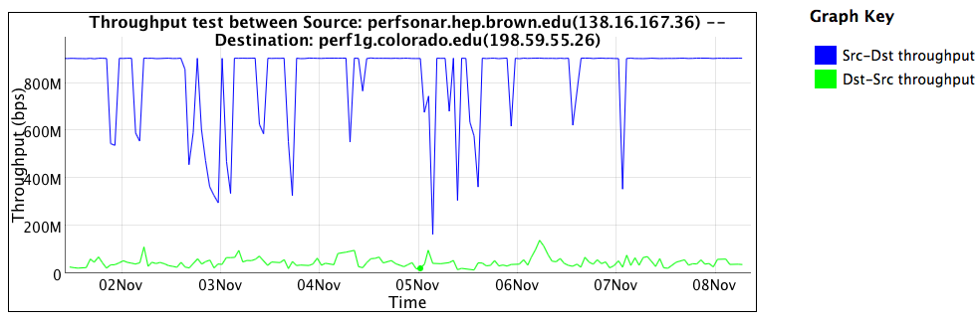
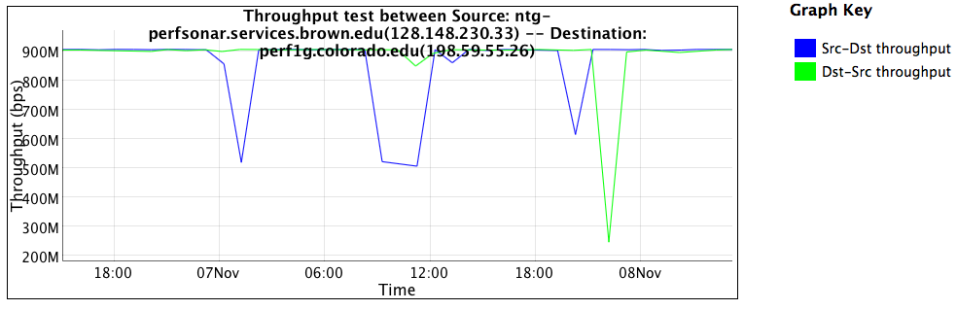
Firewall Performance Example
Observed performance, via perfSONAR, through a firewall:
Observed performance, via perfSONAR, bypassing firewall:
Almost 20 times
slower!
Traffic was unimpeded by
additional processing or
resource constraints

Slide 37
Security Without Firewalls
Does this mean we ignore security? NO!
  We must protect our systems
  Just do security without preventing science
  You can do packet filtering without using a firewall
Example – firewall rules for science traffic use address/port
  Instead implement filtering on Science DMZ router. Protect hosts and services on a direct basis (instead of blanket policy)
  Science wins – increased performance
  Business network wins – no need to size the firewall for science data deluge (10G firewalls are more expensive than 1G)
Key point – security policies and mechanisms that protect the Science DMZ should be implemented so that they do not compromise performance

Slide 38
Overview
What is ESnet?
Science DMZ Motivation and Introduction
Science DMZ Architecture
Network Monitoring
Data Transfer Nodes & Applications
On the Topic of Security
User Engagement
Wrap Up

Slide 39
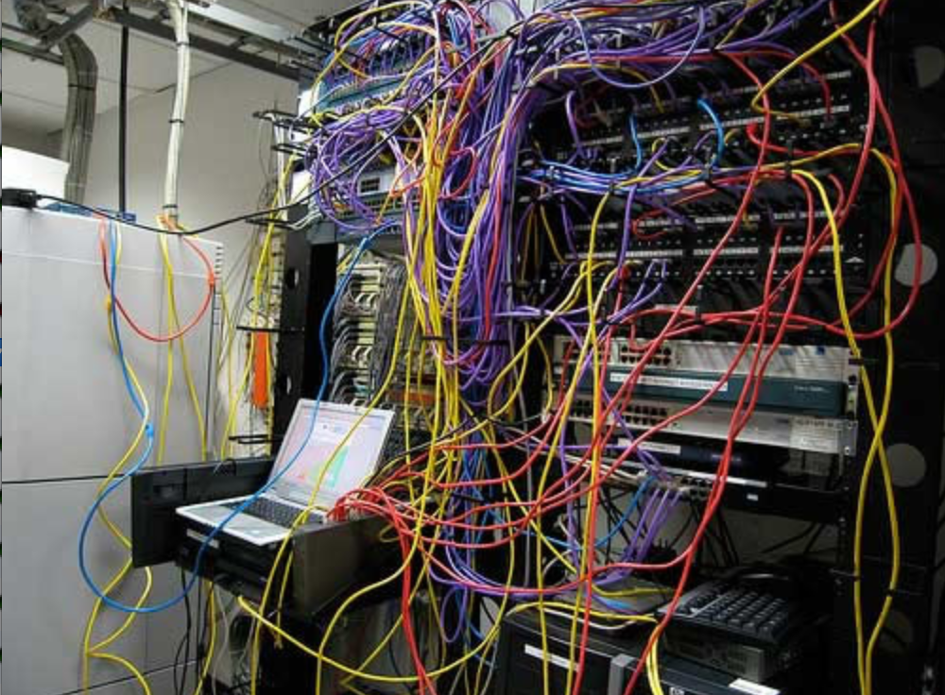
Engagement - Challenges to Network Adoption
Causes of performance issues are complicated for users.
Lack of communication and collaboration between the CIO’s office and researchers on campus.
Lack of IT expertise within a science collaboration or experimental facility
User’s performance expectations are low (“The network is too slow”, “I tried it and it didn’t work”).
Cultural change is hard (“we’ve always shipped disks!”).
Scientists want to do science not IT support
The Capability Gap

Slide 40
Overview
What is ESnet?
Science DMZ Motivation and Introduction
Science DMZ Architecture
Network Monitoring
Data Transfer Nodes & Applications
On the Topic of Security
User Engagement
Wrap Up

Slide 41
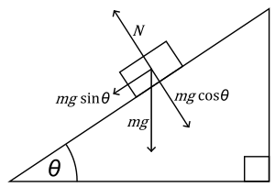


The Science DMZ in 1 Slide
Consists of three key components, all required:
“Friction free” network path
  Highly capable network devices (wire-speed, deep queues)
  Virtual circuit connectivity option
  Security policy and enforcement specific to science workflows
  Located at or near site perimeter if possible
Dedicated, high-performance Data Transfer Nodes (DTNs)
  Hardware, operating system, libraries all optimized for transfer
  Includes optimized data transfer tools such as Globus Online and GridFTP
Performance measurement/test node
  perfSONAR
  Details at http://fasterdata.es.net/science-dmz/
© 2013 Wikipedia
© 2013 Globus

Slide 42
Links
  ESnet fasterdata knowledge base
    http://fasterdata.es.net/
  Science DMZ paper from SC13
    http://www.es.net/assets/pubs_presos/sc13sciDMZ-final.pdf
  Science DMZ email list
    https://gab.es.net/mailman/listinfo/sciencedmz
  perfSONAR
    http://psps.perfsonar.net/
  Additional material
    http://fasterdata.es.net/science-dmz/
    http://fasterdata.es.net/host-tuning/

Slide 43
A Brief Overview of the Science DMZ
Questions/Comments/Criticisms?
Jason Zurawski - zurawski@es.net
ESnet Science Engagement – engage@es.net
http://fasterdata.es.net

Slide 44
Extra Slides
Router Buffering

Slide 45
Multiple Ingress Data Flows, Common Egress
Hosts will typically send packets at the speed of their interface (1G, 10G, etc.)
  Instantaneous rate, not average rate
  If TCP has window available and data to send, host sends until there is either no data or no window
Hosts moving big data (e.g. DTNs) can send large bursts of back-to-back packets
  This is true even if the average rate as measured over seconds is slower (e.g. 4Gbps)
  On microsecond time scales, there is often congestion
  Router or switch must queue packets or drop them

Slide 46
Router and Switch Output Queues
Interface output queue allows the router or switch to avoid causing packet loss in cases of momentary congestion
In network devices, queue depth (or ‘buffer’) is often a function of cost
  Cheap, fixed-config LAN switches (especially in the 10G space) have inadequate buffering. Imagine a 10G ‘data center’ switch as the guilty party
  Cut-through or low-latency Ethernet switches typically have inadequate buffering (the whole point is to avoid queuing!)
Expensive, chassis-based devices are more likely to have deep enough queues
  Juniper MX and Alcatel-Lucent 7750 used in ESnet backbone
  Other vendors make such devices as well - details are important
  Thx to Jim: http://people.ucsc.edu/~warner/buffer.html
This expense is one driver for the Science DMZ architecture – only deploy the expensive features where necessary

Slide 47
Output Queue Drops – Common Locations

Slide 48
Extra Slides
ALS Use Case/Workflow Design

Slide 49
Photon Science Data Increase
Many detectors are semiconductors
  Similar technology to digital cameras
  Exponential growth
  Increase in sensor area (512x512, 1024x1024, 2048x2048, …)
  Increase in readout rate (1Hz, 10Hz, 100Hz, 1kHz, 1MHz, …)
Data infrastructure needs significant change/upgrade
  Most photon scientists are not “computer people”
    Different from HEP, HPC centers
    They need data issues solved – they don’t want to solve them
    They should not have to be come network experts!
  Physical transport of portable media has reached a breaking point
  Default configs no longer perform well enough

Slide 50
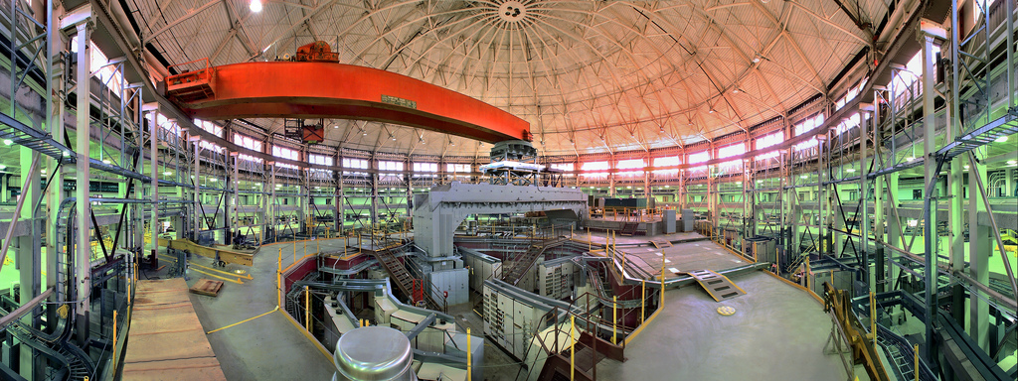
ALS Beamline 8.3.2
Broad science portfolio: Applied science, biology, earth sciences, energy, environmental sciences, geology, cosmological chemistry
Detector upgrade → large increase in data rate/volume (50x)
Detector output: sets of large TIFF files
Beamline scientist Dula Parkinson reached out to LBLnet
LBLnet reached out to ESnet
Infrastructure improvements
  Used perfSONAR to find failing router line card
  DTN built from Fasterdata reference design
NERSC collaboration
  Data workflow (python scripts, etc.)
  Data analysis
Collaboration is ongoing

Slide 51
Original Workflow Infrastructure
Notes:
Data acquisition uses LabView
Data written to shared drive on firewalled Windows server
Analysis done on workstations
High-powered Windows hosts
Mix of proprietary and open-source tools
Scientists can be physically present or use Remote Desktop
Data export post-analysis – physical transport of portable media
USB hard drives

Slide 52
Improved Workflow Infrastructure
Notes:
Data acquisition uses LabView
Data written to SAMBA share on beamline Linux DTN
Writing via SAMBA is faster than local disk on acquisition computer
Data are TIFF files ~10MB each, ~1000 files per data set
Current max performance is ~200MB/sec
Automated workflow pushes data to NERSC for analysis
Workflow managed using signal files
Data set is rolled up into an HDF5 file
Python scripts drive Globus Online CLI
Data transferred to NERSC DTNs at ~300MB/sec
Analysis results pulled back to beamline DTN
Additional analysis done on workstations (still use some proprietary tools)
Primary data export is via Globus Online from beamline DTN

Slide 53
Extra Slides
SDN on the DMZ

Slide 54
Science DMZ – Flexible Design Pattern
The Science DMZ design pattern is highly adaptable to research
Deploying a research Science DMZ is straightforward
  The basic elements are the same
    Capable infrastructure designed for the task
    Test and measurement to verify correct operation
    Security policy well-matched to the environment, application set is strictly limited to reduce risk
  Connect the research DMZ to other resources as appropriate
The same ideas apply to supporting an SDN effort
  Test/research areas for development
  Transition to production as technology matures and need dictates
  One possible trajectory follows…

Slide 55
Science DMZ – Separate SDN Connection
Notes:
Initial deployment brings SDN services to research DMZ via a separate link

Slide 56
Science DMZ – Production SDN Connection
Notes:
Once SDN software for the switch platform is solid and operational models are clear, production Science DMZ supports SDN

Slide 57
Science DMZ – SDN Campus Border
Notes:
When the entire production path supports SDN, SDN is another production service on the Science DMZ and we’re back to the original picture
ESnet5 supports routed traffic and OSCARS on the same platform in a similar way

