Slide 1

FAIL-transfer: Removing the Mystery of Network Performance from Scientific Data Movement
Jason Zurawski – zurawski@es.net
Science Engagement Engineer, ESnet
Lawrence Berkeley National Laboratory
XSEDE Campus Champions Webinar
August 20th 2014

Slide 2
Outline
Introduction & Motivation
Network Support for Science
Data Mobility Expectations & Realities
Preparing the Campus
Conclusions

Slide 3
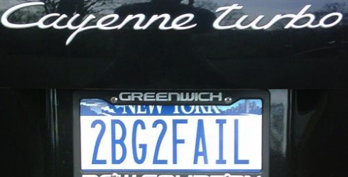
ESnet at a Glance
High-speed national network, optimized for DOE science missions:
  connecting 40 labs, plants and facilities with >100 networks
  $32.6M in FY14, 42FTE
  older than commercial Internet, growing twice as fast
$62M ARRA grant for 100G upgrade:
  transition to new era of optical networking
  world’s first 100G network at continental scale
Culture of urgency:
  4 awards in past 3 years
  R&D100 in FY13
  “5 out of 5” for customer satisfaction in last review
  Dedicated staff to support the mission of science

Slide 4
Network as Infrastructure Instrument
SEAT
100
LIGO
10
PNNL
BOST
STAR
10
MIT/
PSFC
INL
NEWY
100
10
10
10
100
100
AOFA
100
100
LBNL
JGI
BOIS
FNAL
10
10
BNL
10
SACR
ANL
100
10
100
100
1
PPPL
SUNN
AMES
100
CLEV
GFDL
100
10
SNLL
SALT
CHIC
100
PU Physics
NERSC
10
100
100
LLNL
1
100
100
WASH
10
SLAC
NREL
DENV
KANS
ORNL
JLAB
1
LASV
LANL
100
100
LOSA
10
100
SREL
SDSC
10
ALBU
100
10
SNLA
NASH
100
1
10
CHAT
ATLA
GA
ELPA
100
HOUS
100
    Vision: Scientific progress will be completely unconstrained by the physical location of instruments, people, computational resources, or data.
Notes:
4
We used to think of networks as passive infrastructures for service delivery.
But that’s changing. For a number reasons, networks are evolving into much more flexible, programmable systems.
I like to say that they are becoming extensions of the discovery instruments they serve.

Slide 5
Outline
Introduction & Motivation
Network Support for Science
Data Mobility Expectations & Realities
Preparing the Campus
Conclusions

Slide 6
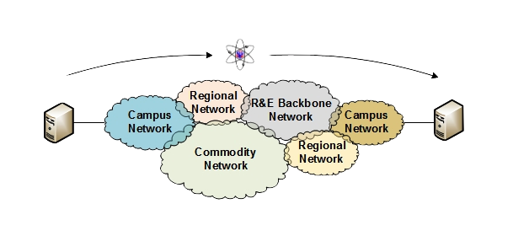
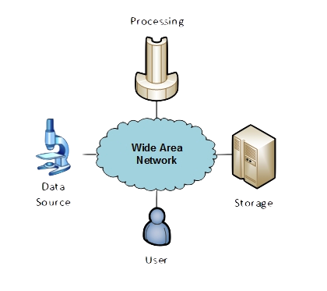
The R&E Community
The global Research & Education network ecosystem is comprised of hundreds of international, national, regional and local-scale resources – each independently owned and operated.
This complex, heterogeneous set of networks must operate seamlessly from “end to end” to support science and research collaborations that are distributed globally.
Data mobility is required; there is no liquid market for HPC resources (people use what they can get – DOE, XSEDE, NOAA, etc. etc.)
  To stay competitive, we must learn the science, and support it
  This may mean making sure your network, and the networks of overs, are functional
Notes:
Issues are

Slide 7
Understanding Data Trends
http://www.es.net/about/science-requirements/network-requirements-reviews/
7 – ESnet Science Engagement (engage@es.net) - 8/20/14
Notes:
Requirements workshops for all six program offices within the DOE office of Science

Slide 8
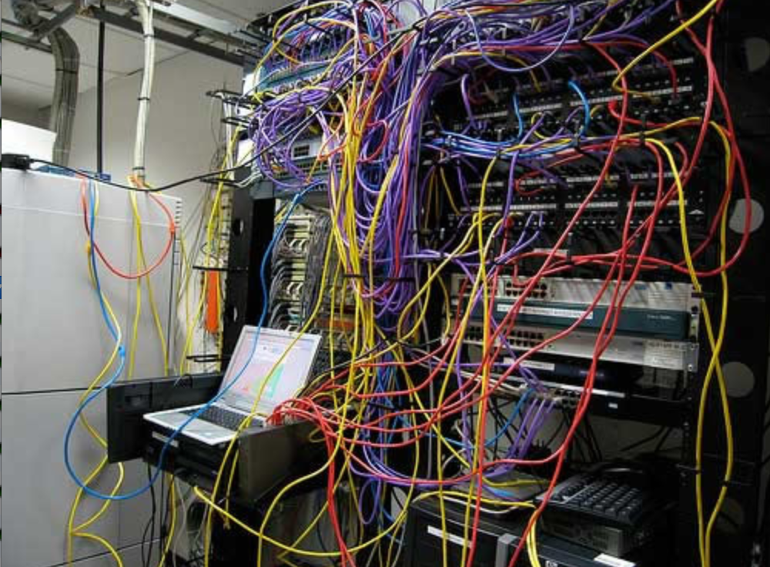
Challenges to Network Adoption
Causes of performance issues are complicated for users.
Lack of communication and collaboration between the CIO’s office and researchers on campus.
Lack of IT expertise within a science collaboration or experimental facility
User’s performance expectations are low (“The network is too slow”, “I tried it and it didn’t work”).
Cultural change is hard (“we’ve always shipped disks!”).
Scientists want to do science not IT support
The Capability Gap
8 – ESnet Science Engagement (engage@es.net) - 8/20/14

Slide 9

Lets Talk Performance …
"In any large system, there is always something broken.”
Jon Postel
Modern networks are occasionally designed to be one-size-fits-most
  e.g. if you have ever heard the phrase “converged network”, the design is to facilitate CIA (Confidentiality, Integrity, Availability)
  This is not bad for protecting the HVAC system from hackers.
Its all TCP
  Bulk data movement is a common thread (move the data from the microscope, to the storage, to the processing, to the people – and they are all sitting in different facilities)
  This fails when TCP suffers due to path problems (ANYWHERE in the path)
  its easier to work with TCP than to fix it (20+ years of trying…)
TCP suffers the most from unpredictability; Packet loss/delays are the enemy
  Small buffers on the network gear and hosts
  Incorrect application choice
  Packet disruption caused by overzealous security
  Congestion from herds of mice
It all starts with knowing your users, and knowing your network

Slide 10
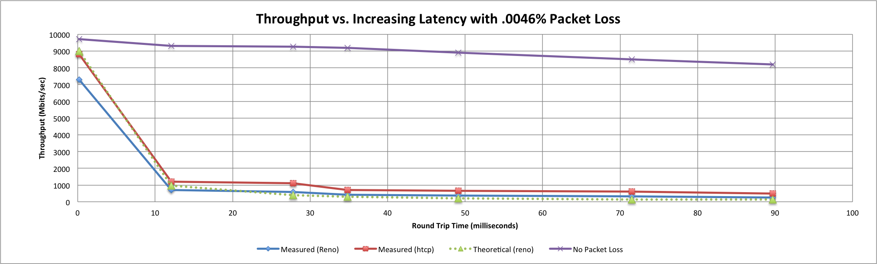
A small amount of packet loss makes a huge difference in TCP performance
Local
(LAN)
With loss, high performance beyond metro distances is essentially impossible
International
Metro Area
Regional
Continental
Measured (TCP Reno)
Measured (HTCP)
Theoretical (TCP Reno)
Measured (no loss)
Notes:
This is an annotated version of the plot from the Science DMZ paper
Beyond your metro area, zero loss is essentially required for high performance
Where are your collaborators? Where are your users?
When global collaboration is the norm, nobody can afford to be a local-only resource

Slide 11

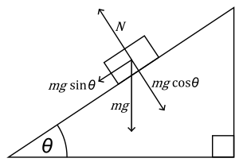

The Science DMZ in 1 Slide
Consists of three key components, all required:
“Friction free” network path
  Highly capable network devices (wire-speed, deep queues)
  Virtual circuit connectivity option
  Security policy and enforcement specific to science workflows
  Located at or near site perimeter if possible
Dedicated, high-performance Data Transfer Nodes (DTNs)
  Hardware, operating system, libraries all optimized for transfer
  Includes optimized data transfer tools such as Globus and GridFTP
Performance measurement/test node
  perfSONAR
Education & Engagement w/ End Users
  Details at http://fasterdata.es.net/science-dmz/
© 2013 Globus
© 2013 Wikipedia
11 – ESnet Science Engagement (engage@es.net) - 8/20/14

Slide 12
The Abstract Science DMZ

Slide 13
But … It’s Not Just the Network
Perhaps you are saying to yourself “I have no control over parts of my campus, let alone the 5 networks that sit between me and my collaborators”
  Agree to disagree – network are like ogres, and ogres are like onions; both stink, and have layers*
  Significant gains are possible in isolated areas of the OSI Stack
Things “you” control:
  Choice of data movement applications (say no to SCP and RSYNC)
  Configuration of local gear (hosts, network devices)
  Placement and configuration of diagnostic tools, e.g. perfSONAR
  Use of the diagnostic tools
Things that need some help:
  Configuration of remote gear
  Addressing issues when the diagnostic tools alarm
  Getting someone to “care”
*Google it

Slide 14
Outline
Introduction & Motivation
Network Support for Science
Data Mobility Expectations & Realities
Preparing the Campus
Conclusions

Slide 15
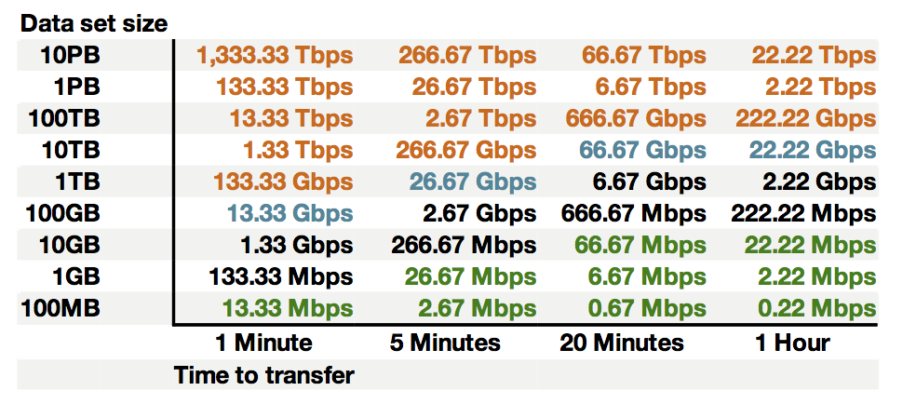
Sample Data Transfer Rates
This table available at:
http://fasterdata.es.net/fasterdata-home/requirements-and-expectations/
15 – ESnet Science Engagement (engage@es.net) - 8/20/14

Slide 16
Simulating Performance
It’s infeasible to perform at-scale data movement all the time – as we see in other forms of science, we need to rely on simulations
Network performance comes down to a couple of key metrics:
  Throughput (e.g. “how much can I get out of the network”)
  Latency (time it takes to get to/from a destination)
  Packet loss/duplication/ordering (for some sampling of packets, do they all make it to the other side without serious abnormalities occurring?)
  Network utilization (the opposite of “throughput” for a moment in time)
We can get many of these from a selection of active and passive measurement tools – enter the perfSONAR Toolkit

Slide 17
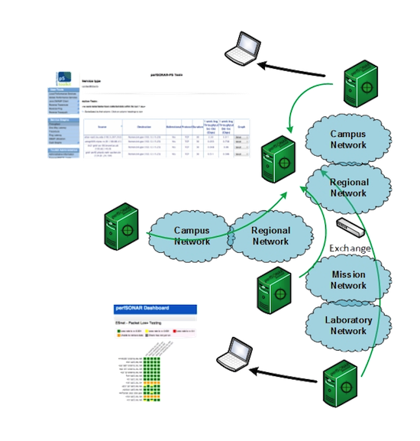
Toolkit Use Case
The general use case is to establish some set of tests to other locations/facilities
  Sometimes you establish GUIs on top of this – XSEDE has one
To answer the what/why questions:
  Regular testing with select tools helps to establish patterns – how much bandwidth we would see during the course of the day – or when packet loss appears
  We do this to ‘points of interest’ to see how well a real activity (e.g. Globus transfer) would do.
If performance is ‘bad’, don’t expect much from the data movement tool

Slide 18
Its All About the Buffers
A prequel – The Bandwidth Delay Product
  The amount of “in flight” data allowed for a TCP connection (BDP = bandwidth * round trip time)
  Example: 1Gb/s cross country, ~100ms
    1,000,000,000 b/s * .1 s = 100,000,000 bits
    100,000,000 / 8 = 12,500,000 bytes
    12,500,000 bytes / (1024*1024) ~ 12MB
  Major OSs default to a base of 64k.
    For those playing at home, the maximum throughput with a TCP window of 64 KByte for RTTs:
      10ms = 50Mbps
      50ms = 10Mbps
      100ms = 5Mbps
    Autotuning does help by growing the window when needed. Do make this work properly, the host needs tuning: https://fasterdata.es.net/host-tuning/
Ignore the math aspect, its really just about making sure there is memory to catch packets. As the speed increases, there are more packets. If there is not memory, we drop them, and that makes TCP sad.
  Memory on hosts, and network gear

Slide 19
What BWCTL Tells Us
Lets start by describing throughput, which is vague.
  Capacity: link speed
    Narrow Link: link with the lowest capacity along a path
    Capacity of the end-to-end path = capacity of the narrow link
  Utilized bandwidth: current traffic load
  Available bandwidth: capacity – utilized bandwidth
    Tight Link: link with the least available bandwidth in a path
  Achievable bandwidth: includes protocol and host issues (e.g. BDP!)
All of this is “memory to memory”, e.g. we are not involving a spinning disk (more later)
45 Mbps
10 Mbps
100 Mbps
45 Mbps
source
sink
Narrow Link
Tight Link
(Shaded portion shows background traffic)

Slide 20
What BWCTL Tells Us
BWCTL gives us a number – a number from the iperf2/iperf3/nuttcp tools
[zurawski@wash-pt1 ~]$ bwctl -T iperf -f m -t 10 -i 2 -c sunn-pt1.es.net
bwctl: 83 seconds until test results available
RECEIVER START
bwctl: exec_line: /usr/bin/iperf -B 198.129.254.58 -s -f m -m -p 5136 -t 10 -i 2.000000
bwctl: run_tool: tester: iperf
bwctl: run_tool: receiver: 198.129.254.58
bwctl: run_tool: sender: 198.124.238.34
bwctl: start_tool: 3598657357.738868
------------------------------------------------------------
Server listening on TCP port 5136
Binding to local address 198.129.254.58
TCP window size: 0.08 MByte (default)
------------------------------------------------------------
[ 16] local 198.129.254.58 port 5136 connected with 198.124.238.34 port 5136
[ ID] Interval Transfer Bandwidth
[ 16] 0.0- 2.0 sec 90.4 MBytes 379 Mbits/sec
[ 16] 2.0- 4.0 sec 689 MBytes 2891 Mbits/sec
[ 16] 4.0- 6.0 sec 684 MBytes 2867 Mbits/sec
[ 16] 6.0- 8.0 sec 691 MBytes 2897 Mbits/sec
[ 16] 8.0-10.0 sec 691 MBytes 2898 Mbits/sec
[ 16] 0.0-10.0 sec 2853 MBytes 2386 Mbits/sec
[ 16] MSS size 8948 bytes (MTU 8988 bytes, unknown interface)
bwctl: stop_tool: 3598657390.668028
RECEIVER END
N.B. This is what perfSONAR Graphs – the average of the complete test

Slide 21
What BWCTL Tells Us
Iperf2 is not the tool you are looking for, hello iperf3
[zurawski@wash-pt1 ~]$ bwctl -T iperf3 -f m -t 10 -i 2 -c sunn-pt1.es.net
bwctl: 55 seconds until test results available
SENDER START
bwctl: run_tool: tester: iperf3
bwctl: run_tool: receiver: 198.129.254.58
bwctl: run_tool: sender: 198.124.238.34
bwctl: start_tool: 3598657653.219168
Test initialized
Running client
Connecting to host 198.129.254.58, port 5001
[ 17] local 198.124.238.34 port 34277 connected to 198.129.254.58 port 5001
[ ID] Interval Transfer Bandwidth Retransmits
[ 17] 0.00-2.00 sec 430 MBytes 1.80 Gbits/sec 2
[ 17] 2.00-4.00 sec 680 MBytes 2.85 Gbits/sec 0
[ 17] 4.00-6.00 sec 669 MBytes 2.80 Gbits/sec 0
[ 17] 6.00-8.00 sec 670 MBytes 2.81 Gbits/sec 0
[ 17] 8.00-10.00 sec 680 MBytes 2.85 Gbits/sec 0
[ ID] Interval Transfer Bandwidth Retransmits
Sent
[ 17] 0.00-10.00 sec 3.06 GBytes 2.62 Gbits/sec 2
Received
[ 17] 0.00-10.00 sec 3.06 GBytes 2.63 Gbits/sec
iperf Done.
bwctl: stop_tool: 3598657664.995604
SENDER END
N.B. This is what perfSONAR Graphs – the average of the complete test.

Slide 22
What BWCTL May Not be Telling Us
Why kick iperf2 to the curb?
  No notion of TCP retransmits – and you really want to have this to understand what is going on in a transfer (retransmits = a symptom of something dropping/corrupting/delaying packets)
  CPU waster when you are doing UDP tests, e.g. it can’t give you an accurate notion of network performance since it is host limited
  Entering into non-supported territory (the best reason to switch)
In general, there are other problems with a throughput tool we need to be concerned with – some are controllable and some aren’t
  Relies on the tuning of the host (e.g. did you follow http://fasterdata.es.net recommendations?)
  Single number is not descriptive of what is really going on (e.g. was it 1Mbps because of my local host, local network, remote network, or remote host?)
  Easy to test ‘poorly’ – lets get into that

Slide 23

What BWCTL May Not be Telling Us
Fasterdata Tunings
  Fasterdata recommends a set of tunings (https://fasterdata.es.net/host-tuning/) that are designed to increase the performance of a single COTS host, on a shared network infrastructure
  What this means is that we don’t recommend ‘maximum’ tuning
  We are assuming (expecting? hoping?) the host can do parallel TCP streams via the data transfer application (e.g. Globus)
  Because of that you don’t want to assign upwards of 256M of kernel memory to a single TCP socket – a sensible amount is 32M/64M, and if you have 4 streams you are getting the benefits of 128M/256M (enough for a 10G cross country flow)
  We also strive for good citizenship – its very possible for a single 10G machine to get 9.9Gbps TCP, we see this often. If its on a shared infrastructure, there is benefit to downtuning buffers.
Can you ignore the above? Sure – overtune as you see fit, KNOW YOUR NETWORK, USERS, AND USE CASES
What does this do to perfSONAR testing?

Slide 24
What BWCTL May Not be Telling Us
Regular Testing Setup
  If we don’t ‘max tune’, and run a 20/30 second single streamed TCP test (defaults for the toolkit) we are not going to see 9.9Gbps.
  Think critically: TCP ramp up takes 1-5 seconds (depending on latency), and any tiny blip of congestion will cut TCP performance in half.
  It is common (and in my mind - expected) to see regular testing values on clean networks range between 1Gbps and 5Gbps, latency dependent
  Performance has two ranges – really crappy, and expected (where expected has a lot of headroom). You will know when its really crappy (trust me).
Diagnostic Suggestions
  You can max out BWCTL in this capacity
  Run long tests (-T 60), with multiple streams (-P 4), and large windows (-W 128M); go crazy
  It is also VERY COMMON that doing so will produce different results than your regular testing. It’s a different set of test parameters, its not that the tools are deliberately lying.

Slide 25
What Happens When BWCTL Says “Crappy”
Science does not live by throughput alone – mainly because if its low you need to understand why.
[zurawski@wash-pt1 ~]$ bwctl -T nuttcp -f m -t 10 -i 2 -c sunn-pt1.es.net
bwctl: 41 seconds until test results available
SENDER START
bwctl: exec_line: /usr/bin/nuttcp -vv -p 5004 -i 2.000000 -T 10 -t 198.129.254.58
bwctl: run_tool: tester: nuttcp
bwctl: run_tool: receiver: 198.129.254.58
bwctl: run_tool: sender: 198.124.238.34
bwctl: start_tool: 3598658394.807831
nuttcp-t: v7.1.6: socket
nuttcp-t: buflen=65536, nstream=1, port=5004 tcp -> 198.129.254.58
nuttcp-t: time limit = 10.00 seconds
nuttcp-t: connect to 198.129.254.58 with mss=8948, RTT=62.440 ms
nuttcp-t: send window size = 98720, receive window size = 87380
nuttcp-t: available send window = 74040, available receive window = 65535
nuttcp-r: v7.1.6: socket
nuttcp-r: buflen=65536, nstream=1, port=5004 tcp
nuttcp-r: interval reporting every 2.00 seconds
nuttcp-r: accept from 198.124.238.34
nuttcp-r: send window size = 98720, receive window size = 87380
nuttcp-r: available send window = 74040, available receive window = 65535
6.3125 MB / 2.00 sec = 26.4759 Mbps 27 retrans
3.5625 MB / 2.00 sec = 14.9423 Mbps 4 retrans
3.8125 MB / 2.00 sec = 15.9906 Mbps 7 retrans
4.8125 MB / 2.00 sec = 20.1853 Mbps 13 retrans
6.0000 MB / 2.00 sec = 25.1659 Mbps 7 retrans
nuttcp-t: 25.5066 MB in 10.00 real seconds = 2611.85 KB/sec = 21.3963 Mbps
nuttcp-t: 25.5066 MB in 0.01 CPU seconds = 1741480.37 KB/cpu sec
nuttcp-t: retrans = 58
nuttcp-t: 409 I/O calls, msec/call = 25.04, calls/sec = 40.90
nuttcp-t: 0.0user 0.0sys 0:10real 0% 0i+0d 768maxrss 0+2pf 51+3csw
nuttcp-r: 25.5066 MB in 10.30 real seconds = 2537.03 KB/sec = 20.7833 Mbps
nuttcp-r: 25.5066 MB in 0.02 CPU seconds = 1044874.29 KB/cpu sec
nuttcp-r: 787 I/O calls, msec/call = 13.40, calls/sec = 76.44
nuttcp-r: 0.0user 0.0sys 0:10real 0% 0i+0d 770maxrss 0+4pf 382+0csw
bwctl: stop_tool: 3598658417.214024
N.B. This is what perfSONAR Graphs – the average of the complete test.

Slide 26
What OWAMP Tells Us
OWAMP is designed to tell us when small packets (~50B in size, UDP based) have perturbation when sent end to end.
[zurawski@wash-owamp ~]$ owping sunn-owamp.es.net
Approximately 12.6 seconds until results available
--- owping statistics from [wash-owamp.es.net]:8852 to [sunn-owamp.es.net]:8837 ---
SID: c681fe4ed67f1f0908224c341a2b83f3
first: 2014-01-13T18:27:22.032
last: 2014-01-13T18:27:32.904
100 sent, 12 lost (12.000%), 0 duplicates
one-way delay min/median/max = 31.1/31.1/31.3 ms, (err=0.00502 ms)
one-way jitter = nan ms (P95-P50)
Hops = 7 (consistently)
no reordering
--- owping statistics from [sunn-owamp.es.net]:9182 to [wash-owamp.es.net]:8893 ---
SID: c67cfc7ed67f1f09531c87cf38381bb6
first: 2014-01-13T18:27:21.993
last: 2014-01-13T18:27:33.785
100 sent, 0 lost (0.000%), 0 duplicates
one-way delay min/median/max = 31.4/31.5/31.5 ms, (err=0.00502 ms)
one-way jitter = 0 ms (P95-P50)
Hops = 7 (consistently)
no reordering

Slide 27
What OWAMP Tells Us
OWAMP is a necessity in regular testing – if you aren’t using this you need to be
  Queuing often occurs in a single direction (think what everyone is doing at noon on a college campus)
  Packet loss (and how often/how much occurs over time) is more valuable than throughput
  If your router is going to drop a 50B UDP packet, it is most certainly going to drop a 15000B/9000B TCP packet
Overlaying data
  Compare your throughput results against your OWAMP – do you see patterns?
  Alarm on each, if you are alarming (and we hope you are alarming …)

Slide 28
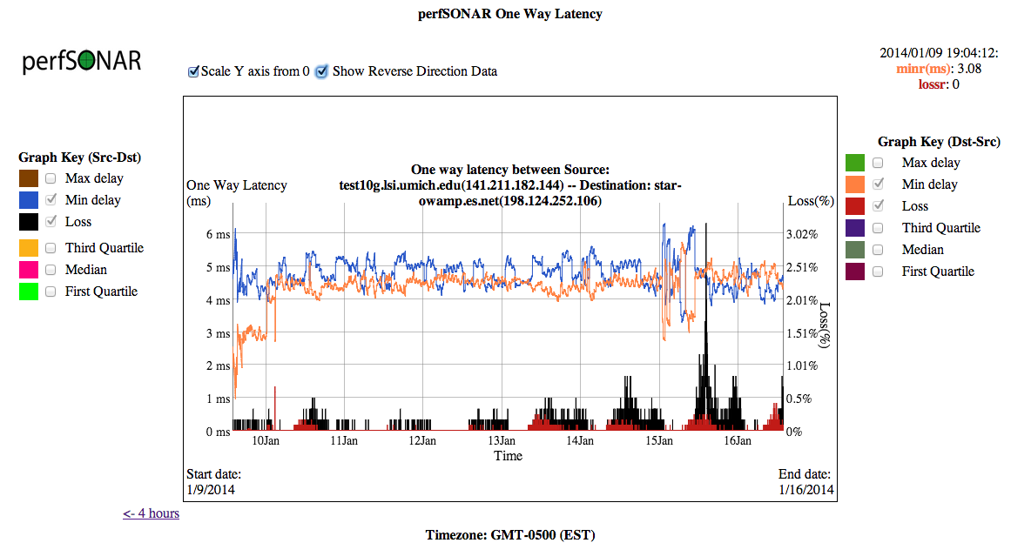
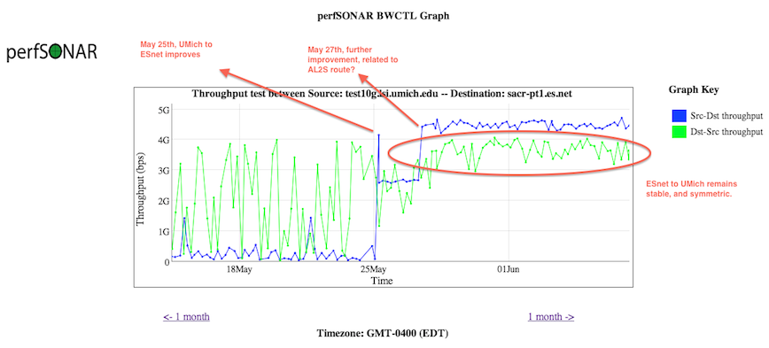
What OWAMP Tells Us

Slide 29
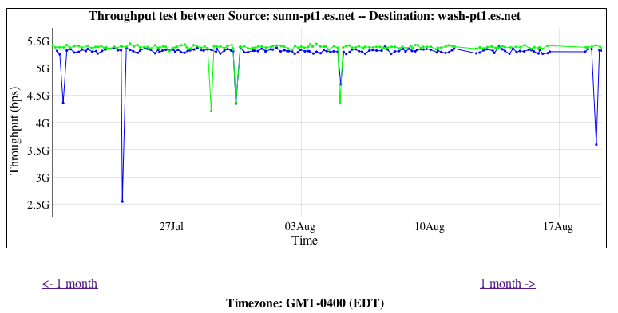
Common Pitfalls – “it should be higher!”
There have been some expectation management problems with the tools that we have seen (in XSEDE and elsewhere)
  Some feel that if they have 10G, they will get all of it
  Some may not understand the makeup of the test
  Some may not know what they should be getting
Lets start with an ESnet to ESnet test, between very well tuned and recent pieces of hardware
5Gbps is “awesome” for:
  A 20 second test
  60ms Latency
  Homogenous servers
  Using fasterdata tunings
  On a shared infrastructure

Slide 30
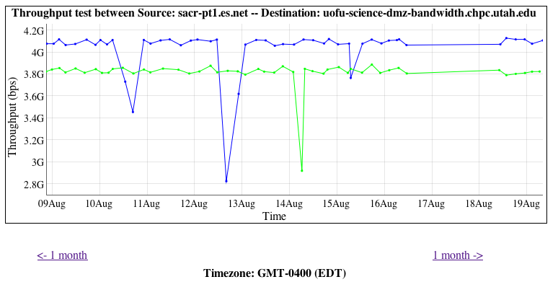
Common Pitfalls – “it should be higher!”
Another example, ESnet (Sacremento CA) to Utah, ~20ms of latency
Is it 5Gbps? No, but still outstanding given the environment:
  20 second test
  Heterogeneous hosts
  Possibly different configurations (e.g. similar tunings of the OS, but not exact in terms of things like BIOS, NIC, etc.)
  Different congestion levels on the ends

Slide 31
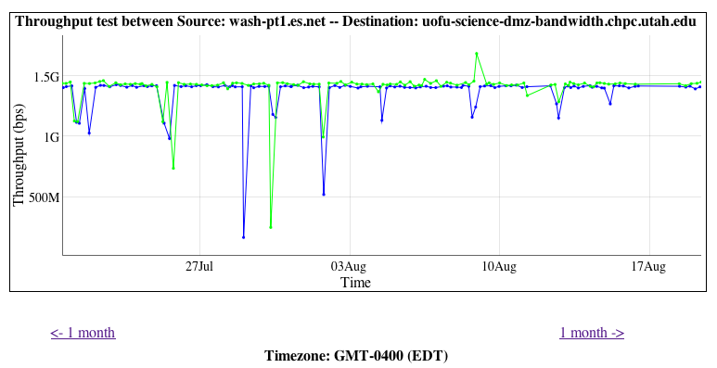
Common Pitfalls – “it should be higher!”
Similar example, ESnet (Washington DC) to Utah, ~50ms of latency
Is it 5Gbps? No. Should it be? No! Could it be higher? Sure, run a different diagnostic test.
  Longer latency – still same length of test (20 sec)
  Heterogeneous hosts
  Possibly different configurations (e.g. similar tunings of the OS, but not exact in terms of things like BIOS, NIC, etc.)
  Different congestion levels on the ends
Takeaway – you will know bad performance when you see it. This is consistent and jives with the environment.

Slide 32
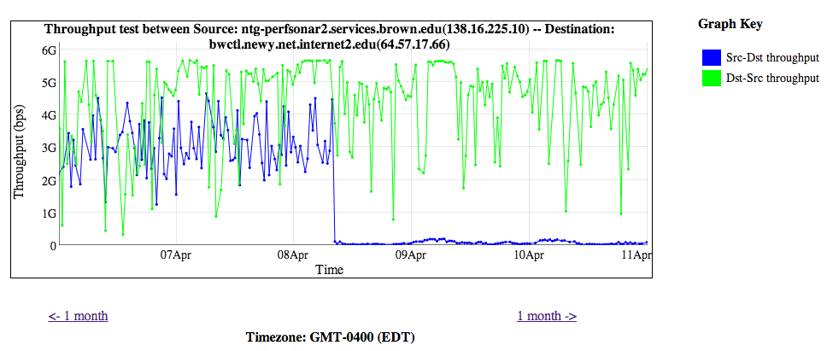
Common Pitfalls – “it should be higher!”
Another Example – the 1st half of the graph is perfectly normal
  Latency of 10-20ms (TCP needs time to ramp up)
  Machine placed in network core of one of the networks – congestion is a fact of life
  Single stream TCP for 20 seconds
The 2nd half is not (e.g. packet loss caused a precipitous drop)
You will know it, when you see it.

Slide 33
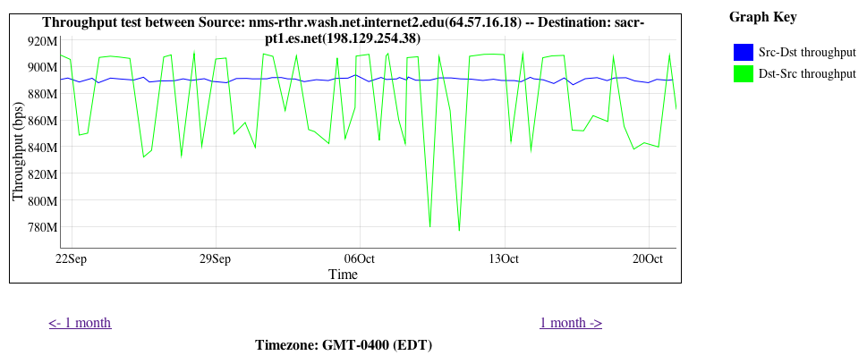
Common Pitfalls – “the tool is unpredictable”
Sometimes this happens:
Is it a “problem”? Yes and no.
Cause: this is called “overdriving” and is common. A 10G host and a 1G host are testing to each other
  1G to 10G is smooth and expected (~900Mbps, Blue)
  10G to 1G is choppy (variable between 900Mbps and 700Mbps, Green)

Slide 34
Common Pitfalls – “the tool is unpredictable”
A NIC doesn’t stream packets out at some average rate - it’s a binary operation:
  Send (e.g. @ max rate) vs. not send (e.g. nothing)
10G of traffic needs buffering to support it along the path. A 10G switch/router can handle it. So could another 10G host (if both are tuned of course)
A 1G NIC is designed to hold bursts of 1G. Sure, they can be tuned to expect more, but may not have enough physical memory
  Ditto for switches in the path
At some point things ‘downstep’ to a slower speed, that drops packets on the ground, and TCP reacts like it were any other loss event.

Slide 35
Common Pitfalls – “GridFTP is much worse than BWCTL!”
And now we come to our frienemy, the disk
perfSONAR tests are memory to memory for a reason:
  Remove the host from the equation as much as we can
  Unify tunings of the OS and tools
  May sometimes need to get picky about the BIOS, motherboard, system bus, NIC and driver – but a good baseline is possible without all that
Learning to use disks correctly:
  You *DO* need to care about tunings, all the way down
  Way too much to describe here, reading material: https://fasterdata.es.net/science-dmz/DTN/
  In general, you need to worry about performance per spindle, you will learn to care about things like RAID to stripe data, and the RAID card performance to ensure it streams off the device to the hardware as fast as possible.
  Realities from ESnet reference implementation:
    memory to memory, 1 10GE NIC: 9.9 Gbps
    disk to disk: 9.6 Gbps (1.2 GBytes/sec) using large files on all 3 disk partitions in parallel

Slide 36
Common Pitfalls – Summary
When in doubt – test again!
  Diagnostic tests are informative – and they should provide more insight into the regular stuff (still do regular testing, of course)
  Be prepared to divide up a path as need be
A poor carpenter blames his tools
  The tools are only as good as the people using them, do it methodically
  Trust the results – remember that they are giving you a number based on the entire environment
If the site isn’t using perfSONAR – step 1 is to get them to do so
  http://www.perfsonar.net
Get some help
  To quote Blondie, “Call me, call me any, anytime”
  engage@es.net

Slide 37
Outline
Introduction & Motivation
Network Support for Science
Data Mobility Expectations & Realities
Preparing the Campus
Conclusions

Slide 38
Small Bufffer = Science FAIL
TCP Test flows, 50ms path
30 Second test, 2 TCP streams
Buffer Size | Packets Dropped | TCP Throughput
120 MB | 0 | 8Gbps
60 MB | 0 | 8Gbps
36 MB | 200 | 2Gbps
24 MB | 205 | 2Gbps
12 MB | 204 | 2Gbps
6 MB | 207 | 2Gbps
2Gbps UDP background data
Modify this egress buffer size

Slide 39
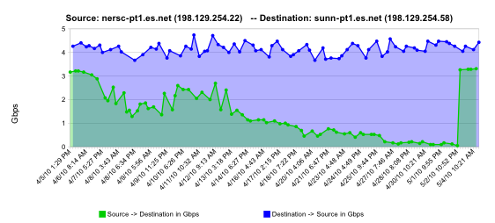
Infrastructure FAIL = Science FAIL
perfSONAR is designed to pinpoint and identify soft failures to accelerate resolution.
Example: Find and replace failing optics
normal performance
Gb/s
degrading performance
repair
one month
Notes:
This graph shows how perfsonar identified failing optics leading to a repair and improvement in performance

Slide 40
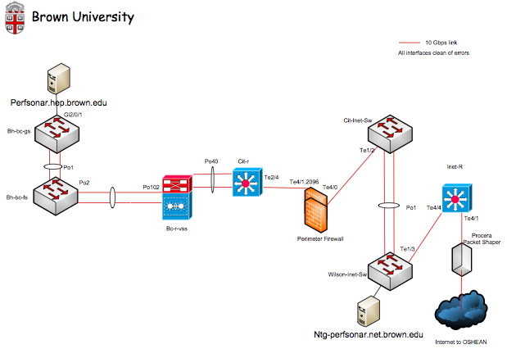
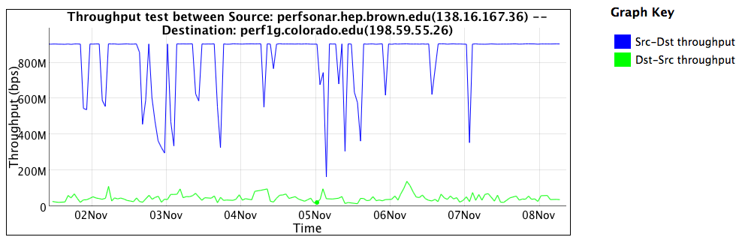
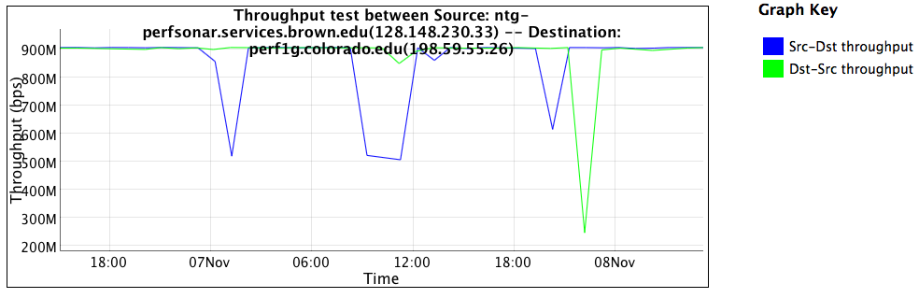
Overzealous Security = Science FAIL
Behind vs. in front of the firewall. Performance differences of an order of magnitude have a way of catching the attention of management.

Slide 41
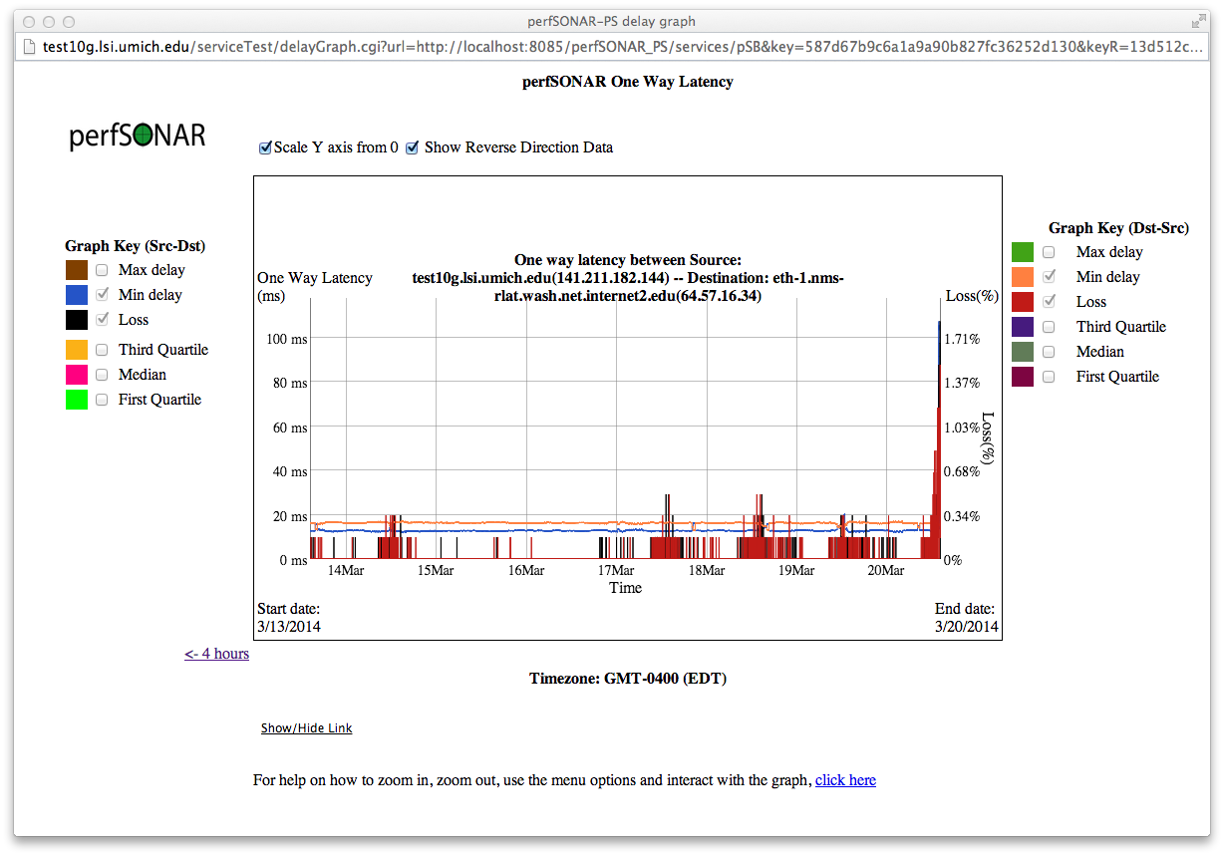
Congestion = Science FAIL
Networks are designed to be used after all – unless you engineer capacity and respect use cases

Slide 42
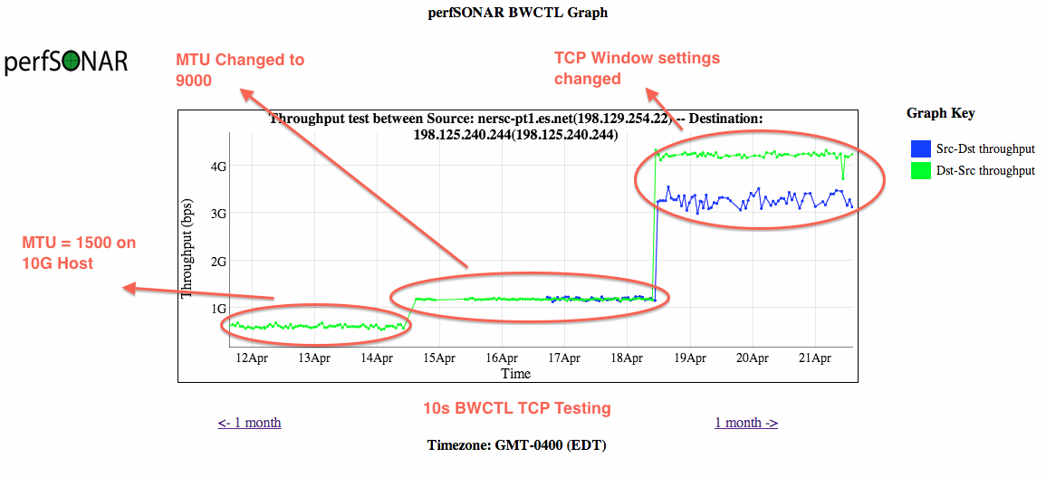
Turning a FAILs into WINs
12 Step programs encourage you to admit your problems – and then work toward a solution
  Tuning the network for science takes time

Slide 43
Outline
Introduction & Motivation
Network Support for Science
Data Mobility Expectations & Realities
Preparing the Campus
Conclusions

Slide 44
Summary
Data mobility problems are not going to go away
  It is unlikely everyone will have a particle accelerator, a supercomputer, EBs of storage, and 100s of researchers all within 10ms of each other
Capacity will increase, but is meaningless when problems exist
Insight into the network comes from tools like perfSONAR – if you aren’t using it, start. If you need help, ask.
  If its useful to XSEDE – ask for more ☺
To combat this:
  We need to identify users and use cases
  We need to clean up networks to support science – while still offering all the CIA components
  We need to move toward the proper tools and procedures to accomplish goals
This is a team effort – because you cannot fix network performance in a vacuum

Slide 45
The “Data Champion”
I propose the creation of a new focus for XSEDE to go hand and hand with the campus champion: the “Data Champion”
  A Lorax for Science (Scorax?) – someone to speak for the bits
Basic idea:
  Someone who knows the needs and workflows of the campus users
    Doesn’t ask “how much they need”, asks “what do you need to do”
  Someone who can translate the needs into a requirement for the campus IT/Regional IT/National IT powers
    Translates “transfer light source data” into actionable network engineering considerations
  Someone who is there to listen, and step in, when there is a problem
    Coordinates with other engagement efforts at ESnet, regional networks, etc.
  Stays relevant in technology and training (http://oinworkshop.com)
  Stays connected (e.g. human networking) with the parties that are on the critical path to success. XSEDE to XSEDE happens, but so does XSEDE to DOE, etc.
    Its all connected, and we need to make sure it all works
Who is with me on this? Who can make this happen at XSEDE?

Slide 46

Conclusion
Science is good, growing, and changing. Adapt with these factors
Science support doesn’t need to be hard
For those that design the networks – consider the Science DMZ Approach for network architecture and security posture
For those that use the networks – consider the Science DMZ approach for data movement hosts and tools
Monitoring matters to everyone
A little knowledge goes a long way – learn to understand the tools, and ask when you don’t understand.

Slide 47
FAIL-transfer: Removing the Mystery of Network Performance from Scientific Data Movement
Jason Zurawski – zurawski@es.net
Science Engagement Engineer, ESnet
Lawrence Berkeley National Laboratory
XSEDE Campus Champions Webinar
August 20th 2014

Slide 48
Extra Material

Slide 49

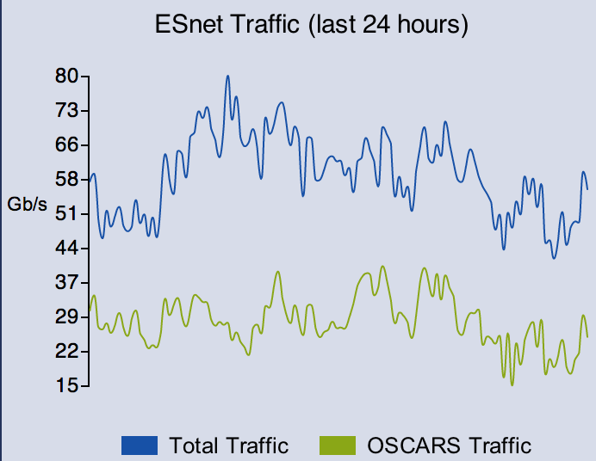
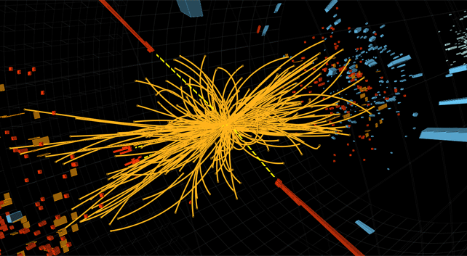



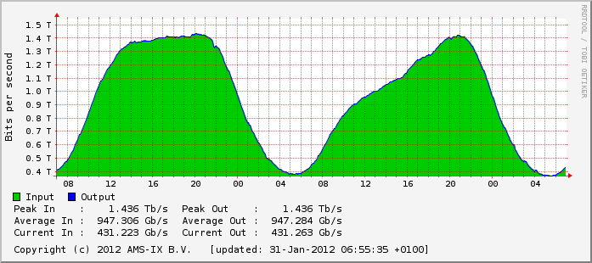



ESnet != Commercial Internet
Notes:
ESnet has a different workload than the commercial internet and many capabilities that commercial internet providers do not.

Slide 50


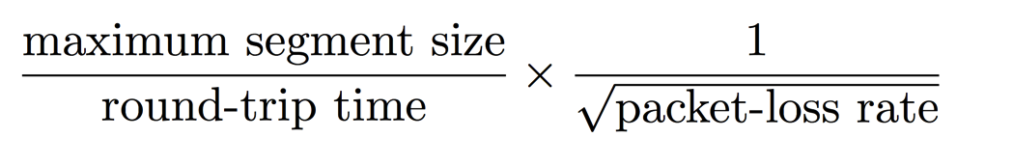
Elephant Flows Place Great Demands on Networks
Physical pipe that leaks water at rate of .0046% by volume.
Result 99.9954% of water transferred, at “line rate.”
➔
➔
Result
100% of data transferred, slowly, at <<5% optimal speed.
Network ‘pipe’ that drops packets at rate of .0046%.
➔
➔
essentially fixed
Through careful engineering, we can minimize packet loss.
determined by speed of light
Assumptions: 10Gbps TCP flow, 80ms RTT.
See Eli Dart, Lauren Rotman, Brian Tierney, Mary Hester, and Jason Zurawski. The Science DMZ: A Network Design Pattern for Data-Intensive Science. In Proceedings of the IEEE/ACM Annual SuperComputing Conference (SC13), Denver CO, 2013.
50 – ESnet Science Engagement (engage@es.net) - 8/20/14
Notes:
It turns out a network has to be almost perfect in order to move the elephant flows effectively.
This is a little bit counterintuitive.
We have to take special care in engineering for the elephant flows.
Irony: van jacobsen 1986 – 88.

