Slide 1
Science Engagement: A Non-Technical Approach to the Technical Divide
Jason Zurawski – zurawski@es.net
Science Engagement Engineer, ESnet
Lawrence Berkeley National Laboratory
CYBERA Summit 2014
September 24th, 2014

Slide 2
Outline
What is ESnet?
Defining Science Engagement
Lessons Learned in Supporting Science
Preparing for What Comes Next
Conclusions

Slide 3
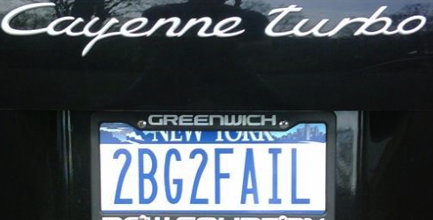
ESnet at a Glance
High-speed national network, optimized for DOE science missions:
  connecting 40 labs, plants and facilities with >100 networks
  $32.6M in FY14, 42FTE
  older than commercial Internet, growing twice as fast
$62M ARRA grant for 100G upgrade:
  transition to new era of optical networking
  world’s first 100G network at continental scale
Culture of urgency:
  4 awards in past 3 years
  R&D100 Award in FY13
  “5 out of 5” for customer satisfaction in last review
  Dedicated staff to support the mission of science

Slide 4
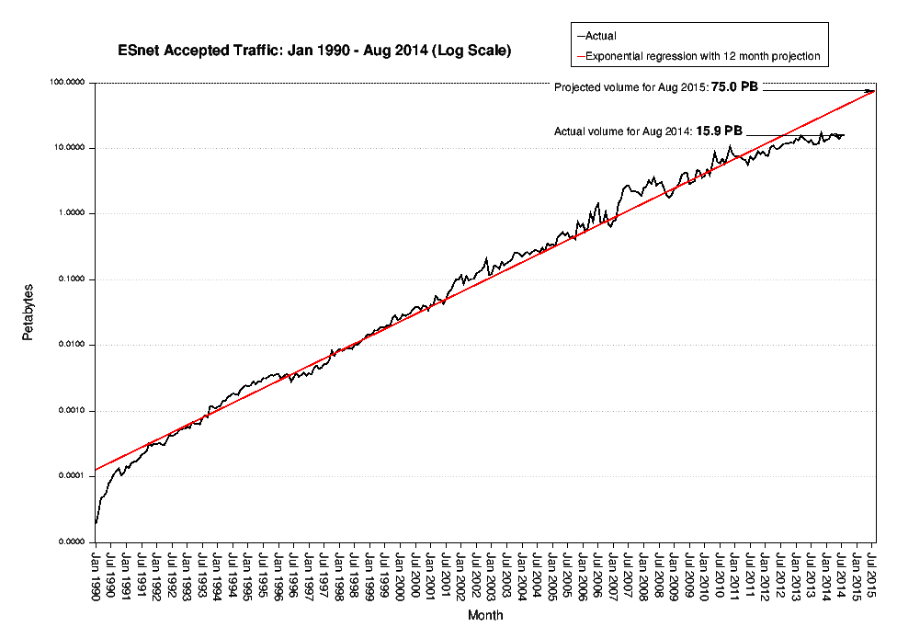
Notes:
Left hand side is about changing the world. This is important because 80% of ESnet traffic leaves the DOE complex.
Right hand side is about innovation and discovery.
Research challenges:
Challenges of Predictability
Challenges of Flexibility
Challenges of Scale
Challenges of Complexity

Slide 5
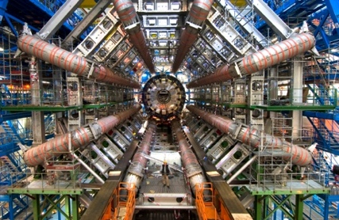
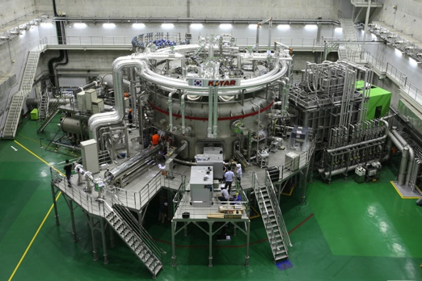
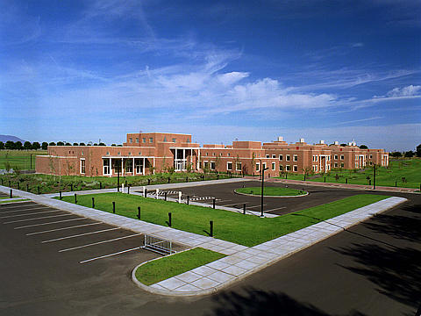
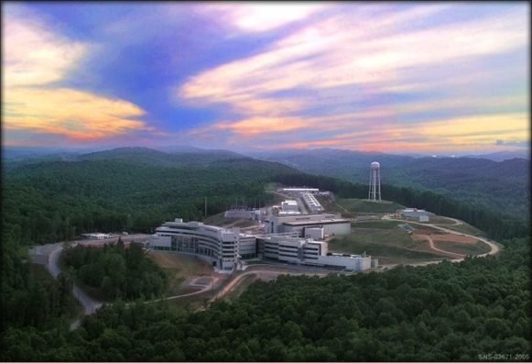
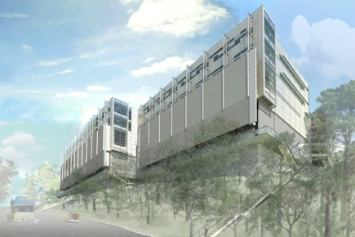
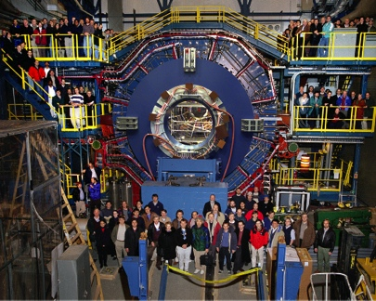
Network as Infrastructure Instrument
    Vision: Scientific progress will be completely unconstrained by the physical location of instruments, people, computational resources, or data.
Notes:
Summing up ESnet’s vision in one slide, one phrase…
Physical location of instruments, people, computational resources, data. It just should not matter.
[KSTAR, SNS, ATLAS, EMSL, CRT/NERSC, STAR Detector at RHIC [BNL, NP-funded]]

Slide 6
Outline
What is ESnet?
Defining Science Engagement
Lessons Learned in Supporting Science
Preparing for What Comes Next
Conclusions

Slide 7
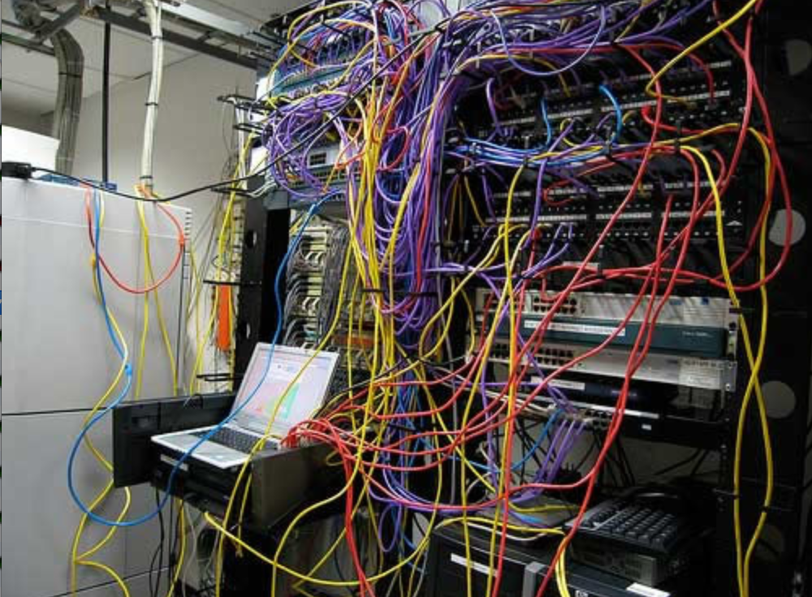
Challenges to Network Adoption
Causes of performance issues are complicated for users.
Lack of communication and collaboration between the CIO’s office and researchers on campus.
Lack of IT expertise within a science collaboration or experimental facility
User’s performance expectations are low (“The network is too slow”, “I tried it and it didn’t work”).
Cultural change is hard (“we’ve always shipped disks!”).
Scientists want to do science not IT support
The Capability Gap

Slide 8
Requirements Reviews
http://www.es.net/about/science-requirements/network-requirements-reviews/
The purpose of these reviews is to accurately characterize the near-term, medium-term and long-term network requirements of the science conducted by each program office.
The reviews attempt to bring about a network-centric understanding of the science process used by the researchers and scientists, to derive network requirements.
We have found this to be an effective method for determining network requirements for ESnet's customer base.
Notes:
2006
ELI + company
Led to science DMZ and other important end site innovations

Slide 9
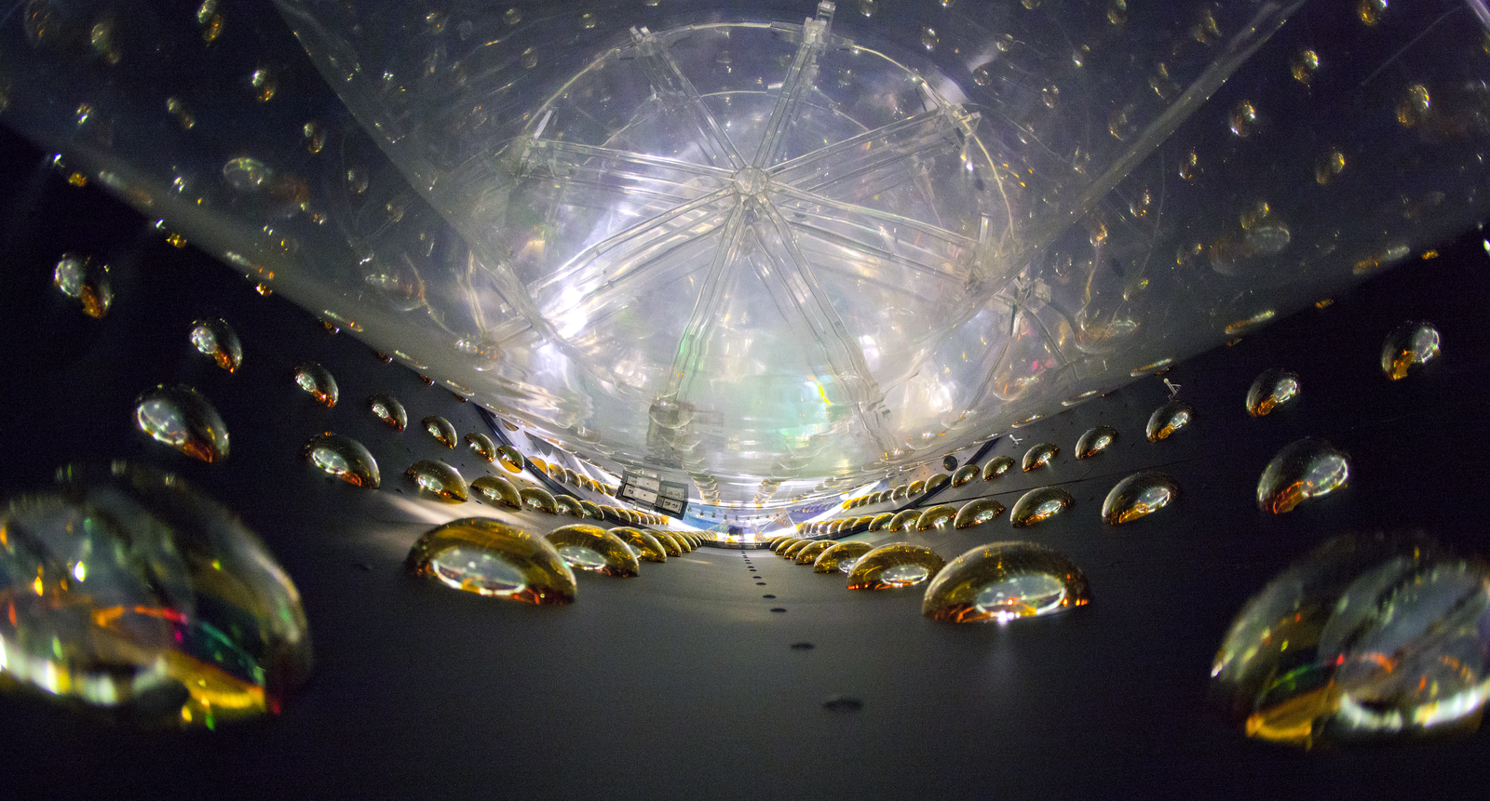
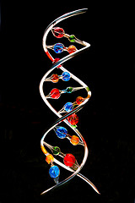


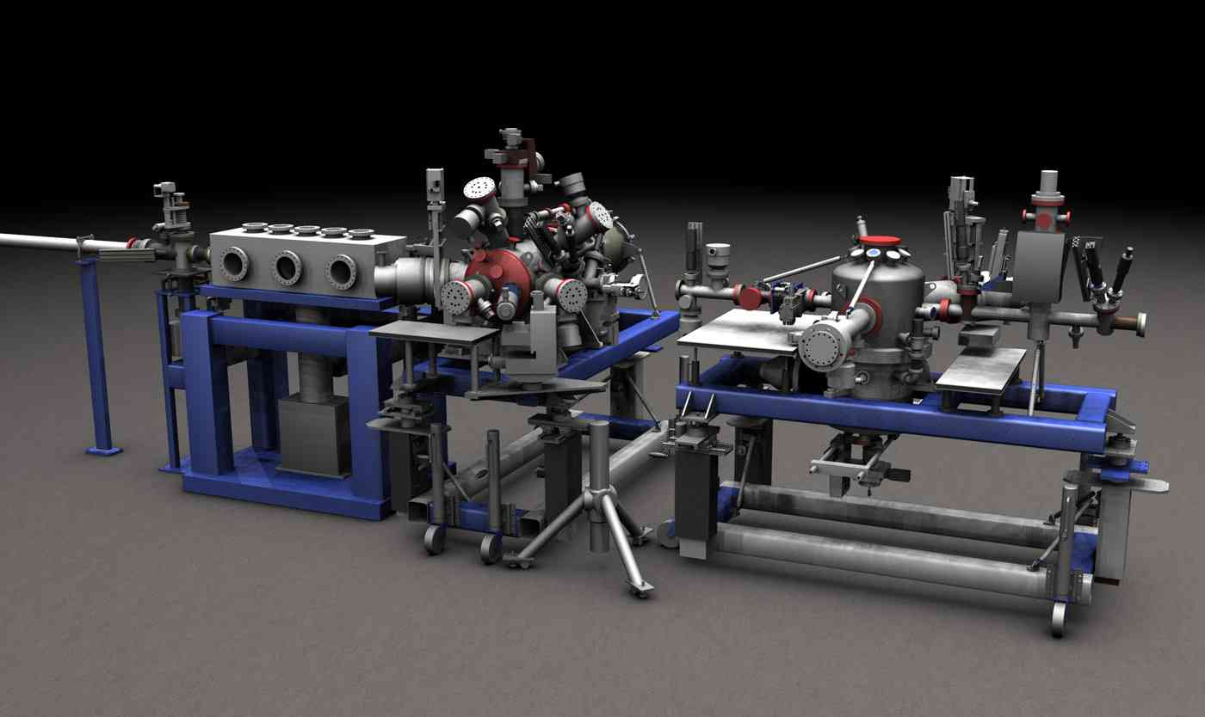
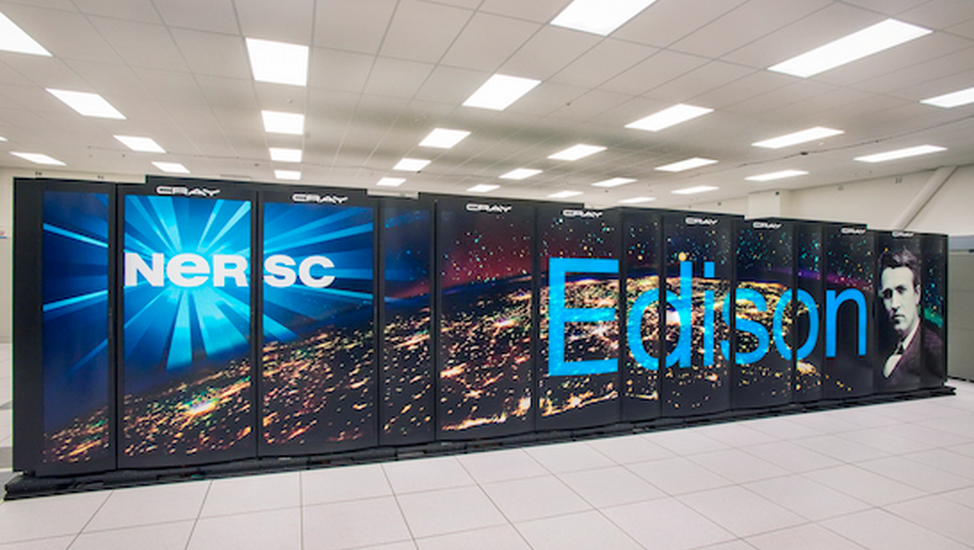
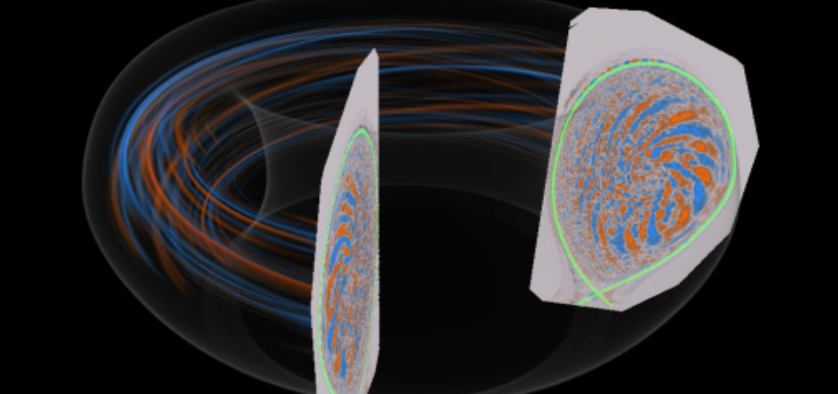
High Energy Physics
Biological and Environmental Research
Photo courtesy of LBL
Nuclear Physics
Photo courtesy of JGI
Photo courtesy of NIST
Advanced Scientific Computing Research
Basic Energy Research
Fusion Energy Sciences
Photo courtesy of LBL
Photo courtesy of SLAC
Photo courtesy of PPPL

Slide 10
How do we know what our scientists need?
Each Program Office has a dedicated requirements review every three years
Two workshops per year, attendees chosen by science programs
Discussion centered on science case studies
    Instruments and Facilities – the “hardware”
    Process of Science – science workflow
    Collaborators
    Challenges
Network requirements derived from science case studies + discussions
Reports contain requirements analysis, case study text, outlook
Notes:
Two reviews per year, One review per program office every 3 years
Goals –
1. Accurately characterize current and future network requirements
2. Collect network requirements from scientists and Program Office
Structure
Elicit information from managers, scientists and network users regarding usage patterns, science process, instruments and facilities – codify in “Case Studies”
Case studies focus on two different aspects of the science
Instruments and Facilities – the “hardware” of science
Process of Science – the way in which the Instruments and Facilities are used in the conduct of the science
Synthesize network requirements from the Case Studies
ESnet’s core mission is to serve the DOE/SC science programs
Large-scale data movement
Network services to enable science
Network implications arise from the conduct of science
Science instruments and facilities
Process of science
How will these change over time?

Slide 11
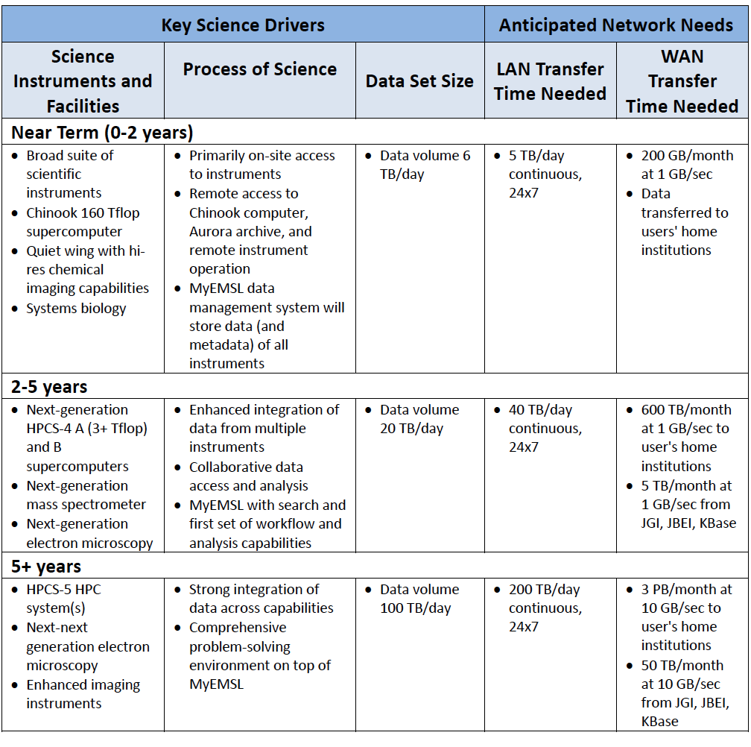
2013 BER
Sample
Findings:
Environmental Molecular Sciences Laboratory
(EMSL)
“EMSL frequently needs to ship physical copies of media to users when data sizes exceed a few GB. More often than not, this is due to lack of bandwidth or storage resources at the user's home institution.”

Slide 12
Outline
What is ESnet?
Defining Science Engagement
Lessons Learned in Supporting Science
Preparing for What Comes Next
Conclusions

Slide 13
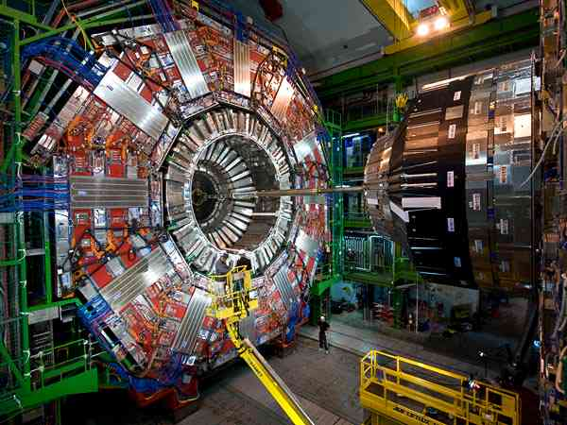
Traditional “Big Science”

Slide 14
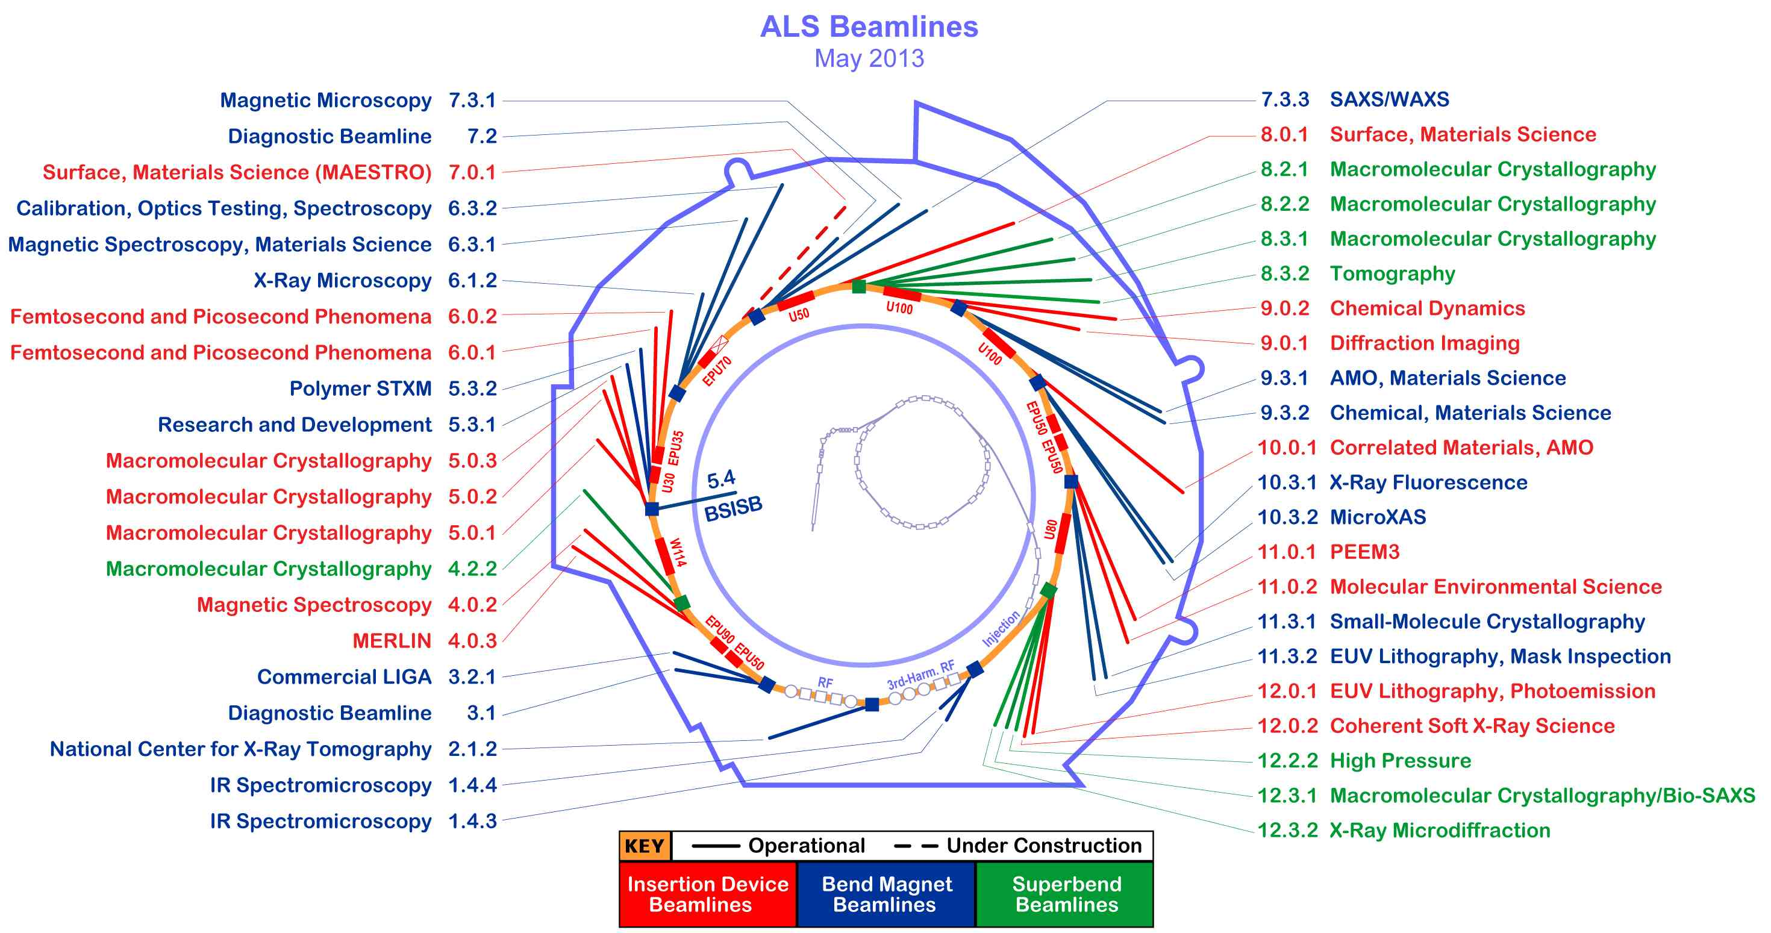
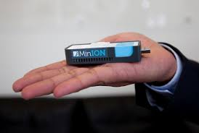
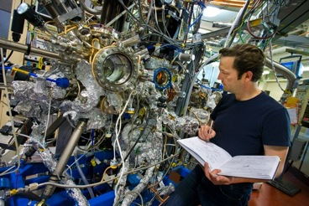
Big Science Now Comes in Small Packages
Notes:
Beamline 8.3.2 at the Advanced Light Source is a Synchrotron-based Hard X-ray Micro-Tomography instrument. It allows non-destructive 3-Dimensional imaging of solid objects at a resolution of approximately 1 micron.
10⁶ increase in data output compared to previous generation
8 Gbps flows to supercomputer for real-time analysis

Slide 15

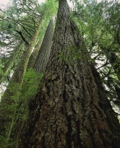


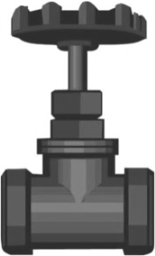

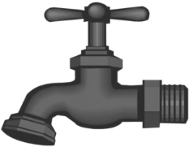
User Workflow & Bottleneck Identification
2. Endstation
3. Sample
4. Control Software
5. Data Collection
Users
1. Allocation
6. Data Transfer / Management
Publications
9. Write and edit
8. Data Analysis / Info Extraction / Visualization / Simulation
7. Data Processing

Slide 16
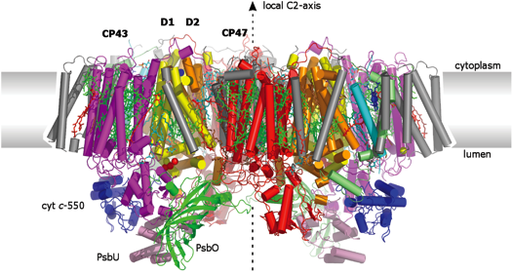
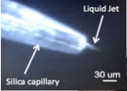
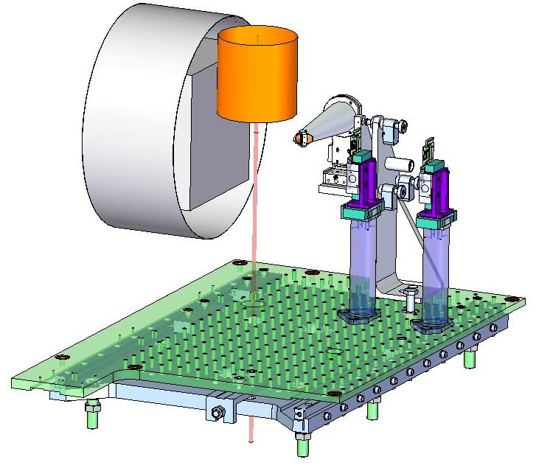
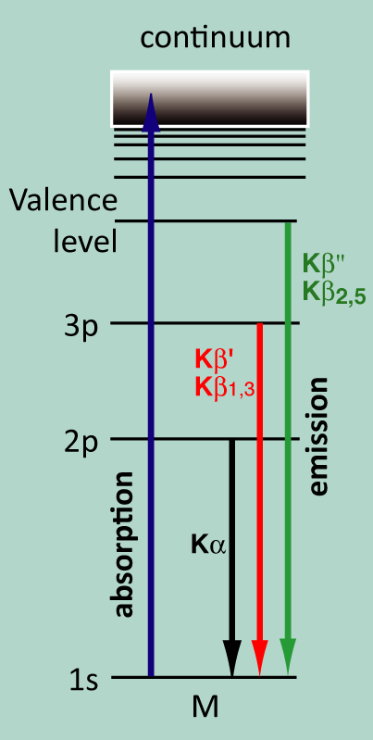
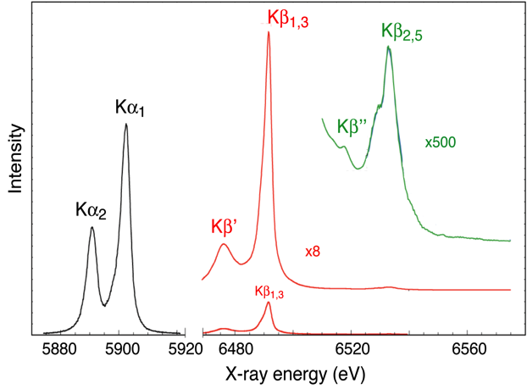
Coupling Research Facilities & HPC resources with Networks
X-ray diffraction
(structure)
Recent beam time on free-electron laser (LCLS) at SLAC to take ‘snapshots’ of catalytic reaction in Photosystem II (Nick Sauter et al).
Data transported to a nearby HPC resource (NERSC) for real-time computational analysis.
This one experiment tripled NERSC’s network utilization.
Liquid-jet
Injection of
μm-size crystals
Optical
pump
Injector
Diffraction
Detector
X-ray emission spectroscopy
(Chemistry at the catalytic site)
LCLS Beam
Analyzer
Crystals
XES Detector
X-ray Beam
Apertures
Source: Nicholas Sauter, LBNL
charge density/spin state
ligand environment
Kern et al (2012) PNAS 109: 9721
Sierra et al (2012) Acta Cryst D68: 1584
Mori et al (2012) PNAS 109: 19103
16 – ESnet Science Engagement (engage@es.net) - 9/19/14
Notes:
Goal – understand photosynthesis
Over 100 TB/ over 5 days - Data moved from the LCLS data acquisition to NERSC's data transfer nodes at over 7.5 gigabits per second where it was processed on thousands of cores. The science team at the SLAC beamline was able to use this analysis to adjust their light source equipment daily during their five-day allocation at LCLS to get the best results possible.

Slide 17

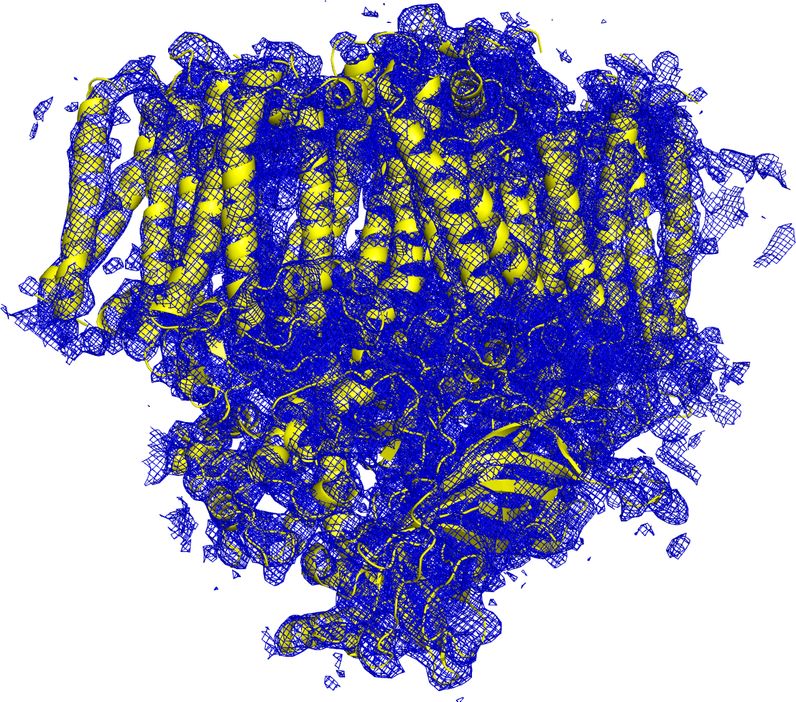
E Pluribus Unum
Hundreds to thousands of these images are created in a few hours…they can range in size from MB to TB
After processing on a supercomputer, models are created…once we get them there.
17 – ESnet Science Engagement (engage@es.net) - 9/19/14

Slide 18
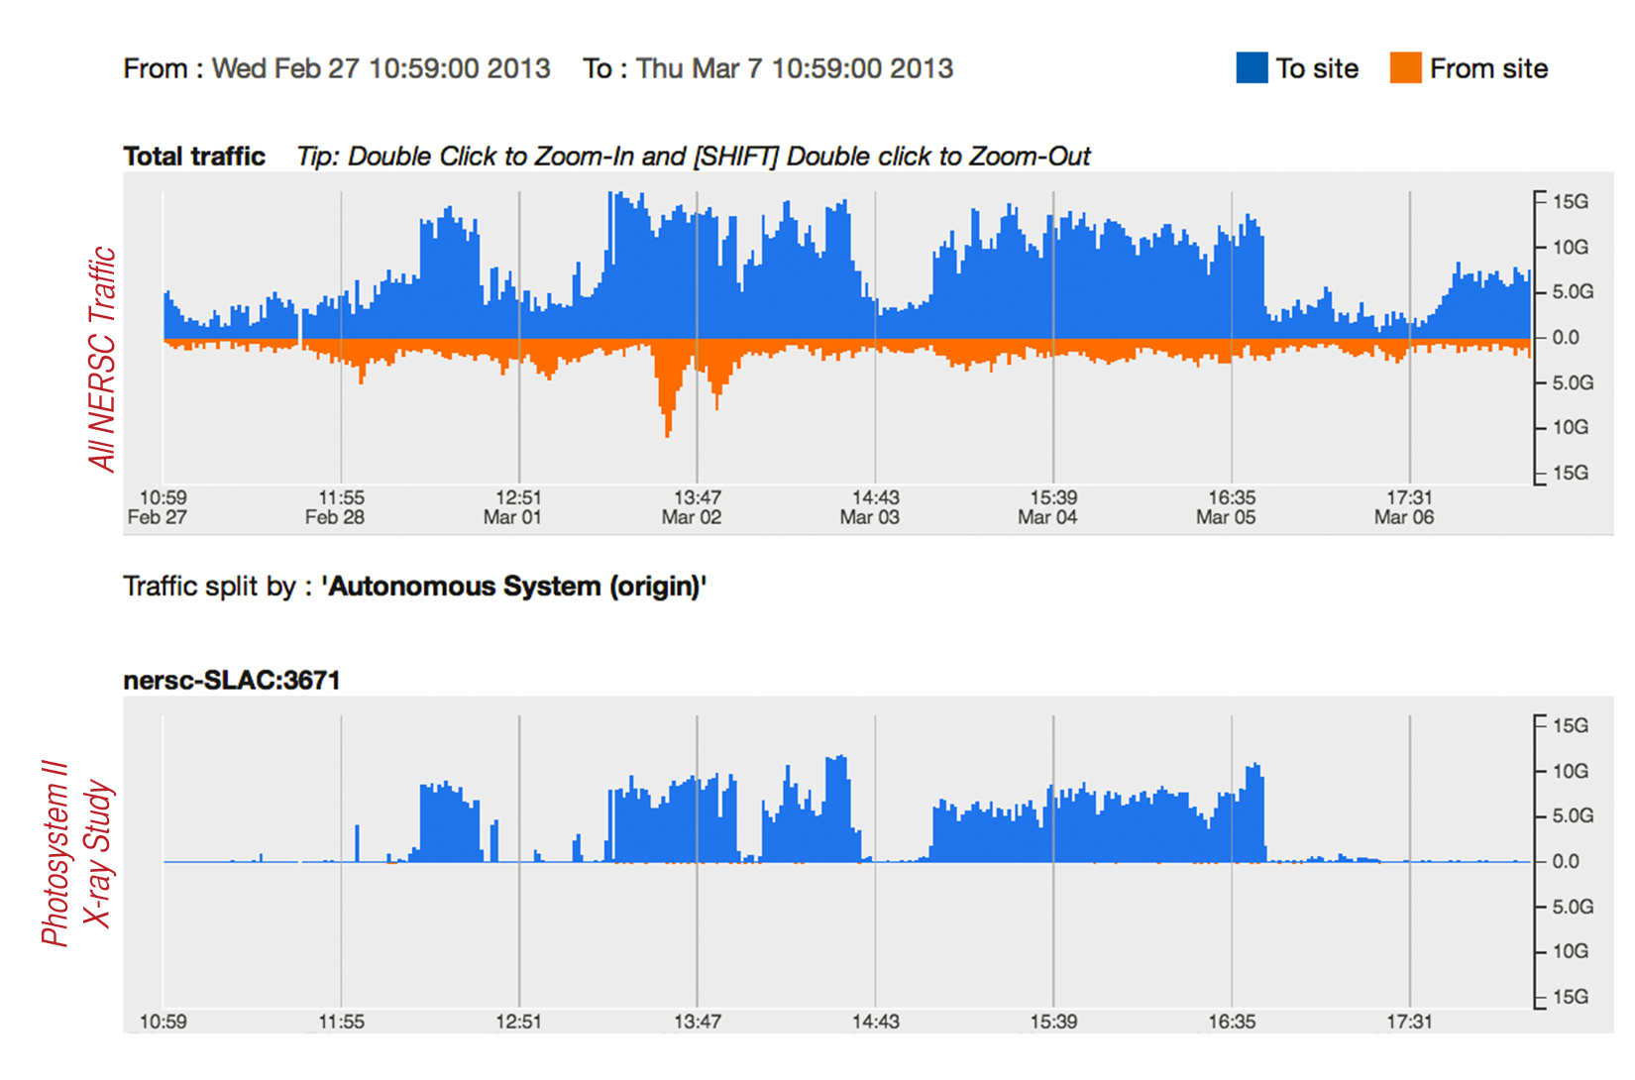
Experimental Facility to Computing Facility over ESnet

Slide 19
Outline
What is ESnet?
Defining Science Engagement
Lessons Learned in Supporting Science
Preparing for What Comes Next
Conclusions

Slide 20
Understanding Data Trends
Notes:
Requirements workshops for all six program offices within the DOE office of Science

Slide 21
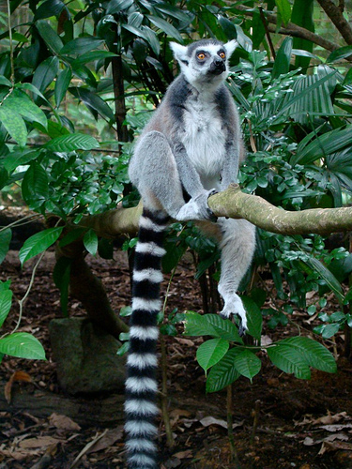
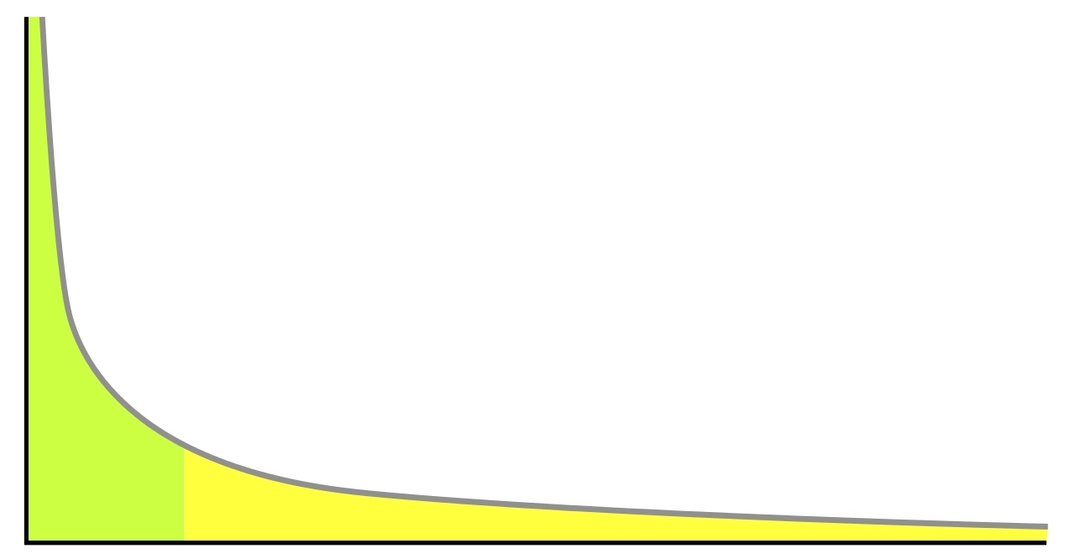
The Long Tail
First result on Google:
There will always be a small population of users that produce “Big data”
  Normally these are groups that have technological sophistication
  IT shops for software, Network teams to implement tech du-jour (SDN, Cloud, blah blah)
Science doesn’t only occur on the left side of the graph below
  The long tail needs the most help
  Progress will be made regardless; there are a lot more “easy wins” (e.g. orders of magnitude of improvement available) on the right side

Slide 22
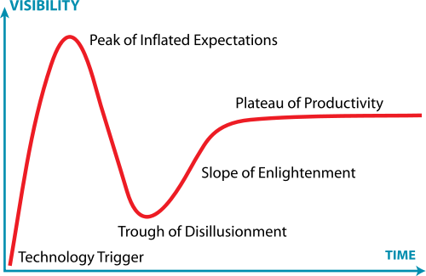
Post-it I keep On My Desk
Engineers are the early adopters of most things
Impacted science groups come in much later
We don’t want scientists to be engineers. They do better as scientists
Engagement != dropping something new into a user’s lap and hoping for the best
Engagement = figuring out if the solution is a good idea, and then helping with integration
  Asking questions, building trust
  Provide a solution, not a technology (and certainly not a headache)
Lots of easy things – e.g. changing data management tools, eliminating capacity bottlenecks, stopping non-congestive packet loss

Slide 23
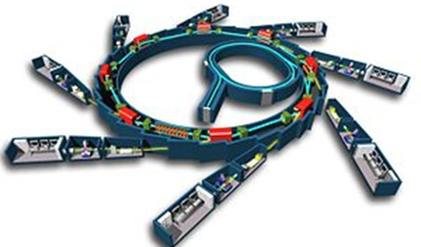
DOE Facilities in 2025: More Data, More Users, More Discovery
Experimental facilities will be transformed by high-resolution detectors, advanced mathematical analysis techniques, robotics, software automation, and programmable networks.
Detectors capable of generating terabit data streams.
Integration of experimental and computational facilities in real time, using programmable networks.
Computational tools for analysis, data reduction & feature extraction in situ, using advanced algorithms and special-purpose hardware.
Data management and sharing, with federated identity management and flexible access control.
Increase scientific throughput from robotics and automation software.
Post-processing: reconstruction, inter-comparison, simulation, visualization.

Slide 24
Outline
What is ESnet?
Defining Science Engagement
Lessons Learned in Supporting Science
Preparing for What Comes Next
Conclusions

Slide 25
Conclusions (& Action Items)
Science engagement isn’t hard
  More about listening than building
  Building occurs with or without knowing the use cases, this can help refine
Science engagement can’t be done on found cycles
  Dedicated person(s) with a communications/technology background
  Gives a known ‘landing point’; builds trust, encourages growth
Benefits when attempted:
  Potentially saving on costs of build/operation
  Happy customers
  Deeper understanding of the science, which advances society (e.g. I want to see a cure for cancer before I need one, networks are a part of that)

Slide 26
Conclusions (& Action Items)
Country/Region/Province Suggestions:
  Find a ‘champion’ to coordinate, and participants from other locations
  Develop a system similar to ESnet’s Requirements Reviews (we are happy to help)
  Tie the success of science to the network:
    Will help to gauge ‘how big’ to build the network, and on what time scales
    Will also turn out some negative information, e.g. how the network problems/lack of capability may be hurting innovation
  Tie in to PERT (PErformance Response Team) activities
    E.g. if you have a PERT. If you don’t, you need one ☺
    A PERT debugs end to end performance problems. These are often different than ‘Link X flapped to Peer Y’
    The PERT would advocate for Science DMZs, DTNs, perfSONAR, and other network solutions to assist in science
engage@es.net

Slide 27
Science Engagement: A Non-Technical Approach to the Technical Divide
Jason Zurawski – zurawski@es.net
Science Engagement Engineer, ESnet
Lawrence Berkeley National Laboratory
CYBERA Summit 2014
September 24th, 2014

