Slide 1
The Science DMZ and the CIO:
Data Intensive Science and the Enterprise
Eli Dart & Jason Zurawski
ESnet Science Engagement
Lawrence Berkeley National Laboratory
RMCMOA Workshop @ Westnet Conference
Tempe, AZ
January 13th, 2014

Slide 2
Outline
What is ESnet?
  Overview & Mission
  Scientific Drivers
Science DMZ context
  Where we are
  Why would you build a Science DMZ?
Success factors
  What makes a Science DMZ successful?
Enterprise traffic vs. science traffic
  Differences
  Security implications
© 2015, Energy Sciences Network

Slide 3
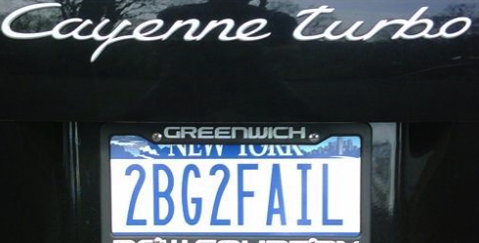
ESnet at a Glance
High-speed national network, optimized for DOE science missions:
  connecting 40 labs, plants and facilities with >100 networks
  $32.6M in FY14, 42FTE
  older than commercial Internet, growing twice as fast
$62M ARRA grant for 100G upgrade:
  transition to new era of optical networking
  world’s first 100G network at continental scale
Culture of urgency:
  4 awards in past 3 years
  R&D100 Award in FY13
  “5 out of 5” for customer satisfaction in last review
  Dedicated staff to support the mission of science

Slide 4
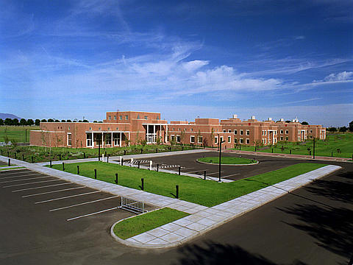
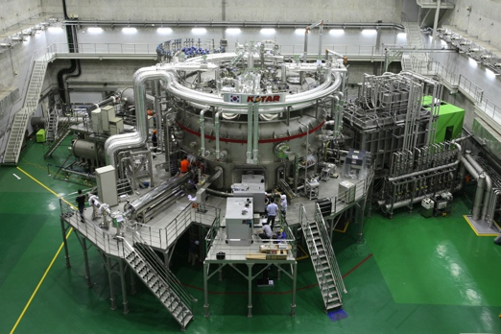
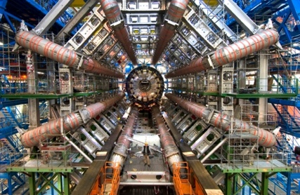
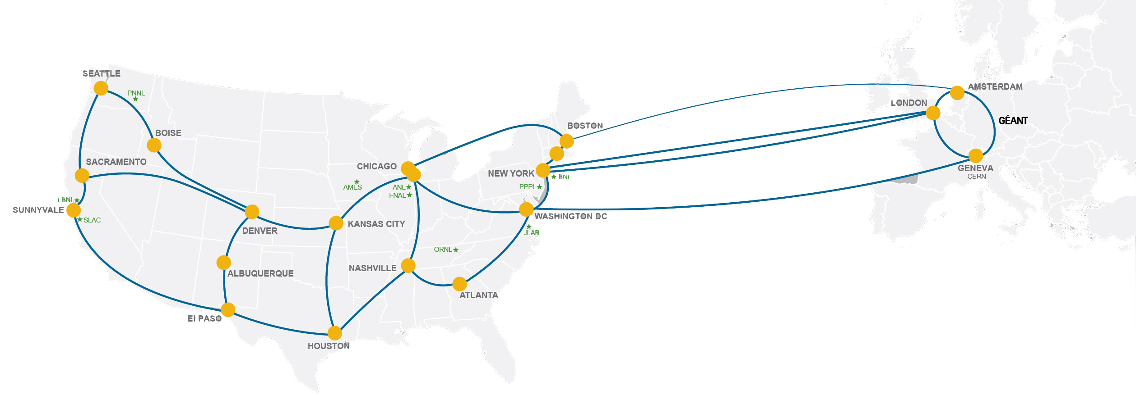
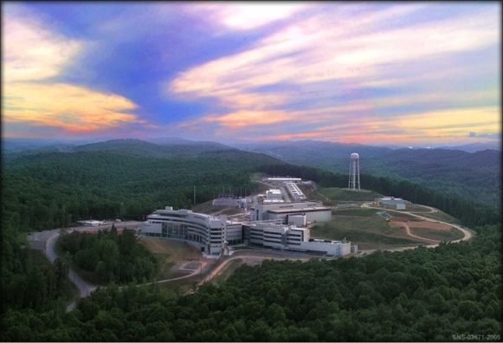
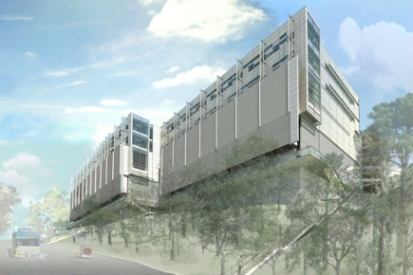
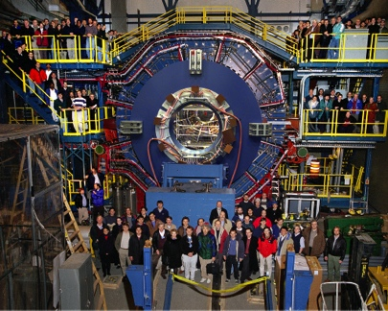
Network as Infrastructure Instrument
    Vision: Scientific progress will be completely unconstrained by the physical location of instruments, people, computational resources, or data.
Notes:
Summing up ESnet’s vision in one slide, one phrase…
Physical location of instruments, people, computational resources, data. It just should not matter.
[KSTAR, SNS, ATLAS, EMSL, CRT/NERSC, STAR Detector at RHIC [BNL, NP-funded]]

Slide 5
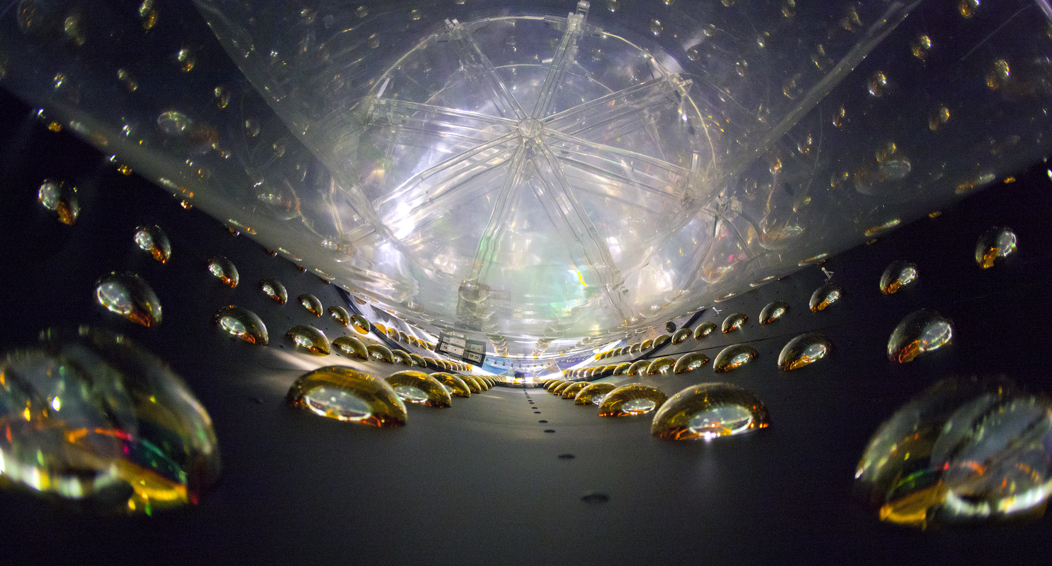

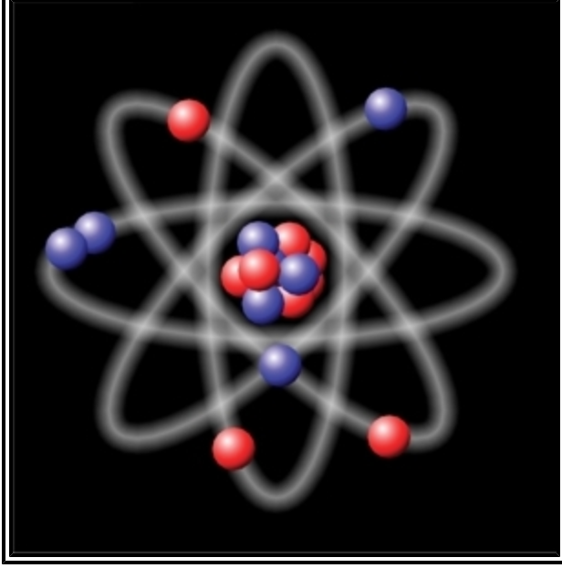

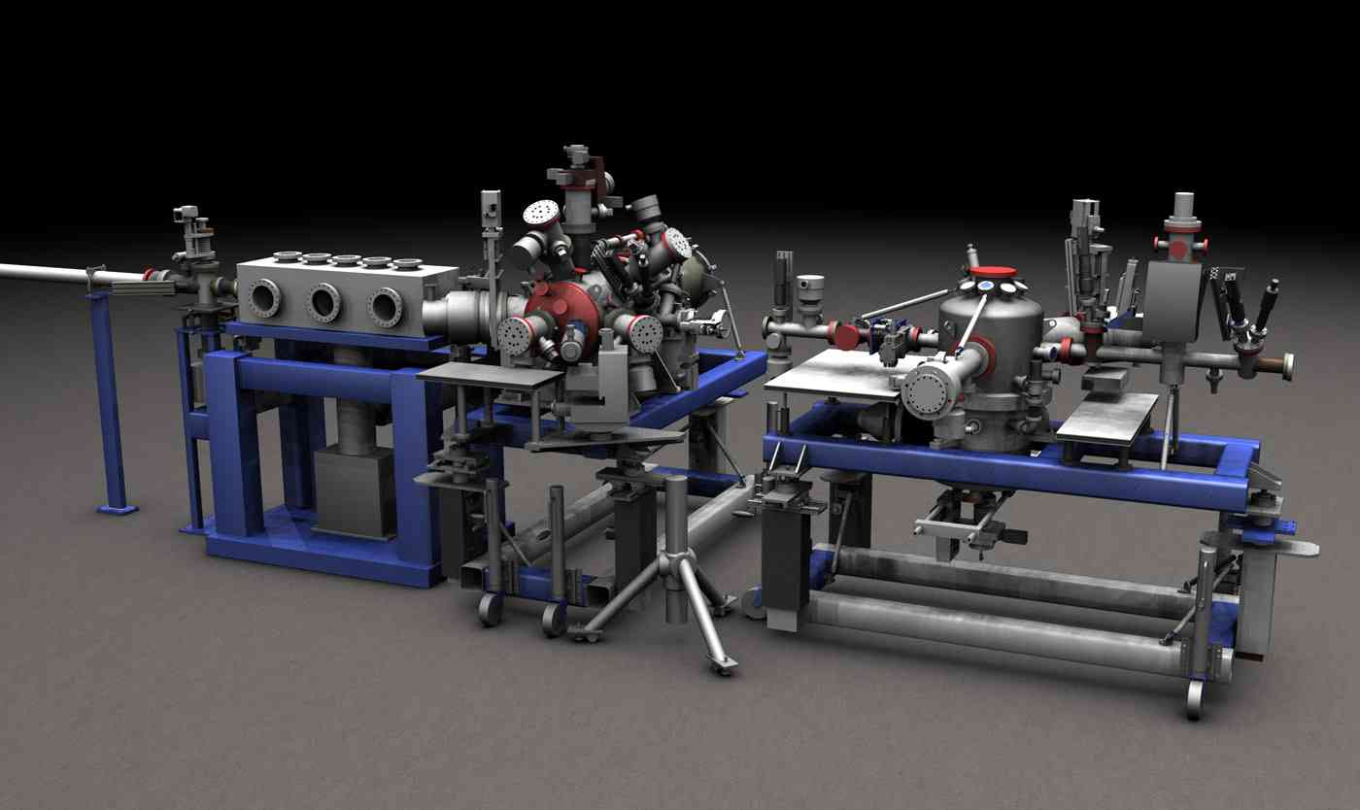
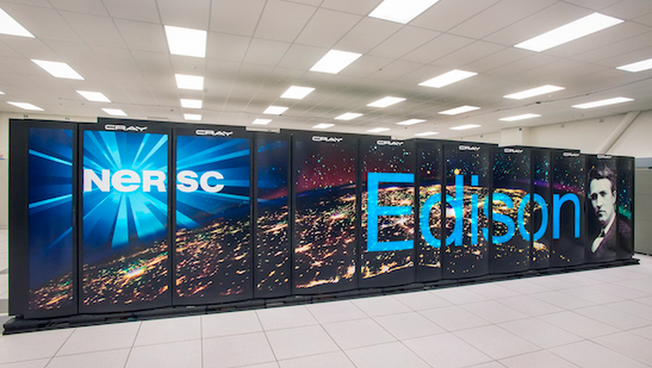
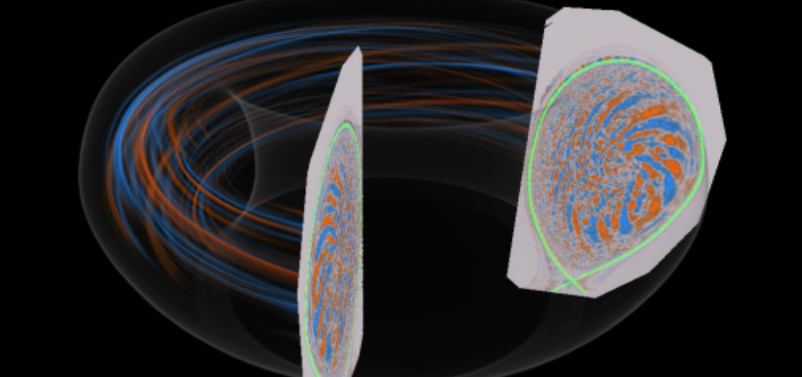
High Energy Physics
Biological and Environmental Research
Photo courtesy of LBL
Nuclear Physics
Photo courtesy of JGI
Photo courtesy of NIST
Advanced Scientific Computing Research
Basic Energy Science
Fusion Energy Sciences
Photo courtesy of LBL
Photo courtesy of SLAC
Photo courtesy of PPPL

Slide 6
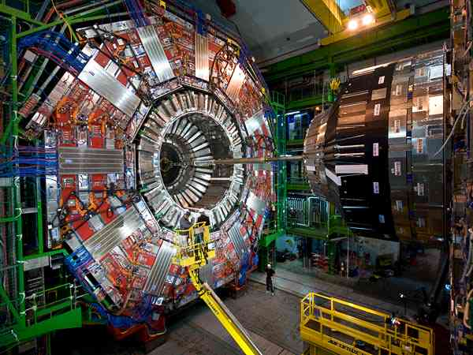
Traditional “Big Science”

Slide 7
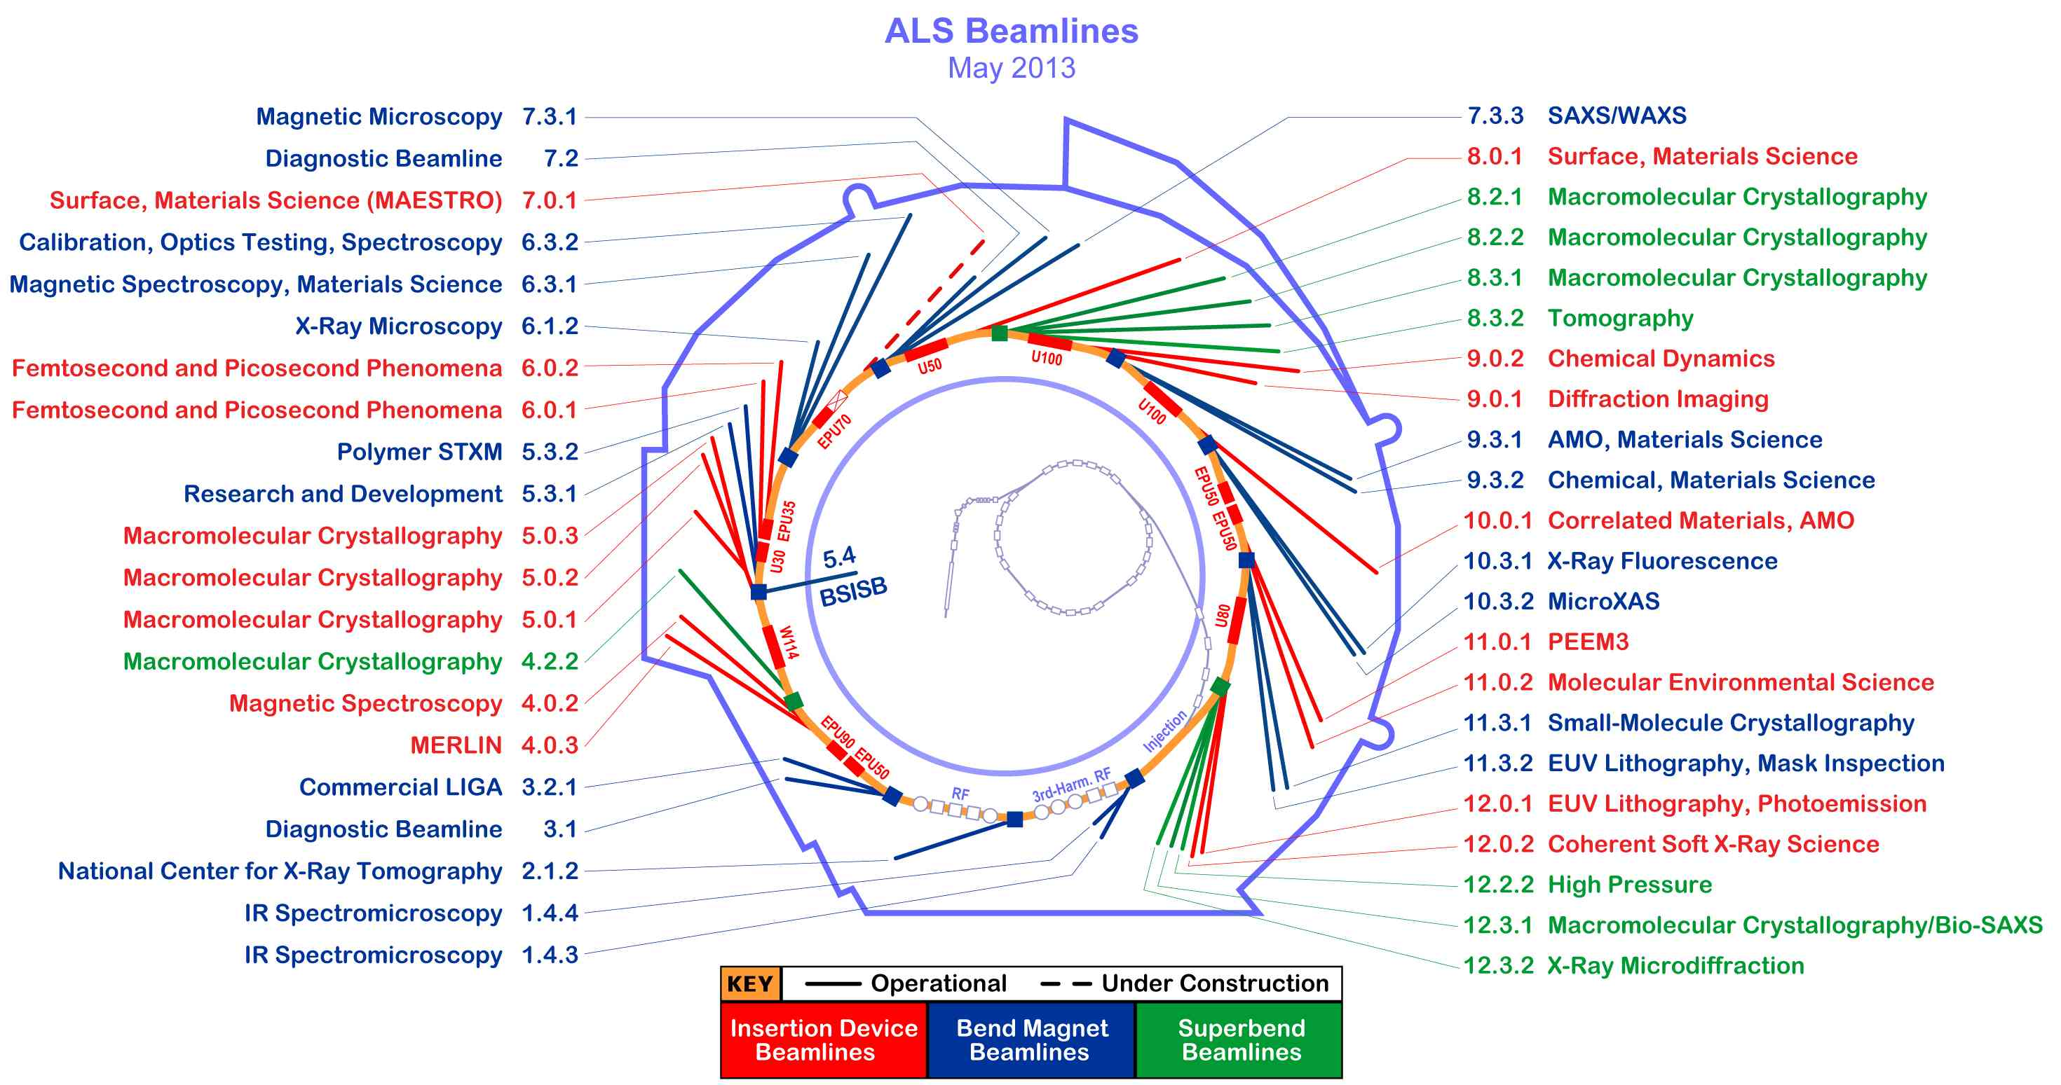
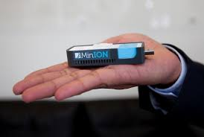
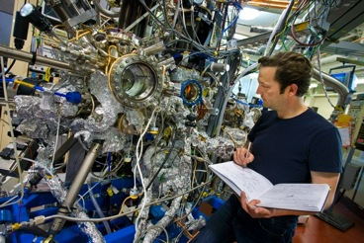
Big Science Now Comes in Small Packages
Notes:
Beamline 8.3.2 at the Advanced Light Source is a Synchrotron-based Hard X-ray Micro-Tomography instrument. It allows non-destructive 3-Dimensional imaging of solid objects at a resolution of approximately 1 micron.
10⁶ increase in data output compared to previous generation
8 Gbps flows to supercomputer for real-time analysis

Slide 8
Outline
What is ESnet?
  Overview & Mission
  Scientific Drivers
Science DMZ context
  Where we are
  Why would you build a Science DMZ?
Success factors
  What makes a Science DMZ successful?
Enterprise traffic vs. science traffic
  Differences
  Security implications
© 2015, Energy Sciences Network

Slide 9
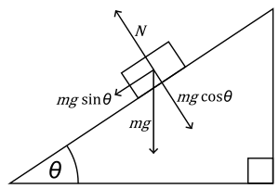


The Science DMZ in 1 Slide
“Friction free” network path
  Highly capable network devices (wire-speed, deep queues)
  Virtual circuit connectivity option
  Security policy and enforcement specific to science workflows
  Located at or near site perimeter
Dedicated, high-performance Data Transfer Nodes (DTNs)
  Hardware, operating system, config all optimized for data transfer
  High-performance data transfer tools such as Globus
Performance test and measurement – perfSONAR
Science engagement
  Map experiments onto cyberinfrastructure
  Work with users to ensure they are successful
Details at http://fasterdata.es.net/science-dmz/
© 2013 Wikipedia
© 2015 Globus
© 2015, Energy Sciences Network
Notes:
Single slide summary
This talk assumes prior exposure to the Science DMZ model – if this is new to you, come see me after.

Slide 10
Science DMZ Design Pattern (Abstract)
© 2015, Energy Sciences Network
Notes:
Abstract cartoon – minimum design with all relevant components.
Composable design patterns
Supercomputer center, LHC, others

Slide 11
Context: Science DMZ Adoption
DOE National Laboratories
  Both large and small sites
  HPC centers, LHC sites, experimental facilities
NSF CC-NIE and CC*IIE programs leverage Science DMZ
  $40M and counting (third round awards coming soon, estimate additional $18M to $20M)
  Significant investments across the US university complex, ~130 awards
  Big shoutout to Kevin Thompson and the NSF – these programs are critically important
National Institutes of Health
  100G network infrastructure refresh
US Department of Agriculture
  Agricultural Research Service is building a new science network based on the Science DMZ model
  https://www.fbo.gov/index?s=opportunity&mode=form&tab=core&id=a7f291f4216b5a24c1177a5684e1809b
Other US agencies looking at Science DMZ model
  NASA
  NOAA
Australian Research Data Storage Infrastructure (RDSI)
  Science DMZs at major sites, connected by a high speed network
  https://www.rdsi.edu.au/dashnet
  https://www.rdsi.edu.au/dashnet-deployment-rdsi-nodes-begins
© 2015, Energy Sciences Network

Slide 12
Context: Community Capabilities
Many Science DMZs directly support science applications
  LHC (Run 2 is coming soon)
  Experiment operation (Fusion, Light Sources, etc.)
  Data transfer into/out of HPC facilities
Many Science DMZs are Software Defined Networking (SDN)-ready
  Openflow-capable gear
  SDN research ongoing
High-performance components
  High-speed WAN connectivity
  perfSONAR deployments
  DTN deployments
Metcalfe’s Law of Network Utility
  Value proportional to the square of the number of DMZs? n log(n)?
  Cyberinfrastructure value increases as we all upgrade
© 2015, Energy Sciences Network

Slide 13
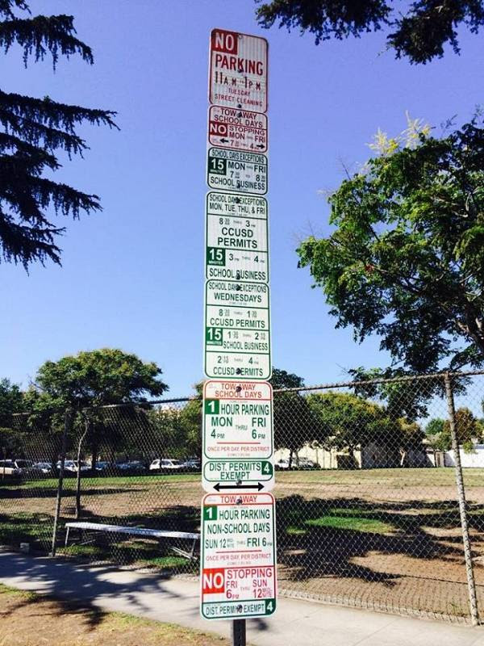
Strategic Impacts
What does this mean?
  We are in the midst of a significant cyberinfrastructure upgrade
  Enterprise networks need not be unduly perturbed ☺
    E.g. Remove the restrictions from scientific operation so they can run better, and the enterprise network will benefit as well.
Significantly enhanced capabilities compared to 3 years ago
  Terabyte-scale data movement is much easier
  Petabyte-scale data movement possible outside the LHC experiments
    3.1Gbps = 1PB/month
    (Try doing that through your enterprise firewall!)
  Widely-deployed tools are much better (e.g. Globus)
Raised expectations for network infrastructures
  Scientists should be able to do better than residential broadband
    Many more sites can now achieve good performance
    Incumbent on science networks to meet the challenge
      Remember the TCP loss characteristics
      Use perfSONAR
  Science experiments assume this stuff works – we can now meet their needs
© 2015, Energy Sciences Network
Notes:
I know a group that wants to do 1PB/week – they want to use Globus

Slide 14
Why Build A Science DMZ?
Data set scale
  Detector output increasing
    1Hz → 10Hz → 100Hz → 1kHz … → 1MHz
  HPC scale increasing
    Increased model resolution → increased data size
    Increased HPC capability means additional problems can now be solved
  Sequencers, Mass Spectrometers, …
Data placement
  Move compute to the data?
  Sure, if you can…otherwise you need to move it
Who needs the raw data?
  Anyone working on processing algorithms for raw data
  Anyone aggregating/integrating data sets (absent perfect prior reduction)
  Anyone doing data analysis for which a canned service does not exist
Without a Science DMZ, this stuff is hard
  Can you assume nobody at your institution will do this kind of work?
  If this kind of work can’t be done, what does that mean in 5 years?
© 2015, Energy Sciences Network
Notes:
Data placement – a liquid market in fungible computing allocations does not exist, and is not expected to exist
This ignores network research – e.g. on SDN

Slide 15
Outline
What is ESnet?
  Overview & Mission
  Scientific Drivers
Science DMZ context
  Where we are
  Why would you build a Science DMZ?
Success factors
  What makes a Science DMZ successful?
Enterprise traffic vs. science traffic
  Differences
  Security implications
© 2015, Energy Sciences Network

Slide 16
What Makes A Science DMZ Successful?
A Science DMZ is successful when it’s useful
  Contribution to science outcomes
  Reduced cost for supporting science projects
  Enable research that could not otherwise be done
Several different parts to this
  Networking organization must understand it
  Systems organization must understand it
  Security organization must understand it
  Scientists/researchers must understand it
Once everyone understands it and agrees, then it’s just implementation
How do we bring this about?
© 2015, Energy Sciences Network

Slide 17
Networking and Systems
It’s pretty easy for networking folks to understand this stuff
  It’s networking stuff, after all…
  Sometimes a bit trickier to explain it to senior leadership
    Roll up the technical detail
    Strategic implications rather than bits and bytes
Systems folks are generally on board as well
  DTNs are straightforward
  Most systems folks tend to like performance anyway
  Systems people deal with users a lot – they like to be able to make users happy
© 2015, Energy Sciences Network

Slide 18
Security
Security folks can be harder to convince
  Firewall people in particular can be a challenge
  We have seen some very “steadfast” firewall people
    They can kill a project if they aren’t on board
    Depending on the personalities involved, data may not be enough
    In some cases, getting the security people on board means senior leadership giving them orders – try to avoid that if possible
Remember – most of us work for science organizations
  If science is the primary mission, then everybody works for the scientists
  In a lot of cases security is reasonable – they just need to be included rather than dictated to
  (Security people like performance too)
    E.g. if a 10G flow is going to hurt the way a firewall works, the risks are well known for this flow, then it makes sense to discuss ways to route the traffic in a manner that is not harmful for anyone. Start the conversation.
© 2015, Energy Sciences Network
Notes:
Application and service constraints are helpful for getting security folks on board
Science is the primary mission of many organizations here
Much better to get buy-in than to impose

Slide 19
Science Engagement
Scientists and researchers need to be able to use cyberinfrastructure
  If I can’t use a tool, that tool doesn’t exist for me
  There are already too many tools – we can’t expect folks to find the right ones at random
  Scientists don’t have the cycles to be system integrators
Science engagement bridges the gap
  Understand what the scientists need to do with their data
  Understand the capabilities of the cyberinfrastructure
  Map the science onto the infrastructure
Understanding the infrastructure is straightforward for us
  We’re infrastructure people, right?
  How do we understand the science?
“Requirements and Relationships”
© 2015, Energy Sciences Network
Notes:
We’ve done networking, systems, security – what about the scientists?

Slide 20
Requirements
Requirements – what does the science project need?
  Several different ways of getting to this
  We can be told late, or we can go find out (I prefer to be proactive)
  ESnet requirements process: http://www.es.net/requirements/
Characterize science project from multiple angles
  Instruments and facilities
    “Hardware of science”
    Detectors, telescopes, tokamaks, HPC facilities
    Tells us about the data – where, how fast, how much, etc.
  Process of science
    How do scientists use the data for discovery?
    Where does the data need to go? How is it analyzed? What time scale?
  Assessments done in formal reviews
© 2015, Energy Sciences Network
Notes:
I’ve been in the place of being told we suck in front of program management because of end site issues
Case studies on next slide

Slide 21
Requirements Review Structure
Several key elements
  Case studies provide a network-centric narrative of the science
  Requirements synthesized from science instruments, facilities, and science process – in collaboration with science programs
Process details are important
  Four actors have the same conversation at the same time
    ESnet, ESnet program management at DOE
    Senior science program members, science program management at DOE
  Open discussion about needs, issues, changes, best practice
    All parties have the same conversation in the same room at the same time
    Common understanding of program needs and the solutions ESnet undertakes to meet those needs
  Review reports are vetted by ESnet and by both programs
© 2015, Energy Sciences Network
Notes:
Case study is key

Slide 22
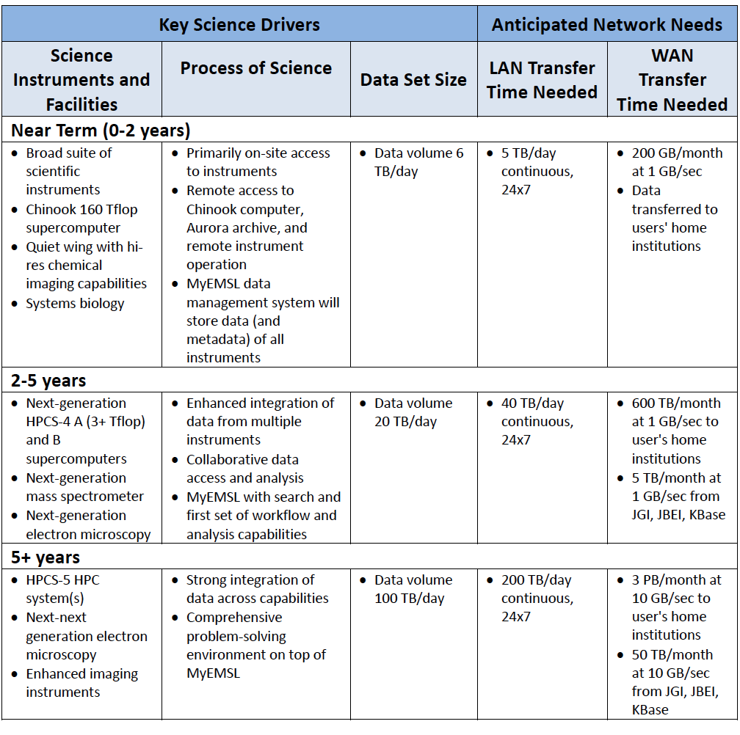
2013 BER
Sample
Findings:
Environmental Molecular Sciences Laboratory
(EMSL)
“EMSL frequently needs to ship physical copies of media to users when data sizes exceed a few GB. More often than not, this is due to lack of bandwidth or storage resources at the user's home institution.”

Slide 23
Relationships
Relationships – familiarity, understanding, trust
  Work with science collaborations to understand their needs
  Make their lives better
    Fix problems
    Give them better tools and workflows
  Make sure you are accurate (expectations are important)
  Check in with people periodically
    I make it a practice to ask “is there anything we need to talk about?”
    Often people won’t come to you first, but they will give you a chance to help if you check in
Once you get a reputation for solving problems, it all gets easier
  People come to you first
  You get in early on the planning
  People are more willing to push the envelope
© 2015, Energy Sciences Network
Notes:
Describe requirements process
Key – we do case studies, talk through it with scientists, instruments/facilities/process
I’ve been in the place of being told we suck in front of program management because of end site issues

Slide 24
Outline
What is ESnet?
  Overview & Mission
  Scientific Drivers
Science DMZ context
  Where we are
  Why would you build a Science DMZ?
Success factors
  What makes a Science DMZ successful?
Enterprise traffic vs. science traffic
  Differences
  Security implications
© 2015, Energy Sciences Network

Slide 25
Science Traffic – What Makes It Special?
Large scale data transfers are a hallmark of science traffic
  Yes, scientists use web browsers, email, etc.
  However, moving the data is the differentiator
Enterprise traffic is typically composed of a large number of small flows
  Web, email, document sharing, IP phones, …
  VPNs carrying all of the above
We distinguish these in the following way:
  Large-scale science traffic: Elephant flows
  Enterprise traffic: Mouse flows
© 2015, Energy Sciences Network

Slide 26
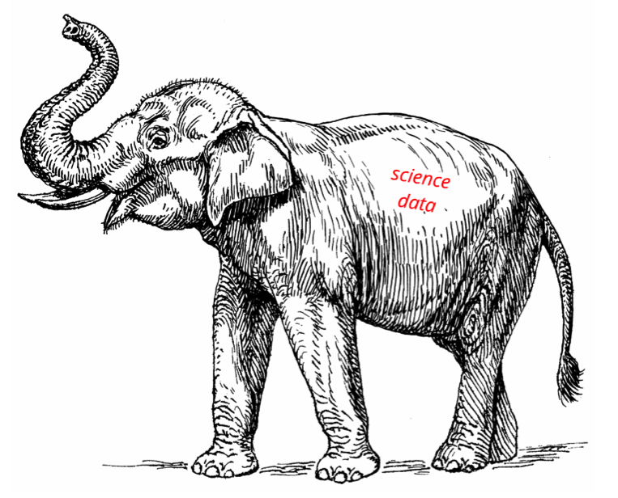
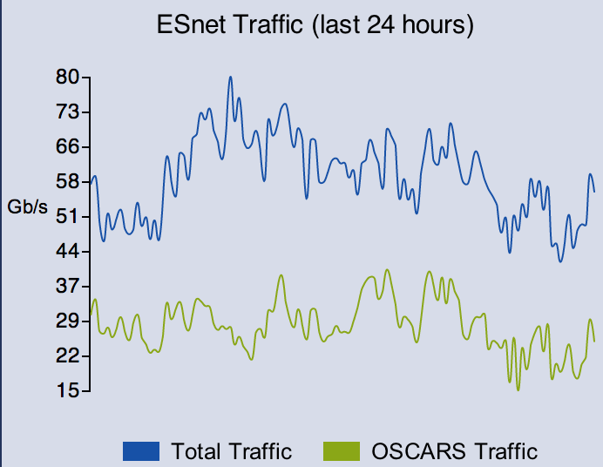
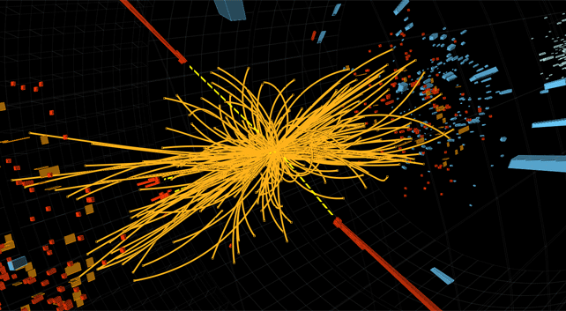



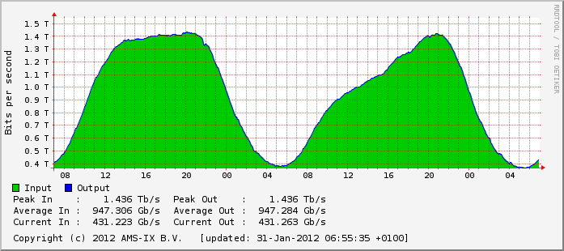



ESnet is not the Commercial Internet
26 – ESnet Science Engagement (engage@es.net) - 1/12/15
© 2015, Energy Sciences Network

Slide 27
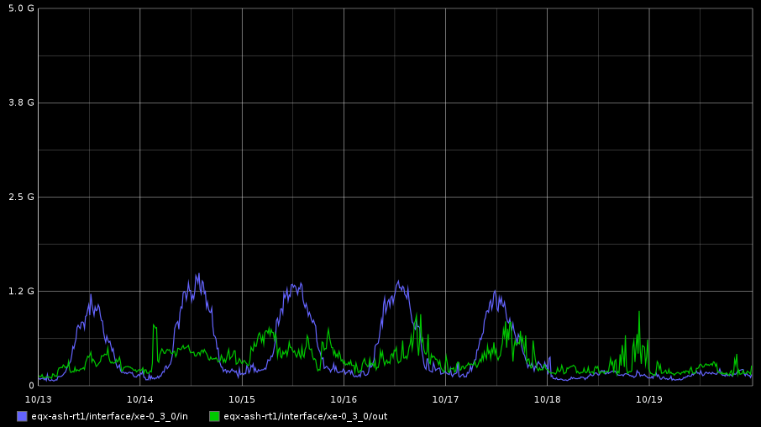
Commodity Traffic: Peering Interface
© 2015, Energy Sciences Network

Slide 28
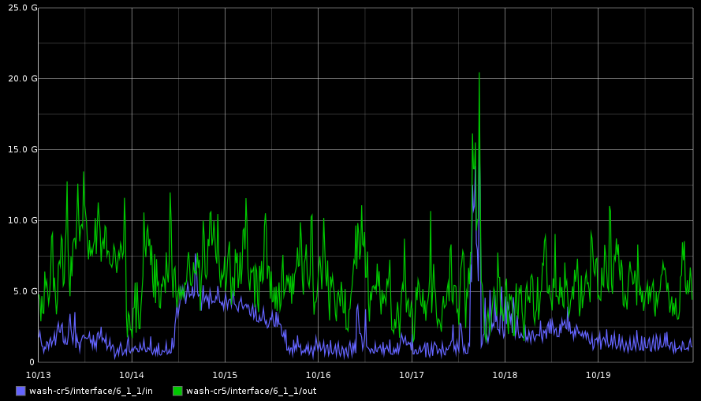
Science Traffic: Peering Interface
© 2015, Energy Sciences Network

Slide 29
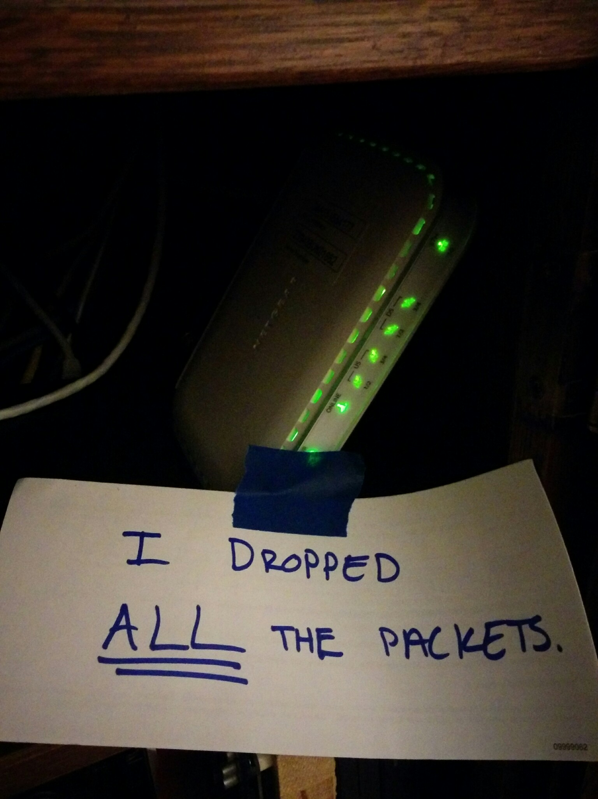
Support For Science Traffic
The Science DMZ is typically deployed to support science traffic
  Typically large data transfers over long distances
  In most cases, the data transfer applications use TCP
The behavior of TCP is a legacy from the congestion collapse of the Internet in the 1980s
  Loss is interpreted as congestion
  TCP backs off to avoid congestion → performance degrades
  Performance hit related to the square of the packet loss rate
Addressing this problem is a dominant engineering consideration for science networks
  Lots of design effort
  Lots of engineering time
  Lots of troubleshooting effort
© 2015, Energy Sciences Network
Notes:
Why do we do all this work? To get the loss to zero.
How bad is it?

Slide 30
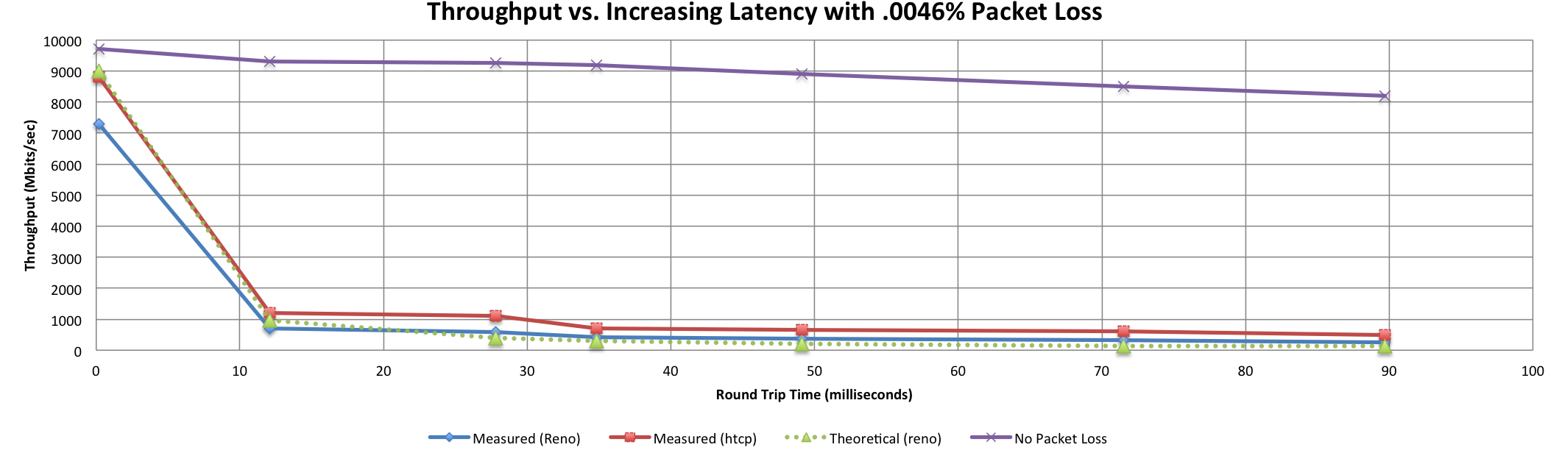
A small amount of packet loss makes a huge difference in TCP performance
Local
(LAN)
With loss, high performance beyond metro distances is essentially impossible
International
Metro Area
Regional
Continental
Measured (TCP Reno)
Measured (HTCP)
Theoretical (TCP Reno)
Measured (no loss)
© 2015, Energy Sciences Network
Notes:
This is an annotated version of the plot from the Science DMZ paper
Beyond your metro area, zero loss is essentially required for high performance
Where are your collaborators? Where are your users?
When global collaboration is the norm, nobody can afford to be a local-only resource

Slide 31
Security Implications For Traffic Types
We have two distinct traffic profiles
  Commodity/enterprise traffic
    Many, many mouse flows
    High loss tolerance (they are low-bandwidth flows anyway)
  Science traffic
    Small number of elephant flows
    Very sensitive to loss
Traditional security approaches (i.e. enterprise firewalls) cause performance problems
If we look at the security implications for science and commodity traffic, what do we see?
© 2015, Energy Sciences Network

Slide 32
Commodity Traffic – Web Broswers
What does a web browser do?
  Download a text file from a web server (may be dynamically generated)
  Render what we download
  Fetch and render a bunch of other stuff based on links
  When there is nothing left to fetch and render, the page is done
What is all this stuff?
  HTML (fine – it’s a web browser, after all)
  Mobile code (sometimes useful, sometimes hostile)
  Images to display
  Rich media content (Flash and friends)
Impossible to attribute content to people in practice
© 2015, Energy Sciences Network

Slide 33
Science Traffic (DTN)
A Data Transfer Node doesn’t run commodity applications
  Or, at least, it shouldn’t
  If people are running that goo on your DTN, shut it down
What does a DTN do?
  Negotiate a transfer with remote DTN
  Open a few data connections
  Push a few TB over those connections
  Close the connections
If data is being written, it’s being written by someone with an account (presumably you’ve already vetted that user if you gave them the account)
© 2015, Energy Sciences Network

Slide 34
Commodity Traffic – Attack Surface
There is a large “attack surface” involved with commodity traffic
  Mobile code execution
  Media codecs
  Image rendering libraries
Go look at what some common web pages do
  Say your users are into sports, or celebrity gossip, or news blogs *. Maybe even watching a self-help video on youtube **
  Go look at some popular sites (your users do at lunch time!)
    You don’t have to get fancy – just turn on the javascript console
    Look at all the places content comes from, what gets executed
      Mobile code comes down as code, or maybe as text (but gets executed)
      Images come down as images, or maybe as encoded text (but rendered as images)
      Content comes from all over the place, depending on who bought what ad space
  All of this comes over port 80 or port 443 – standard web stuff
* http://www.cyphort.com/huffingtonpost-serving-malware/
** http://blog.trendmicro.com/trendlabs-security-intelligence/youtube-ads-lead-to-exploit-kits-hit-us-victims/
© 2015, Energy Sciences Network

Slide 35
Science Traffic – Attack Surface
There is one listening service – the data transfer tool (assume Globus)
  Port 2811: control
  Ports 443 and 7512: oauth (ports depend on config)
  Large data port range (1001 ports – 50,000 to 51,000)
    Data ports are open during a transfer
    Closed otherwise
Nice clean behavior – just POSIX file operations (open, read, write, close)
  No image rendering
  No rich media
  No document rendering
  No mobile code
© 2015, Energy Sciences Network

Slide 36
Attack Surface – Which is Greater?
A web browser typically uses just two ports – 80 and 443
  Most firewall people count that as two
  Web is a normal service, critical for business functions
A Globus DTN uses over 1000 ports
  Many naïve security people count that as “too many”
  Weird service, they don’t understand it, and “too many ports”
A naïve security person will view the DTN as more dangerous because of the high port count
  This is not rational
If you look at attack surfaces, the web browser is far more dangerous
  Web browsers render and execute whatever the ‘net hands them
  Port count has little to do with an application’s attack surface
© 2015, Energy Sciences Network

Slide 37
To Each Its Own
The preceding is another example of why science traffic and commodity traffic should be separated
Enterprise traffic is enterprise traffic, and requires enterprise engineering solutions
  Sufficient aggregate bandwidth
  Inexpensive hardware
  Firewalls
  Proxies
  Virus scanners
Science traffic is science traffic, and requires science engineering solutions
  Highly capable gear
  Loss-free IP layer for TCP performance
  High per-flow bandwidth, and tools that can use it
  High visibility (perfSONAR)
  Specific security policy tailored to science applications
© 2015, Energy Sciences Network

Slide 38
Science DMZ – Moving Forward
This is about the science
Build it well, make sure they can use it
Reminder of the ESnet vision:
  Scientific progress is completely unconstrained by the physical location of instruments, people, computational resources, or data
  Collaborations at every scale, in every domain, will have the information and tools they need to achieve maximum benefit from global networks
We are here to help: engage@es.net
  Want to talk architecture?
  Want to ask about requirements for your own site?
© 2015, Energy Sciences Network

Slide 39
Thanks!
Eli Dart dart@es.net
Jason Zurawski zurawski@es.net
Energy Sciences Network (ESnet)
Lawrence Berkeley National Laboratory
http://fasterdata.es.net/
http://my.es.net/
http://www.es.net/

Slide 40
Extra Slides

Slide 41
Science DMZ Security
Goal – disentangle security policy and enforcement for science flows from security for business systems
Rationale
  Science data traffic is simple from a security perspective
  Narrow application set on Science DMZ
    Data transfer, data streaming packages
    No printers, document readers, web browsers, building control systems, financial databases, staff desktops, etc.
  Security controls that are typically implemented to protect business resources often cause performance problems
Separation allows each to be optimized
© 2014, Energy Sciences Network

Slide 42
Performance Is A Core Requirement
Core information security principles
  Confidentiality, Integrity, Availability (CIA)
  Often, CIA and risk mitigation result in poor performance
In data-intensive science, performance is an additional core mission requirement: CIA → PICA
  CIA principles are important, but if performance is compromised the science mission fails
  Not about “how much” security you have, but how the security is implemented
  Need a way to appropriately secure systems without performance compromises
© 2014, Energy Sciences Network
Notes:
You can still have really tight security if you need really tight security – just do it in a way that does not cause performance problems for traffic permitted by policy

Slide 43
Placement Outside the Firewall
The Science DMZ resources are placed outside the enterprise firewall for performance reasons
  The meaning of this is specific – Science DMZ traffic does not traverse the firewall data plane
  Packet filtering is fine – just don’t do it with a firewall
Lots of heartburn over this, especially from the perspective of a conventional firewall manager
  Lots of organizational policy directives mandating firewalls
  Firewalls are designed to protect converged enterprise networks
  Why would you put critical assets outside the firewall???
The answer is that firewalls are typically a poor fit for high-performance science applications
© 2014, Energy Sciences Network
Notes:
Packets do not traverse a firewall device
Firewalls are typically engineered very differently than routers and switches

Slide 44
Firewall Internals
Typical firewalls are composed of a set of processors which inspect traffic in parallel
  Traffic distributed among processors such that all traffic for a particular connection goes to the same processor
  Simplifies state management
  Parallelization scales deep analysis
Excellent fit for enterprise traffic profile
  High connection count, low per-connection data rate
  Complex protocols with embedded threats
Each processor is a fraction of firewall link speed
  Significant limitation for data-intensive science applications
  Overload causes packet loss – performance crashes
© 2014, Energy Sciences Network
Notes:
Each individual processor is typically a fraction of link speed (e.g. eight 1.25Gbps processors for a 10G firewall)

Slide 45
Thought Experiment
We’re going to do a thought experiment
Consider a network between three buildings – A, B, and C
This is supposedly a 10Gbps network end to end (look at the links on the buildings)
Building A houses the border router – not much goes on there except the external connectivity
Lots of work happens in building B – so much that the processing is done with multiple processors to spread the load in an affordable way, and results are aggregated after
Building C is where we branch out to other buildings
Every link between buildings is 10Gbps – this is a 10Gbps network, right???
© 2014, Energy Sciences Network
Notes:
Go to next slide, speak to the diagram
The text on this slide is for people looking at the deck who are not present at the talk

Slide 46
Notional 10G Network Between Buildings
© 2014, Energy Sciences Network
Notes:
Building A houses the border router – not much goes on there except the external connectivity
Lots of work happens in building B – so much that the processing is done with multiple processors to spread the load in an affordable way, and results are aggregated after
Building C is where we branch out to other buildings

Slide 47
Clearly Not A 10Gbps Network
If you look at the inside of Building B, it is obvious from a network engineering perspective that this is not a 10Gbps network
  Clearly the maximum per-flow data rate is 1Gbps, not 10Gbps
  However, if you convert the buildings into network elements while keeping their internals intact, you get routers and firewalls
  What firewall did the organization buy? What’s inside it?
  Those little 1G “switches” are firewall processors
This parallel firewall architecture has been in use for years
  Slower processors are cheaper
  Typically fine for a commodity traffic load
  Therefore, this design is cost competitive and common
© 2014, Energy Sciences Network

Slide 48
Notional 10G Network Between Devices
© 2014, Energy Sciences Network
Notes:
Now, convert the buildings into network devices
Building A becomes a border router
Building B becomes a firewall
Building C becomes a core router

Slide 49
Notional Network Logical Diagram
© 2014, Energy Sciences Network
Notes:
If you’re not allowed to look inside, this is all you see
This network is broken, but unless you know to go look you’ll never know why

Slide 50
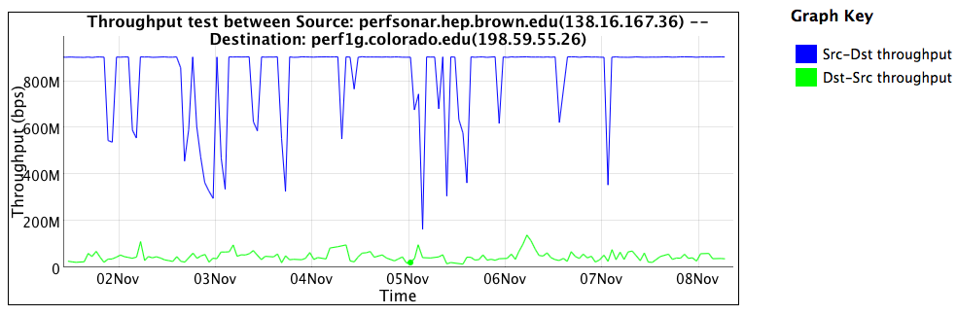
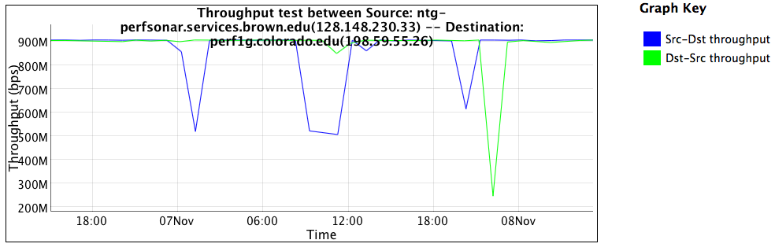
Firewall Performance Example
Observed performance, via perfSONAR, through a firewall:
Observed performance, via perfSONAR, bypassing firewall:
Almost 20 times slower through the firewall
Huge improvement without the firewall
© 2014, Energy Sciences Network
Notes:
Real life example, in front of and in back of a firewall that was dramatically impacting performance
perfSONAR is good at finding these issues
Engineers still have to take action to fix the problem

Slide 51
What’s Inside Your Firewall?
Vendor: “but wait – we don’t do this anymore!”
  It is true that vendors are working toward line-rate 10G firewalls, and some may even have them now
  10GE has been deployed in science environments for over 10 years
  Firewall internals have only recently started to catch up with the 10G world
  100GE is being deployed now, 40Gbps host interfaces are available now
  Firewalls are behind again
In general, IT shops want to get 5+ years out of a firewall purchase
  This often means that the firewall is years behind the technology curve
  Whatever you deploy now, that’s the hardware feature set you get
  When a new science project tries to deploy data-intensive resources, they get whatever feature set was purchased several years ago
© 2014, Energy Sciences Network
Notes:
As an element of network design, the enterprise firewall is a poor fit for high-performance scientific applications
Find another way to secure the high-performance scientific applications

Slide 52
The Firewall State Table
Many firewalls use a state table to improve performance
  State table lookup is fast
  No need to process entire ruleset for every packet
  Also allows session tracking (e.g. TCP sequence numbers)
State table built dynamically
  Incoming packets are matched against the state table
  If no state table entry, go to the ruleset
  If permitted by ruleset, create state table entry
  Remove state table entry after observing connection teardown
Semantically similar to punt-and-switch model of traffic forwarding used on many older routers
© 2014, Energy Sciences Network

Slide 53
State Table Issues
If the state table is not pruned, it will overflow
  Not all connections close cleanly
    I shut my laptop and go to a meeting
    Software crashes happen
  Some attacks try to fill state tables
Solution: put a timer on state table entries
  When a packet matches the state table entry, update the timer
  If the timer expires, delete the state table entry
What if I just pause for a few minutes?
  This turns out to be a problem – state table timers are typically in the 5-15 minute range, while host keepalive timers are 2 hours
  If a connection pauses (e.g. control channel waits for a large transfer), the firewall will delete the state table entry from under it – the control connection now hangs
  We have seen this in production environments
© 2014, Energy Sciences Network
Notes:
Enterprise firewall designers assume that everything is an email, a web browser, or streaming content
Science environments are more complex than that – they make use of the full set of capabilities available
If you violate the assumptions of an enterprise firewall, you experience denial of service – by design!

Slide 54
Firewall Capabilities and Science Traffic
Firewalls have a lot of sophistication in an enterprise setting
  Application layer protocol analysis (HTTP, POP, MSRPC, etc.)
  Built-in VPN servers
  User awareness
Data-intensive science flows typically don’t match this profile
  Common case – data on filesystem A needs to be on filesystem Z
    Data transfer tool verifies credentials over an encrypted channel
    Then open a socket or set of sockets, and send data until done (1TB, 10TB, 100TB, …)
  One workflow can use 10% to 50% or more of a 10G network link
Do we have to use a firewall?
© 2014, Energy Sciences Network

Slide 55
Firewalls As Access Lists
When you ask a firewall administrator to allow data transfers through the firewall, what do they ask for?
  IP address of your host
  IP address of the remote host
  Port range
  That looks like an ACL to me!
No special config for advanced protocol analysis – just address/port
Router ACLs are better than firewalls at address/port filtering
  ACL capabilities are typically built into the router
  Router ACLs typically do not drop traffic permitted by policy
© 2014, Energy Sciences Network
Notes:
Remember – we have mission requirements for high performance scientific data mobility, and business requirements for cost efficiency.
A firewall mandate is an expensive solution that is a poor match for the task at hand and jeopardizes the scientific mission of the organization.

Slide 56
Security Without Firewalls
Data intensive science traffic interacts poorly with firewalls
Does this mean we ignore security? NO!
  We must protect our systems
  We just need to find a way to do security that does not prevent us from getting the science done
Key point – security policies and mechanisms that protect the Science DMZ should be implemented so that they do not compromise performance
Traffic permitted by policy should not experience performance impact as a result of the application of policy
© 2014, Energy Sciences Network

Slide 57
If Not Firewalls, Then What?
Remember – the goal is to protect systems in a way that allows the science mission to succeed
I like something I heard at NERSC – paraphrasing: “Security controls should enhance the utility of science infrastructure.”
There are multiple ways to solve this – some are technical, and some are organizational/sociological
I’m not going to lie to you – this is harder than just putting up a firewall and closing your eyes
© 2014, Energy Sciences Network
Notes:
It will probably work better because the firewall isn’t doing that much for high-performance DTNs anyway

Slide 58
Other Technical Capabilities
Intrusion Detection Systems (IDS)
  One example is Bro – http://bro-ids.org/
  Bro is high-performance and battle-tested
    Bro protects several high-performance national assets
    Bro can be scaled with clustering: http://www.bro-ids.org/documentation/cluster.html
  Other IDS solutions are available also
Netflow and IPFIX can provide intelligence, but not filtering
Openflow and SDN
  Using Openflow to control access to a network-based service seems pretty obvious
  This could significantly reduce the attack surface for any authenticated network service
  This would only work if the Openflow device had a robust data plane
© 2014, Energy Sciences Network

Slide 59
Other Technical Capabilities (2)
Aggressive access lists
  More useful with project-specific DTNs
  If the purpose of the DTN is to exchange data with a small set of remote collaborators, the ACL is pretty easy to write
  Large-scale data distribution servers are hard to handle this way (but then, the firewall ruleset for such a service would be pretty open too)
Limitation of the application set
  One of the reasons to limit the application set in the Science DMZ is to make it easier to protect
  Keep desktop applications off the DTN (and watch for them anyway using logging, netflow, etc – take violations seriously)
  This requires collaboration between people – networking, security, systems, and scientists
© 2014, Energy Sciences Network

Slide 60
Collaboration Within The Organization
All stakeholders should collaborate on Science DMZ design, policy, and enforcement
The security people have to be on board
  Remember: security people already have political cover – it’s called the firewall
  If a host gets compromised, the security officer can say they did their due diligence because there was a firewall in place
  If the deployment of a Science DMZ is going to jeopardize the job of the security officer, expect pushback
The Science DMZ is a strategic asset, and should be understood by the strategic thinkers in the organization
  Changes in security models
  Changes in operational models
  Enhanced ability to compete for funding
  Increased institutional capability – greater science output
© 2014, Energy Sciences Network

Slide 61
Commodity vs. Science Traffic
Stark difference in behavior
Commodity traffic
  When there are eyeballs, there is traffic
  No eyeballs, no traffic
  Web, email, etc.
  Many, many, many mouse flows
Science traffic
  When there is data to move, there is traffic
  Science facilities run 24x7
  Small number of elephant flows
  Individual workflows are sometimes visible in aggregate statistics

Slide 62
Security Footprint of a Globus Transfer

Slide 63
Security Footprint of a Globus DTN
Notes:
Remote DTNs also need to access the Globus instance in AWS, but that is not a concern of the Local DTN security policy

