Slide 1







Science Engagement: A Non-Technical Approach to the Technical Divide
Jason Zurawski – zurawski@es.net
Science Engagement Engineer, ESnet
Lawrence Berkeley National Laboratory
ENhancing CyberInfrastructure by Training and Engagement (ENCITE) Webinar
January 16th, 2015

Slide 2
Outline
What is ESnet?
Modern Science
The Challenges Scientists Face
The Role of Engagement
Call to Arms
Conclusions
© 2015, Energy Sciences Network

Slide 3
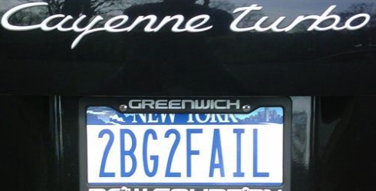
ESnet at a Glance
High-speed national network, optimized for DOE science missions:
  connecting 40 labs, plants and facilities with >100 networks
  $32.6M in FY14, 42FTE
  older than commercial Internet, growing twice as fast
$62M ARRA grant for 100G upgrade:
  transition to new era of optical networking
  world’s first 100G network at continental scale
Culture of urgency:
  4 awards in past 3 years
  R&D100 Award in FY13
  “5 out of 5” for customer satisfaction in last review
  Dedicated staff to support the mission of science
© 2015, Energy Sciences Network

Slide 4
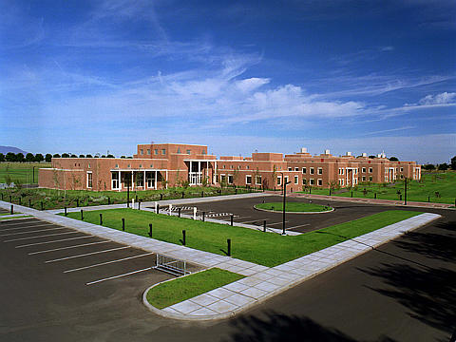
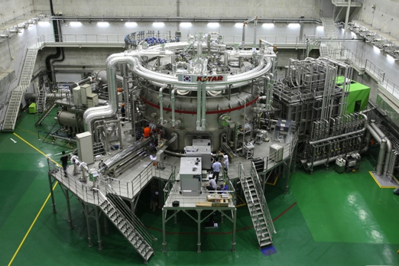
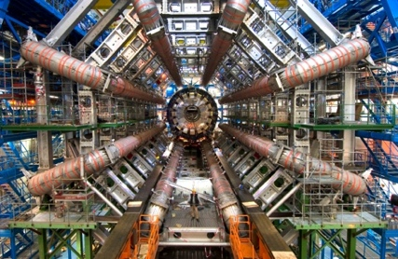
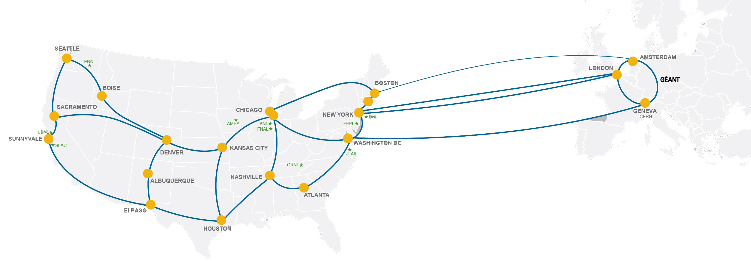
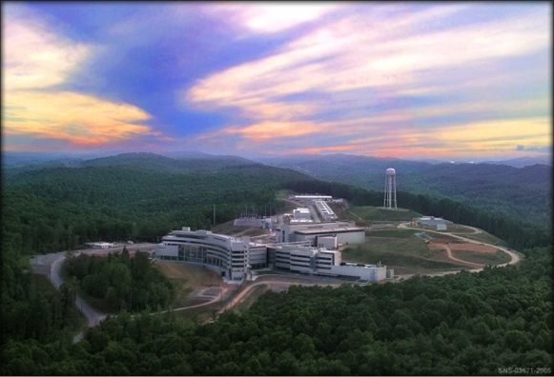
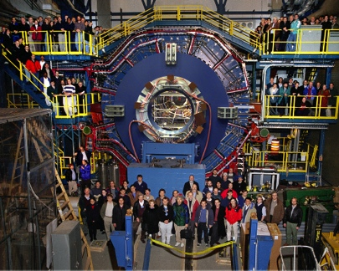
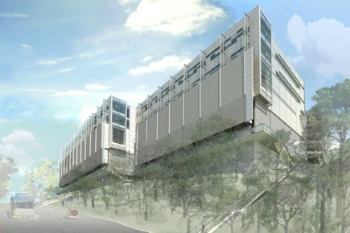
Network as Infrastructure Instrument
    Vision: Scientific progress will be completely unconstrained by the physical location of instruments, people, computational resources, or data.
© 2015, Energy Sciences Network
Notes:
Summing up ESnet’s vision in one slide, one phrase…
Physical location of instruments, people, computational resources, data. It just should not matter.
[KSTAR, SNS, ATLAS, EMSL, CRT/NERSC, STAR Detector at RHIC [BNL, NP-funded]]

Slide 5
Outline
What is ESnet?
Modern Science
The Challenges Scientists Face
The Role of Engagement
Call to Arms
Conclusions
© 2015, Energy Sciences Network

Slide 6
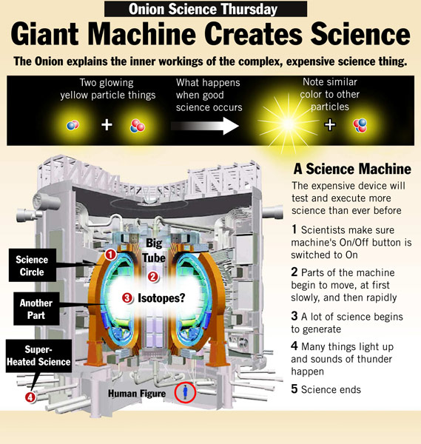
Where the Rubber Meets the Road: The Science
As a mission network, our mission fails if our users can’t do what they are supposed to do.
  So what is it they do?
There are 6 divisions of the DOE office of science that reflect different research disciplines
Modern scientific research still relies on the classic ‘scientific method’ (e.g. question, research, hypothesize, experiment, conclude, communicate)
The involvement of digital data collection and analysis is a given for everyone.
  E.g. machines to experiment with, networks to transmit results, analysis on supercomputers, etc.
© 2015, Energy Sciences Network
Notes:
We’ve done networking, systems, security – what about the scientists?

Slide 7
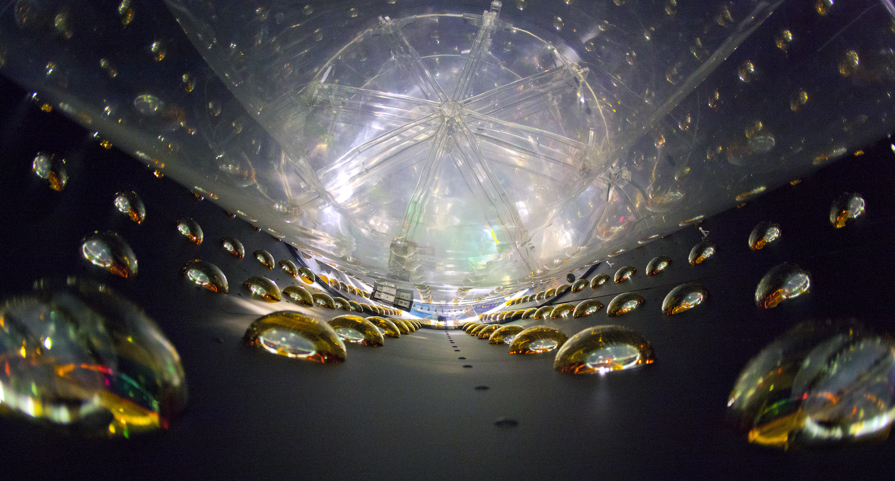



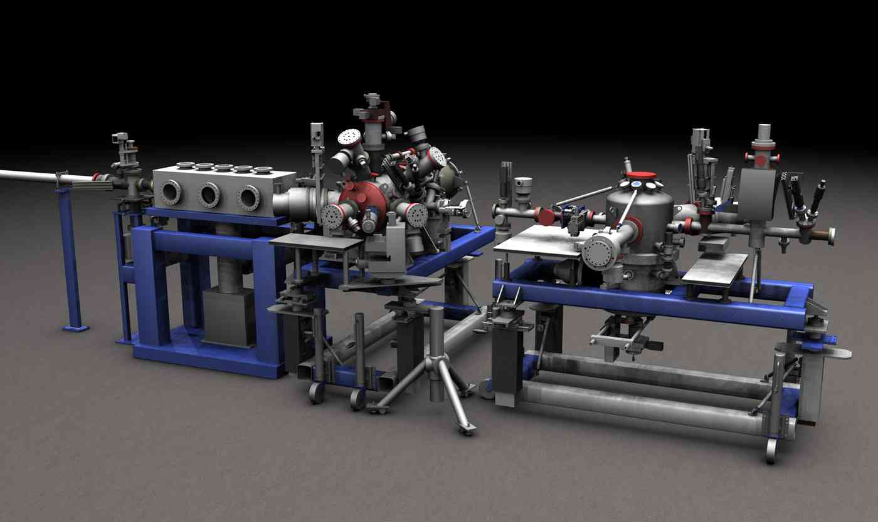
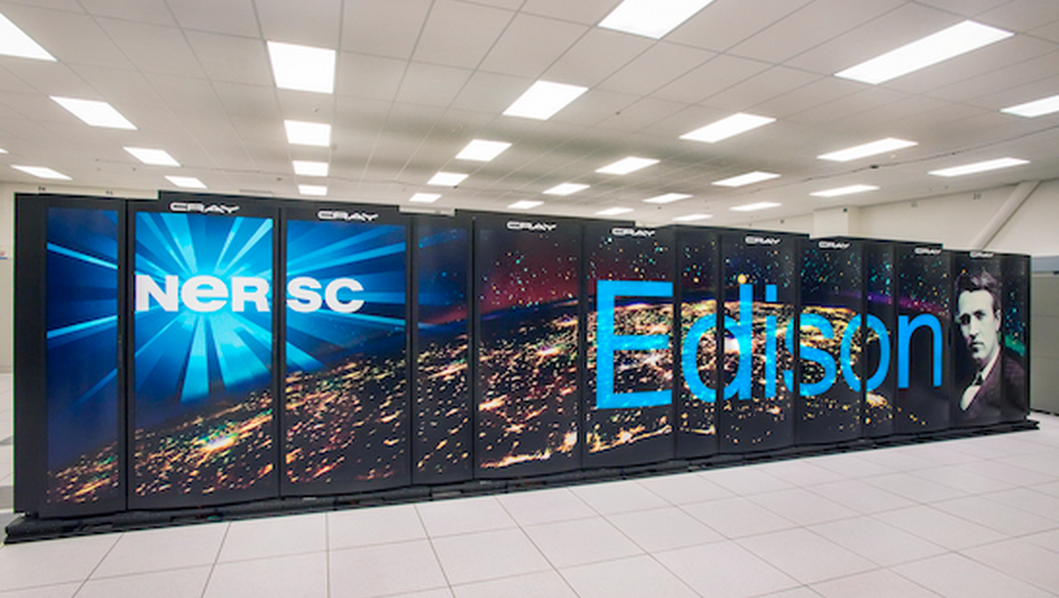
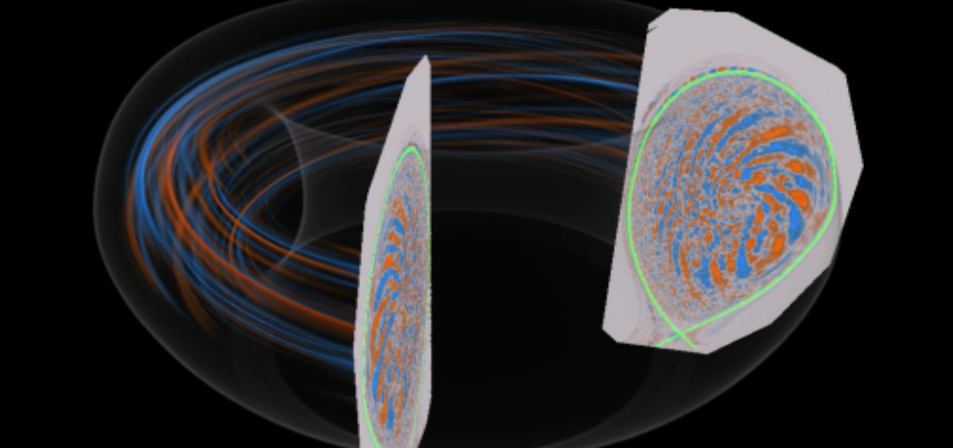
High Energy Physics
Biological and Environmental Research
Photo courtesy of LBL
Nuclear Physics
Photo courtesy of JGI
Photo courtesy of NIST
Advanced Scientific Computing Research
Basic Energy Science
Fusion Energy Sciences
Photo courtesy of LBL
Photo courtesy of SLAC
Photo courtesy of PPPL

Slide 8
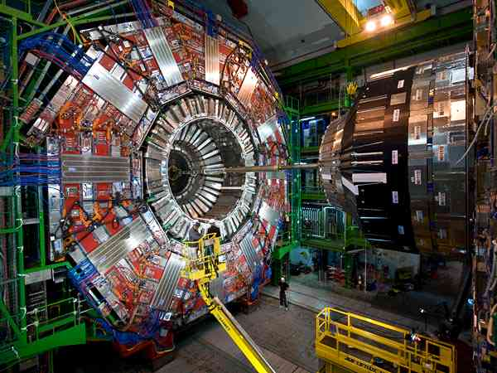
Traditional “Big Science”
© 2015, Energy Sciences Network

Slide 9
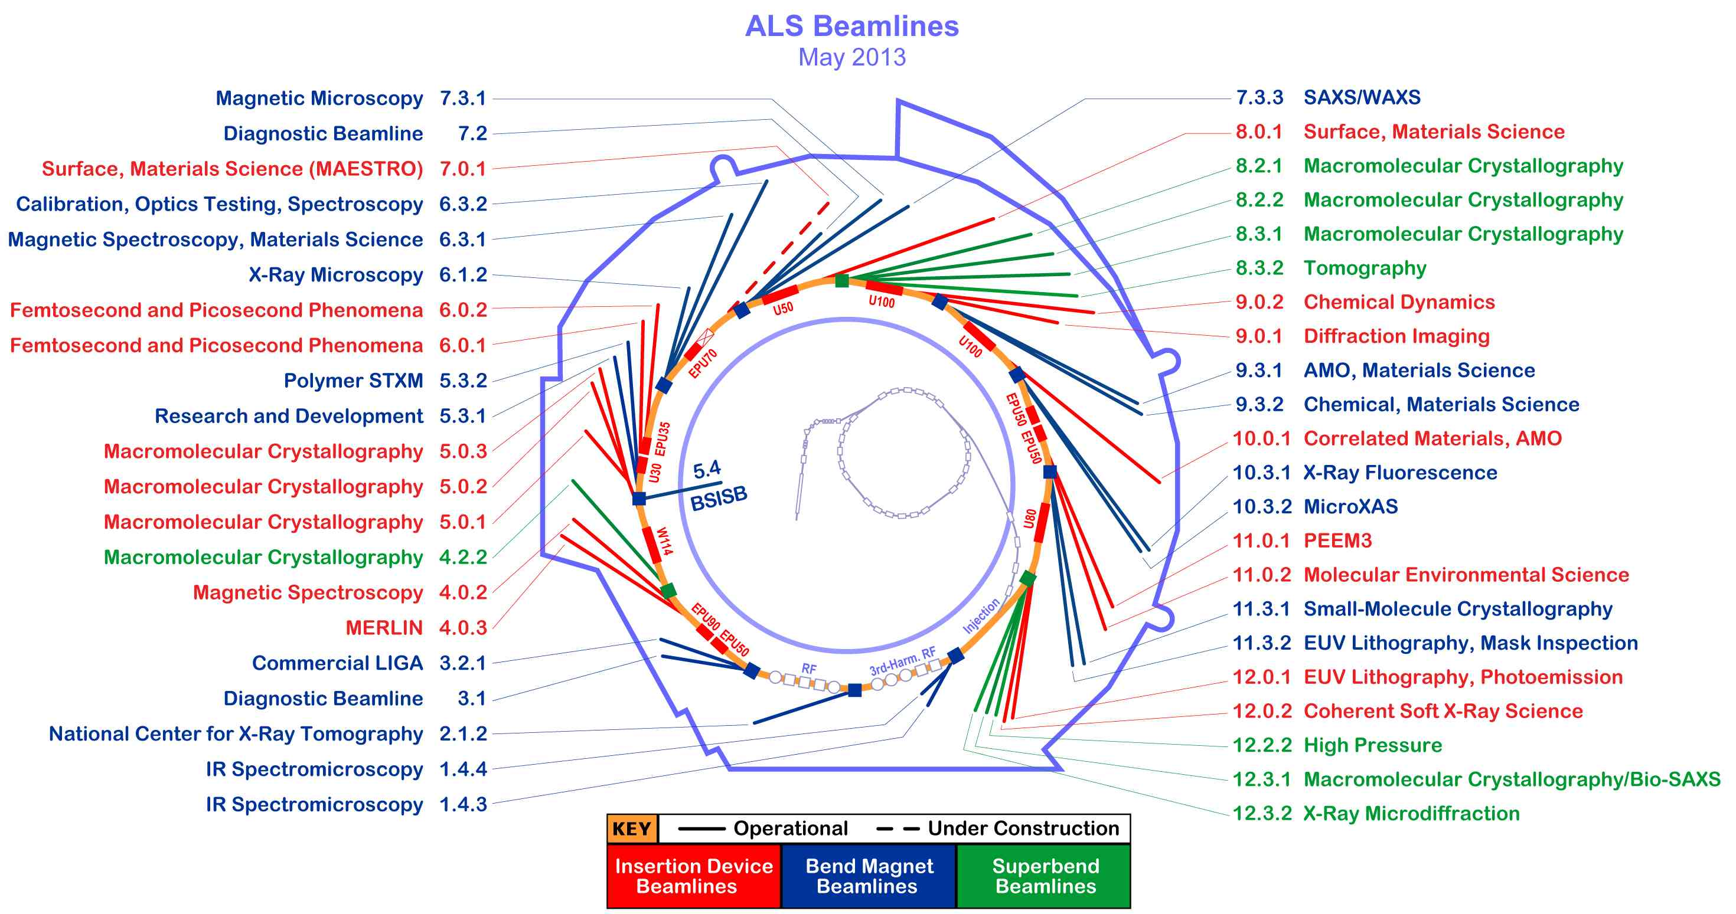
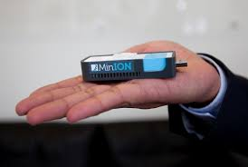
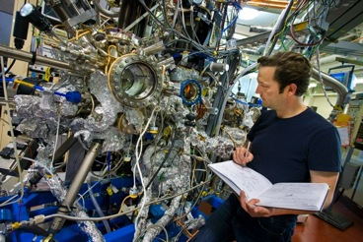
Big Science Now Comes in Small Packages
© 2015, Energy Sciences Network
Notes:
Beamline 8.3.2 at the Advanced Light Source is a Synchrotron-based Hard X-ray Micro-Tomography instrument. It allows non-destructive 3-Dimensional imaging of solid objects at a resolution of approximately 1 micron.
10⁶ increase in data output compared to previous generation
8 Gbps flows to supercomputer for real-time analysis

Slide 10
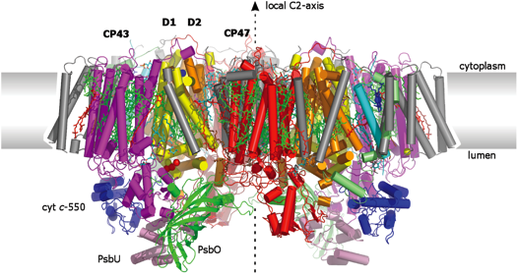
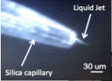
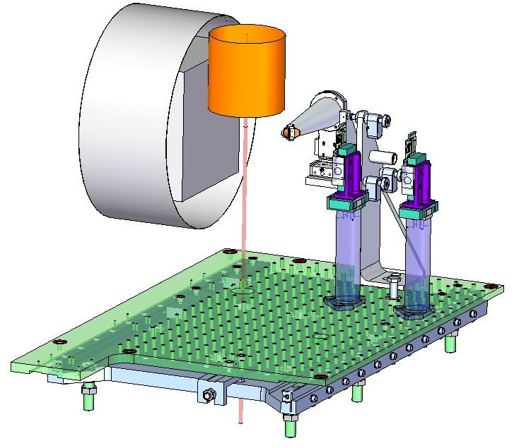
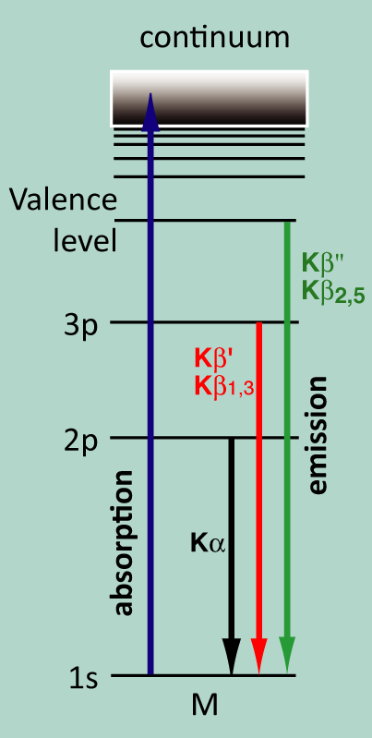
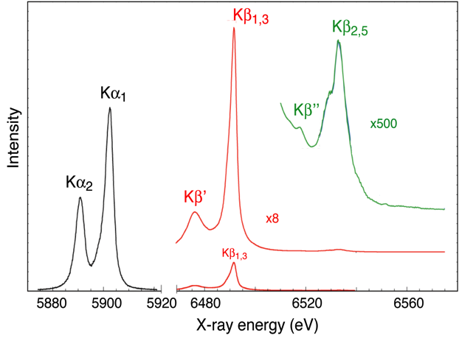
Coupling Research Facilities & HPC resources with Networks
X-ray diffraction
(structure)
Recent beam time on free-electron laser (LCLS) at SLAC to take ‘snapshots’ of catalytic reaction in Photosystem II (Nick Sauter et al).
Data transported to a nearby HPC resource (NERSC) for real-time computational analysis.
This one experiment tripled NERSC’s network utilization.
Liquid-jet
Injection of
μm-size crystals
Optical
pump
Injector
Diffraction
Detector
X-ray emission spectroscopy
(Chemistry at the catalytic site)
LCLS Beam
Analyzer
Crystals
XES Detector
X-ray Beam
Apertures
Source: Nicholas Sauter, LBNL
charge density/spin state
ligand environment
Kern et al (2012) PNAS 109: 9721
Sierra et al (2012) Acta Cryst D68: 1584
Mori et al (2012) PNAS 109: 19103
10 – ESnet Science Engagement (engage@es.net) - 1/13/15
© 2015, Energy Sciences Network
Notes:
Goal – understand photosynthesis
Over 100 TB/ over 5 days - Data moved from the LCLS data acquisition to NERSC's data transfer nodes at over 7.5 gigabits per second where it was processed on thousands of cores. The science team at the SLAC beamline was able to use this analysis to adjust their light source equipment daily during their five-day allocation at LCLS to get the best results possible.

Slide 11

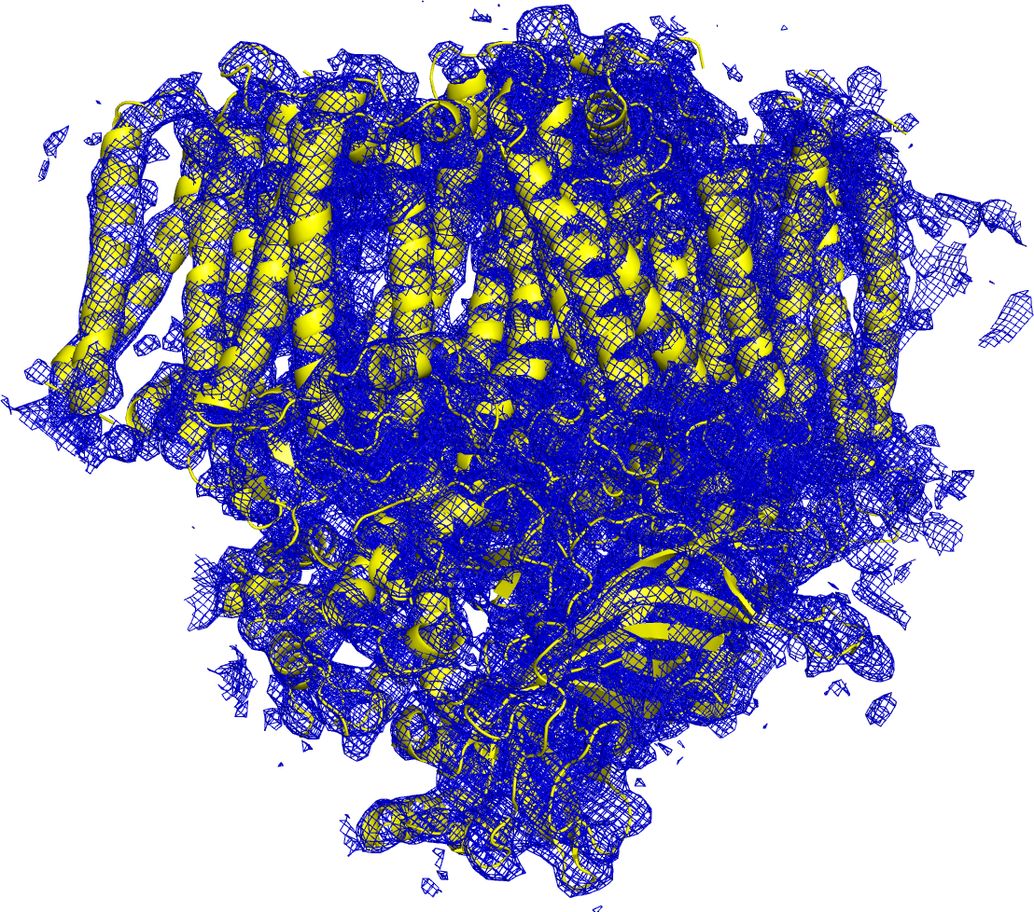
E Pluribus Unum
Hundreds to thousands of these images are created in a few hours…they can range in size from MB to TB
After processing on a supercomputer, models are created…once we get them there.
© 2015, Energy Sciences Network

Slide 12
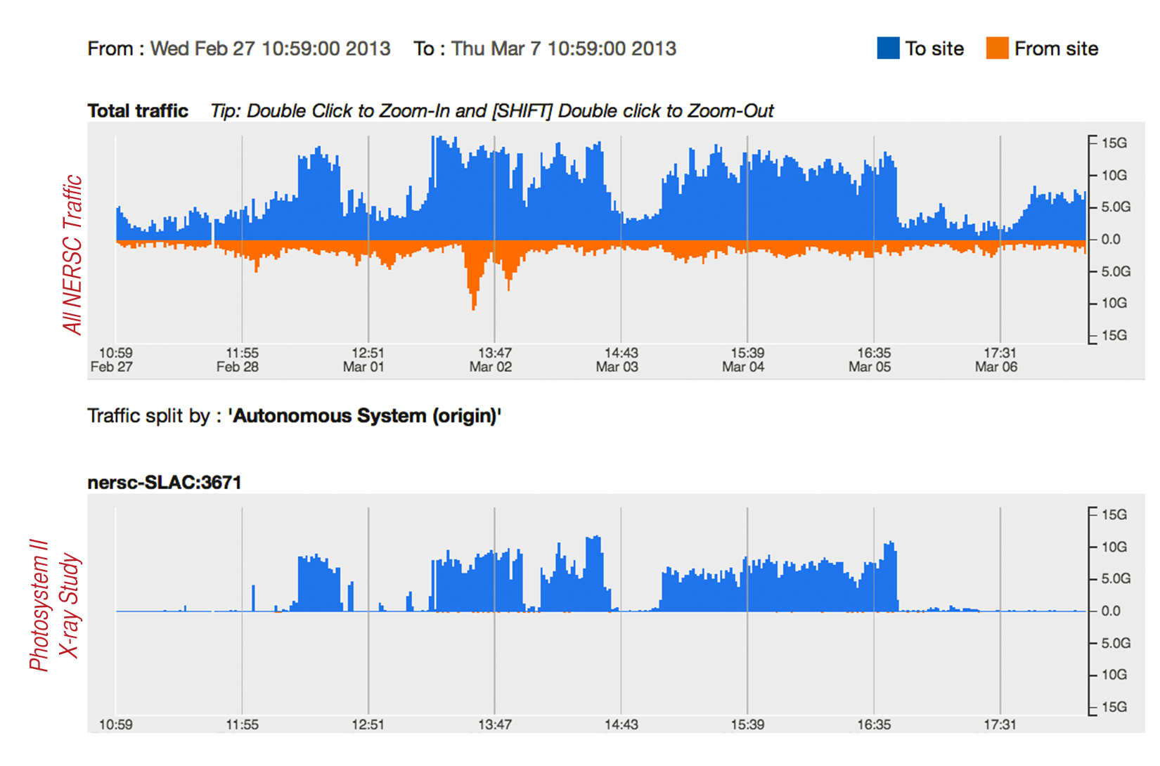
Experimental Facility to Computing Facility over ESnet
© 2015, Energy Sciences Network

Slide 13
Outline
What is ESnet?
Modern Science
The Challenges Scientists Face
The Role of Engagement
Call to Arms
Conclusions
© 2015, Energy Sciences Network

Slide 14
Size vs. Results
Every research project establishes a ‘workflow’ that is associated with their operational pattern. E.g.
  Experiment, Data Storage, Pre-Processing, Additional Experimentation, Post Processing, Conclusion & Publication
Workflow can be manual (single person handling all of the above aspects), it can be automated via computers, robots, and networks.
Workflow can involve multiple locations
  You may sample in a different location where you compute, store, or are sitting right now.
Learning the workflow is important in understanding where things are limited
  Limited because of a physical constraint (e.g. a human can only sample 100 items on a microscope per day)
  Limited because of a logical constraint (e.g. the scientist feels that a portable USB drive is the best storage, and there is only 1G of data available – limiting how many samples can be collected)
© 2015, Energy Sciences Network

Slide 15

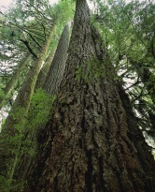


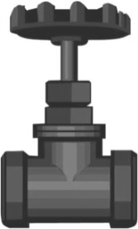

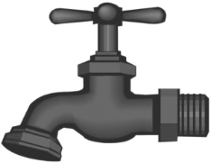
User Workflow & Bottleneck Identification
2. Endstation
3. Sample
4. Control Software
5. Data Collection
Users
1. Allocation
6. Data Transfer / Management
Publications
9. Write and edit
8. Data Analysis / Info Extraction / Visualization / Simulation
7. Data Processing
© 2015, Energy Sciences Network

Slide 16
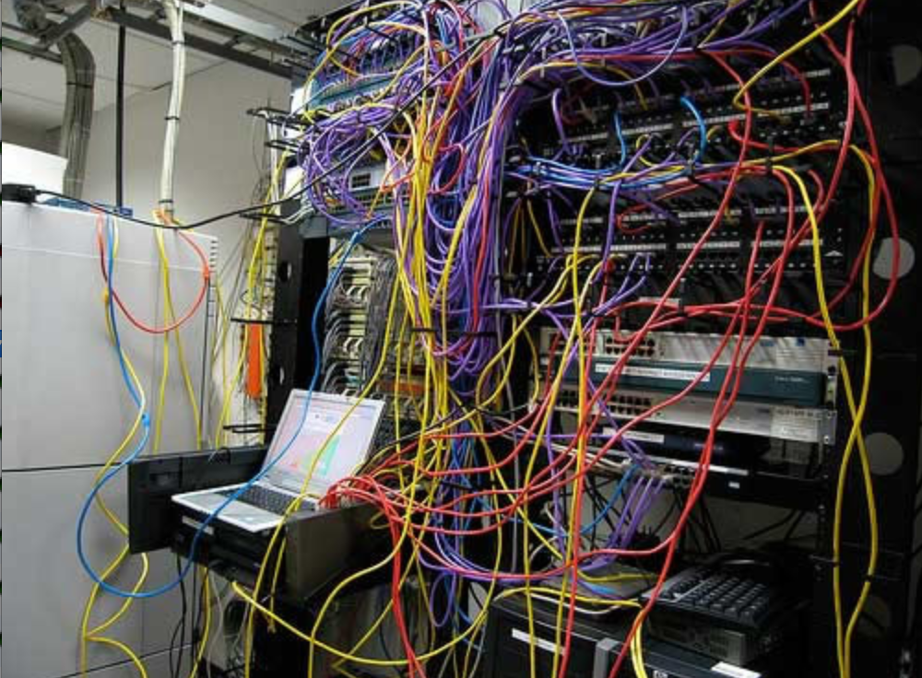
Challenges to Network Adoption
Causes of performance issues are complicated for users.
Lack of communication and collaboration between the CIO’s office and researchers on campus.
Lack of IT expertise within a science collaboration or experimental facility
User’s performance expectations are low (“The network is too slow”, “I tried it and it didn’t work”).
Cultural change is hard (“we’ve always shipped disks!”).
Scientists want to do science not IT support
The Capability Gap
© 2015, Energy Sciences Network

Slide 17
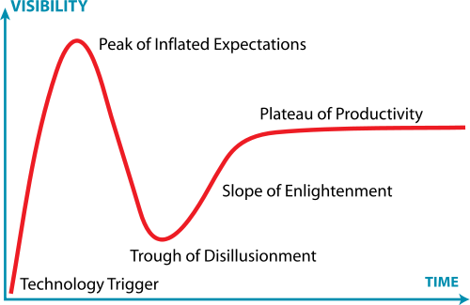
Post-it I keep On My Desk
Engineers are the early adopters of most things
Impacted science groups come in much later
We don’t want scientists to be engineers. They do better as scientists
Engagement != dropping something new into a user’s lap and hoping for the best
Engagement = figuring out if the solution is a good idea, and then helping with integration
  Asking questions, building trust
  Provide a solution, not a technology (and certainly not a headache)
Lots of easy things – e.g. changing data management tools, eliminating capacity bottlenecks, stopping non-congestive packet loss
© 2015, Energy Sciences Network

Slide 18
Bridging the Gap
Identified gaps:
  As tech experts – we know the tech and perhaps don’t know the science.
  As science experts – they know the process and don’t have a clue about how to make it fly.
Its not feasible for every scientist to be an IT person. Its also not realistic for the network engineering department to appreciate a quark.
  For a campus to run smoothly, everyone should be doing what they are trained to do, even if we know there are gaps to overcome
A (not so) middle ground for the tech people that are listening:
  Engineers establishing some basic knowledge of the process of science from the scientists
  Have a toolbox full of well known (e.g. tested, ready to rock) solutions for a variety of problems: data movement, data storage, etc.
  Suggest incremental changes to smooth out the areas that touch networks
  COMMUNICATE!
    (can’t overemphasize this one – none of the above works unless you are talking things out)
We have now defined Science Engagement, lets see it in action
© 2015, Energy Sciences Network

Slide 19
Outline
What is ESnet?
Modern Science
The Challenges Scientists Face
The Role of Engagement
Call to Arms
Conclusions
© 2015, Energy Sciences Network

Slide 20
Science Engagement
Scientists and researchers need to be able to use cyberinfrastructure
  If I can’t use a tool, that tool doesn’t exist for me
  There are already too many tools – we can’t expect folks to find the right ones at random
  Scientists don’t have the cycles to be system integrators
Science engagement bridges the gap
  Understand what the scientists need to do with their data
  Understand the capabilities of the cyberinfrastructure
  Map the science onto the infrastructure
Understanding the infrastructure is straightforward for us
  We’re infrastructure people, right?
  How do we understand the science?
“Requirements and Relationships”
© 2015, Energy Sciences Network
Notes:
We’ve done networking, systems, security – what about the scientists?

Slide 21
Requirements
Requirements – what does the science project need?
  Several different ways of getting to this
  We can be told late, or we can go find out (I prefer to be proactive)
Characterize science project from multiple angles
  Instruments and facilities
    “Hardware of science”
    Detectors, telescopes, tokamaks, HPC facilities
    Tells us about the data – where, how fast, how much, etc.
  Process of science
    How do scientists use the data for discovery?
    Where does the data need to go? How is it analyzed? What time scale?
  Assessments done in formal reviews
© 2015, Energy Sciences Network
Notes:
I’ve been in the place of being told we suck in front of program management because of end site issues
Case studies on next slide

Slide 22
Requirements Review Structure
Several key elements
  Case studies provide a network-centric narrative of the science
  Requirements synthesized from science instruments, facilities, and science process – in collaboration with science programs
Process details are important
  Four actors have the same conversation at the same time
    ESnet, ESnet program management at DOE
    Senior science program members, science program management at DOE
  Open discussion about needs, issues, changes, best practice
    All parties have the same conversation in the same room at the same time
    Common understanding of program needs and the solutions ESnet undertakes to meet those needs
  Review reports are vetted by ESnet and by both programs
© 2015, Energy Sciences Network
Notes:
Case study is key

Slide 23
Requirements Reviews
ESnet requirements process: http://www.es.net/requirements/
The purpose of these reviews is to accurately characterize the near-term, medium-term and long-term network requirements of the science conducted by each program office.
The reviews attempt to bring about a network-centric understanding of the science process used by the researchers and scientists, to derive network requirements.
We have found this to be an effective method for determining network requirements for ESnet's customer base.
© 2015, Energy Sciences Network
Notes:
2006
ELI + company
Led to science DMZ and other important end site innovations

Slide 24
How do we know what our scientists need?
Each Program Office has a dedicated requirements review every three years
Two workshops per year, attendees chosen by science programs
Discussion centered on science case studies
    Instruments and Facilities – the “hardware”
    Process of Science – science workflow
    Collaborators
    Challenges
Network requirements derived from science case studies + discussions
Reports contain requirements analysis, case study text, outlook
© 2015, Energy Sciences Network
Notes:
Two reviews per year, One review per program office every 3 years
Goals –
1. Accurately characterize current and future network requirements
2. Collect network requirements from scientists and Program Office
Structure
Elicit information from managers, scientists and network users regarding usage patterns, science process, instruments and facilities – codify in “Case Studies”
Case studies focus on two different aspects of the science
Instruments and Facilities – the “hardware” of science
Process of Science – the way in which the Instruments and Facilities are used in the conduct of the science
Synthesize network requirements from the Case Studies
ESnet’s core mission is to serve the DOE/SC science programs
Large-scale data movement
Network services to enable science
Network implications arise from the conduct of science
Science instruments and facilities
Process of science
How will these change over time?

Slide 25
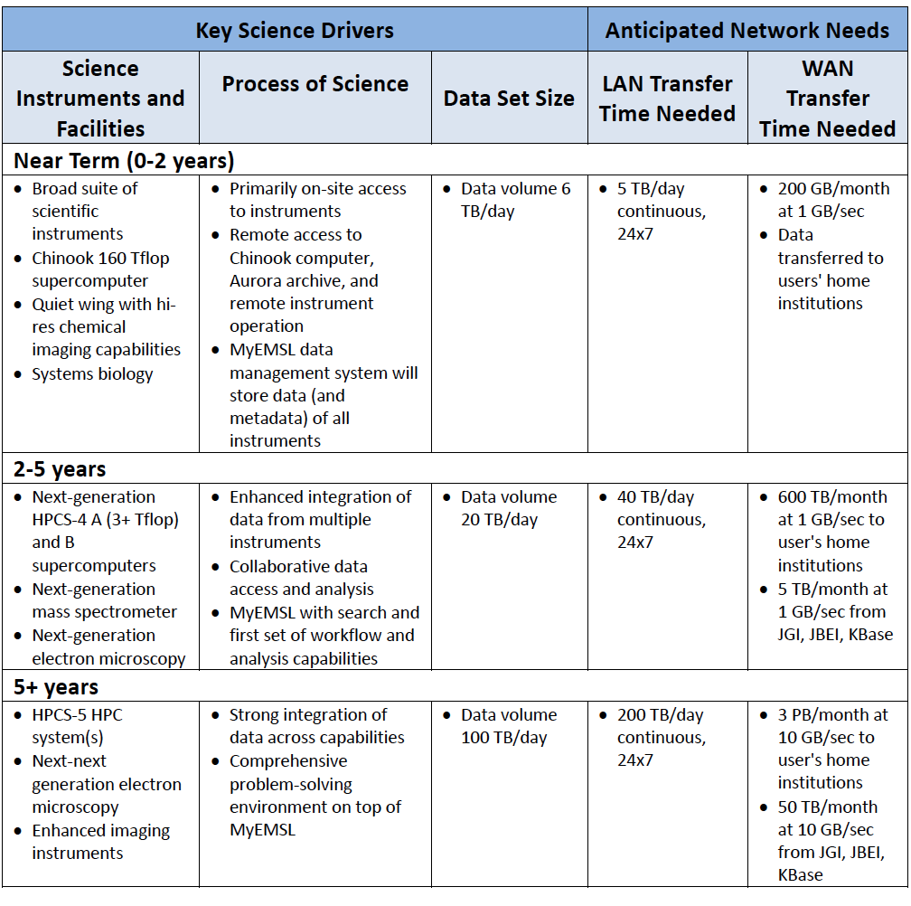
2013 BER
Sample
Findings:
Environmental Molecular Sciences Laboratory
(EMSL)
“EMSL frequently needs to ship physical copies of media to users when data sizes exceed a few GB. More often than not, this is due to lack of bandwidth or storage resources at the user's home institution.”
© 2015, Energy Sciences Network

Slide 26
Relationships
Relationships – familiarity, understanding, trust
  Work with science collaborations to understand their needs
  Make their lives better
    Fix problems
    Give them better tools and workflows
  Make sure you are accurate (expectations are important)
  Check in with people periodically
    I make it a practice to ask “is there anything we need to talk about?”
    Often people won’t come to you first, but they will give you a chance to help if you check in
Once you get a reputation for solving problems, it all gets easier
  People come to you first
  You get in early on the planning
  People are more willing to push the envelope
© 2015, Energy Sciences Network
Notes:
Describe requirements process
Key – we do case studies, talk through it with scientists, instruments/facilities/process
I’ve been in the place of being told we suck in front of program management because of end site issues

Slide 27
Understanding Data Trends
© 2015, Energy Sciences Network
Notes:
Requirements workshops for all six program offices within the DOE office of Science

Slide 28
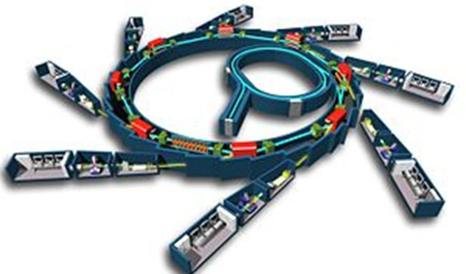
DOE Facilities in 2025: More Data, More Users, More Discovery
Experimental facilities will be transformed by high-resolution detectors, advanced mathematical analysis techniques, robotics, software automation, and programmable networks.
Detectors capable of generating terabit data streams.
Integration of experimental and computational facilities in real time, using programmable networks.
Computational tools for analysis, data reduction & feature extraction in situ, using advanced algorithms and special-purpose hardware.
Data management and sharing, with federated identity management and flexible access control.
Increase scientific throughput from robotics and automation software.
Post-processing: reconstruction, inter-comparison, simulation, visualization.
© 2015, Energy Sciences Network

Slide 29
Outline
What is ESnet?
Modern Science
The Challenges Scientists Face
The Role of Engagement
Call to Arms
Conclusions
© 2015, Energy Sciences Network

Slide 30
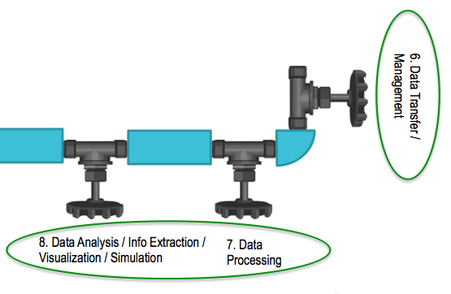
Putting Theory into Practice
Remember our bottlenecks from before?
  We can’t fix *all* of these with the network, but lets think critically about where we have control
Data Flow:
  Comes off of the detector to local storage
  There is no supercomputer on campus, that lives a couple of States over (e.g. XSEDE centers, DOE facilities, etc.)
  We don’t always get allocation time on the same machine (computing is ‘fungible’), and some machines are good at one thing (analysis) and not good at others (visualization)
  Storage may be somewhere else completely different – and recall that NSF grants require you to have a data management plan now …
Areas we have some control over:
  Network in/out of our campus
  Our friends (Hi GPN!) control a larger area of networking
  The ability to suggest tools/strategies to best move the data around
© 2015, Energy Sciences Network
Notes:
Describe requirements process
Key – we do case studies, talk through it with scientists, instruments/facilities/process
I’ve been in the place of being told we suck in front of program management because of end site issues

Slide 31
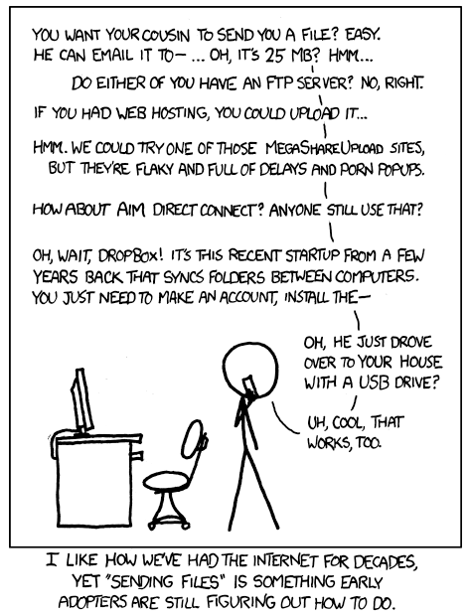
Putting Theory into Practice
‘Easy’ Wins:
  Making sure your network is running clean
    The Science DMZ – http://fasterdata.es.net/science-dmz/
    Or tune back in a couple of weeks – same bat time, same bat channel.
  Making sure your partners are doing the same
    Performance verification with perfSONAR – http://www.perfsonar.net
  Solving data movement once and for all
    Find the tool that will not annoy your scientists. If they are using sneaker net, or SCP, they are doing it wrong.
    There are oodles of tools out there that can do the job many many times better – some suggestions: http://fasterdata.es.net/data-transfer-tools/
© 2015, Energy Sciences Network
Notes:
Describe requirements process
Key – we do case studies, talk through it with scientists, instruments/facilities/process
I’ve been in the place of being told we suck in front of program management because of end site issues

Slide 32
Inductive Proof
If you can do this once, you can do it an infinite amount of times on your campus
  Typical ESnet approach: find your ‘champion’, someone who is clearly suffering and willing to try something new to not suffer any more.
  Implement some easy wins, measure the progress as much as you can
  At your next ‘campus science day’, you now have a presentation to make – and one convert who doesn’t hate IT anymore
  Set up the velvet ropes, and allow the line to form
CC-IIE/NIE/DNI is designed to do all of this (Thanks NSF!)
  Money to support upgrades to critical infrastructure
  The requirement to identify science, and propose ways to improve it
  The suggestion to hire a person who’s job it becomes to sit and listen to the problems, and offer creative solutions to make them go away
© 2015, Energy Sciences Network
Notes:
Describe requirements process
Key – we do case studies, talk through it with scientists, instruments/facilities/process
I’ve been in the place of being told we suck in front of program management because of end site issues

Slide 33
Outline
What is ESnet?
Modern Science
The Challenges Scientists Face
The Role of Engagement
Call to Arms
Conclusions
© 2015, Energy Sciences Network

Slide 34
Conclusions (& Action Items)
Science engagement isn’t hard
  More about listening than building
  Building occurs with or without knowing the use cases, this can help refine
Science engagement can’t be done on found cycles
  Dedicated person(s) with a communications/technology background
  Gives a known ‘landing point’; builds trust, encourages growth
Benefits when attempted:
  Potentially saving on costs of build/operation
  Happy customers
  Deeper understanding of the science, which advances society (e.g. I want to see a cure for cancer before I need one, networks are a part of that)
© 2015, Energy Sciences Network

Slide 35
Conclusions (& Action Items)
State/Region Suggestions:
  Find a ‘champion’ to coordinate, and participants that want to be supercharged
  Develop a system similar to ESnet’s Requirements Reviews (we are happy to help – ask us anything)
  Tie the success of science to the network:
    Will help to gauge ‘how big’ to build the network, and on what time scales
    Will also turn out some negative information, e.g. how the network problems/lack of capability may be hurting innovation
engage@es.net
© 2015, Energy Sciences Network

Slide 36
Science Engagement: A Non-Technical Approach to the Technical Divide
Jason Zurawski – zurawski@es.net
Science Engagement Engineer, ESnet
Lawrence Berkeley National Laboratory
ENhancing CyberInfrastructure by Training and Engagement (ENCITE) Webinar
January 16th, 2015

