Slide 1
perfSONAR at 10 Years: Cleaning Networks & Disrupting Operation
Jason Zurawski – zurawski@es.net
Science Engagement Engineer, ESnet
Lawrence Berkeley National Laboratory
FTW: perfSONAR Deployment Best Practices, Architecture, and Moving the Needle
January 22nd, 2015

Slide 2

© 2015, Energy Sciences Network

Slide 3
Outline
Introduction and Motivation
“I wish we had a solution to expedite network performance debugging”
Break out the duct tape and beer
perfSONAR use (theory & practice)
The ESnet use case
Looking forward – perfSONAR in 20 years
© 2015, Energy Sciences Network

Slide 4
Introduction & Motivation
Networks are an essential part of modern research & education
  Connect data sources to data analysis
  Connect collaborators to each other
  Enable machine-consumable interfaces to data and analysis resources (e.g. portals), automation, scale
Performance is critical
  Exponential data growth
  Constant human factors
  Technology changes/improvements/paradigm shifts
  Data movement and data analysis must keep up
Effective use of wide area (long-haul) networks by has historically been difficult, except for the “wizards”
© 2015, Energy Sciences Network
Notes:
Human factors – attention span, ability to manage complexity
It is our hope that this work enables effective use of networking for science

Slide 5
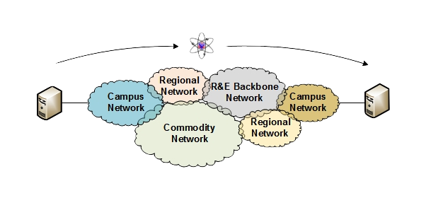
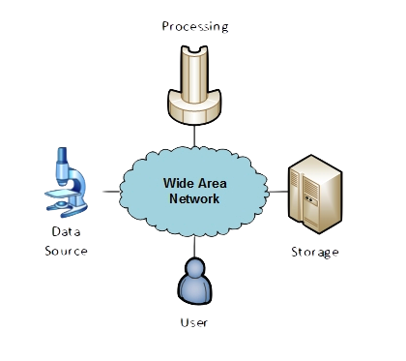
The R&E Community
The global Research & Education network ecosystem is comprised of hundreds of international, national, regional and local-scale resources – each independently owned and operated.
This complex, heterogeneous set of networks must operate seamlessly from “end to end” to support science and research collaborations that are distributed globally.
Data mobility is required; there is no liquid market for HPC resources (people use what they can get – DOE, XSEDE, NOAA, etc. etc.)
  To stay competitive, we must learn the use patterns, and support them
  This may mean making sure your network, and the networks of others, are functional
© 2015, Energy Sciences Network

Slide 6
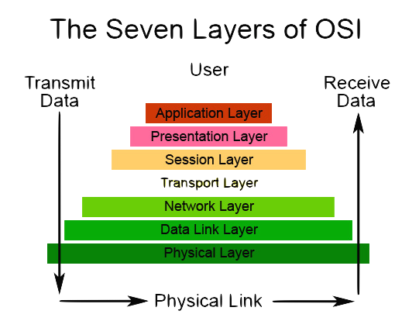
The Guiding Light
Something we should all remember:
  The “network” extends all the way to the application layer (e.g. I will blast some data through software APIs over a socket and protocol that are running on hardware around the world, and it ‘appears’ on the other end).
Making sure this is all working requires monitoring (active testing, passive observation) – and it needs to be done AT EVERY LAYER
© 2013 University of Washington
© 2015, Energy Sciences Network
Notes:
The very structure of modern scientific use assumes networks exist: high performance, feature rich, global scope (e.g. not commodity networking – R&E networking)
What is “The Network” anyway?
“The Network” is the set of devices, applications, and processes involved in the use of a remote resource
This is not just about the network interconnection
This is about data flow from experiment to analysis, between facilities, etc.
User interfaces for “The Network” – portal, data transfer tool, workflow engine
Therefore, servers and applications must always be considered
Historically not something the campus networking team has dealt with; campus networking must evolve to remaining competitive
What is important?
Correctness
Consistency
Performance

Slide 7
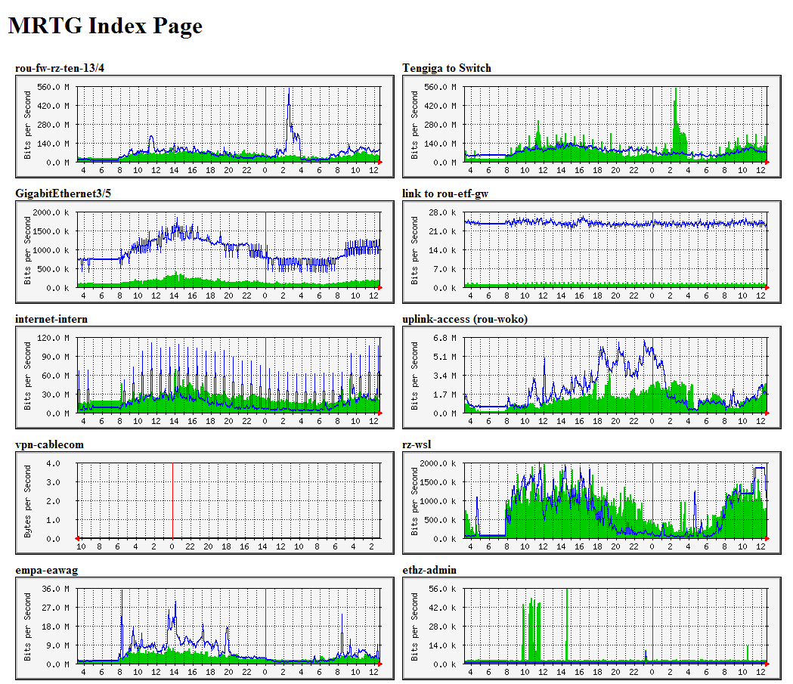
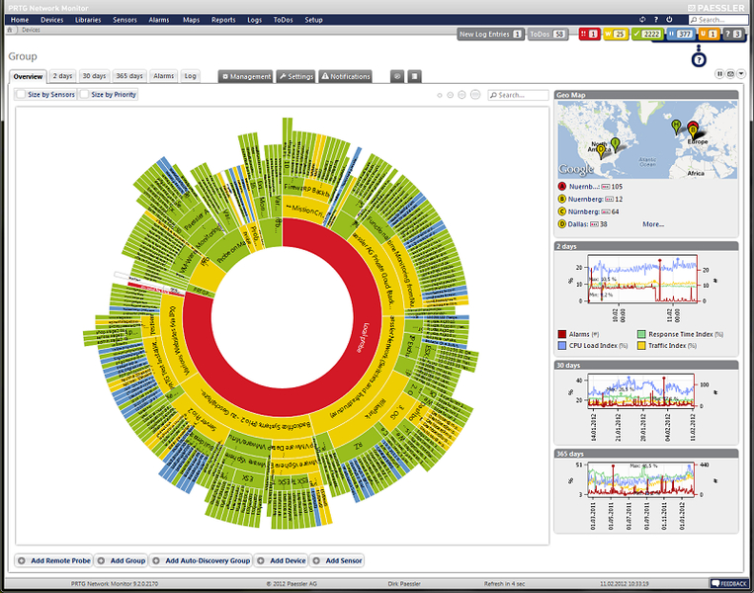
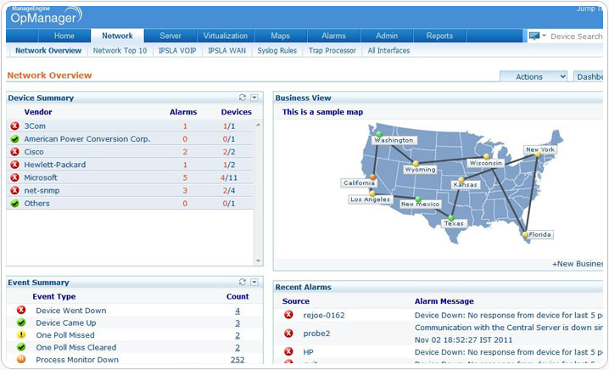
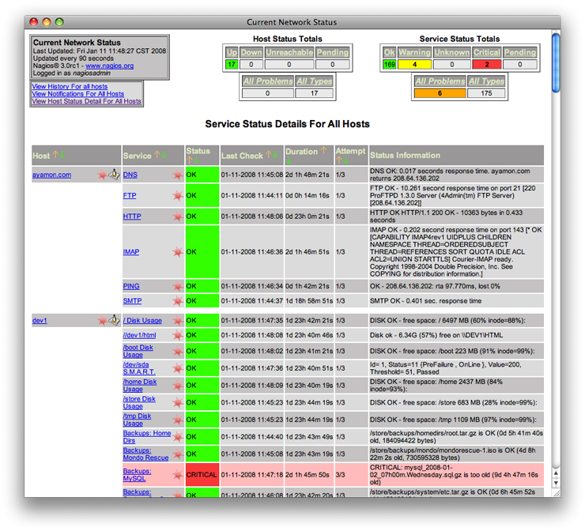
Not Lacking in Products
The key difference: “end-to-end” isn’t always a concern.
Metrics you need?
All of the layers?
Where do you start?
© 2015, Energy Sciences Network

Slide 8
Outline
Introduction and Motivation
“I wish we had a solution to expedite network performance debugging”
Break out the duct tape and beer
perfSONAR use (theory & practice)
The ESnet use case
Looking forward – perfSONAR in 20 years
© 2015, Energy Sciences Network

Slide 9
Why is this so hard?
There is a lot of network out there to cover
  think about all the pieces on your own campus network
  Multiply that by ~300 other colleges, ~50 RONs, a handful of national networks, exchange points, etc. etc.
There are things that ‘work’, but no real BCPs
  Everyone has their own form of monitoring – some of the important things (utilization, latency) may be covered
Not all campus networks are the same – Dale Smith will be talking later
Lack of understanding about problems, or how expectation and reality aren’t matching for some use cases
  Remember TCP? Could you diagram it on a board?
  Converged network designs do not perform well.
Many suffering in silence
  For every ‘bothersome’ network user that is letting you know his file transfers aren’t working, there are are probably 10-50 more who ‘expect’ the network in a crappy manner – that’s what happens at home after all.
© 2015, Energy Sciences Network

Slide 10

Where Are The Problems?
Congested or faulty links between domains
Latency dependant problems inside domains with small RTT
Source
Campus
Backbone
Destination
Campus
S
D
NREN
Regional
Congested intra- campus links
© 2015, Energy Sciences Network

Slide 11
Local Testing Will Not Find Everything
Performance is poor when RTT exceeds ~10 ms
Performance is good when RTT is < ~10 ms
Source
Campus
R&E
Backbone
Destination
Campus
S
D
Switch with small buffers
Regional
Regional
© 2015, Energy Sciences Network

Slide 12
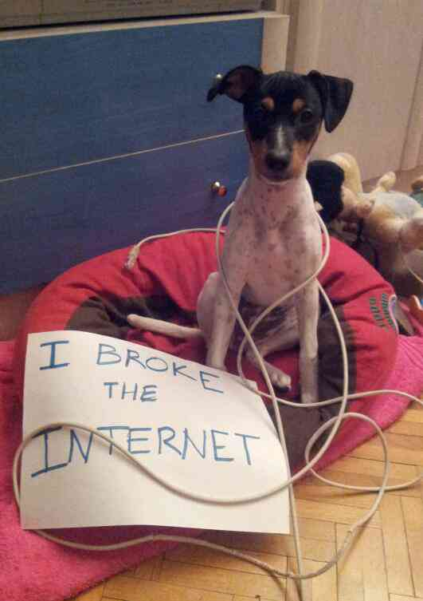
What are the problems? Soft Network Failures
Soft failures are where basic connectivity functions, but high performance is not possible.
TCP was intentionally designed to hide all transmission errors from the user:
  “As long as the TCPs continue to function properly and the internet system does not become completely partitioned, no transmission errors will affect the users.” (From IEN 129, RFC 716)
Some soft failures only affect high bandwidth long RTT flows.
Hard failures are easy to detect & fix
  soft failures can lie hidden for years!
One network problem can often mask others
Active testing is required to really get a handle on these – you won’t see soft failure behavior via a 5 minute poll of a counter
© 2015, Energy Sciences Network

Slide 13



Second star to the right, and straight on till morning
Lets dream big - In an ideal world, we need:
  Something that is easily deployed
  Has the ability to test up and down the stack, and always end-to-end
  Features active testing …
  … for many different kinds of metric (most related to TCP behavior)
There are many attempts to build such things, the graveyard has a lot of fresh stones marking the tools that were great and never took off
Maybe the most important item missing from the above list:
  Deployment numbers
The usefulness of a tool of this nature is bound to how many instances there are. It’s a crappy framework for debugging a world of networks if there are only 5 instances available
© 2015, Energy Sciences Network

Slide 14
Outline
Introduction and Motivation
“I wish we had a solution to expedite network performance debugging”
Break out the duct tape and beer
perfSONAR use (theory & practice)
The ESnet use case
Looking forward – perfSONAR in 20 years
© 2015, Energy Sciences Network

Slide 15
Network Monitoring
All networks do some form monitoring.
  Addresses needs of local staff for understanding state of the network
    Would this information be useful to external users?
    Can these tools function on a multi-domain basis?
Beyond passive methods, there are active tools.
    E.g. often we want a ‘throughput’ number. Can we automate that idea?
    Wouldn’t it be nice to get some sort of plot of performance over the course of a day? Week? Year? Multiple endpoints?
Where is the “Measurement Middleware”? Something to allow for the easy exchange of metrics that are collected locally, on a global scale?
© 2015, Energy Sciences Network

Slide 16
The Ghost of perfSONAR Past
Internet2 Performance Evaluation and Review Framework (PERF) - ~2002
© 2015, Energy Sciences Network

Slide 17
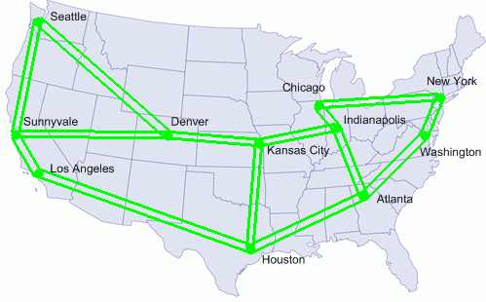
The Ghost of perfSONAR Past
Internet2 E2E piPEs (End-to-End Performance Initiatives Performance Environment System) ~2003/2004
© 2015, Energy Sciences Network

Slide 18
Problem: Nobody’s Fault
Courtesy of E. Boyd @ Internet2
Hey, this is not working right!
Others are
getting in ok
Applications
Developer
Not our problem
Applications
Developer
LAN
Administrator
Talk to the other guys
LAN
Administrator
Everything is
AOK
System
Administrator
System
Administrator
Campus
Networking
Campus
Networking
The computer
Is working OK
No other
complaints
Looks fine
All the lights
are green
Gigapop
Gigapop
How do you solve
a problem along a path?
Everyone says it is
working fine!
We don’t see
anything wrong
Backbone
The network is lightly loaded
Notes:
No one claims that their cloud has a performance problem.
Note that a majority of the clouds are on campus

Slide 19
Suddenly – the plot thickened
GEANT2/JRA1 Framework Layers (~2004)
© 2015, Energy Sciences Network

Slide 20
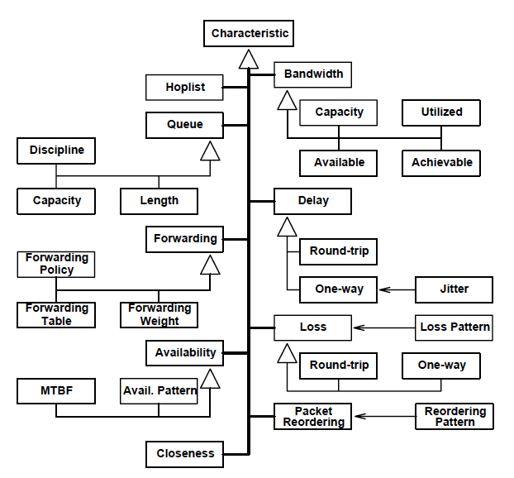
And other smart people were thinking about metrics
Global Grid Forum (~2003)
  Hierarchy of Network Performance Characteristics
    http://www.ogf.org/documents/GFD.23.pdf
  Request Schema Requirements and Sample Implementation
  Report Schema Requirements and Sample Implementation
© 2015, Energy Sciences Network

Slide 21
Revisionist History of perfSONAR
~2004
  GN2/JRA1 + Internet2 piPEs/AMI + ESnet Science Support + GGF/OGF Metrics work = perfSONAR
  First real software was a ‘Measurement Archive’ that read RRD files (e.g. from MRTG)
  Purpose was to share measurements in a uniform and standard way – we don’t want to re-invent the measurement wheel.
  Lots of other infrastructure planned and implemented (visualization, infrastructure, support of other metrics)
~2007
  Listening to many communities can sometimes mean many paths. perfSONAR splits into two implementations to meet the needs of operations teams in different parts of the world.
~2009
  The NPToolkit (grand relation of the current perfSONAR Toolkit) is launched. Ready to rock tools on a LiveCD or a complete Linux distro. Now there are no more minimal deployment excuses
~2013
  perfSONAR passes 1000 public deployments. The number could me much higher for private use cases.
Present Day
  ~1250 deployments, most running the latest release
  Reboot on the relationship of perfSONAR partners, the addition of Indiana University, and a new roadmap: http://www.perfsonar.net/project-information/project-roadmap/
© 2015, Energy Sciences Network

Slide 22
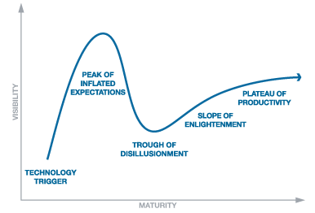

Hype Curve?
?
© 2015, Energy Sciences Network

Slide 23
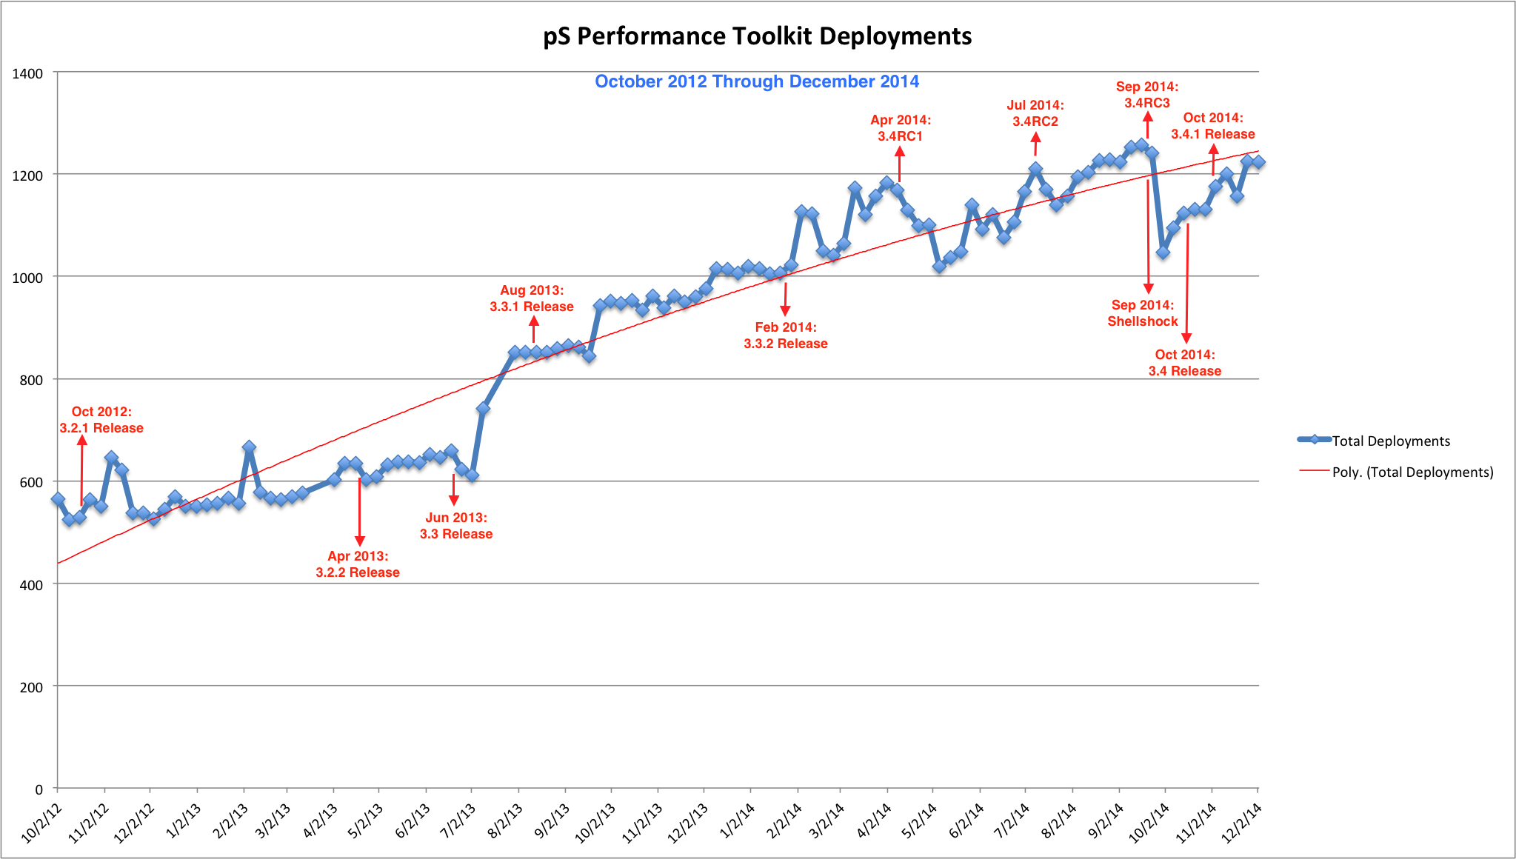
Deployment Trends
© 2015, Energy Sciences Network

Slide 24
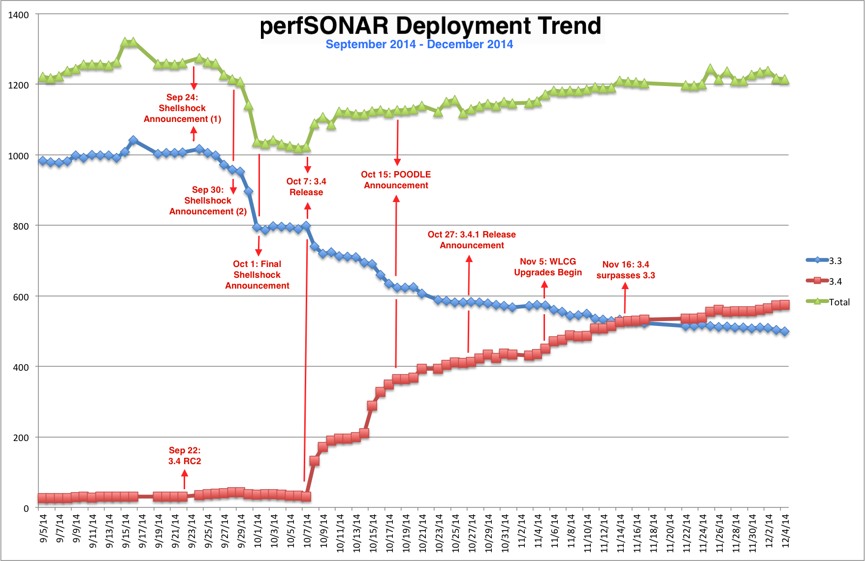
Deployment Trends
© 2015, Energy Sciences Network

Slide 25
Outline
Introduction and Motivation
“I wish we had a solution to expedite network performance debugging”
Break out the duct tape and beer
perfSONAR use (theory & practice)
The ESnet use case
Looking forward – perfSONAR in 20 years
© 2015, Energy Sciences Network

Slide 26
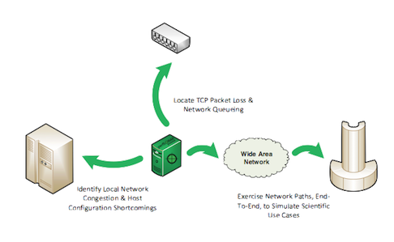
The perfSONAR Solution (Theoretical)
At the core, perfSONAR was designed to:
  Work across the boundaries of a domain
  Find the problems that traditional tools couldn’t
  Improve the outcomes for network use cases
Conceptually, a single perfSONAR node can be used for inter and intra network use cases:
© 2015, Energy Sciences Network

Slide 27
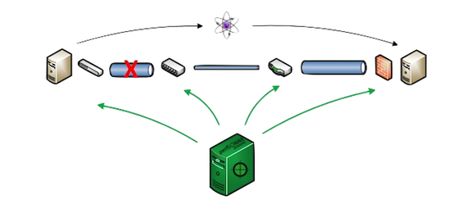
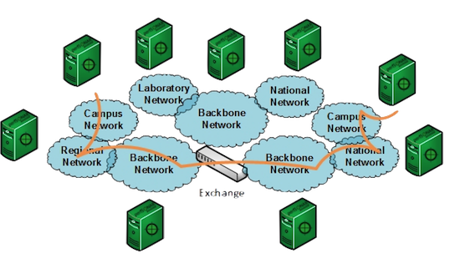
The perfSONAR Solution (Theoretical)
Finding problems along the end to end path remains the single most compelling use case.
Because there are more than a 1000 instances, many paths are fully covered and thus problems can be ( and are being ) solved frequently
© 2015, Energy Sciences Network

Slide 28
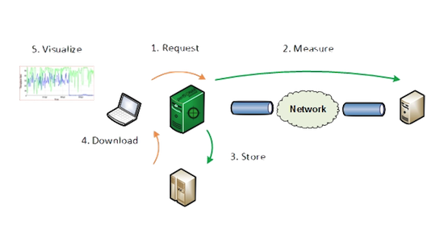
The perfSONAR Solution (Theoretical)
Each toolkit node has the tooling to:
  Manage normal sysadmin like functions (software maintenance, server maintenance, targeted security)
  Become a ‘beacon’ so that others can locate and test against the resource
  Create and perform regular tests of its own, for a couple of key metrics
  Store the data for an extended period of time
  Visualize the results
© 2015, Energy Sciences Network

Slide 29
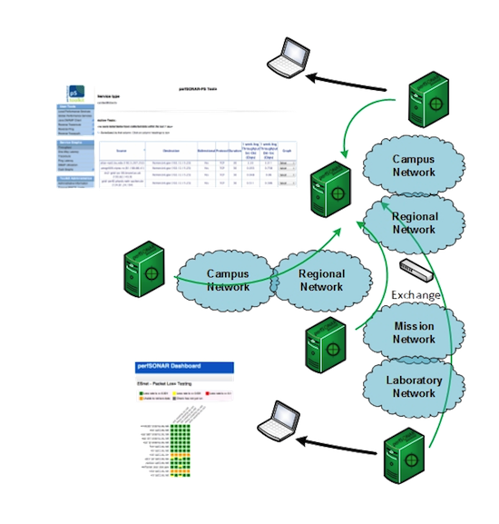
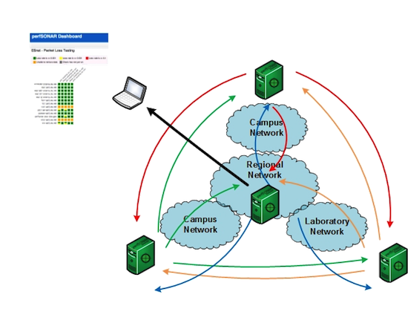
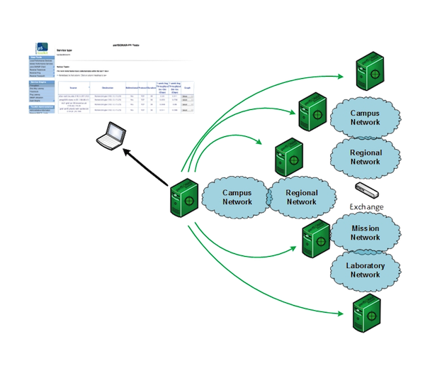
The perfSONAR Solution (Theoretical)
Deployments can be unmanaged, loosely managed, or completely managed
© 2015, Energy Sciences Network

Slide 30
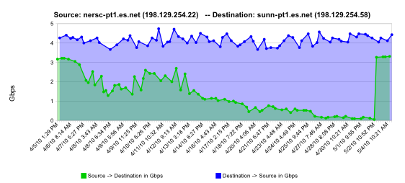
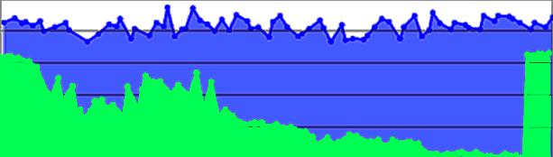
The perfSONAR Solution (Practical)
Gradual link failure (e.g. no hard alarms)
  Regular throughput shows the problem over time – single measurements wouldn’t be useful
normal performance
Gb/s
degrading performance
repair
one month
© 2015, Energy Sciences Network

Slide 31
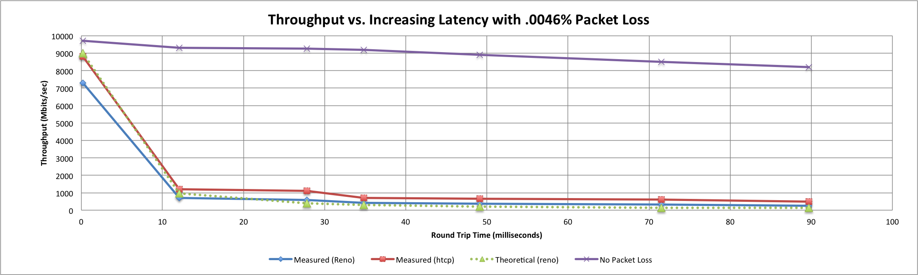
Reminder: We want 0 packet loss
Throughput vs. increasing latency on a 10Gb/s link with 0.0046% packet loss
Local
(LAN)
With loss, high performance beyond metro distances is essentially impossible
International
Metro Area
Regional
Continental
Measured (TCP Reno)
Measured (HTCP)
Theoretical (TCP Reno)
Measured (no loss)
© 2015, Energy Sciences Network

Slide 32
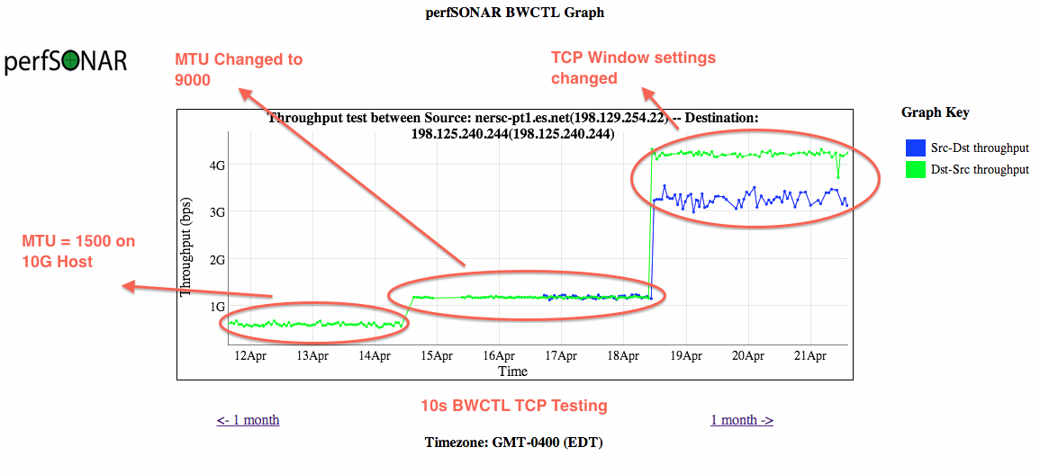
The perfSONAR Solution (Practical)
The impacts of host tuning (e.g. here is a non-’network’ problem, its further up the stack). Not all hosts are built the same.
© 2015, Energy Sciences Network

Slide 33
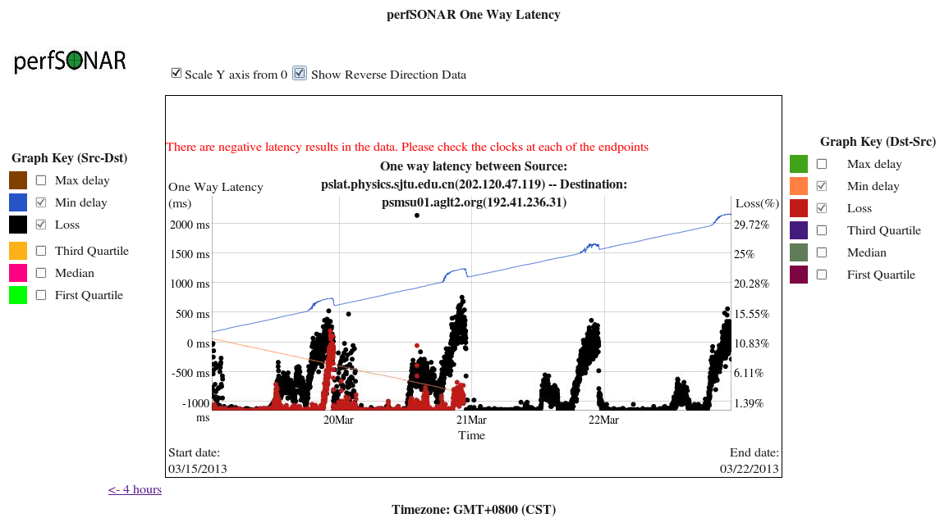
The perfSONAR Solution (Practical)
OWAMP can tell us about congestion, probably better than MRTG can. Spot the congestion.
© 2015, Energy Sciences Network

Slide 34
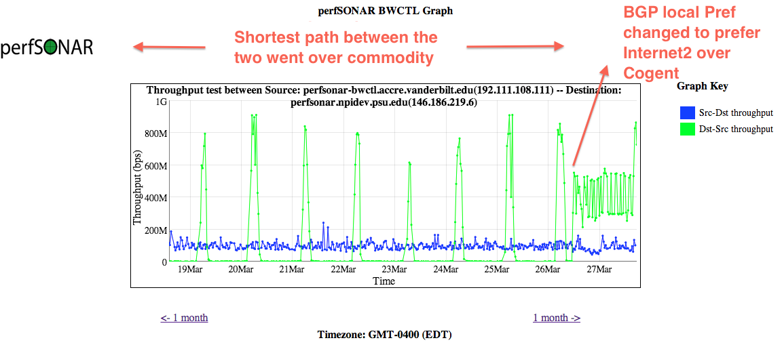
The perfSONAR Solution (Practical)
  Routing can be hard – we can verify that things are correct/incorrect with traceroute – but the traffic ‘gets there’ which may be good enough.
  Now we have a record that ‘gets there’ isn’t sufficient.
© 2015, Energy Sciences Network

Slide 35
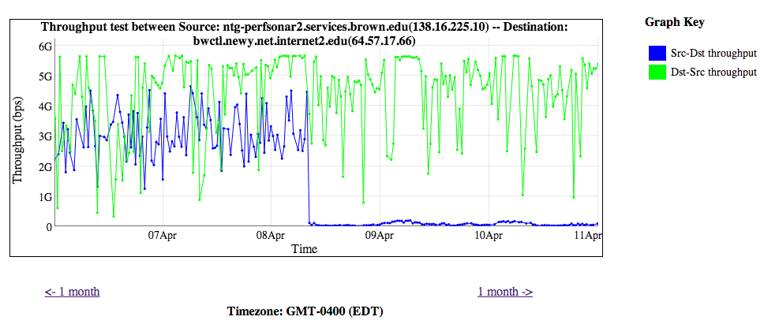
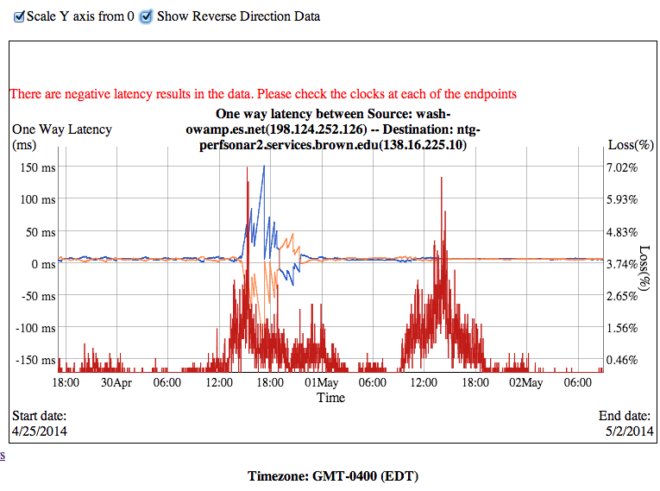
The perfSONAR Solution (Practical)
  Sometimes your provider makes a boo boo – wouldn’t it be nice to be able to send them a network selfie when that happens?
© 2015, Energy Sciences Network

Slide 36
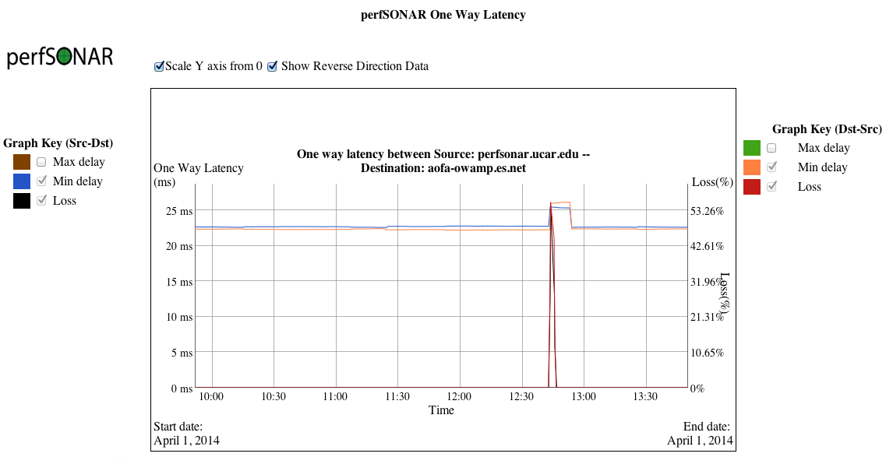
The perfSONAR Solution (Practical)
  Even hard failures have an interesting pattern (fiber bump/cut):
© 2015, Energy Sciences Network

Slide 37
Outline
Introduction and Motivation
“I wish we had a solution to expedite network performance debugging”
Break out the duct tape and beer
perfSONAR use (theory & practice)
The ESnet use case
Looking forward – perfSONAR in 20 years
© 2015, Energy Sciences Network

Slide 38
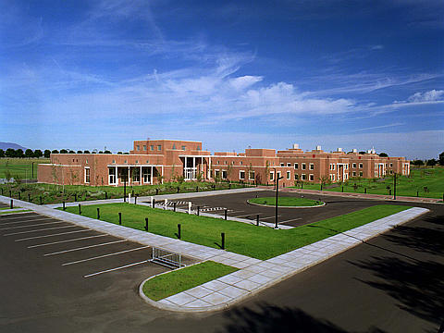
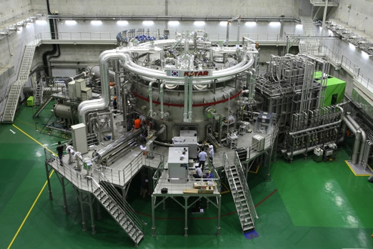
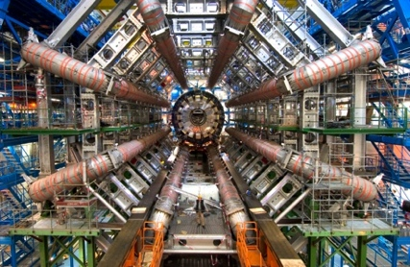
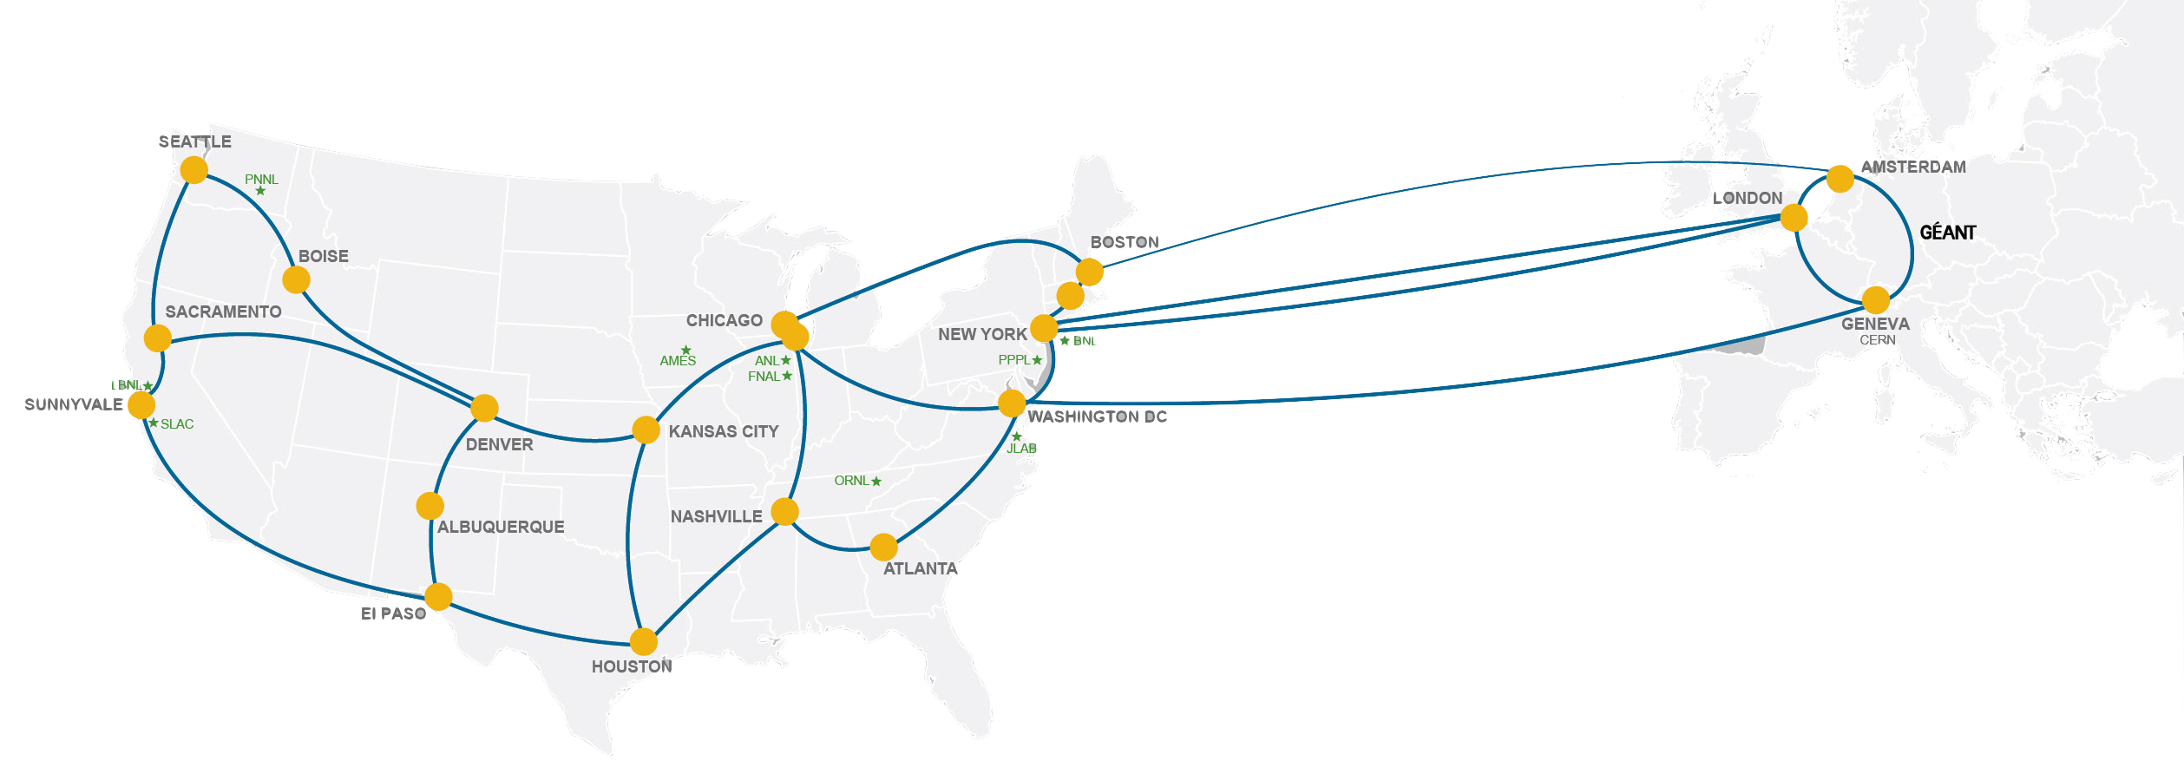
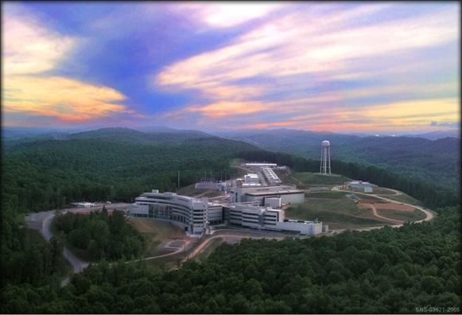
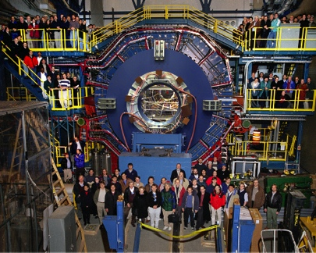
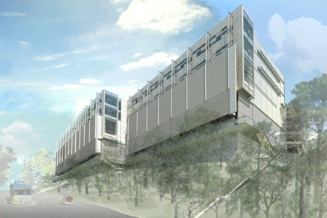
Network as Infrastructure Instrument
    Vision: Scientific progress will be completely unconstrained by the physical location of instruments, people, computational resources, or data.
© 2015, Energy Sciences Network
Notes:
Summing up ESnet’s vision in one slide, one phrase…
Physical location of instruments, people, computational resources, data. It just should not matter.
[KSTAR, SNS, ATLAS, EMSL, CRT/NERSC, STAR Detector at RHIC [BNL, NP-funded]]

Slide 39
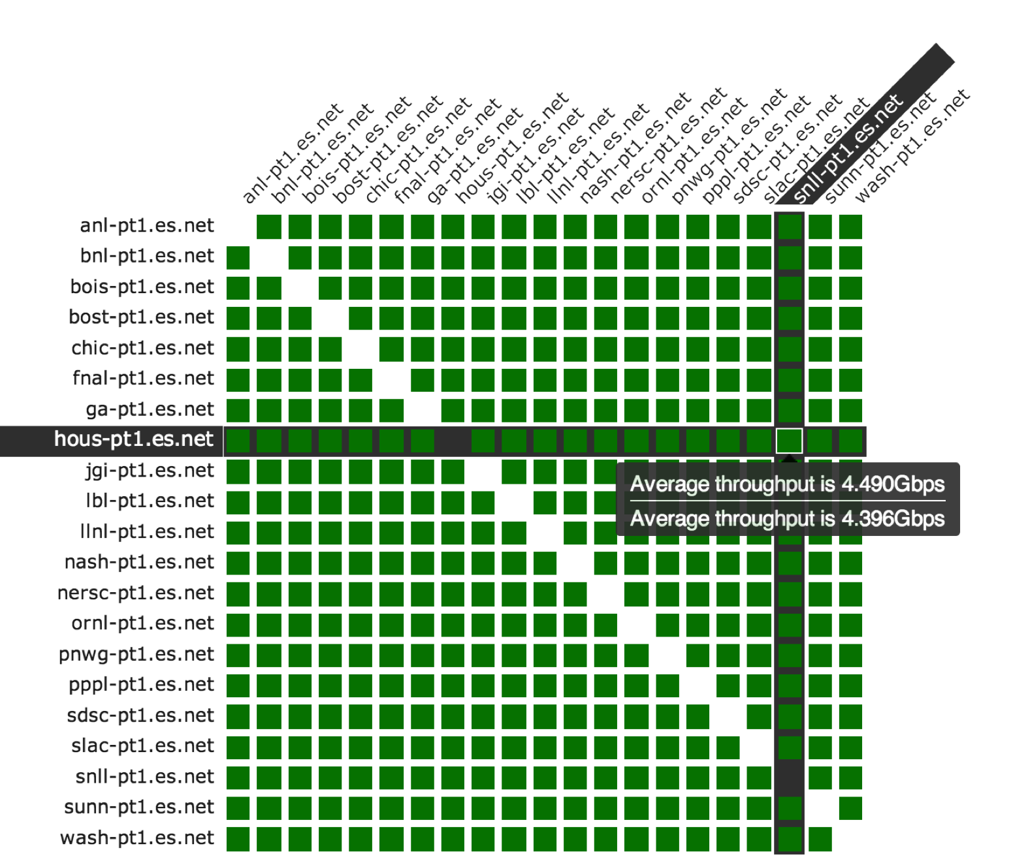
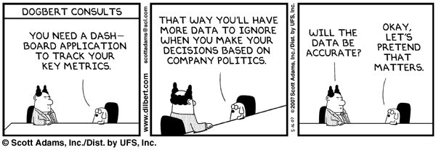
Full Coverage …
© 2015, Energy Sciences Network
Notes:
Summing up ESnet’s vision in one slide, one phrase…
Physical location of instruments, people, computational resources, data. It just should not matter.
[KSTAR, SNS, ATLAS, EMSL, CRT/NERSC, STAR Detector at RHIC [BNL, NP-funded]]

Slide 40
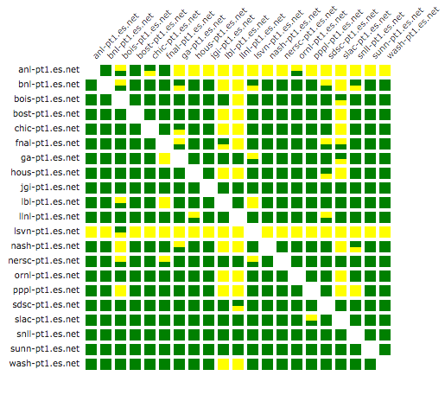
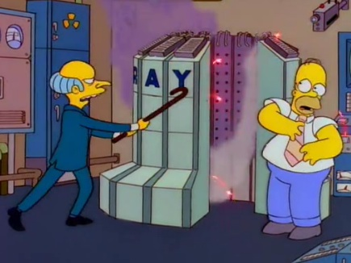
…So you know when its gone bad
And most times the user may blame the network, their machinery, or a combination of both.
Regular perfSONAR testing helps to isolate the problem almost immediately – our productivity has already increase by a large factor.
© 2015, Energy Sciences Network
Notes:
Summing up ESnet’s vision in one slide, one phrase…
Physical location of instruments, people, computational resources, data. It just should not matter.
[KSTAR, SNS, ATLAS, EMSL, CRT/NERSC, STAR Detector at RHIC [BNL, NP-funded]]

Slide 41
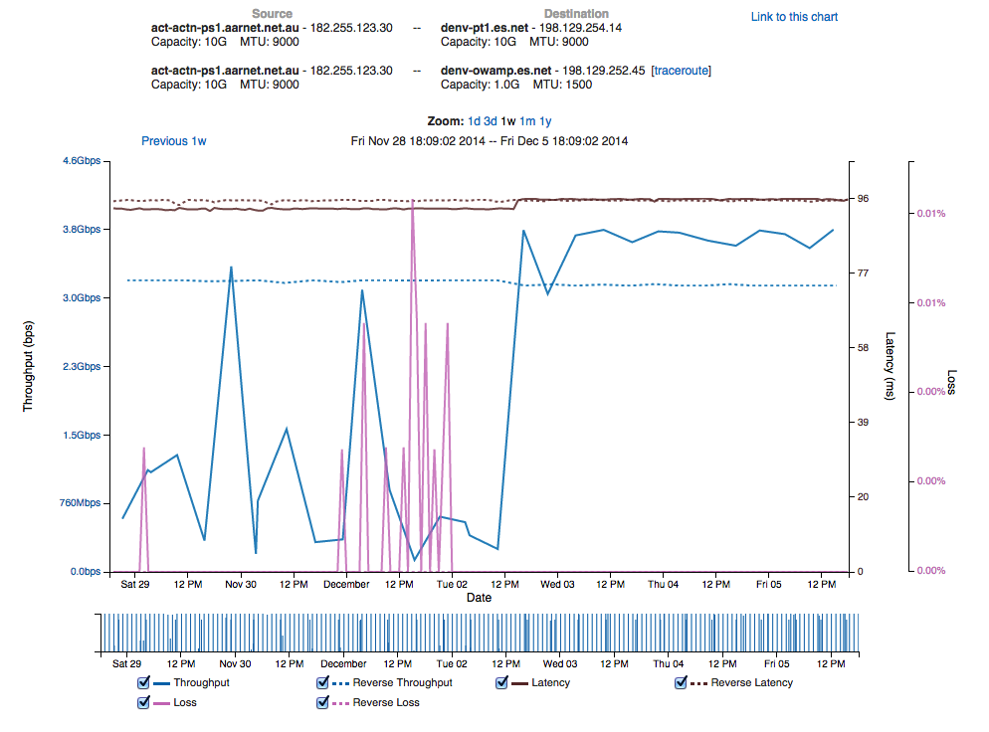
And have a record of changes
© 2015, Energy Sciences Network

Slide 42
Minor changes can have a small impact in one metric
Peering moved from 10G link to 100G link
Latency change shows path change
© 2015, Energy Sciences Network

Slide 43
And have a large one for others
Performance increases
Performance stabilizes
© 2015, Energy Sciences Network

Slide 44
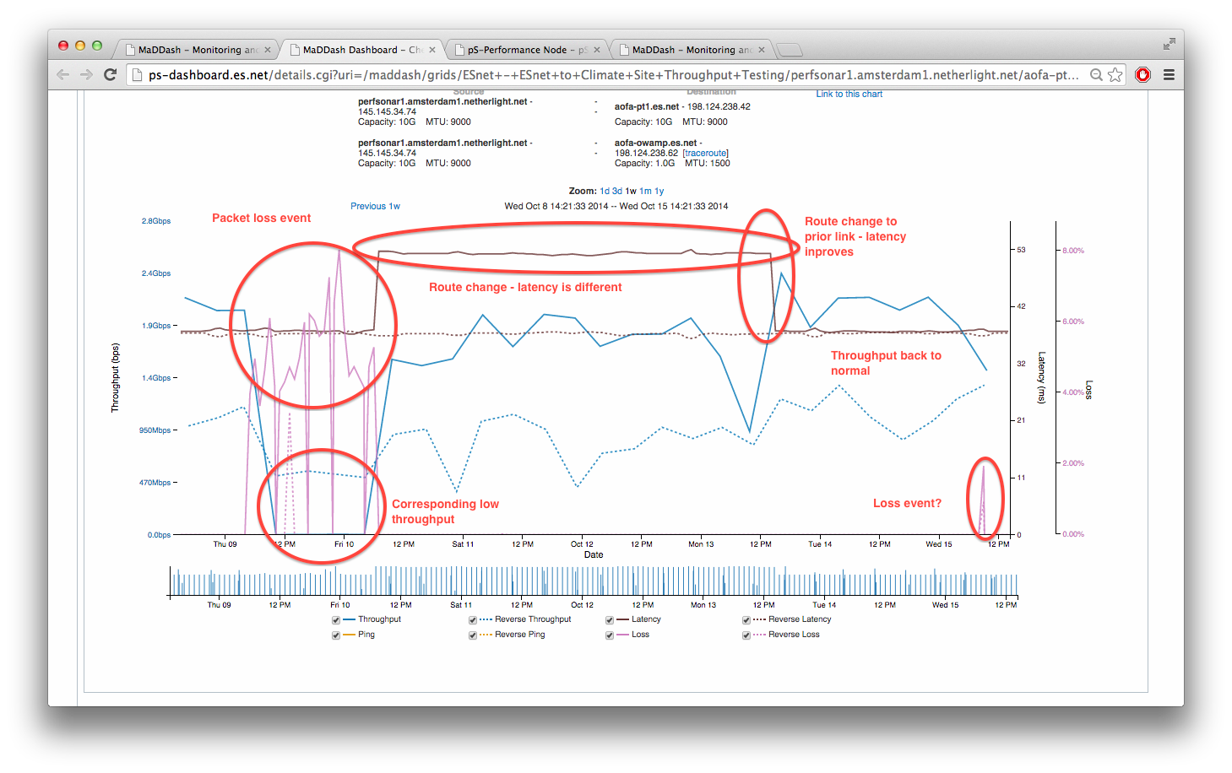
Some pictures have more story associated
© 2015, Energy Sciences Network
Notes:
Summing up ESnet’s vision in one slide, one phrase…
Physical location of instruments, people, computational resources, data. It just should not matter.
[KSTAR, SNS, ATLAS, EMSL, CRT/NERSC, STAR Detector at RHIC [BNL, NP-funded]]

Slide 45
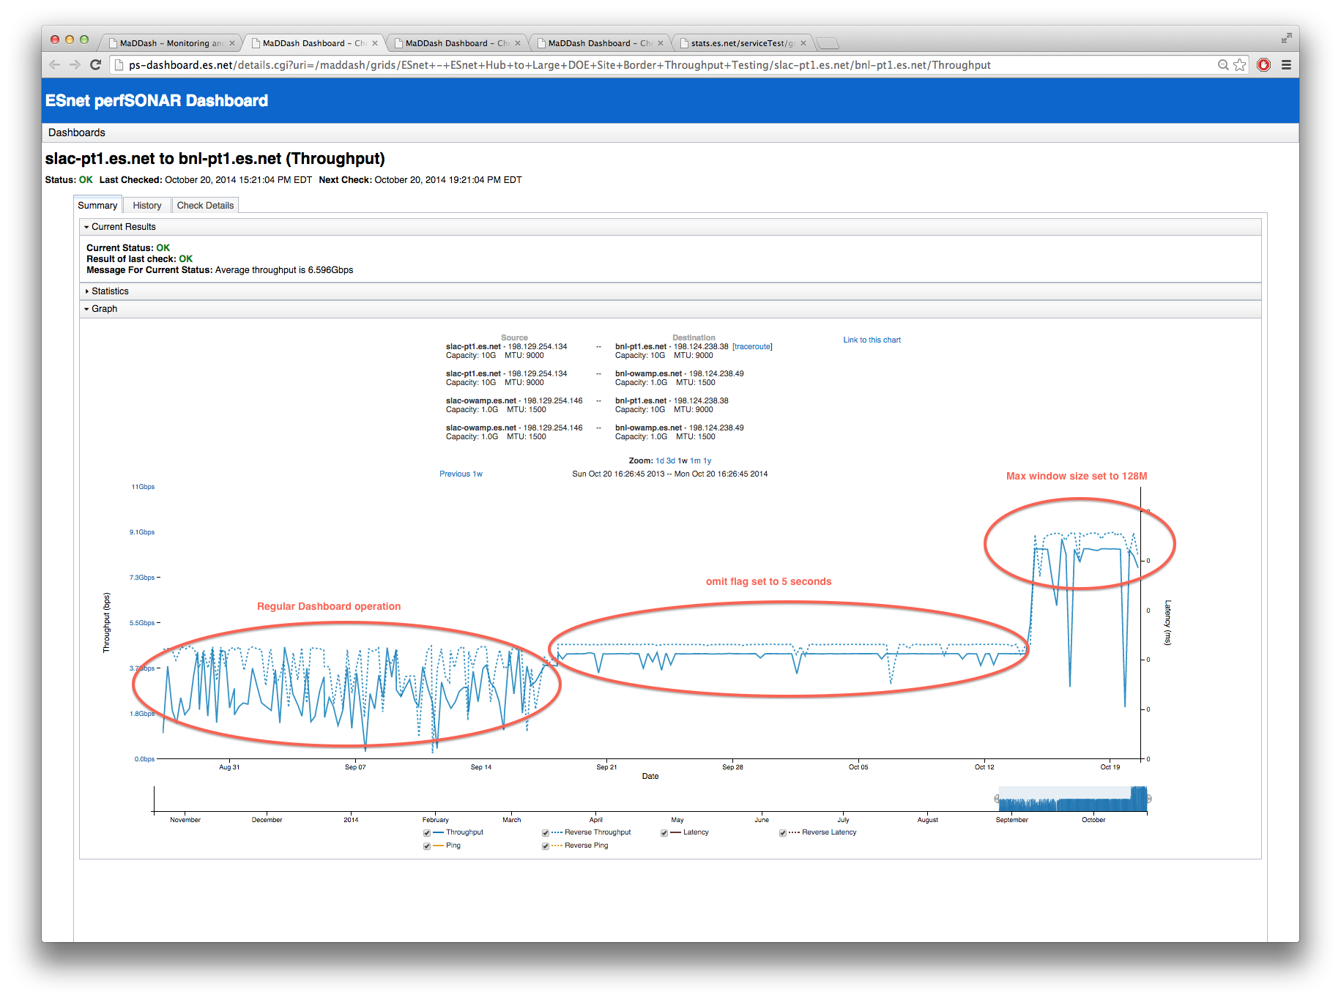
Even minor tweaks to the testing itself matter
© 2015, Energy Sciences Network
Notes:
Summing up ESnet’s vision in one slide, one phrase…
Physical location of instruments, people, computational resources, data. It just should not matter.
[KSTAR, SNS, ATLAS, EMSL, CRT/NERSC, STAR Detector at RHIC [BNL, NP-funded]]

Slide 46
Outline
Introduction and Motivation
“I wish we had a solution to expedite network performance debugging”
Break out the duct tape and beer
perfSONAR use (theory & practice)
The ESnet use case
Looking forward – perfSONAR in 20 years
© 2015, Energy Sciences Network

Slide 47
The Event Horizon
Today will be full of lots of discussion:
  perfSONAR for the operations community
  perfSONAR for the research community
  Things that are sensible (BCPs, etc.)
  Things that may not be (creating a 1G bandwidth tester the size of a cell phone)
My position (not representative of perfSONAR or ESnet) – I am a user like many others; I do not conduct the orchestra:
  There are things we can do well
    Supporting what is out there (documentation, deployment, training) and building the community
  There are things we can take risks on
    Big “R” in “R&D”. This should never be stifled, and needs to be be brought back into the mainline of the project instead of being and related curiosity.
  There are things we will fail at.
    Not all ideas for software/metrics to care about/attempts to please will work. Failure is an option if it can be learned from.
© 2015, Energy Sciences Network

Slide 48
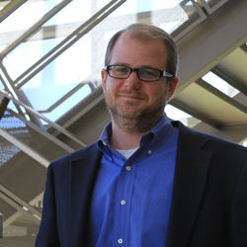
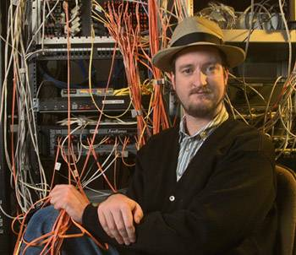
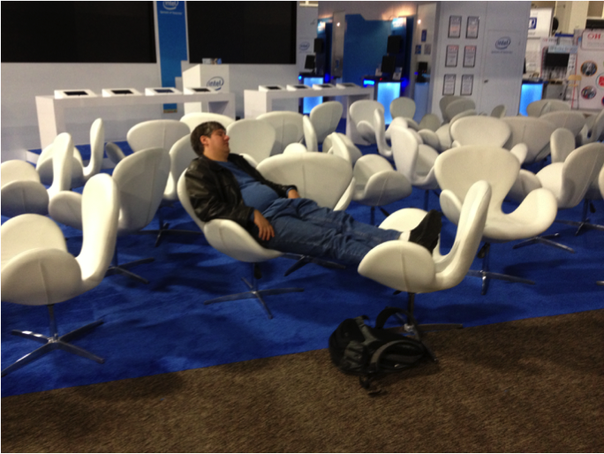
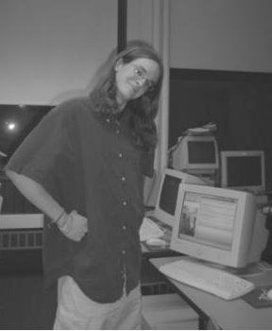
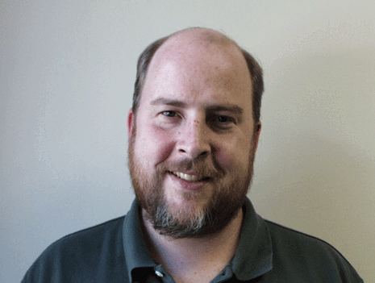
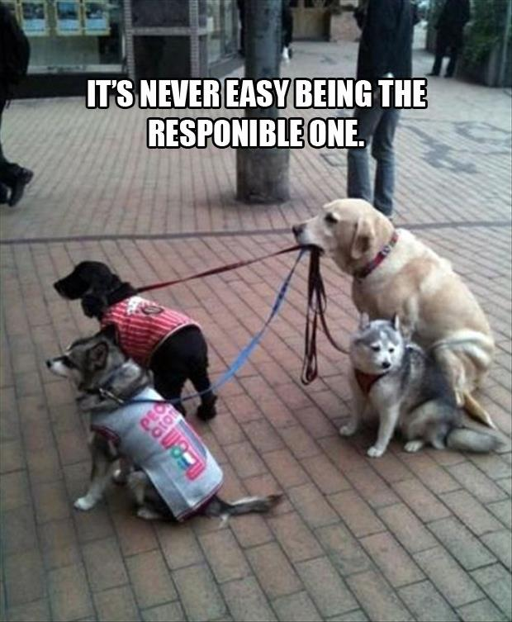

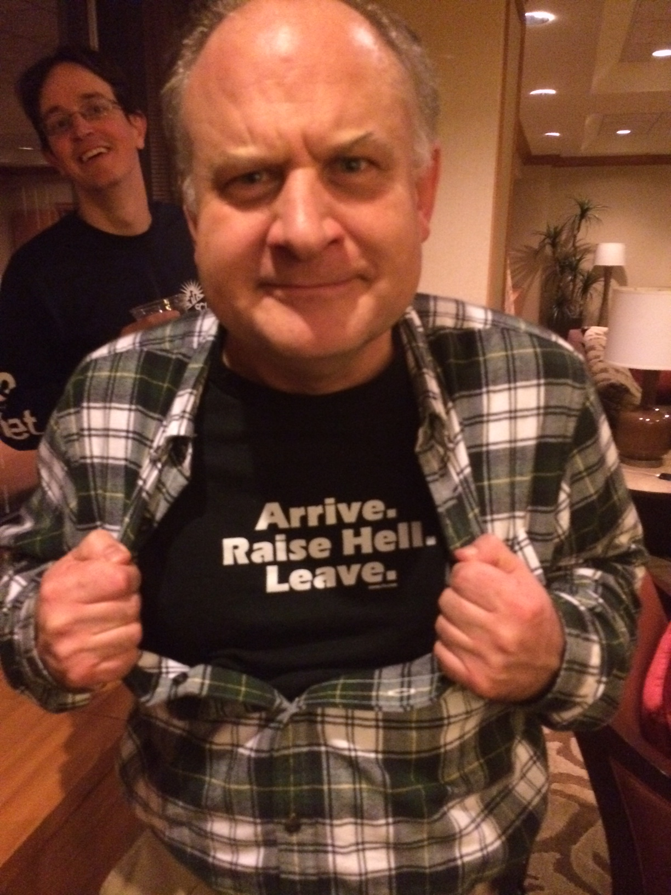





Some (not all) of the Guilty Parties Who Started This Mess
B. Tierney
D. Gunter
M. Swany
A. Brown
E. Boyd
J. Metzger
J. Boote
M. Zekauskas
J. Zurawski
B. Lowekamp
R. Hughes-Jones
M. Leese
L. Cottrell
© 2015, Energy Sciences Network

Slide 49
perfSONAR at 10 Years: Cleaning Networks & Disrupting Operation
Jason Zurawski – zurawski@es.net
Science Engagement Engineer, ESnet
Lawrence Berkeley National Laboratory
FTW: perfSONAR Deployment Best Practices, Architecture, and Moving the Needle
January 22nd, 2015

