Slide 1
Understanding Big Data Trends and the Key Role of the Regionals in Bridging Needs and Solutions
Jason Zurawski – zurawski@es.net
Science Engagement Engineer, ESnet
Lawrence Berkeley National Laboratory
Quilt Winter Member Meeting 2015
February 11th, 2015

Slide 2
Outline
The ESnet Story
Science What?
Learning the Hard Way
The Golden Spike
A Call to Arms

Slide 3

ESnet at a Glance
High-speed national network, optimized for DOE science missions:
  connecting 40 labs, plants and facilities with >100 networks (national and international)
  $32.6M in FY14, 42FTE
  older than commercial Internet, growing twice as fast
$62M ARRA in 2009/2010 grant for 100G upgrade:
  transition to new era of optical networking
  world’s first 100G network at continental scale
Culture of urgency:
  4 awards in past 3 years
  R&D100 Award in FY13
  “5 out of 5” for customer satisfaction in last review
  Dedicated staff to support the mission of science

Slide 4
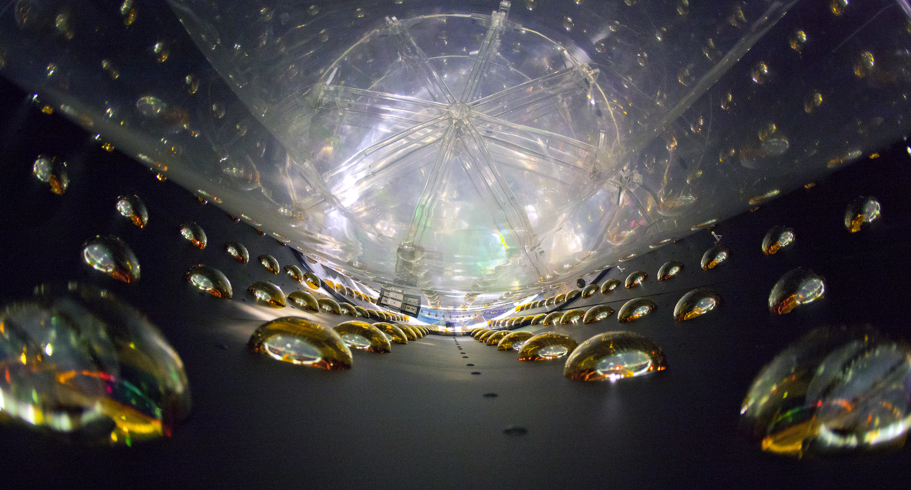



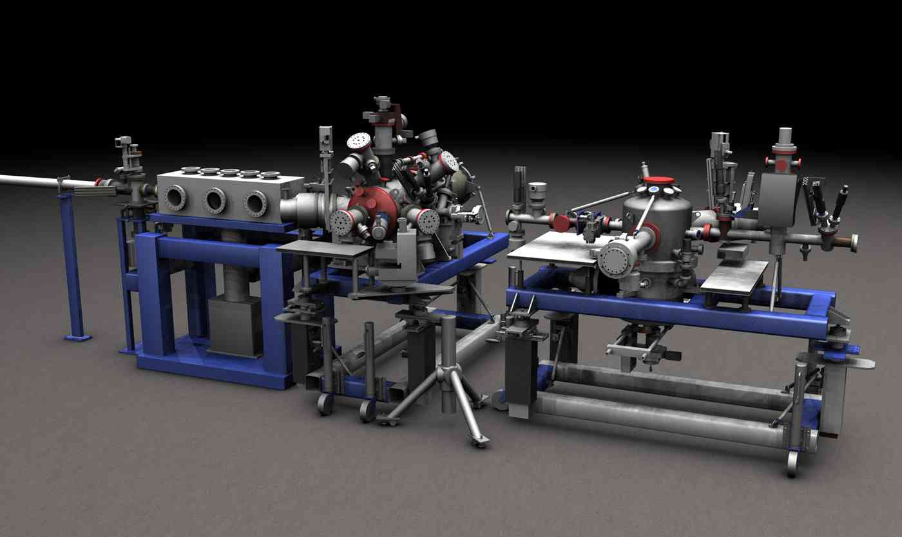
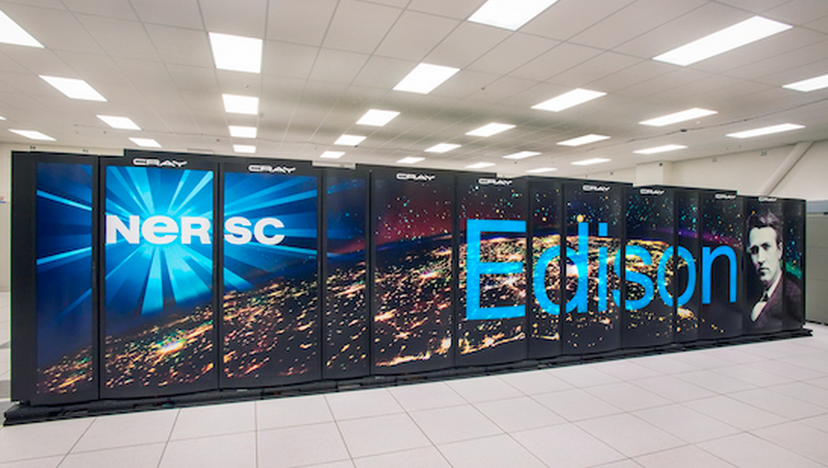
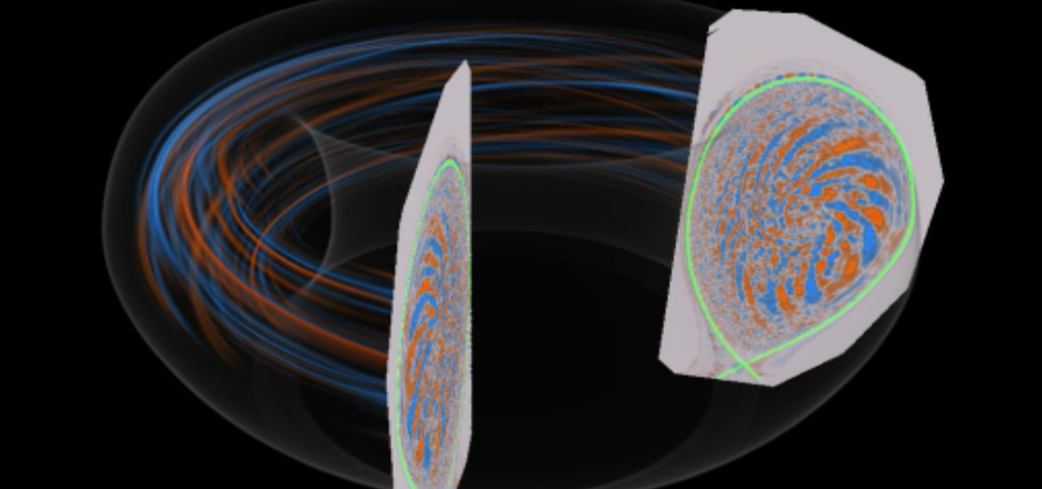
High Energy Physics
Biological and Environmental Research
Photo courtesy of LBL
Nuclear Physics
Photo courtesy of JGI
Photo courtesy of NIST
Advanced Scientific Computing Research
Basic Energy Science
Fusion Energy Sciences
Photo courtesy of LBL
Photo courtesy of SLAC
Photo courtesy of PPPL

Slide 5
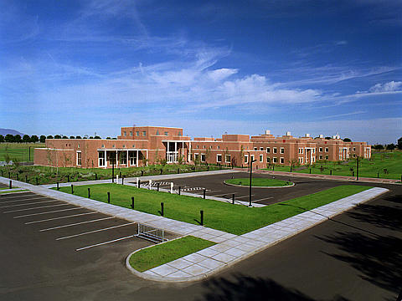
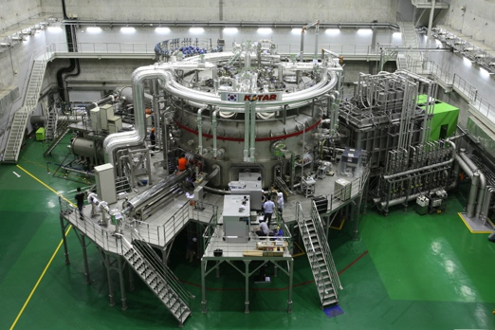
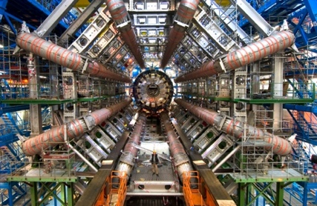
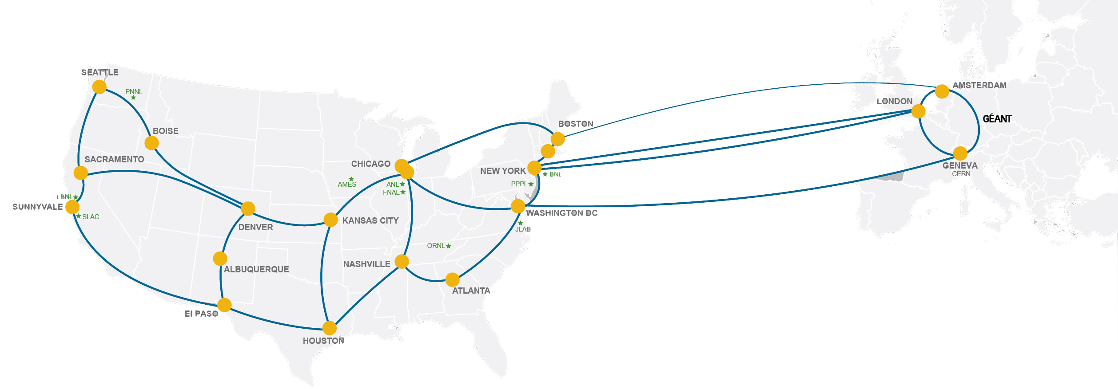
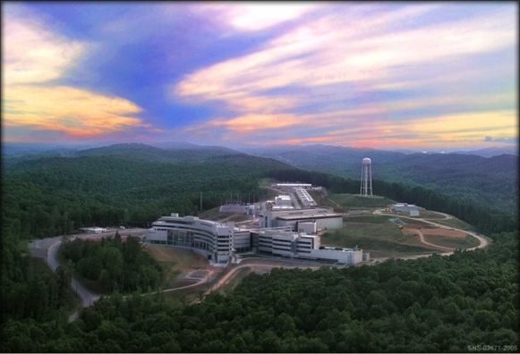
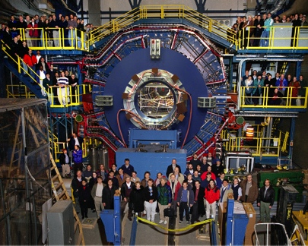
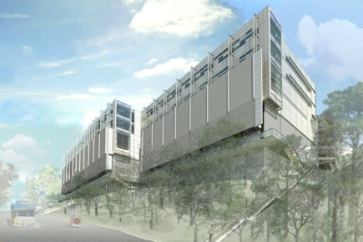
Network as Infrastructure Instrument
    Vision: Scientific progress will be completely unconstrained by the physical location of instruments, people, computational resources, or data.

Slide 6
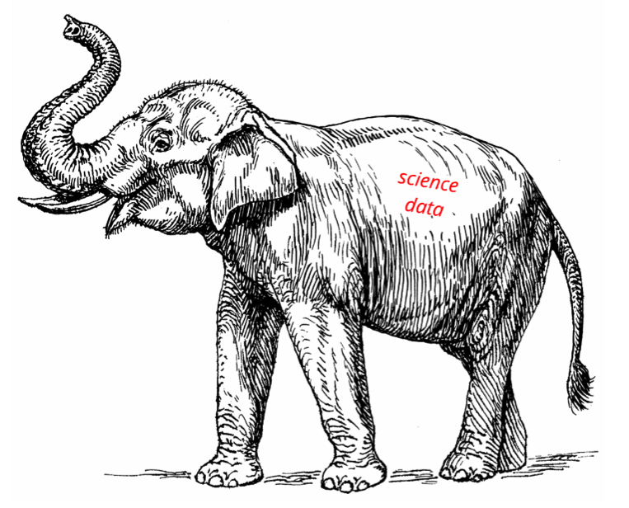
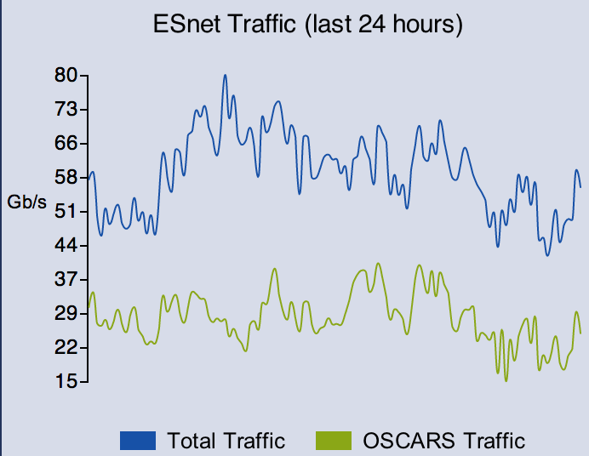
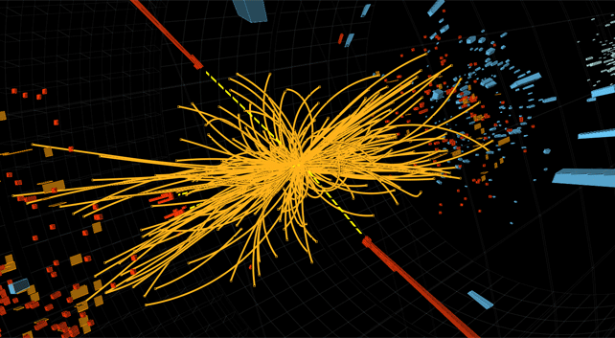



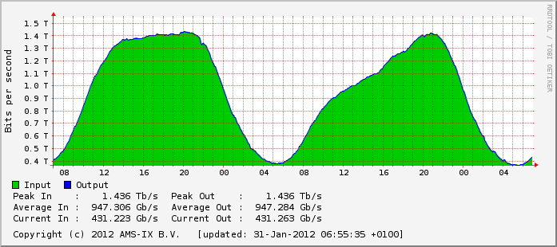



ESnet is not the Commercial Internet
6 – ESnet Science Engagement (engage@es.net) - 2/5/15

Slide 7
Outline
The ESnet Story
Science What?
Learning the Hard Way
The Golden Spike
A Call to Arms

Slide 8
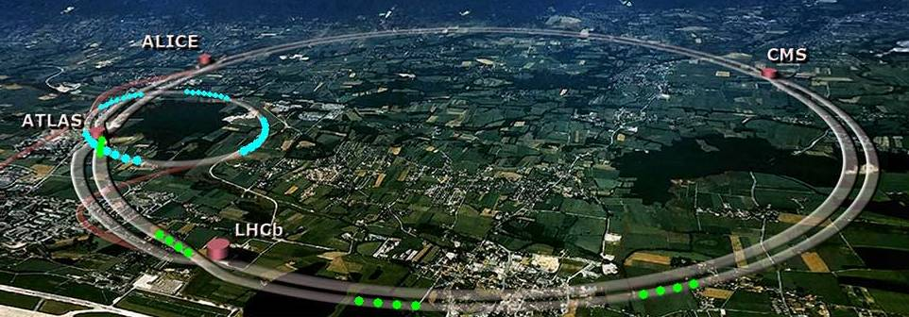
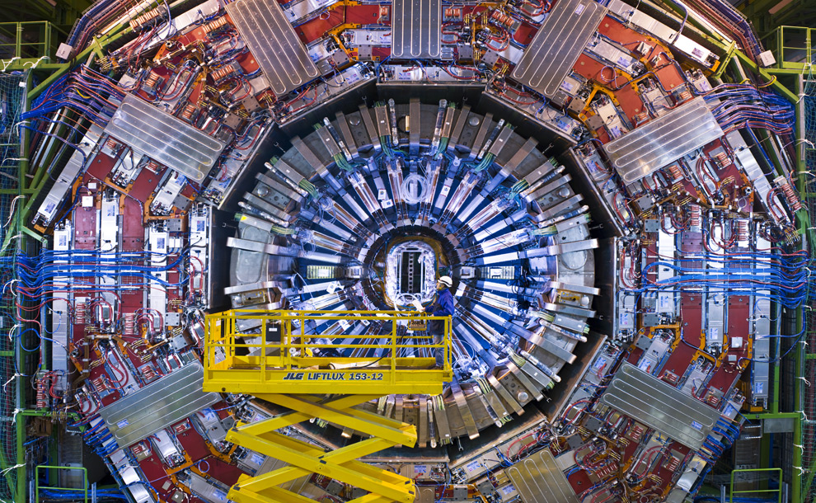
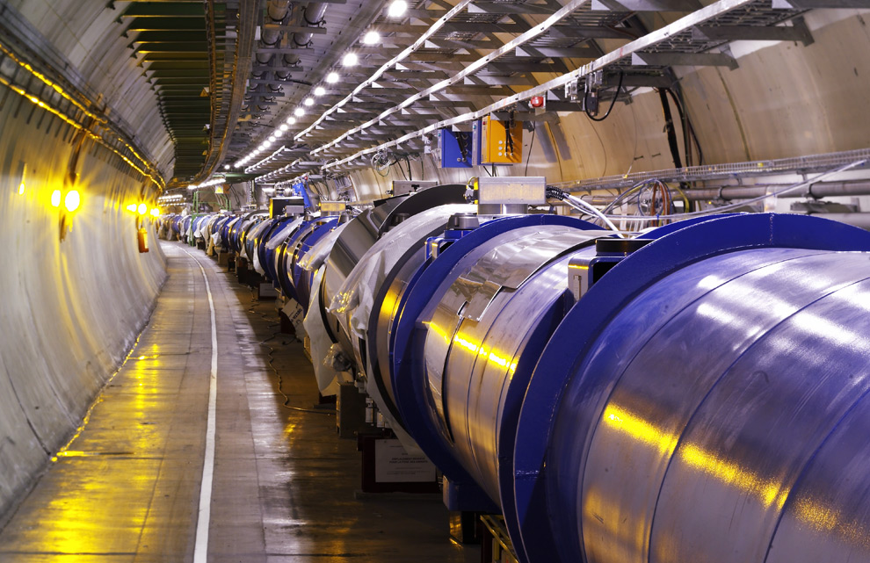
Traditional “Big Science”

Slide 9
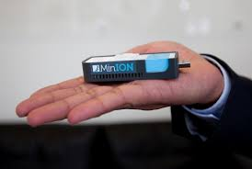
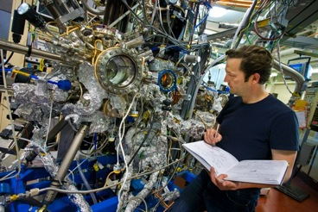
Big Science Now Comes in Small Packages

Slide 10
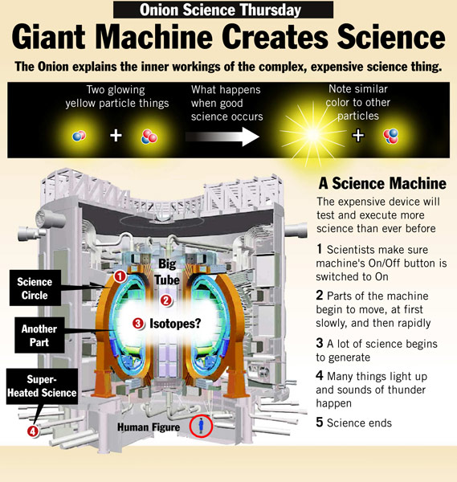
Intellectual Curiosity
How do these magical science devices work, and why should we care?
  Many of us are just plumbers
The reality is that the network is a critical part of any experiment:
  Connects the device to the people, storage, and processing
  The only way to figure out the network impact is to drill down

Slide 11
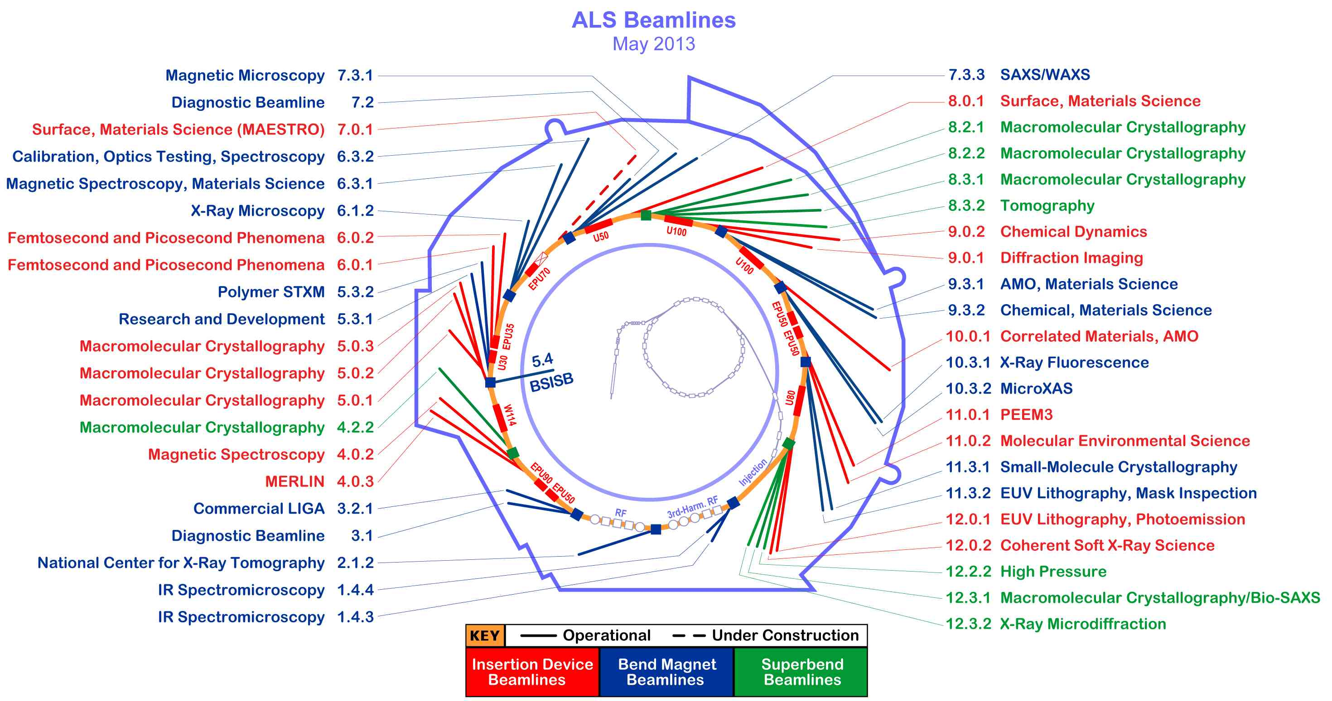
LBNL’s Advanced Light Source (ALS)

Slide 12
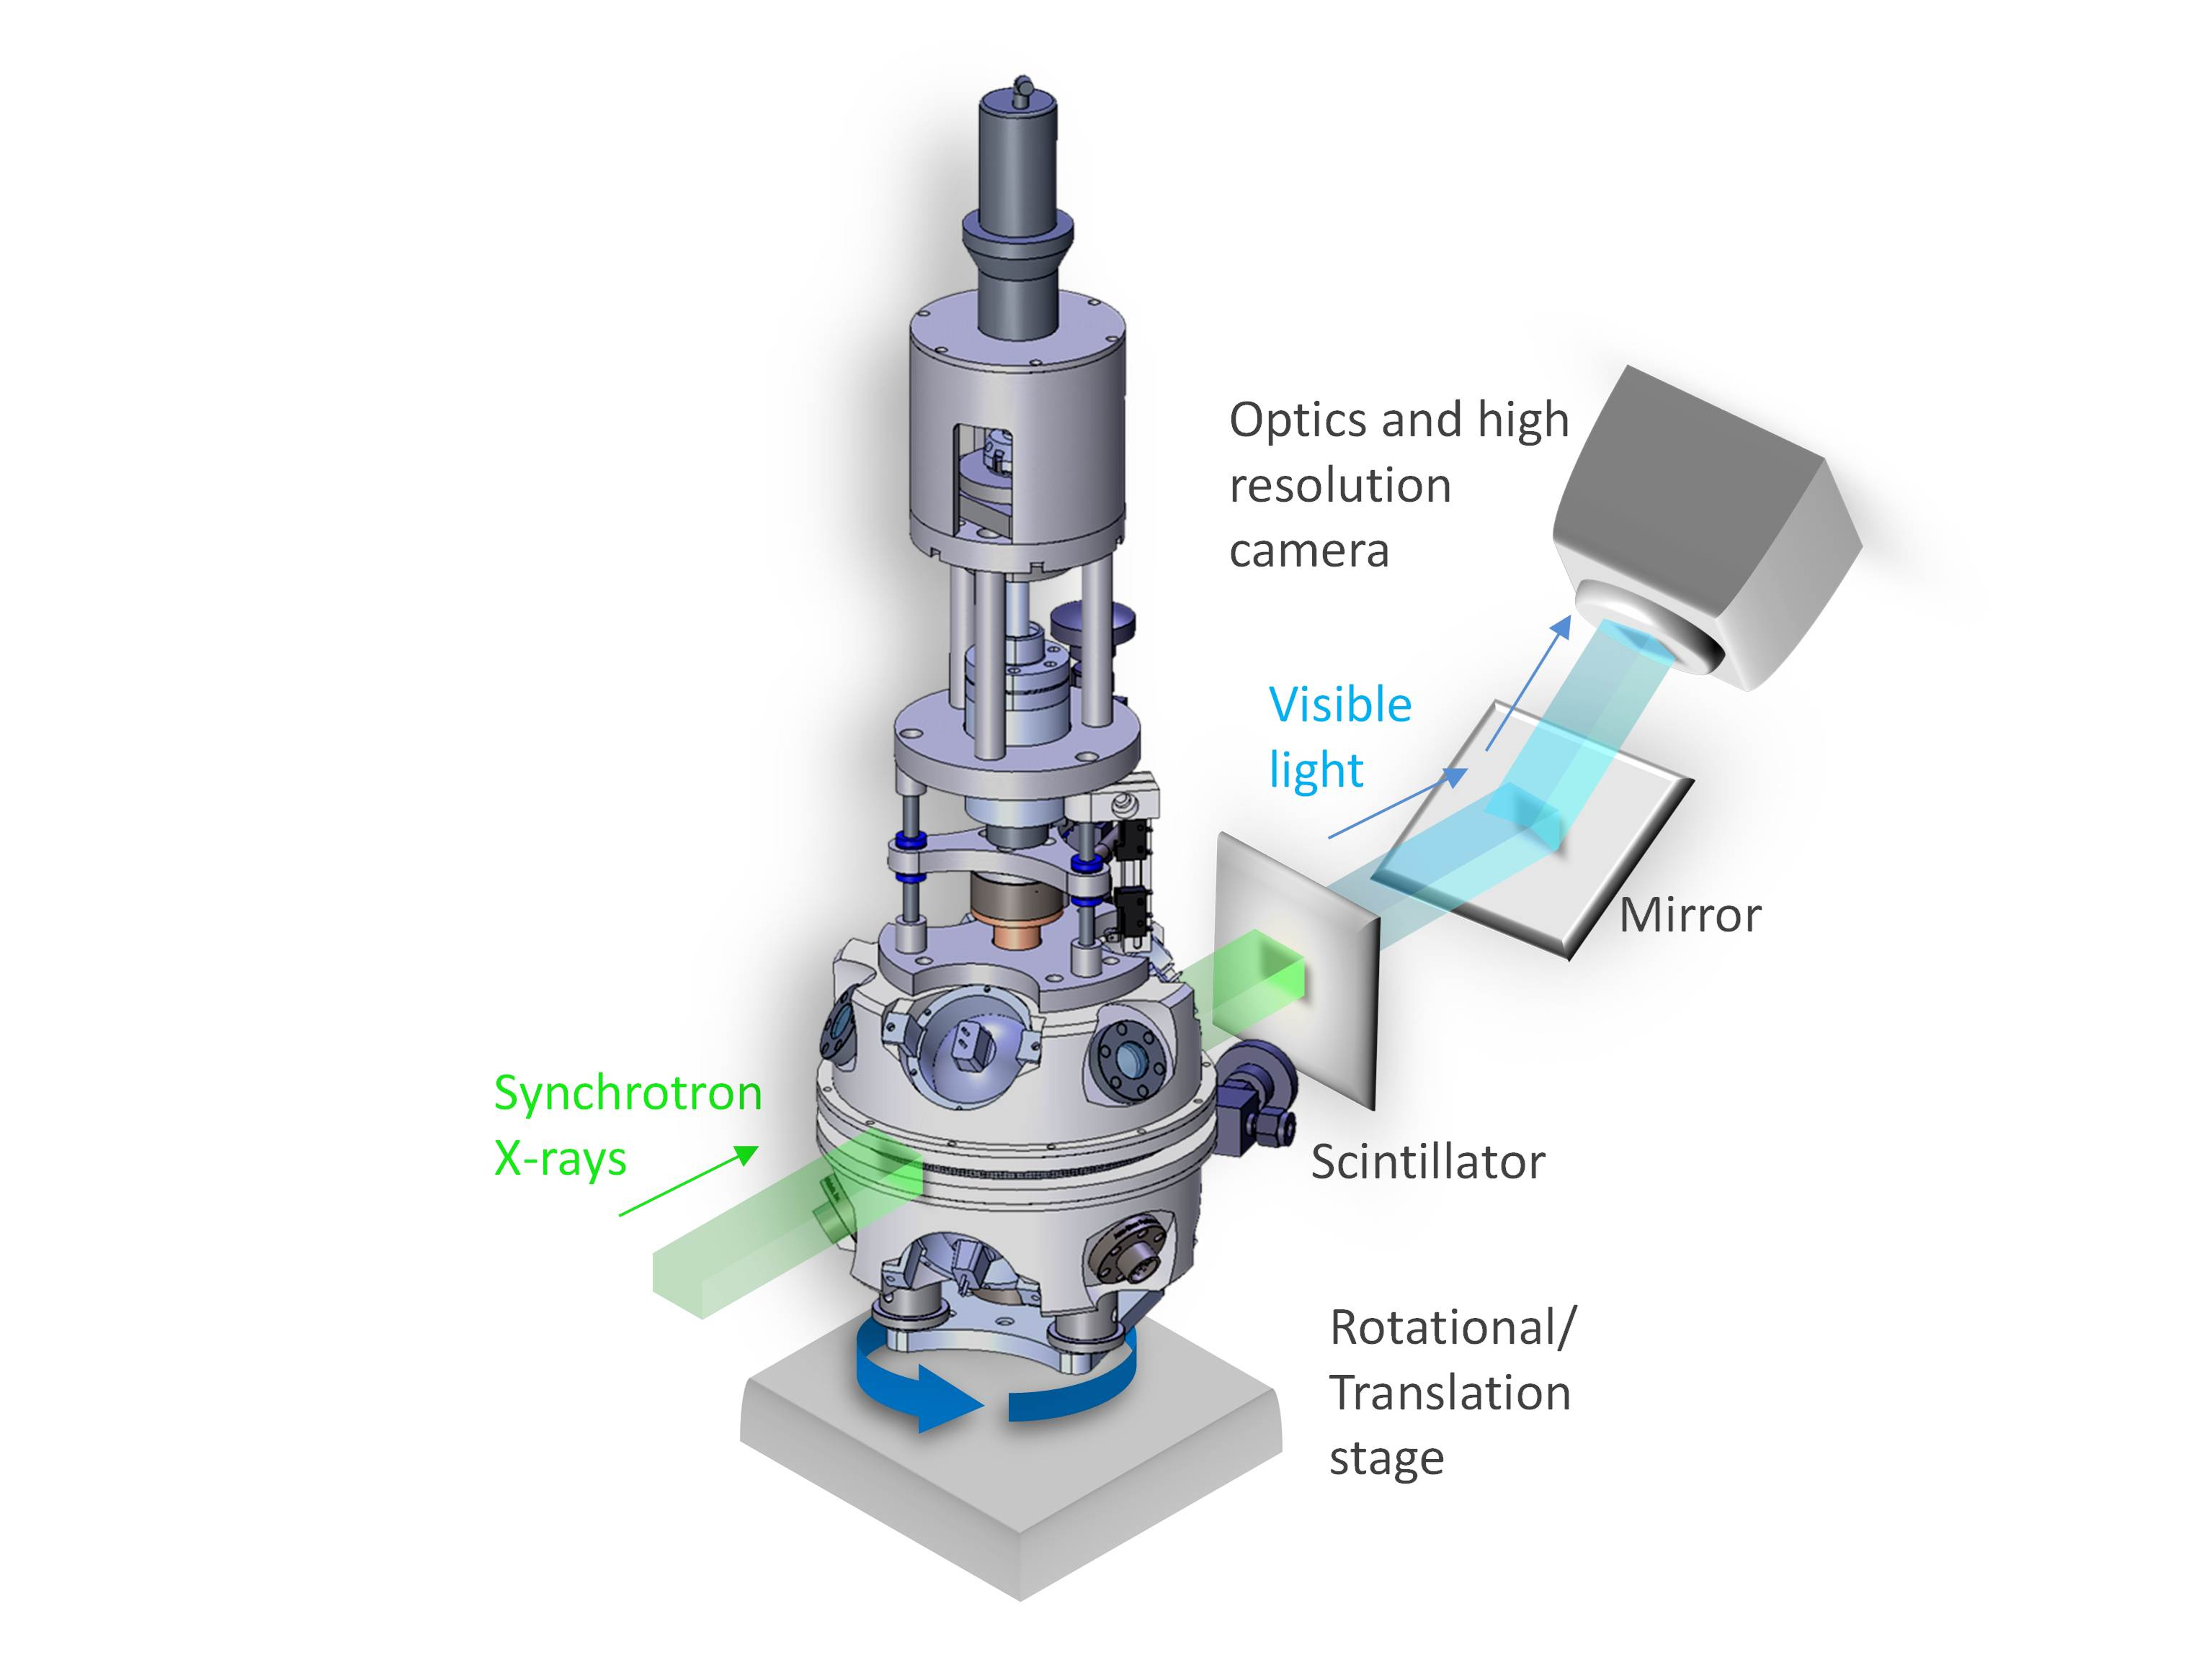
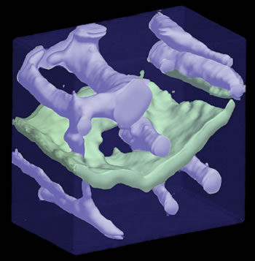
Application – Capture to Results
Basic Energy Sciences (BES) supports fundamental research to understand, predict, and ultimately control matter and energy at the electronic, atomic, and molecular levels in order to provide the foundations for new energy technologies and to support DOE missions in energy, environment, and national security.
http://science.energy.gov/bes/

Slide 13

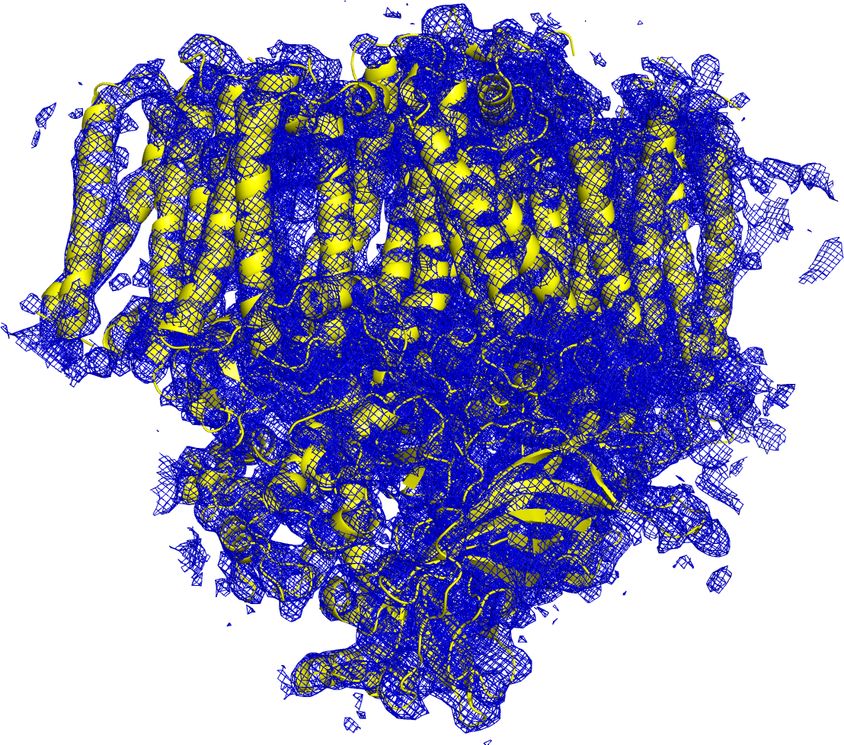
E Pluribus Unum
Processing on this order of magnitude can’t be done locally – we need to send (over a network) to a more capable facility
Hundreds to thousands of images are created in a few hours…they can range in size from MB to TB
After processing on a supercomputer, models are created.
13 – ESnet Science Engagement (engage@es.net) - 2/5/15

Slide 14
Preliminary Layman Takeaways
Science happens in many possible locations…
  Data generation/observation + storage + processing + users.
…technology is improving…
  Price is dropping, resolution and accuracy are increasing, size is reduced
…with many possible actors…
  Local staff, remote visitors, or completely automated operation
…on time scales defined by the actors.
  Expectations of results in minutes to being ok in waiting hours/days for a transfer of results
We need to dig deeper to gauge the impact of each

Slide 15
Outline
The ESnet Story
Science What?
Learning the Hard Way
The Golden Spike
A Call to Arms

Slide 16
Requirements Reviews
http://www.es.net/science-engagement/science-requirements-reviews/
The purpose of these reviews is to accurately characterize the near-term, medium-term and long-term network requirements of the science conducted by each program office.
The reviews attempt to bring about a network-centric understanding of the science process used by the researchers and scientists, to derive network requirements.
We have found this to be an effective method for determining network requirements for ESnet's customer base.

Slide 17
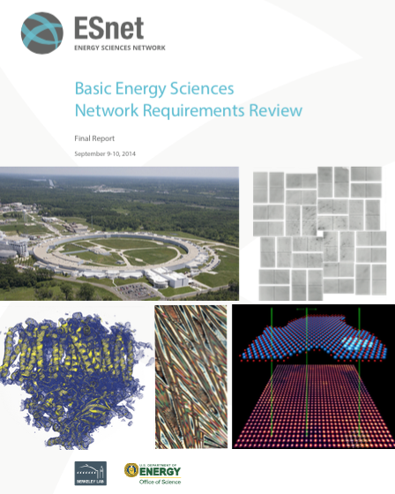
How do we know what our scientists need?
Each Program Office has a dedicated requirements review every three years
Two workshops per year, attendees chosen by science programs
Discussion centered on science case studies
    Instruments and Facilities – the “hardware”
    Process of Science – science workflow
    Collaborators
    Challenges
Network requirements derived from science case studies + discussions
Reports contain requirements analysis, case study text, outlook
  http://www.es.net/science-engagement/science-requirements-reviews/requirements-review-reports/
  Reports stretching back to 2002

Slide 18
Procedural Lessons Learned (2002-2014)
Audience Maters
  Invite the people that matter (management, users, network operators, funding bodies)
Asking the right questions (before the event)
  “How much bandwidth do you need” is wrong.
  Our template:
    Explain the facility, the science, the people involved (local and remote)
    Explain the instrumentation being used, how it is connected to resources
    Describe the software for workflow, data movement, collaboration
    Estimate the volume and frequency of data, movement deadlines
    All of the above are to be done on a 1-2, 2-5, and 5+ event horizon

Slide 19
Procedural Lessons Learned (2002-2014)
Preparation
  Give people 2-3 weeks to prepare
  A well designed template to share
    http://www.es.net/science-engagement/science-requirements-reviews/network-requirements-reviews/documents-and-background-materials/
  Encourage everyone to work on case studies together
    The scientist, facility management, networking group, and remote users/VOs
Staying on task
  Powerpoint fest = bad. You get 5 minutes to state your case
  Discussion follows – questions will be asked.
    You learn more this way than in the case study
  Goal is to get the positive/negative things in the open:
    How well they did with what was available in the last couple of years
    Areas they could improve if they had access to more technology
    Worries they have for the next event horizon

Slide 20
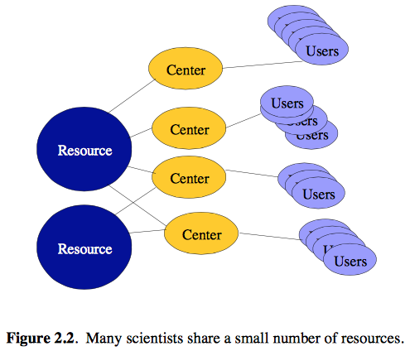
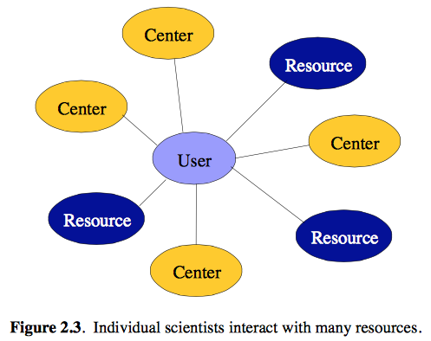
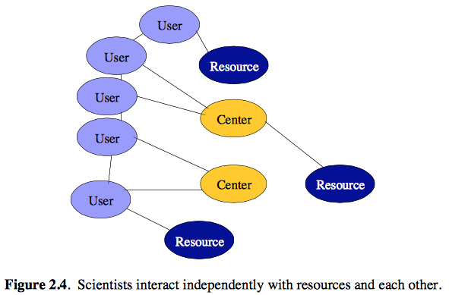
Scientific Lessons Learned (2002-2014)
The structure of networking for science hasn’t changed much in 13 years.
From: “High-Performance Networks for High-Impact Science”, High-Performance Network Planning Workshop, August 13, 2002
http://www.es.net/assets/Uploads/Highperformancenetworks-report.pdf

Slide 21
Scientific Lessons Learned (2002-2014)
All snowflakes are unique, some are less unique than others
  The process of science for almost everyone is similar
  Because workflows overlap, there OTS ideas that can help many
Data volume will always increase on a Moore’s law curve in terms of data, and reverse in terms of price
  Instruments are getting more and more precise
  More precision = more data
Collaboration space will always increase
  Addition of new collaborators (domestic and international) doesn’t go down
  More users means more need for collaboration tools
    Video, audio, shared diaries

Slide 22
Scientific Lessons Learned (2002-2014)
Budgets are flat
Software is getting more sophisticated
  In terms of the science:
    There are entire suites designed to manage data flow from the instrument to an analysis center (curating, transfer, etc.)
    Not everyone uses these, sometimes they make their own, sometimes they do nothing.
  In terms of collaboration:
    Hardly anyone does voice, that’s why we have video
    Why travel 2000+ miles to visit a light source (for a cost of $2000…) when you can mail you sample and control a robot via an online interface.

Slide 23
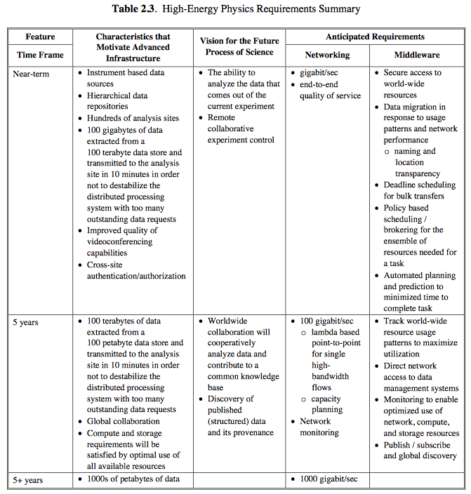
Scientific Lessons Learned (2002-2014)
HEP information from 2002 report, the predictions for 2007 are not very far from the truth:
Multi-petabyte data requirements (off of instrument, and for long term storage)
Globally increasing number of collaborators
100Gbps requirement to handle multiple data flows at T1/T2 facilities
Network monitoring
How did they do? Pretty accurate on data growth and network needs (100G was a little delayed)
Expect factor of 2-5 as of the 2013 report.

Slide 24
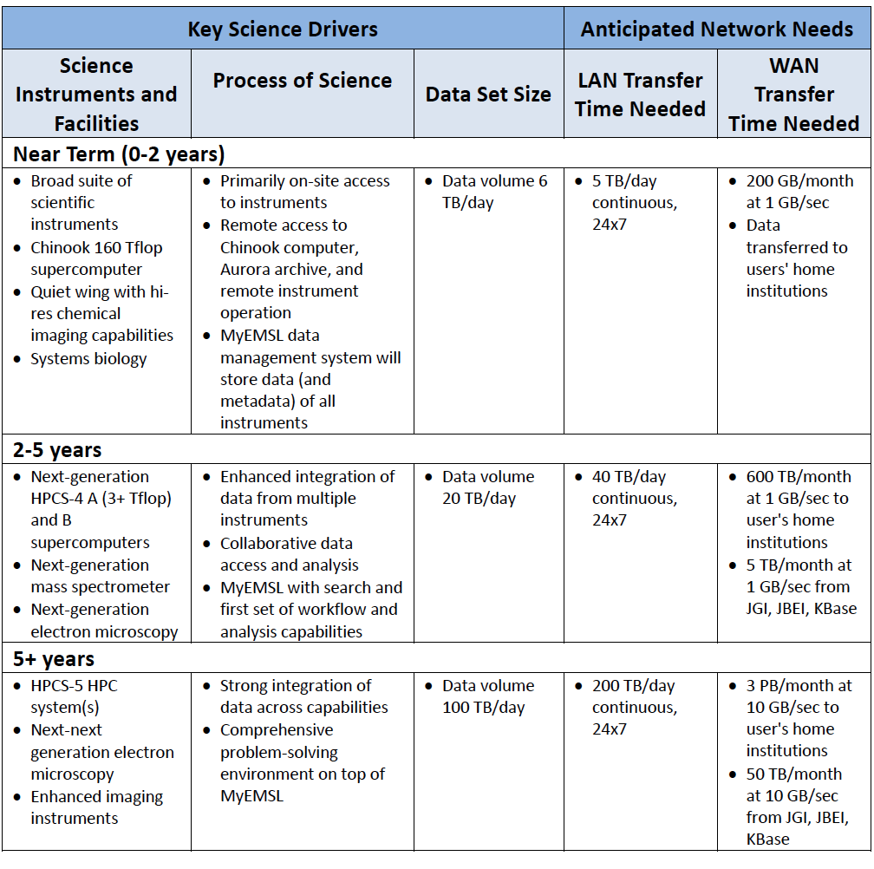
Sometimes we get more than we bargained for…
“EMSL frequently needs to ship physical copies of media to users when data sizes exceed a few GB. More often than not, this is due to lack of bandwidth or storage resources at the user's home institution.”

Slide 25
Networking Lessons Learned (2002-2014)
Network upgrades are justifiable to a specific voice
Your performance depends highly on the resources of others
  We all work as well as the worst setup – there is a significant amount of peer pressure to run it clean and fast
The problems that exist:
  Packet loss (implement Science DMZs and use perfSONAR)
  Tools (buy a DTN and use a tool designed for data movement)

Slide 26
Understanding Data Trends

Slide 27
After a Review – Actions Spill Out
For the Funders:
  An identified lists of ways the program can be better (and possibly costs)
For the Experiments/Facilities/Scientists
  Understanding of the technical barriers that may have impacted them
  Local problems are common knowledge, than now have a clock associated with when a fix will occur
For the Network Providers
  Capacity planning:
    Knowledge of data movement patterns
    Knowledge of data volumes for several event horizons
  Technology wish-list from users
  A sense of timing that assists with upgrade schedules
For everyone: faces and names

Slide 28
Outline
The ESnet Story
Science What?
Learning the Hard Way
The Golden Spike
A Call to Arms

Slide 29
From the Source of all Truth
Technology (from Greek τέχνη, techne, "art, skill, cunning of hand"; and -λογία, -logia)
  The collection of tools, including machinery, modifications, arrangements and procedures used by humans
  Engineering is the discipline that seeks to study and design new technologies.
  Technologies significantly affect human as well as other animal species' ability to control and adapt to their natural environments.
http://en.wikipedia.org/wiki/Technology

Slide 30
The cause of, and solution to, all of life’s problems
All previous science examples have many technologies under the hood to address the 6 steps (question, research, hypothesize, experiment, conclude, communicate):
  Experimental devices to fling atoms and take pictures when they smack into each other. Optical lenses to view really close, or really far away
  Localized processing and storage to give immediate results
  Remote storage and processing (on larger scales) to condense hours/days/weeks/years of research into a picture, or “42”
  Networks of various sizes
  Software to manage many aspects of the pipeline (controlling a camera or managing a data transfer – lots of moving parts)
What could possibly go wrong?

Slide 31
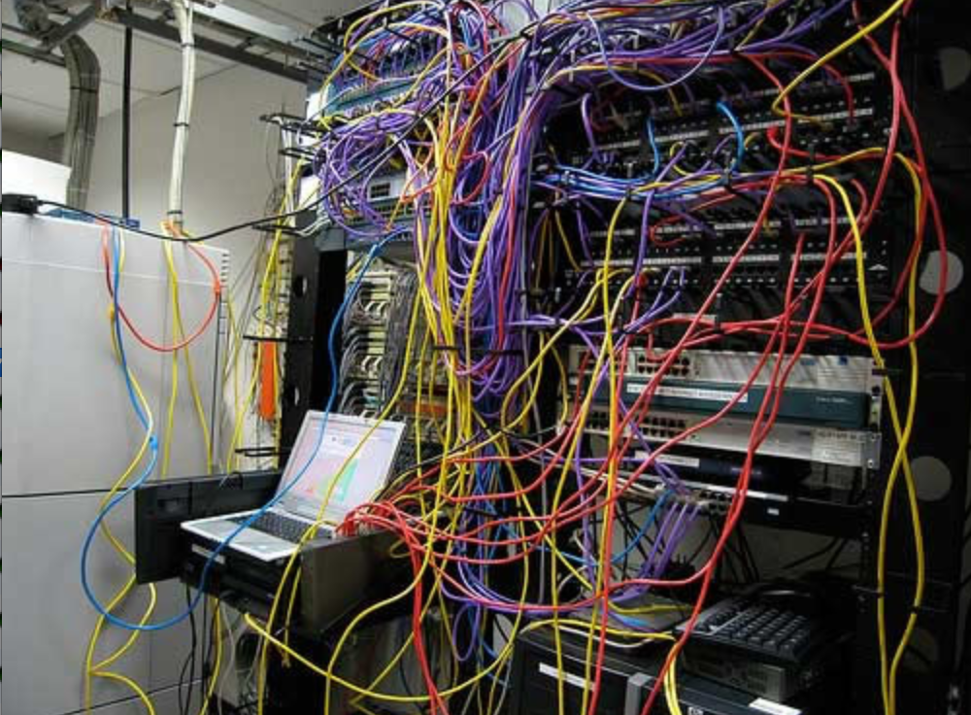
Challenges to Sophisticated Network Use
Network use has historically been challenging for end users (e.g. the ‘wizard’ gap)
Lack of communication and collaboration between the CIO’s office and researchers on campus
Lack of IT expertise within a science collaboration or experimental facility
User’s performance expectations are low (“The network is too slow”, “I tried it and it didn’t work”).
Cultural change is hard (“we’ve always shipped disks!”).
Scientists want to do science not IT support – IT support has to worry about things like projectors and babysitting a student population: not learning why frog DNA matters.
The Capability Gap

Slide 32
Picking the Battles Wisely
There are many solutions to the common problems that plague the scientific community – many are easy wins that just require some time:
  Network upgrades
    Don’t think ‘capacity’ – capacity is not the correct answer to solve the entire problem.
  Workflow analysis
    How the work is approached is just as important as what is done.
  Use case identification
    Everyone wants to be a unique snowflake. Years of experience has shown that most science looks the same from a technology standpoint.
  An ear to listen
    “Checking in” is important. Someone is more likely to tell you a problem if you ask them what is going on.

Slide 33
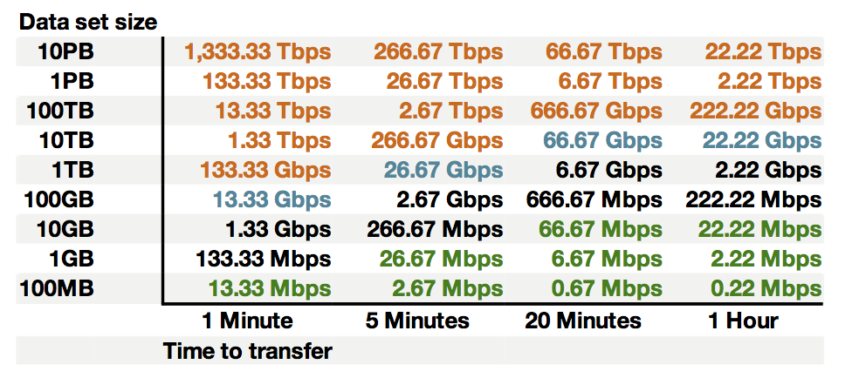
ROI
Improving the process of science has a large impact on ROI
  For the NSF/Dept of Commerce/DOE, etc.
  For the university
  For the scientific VO/facilities
http://fasterdata.es.net/fasterdata-home/requirements-and-expectations/
  For the users
The converse is to think about how many resources are being wasted:
  Using sneakernet instead of that fast network
  Wasting hours transferring files when it could take minutes
  Reinventing the wheel with each new endeavor

Slide 34
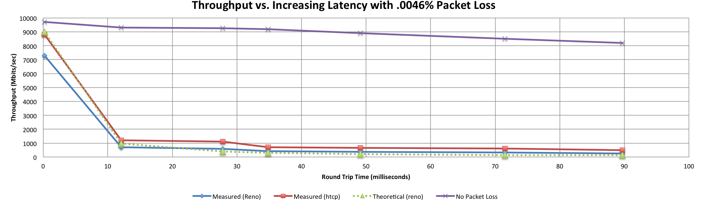

A small amount of packet loss makes a huge difference in TCP performance
Local
(LAN)
With loss, high performance beyond metro distances is essentially impossible
International
Metro Area
Regional
Continental
Measured (TCP Reno)
Measured (HTCP)
Theoretical (TCP Reno)
Measured (no loss)

Slide 35
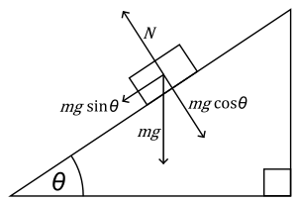


The Science DMZ in 1 Slide
“Friction free” network path
  Highly capable network devices (wire-speed, deep queues)
  Virtual circuit connectivity option
  Security policy and enforcement specific to science workflows
  Located at or near site perimeter
Dedicated, high-performance Data Transfer Nodes (DTNs)
  Hardware, operating system, config all optimized for data transfer
  High-performance data transfer tools such as Globus
Performance test and measurement – perfSONAR
Science engagement
  Map experiments onto cyberinfrastructure
  Work with users to ensure they are successful
Details at http://fasterdata.es.net/science-dmz/
© 2013 Wikipedia
© 2015 Globus

Slide 36
World Famous Science DMZ Design Pattern

Slide 37
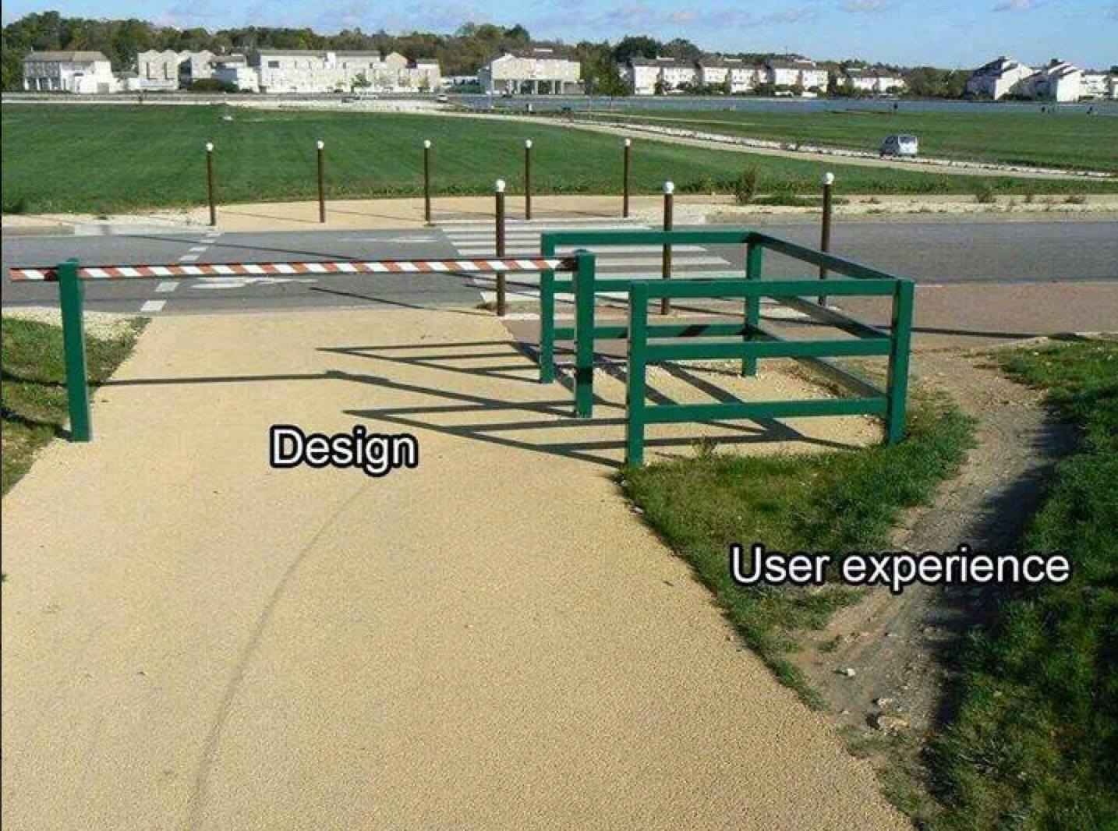
Why Build A Science DMZ Though?
Data set scale
  Detector output increasing
    1Hz → 10Hz → 100Hz → 1kHz … → 1MHz
  HPC scale increasing
    Increased model resolution → increased data size
    Increased HPC capability means additional problems can now be solved
Data placement
  Move compute to where the data is?
  Move data to where the compute is?
Data Availability
  Instant to collaborators?
  Long term storage ‘just because’?
  Different formats (raw, processed) because you can?
Without a Science DMZ, this stuff is all hard
  “No one will use it”. Maybe today, what about tomorrow?
  “We don’t have these demands currently”. Next gen technology is always a day away

Slide 38
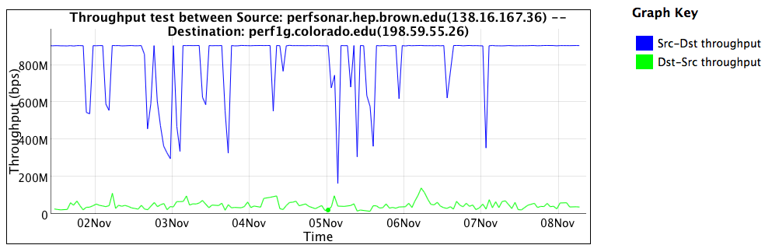
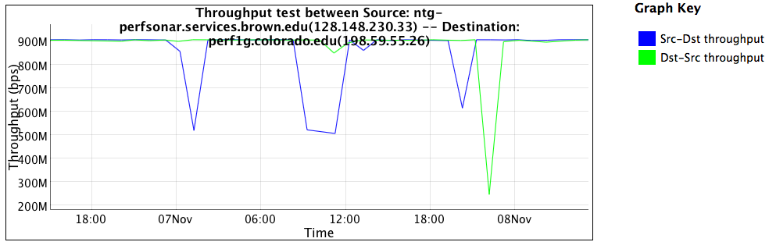
[Insert Lame Excuse #1], I don’t need a Science DMZ
The impacts of overzealous
security
10x improvement if you identify a use case: the alternative is application of policy without any thought as to the consequences.

Slide 39
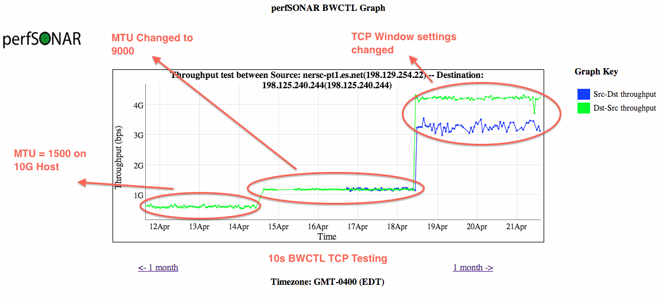
[Insert Lame Excuse #2], Our users will figure it out
Improving things, when you don’t know what you are doing, is a random walk. Sharing and educating your local community is important

Slide 40
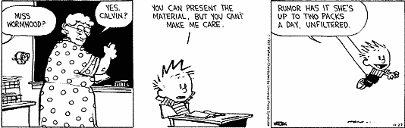
Bridging the Gap
Implementing technology is ‘easy’ in the grand scheme of assisting with science
Adoption of technology is different
  Does your cosmologist care what SDN is?
  Does your cosmologist want to get data from Chile each night so that they can start the next day without having to struggle with the tyranny of ineffective data movement strategies that involve airplanes and white/brown trucks?

Slide 41
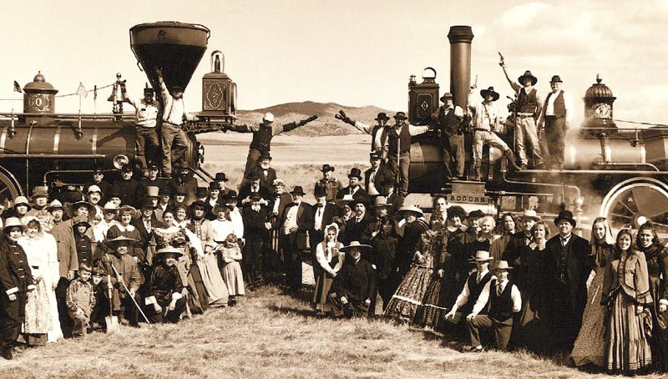
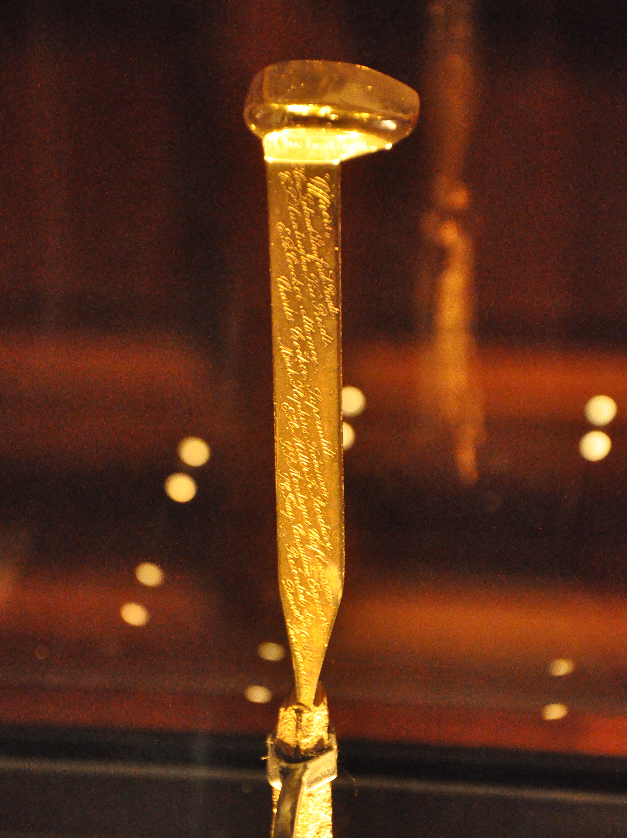
The Golden Spike
We don’t want Scientists to have to build their own networks
Engineers don’t have to understand what a tokomak accomplishes
Meeting in the middle is the process of science engagement:
  Engineering staff learning enough about the process of science to be helpful in how to adopt technology
  Science staff having an open mind to better use what is out there

Slide 42
ESnet Approach to Engagement
Education & Consulting
Webinars, workshops, 1:1 data mobility consultations with scientists, support teams.
Partnerships
With facilities / research teams / providers, building foundation for lasting impact.
Resources & Knowledgebase
Reference designs, case studies, papers, FAQs – tailored for multiple audiences.

Slide 43
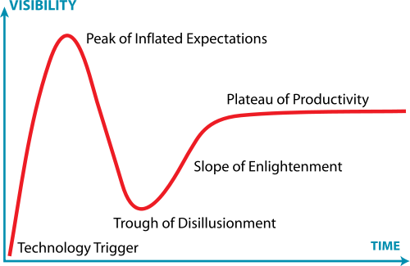
Post-it I keep On My Desk
Engagement != dropping something new into a user’s lap and hoping for the best
Engagement = figuring out if the solution is a good idea, and then helping with integration
  Asking questions, building trust
  Provide a solution, not a technology (and certainly not a headache)

Slide 44

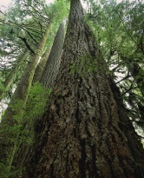


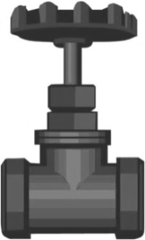

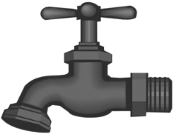
User Workflow & Bottleneck Identification
2. Endstation
3. Sample
4. Control Software
5. Data Collection
Users
1. Allocation
6. Data Transfer / Management
Publications
9. Write and edit
8. Data Analysis / Info Extraction / Visualization / Simulation
7. Data Processing

Slide 45
Workflow Overlay on Network
#3
#1
#2

Slide 46
Modified Workflow & Network
#3
#2
#3
#1

Slide 47
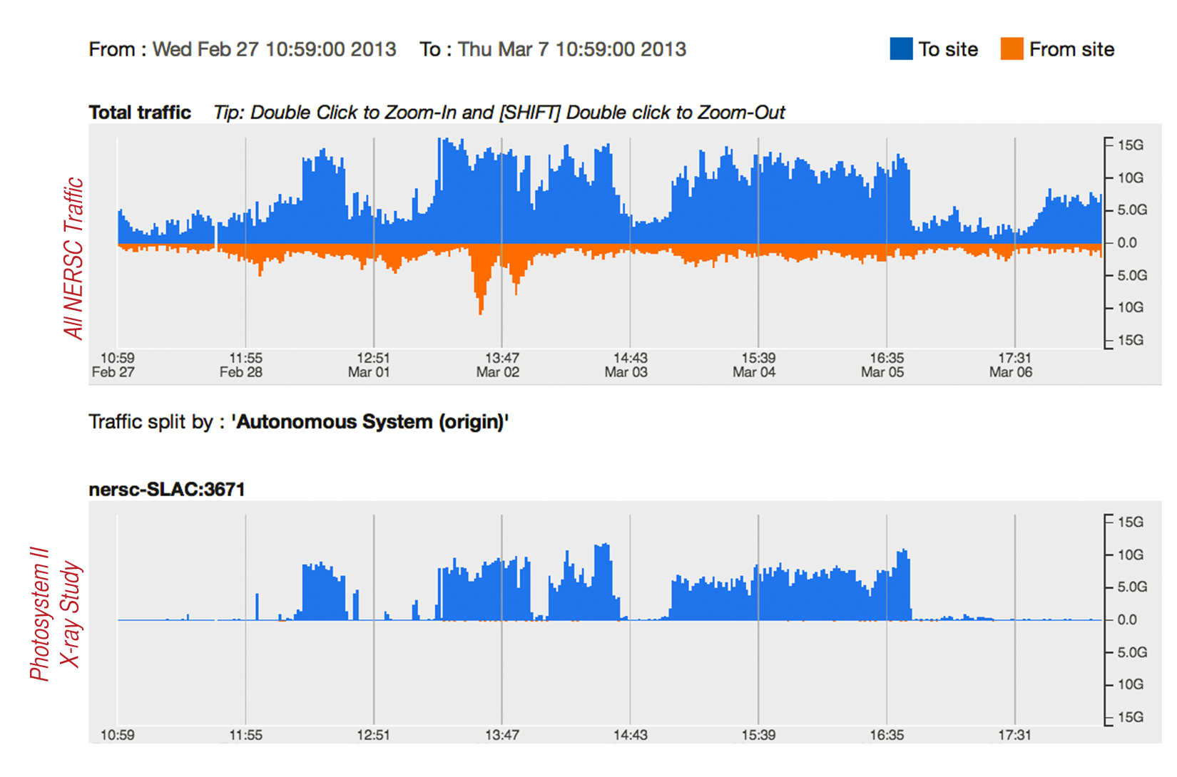
Experimental Facility to Computing Facility over ESnet

Slide 48

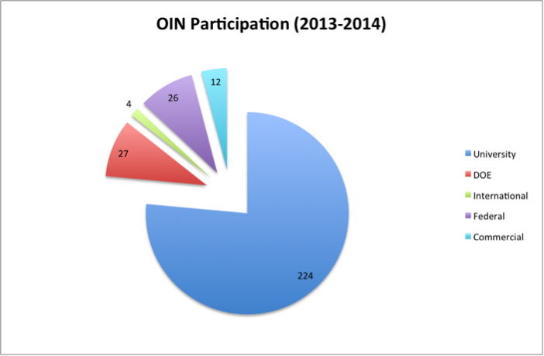
Training/Education
OIN = Operating Innovative Workshops
  http://oinworkshop.com
Joint partnership between ESnet, Indiana University and Internet2
Training in the technology that matters
  Science DMZ (perfSONAR, DTNs, Architecture, Security)
  SDN (Installation, Configuration, Use Cases)

Slide 49

Additional Information
The goal of the OIN series is to remove the mystery from technology
Anyone can host (you don’t have to be a CC-IIE/NIE/DNI award winner)
  2015 is nearly full (Pittsburgh, Kansas City, Clemson, St. Louis, Texas) – catch me after if there is a need for a region not listed above
Webinars can be done upon request
Open Source Learning:
  The materials are available if you want to use them
We are looking to regional networks to help us reach the people that need it.
Bottom line: the only way to clean up networks is to get people trained. Send your engineers please.

Slide 50
Outline
The ESnet Story
Science What?
Learning the Hard Way
The Golden Spike
A Call to Arms

Slide 51
Some Conclusions
Networking is a means to an end – it is an enabler of technology
Scientific innovation will continue to press the envelope with more accurate machines that cost less
Having a game plan to identify what is coming is a good idea – for the campus, for the region, and for the country
Science engagement isn’t hard
  More about listening than building
  Building occurs with or without knowing the use cases, this can help refine
Science engagement can’t be done on found cycles
  Dedicated person(s) with a communications/technology background
  Gives a known ‘landing point’; builds trust, encourages growth
Benefits when attempted:
  Potentially saving on costs of build/operation – remember that ROI matters
  Happy customers
  Deeper understanding of the science, which advances society (e.g. I want to see a cure for cancer before I need one, networks are a part of that)

Slide 52
Regional Engagement Strategy
Create a “culture of urgency” – who wants to start?
Naming a person matters – someone people associate as the go to person
What could/should this person do on a per region basis?
  Get a regional perfSONAR mesh going. CENIC and OARnet are onboard as of last month:
    https://ps-dashboard.cenic.net/maddash-webui/
    http://perfsonar-dashboard.oar.net/maddash-webui/
  Develop a system similar to ESnet’s Requirements Reviews (we are happy to help – ask us anything)
  Tie the success of science to the network:
    Will help to gauge ‘how big’ to build the network, and on what time scales
    Will also turn out some negative information, e.g. how problems are hurting innovation
  Maintains a contacts database for technical personnel at each facility
  Would be who the national powers coordinate with for performance anomalies or science support.

Slide 53
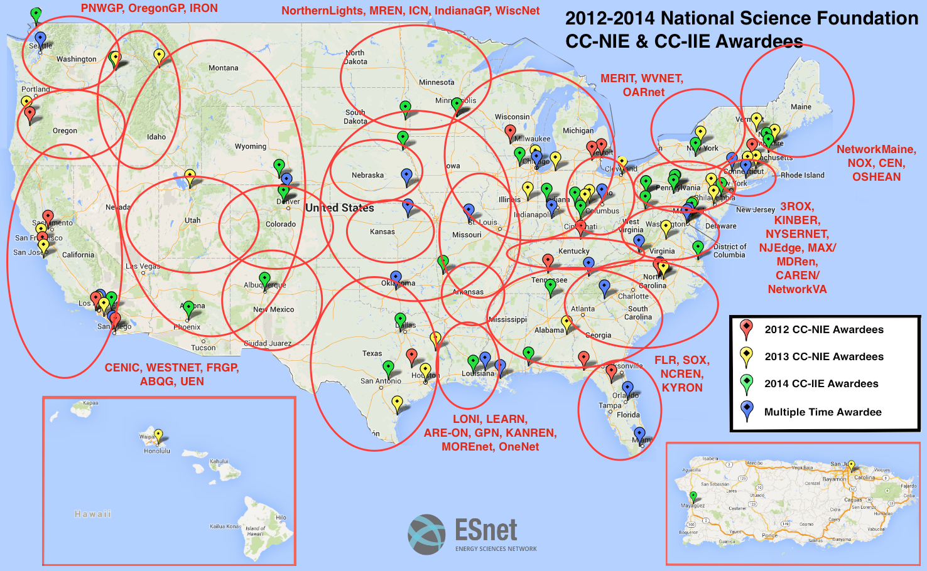
A Helpful (?) Modification

Slide 54
engage@es.net

Slide 55
Understanding Big Data Trends and the Key Role of the Regionals in Bridging Needs and Solutions
Jason Zurawski – zurawski@es.net
Science Engagement Engineer, ESnet
Lawrence Berkeley National Laboratory
Quilt Winter Member Meeting 2015
February 11th, 2015

