Slide 1







The Science DMZ:
A Network Design Pattern for Data-Intensive Science
Jason Zurawski – zurawski@es.net
Science Engagement Engineer, ESnet
Lawrence Berkeley National Laboratory
ENhancing CyberInfrastructure by Training and Engagement (ENCITE) Webinar
April 3rd 2015

Slide 2
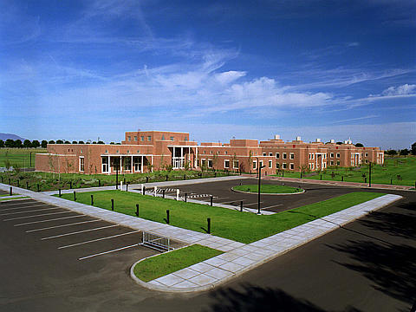
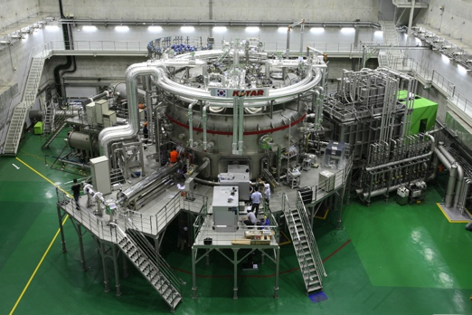
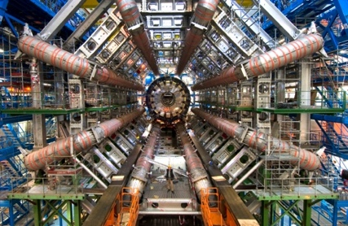
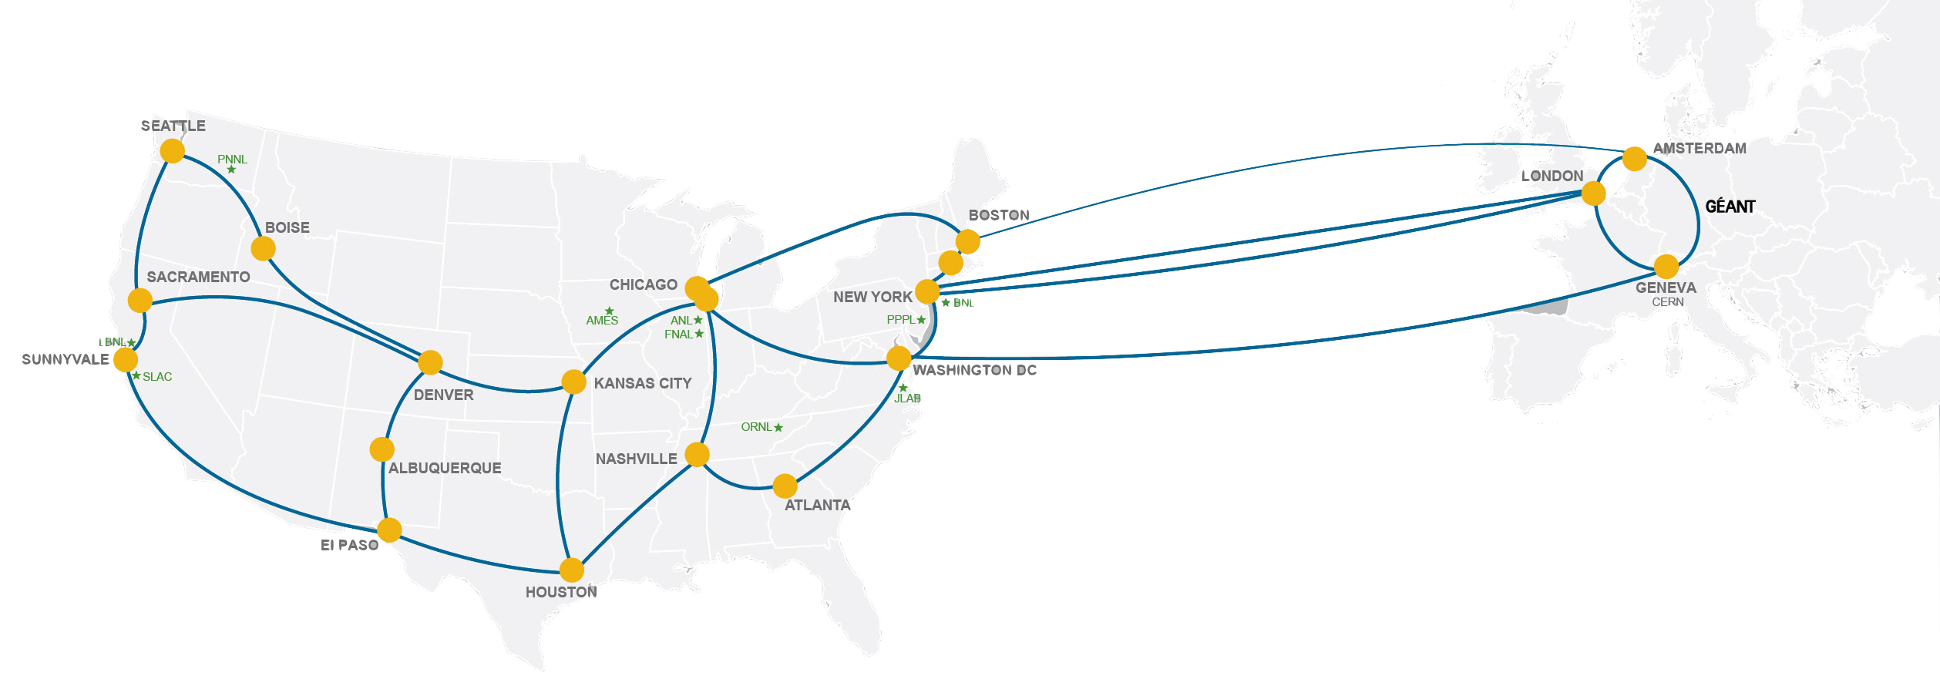
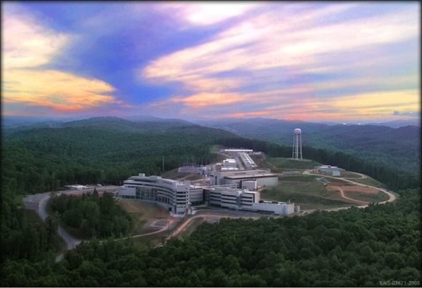
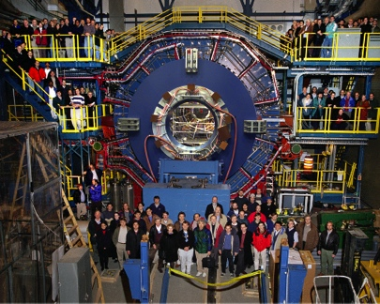
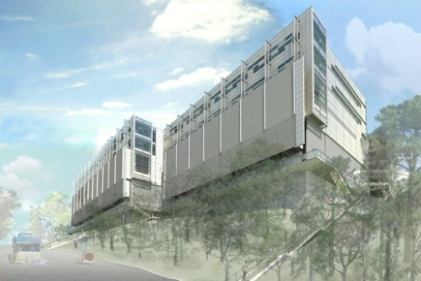
Network as Infrastructure Instrument
    ESnet Vision: Scientific progress will be completely unconstrained by the physical location of instruments, people, computational resources, or data.
© 2015, Energy Sciences Network
Notes:
Summing up ESnet’s vision in one slide, one phrase…
Physical location of instruments, people, computational resources, data. It just should not matter.
[KSTAR, SNS, ATLAS, EMSL, CRT/NERSC, STAR Detector at RHIC [BNL, NP-funded]]

Slide 3
Overview
Science DMZ Motivation and Introduction
Science DMZ Architecture
Network Monitoring
Data Transfer Nodes & Applications
Science DMZ Security
User Engagement
Wrap Up
© 2015, Energy Sciences Network

Slide 4
Motivation
Science & Research is everywhere
  Size of school/endowment does not matter – there is a researcher at your facility right now that is attempting to use the network for a research activity
Networks are an essential part of data-intensive science
  Connect data sources to data analysis
  Connect collaborators to each other
  Enable machine-consumable interfaces to data and analysis resources (e.g. portals), automation, scale
Performance is critical
  Exponential data growth
  Constant human factors (timelines for analysis, remote users)
  Data movement and analysis must keep up
Effective use of wide area (long-haul) networks by scientists has historically been difficult (the “Wizard Gap”)
© 2015, Energy Sciences Network
Notes:
Human factors – attention span, ability to manage complexity – these are constant
There is a huge amount of promise in data-intensive science. Effective use of networks can help realize those benefits.
The Science DMZ model helps address the difficulties scientists often experience with using networks.

Slide 5
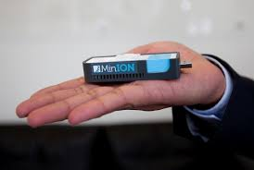
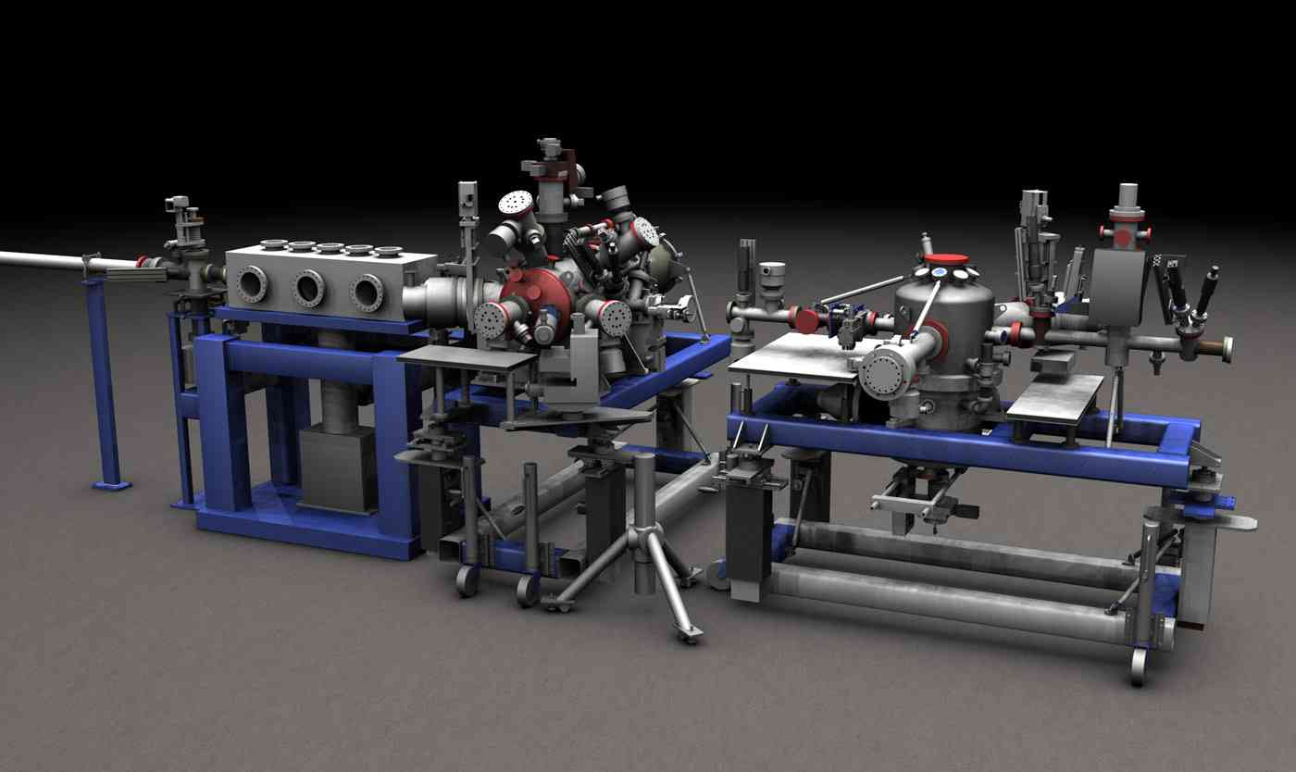
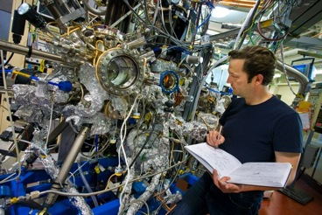
Big Science Now Comes in Small Packages …
…and is happening on your campus. Guaranteed.
© 2015, Energy Sciences Network

Slide 6
Understanding Data Trends
© 2015, Energy Sciences Network
Notes:
Requirements workshops for all six program offices within the DOE office of Science

Slide 7
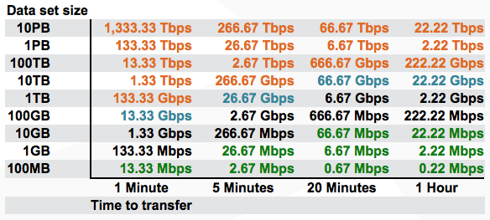
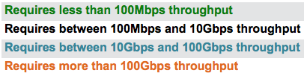
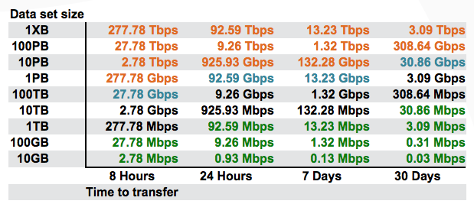
Data Mobility in a Given Time Interval (Theoretical)
These tables available:
http://fasterdata.es.net/fasterdata-home/requirements-and-expectations/
© 2015, Energy Sciences Network
Notes:
This succinctly describes what the end to end data path must achieve – network, hosts, storage, application
Green: <= 100Mbps Throughput (almost all domestic locations can do this) – less than Fast Ethernet!
Black: 100Mbps to 10Gbps Throughput (most major research institutions can do this, if its running clean)
Blue 10Gbps to 100Gbps Throughput (emerging at major locations)
Orange > 100Gbps Throughput (future for many)
Note: 1TB/hour and 100TB/week fit easily within 10G of throughput

Slide 8
The Central Role of the Network
The very structure of modern science assumes science networks exist: high performance, feature rich, global scope
What is “The Network” anyway?
  “The Network” is the set of devices and applications involved in the use of a remote resource
    This is not about supercomputer interconnects
    This is about data flow from experiment to analysis, between facilities, etc.
  User interfaces for “The Network” – portal, data transfer tool, workflow engine
  Therefore, servers and applications must also be considered
What is important? Ordered list:
  Correctness
  Consistency
  Performance
© 2015, Energy Sciences Network
Notes:
Networks are key. However, the user interface runs on systems at the edges.
The ordered list of important items is derived from the users of the network:
1) If a tool doesn’t behave correctly, the tool is broken – get another tool
2) If the tool doesn’t behave consistently, I can’t organize my life
3) Among the tools that behave correctly and consistently, choose the tool with the required performance that is easiest to use

Slide 9
TCP – Ubiquitous and Fragile
Networks provide connectivity between hosts – how do hosts see the network?
  From an application’s perspective, the interface to “the other end” is a socket
  Communication is between applications – mostly over TCP
TCP – the fragile workhorse
  TCP is (for very good reasons) timid – packet loss is interpreted as congestion
  Packet loss in conjunction with latency is a performance killer
    We can address the first, science hasn’t fixed the 2nd (yet)
  Like it or not, TCP is used for the vast majority of data transfer applications (more than 95% of ESnet traffic is TCP)
© 2015, Energy Sciences Network
Notes:
The application sees the network as a socket.
The socket interface does not provide path diagnostics or other troubleshooting information.
TCP behaves as it does because of measures taken in the 1980s to fix the congestion collapse of the Internet
TCP makes a promise to the application – TCP will get the data to the other end, or TCP will return an error. TCP makes no promises about performance.

Slide 10
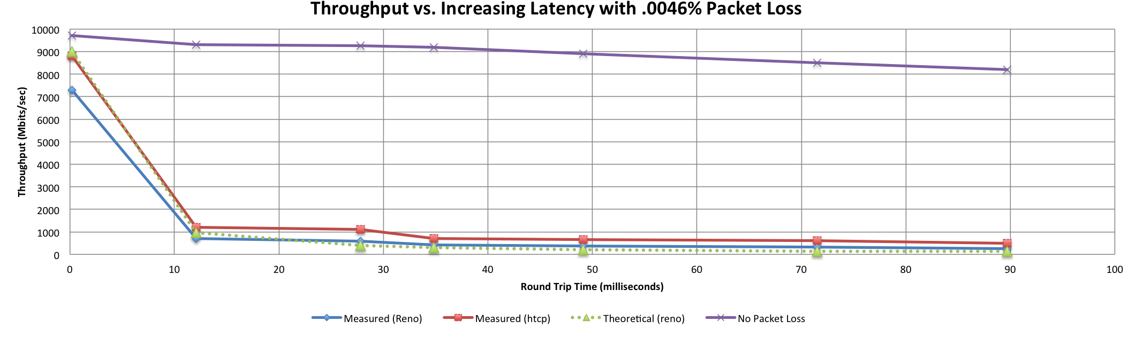

A small amount of packet loss makes a huge difference in TCP performance
Local
(LAN)
With loss, high performance beyond metro distances is essentially impossible
International
Metro Area
Regional
Continental
Measured (TCP Reno)
Measured (HTCP)
Theoretical (TCP Reno)
Measured (no loss)
© 2015, Energy Sciences Network
Notes:
This is an annotated version of the plot from the Science DMZ paper
Beyond your metro area, zero loss is essentially required for high performance
Where are your collaborators? Where are your users?
When global collaboration is the norm, nobody can afford to be a local-only resource

Slide 11
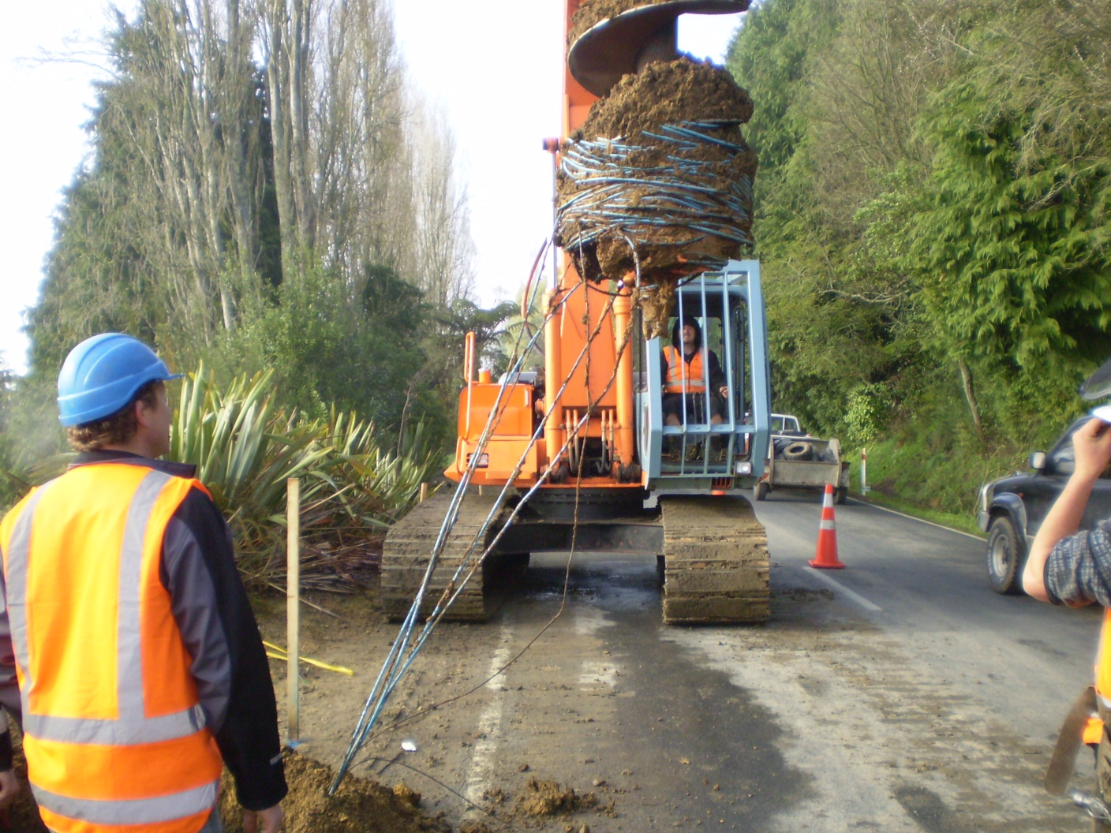
Lets Talk Performance …
"In any large system, there is always something broken.”
Jon Postel
Modern networks are occasionally designed to be one-size-fits-most
  e.g. if you have ever heard the phrase “converged network”, the design is to facilitate CIA (Confidentiality, Integrity, Availability)
  This is not bad for protecting the HVAC system from hackers.
Causes of friction/packet loss:
  Small buffers on the network gear and hosts
  Incorrect application choice
  Packet disruption caused by overzealous security
  Congestion from herds of mice
It all starts with knowing your users, and knowing your network
© 2015, Energy Sciences Network

Slide 12
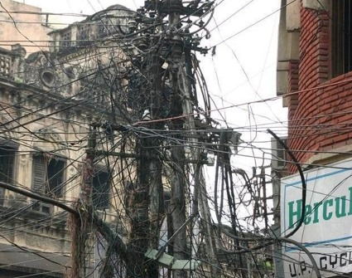
Putting A Solution Together
Effective support for TCP-based data transfer
  Design for correct, consistent, high-performance operation
  Design for ease of troubleshooting
Easy adoption (for all stakeholders) is critical
  Large laboratories and universities have extensive IT deployments
  Small universities/facilities have overworked/understaffed IT departments
  Drastic change is prohibitively difficult
Cybersecurity – defensible without compromising performance
Borrow ideas from traditional network security
  Traditional DMZ
    Separate enclave at network perimeter (“Demilitarized Zone”)
    Specific location for external-facing services
    Clean separation from internal network
  Do the same thing for science – Science DMZ
© 2015, Energy Sciences Network
Notes:
In order to accommodate TCP, we need a pragmatic engineering solution that:
Addresses the needs
Is implementable given financial, policy, and cultural constraints
Can be defended – we cannot ignore security

Slide 13
The Science DMZ Superfecta
  Engagement
Partnerships
Education & Consulting
Resources & Knowledgebase
Engagement with Network Users
perfSONAR
Enables fault isolation
Verify correct operation
Widely deployed in ESnet and other networks, as well as sites and facilities
  Data Transfer Node
High performance
Configured for data transfer
Proper tools
Dedicated Systems for Data Transfer
Performance Testing & Measurement
Network Architecture
Science DMZ
Dedicated location for DTN
Proper security
Easy to deploy - no need to redesign the whole network
© 2015, Energy Sciences Network
Notes:
The Science DMZ design pattern is a set of composable ideas, including:
The architectural element itself – the Science DMZ enclave
Appropriate security that does not impact performance
Dedicated systems – Data Transfer Nodes
perfSONAR
The elements of the Science DMZ can be combined in a variety of ways depending on the need

Slide 14
Overview
Science DMZ Motivation and Introduction
Science DMZ Architecture
Network Monitoring
Data Transfer Nodes & Applications
Science DMZ Security
User Engagement
Wrap Up
© 2015, Energy Sciences Network

Slide 15
Science DMZ Takes Many Forms
There are a lot of ways to combine these things – it all depends on what you need to do
  Small installation for a project or two
  Facility inside a larger institution
  Institutional capability serving multiple departments/divisions
  Science capability that consumes a majority of the infrastructure
Some of these are straightforward, others are less obvious
Key point of concentration: eliminate sources of packet loss / packet friction
© 2015, Energy Sciences Network

Slide 16
Legacy Method: Ad Hoc DTN Deployment
This is often what gets tried first
Data transfer node deployed where the owner has space
  This is often the easiest thing to do at the time
  Straightforward to turn on, hard to achieve performance
If lucky, perfSONAR is at the border
  This is a good start
  Need a second one next to the DTN
Entire LAN path has to be sized for data flows (is yours?)
Entire LAN path becomes part of any troubleshooting exercise
This usually fails to provide the necessary performance.
© 2015, Energy Sciences Network
Notes:
Previous slide is diagram for this; just say these things while showing previous slide

Slide 17
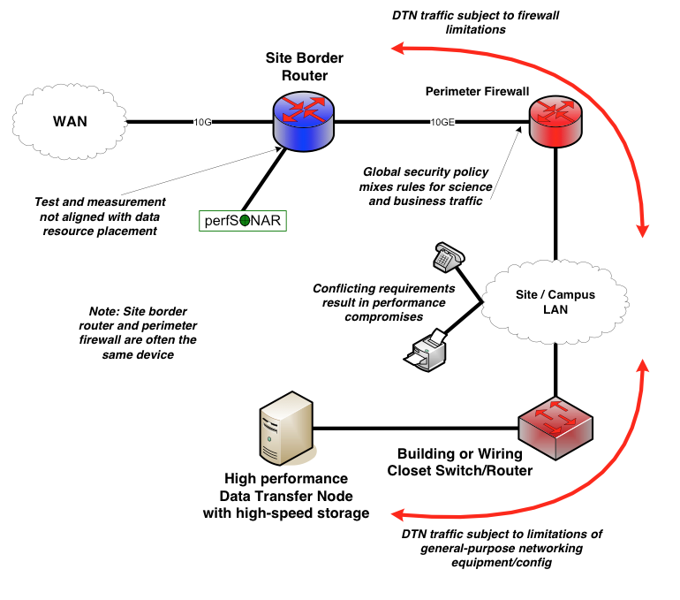
Ad Hoc DTN Deployment
© 2015, Energy Sciences Network
Notes:
DTN node deep within campus infrastructure.

Slide 18
Abstract Deployment
Simplest approach : add-on to existing network infrastructure
  All that is required is a port on the border router
  Small footprint, pre-production commitment
Easy to experiment with components and technologies
  DTN prototyping
  perfSONAR testing
Limited scope makes security policy exceptions easy
  Only allow traffic from partners (use ACLs)
  Add-on to production infrastructure – lower risk
  Identify applications that are running (e.g. the DTN is not a general purpose machine – it does data transfer, and data transfer only)
Start with a single user/user case. If it works for them in a pilot, you can expand
© 2015, Energy Sciences Network

Slide 19
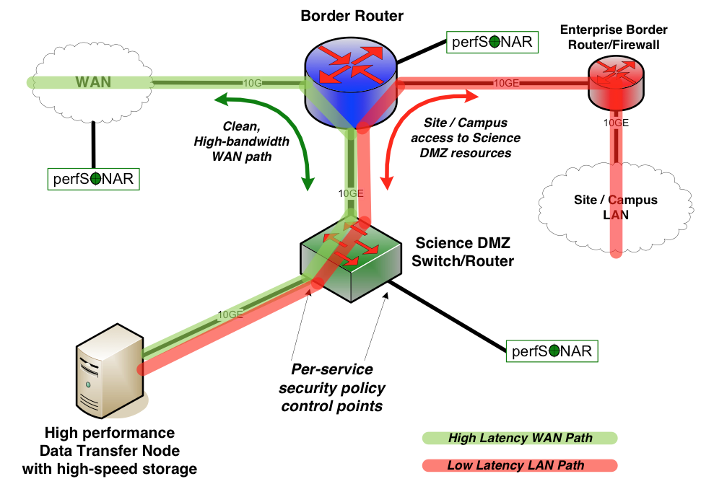
Local And Wide Area Data Flows
© 2015, Energy Sciences Network
Notes:
The green data path is susceptible to TCP performance problems stemming from packet loss combined with long distances
The red data path is very low latency – loss matters much less here (though too much loss will still cause problems)
Remember the throughput vs. latency graph

Slide 20
Large Facility Deployment
High-performance networking is assumed in this environment
  Data flows between systems, between systems and storage, wide area, etc.
  Global filesystem (GPFS, Luster, etc.) often ties resources together
    Portions of this may not run over Ethernet (e.g. IB)
    Implications for Data Transfer Nodes – these are ‘gateways’ really
“Science DMZ” may not look like a discrete entity here
  By the time you get through interconnecting all the resources, you end up with most of the network in the Science DMZ
  This is as it should be – the point is appropriate deployment of tools, configuration, policy control, etc.
  Can still employee security techniques to limit access (e.g. a bastion host to control logins)
Office networks can look like an afterthought, but they aren’t
  Deployed with appropriate security controls
  Office infrastructure need not be sized for science traffic
© 2015, Energy Sciences Network

Slide 21
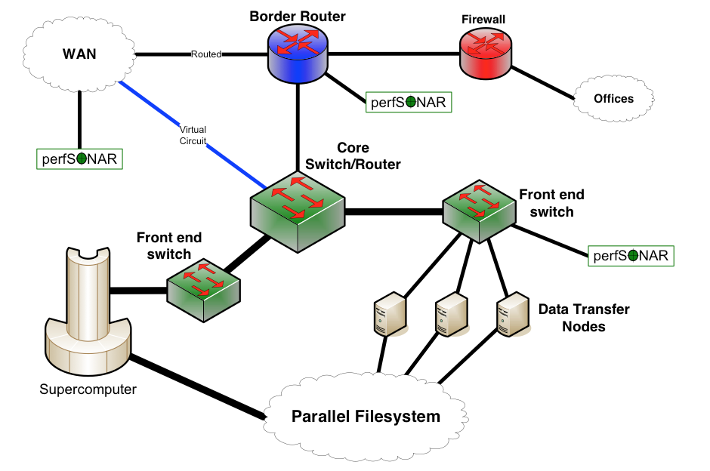
Large Facility (HPC, etc.)
© 2015, Energy Sciences Network

Slide 22
Non-R1 Campus
This paradigm is not just for the big guys – there is a lot of value for smaller institutions with a smaller number of users
Can be constructed with existing hardware, or small additions
  Does not need to be 100G, or even 10G. Capacity doesn’t matter – we want to eliminate friction and packet loss
  The best way to do this is to isolate the important traffic from the enterprise
Can be scoped to either the expected data volume of the science, or the availability of external facing resources (e.g. if your pipe to GPN is small – you don’t want a single user monopolizing it)
Factors:
  Are you comfortable with Layer 2 Networking?
  How rich is your cable/fiber plant?
  Can you create a dedicated facility for science?
© 2015, Energy Sciences Network

Slide 23
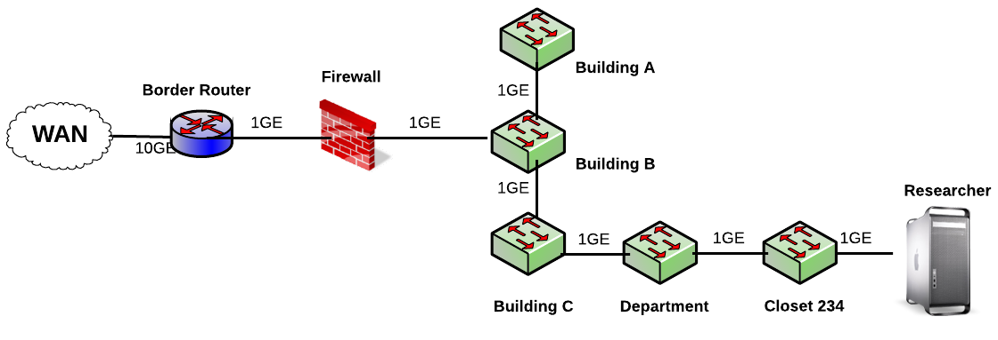
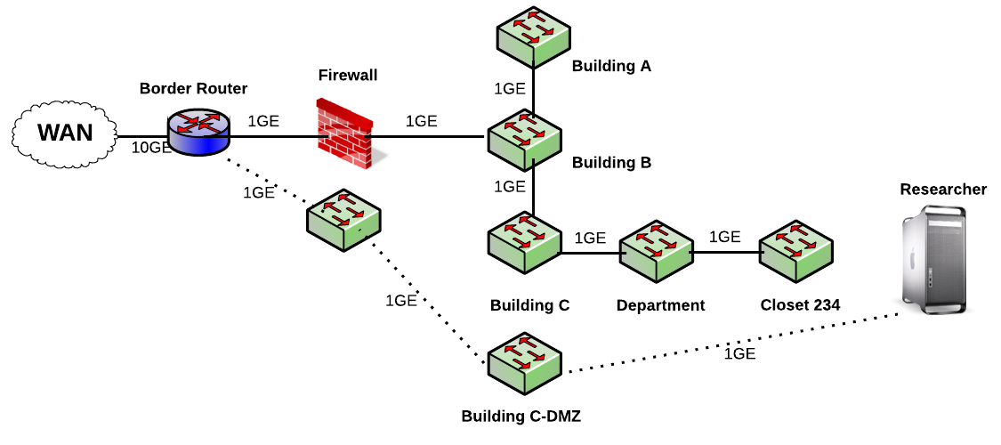
Non-R1 Campus
Fiber Rich Environment
© 2015, Energy Sciences Network

Slide 24
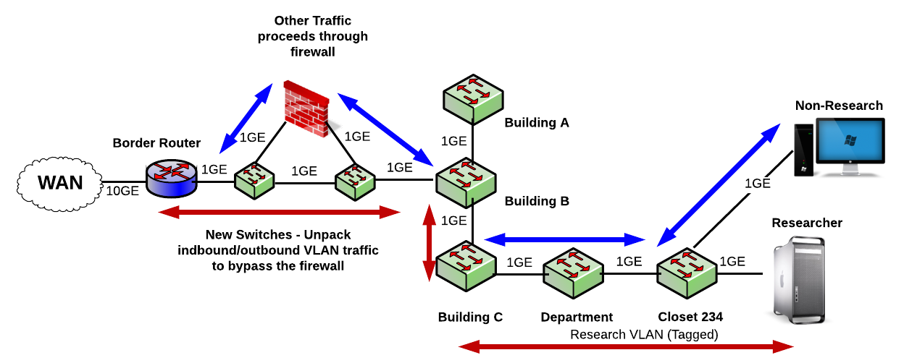
Non-R1 Campus
Layer 2 Switching
© 2015, Energy Sciences Network

Slide 25
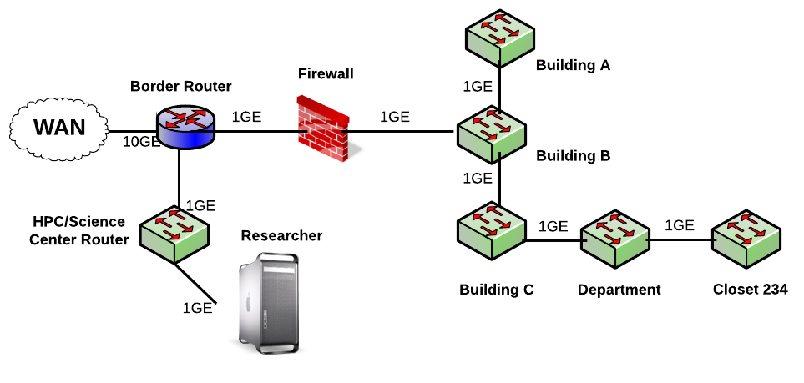
Non-R1 Campus
Single Facility
© 2015, Energy Sciences Network

Slide 26
Non-R1 Campus
Every campus will be different
  If you are not fiber rich, other choices may be needed.
  If the researchers don’t want to move to a dedicated facility, your options are also limited
  Have discussions – lay out what is possible and what is not
ROI Statements:
  Eliminate congestion where you can – the network path for the science user does not traverse the core -> better performance for her, and everyone else
  Improve the process of science – the next time they go for an NSF/DOE/NIST grant, they can say (with confidence) the network does what they need it to do
  Encourage others that are suffering in silence to seek you out. Once you have a success story, there will be others asking about it.
© 2015, Energy Sciences Network

Slide 27
Common Threads
Two common threads exist in all these examples
Accommodation of TCP
  Wide area portion of data transfers traverses purpose-built path
  High performance devices that don’t drop packets
Ability to test and verify
  When problems arise (and they always will), they can be solved if the infrastructure is built correctly
  Small device count makes it easier to find issues
  Multiple test and measurement hosts provide multiple views of the data path
    perfSONAR nodes at the site and in the WAN
    perfSONAR nodes at the remote site
© 2015, Energy Sciences Network

Slide 28
Overview
Science DMZ Motivation and Introduction
Science DMZ Architecture
Network Monitoring
Data Transfer Nodes & Applications
Science DMZ Security
User Engagement
Wrap Up
© 2015, Energy Sciences Network

Slide 29
Performance Monitoring
Everything may function perfectly when it is deployed
Eventually something is going to break
  Networks and systems are complex
  Bugs, mistakes, …
  Sometimes things just break – this is why we buy support contracts
Must be able to find and fix problems when they occur (even if they have been that way for a long time)
Must be able to find problems in other networks (your network may be fine, but someone else’s problem can impact your users)
TCP was intentionally designed to hide all transmission errors from the user:
  “As long as the TCPs continue to function properly and the internet system does not become completely partitioned, no transmission errors will affect the users.” (From RFC793, 1981)
© 2015, Energy Sciences Network
Notes:
Remember – TCP promises reliable data delivery, not performance
In order for scientists to see high-performance correct behavior consistently, network engineers must be able to find and fix problems quickly.
Waiting around for trouble tickets is clearly the wrong approach
Not all problems are immediately obvious – many are known as “soft failures”

Slide 30
Soft Network Failures – Hidden Problems
Hard failures are well-understood
  Link down, system crash, software crash
  Traditional network/system monitoring tools designed to quickly find hard failures
Soft failures result in degraded capability
  Connectivity exists
  Performance impacted
  Typically something in the path is functioning, but not well
Soft failures are hard to detect with traditional methods
  No obvious single event
  Sometimes no indication at all of any errors
Independent testing is the only way to reliably find soft failures
© 2015, Energy Sciences Network
Notes:
If something is down hard, it’s easy to find
Soft failures are often visible only from the end systems
This is what makes perfSONAR so valuable – it behaves as an end system behaves, but it measures what the network does
Remember – we want to find the problems BEFORE the users do

Slide 31
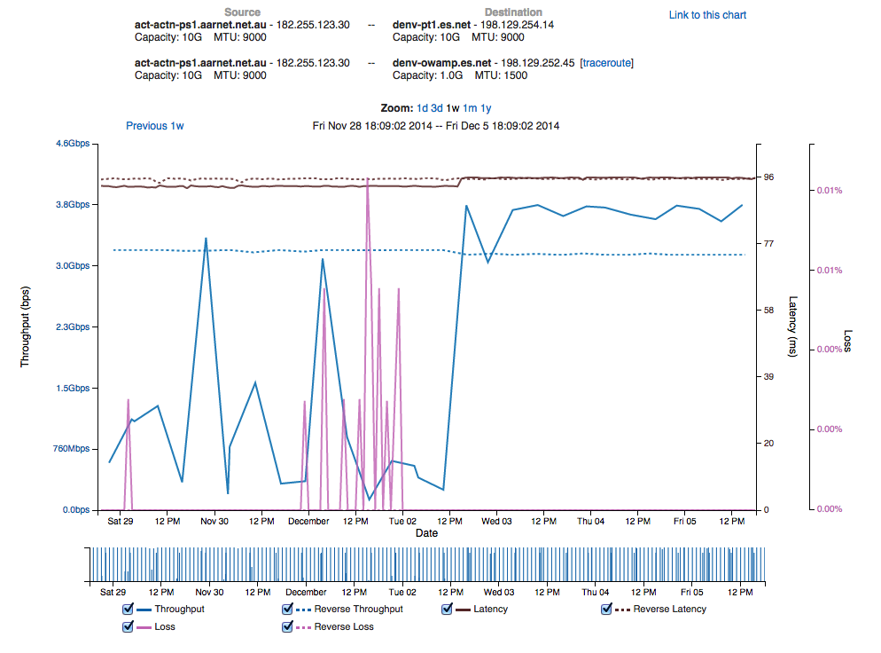
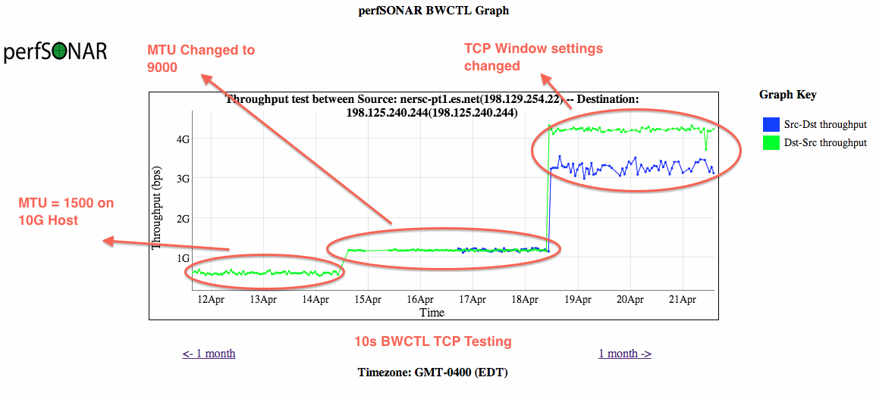
Sample Soft Failures
Peering moved from 10G link to 100G link
Latency change shows path change
Performance increases
Performance stabilizes
Experiments with host tuning (parallels DTN performance)
© 2015, Energy Sciences Network
Notes:
2 quick examples of soft failures:
The first of these was a Cisco 6509 that had over-filled its route table due to a misconfiguration, but the config had been fixed. The performance problem persisted until the router was rebooted. This could not have been found by auditing the configuration.
The second is a relatively common problem – in a big network there are a lot of pluggable optics packs, and sometimes they just go bad. Often they cause performance problems (soft failure) for a long time before they finally die (hard failure)

Slide 32

Testing Infrastructure – perfSONAR
perfSONAR is:
  A widely-deployed test and measurement infrastructure
    ESnet, Internet2, US regional networks, international networks
    Laboratories, supercomputer centers, universities
  A suite of test and measurement tools
  A collaboration that builds and maintains the toolkit
By installing perfSONAR, a site can leverage over 1300 test servers deployed around the world
perfSONAR is ideal for finding soft failures
  Alert to existence of problems
  Fault isolation
  Verification of correct operation
Open Source, widely supported by a number of stakeholder organizations
© 2015, Energy Sciences Network
Notes:
perfSONAR is the gold standard tool for performance testing, measurement, and interdomain troubleshooting in science networks

Slide 33
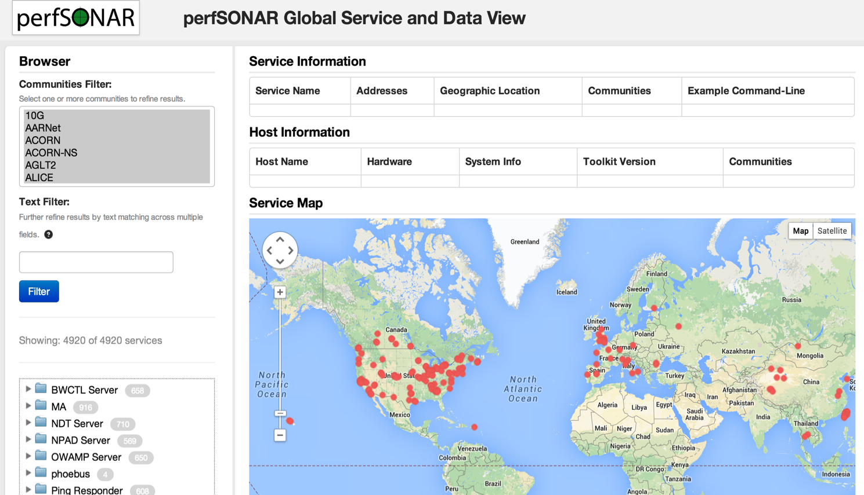
Lookup Service Directory Search: http://stats.es.net/ServicesDirectory/
© 2015, Energy Sciences Network
Notes:
How to find perfSONAR servers and services

Slide 34
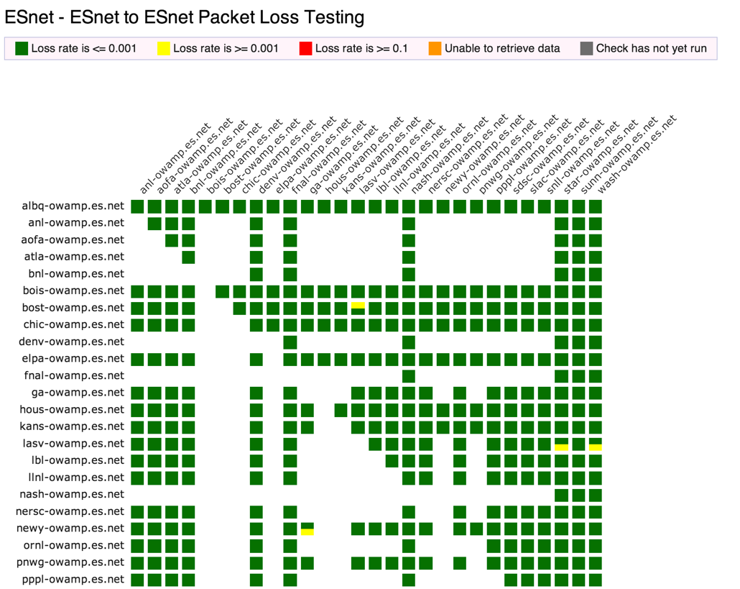
perfSONAR Dashboard: http://ps-dashboard.es.net
© 2015, Energy Sciences Network
Notes:
Integrating regular testing into a visualization (ESnet example).
Performance data is public
The tool can trigger alerts to notify NOC staff.
This is a very valuable tool for setting expectations

Slide 35
Overview
Science DMZ Motivation and Introduction
Science DMZ Architecture
Network Monitoring
Data Transfer Nodes & Applications
Science DMZ Security
User Engagement
Wrap Up
© 2015, Energy Sciences Network

Slide 36
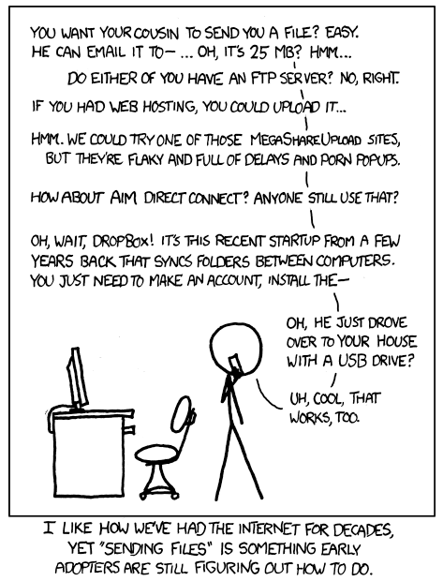
Dedicated Systems – Data Transfer Node
The DTN is dedicated to data transfer
Set up specifically for high-performance data movement
  System internals (BIOS, firmware, interrupts, etc.)
  Network stack
  Storage (global filesystem, Fibrechannel, local RAID, etc.)
  High performance tools
  No extraneous software
Limitation of scope and function is powerful
  No conflicts with configuration for other tasks
  Small application set makes cybersecurity easier
© 2015, Energy Sciences Network
Notes:
All aspects of the DTN must be tuned – even the BIOS matters
Limit the scope of the DTN as well – its job is data movement, its job is not to have office software on it.
Craft a specific security profile/policy around its only task.

Slide 37

Data Transfer Tool Comparison
In addition to the network, using the right data transfer tool is critical
Data transfer test from Berkeley, CA to Argonne, IL (near Chicago). RTT = 53 ms, network capacity = 10Gbps.
    Tool Throughput
    scp: 140 Mbps
    HPN patched scp: 1.2 Gbps
    ftp 1.4 Gbps
    GridFTP, 4 streams 5.4 Gbps
    GridFTP, 8 streams 6.6 Gbps
    Note that to get more than 1 Gbps (125 MB/s) disk to disk requires properly engineered storage (RAID, parallel filesystem, etc.)
© 2015, Energy Sciences Network
Notes:
Comparison of legacy and recommended tools.
Note that rsync over HPN-SSH is reasonable in a 1Gbps environment – if you are stuck with rsync over SSH, at least use HPN-SSH.
Globus is now deployed at a large number of major scientific sites – the basic data transfer functionality is free.
=-=-=-
Parallelism is important
It is often easier to achieve a given performance level with four parallel connections than one connection
Several tools offer parallel transfers, including Globus/GridFTP
Latency interaction is critical
Wide area data transfers have much higher latency than LAN transfers
Many tools and protocols assume a LAN
Workflow integration is important
Key tools: Globus Online, HPN-SSH

Slide 38
Overview
Science DMZ Motivation and Introduction
Science DMZ Architecture
Network Monitoring
Data Transfer Nodes & Applications
Science DMZ Security
User Engagement
Wrap Up
© 2015, Energy Sciences Network

Slide 39

Science DMZ Security
Goal – disentangle security policy and enforcement for science flows from security for business systems
Rationale
  Science data traffic is simple from a security perspective
  Narrow application set on Science DMZ
    Data transfer, data streaming packages
    No printers, document readers, web browsers, building control systems, financial databases, staff desktops, etc.
  Security controls that are typically implemented to protect business resources often cause performance problems
Separation allows each to be optimized
© 2015, Energy Sciences Network

Slide 40
Performance Is A Core Requirement
Core information security principles
  Confidentiality, Integrity, Availability (CIA)
  Often, CIA and risk mitigation result in poor performance
In data-intensive science, performance is an additional core mission requirement: CIA → PICA
  CIA principles are important, but if performance is compromised the science mission fails
  Not about “how much” security you have, but how the security is implemented
  Need a way to appropriately secure systems without performance compromises
Collaboration Within The Organization
  All parties (users, operators, security, administration) needs to sign off up this idea – revolutionary vs. evolutionary change.
  Make sure everyone understands the ROI potential.
© 2015, Energy Sciences Network
Notes:
You can still have really tight security if you need really tight security – just do it in a way that does not cause performance problems for traffic permitted by policy
Collaboration Within The Organization

Slide 41
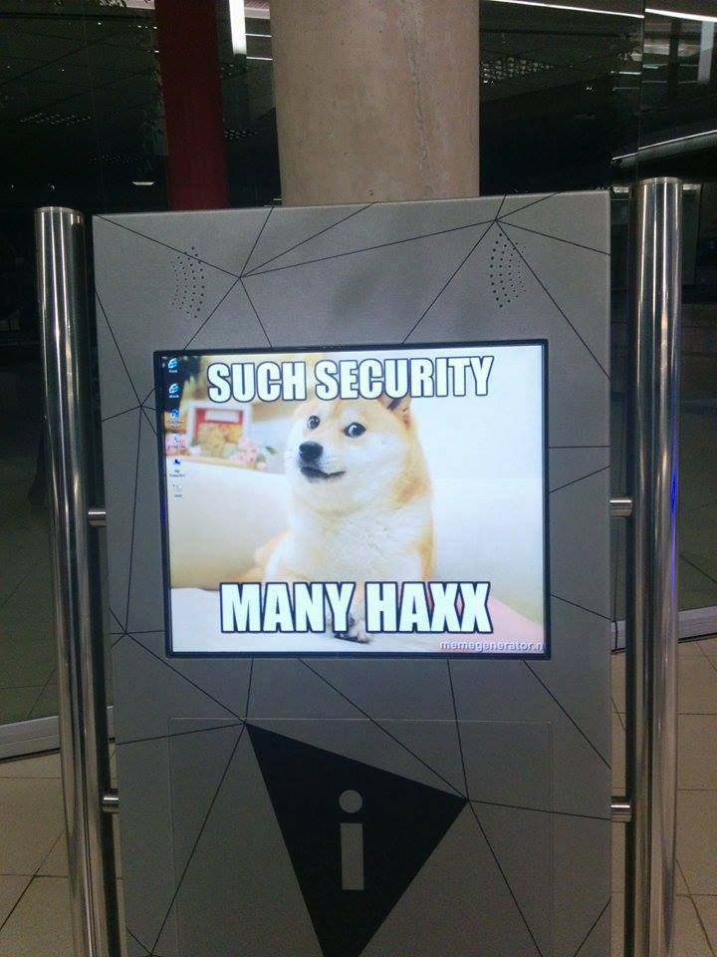
Security Without Firewalls
Data intensive science traffic interacts poorly with firewalls
Does this mean we ignore security? NO!
  We must protect our systems
  We just need to find a way to do security that does not prevent us from getting the science done
Key point – security policies and mechanisms that protect the Science DMZ should be implemented so that they do not compromise performance
Traffic permitted by policy should not experience performance impact as a result of the application of policy
© 2015, Energy Sciences Network

Slide 42
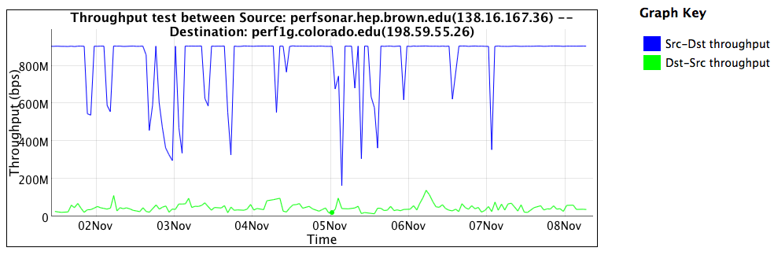
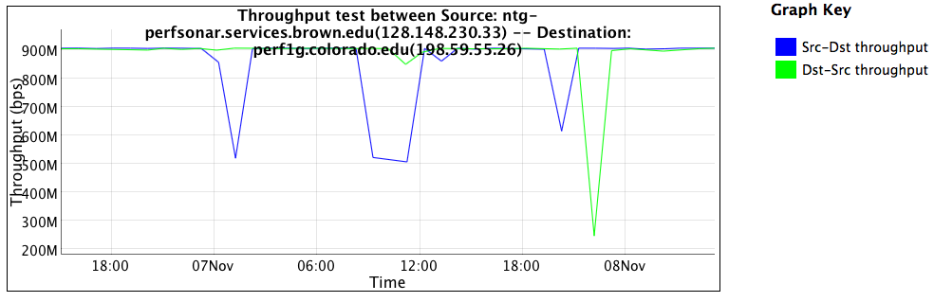
Firewall Performance Example
Observed performance, via perfSONAR, through a firewall:
Observed performance, via perfSONAR, bypassing firewall:
Almost 20 times slower through the firewall
Huge improvement without the firewall
© 2015, Energy Sciences Network
Notes:
Real life example, in front of and in back of a firewall that was dramatically impacting performance
perfSONAR is good at finding these issues
Engineers still have to take action to fix the problem

Slide 43
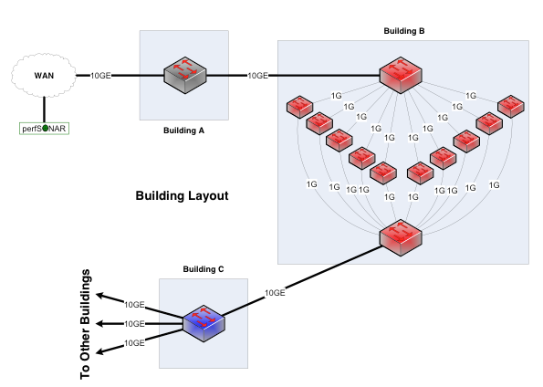
“Why Does it Do That?”
Consider a network between three buildings – A, B, and C
  This is supposedly a 10Gbps network end to end (look at the links on the buildings)
  Building A houses the border router – not much goes on there except the external connectivity
  Lots of work happens in building B – so much so that the processing is done with multiple processors to spread the load in an affordable way, and aggregate the results after
  Building C is where we branch out to other buildings
Every link between buildings is 10Gbps – this is a 10Gbps network, right???
© 2015, Energy Sciences Network

Slide 44
Clearly Not A 10Gbps Network
If you look at the inside of Building B, it is obvious from a network engineering perspective that this is not a 10Gbps network
  Clearly the maximum per-flow data rate is 1Gbps, not 10Gbps
  However, if you convert the buildings into network elements while keeping their internals intact, you get routers and firewalls
  What firewall did the organization buy? What’s inside it?
  Those little 1G “switches” are firewall processors
This parallel firewall architecture has been in use for years
  Slower processors are cheaper
  Typically fine for a commodity traffic load
  Therefore, this design is cost competitive and common
This mangles TCP (see results from perfSONAR).
  Packets are forced out of order
  Delay occurs as we queue for access to a processor (even just to verify state and continue on)
  Delay and ordering matter to TCP – all flows are reduced. The larger ones just feel it more
© 2015, Energy Sciences Network

Slide 45
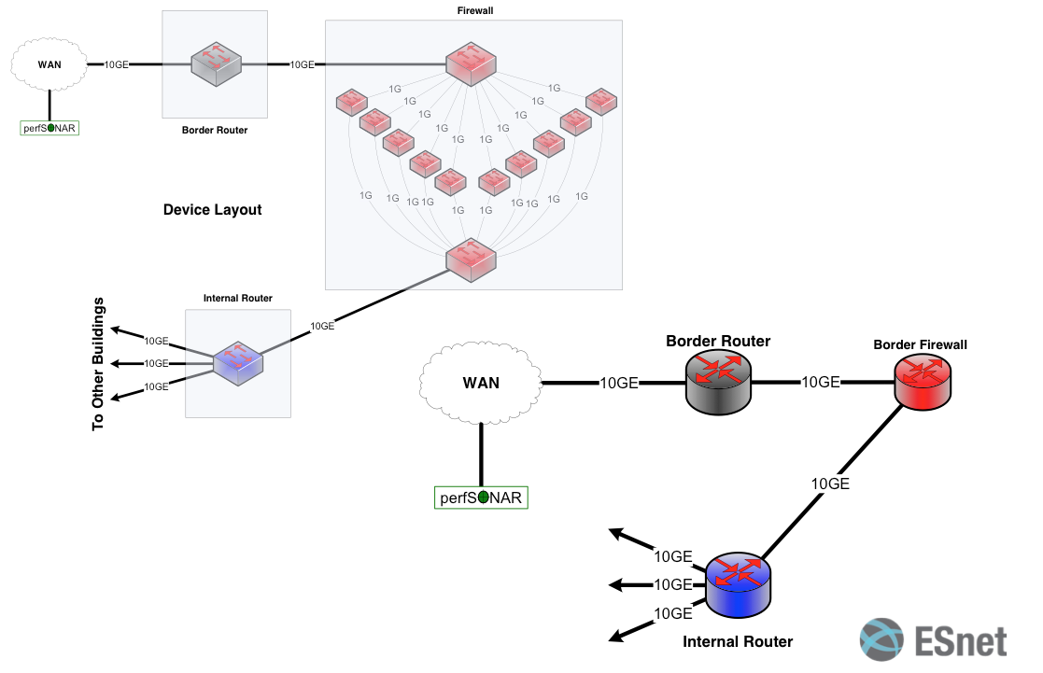
Notional 10G Network Between Devices
© 2015, Energy Sciences Network
Notes:
This parallel firewall architecture has been in use for years
Slower processors are cheaper
Typically fine for a commodity traffic load
Therefore, this design is cost competitive and common

Slide 46
What’s Inside Your Firewall?
“But wait – we don’t do this anymore!”
  It is true that vendors are working toward line-rate 10G firewalls, and some may even have them now
  10GE has been deployed in science environments for over 10 years
  Firewall internals have only recently started to catch up with the 10G world
  100GE is being deployed now, 40Gbps host interfaces are available now
  Firewalls are behind again
In general, IT shops want to get 5+ years out of a firewall purchase
  This often means that the firewall is years behind the technology curve
  Whatever you deploy now, that’s the hardware feature set you get
  When a new science project tries to deploy data-intensive resources, they get whatever feature set was purchased several years ago
© 2015, Energy Sciences Network

Slide 47
Overview
Science DMZ Motivation and Introduction
Science DMZ Architecture
Network Monitoring
Data Transfer Nodes & Applications
Science DMZ Security
User Engagement
Wrap Up
© 2015, Energy Sciences Network

Slide 48
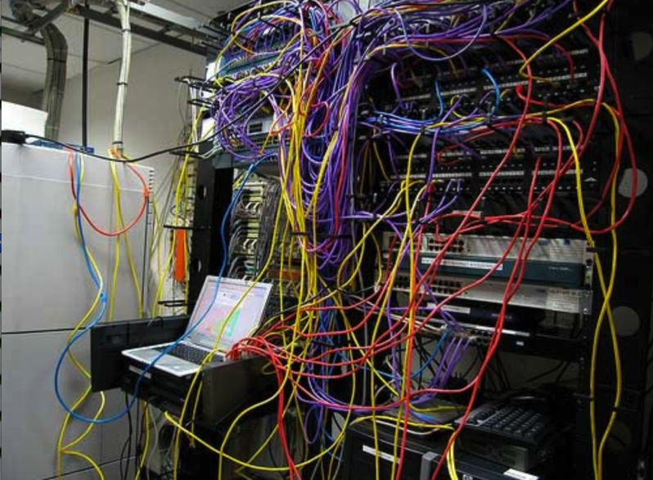
Challenges to Network Adoption
Causes of performance issues are complicated for users.
Lack of communication and collaboration between the CIO’s office and researchers on campus.
Lack of IT expertise within a science collaboration or experimental facility
User’s performance expectations are low (“The network is too slow”, “I tried it and it didn’t work”).
Cultural change is hard (“we’ve always shipped disks!”).
Scientists want to do science not IT support
The Capability Gap
© 2015, Energy Sciences Network
Notes:
The struggle in engagement – management, engineering, and users often have dug in on bad behavior.
This amounts a capability gap – there is a disconnect from the capabilities of the network and the ability of the scientists to effectively use it
To fix this, we need to get everyone working toward a common goal:
- Management must fund and support the base needs of research
- IT is there to support the users in doing things correctly, and having all components work

Slide 49
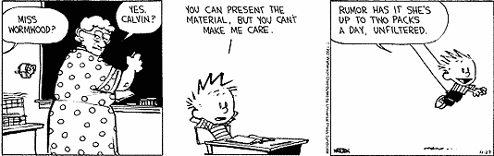
Bridging the Gap
Implementing technology is ‘easy’ in the grand scheme of assisting with science
Adoption of technology is different
  Does your cosmologist care what SDN is?
  Does your cosmologist want to get data from Chile each night so that they can start the next day without having to struggle with the tyranny of ineffective data movement strategies that involve airplanes and white/brown trucks?
© 2015, Energy Sciences Network

Slide 50
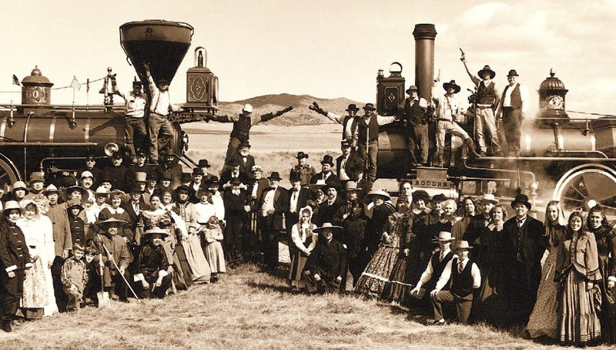
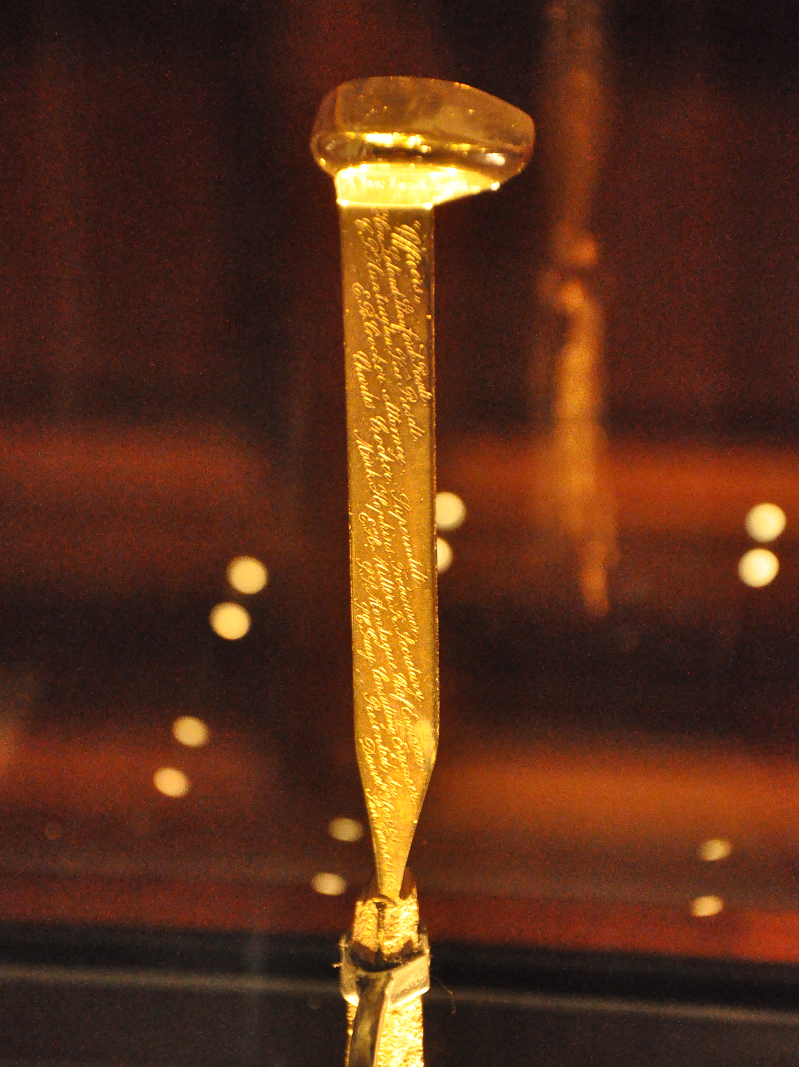
The Golden Spike
We don’t want Scientists to have to build their own networks
Engineers don’t have to understand what a tokomak accomplishes
Meeting in the middle is the process of science engagement:
  Engineering staff learning enough about the process of science to be helpful in how to adopt technology
  Science staff having an open mind to better use what is out there
© 2015, Energy Sciences Network

Slide 51
Overview
Science DMZ Motivation and Introduction
Science DMZ Architecture
Network Monitoring
Data Transfer Nodes & Applications
On the Topic of Security
User Engagement
Wrap Up
© 2015, Energy Sciences Network

Slide 52
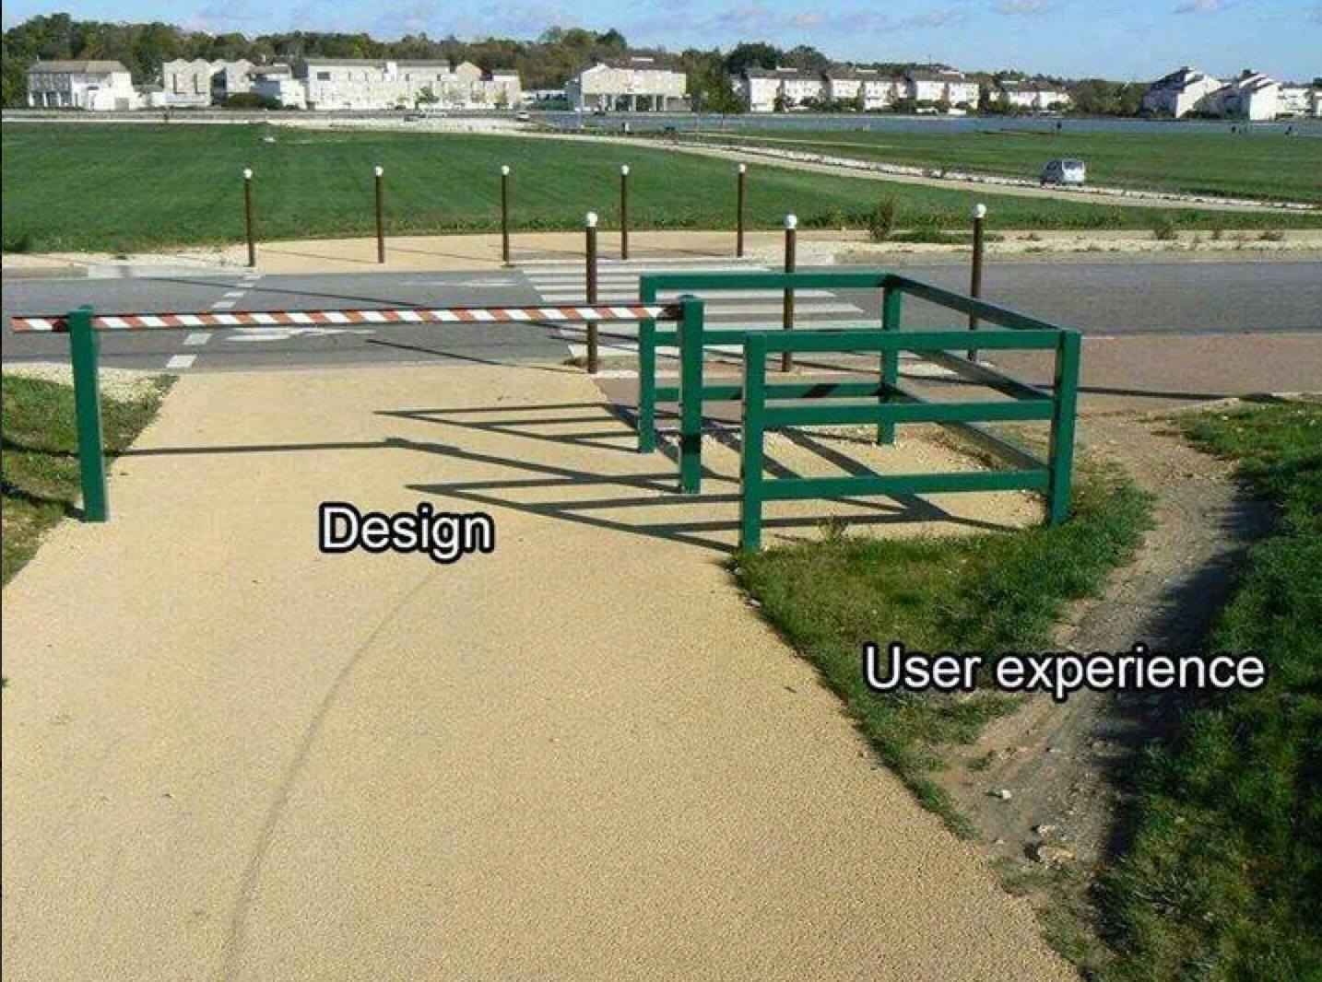
Why Build A Science DMZ Though?
What we know about scientific network use:
  Machine size decreasing, accuracy increasing
  HPC resources more widely available – and potentially distributed from where the scientists are
  WAN networking speeds now at 100G, MAN approaching, LAN as well
Value Proposition:
  If scientists can’t use the network to the fullest potential due to local policy constraints or bottlenecks – they will find a way to get their done outside of what is available.
Without a Science DMZ, this stuff is all hard
  “No one will use it”. Maybe today, what about tomorrow?
  “We don’t have these demands currently”. Next gen technology is always a day away

Slide 53
Wrapup
The Science DMZ design pattern provides a flexible model for supporting high-performance data transfers and workflows
Key elements:
  Accommodation of TCP
    Sufficient bandwidth to avoid congestion
    Loss-free IP service
  Location – near the site perimeter if possible
  Test and measurement
  Dedicated systems
  Appropriate security
Support for advanced capabilities (e.g. SDN) is much easier with a Science DMZ
© 2015, Energy Sciences Network

Slide 54
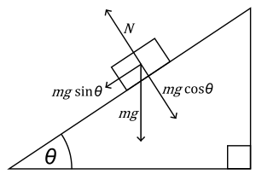

The Science DMZ in 1 Slide
Consists of four key components, all required:
“Friction free” network path
  Highly capable network devices (wire-speed, deep queues)
  Virtual circuit connectivity option
  Security policy and enforcement specific to science workflows
  Located at or near site perimeter if possible
Dedicated, high-performance Data Transfer Nodes (DTNs)
  Hardware, operating system, libraries all optimized for transfer
  Includes optimized data transfer tools such as Globus Online and GridFTP
Performance measurement/test node
  perfSONAR
Engagement with end users
  Details at http://fasterdata.es.net/science-dmz/
© 2013 Wikipedia
© 2015, Energy Sciences Network
Notes:
Single slide summary

Slide 55
Links
  ESnet fasterdata knowledge base
    http://fasterdata.es.net/
  Science DMZ paper
    http://www.es.net/assets/pubs_presos/sc13sciDMZ-final.pdf
  Science DMZ email list
    Send mail to sympa@lists.lbl.gov with the subject "subscribe esnet-sciencedmz”
  Fasterdata Events (Workshop, Webinar, etc. announcements)
    Send mail to sympa@lists.lbl.gov with the subject "subscribe esnet-fasterdata-events”
  perfSONAR
    http://fasterdata.es.net/performance-testing/perfsonar/
    http://www.perfsonar.net
© 2015, Energy Sciences Network

Slide 56
  engage@es.net
  Ask us anything:
  Implementing CC-IIE/CC-DNI
  Deploying perfSONAR
  Debugging a problem
  Attending a training event
  Designing a network
© 2015, Energy Sciences Network

Slide 57
Thanks!
Jason Zurawski – zurawski@es.net
Science Engagement Engineer, ESnet
Lawrence Berkeley National Laboratory
ENhancing CyberInfrastructure by Training and Engagement (ENCITE) Webinar
April 3rd 2015

