Slide 1
Improving Scientific Outcomes at the APS with a Science DMZ
Jason Zurawski – zurawski@es.net
Science Engagement Engineer, ESnet
Lawrence Berkeley National Laboratory
GlobusWorld 2015
April 15th, 2015

Slide 2
Outline
Background
Current Network
Pilot Network
Future Work
© 2015, Energy Sciences Network

Slide 3
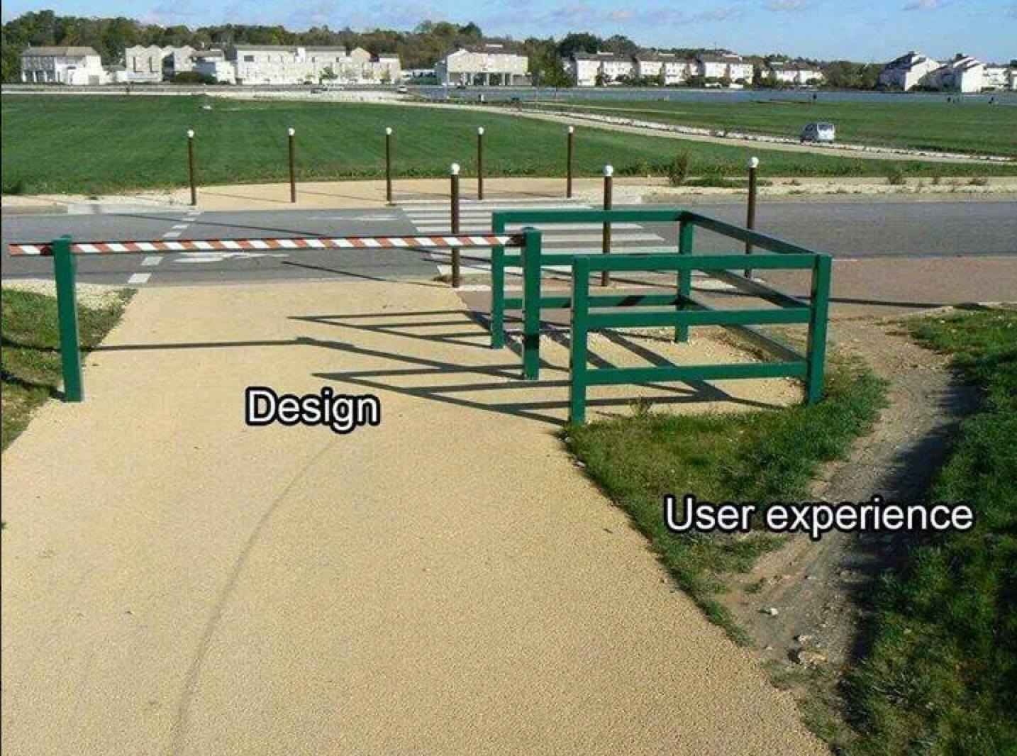
Why Build A Science DMZ Though?
What we know about scientific network use:
  Machine size decreasing, accuracy increasing
  HPC resources more widely available – and potentially distributed from where the scientists are
  WAN networking speeds now at 100G, MAN approaching, LAN as well
Value Proposition:
  If scientists can’t use the network to the fullest potential due to local policy constraints or bottlenecks – they will find a way to get their done outside of what is available.
Without a Science DMZ, this stuff is all hard
© 2015, Energy Sciences Network

Slide 4
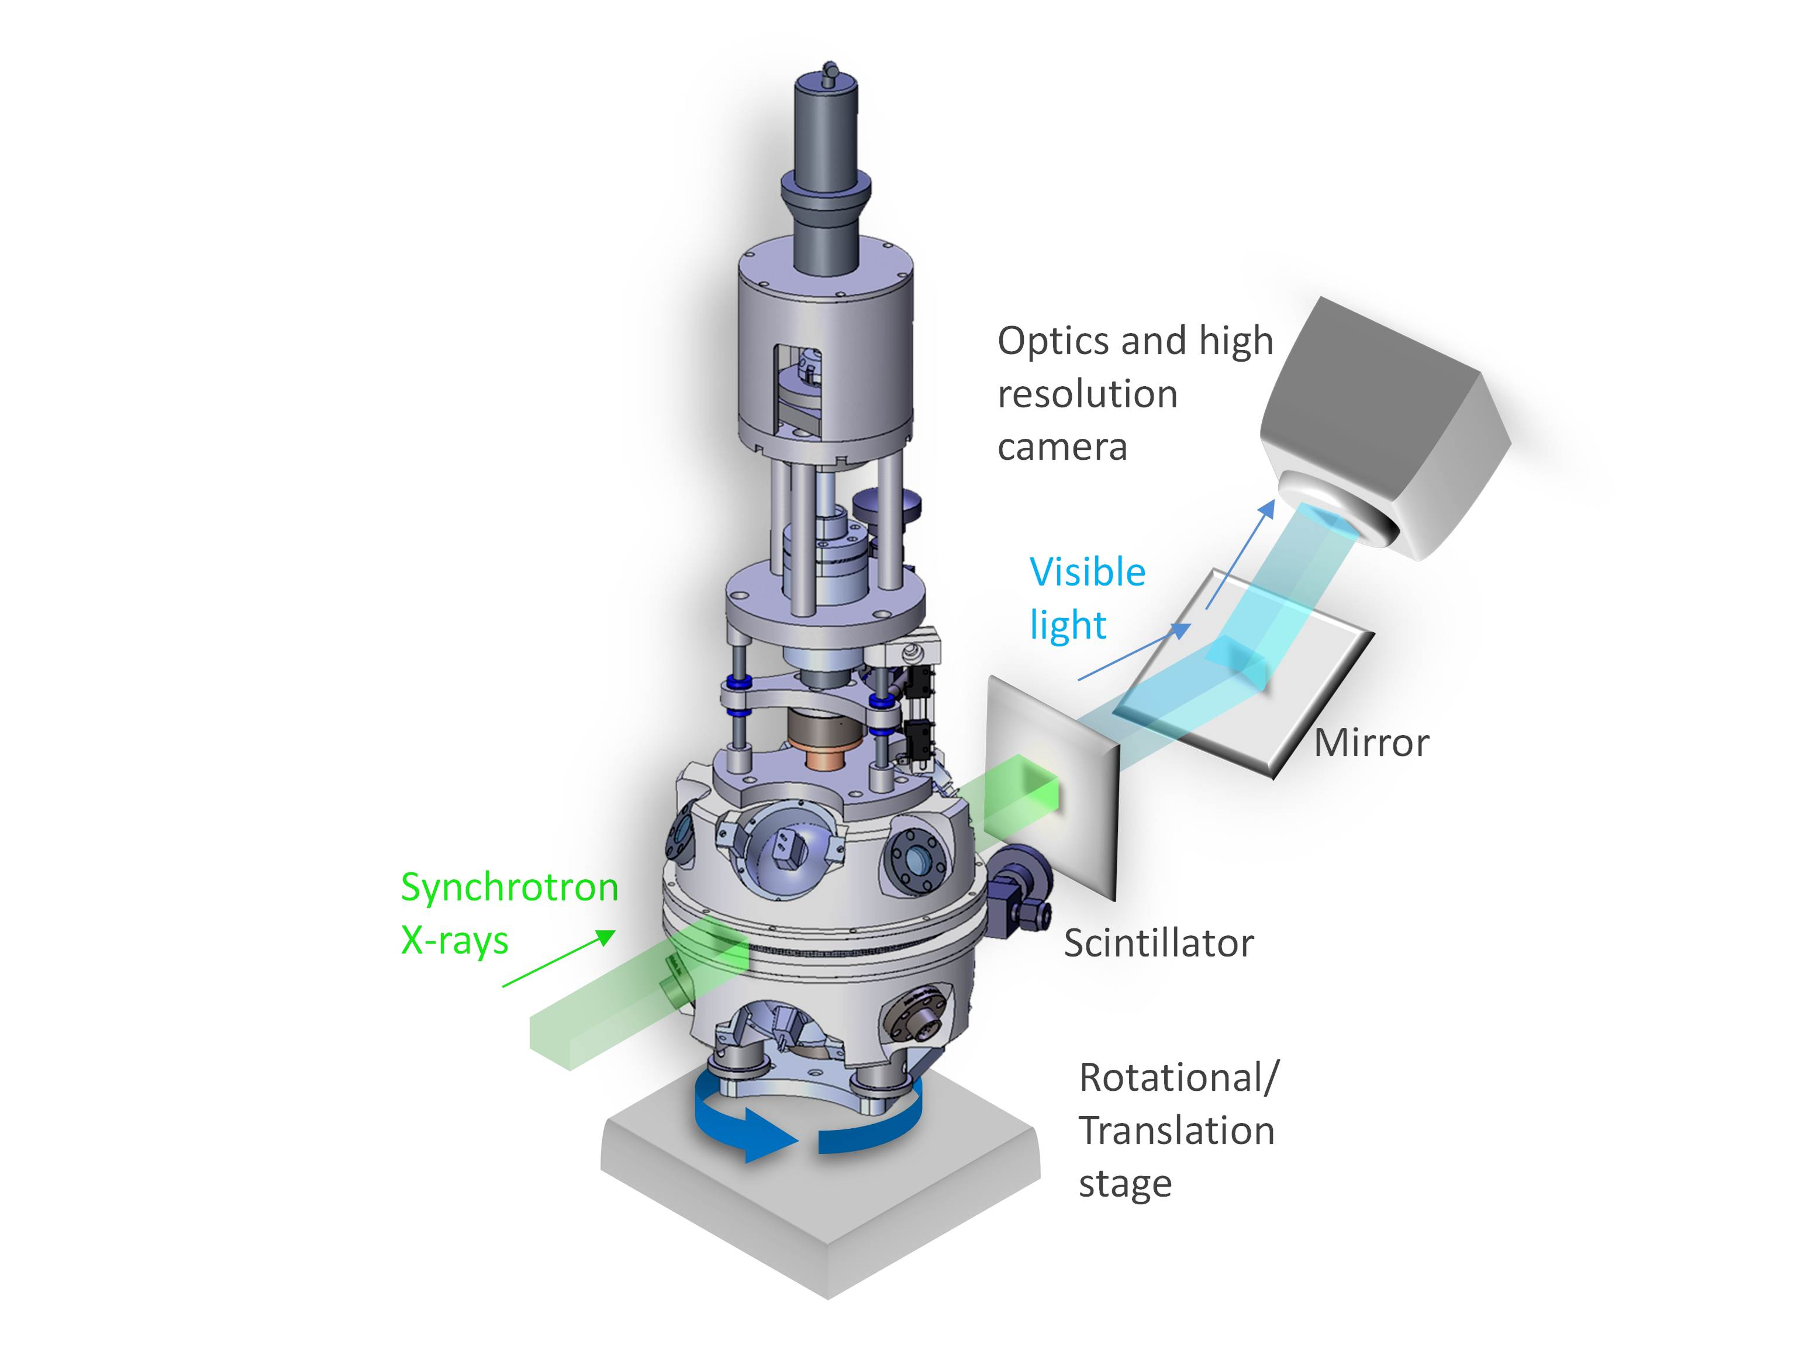
GM/CA
General Medical Sciences and Cancer Institutes Structural Biology Facility @ APS
  Focused on the study of crystallographic structure determination of biological macromolecules by X-ray diffraction
Typical User:
  Visits and spends some allocated time with samples and the beamline machinery
  Mails samples, controls device remotely
  In either case – data has to go ‘somewhere’
© 2015, Energy Sciences Network

Slide 5

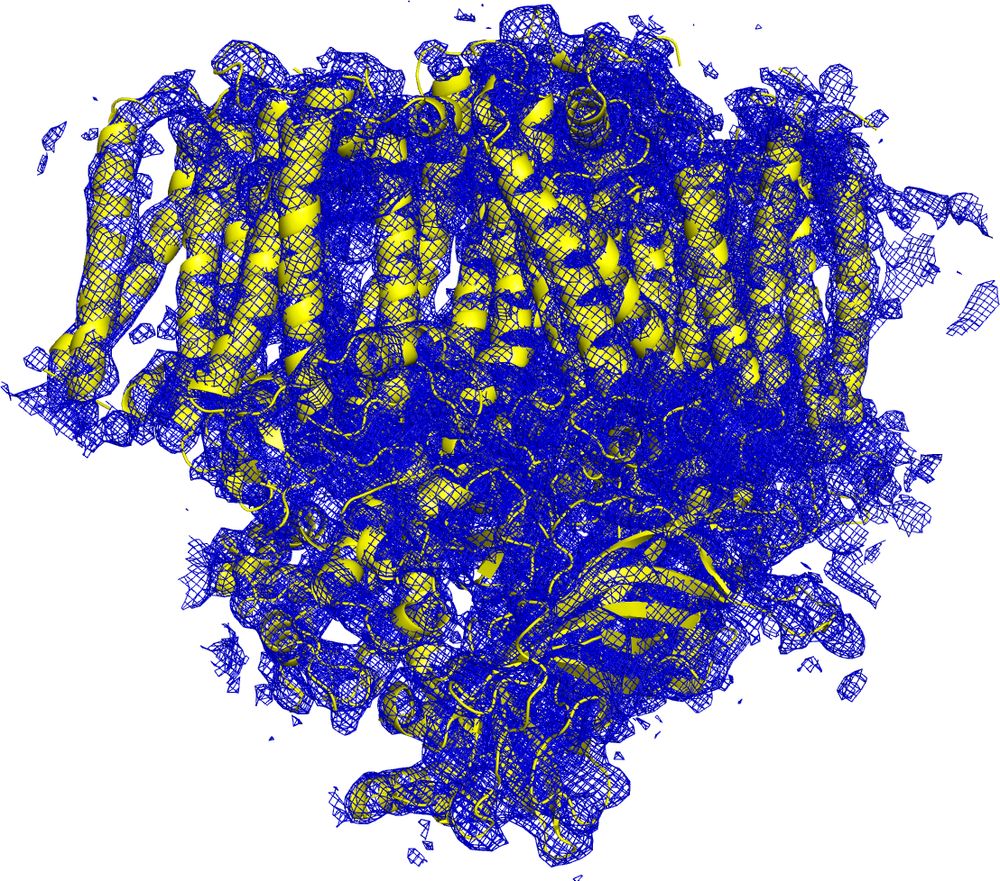
E Pluribus Unum
Processing on this order of magnitude can’t be done locally – we need to send (over a network) to a more capable facility
Hundreds to thousands of images are created in a few hours…they can range in size from MB to TB
After processing on a supercomputer, models are created.
© 2015, Energy Sciences Network

Slide 6
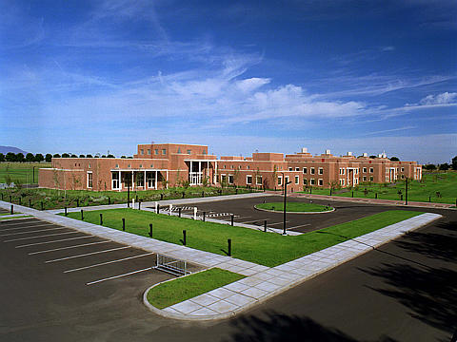
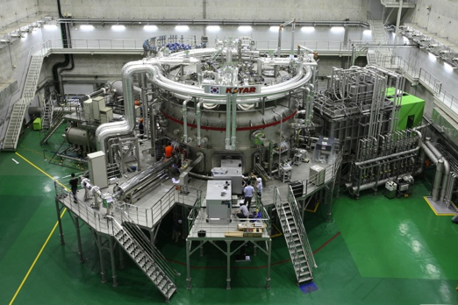
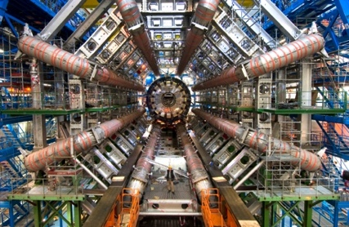
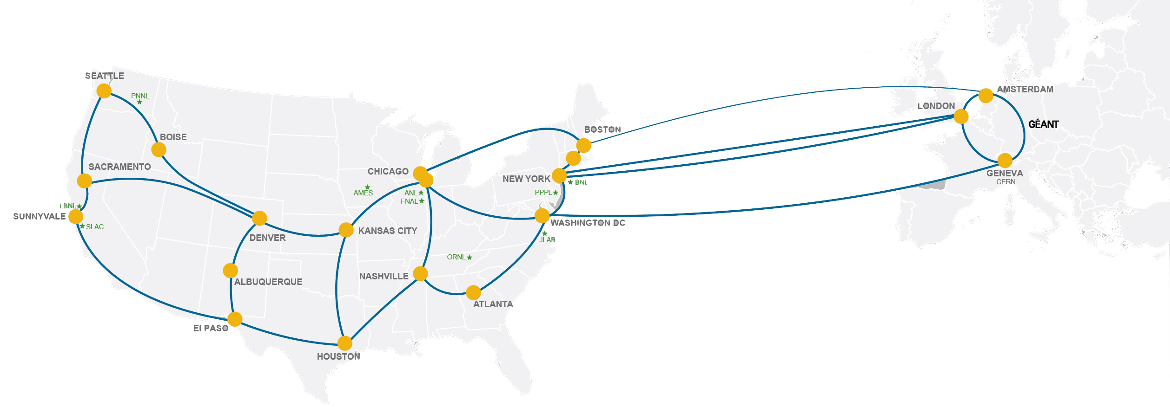
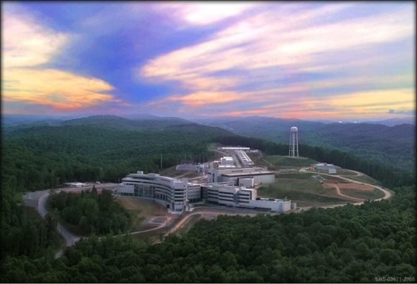
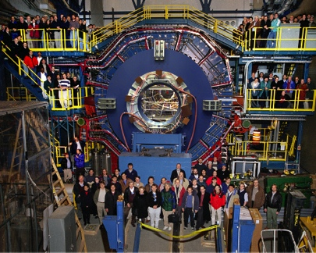
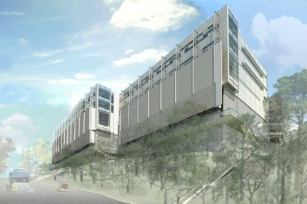
Network as Infrastructure Instrument
    ESnet Vision: Scientific progress will be completely unconstrained by the physical location of instruments, people, computational resources, or data.
© 2015, Energy Sciences Network
Notes:
Summing up ESnet’s vision in one slide, one phrase…
Physical location of instruments, people, computational resources, data. It just should not matter.
[KSTAR, SNS, ATLAS, EMSL, CRT/NERSC, STAR Detector at RHIC [BNL, NP-funded]]

Slide 7
Outline
Background
Current Network
Pilot Network
Future Work
© 2015, Energy Sciences Network

Slide 8
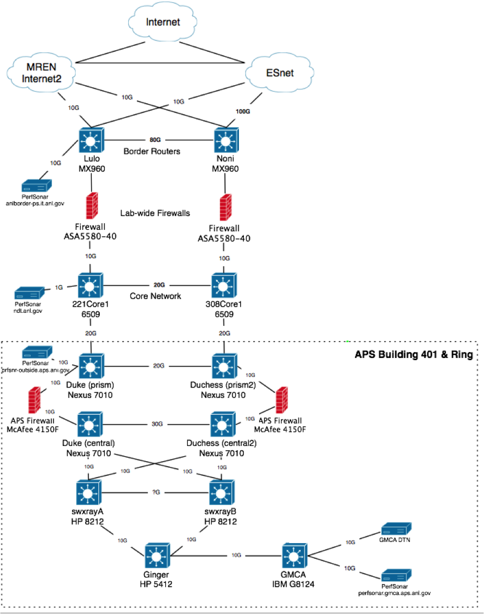
Current Design

Slide 9
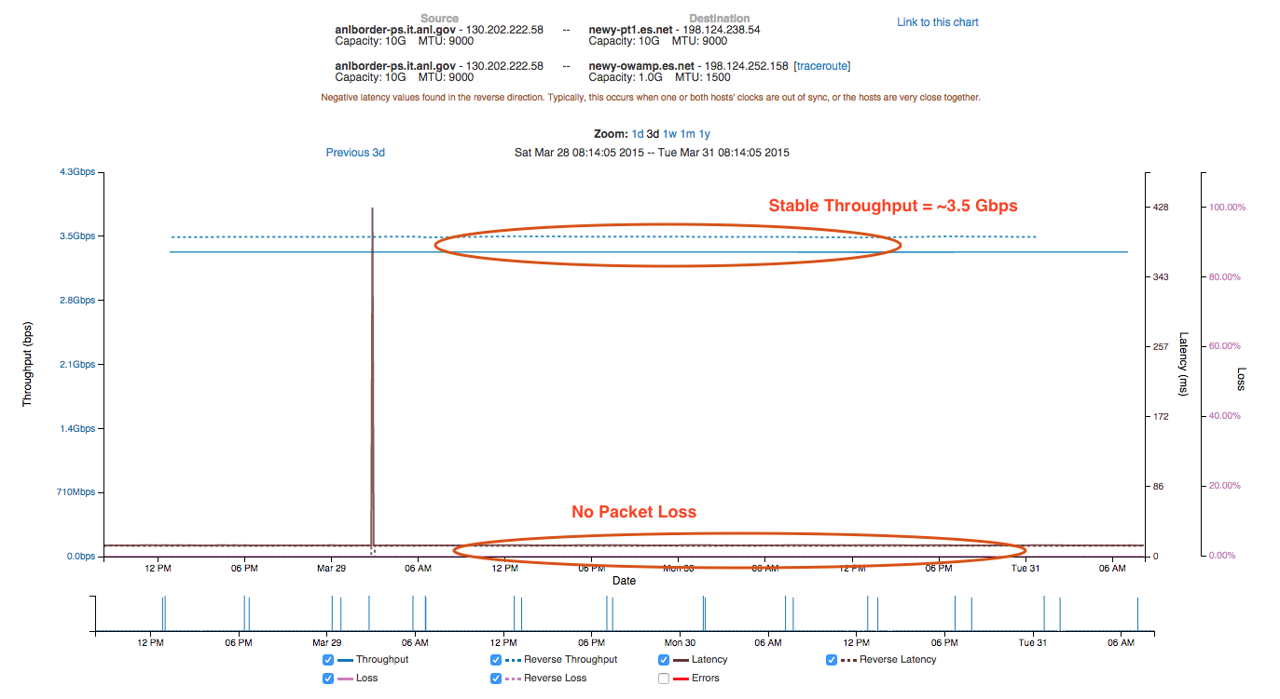
ANL Border to ESnet New York (perfSONAR Test)
© 2015, Energy Sciences Network

Slide 10
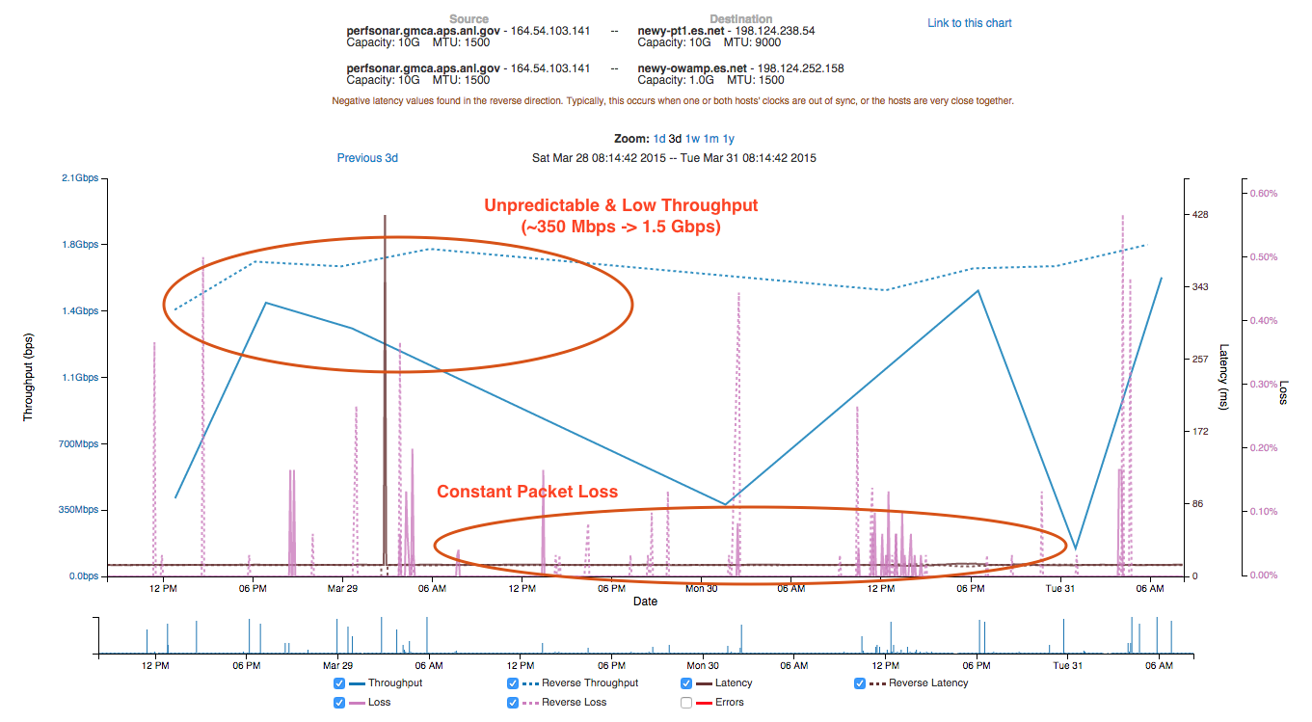
GM/CA to ESnet New York (perfSONAR Test)
© 2015, Energy Sciences Network

Slide 11
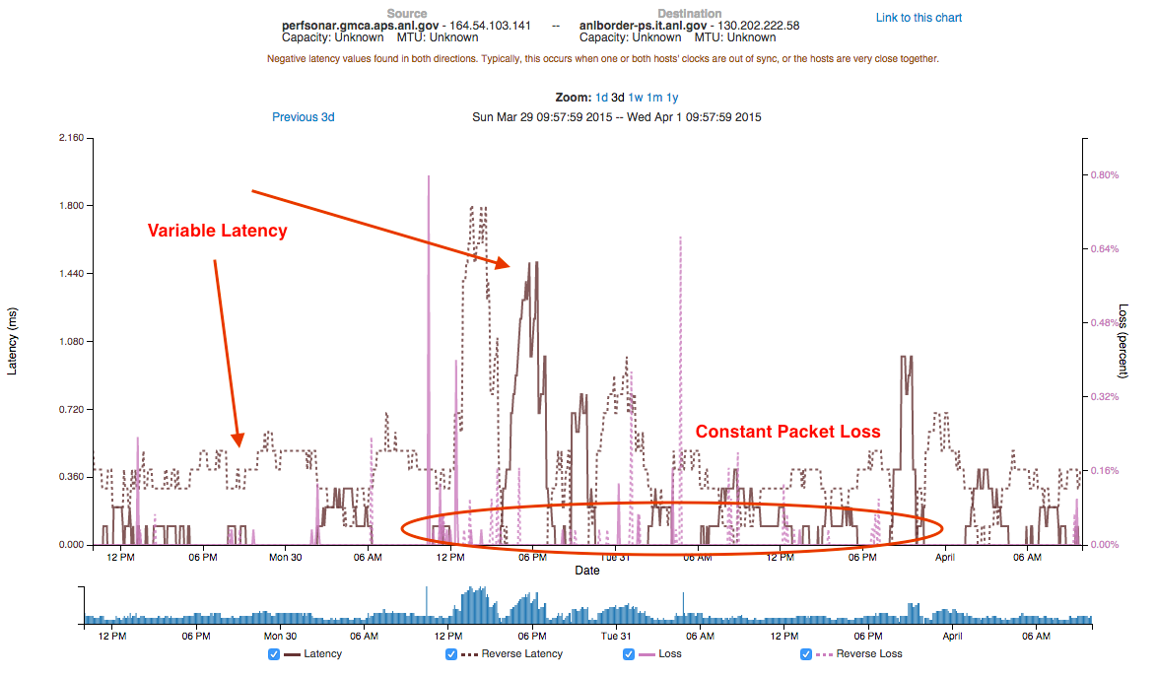
GM/CA to ANL Border (perfSONAR Test)
© 2015, Energy Sciences Network

Slide 12
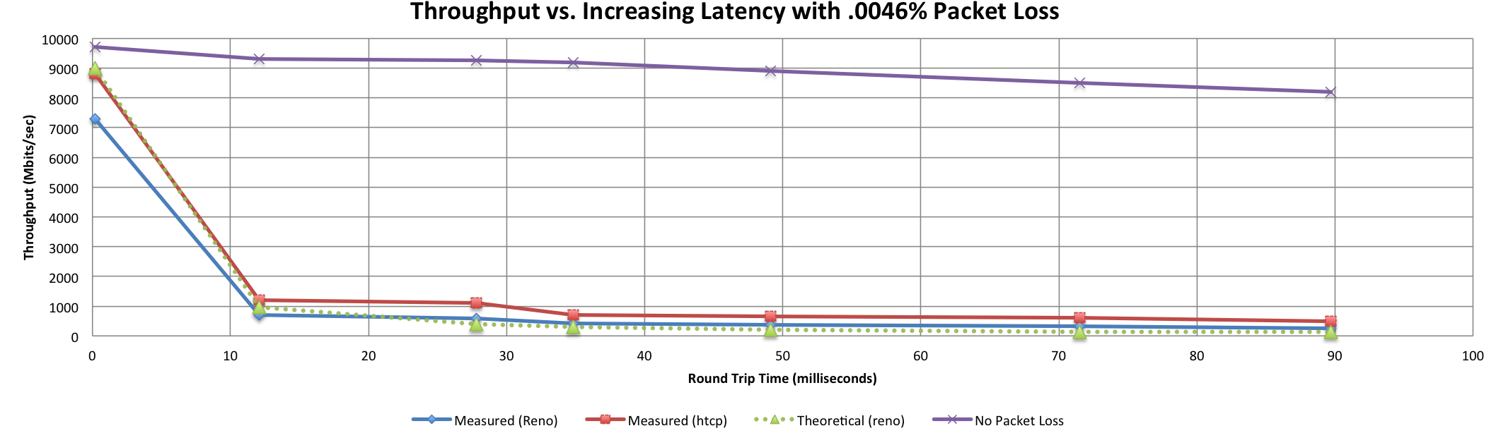

A small amount of packet loss makes a huge difference in TCP performance
Local
(LAN)
With loss, high performance beyond metro distances is essentially impossible
International
Metro Area
Regional
Continental
Measured (TCP Reno)
Measured (HTCP)
Theoretical (TCP Reno)
Measured (no loss)
© 2015, Energy Sciences Network
Notes:
This is an annotated version of the plot from the Science DMZ paper
Beyond your metro area, zero loss is essentially required for high performance
Where are your collaborators? Where are your users?
When global collaboration is the norm, nobody can afford to be a local-only resource

Slide 13
Globus Results
GM/CA Downloading from:
  ESnet ANL (~2ms)
    Average: 285 Mbps
    Max: 360 Mbps
  ESnet BNL (~30ms)
    Average: 26 Mbps
    Max: 28 Mbps
  ESnet LBL (~50ms)
    Average: 16 Mbps
    Max: 17 Mbps
GM/CA Downloading from:
  ESnet CERN (~110ms)
    Average: 7 Mbps
    Max: 8 Mbps
  NERSC HPSS (~50ms)
    Average: 127 Mbps
    Max: 134 Mbps
GM/CA Uploading to:
  NERSC HPSS (~50ms)
    Average: 112 Mbps
    Max: 142 Mbps
© 2015, Energy Sciences Network

Slide 14
Outline
Background
Current Network
Pilot Network
Future Work
© 2015, Energy Sciences Network

Slide 15
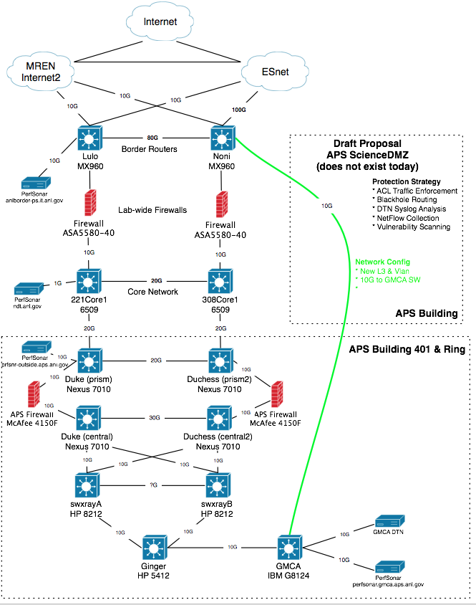
Pilot Network
Plan:
  Use campus and building fiber resources for 2nd path
  Applies to only a limited set of resources (perfSONAR, DTN)
Benefits
  Bypass congested local infrastructure
  Apply targeted (vs. blanket) security policy
Cautions:
  Prevent just ‘anything’ from using fast path – policy to control this
  Still need to figure out cause of local issues (e.g. this isn’t a pave over)
© 2015, Energy Sciences Network

Slide 16
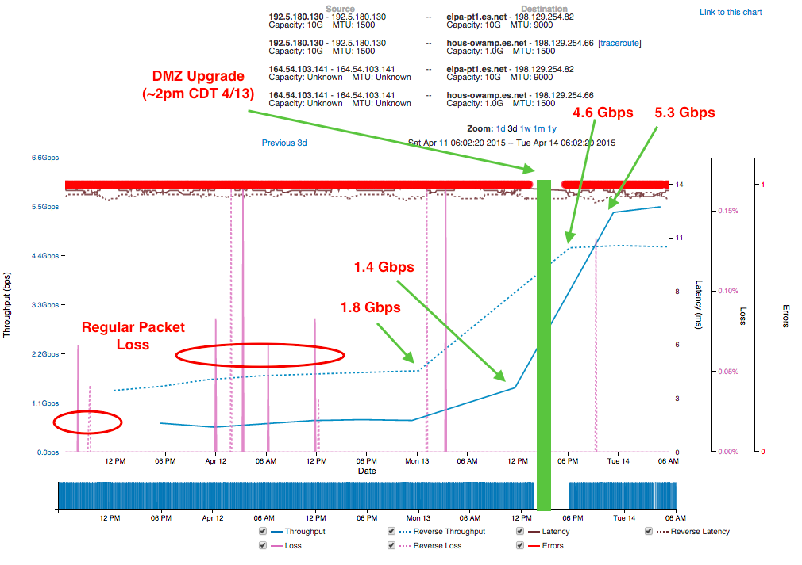
Results (as of 2pm CDT on April 13th)
© 2015, Energy Sciences Network

Slide 17
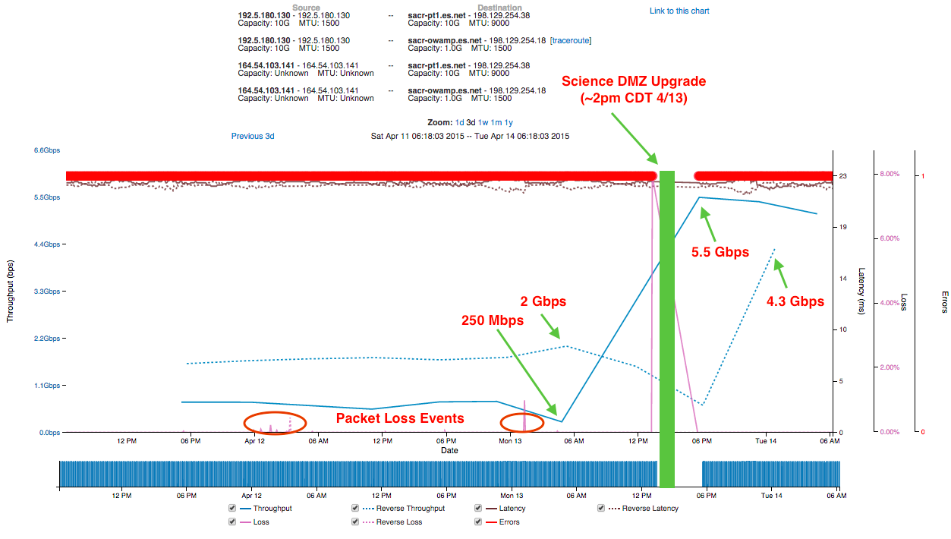
Results (as of 2pm CDT on April 13th)
© 2015, Energy Sciences Network

Slide 18
Outline
Background
Current Network
Pilot Network
Future Work
© 2015, Energy Sciences Network

Slide 19
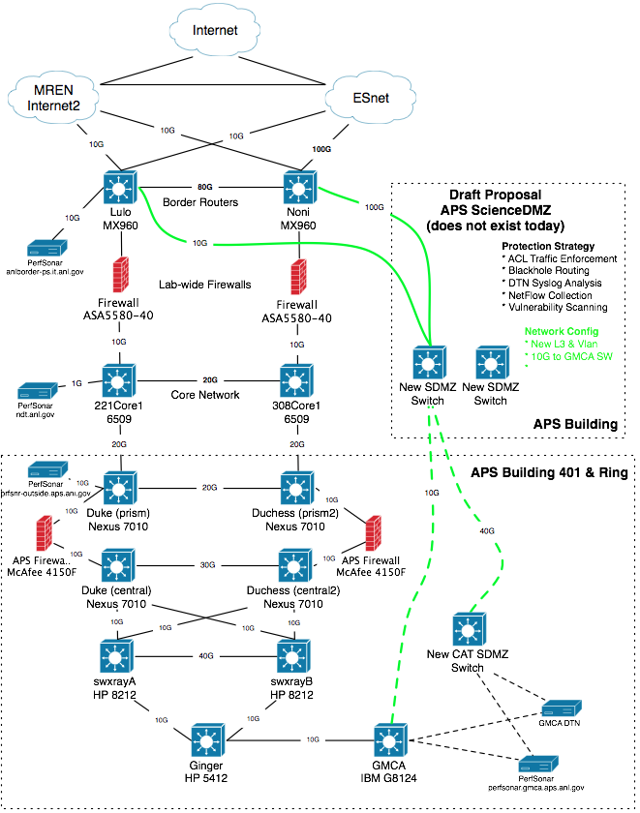
Future
Wider use @ APS
  Solution now goes directly to a specific beamline – how to support the entire facility?
Wider use @ ANL
  Service for other research groups (e.g. ALCF, ARM, etc.)
  Pool of DTN resources w/ Globus, instead of each group manning their own (allows to back up to communal storage)
Defining Policy
  ACLs – ports exposed for things like perfSONAR, Globus. Shut off for things that don’t need it. Gray area is defining what is and is not science.
  Who gets on, who doesn’t
  Managing routing @ the border to best utilize the available WAN links
© 2015, Energy Sciences Network

Slide 20
Participants & Thanks
Argonne National Laboratory Networking
  Corey Hall
  Linda Winkler
  Corby Schmitz
Advanced Photon Source Networking
  David Leibfritz
  Mary Westbrook
GM/CA Beamline
  Sergey Stepanov
© 2015, Energy Sciences Network

Slide 21
Improving Scientific Outcomes at the APS with a Science DMZ
Jason Zurawski – zurawski@es.net
Science Engagement Engineer, ESnet
Lawrence Berkeley National Laboratory
GlobusWorld 2015
April 15th, 2015

