Slide 1
The perfSONAR Effect: Changing the Outcome of Networks by Measuring Them
Jason Zurawski – zurawski@es.net
Science Engagement Engineer, ESnet
Lawrence Berkeley National Laboratory
2015 KINBER Annual Conference
April 16th, 2015

Slide 2
Outline
What is ESnet?
Introduction & Motivation
Problem Classification
perfSONAR Basics
Deployment Strategies
Success Stories
Further Info

Slide 3

ESnet at a Glance
High-speed national network, optimized for DOE science missions:
  connecting 40 labs, plants and facilities with >100 networks (national and international)
  $32.6M in FY14, 42FTE
  older than commercial Internet, growing twice as fast
$62M ARRA in 2009/2010 grant for 100G upgrade:
  transition to new era of optical networking
  world’s first 100G network at continental scale
Culture of urgency:
  4 awards in past 3 years
  R&D100 Award in FY13
  “5 out of 5” for customer satisfaction in last review
  Dedicated staff to support the mission of science

Slide 4
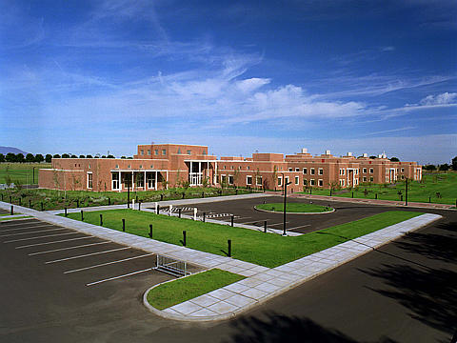
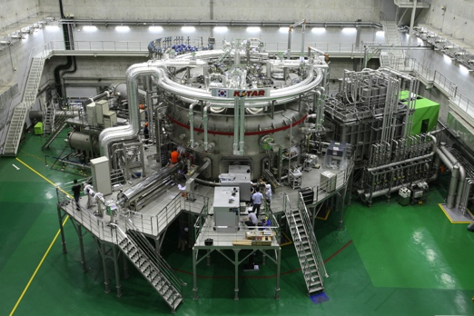
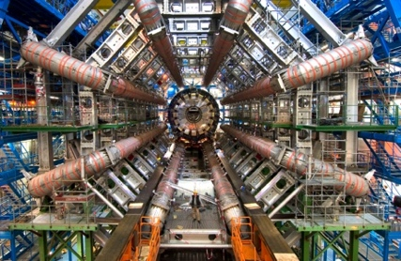
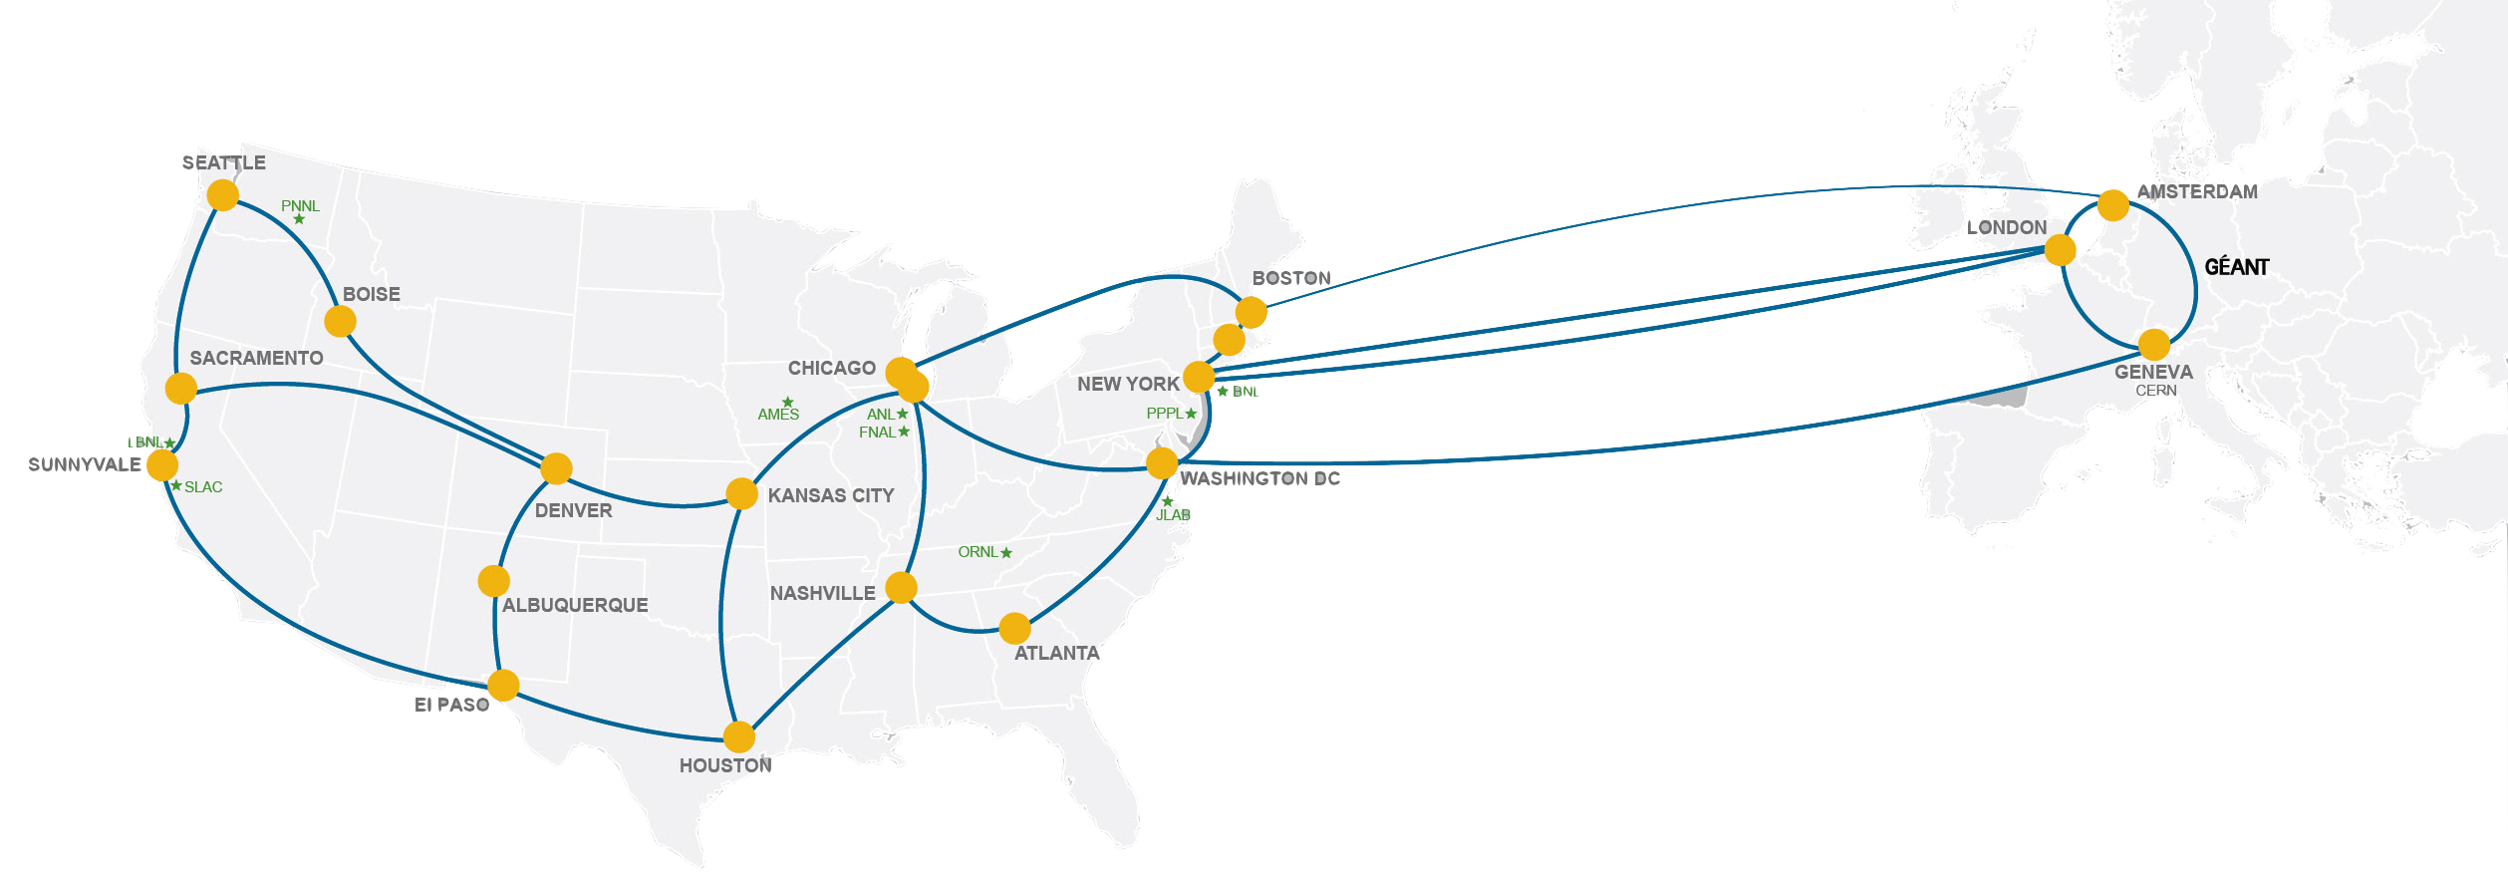
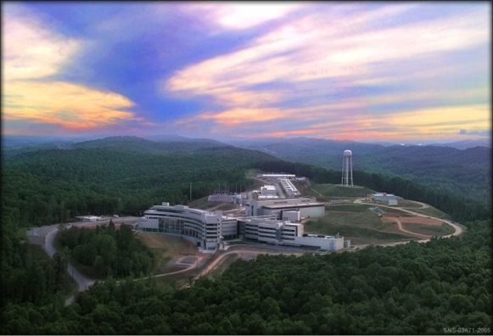
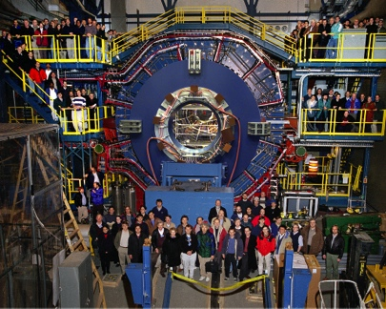
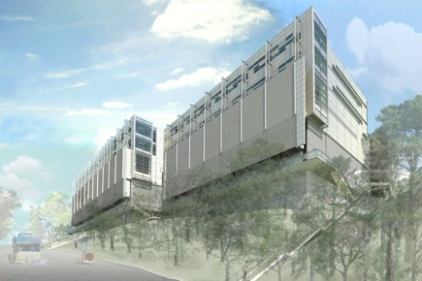
Network as Infrastructure Instrument
    Vision: Scientific progress will be completely unconstrained by the physical location of instruments, people, computational resources, or data.

Slide 5
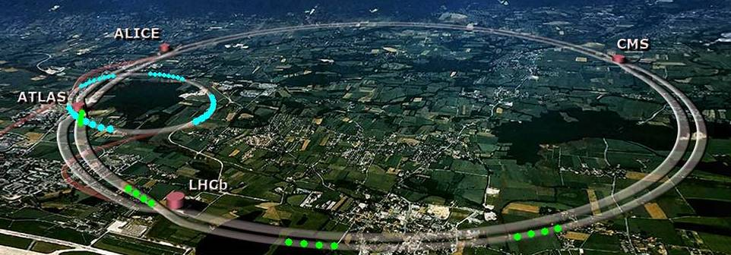
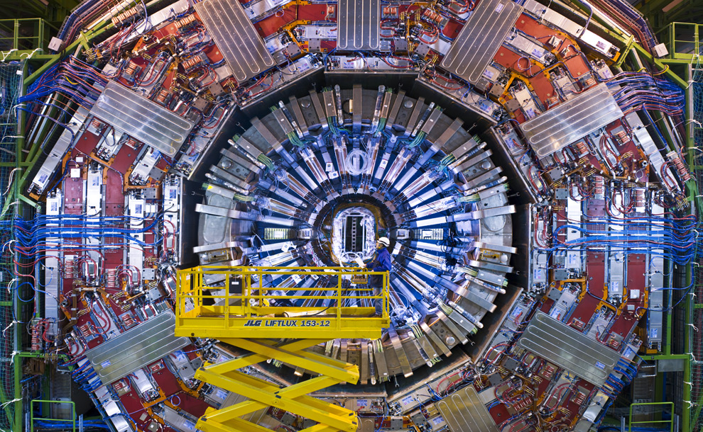
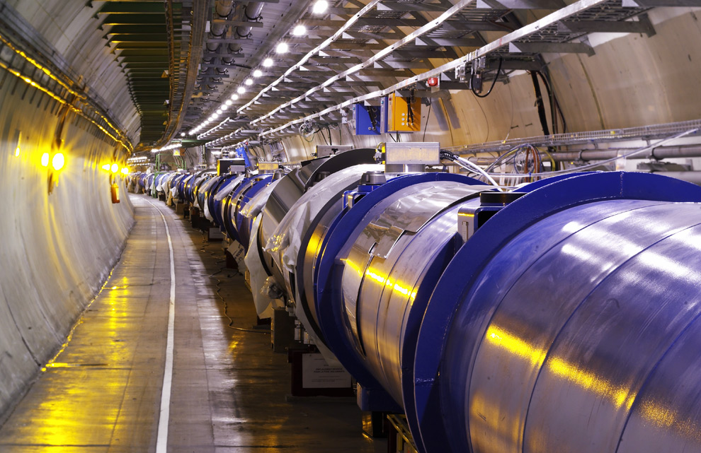
Traditional “Big Science”
Notes:
Science & Research is everywhere
Size of school/endowment does not matter – there is a researcher at your facility right now that is attempting to use the network for a research activity
Networks are an essential part of data-intensive science
Connect data sources to data analysis
Connect collaborators to each other
Enable machine-consumable interfaces to data and analysis resources (e.g. portals), automation, scale
Performance is critical
Exponential data growth
Constant human factors (timelines for analysis, remote users)
Data movement and analysis must keep up
Effective use of wide area (long-haul) networks by scientists has historically been difficult (the “Wizard Gap”)

Slide 6
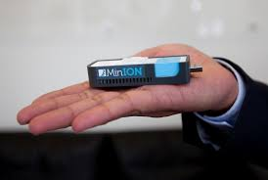
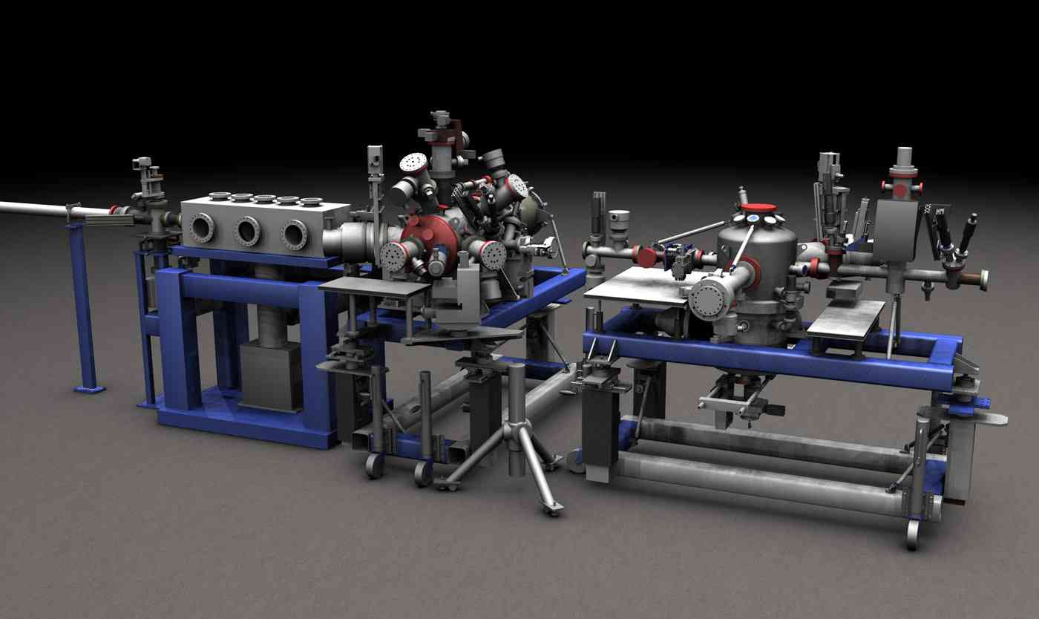
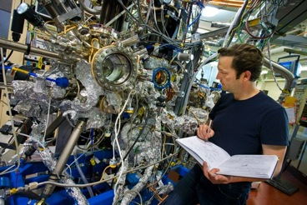
Big Science Now Comes in Small Packages …
…and is happening on your campus. Guaranteed.

Slide 7
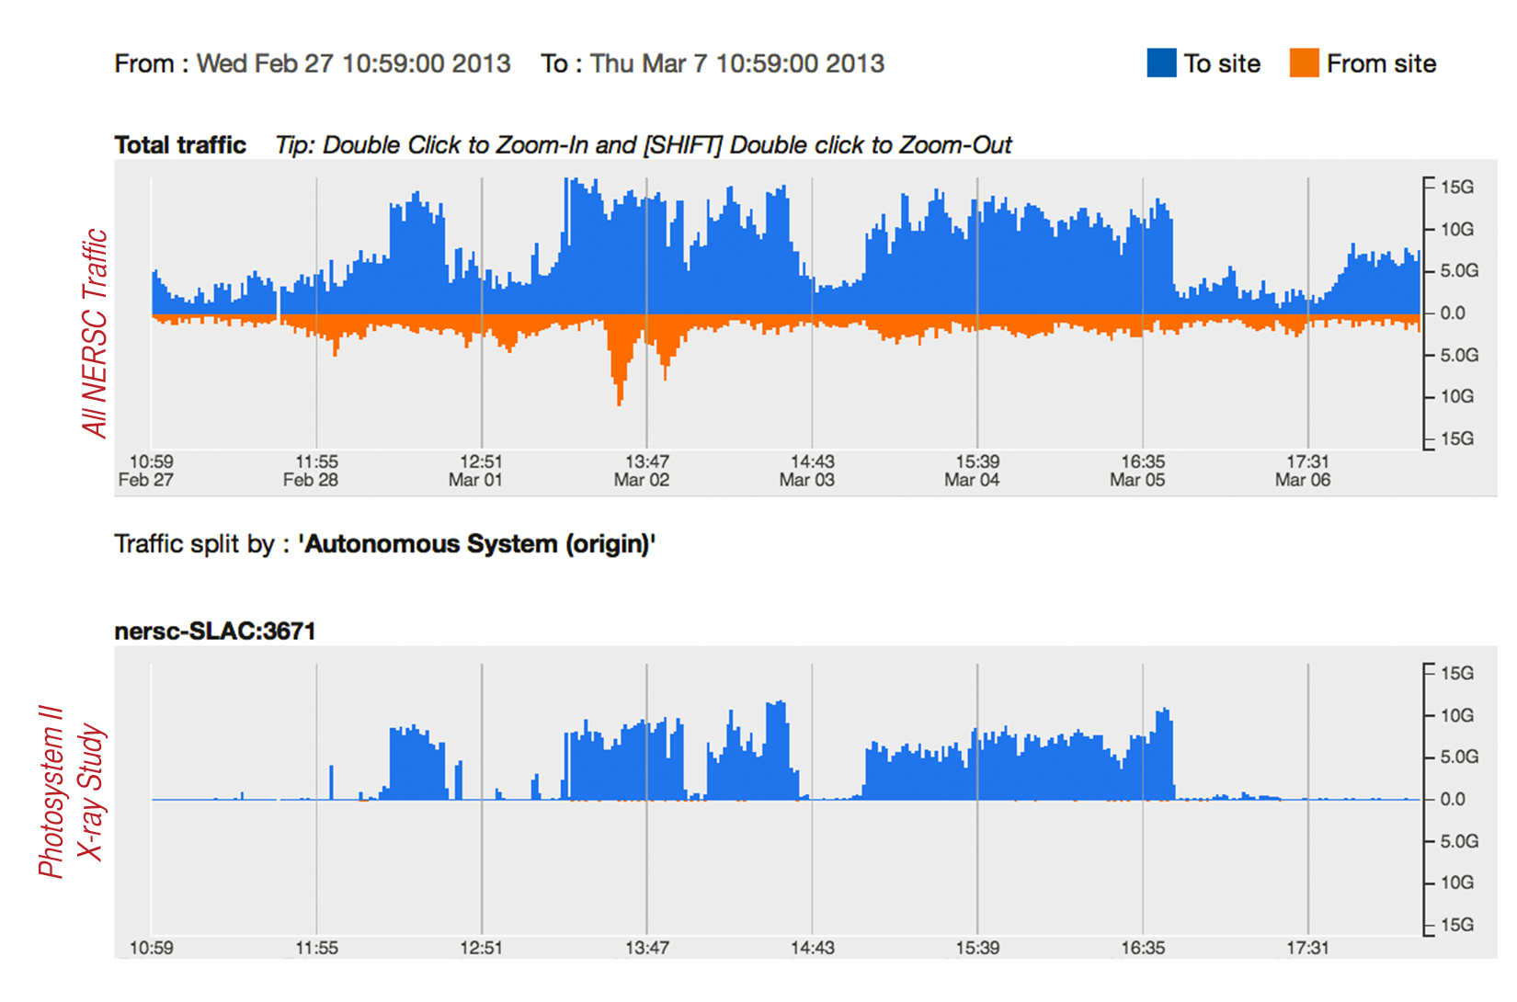
Experimental Facility to Computing Facility over ESnet

Slide 8
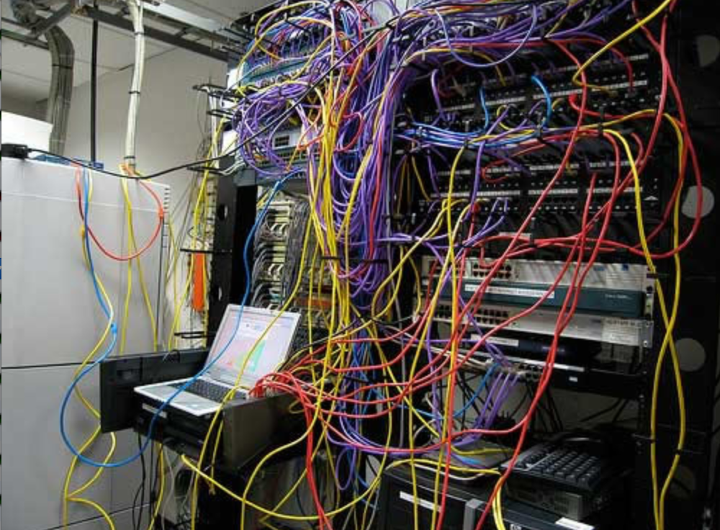
Challenges to Sophisticated Network Use
Network use has historically been challenging for end users (e.g. the ‘wizard’ gap)
Lack of communication and collaboration between the CIO’s office and researchers on campus
Lack of IT expertise within a science collaboration or experimental facility
User’s performance expectations are low (“The network is too slow”, “I tried it and it didn’t work”).
Cultural change is hard (“we’ve always shipped disks!”).
Scientists want to do science not IT support – IT support has to worry about things like projectors and babysitting a student population: not learning why frog DNA matters.
The Capability Gap

Slide 9
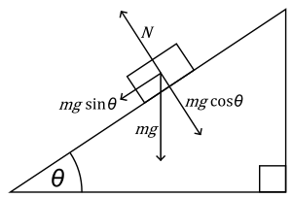


The Science DMZ in 1 Slide
“Friction free” network path
  Highly capable network devices (wire-speed, deep queues)
  Virtual circuit connectivity option
  Security policy and enforcement specific to science workflows
  Located at or near site perimeter
Dedicated, high-performance Data Transfer Nodes (DTNs)
  Hardware, operating system, config all optimized for data transfer
  High-performance data transfer tools such as Globus
Performance test and measurement – perfSONAR
Science engagement
  Map experiments onto cyberinfrastructure
  Work with users to ensure they are successful
Details at http://fasterdata.es.net/science-dmz/
© 2013 Wikipedia
© 2015 Globus

Slide 10
Outline
What is ESnet?
Introduction & Motivation
Problem Classification
perfSONAR Basics
Deployment Strategies
Success Stories
Further Info

Slide 11
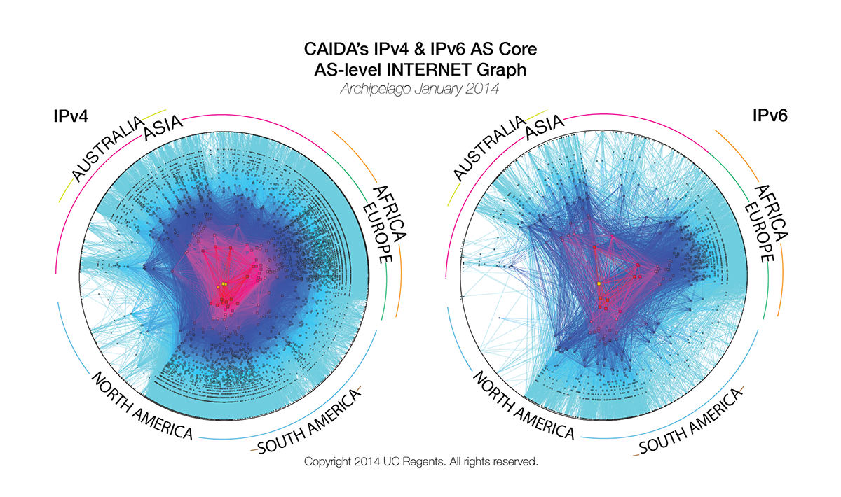
Problem Statement
The global Research & Education network ecosystem is comprised of hundreds of international, national, regional and local-scale networks.
Notes:
Issues are

Slide 12
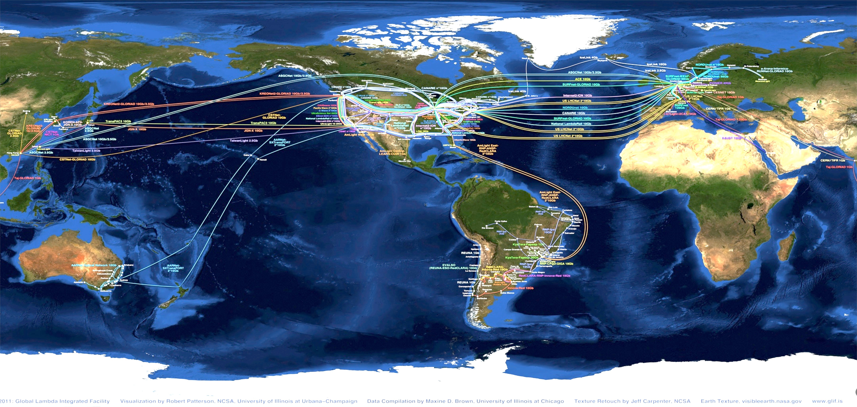
Problem Statement
While these networks all interconnect, each network is owned and operated by separate organizations (called “domains”) with different policies, customers, funding models, hardware, bandwidth and configurations.
Notes:
Issues are

Slide 13
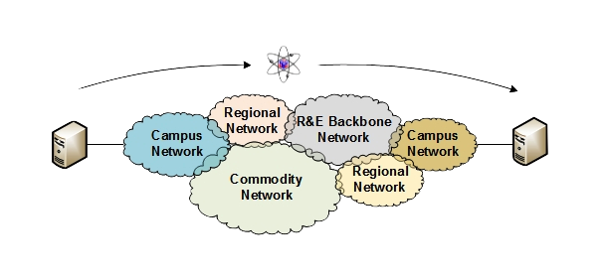
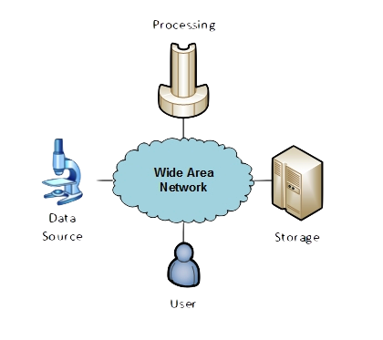
The R&E Community
The global Research & Education network ecosystem is comprised of hundreds of international, national, regional and local-scale resources – each independently owned and operated.
This complex, heterogeneous set of networks must operate seamlessly from “end to end” to support science and research collaborations that are distributed globally.
Data mobility is required; there is no liquid market for HPC resources (people use what they can get – DOE, XSEDE, NOAA, etc. etc.)
  To stay competitive, we must learn the use patterns, and support them
  This may mean making sure your network, and the networks of others, are functional
Notes:
Issues are

Slide 14
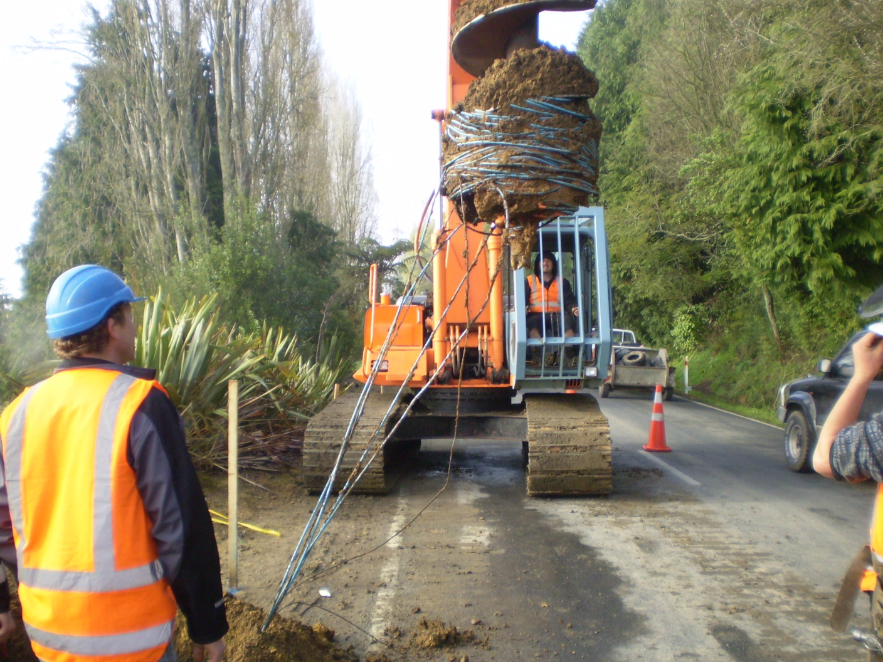
Lets Talk Performance …
"In any large system, there is always something broken.”
Jon Postel
Modern networks are occasionally designed to be one-size-fits-most
  e.g. if you have ever heard the phrase “converged network”, the design is to facilitate CIA (Confidentiality, Integrity, Availability)
  This is not bad for protecting the HVAC system from hackers.
Causes of friction/packet loss:
  Small buffers on the network gear and hosts
  Incorrect application choice
  Packet disruption caused by overzealous security
  Congestion from herds of mice
It all starts with knowing your users, and knowing your network

Slide 15

Where Are The Problems?
Congested or faulty links between domains
Latency dependant problems inside domains with small RTT
Source
Campus
Backbone
Destination
Campus
S
D
NREN
Regional
Congested intra- campus links

Slide 16
Local Testing Will Not Find Everything
Performance is poor when RTT exceeds ~10 ms
Performance is good when RTT is < ~10 ms
Source
Campus
R&E
Backbone
Destination
Campus
S
D
Switch with small buffers
Regional
Regional

Slide 17
TCP – Ubiquitous and Fragile
Networks provide connectivity between hosts – how do hosts see the network?
  From an application’s perspective, the interface to “the other end” is a socket
  Communication is between applications – mostly over TCP
TCP – the fragile workhorse
  TCP is (for very good reasons) timid – packet loss is interpreted as congestion
  Packet loss in conjunction with latency is a performance killer
    We can address the first, science hasn’t fixed the 2nd (yet)
  Like it or not, TCP is used for the vast majority of data transfer applications (more than 95% of ESnet traffic is TCP)
Notes:
The application sees the network as a socket.
The socket interface does not provide path diagnostics or other troubleshooting information.
TCP behaves as it does because of measures taken in the 1980s to fix the congestion collapse of the Internet
TCP makes a promise to the application – TCP will get the data to the other end, or TCP will return an error. TCP makes no promises about performance.

Slide 18
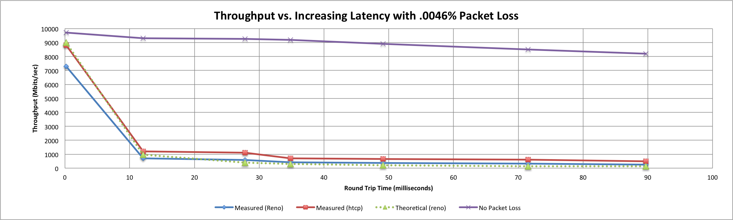

A small amount of packet loss makes a huge difference in TCP performance
Local
(LAN)
With loss, high performance beyond metro distances is essentially impossible
International
Metro Area
Regional
Continental
Measured (TCP Reno)
Measured (HTCP)
Theoretical (TCP Reno)
Measured (no loss)
Notes:
This is an annotated version of the plot from the Science DMZ paper
Beyond your metro area, zero loss is essentially required for high performance
Where are your collaborators? Where are your users?
When global collaboration is the norm, nobody can afford to be a local-only resource

Slide 19
Outline
What is ESnet?
Introduction & Motivation
Problem Classification
perfSONAR Basics
Deployment Strategies
Success Stories
Further Info

Slide 20
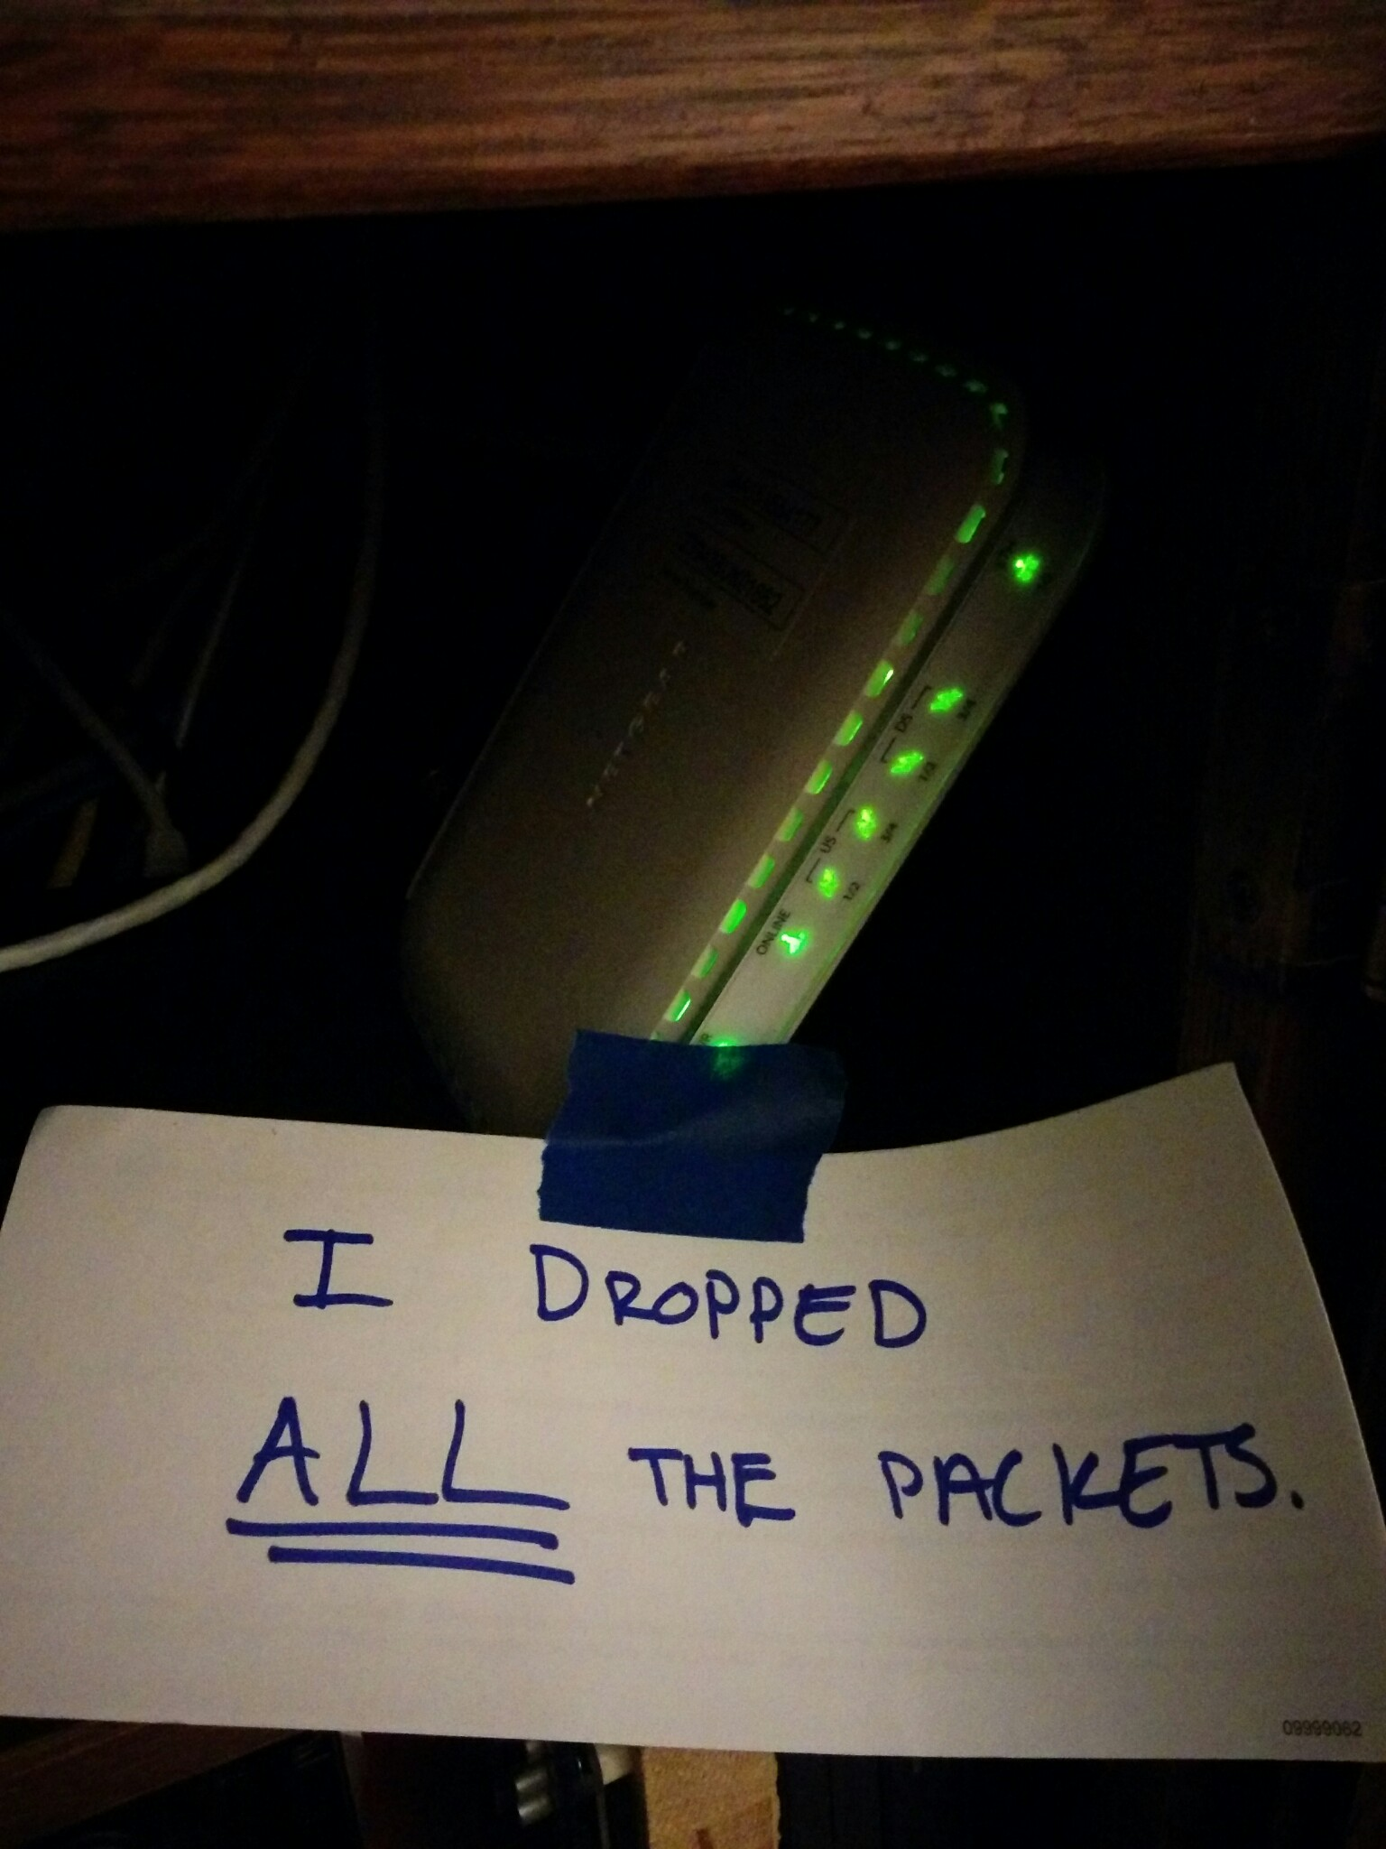
Soft Network Failures
Soft failures are where basic connectivity functions, but high performance is not possible.
TCP was intentionally designed to hide all transmission errors from the user:
  “As long as the TCPs continue to function properly and the internet system does not become completely partitioned, no transmission errors will affect the users.” (From IEN 129, RFC 716)
Some soft failures only affect high bandwidth long RTT flows.
Hard failures (e.g. interface down, fiber cut, etc.) are easy to detect & fix
  soft failures can lie hidden for years!
One network problem can often mask others

Slide 21
Causes of Packet Loss
Network Congestion
  Easy to confirm via SNMP, easy to fix with $$
  This is not a ‘soft failure’, but just a network capacity issue
  Often people assume congestion is the issue when it fact it is not.
Under-buffered switch dropping packets
  Hard to confirm
Under-powered firewall dropping packets
  Hard to confirm
Dirty fibers or connectors, failing optics/light levels
  Sometimes easy to confirm by looking at error counters in the routers
Overloaded or slow receive host dropping packets
  Easy to confirm by looking at CPU load on the host

Slide 22
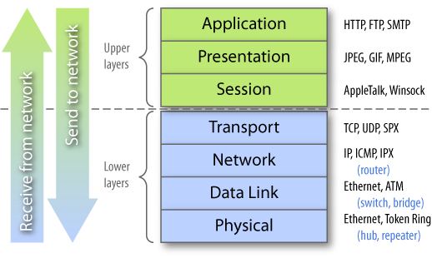
Abstraction Helps & Hurts
Notes:
Need to look at our environment from different angles
Networks are large and complex, but well structured
The environment itself has mechanisms that can be used to address problems

Slide 23
Outline
What is ESnet?
Introduction & Motivation
Problem Classification
perfSONAR Basics
Deployment Strategies
Success Stories
Further Info

Slide 24
Network Monitoring
All networks do some form monitoring.
  Addresses needs of local staff for understanding state of the network
    Would this information be useful to external users?
    Can these tools function on a multi-domain basis?
Beyond passive methods, there are active tools.
    E.g. often we want a ‘throughput’ number. Can we automate that idea?
    Wouldn’t it be nice to get some sort of plot of performance over the course of a day? Week? Year? Multiple endpoints?
perfSONAR = Measurement Middleware

Slide 25
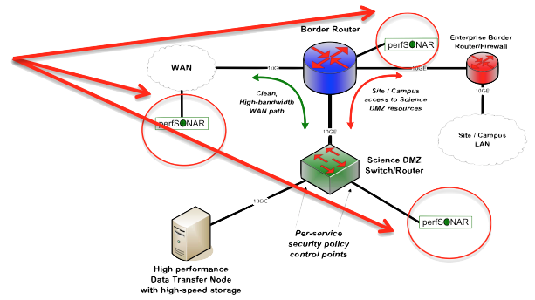
perfSONAR
Our “Science DMZ” network diagrams have little perfSONAR boxes everywhere
  The reason for this is that consistent behavior requires correctness
  Correctness requires the ability to find and fix problems
    You can’t fix what you can’t find
    You can’t find what you can’t see
    perfSONAR lets you see
Especially important when deploying high performance services
  If there is a problem with the infrastructure, need to fix it
  If the problem is not with your stuff, need to prove it
    Many players in an end to end path
    Ability to show correct behavior aids in problem localization

Slide 26
What is perfSONAR?
perfSONAR is a tool to:
  Set network performance expectations
  Find network problems (“soft failures”)
  Help fix these problems
  All in multi-domain environments
These problems are all harder when multiple networks are involved
perfSONAR is provides a standard way to publish active and passive monitoring data
  This data is interesting to network researchers as well as network operators
Notes:
Enables Federation
Service oriented
Designed with ‘multi-domain’ in mind
Brings together useful tools to address different needs
Several active and passive tools
Interface to configure regular testing
Diagnostic tools ready with ‘0 configuration’
Easy to install, easy to use
ISO image can be burned to CD/USB key
‘Wizard’ interface for configuration
Encouraging people to deploy ‘known good’ measurement points near domain boundaries
“known good” = hosts that are well configured, enough memory and CPU to drive the network, proper TCP tuning, clean path, etc.
Community Adoption
Over 600 instances seen world wide as of early May
20+ countries
100s of domains

Slide 27
perfSONAR History
perfSONAR can trace its origin to the Internet2/GN2 JRA1/GGF efforts (~2000)
What has changed since 2000?
  The Good News:
    TCP is much less fragile; Cubic is the default CC alg, autotuning is and larger TCP buffers are everywhere
    Reliable parallel transfers via tools like Globus Online
    High-performance UDP-based commercial tools like Aspera
  The Bad News:
    The wizard gap is still large
    Jumbo frame use is still small
    Under-buffered and switches and routers are still common
    Under-powered/misconfigured firewalls are common
    Soft failures still go undetected for months
    User performance expectations are still too low

Slide 28
Simulating Performance
It’s infeasible to perform at-scale data movement all the time – as we see in other forms of science, we need to rely on simulations
Network performance comes down to a couple of key metrics:
  Throughput (e.g. “how much can I get out of the network”)
  Latency (time it takes to get to/from a destination)
  Packet loss/duplication/ordering (for some sampling of packets, do they all make it to the other side without serious abnormalities occurring?)
  Network utilization (the opposite of “throughput” for a moment in time)
We can get many of these from a selection of active and passive measurement tools – enter the perfSONAR Toolkit

Slide 29

Active Testing Risk
Concept from quantum physics
The act of observing some phenomena will fundamentally change it
Active measurement of a network is similar:
  Introduction of active traffic (UDP, TCP) changes the behavior of other traffic on the network (backing off – potentially causing congestion, etc.)
  Measurement should be done carefully: short periods of time with a realistic purpose in mind
  Some tools are more friendly to the local vs. remote environments

Slide 30
What IPERF Tells Us
Lets start by describing throughput, which is vague.
  Capacity: link speed
    Narrow Link: link with the lowest capacity along a path
    Capacity of the end-to-end path = capacity of the narrow link
  Utilized bandwidth: current traffic load
  Available bandwidth: capacity – utilized bandwidth
    Tight Link: link with the least available bandwidth in a path
  Achievable bandwidth: includes protocol and host issues (e.g. BDP!)
All of this is “memory to memory”, e.g. we are not involving a spinning disk (more later)
45 Mbps
10 Mbps
100 Mbps
45 Mbps
source
sink
Narrow Link
Tight Link
(Shaded portion shows background traffic)

Slide 31
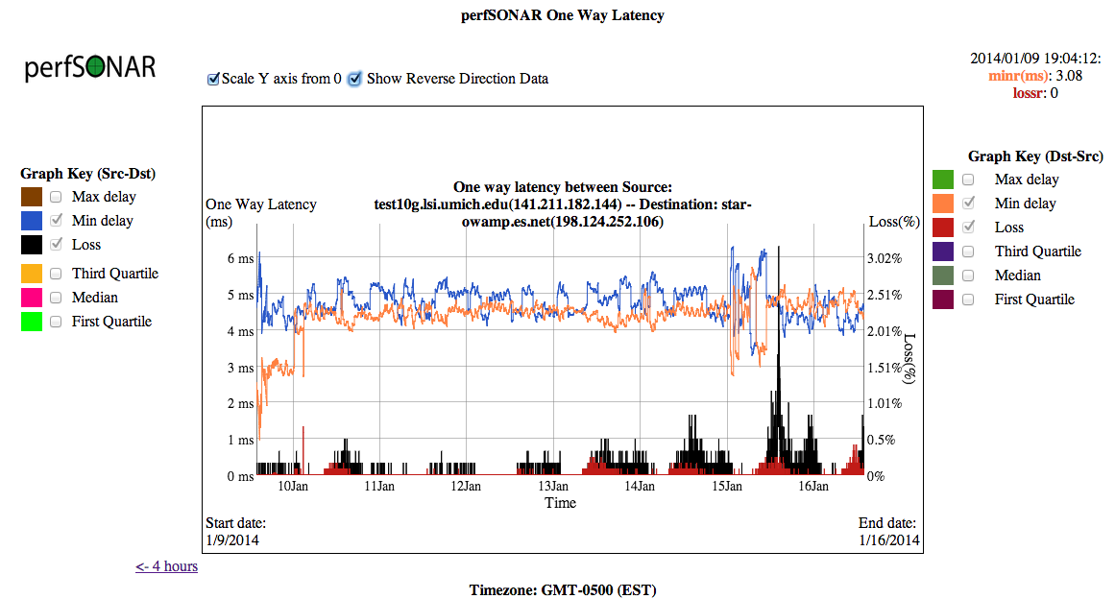
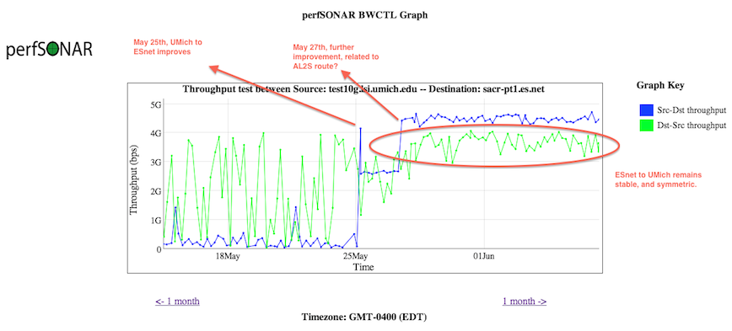
What OWAMP Tells Us

Slide 32
perfSONAR Toolkit
The “perfSONAR Toolkit” is an open source implementation and packaging of the perfSONAR measurement infrastructure and protocols
  http://www.perfsonar.net
All components are available as RPMs, and bundled into a CentOS 6-based “netinstall”
  perfSONAR tools are much more accurate if run on a dedicated perfSONAR host, not on the DTN or something else with a real job to do
Very easy to install and configure
  Usually takes less than 30 minutes
KINBER is working to deploy these around the state.
  Penn State, UPenn, Pitt, Drexel, etc. have instances as well.

Slide 33
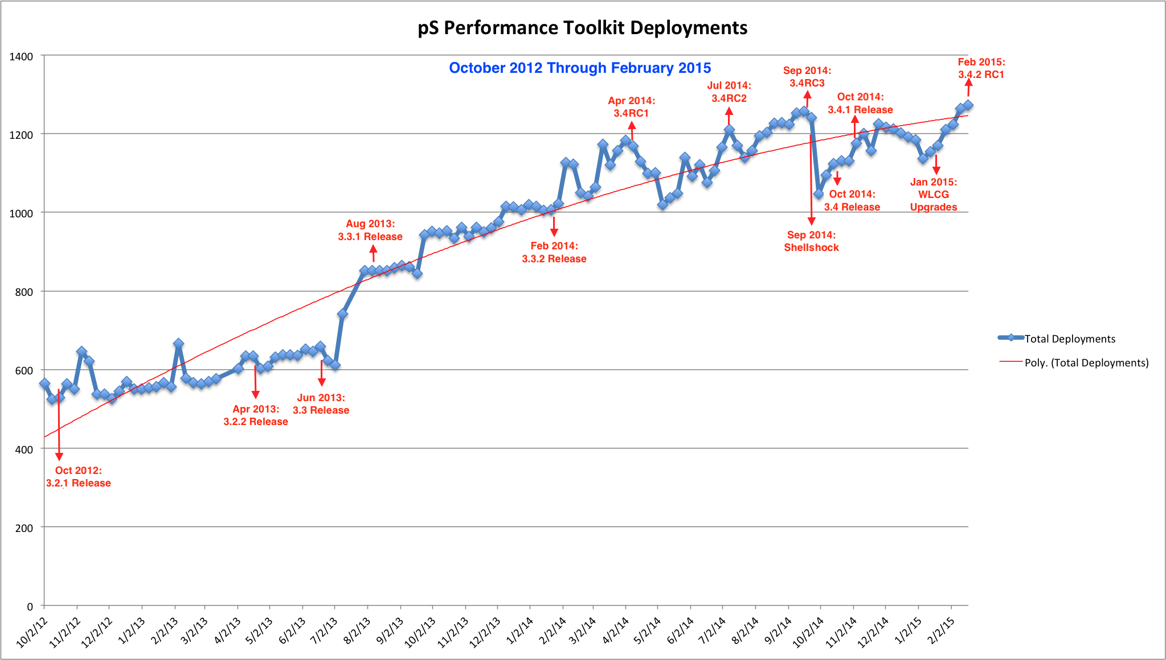
Deployment By The Numbers
Last updated Feb 2015. Adoption trend increases with each release. CC-NIE and innovation platform helped as well.

Slide 34
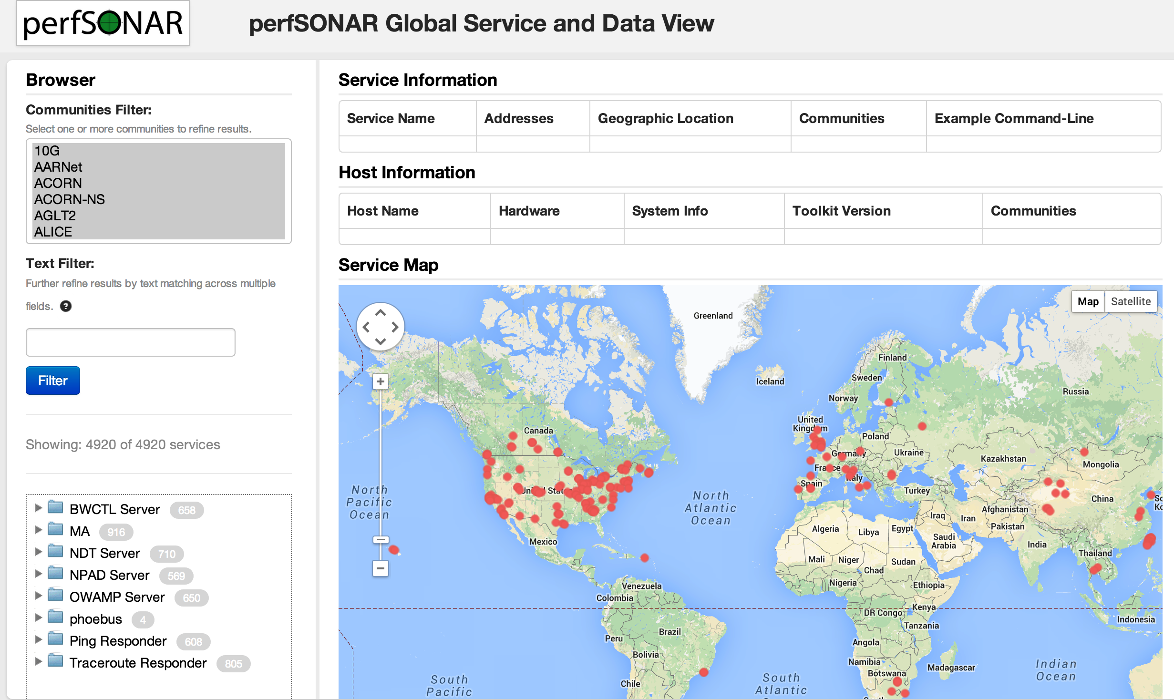
http://stats.es.net/ServicesDirectory/

Slide 35
Outline
What is ESnet?
Introduction & Motivation
Problem Classification
perfSONAR Basics
Deployment Strategies
Success Stories
Further Info

Slide 36
Importance of Regular Testing
We can’t wait for users to report problems and then fix them (soft failures can go unreported for years!)
Things just break sometimes
  Failing optics
  Somebody messed around in a patch panel and kinked a fiber
  Hardware goes bad
Problems that get fixed have a way of coming back
  System defaults come back after hardware/software upgrades
  New employees may not know why the previous employee set things up a certain way and back out fixes
Important to continually collect, archive, and alert on active throughput test results

Slide 37
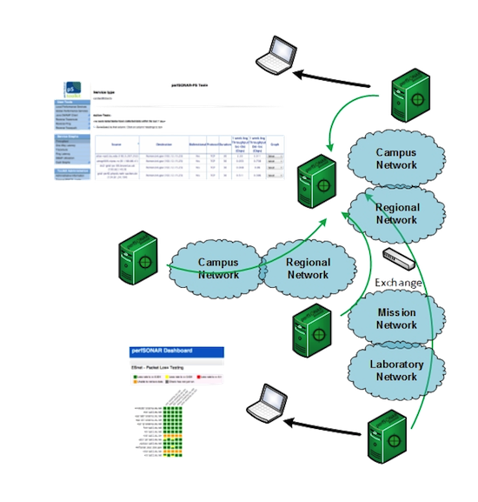
Regular Testing - Beacon
The beacon setup is typically employed by a network provider (regional, backbone, exchange point)
  A service to the users (allows people to test into the network)
  Can be configured with Layer 2 connectivity if needed
  If no regular tests are scheduled, minimum requirements for local storage.
  Makes the most sense to enable all services (bandwidth and latency)

Slide 38
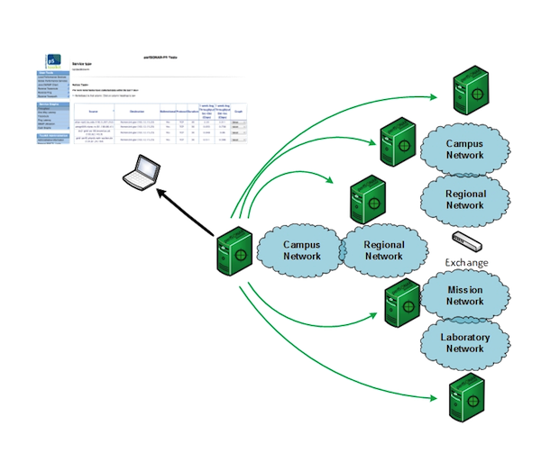
Regular Testing - Island
The island setup allows a site to test against any number of the 1300+ perfSONAR nodes around the world, and store the data locally.
  No coordination required with other sites
  Allows a view of near horizon testing (e.g. short latency – campus, regional) and far horizon (backbone network, remote collaborators).
  OWAMP is particularly useful for determining packet loss in the previous cases.
  Throughput will not be as valuable when the latency is small

Slide 39
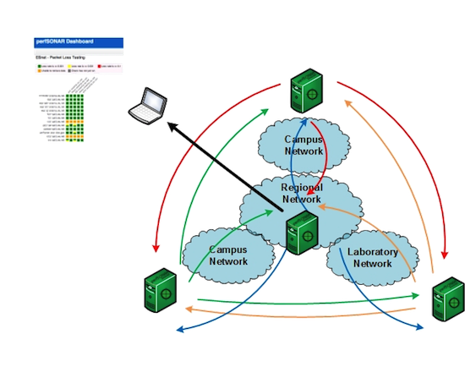
Regular Testing - Mesh
A full mesh requires more coordination:
  A full mesh means all hosts involved are running the same test configuration
  A partial mesh could mean only a small number of related hosts are running a testing configuration
In either case – bandwidth and latency will be valuable test cases

Slide 40
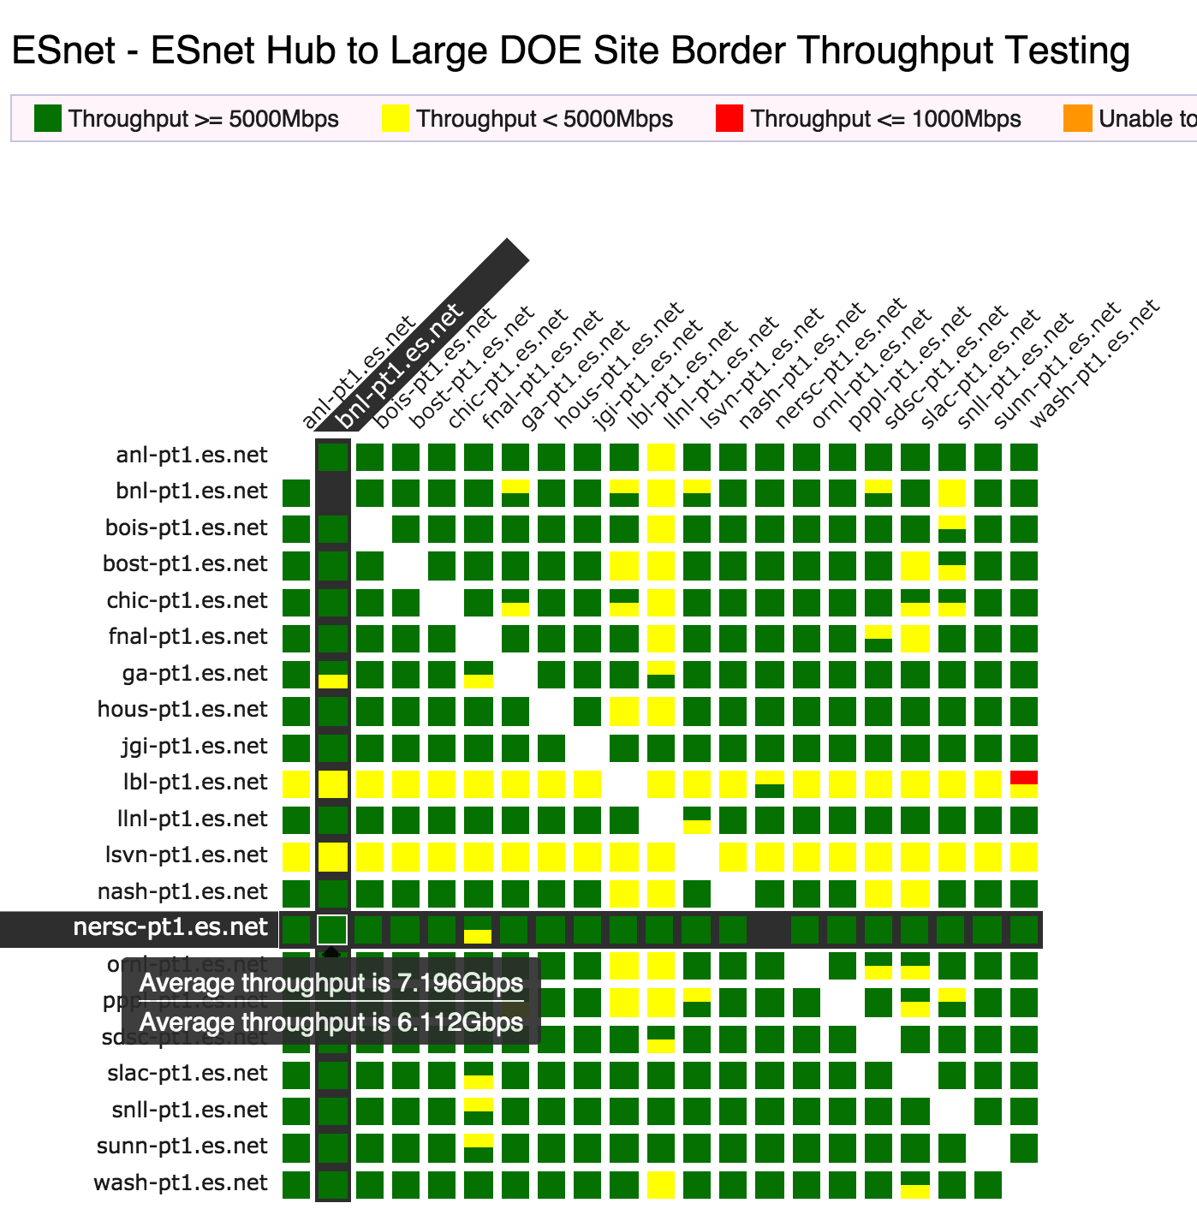
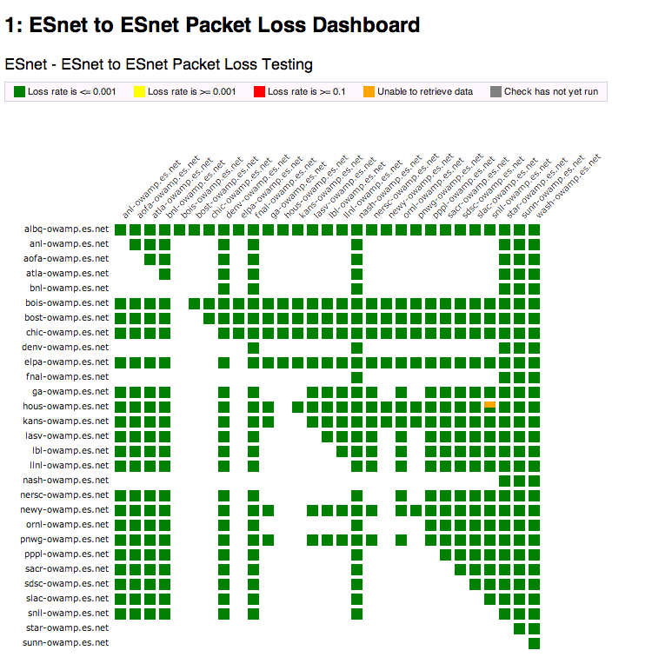
perfSONAR Dashboard: Raising Expectations and improving network visibility
Status at-a-glance
Packet loss
Throughput
Correctness
Current live instances at
http://ps-dashboard.es.net/
http://pas.net.internet2.edu/
Drill-down capabilities:
Test history between hosts
Ability to correlate with other events
Very valuable for fault localization and isolation

Slide 41
Develop a Test Plan
What are you going to measure?
  Achievable bandwidth
    2-3 regional destinations (careful – localized throughput testing is not very valuable – see earlier graph)
    4-8 important collaborators
    4-8 times per day to each destination (e.g. 4hr cadence = 6 tests per day)
    20 second tests within a region, longer across oceans and continents
  Loss/Availability/Latency
    OWAMP: ~10-20 collaborators over diverse paths

Slide 42
Develop a Test Plan
How are you going to Measure?
  Internal Testing
    Testing throughput on a LAN has risks
      Regular throughput testing will fill buffers on LAN switches and cause congestion/loss for local traffic
      Suggestion: very infrequent (once/twoce per day?) test to things on a LAN environment
    Latency/Packet loss = OK, do this everywhere you can
  External Testing
    Regional
      If you are < 10ms away from a regional destination, see above warnings
    National/International
      Best location to test throughput. Pick something > 10ms away
      Try to use a ‘known good’ test point. ESnet, Internet2, etc.

Slide 43
perfSONAR Deployment Locations
Critical to deploy near key resources such as Data Transfer Nodes
More perfSONAR hosts allow segments of the path to be tested separately
  Reduced visibility for devices between perfSONAR hosts
  Must rely on counters or other means where perfSONAR can’t go
Effective test methodology derived from protocol behavior
  TCP suffers much more from packet loss as latency increases
  TCP is more likely to cause loss as latency increases
  Testing should leverage this in two ways
    Design tests so that they are likely to fail if there is a problem
    Mimic the behavior of production traffic as much as possible
  Note: don’t design your tests to succeed
    The point is not to “be green” even if there are problems
    The point is to find problems when they come up so that the problems are fixed quickly
Notes:
A lot of people want to prove that they are not the problem, and design their tests to succeed. This is not helpful.

Slide 44
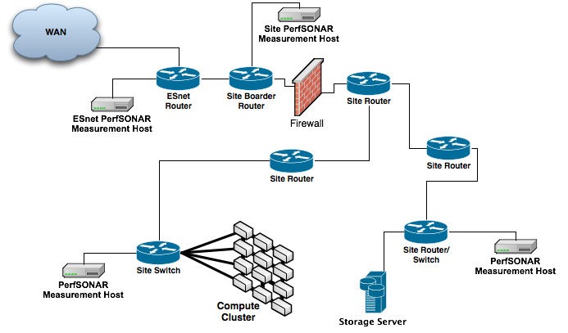
Sample Site Deployment

Slide 45
Outline
What is ESnet?
Introduction & Motivation
Problem Classification
perfSONAR Basics
Deployment Strategies
Success Stories
Further Info

Slide 46
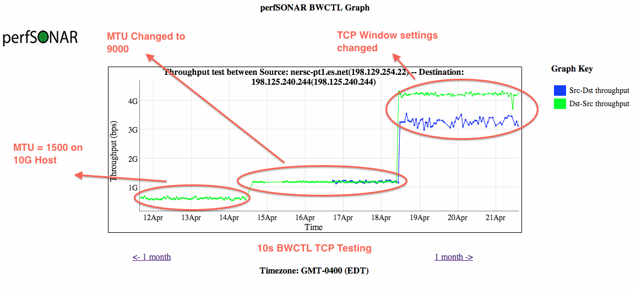
Success Stories - Host Tuning
Showing the role of MTUs and host tuning (e.g. ‘its all related’):

Slide 47
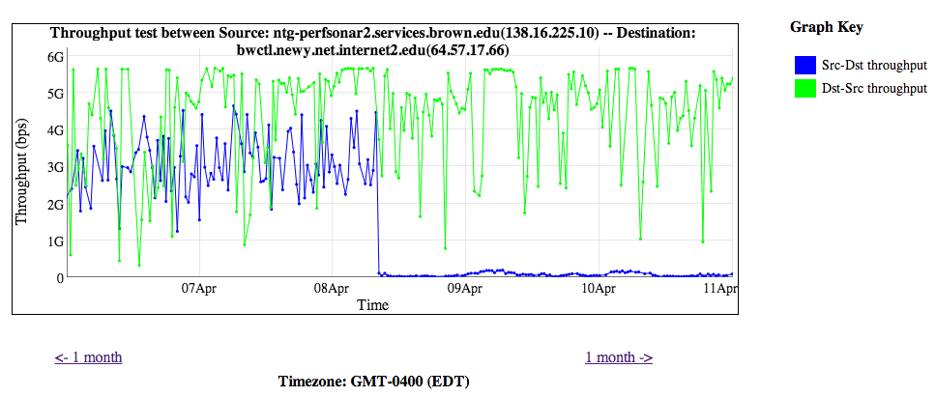
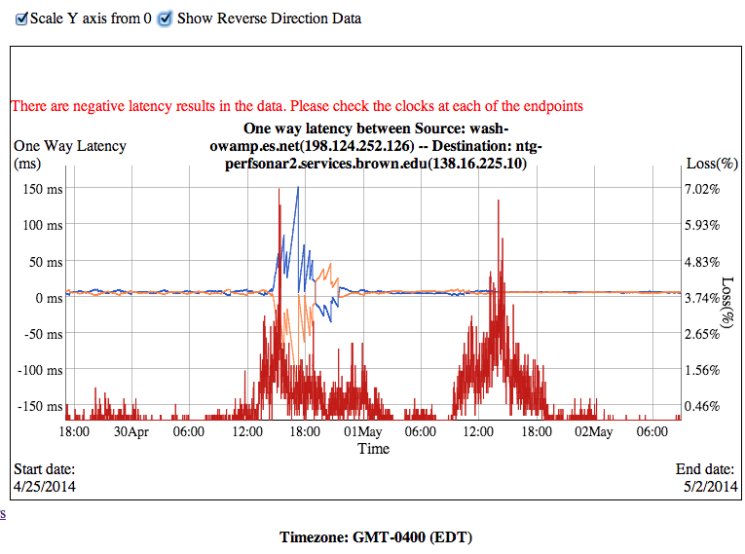
Success Stories - Upstream Packet Loss
  Sometimes its not your fault – this is why monitoring your provider is a good idea:
  Drastic drop in BWCTL normally has a reason (spikes of congestion-caused loss)

Slide 48
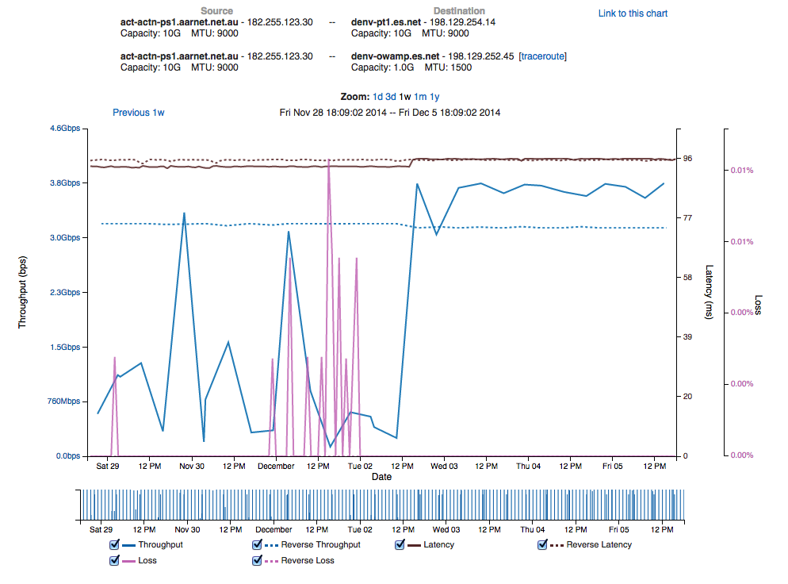
Success Stories - BGP Peering Migration
Performance increases
Performance stabilizes

Slide 49
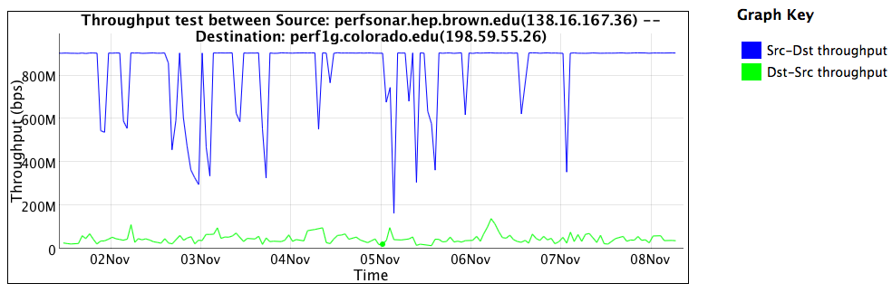
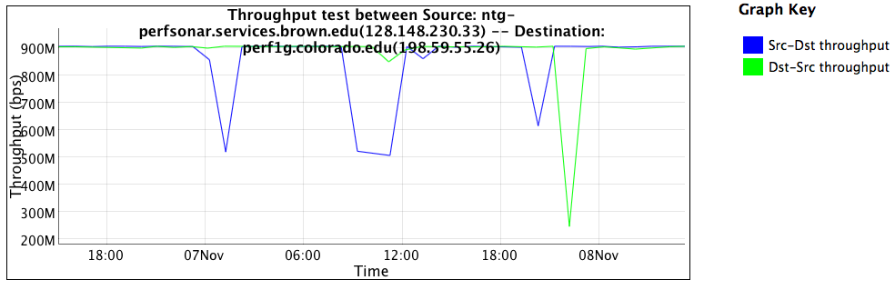
Success Stories – Firewalls & Science Traffic
The impacts of overzealous
security
10 x improvement if you identify a use case: the alternative is application of policy without any thought as to the consequences.

Slide 50
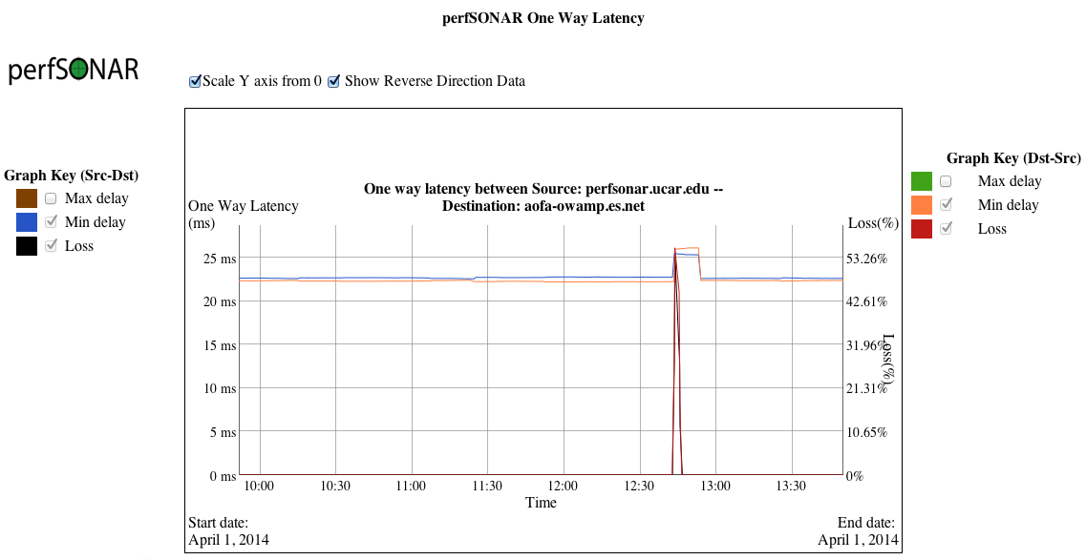
Success Stories – Catastrophic Failure
Patterns like a fiber cut/re-route are cleanly seen

Slide 51
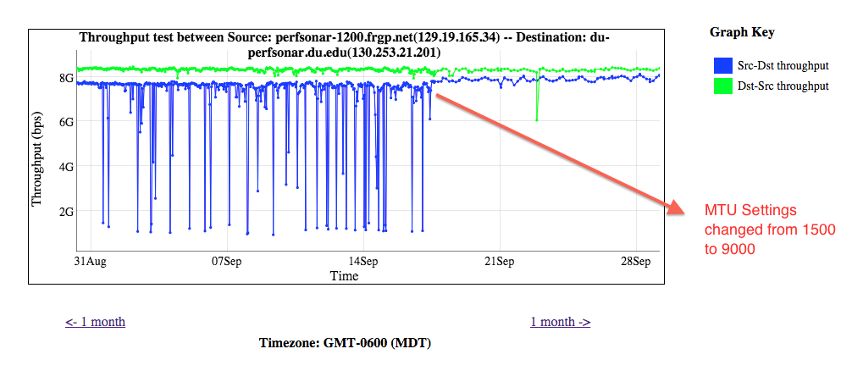
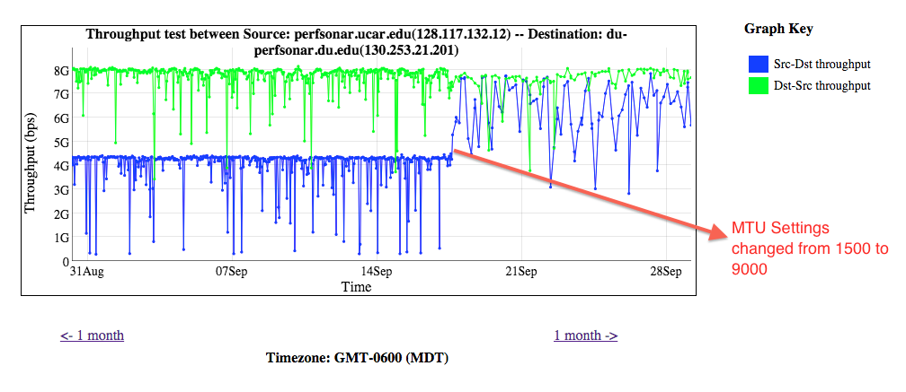
Success Stories – MTU

Slide 52
Outline
What is ESnet?
Introduction & Motivation
Problem Classification
perfSONAR Basics
Deployment Strategies
Success Stories
Further Info

Slide 53
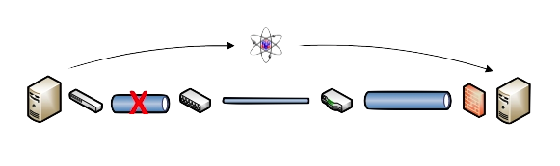
Benefits: Finding the needle in the haystack
Above all, perfSONAR allows you to maintain a healthy, high-performing network because it helps identify the “soft failures” in the network path.
  Classical monitoring systems have limitations
    Performance problems are often only visible at the ends
    Individual network components (e.g. routers) have no knowledge of end host state
  perfSONAR tests the network in ways that classical monitoring systems do not
More perfSONAR distributions equal better network visibility.

Slide 54
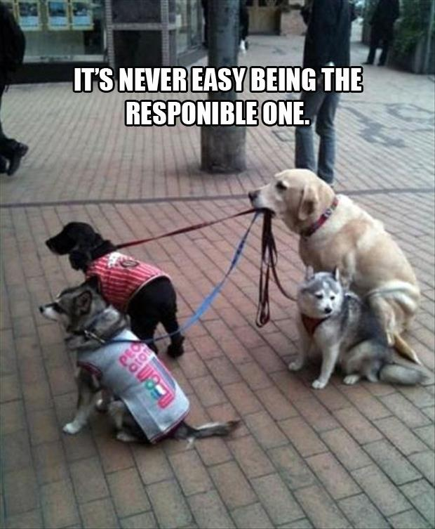
Regional Engagement Strategy
Create a “culture of urgency” to find/fix these problems at your campus
KINBER will be rolling out testers soon
Planning a workshop @ PSU in July
  perfSONAR Hands On
  Science DMZ
  SDN

Slide 55
perfSONAR Community
The perfSONAR collaboration is working to build a strong user community to support the use and development of the software.
perfSONAR Mailing Lists
  Announcement Lists:
    https://mail.internet2.edu/wws/subrequest/perfsonar-announce
  Users List:
    https://mail.internet2.edu/wws/subrequest/perfsonar-users

Slide 56

Resources
perfSONAR website
  http://www.perfsonar.net/
perfSONAR Toolkit Manual
  http://docs.perfsonar.net/
perfSONAR mailing lists
  http://www.perfsonar.net/about/getting-help/
perfSONAR directory
  http://stats.es.net/ServicesDirectory/
FasterData Knowledgebase
  http://fasterdata.es.net/

Slide 57
  engage@es.net
  Ask us anything:
  Implementing CC-IIE/CC-DNI
  Deploying perfSONAR
  Debugging a problem
  Attending a training event
  Designing a network
© 2015, Energy Sciences Network

Slide 58
The perfSONAR Effect: Changing the Outcome of Networks by Measuring Them
Jason Zurawski – zurawski@es.net
Science Engagement Engineer, ESnet
Lawrence Berkeley National Laboratory
2015 KINBER Annual Conference
April 16th, 2015

