Slide 1
Bridging the Technical Gap: Science Engagement at ESnet
Jason Zurawski – zurawski@es.net
Science Engagement Engineer, ESnet
Lawrence Berkeley National Laboratory
GPN Annual Meeting
May 28th, 2015

Slide 2
Outline
The ESnet Story
What Science?
Learning the Hard Way
The Golden Spike
(Brief) Science DMZ Pitch
A Call to Arms

Slide 3

ESnet at a Glance
High-speed national network, optimized for DOE science missions:
  connecting 40 labs, plants and facilities with >100 networks (national and international)
  $32.6M in FY14, 42FTE
  older than commercial Internet, growing twice as fast
$62M ARRA in 2009/2010 grant for 100G upgrade:
  transition to new era of optical networking
  world’s first 100G network at continental scale
Culture of urgency:
  4 awards in past 3 years
  R&D100 Award in FY13
  “5 out of 5” for customer satisfaction in last review
  Dedicated staff to support the mission of science

Slide 4
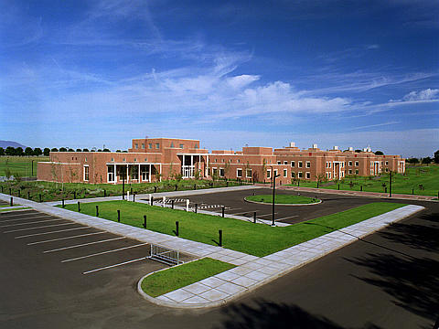
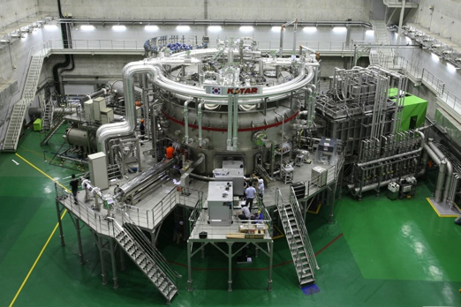
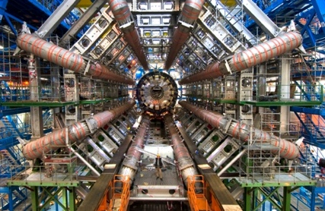
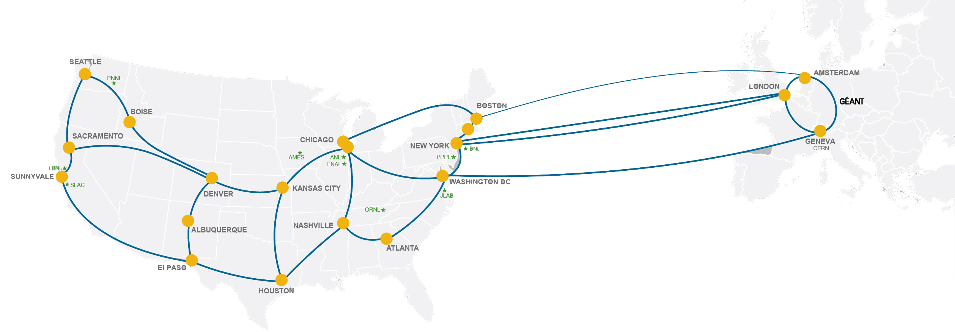
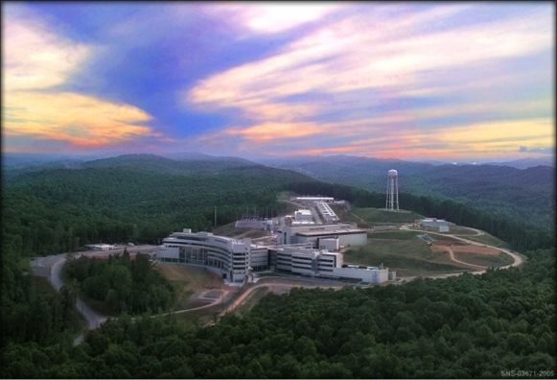
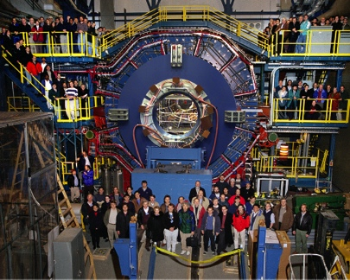
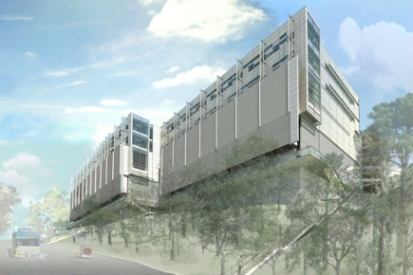
Network as Infrastructure Instrument
    Vision: Scientific progress will be completely unconstrained by the physical location of instruments, people, computational resources, or data.

Slide 5
Outline
The ESnet Story
What Science?
Learning the Hard Way
The Golden Spike
(Brief) Science DMZ Pitch
A Call to Arms

Slide 6
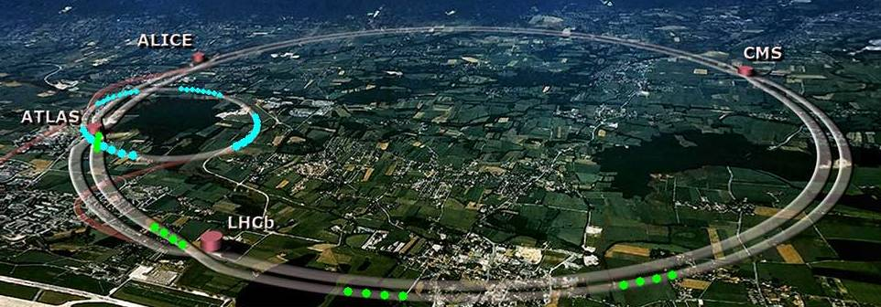
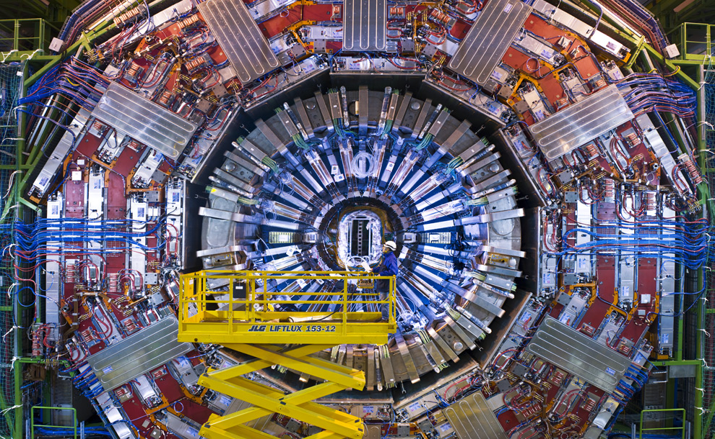
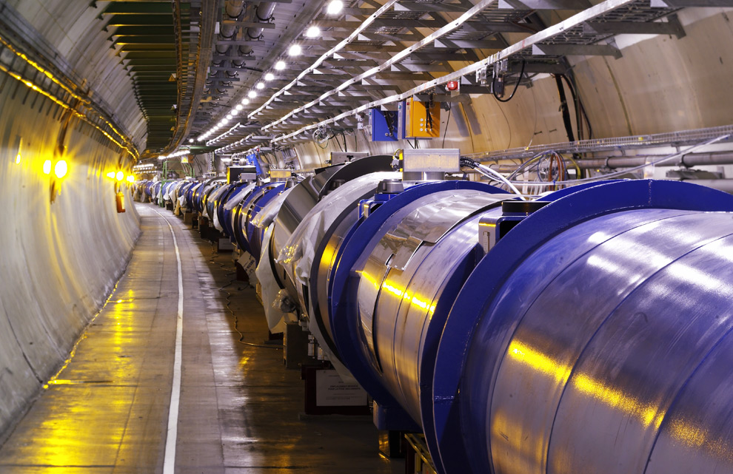
Traditional “Big Science”

Slide 7
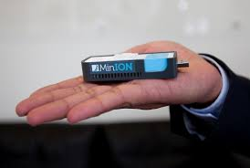
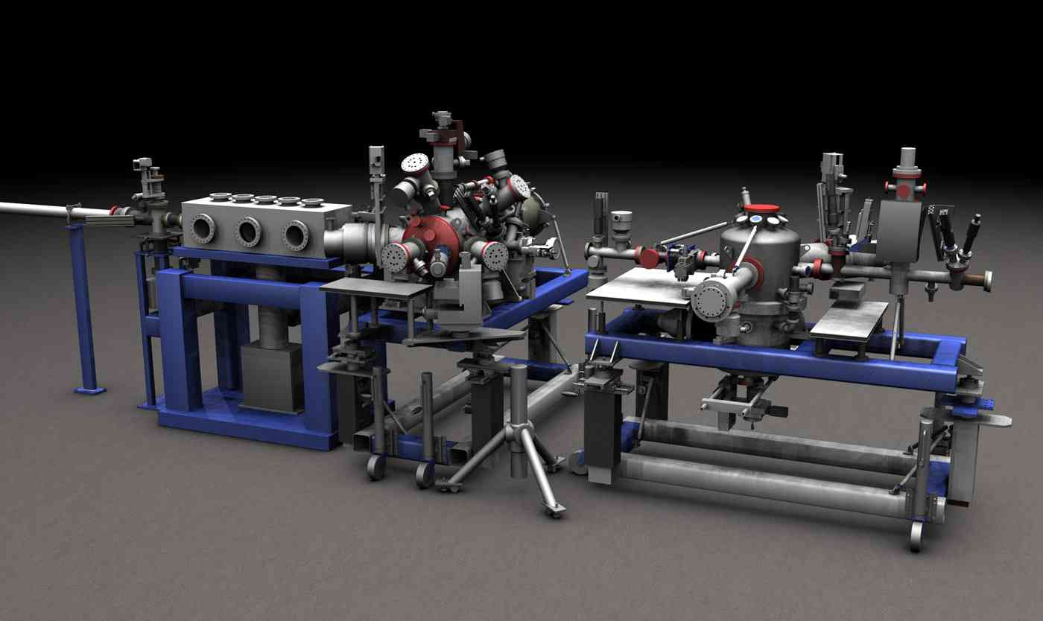
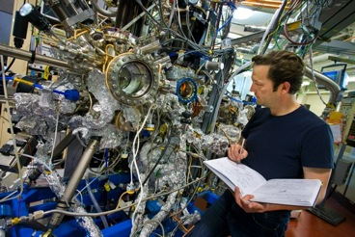
Big Science Now Comes in Small Packages
…and it is happening on your networks. Guaranteed.

Slide 8
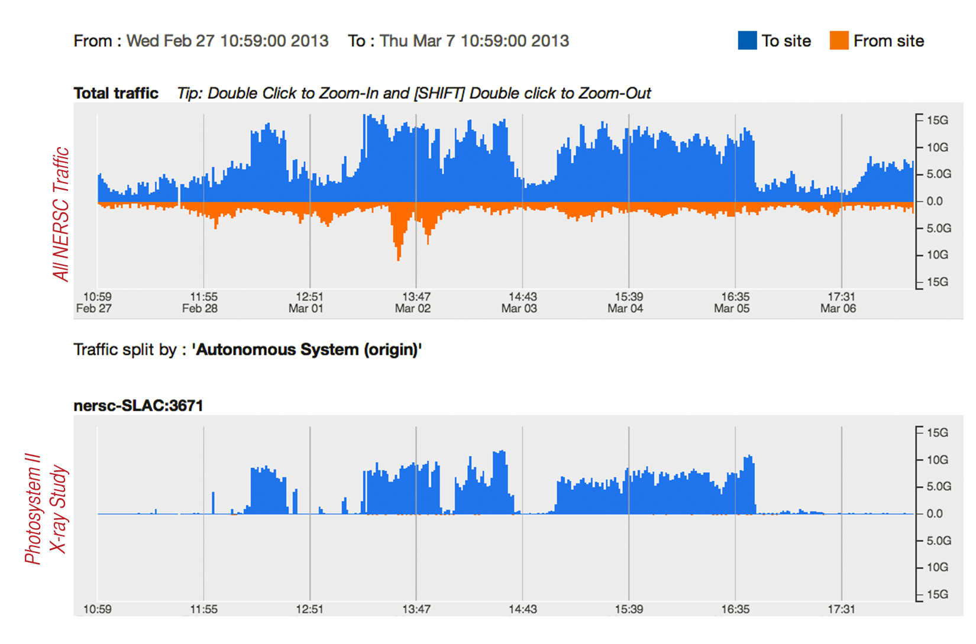
Experimental Facility to Computing Facility over ESnet

Slide 9
Outline
The ESnet Story
What Science?
Learning the Hard Way
The Golden Spike
(Brief) Science DMZ Pitch
A Call to Arms

Slide 10
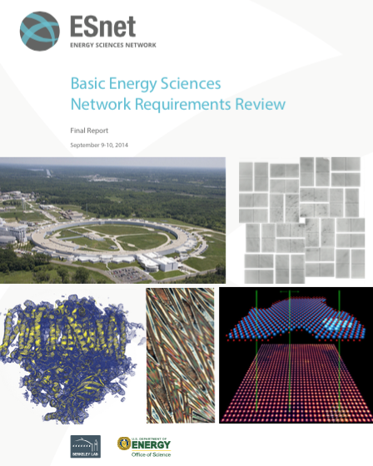
How do we know what our scientists need?
http://www.es.net/science-engagement/science-requirements-reviews/
Each Program Office has a dedicated requirements review every three years
Two workshops per year, attendees chosen by science programs
Discussion centered on science case studies
    Instruments and Facilities – the “hardware”
    Process of Science – science workflow
    Collaborators
    Challenges
Network requirements derived from science case studies + discussions
Reports contain requirements analysis, case study text, outlook
  Reports stretching back to 2002

Slide 11
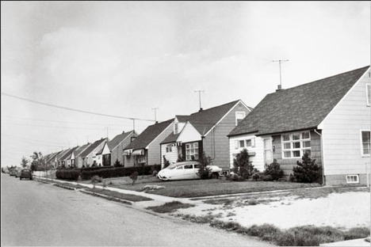
Scientific Lessons Learned (2002-2014)
All snowflakes are unique, some are less unique than others
  The process of science for almost everyone is similar
  Because workflows overlap, there OTS ideas that can help many
Collaboration space will always increase
  Addition of new collaborators (domestic and international) doesn’t go down
  More users means more need for collaboration tools
    Video, audio, shared diaries

Slide 12
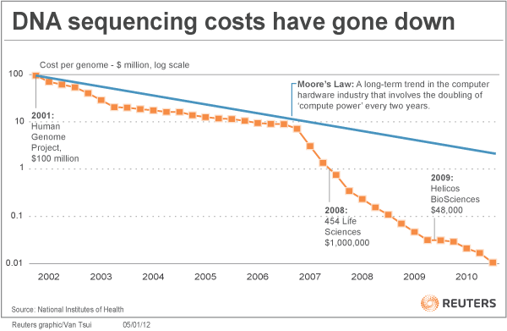
Scientific Lessons Learned (2002-2014)
Data volume will always increase on a better-than-Moore’s law curve in terms of data, and the reverse in terms of price
  Instruments are getting more and more precise
  More precision = more data

Slide 13
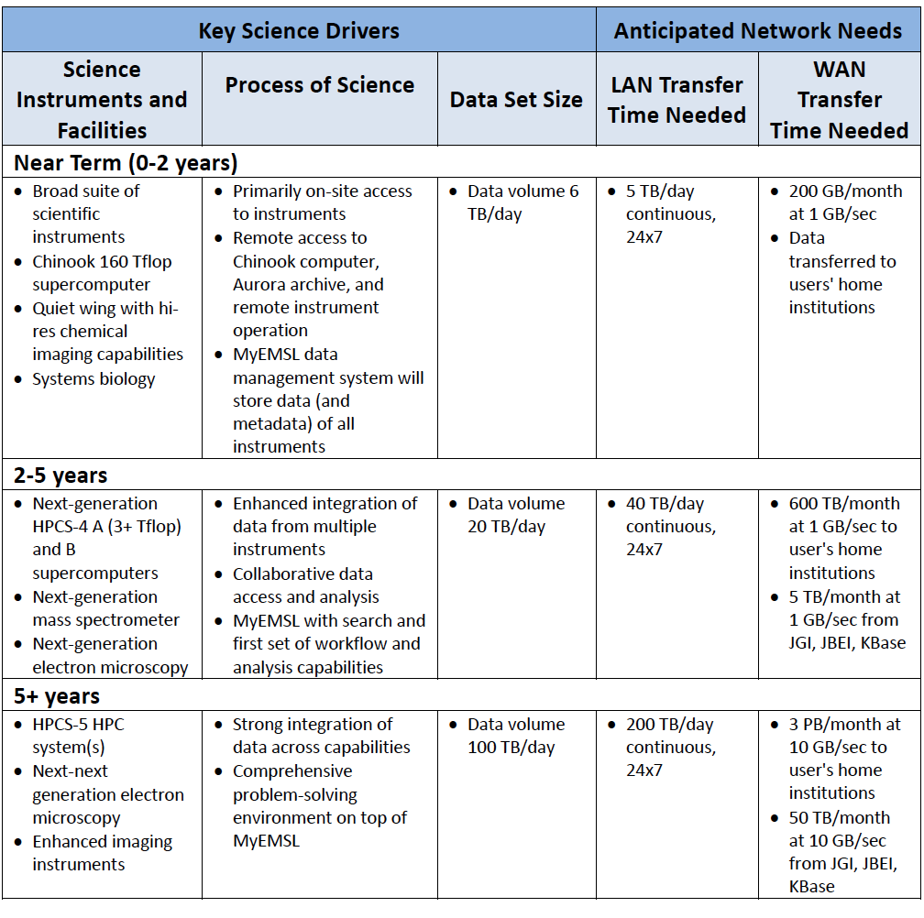
Sometimes we get more than we bargained for…
“EMSL frequently needs to ship physical copies of media to users when data sizes exceed a few GB. More often than not, this is due to lack of bandwidth or storage resources at the user's home institution.”

Slide 14
Understanding Data Trends

Slide 15
Outline
The ESnet Story
What Science?
Learning the Hard Way
The Golden Spike
(Brief) Science DMZ Pitch
A Call to Arms

Slide 16
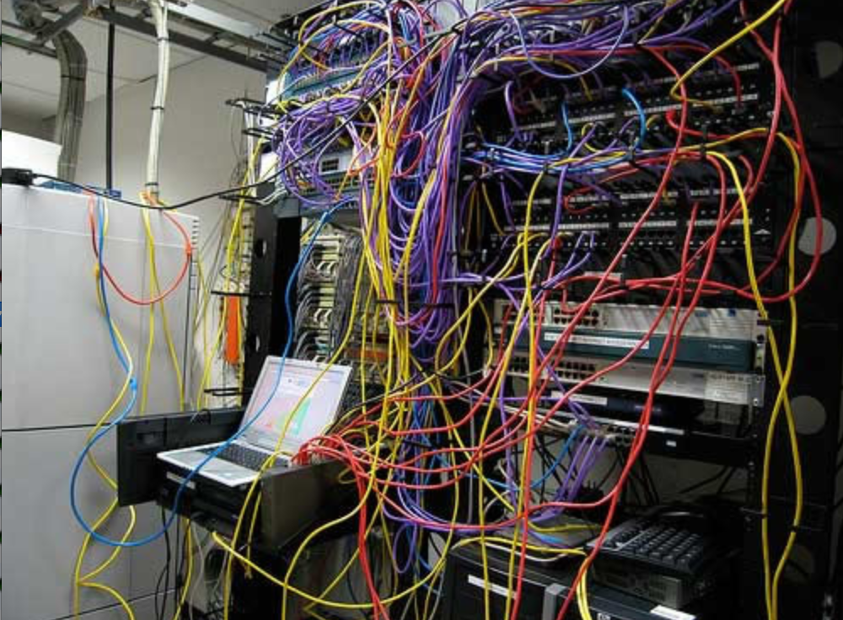
Challenges to Sophisticated Network Use
Network use has historically been challenging for end users (e.g. the ‘wizard’ gap)
Lack of communication and collaboration between the CIO’s office and researchers on campus
Lack of IT expertise within a science collaboration or experimental facility
User’s performance expectations are low (“The network is too slow”, “I tried it and it didn’t work”).
Cultural change is hard (“we’ve always shipped disks!”).
Scientists want to do science not IT support – IT support has to worry about things like projectors and babysitting a student population: not learning why frog DNA matters.
The Capability Gap

Slide 17
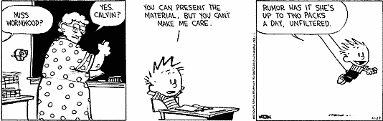
Bridging the Gap
Implementing technology is ‘easy’ in the grand scheme of assisting with science
Adoption of technology is different
  Does your cosmologist care what SDN is?
  Does your cosmologist want to get data from Chile each night so that they can start the next day without having to struggle with the tyranny of ineffective data movement strategies that involve airplanes and white/brown trucks?

Slide 18
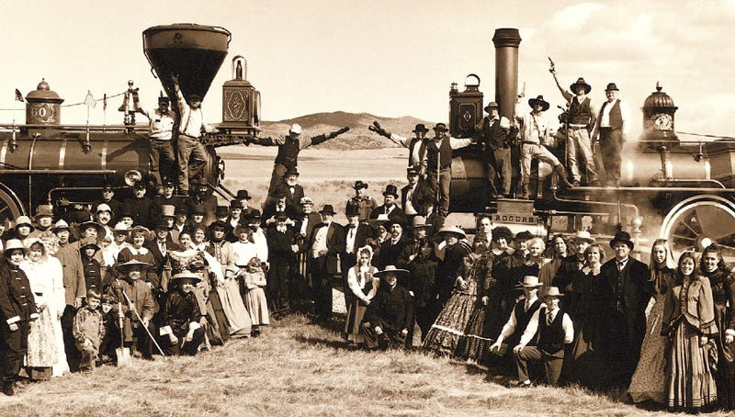
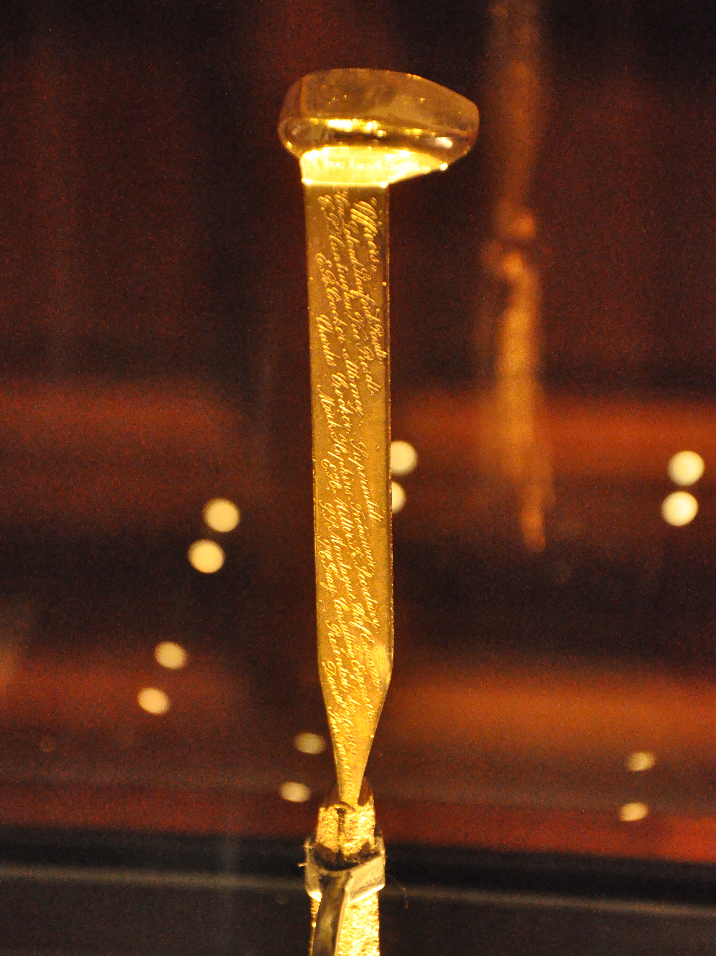
The Golden Spike
We don’t want Scientists to have to build their own networks
Engineers don’t have to understand what a tokomak accomplishes
Meeting in the middle is the process of science engagement:
  Engineering staff learning enough about the process of science to be helpful in how to adopt technology
  Science staff having an open mind to better use what is out there

Slide 19
ESnet Approach to Engagement
Education & Consulting
Webinars, workshops, 1:1 data mobility consultations with scientists, support teams.
Partnerships
With facilities / research teams / providers, building foundation for lasting impact.
Resources & Knowledgebase
Reference designs, case studies, papers, FAQs – tailored for multiple audiences.

Slide 20

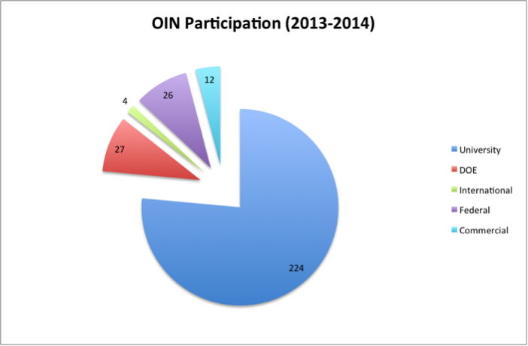
Training/Education
OIN = Operating Innovative Workshops
  http://oinworkshop.com
Joint partnership between ESnet, Indiana University and Internet2
Training in the technology that matters
  Science DMZ (perfSONAR, DTNs, Architecture, Security)
  SDN (Installation, Configuration, Use Cases)

Slide 21
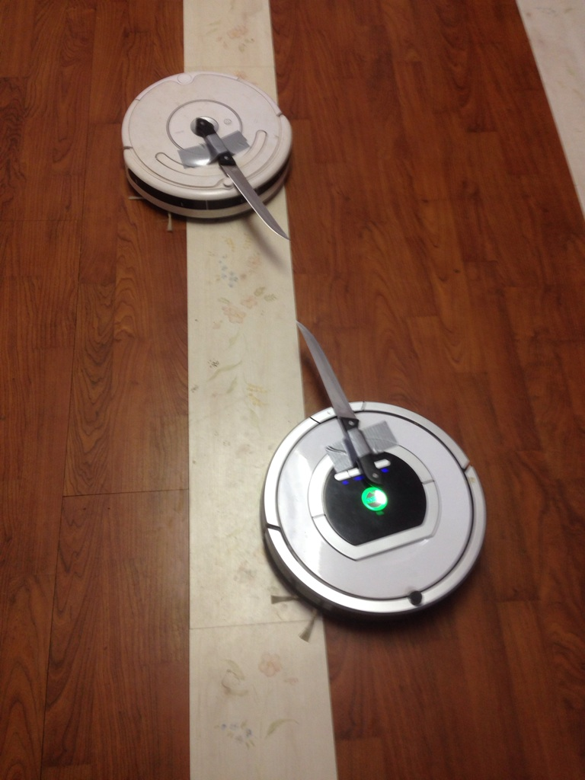
Additional Information
The goal of the OIN series is to remove the mystery from technology
Anyone can host (you don’t have to be a CC-IIE/NIE/DNI award winner)
  2015 is full (Pittsburgh, Kansas City, Clemson, St. Louis, Texas) – catch me after if there is a need for a region not listed above
Webinars can be done upon request
Open Source Learning:
  The materials are available if you want to use them
We are looking to regional networks to help us reach the people that need it.
Bottom line: the only way to clean up networks is to get people trained. Send your engineers please.

Slide 22
Outline
The ESnet Story
What Science?
Learning the Hard Way
The Golden Spike
(Brief) Science DMZ Pitch
A Call to Arms

Slide 23
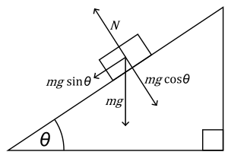


The Science DMZ in 1 Slide
“Friction free” network path
  Highly capable network devices (wire-speed, deep queues)
  Virtual circuit connectivity option
  Security policy and enforcement specific to science workflows
  Located at or near site perimeter
Dedicated, high-performance Data Transfer Nodes (DTNs)
  Hardware, operating system, config all optimized for data transfer
  High-performance data transfer tools such as Globus
Performance test and measurement – perfSONAR
Science engagement
  Map experiments onto cyberinfrastructure
  Work with users to ensure they are successful
Details at http://fasterdata.es.net/science-dmz/
© 2013 Wikipedia
© 2015 Globus

Slide 24
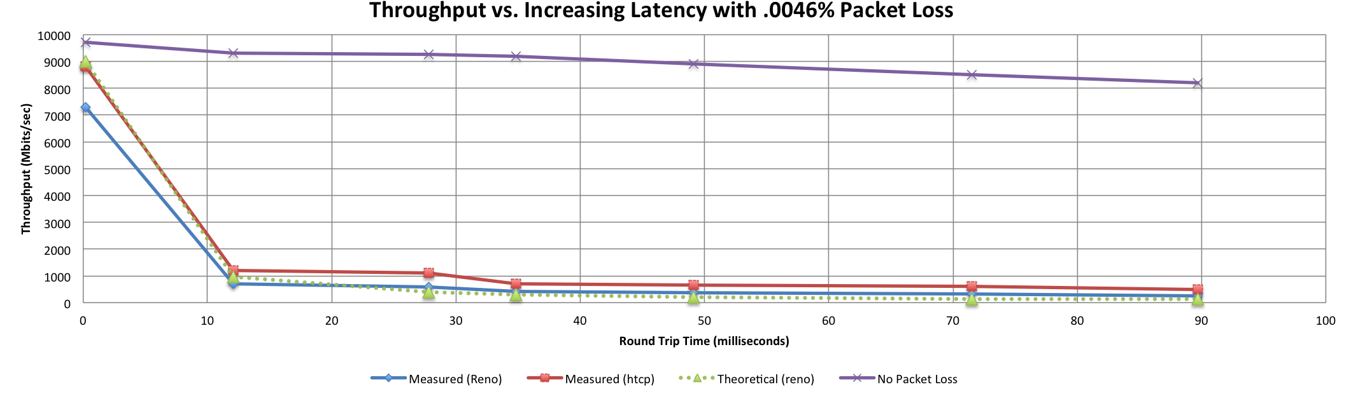

A small amount of packet loss makes a huge difference in TCP performance
Local
(LAN)
With loss, high performance beyond metro distances is essentially impossible
International
Metro Area
Regional
Continental
Measured (TCP Reno)
Measured (HTCP)
Theoretical (TCP Reno)
Measured (no loss)

Slide 25
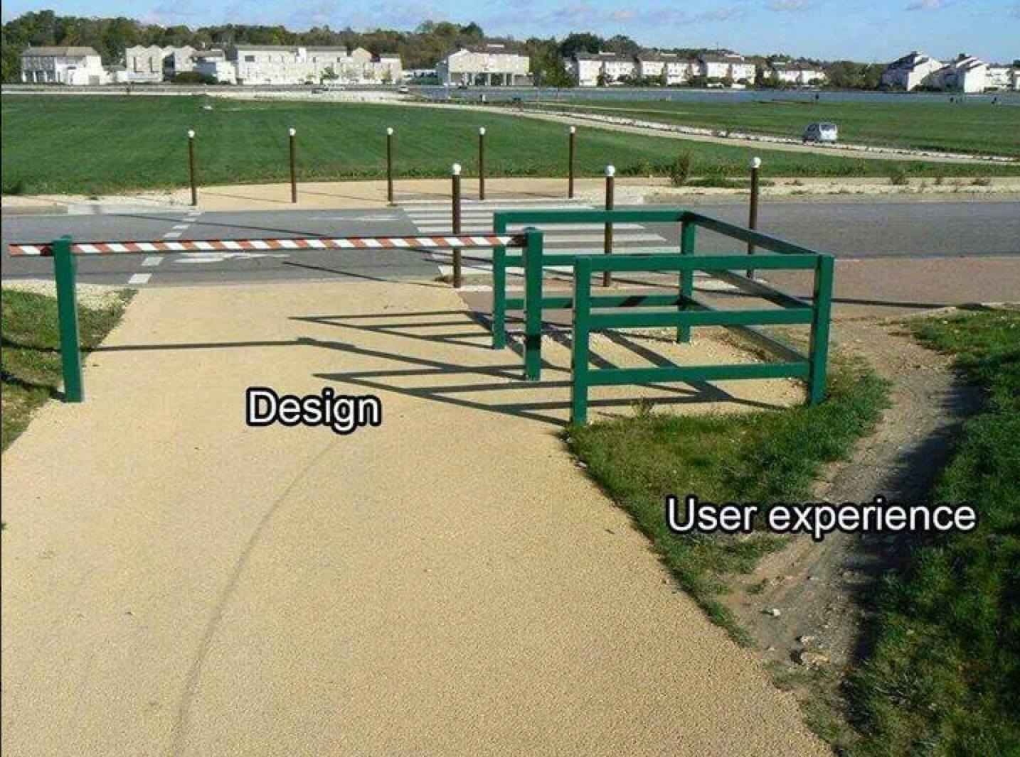
Why Build A Science DMZ Though?
What we know about scientific network use:
  Machine size decreasing, accuracy increasing
  HPC resources more widely available – and potentially distributed from where the scientists are
  WAN networking speeds now at 100G, MAN approaching, LAN as well
Value Proposition:
  If scientists can’t use the network to the fullest potential due to local policy constraints or bottlenecks – they will find a way to get their done outside of what is available.
Without a Science DMZ, this stuff is all hard
  “No one will use it”. Maybe today, what about tomorrow?
  “We don’t have these demands currently”. Next gen technology is always a day away

Slide 26
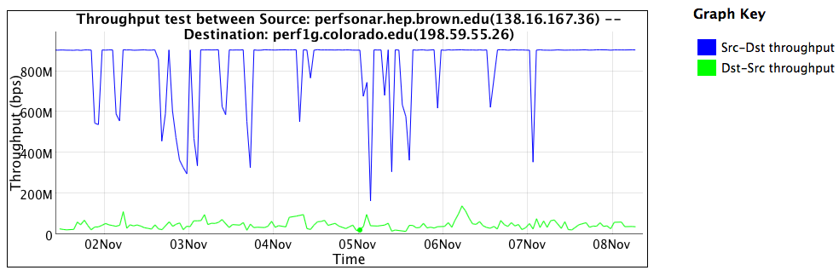
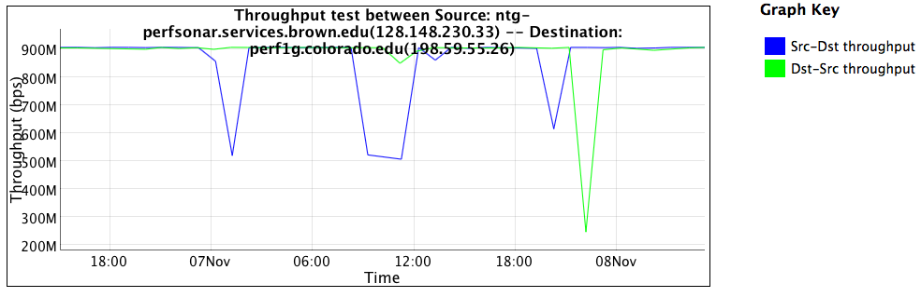
[Insert Lame Excuse #1], I don’t need a Science DMZ
The impacts of overzealous
security
10 x improvement if you identify a use case: the alternative is application of policy without any thought as to the consequences.

Slide 27
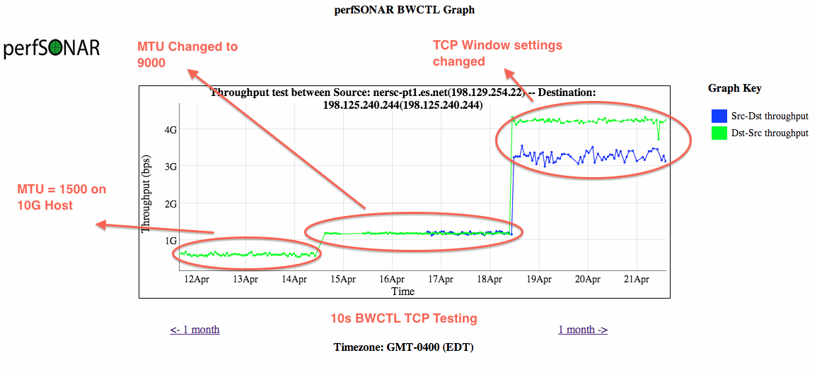
[Insert Lame Excuse #2], Our users will figure it out
Improving things, when you don’t know what you are doing, is a random walk. Sharing and educating your local community is important

Slide 28
Outline
The ESnet Story
What Science?
Learning the Hard Way
The Golden Spike
(Brief) Science DMZ Pitch
A Call to Arms

Slide 29
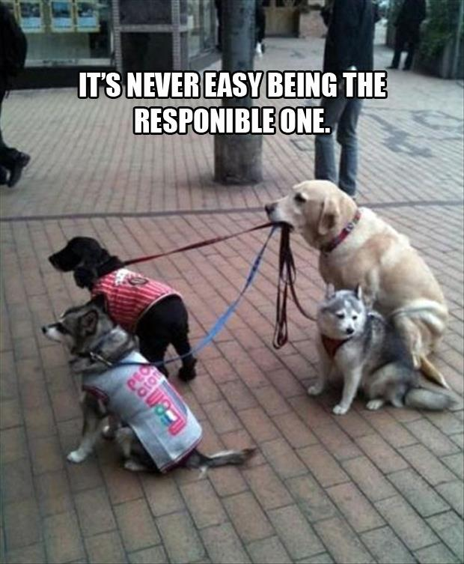
Regional Engagement Strategy
Create a “culture of urgency”
Naming a person matters – someone people associate as the “go to” person
  What could/should this person do on a per region basis?
“Is there a cookbook on regional engagement?”
  We can write one – requires regional input though.
This can be time consuming – but it’s not hard

Slide 30
Regional Engagement Strategy
Get a regional perfSONAR mesh going. CENIC and OARnet examples:
  https://ps-dashboard.cenic.net/maddash-webui/
  http://perfsonar-dashboard.oar.net/maddash-webui/
Develop a system similar to ESnet’s Requirements Reviews (we are happy to help – ask us anything)
Tie the success of science to the network:
  Will help to gauge ‘how big’ to build the network, and on what time scales
  Will also turn out some negative information, e.g. how problems are hurting innovation
Maintains a contacts database for technical personnel at each facility
  Would be who the national powers coordinate with for performance anomalies or science support.

Slide 31
Bridging the Technical Gap: Science Engagement at ESnet
Jason Zurawski – zurawski@es.net
Science Engagement Engineer, ESnet
Lawrence Berkeley National Laboratory
GPN Annual Meeting
May 28th, 2015

