Slide 1
Introduction to
Bandwidth on Demand Concepts
Inder Monga
Chief Technologist, ESnet
Co-chair, NSI working group
LHCONE P2P workshop
Geneva, December 2012

Slide 2
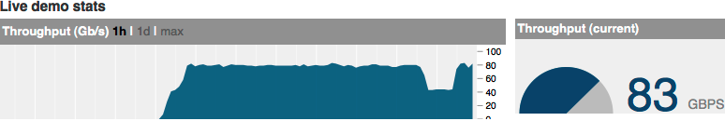
Myth Busters
100
Gbps
Bandwidth:
  Capacity of a given network
Throughput:
  How many bits/second can your carried between any two points of the network
10
Gbps
Network property
From my.es.net
Application or end-to-end property
Notes:
Network as a water pipe, Bandwidth is the maximum water flow

Slide 3

On-Demand
Bandwidth, not throughput
“On-demand” is defined by time-scale
  Not O(days or months)
  But O(seconds to minutes)
Additional property
  Software-controlled
  GUI or Application
  initiated

Slide 4
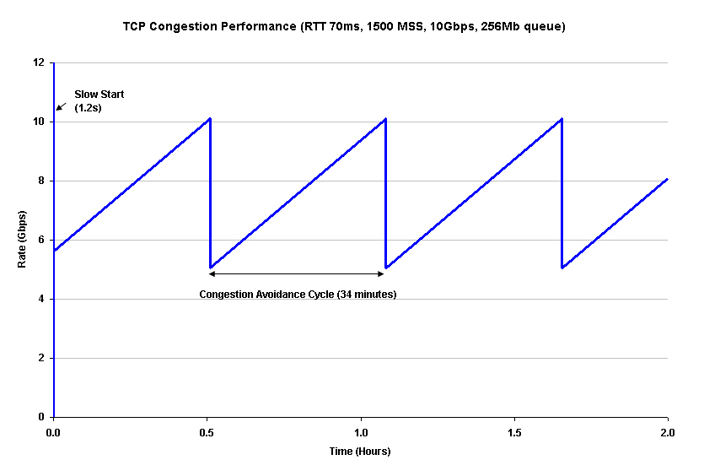
Some more truths
Application can try engineer their end-to-end throughput
Application currently can request
point-to-point bandwidth
  As supported in most installations today
  Point-to-multi-point investigated
Throughput ? Bandwidth
  !=
  ≤
TCP congestion performance
Application A
12 Gbps
Application B
28 Gbps
100 Gbps

Slide 5
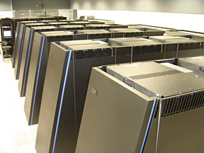

“Guaranteed” Bandwidth
Bandwidth reserved for a single flow or set of application flows
  Edge-to-edge
  End-to-end
Related concepts
  Best Effort
    Public Internet
  Oversubscription
    Aggregation
ESnet
BNL
NERSC
Notes:
Look for appropriate images

Slide 6


Styles of Guarantee
Strict or exact
  Ceiling
  Peak
Floor
  Traffic above floor marked for discard if congestion
2Gbps max
Dropped
t →
1Gbps floor
Marked
but not
dropped
Guaranteed
t →

Slide 7
Domains (networks)
Administrative boundaries are broad and can be arbitrary
Single Domain
  Single administrative management entity
Multi-domain
  Multiple administrative management entities
USLHCnet
BNL
CERN
ESnet

Slide 8
BoD Spans Network Layers
Layer 3/2.5: MPLS
Layer 2: Carrier Eth.
Layer 1: Lightpath/OTN
Layer 0: Wavelength

Slide 9
Scheduling
On-Demand
  Time: Now
  Duration: Till when I please
Scheduled
  Time: Start-time, specific time in the future
  Duration: End-time OR time duration

Slide 10
Reservation
Guaranteed Bandwidth reserved for a certain application at a certain “schedule”
On-demand is equivalent to instant bandwidth reservation with no specified end-time

Slide 11
Path-Finding
Two ends of the network
  Start = A point
  End = Z point
Path
  Creating a physical or virtual circuit between points A and Z passing through multiple network devices
Can be single or multi-domain

Slide 12
Topology
Map of interconnected devices
  Intra-domain
  Inter-domain
Network and technology characteristics
Can represent the physical layer limitations
Notes:
What’s possible

Slide 13
Path Computation Engine (PCE)
Choose a path based on Topology, current state and certain criteria
Current state
  Available capacity and resource commitments
Criteria
  Bandwidth
  Layer
  Latency
  Green energy
  Your favorite metric

Slide 14
Modify
Ability to change certain parameters of the reservation
  May or may not cause service outage
  Focus on a very limited set of parameters
Modify can be powerful for applications facing a varying workload
  Can only be implemented at Layer 2 or above in the network
  Duration is typically the most modified parameter where the connection remains the same
  Bandwidth is the next most common

Slide 15

Limitations

Slide 16
Physical Infrastructure
Most applications not familiar with the topology might assume BoD capabilities that is not physically possible
  For example:
    40G NIC on application host, 10G WAN connectivity of DC
    Can’t do 40G flows over nx10G connectivity

Slide 17
Site Network Architecture
Science DMZ design patterns
Science DMZ
Abstract Design
Supercomputer Center
Data Site

Slide 18
Blocking
‘Guaranteed Reservations’ of other applications might consume all resources
  Even though the traffic profile indicates a lot of headroom
Some of these reservations might be scheduled
  Similar to hotel reservation
An intermediate network domain might have resource constraints
  Path finding needs to be intelligent
  Path computation may take a lot of cycles if network is ‘reservation congested’

Slide 19
Putting it all together
Multi-layer, multi-domain, multi-vendor, On-Demand, Bandwidth Scheduling and Reservation Service
Service is the most important aspect, protocols only are building blocks

Slide 20
What else is needed for a service?
Authorization and Authentication
  Global federated system that works well with applications
Service Level Agreements
  What is the lowest common denominator across the multi-domain network?
Service Definition
  Consistent view of the end-to-end service
  Homogenous service over heterogeneous technologies
Monitoring and measurement
  End-to-end as well
Multi-domain debugging
  How do you find errors, report them so they can be debugged and fixed?

Slide 21

Top to Bottom view
Service Plane:
End-to-end services, application-oriented
Management Plane:
Provisioning and management of the network devices and as a system
Control Plane:
distributed management of
forwarding
Data Plane:
carries real bits, electrical and optical

Slide 22
Does this really work?
An ESnet perspective
OSCARS was introduced into ESnet as a proto-production service in early 2007, by mid-late 2008 was a supported production service
The DICE collaboration (DANTE, Internet2, ESnet) had a prototype of the inter-domain control protocol (IDCP) working by late 2008 – early 2009
The service has managed all LHCOPN Tier 0 – Tier 1 traffic since mid-2008 in ESnet, most T2-T1 traffic since 2009
A lot of what OSCARS is about from ESnet’s point of view is capacity management
A lot of what OSCARS is about from the user’s point of view is capacity guarantees

Slide 23
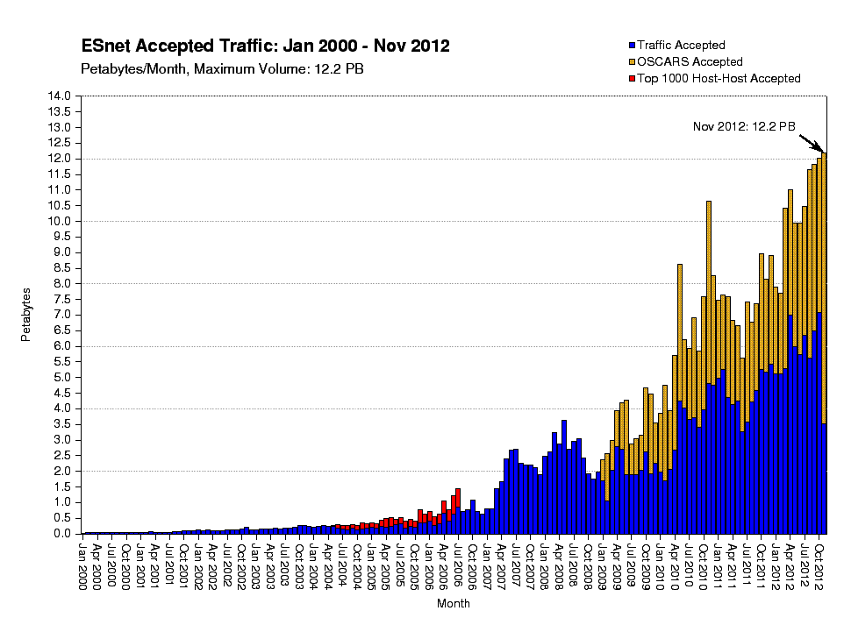
OSCARS service carries
50% of big-data flows

Slide 24
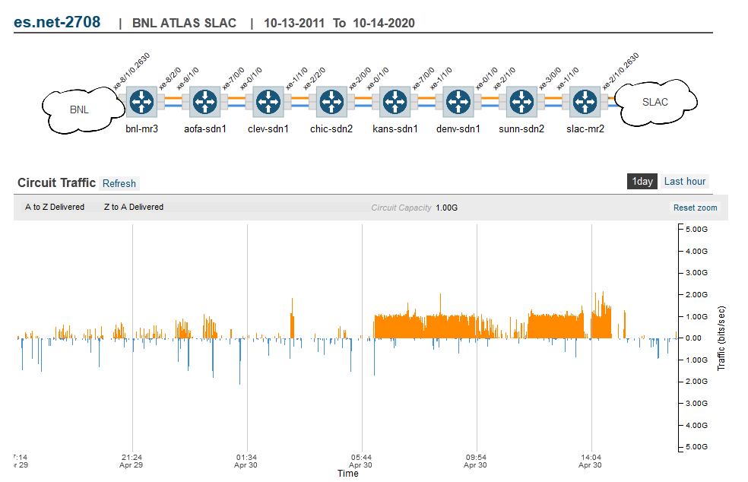
Monitoring is Done Automatically

Slide 25
Network Services Interface
Standards process in OGF
Strong participation from NREN community
Notes:
Unproven in scale, AutoGOLE, Topology

Slide 26
Network Service Framework concepts
Network Services Interface (NSI)
Network Service A
Network Service B
Network Service A
Network Service B
Service
Requestor
Service
Provider
NSI Requestor
Agent (RA)
NSI Provider
Agent (PA)
NRM
NSA
NSA
NRM
Service Plane
Transport Plane
Local Resources
Local Resources
* Slides contain animation, does not show in pdf
NSA = Network Services Agent
NRM = Network Resource Manager
Notes:
1. Connection Service, a service used to request and manage transport connections. Another example is the Topology Service; this is used to exchange network topologies.

Slide 27
Questions?
Imonga at es.net

