Slide 1


Open Transport Switch
A Software Defined Networking Architecture for Transport Networks
Abhinava Sadasivarao, Sharfuddin Syed, Ping Pan, Chris Liou – Infinera
Andy Lake, Chin Guok, Inder Monga – Energy Sciences Network (ESnet)/LBNL
HotSDN Workshop, ACM SIGCOMM, August 2013
Notes:
Hi All, This talk is about joint work done by Infinera and Energy Sciences Network – Infinera is an optical equipment vendor, and ESnet runs a 100G US-wide network over 13,000 miles of fiber, a mission network for science as it connects all US national labs and instruments. This talk is a about how we opened the covers under L2 and shone the SDN light on the layers below.

Slide 2
A multi-layer network: background
Data Center/Campus Chicago
Data Center New York
…
10/40G
100GE
WAN
100GE
…
10/40G
packet
transport
Packet-optical
transport protocol stack
…
…
Clients
S-EC
B-EC
PW
Service-LSP
ETY*
ETY*
Transport-
LSP
ETY*
…
LO ODU
HO ODU
WDM Link
OTU
OCh OChr
Optical Transport
Network Element
OMS
OTS
OPS
OTM-n
OTM-0, OTM-nr
Optical amplifiers
Approx. every 80km
Layers image Courtesy Martin Vissers, Huawei
Icons from Cisco product library
Notes:
Just a background for the folks who have not played with Wide-Area Networks – the packet-based network drawings hide a lot of complexity in the optical transport layer that enables the ‘worldwide’ internet – metro, long-haul and submarine networks. Each of these devices implement a complex multi-layer stack of protocols from L0 (lambdas) to L2 at the edges for packet-transport. If you think of train stations as ‘routers’, transport networks are the complex mesh of railway lines and switching points that interconnect all these stations together.

Slide 3
Transport Paradigm is Different!
Packet World
Connectionless
Transport World
Connection (circuit) oriented
EMS/NMS + Cross-connect paradigm
Distributed CP solutions with numerous protocols
Nascent distributed CP, not inline (GMPLS)
Inline control plane (NMS independent)*
Static pipes/configuration, trends to be more dynamic
Dynamic flows
* Logically centralized model with SDN
Historically, transport networks have been programmable by
Centralized NMS/OSS.
Notes:
The packet world and transport world are different paradigms. Transport networks are more statically configured, with dynamic / agility needed for protection/restoration in case of a fiber cut. These kind of dynamic services have evolved the transport networks to deploy nascent distributed CP solutions based on GMPLS. So in one way, the SDN architecture resonates well with how optical networks have been managed.

Slide 4
Motivation
Applications
Network Virtualization
SDN
Controller
SDN
Controller
SDN
Controller
NMS
OF
OF
Proprietary and/or
TL1
WAN Packet Network
(routers, switches)
WAN
Transport Network
Campus
Pkt . network
Data Center
Packet network
Campus’s
Optical net.
Fast Optical
switching
GMPLS (vendor specific)
Uniform end-to-end control of network resources, agility, application-responsiveness
Services/apps like optical bypass, bandwidth-on-demand, multi-layer TE, virtual overlays
Notes:
Move optical provisioning under SDN control using the same protocols as in the packet world – rather than depend on a different configuration paradigm. One can leverage the same network virtualization methods and applications built on top of the Network OS. The methods use on the WAN can also be applied to large private enterprise networks or university campuses, as well as, the fast optical switching paradigm within the large data centers.
two questions: why? And what’s the best architecture to do so? OTS

Slide 5
Use Case: Multi-Layer Optimization
Orchestration Application/SDN Controller
Analytics
Provisioning
Local IP net
IP/MPLS Layer
$$$,kW
Router
Digital
Switching
Local Enet
Optics
$,W
Converged Packet/OTN/Optical Layer
Next-gen networks drive need for multi-layer representation, topology computation & provisioning
SDN approach facilitates orchestration across layers & domains

Slide 6
Architectural Approach:
Abstract and Simplify
  Abstract the interface between packet-optical layers
Open Transport Switch (OTS) abstraction
  OpenFlow controllable, lightweight virtual switch representation of a Transport Network Element
  Capabilities exposed by OTS depends on the optical network element
  Provides all the interfaces needed to provision, control and monitor

Slide 7
OTS building blocks: a high-level view
Resource configuration
Perf. Monitoring
OTS configuration
Topology
Links
State changes
Match-Action for
Creating connections
OFwire ++*
OTS-Mgmnt.*
OTS-Control/
Discovery
OTS-Data Plane
OTS Abstraction
Optical Control Plane
Data Transport Plane
Transport switch
hardware
/
N physical interfaces
* Recent architectural discussions have decided to not change OFw protocol.
Notes:
Explain Topology (no LLDP) – needed for connections
Degraded optical connections, Bit errors.

Slide 8
OTS Building Blocks (contd.)
OTS instance (1)
OTS instance (n)
Slice a hardware
device
Transport switch
hardware
OTS instance (1)
OTS instance (n)
Virtualize a multi-domain
transport network

Slide 9
Example #1: Explicit Provisioning
(SDN Controller is to provision every flow on every node!)
F
L1
A
L2
L3
L4
D
L5
B
C
E
H
G
SDN
Controller
Topology report:
L1: 10GE
L2: to B, 100GE
Provisioning (e.g., OpenFlow):
L2-L3 :: map VLAN-200 packets to VIF X
VLAN
100
OTS
VLAN
200
OTS
Wave
X
OTS
VLAN
300
OTS
VLAN
400
Ethernet
Switch
Ethernet / DWDM
Ethernet / DWDM
Ethernet
Switch
A
B
C
D

Slide 10
Example #2: Implicit Provisioning
(SDN Controller is to provision every flow on some nodes!)
A
B
C
D
E
F
Topology export:
Node, link and resource (TED)
Including MPLS for packet, GMPLS of optical…
SDN Controller
Provisioning:
Setup C-D with BW X
Map data to C-D
Provisioning:
Setup A-B with BW X
OTS
OTS
LSR
OTS
OTS
POTN
OTS
LSR
MPLS
LSR
POTN
OTN (GMPLS)
OTS
ENET
OTS
A
LSR
B
C
POTN
ENET
L2 Ethernet
ENET
POTN
D
E
ENET
F
Data
Data
Data
Data
Data
Data
Data
Label
ODU
VLAN

Slide 11
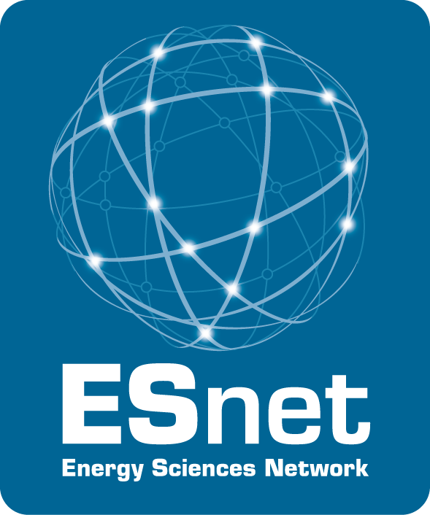
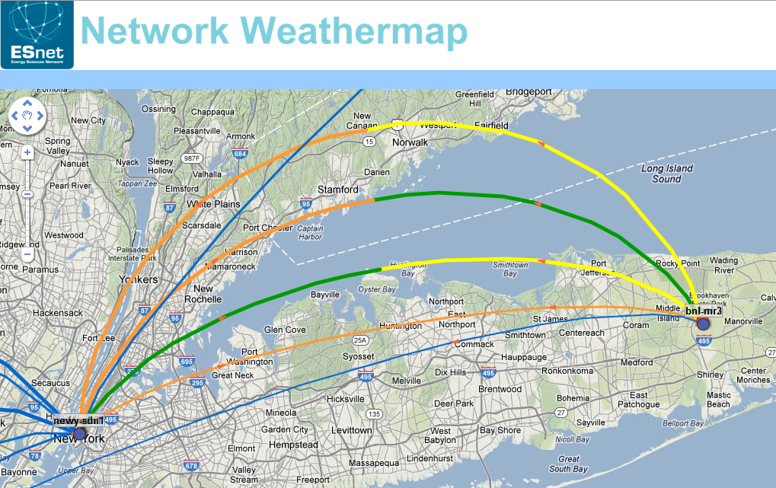

OTS Demo: deployed on Long Island testbed
Topology Monitoring App
On-Demand TE App
ESnet SDN Controller
20G L1 Tunnel
Path #1
ESnet LIMAN Production Network
20G
20G
Brookhaven National Laboratory
Testbed
OTS
OTS
Path #2
40G
Mellanox
bnl-tb-wdm-3
bnl-tb-wdm-4
Mellanox
100G
Path #3
SDN Controller communicating with OTS-DataPlane via OpenFlow extensions
Bandwidth on Demand application for Big Data RDMA transport
3 physical transport path options (with varying latencies)
Implicit & explicit provisioning of 10GbE/40GbE services demonstrated

Slide 12
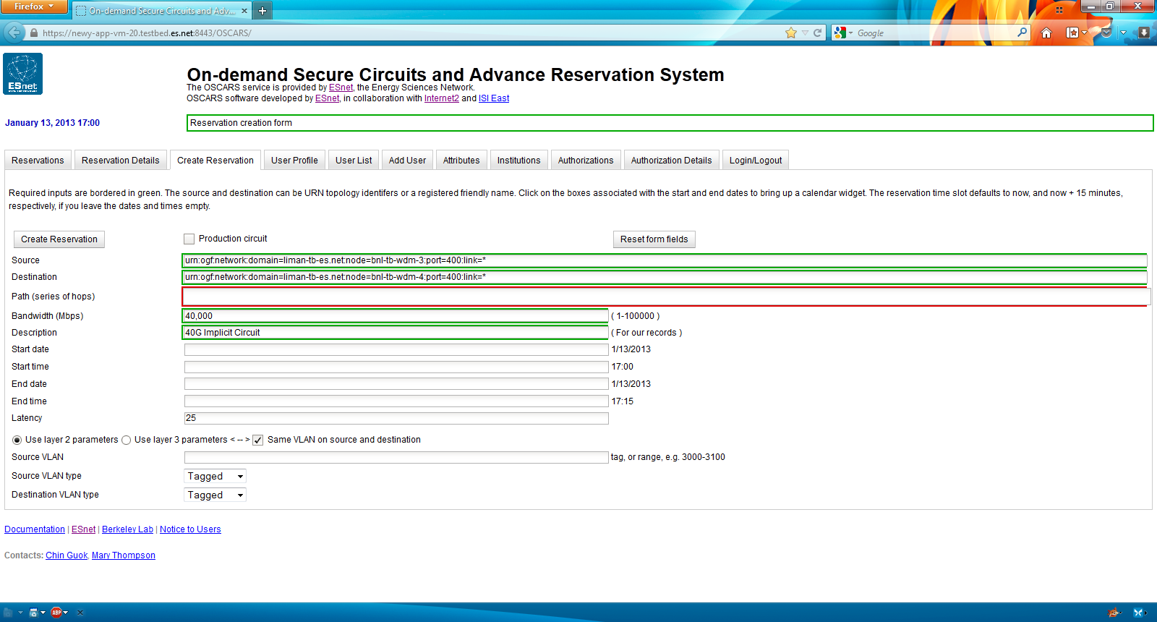
Application: Create Circuit

Slide 13
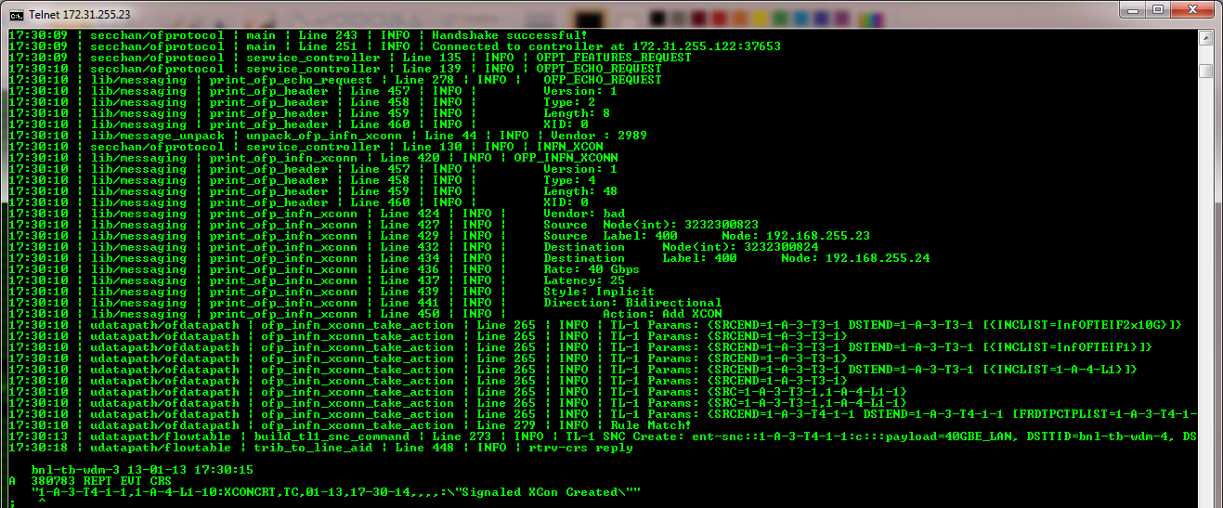
SDN/OTS: Execute Application Req
Vendor extension

Slide 14
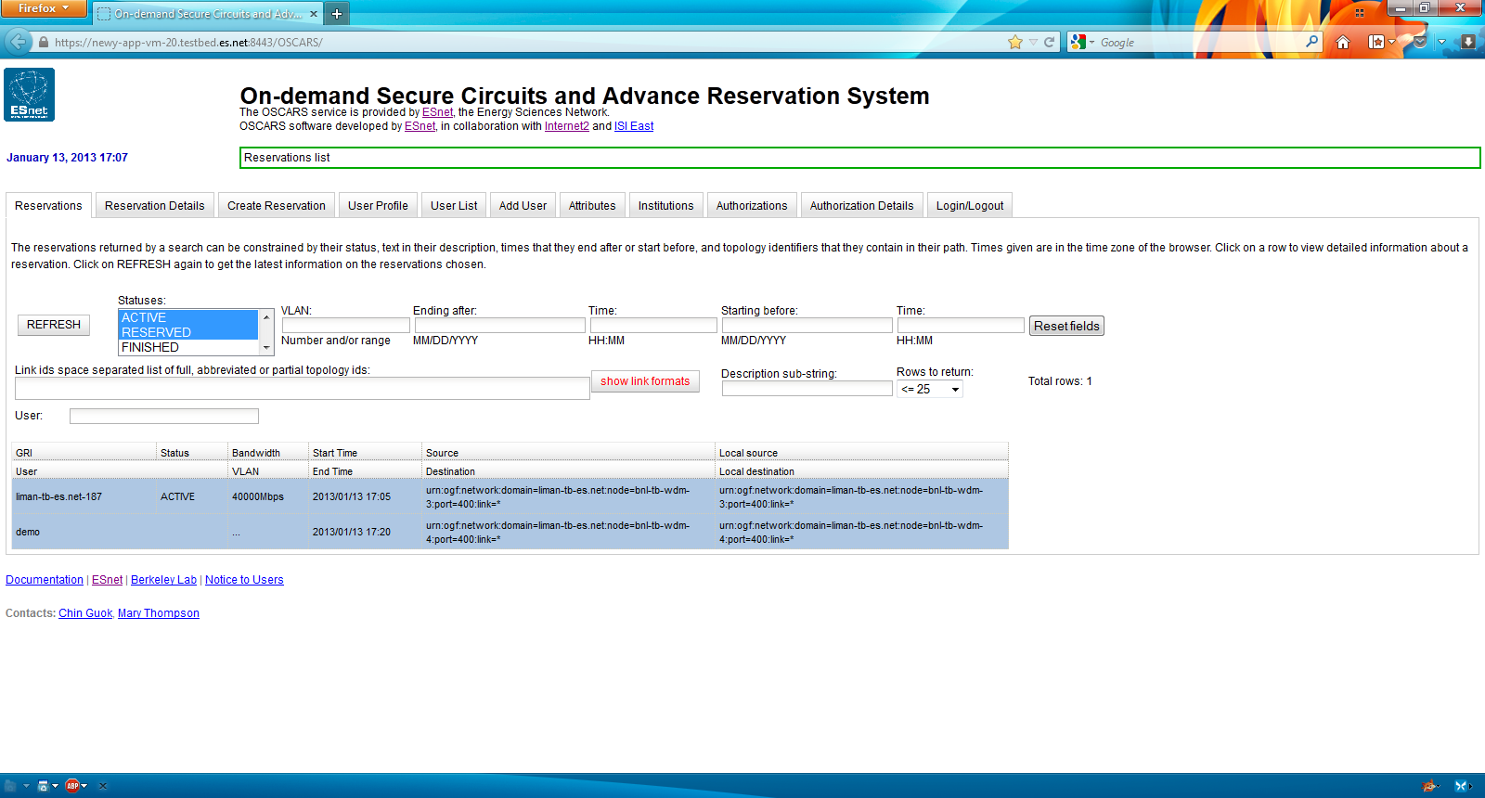
Application: Circuit Active

Slide 15
Previous work
Saurav Das, Unified Control Architecture for Packet and Circuit Network Convergence, PhD Thesis, Stanford University, June 2012

Slide 16
Now to Future
Now
  LIMAN Demonstration: December 2012
  ONF Open Transport Working Group: March 2013
    Use-cases & Architecture: In progress
    Most optical and router companies participating
Future
  Explore Topology and Monitoring
  Network Optimization using multi-layer PCE
  How does protection fit within the architecture?

Slide 17
Thank you!
imonga at es dot net
Energy Sciences Network
http://www.es.net/inder
Shameless plug: We are hiring and looking for a post-doc & software engineer
to work on SDN topics!
https://lbl.taleo.net/careersection/2/jobdetail.ftl?lang=en&job=75692

